Slide 1
Hadron Spectroscopy
Alessandro Pilloni
LHCb Charm WG PhD Days, February 20th, 2025

Slide 2
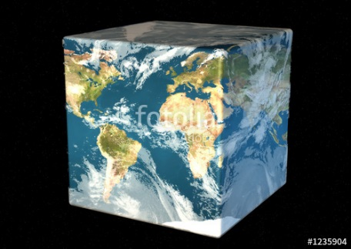
The Richness of the Spectrum
Meson
Baryon
Glueball
Hybrids
Tetraquark
Molecule
Experiment
Data
Amplitude analysis
QCD
Lattice QCD
With great statistics comes great responsibility!
Peter Parker, PhD
For theorists, this is an experimental business
For experimentalists, this is grandma’s recipe
A. Pilloni – Hadron Spectroscopy

Slide 3
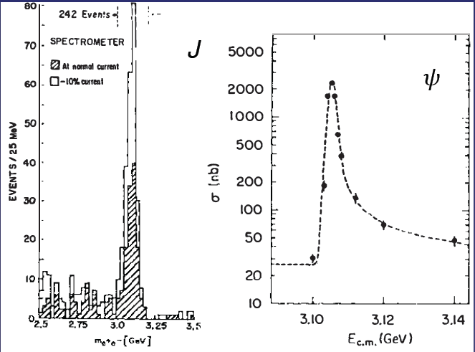
Quarkonium orthodoxy
$$Q$$
$$\overline{Q}$$
Potential models
(meaningful when $M_{Q}→∞$)
$$V\left(r\right)=−\frac{C_{F}α_{s}}{r}+σr$$
(Cornell potential)
$$α_{s}\left(M_{Q}\right)∼0.3$$
(perturbative regime)
OZI-rule, QCD multipole
Solve NR Schrödinger eq. → spectrum
Effective theories
(HQET, NRQCD, pNRQCD...)
Heavy quark spin flip suppressed by quark mass, approximate heavy quark spin symmetry (HQSS)
Integrate out heavy DOF
↓
(spectrum), decay & production rates
A. Pilloni – Hadron Spectroscopy
Notes:
2 slides su Zc, a Bes e a Belle
2 slide su tetraquark model: dall’hamiltoniana di Jaffe al calcolo delle masse
1 slide su molecular models, dove sono i carichi? (non in Tornqvist, si in Hanhart, vedere Braaten, citare Nefediev)
2 slides su decay channels, dove si dovrebbe vedere, e a seconda del modello, vedere qualche plot
1 slide su Y(4260), tetraquark? C’è lo strano (si vede la f0)
1 slide su Zc a cleo (anche il neutro)

Slide 4
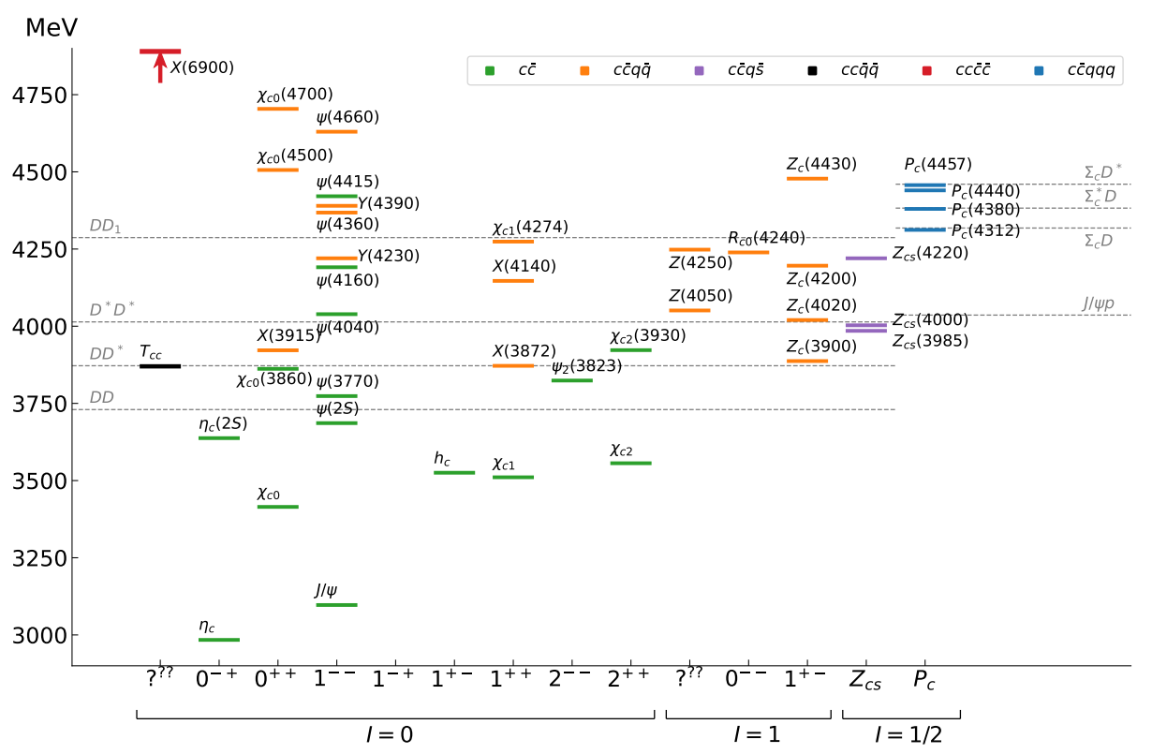
Exotic landscape in $c\overline{c}$
Esposito, AP, Polosa, Phys.Rept. 668
JPAC, PPNP
A host of unexpected resonances have appeared
decaying mostly into charmonium + light Hardly reconciled with usual $q\overline{q}$ pheno
A. Pilloni – Hadron Spectroscopy
Notes:
2 slides su Zc, a Bes e a Belle
2 slide su tetraquark model: dall’hamiltoniana di Jaffe al calcolo delle masse
1 slide su molecular models, dove sono i carichi? (non in Tornqvist, si in Hanhart, vedere Braaten, citare Nefediev)
2 slides su decay channels, dove si dovrebbe vedere, e a seconda del modello, vedere qualche plot
1 slide su Y(4260), tetraquark? C’è lo strano (si vede la f0)
1 slide su Zc a cleo (anche il neutro)

Slide 5
Definition of exotics
Despite it’s wrong, the vaste majority of hadrons obeys QM
Whatever is beyond $q\overline{q}$ for mesons and $qqq$ for baryons is exotic
Flavor exotics: e.g. doubly charged meson, baryon with positive strangeness Ex.: $T_{cc}^{+}$ ; if OZI rule enforced, $Z_{c,b}$, $P_{c}$…
Spin exotics: $J^{PC}$ not allowed in QM Ex.: $π_{1}(1600)$
Criptoexotics: $J^{PC}$ allowed, but properties not compatible with QM expectations Ex.: $Y(4260)$, $Λ(1405)$, hybrid baryons, $X(3872)$
A. Pilloni – Hadron Spectroscopy
Notes:
2 slides su Zc, a Bes e a Belle
2 slide su tetraquark model: dall’hamiltoniana di Jaffe al calcolo delle masse
1 slide su molecular models, dove sono i carichi? (non in Tornqvist, si in Hanhart, vedere Braaten, citare Nefediev)
2 slides su decay channels, dove si dovrebbe vedere, e a seconda del modello, vedere qualche plot
1 slide su Y(4260), tetraquark? C’è lo strano (si vede la f0)
1 slide su Zc a cleo (anche il neutro)

Slide 6
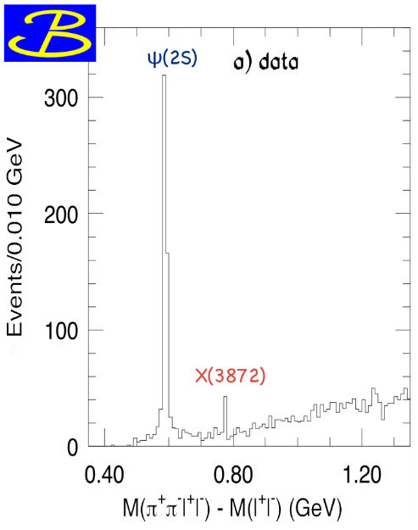
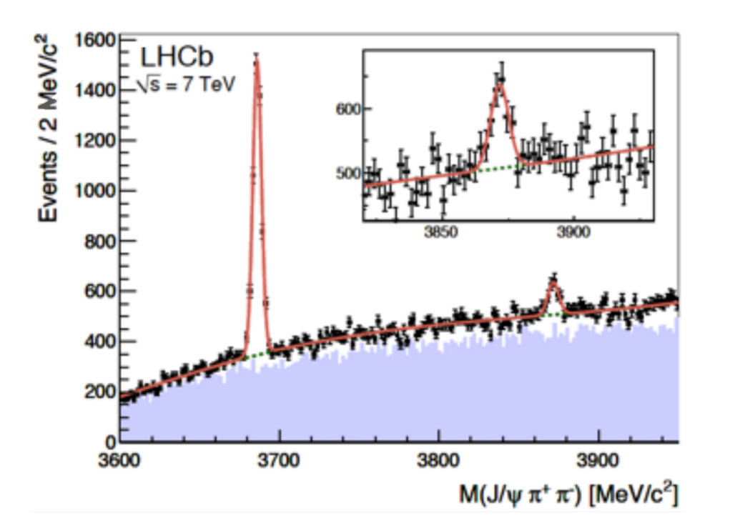
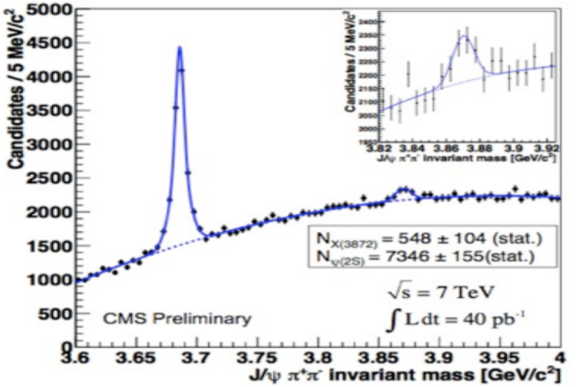
$X(3872)$
Discovered in $B→K X→K J/ψ ππ$
Quantum numbers $1^{++}$
Very close to $DD^{∗}$ threshold
Too narrow for an above-treshold charmonium
Isospin violation too big $\frac{Γ\left(X→J/ψ ω\right)}{Γ\left(X→J/ψ ρ\right)}\sim 1.1±0.4$
Mass prediction not compatible with $χ_{c1}(2P)$
$M=3871.65±0.06$MeV
$$M_{X}−M_{DD^{∗}}=−3±192 \text{keV}$$
$Γ_{BW}=1.19±0.2\text{1 }\text{MeV}$
A. Pilloni – Hadron Spectroscopy

Slide 7
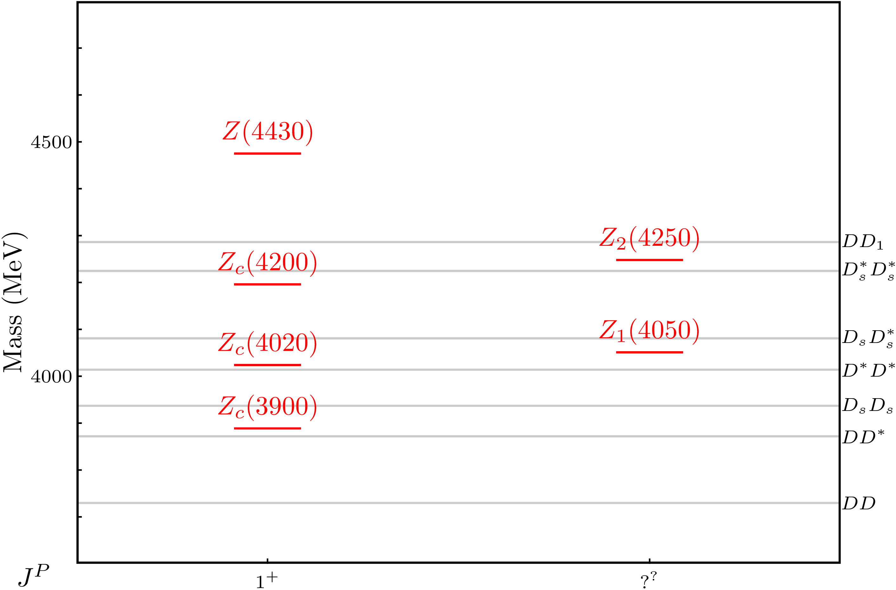
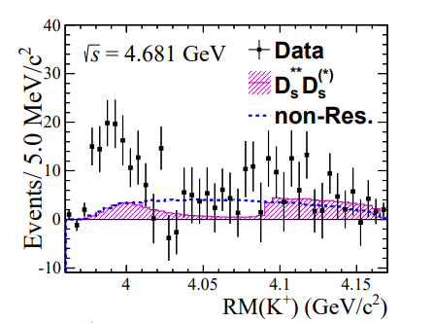
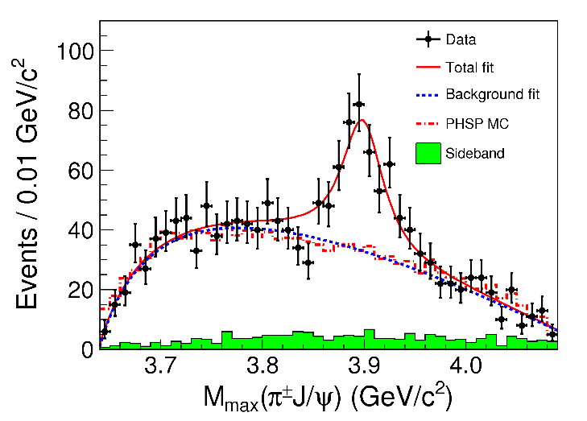
Charged $Z$ states: $Z_{c}\left(3900\right), Z_{c}^{′}\left(4020\right), Z_{cs}(3985)$
Charged quarkonium-like resonances have been found, 4q needed
Two states $J^{PC}=1^{+−}$ appear slightly above $D^{(∗)}D^{∗}$ thresholds
$e^{+}e^{−}→Z_{c}{\left(3900\right)}^{+}π^{−}→J/ψ{ π}^{+}π^{−}$ and $→{\left(DD^{∗}\right)}^{+}π^{−}$ $M=3888.7±3.4$MeV, $Γ=35±7$ MeV
$e^{+}e^{−}→Z_{c}^{′}{\left(4020\right)}^{+}π^{−}→h_{c}{ π}^{+}π^{−}$ and $→{\overline{D}}^{∗0}D^{∗+}π^{−}$
$M=4023.9±2.4$MeV, $Γ=10±6$ MeV
Strange partner with smaller significance $$e^{+}e^{−}→Z_{cs}{\left(3985\right)}^{+}K^{−}→D_{s}^{+}\overline{D^{∗0}}{ K}^{−}$$ $M={3982.5}_{−2.6}^{+1.8}±2.1$MeV, $Γ={12.8}_{−4.4}^{+5.3}±3.0$ MeV
A. Pilloni – Hadron Spectroscopy
Notes:
Y(4260), M=4263 +- 5, Gamma = 95+-14
D_1(2420)^0, M=2421.3 ±0.6, Gamma =27.1 ±2.7
D_1(2420)^+-, M=2423.4 ±3.1, Gamma =25 ±6
I D_1 hanno J^P = 1^+
La molecola D_1 D sta 22 MeV sotto
Se la Y è D_1 D, il pione lega fortemente, come fa la Y a essere così larga?
Come funziona lo scambio del pione???

Slide 8
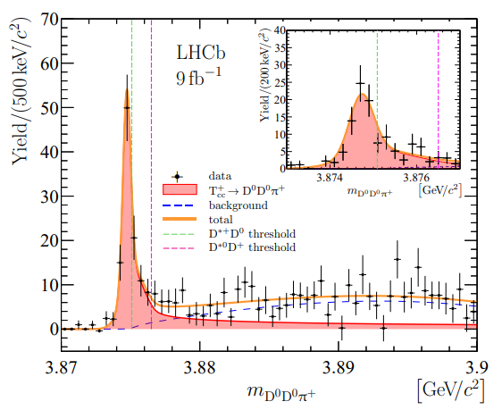
Very open charm: the $T_{cc}^{+}$
A supernarrow state is seen at the $D^{∗+}D^{0}$ threshold
BW parameters give
$δm_{BW}=−273±61 \text{keV}$
$Γ_{BW}=410±65 \text{keV}$
Unitary analysis gives
$δm=−360±{40}_{−0}^{+4} \text{keV}$
$Γ={48±2}_{−14}^{+0} \text{keV}$
It cannot mix with ordinary charmonia It does not have lighter open channels
A. Pilloni – Hadron Spectroscopy
Notes:
Y(4260), M=4263 +- 5, Gamma = 95+-14
D_1(2420)^0, M=2421.3 ±0.6, Gamma =27.1 ±2.7
D_1(2420)^+-, M=2423.4 ±3.1, Gamma =25 ±6
I D_1 hanno J^P = 1^+
La molecola D_1 D sta 22 MeV sotto
Se la Y è D_1 D, il pione lega fortemente, come fa la Y a essere così larga?
Come funziona lo scambio del pione???

Slide 9
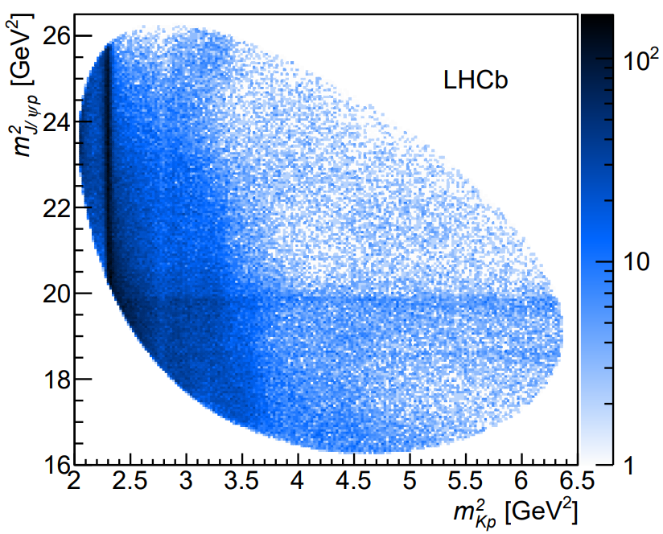
Pentaquarks
LHCb, PRL 115, 072001
LHCb, PRL 117, 082003
States seen in $Λ_{b}→\left(J/ψ p\right) K^{−}$,
Original analysis found a narrow and a broad states
The subsequent 1D update find 3 narrow ones
The lightest $P_{c}(4312)$ appears as an isolated peak at the $Σ_{c}^{+}{\overline{D}}^{0}$ threshold
A. Pilloni – Hadron Spectroscopy
Notes:
Controlla la parte su Regge

Slide 10
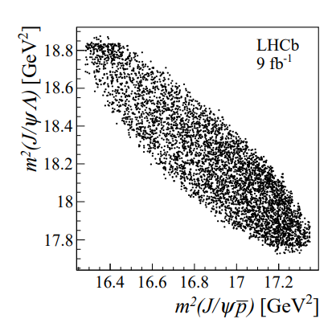
Strange pentaquarks
Can you search pentaquarks in meson decays? $B^{−}→J/ψ Λ^{0} \overline{p}$
Bingo! $P_{cs}$!
$$m=4338.2±0.7±0.4 \text{MeV}$$
$$Γ=7.0±1.2±1.3 \text{MeV}$$
It remains to be seen the connections with the nonstrange pentaquarks
No $K^{∗}$ expected in this $Λ^{0}\overline{p}$ mass region
None seen, mostly flat
A. Pilloni – Hadron Spectroscopy
Notes:
Controlla la parte su Regge

Slide 11
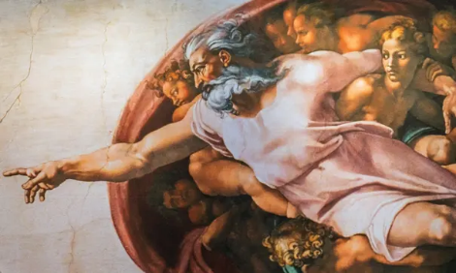
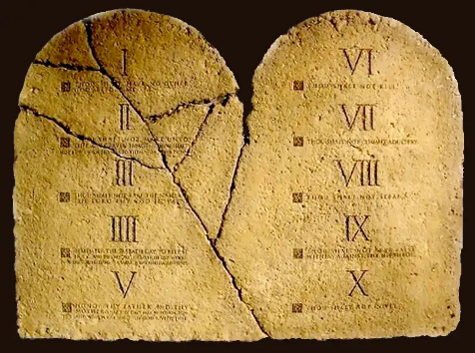
Top-down approach
You are given a model/theory
$$f(s)$$
You calculate the amplitude
You compare with data. Or you don’t.
Predictive power ✓
Physical interpretation ✓ (within the model! ✗) Biased by the input ✗
A. Pilloni – Hadron Spectroscopy

Slide 12
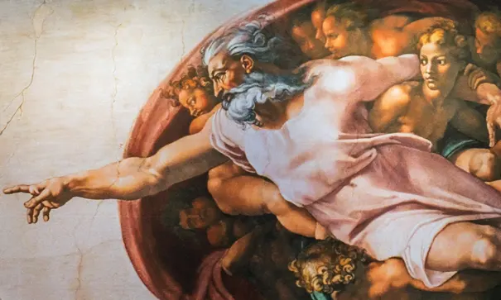
Options on the market
Quark-level calculations:
Quark models, pNRQCD, Hybrids, ...
Spectrum generally calculated as bound states of some potential
Decay rates as «overlap integrals» between two static configurations
Comprehensive picture ✓ Little scattering dynamics ✗
Hadron level calculations:
Compact states vs. molecules, triangles...
States as poles of scattering amplitudes
Couplings as residues at the poles
Scattering dynamics ✓ More case-by-case ✓✗
A. Pilloni – Hadron Spectroscopy

Slide 13
Models for every taste
Compact
Hybrids
Containing gluonic degrees of freedom
Multiquark
Several (cluster) of valence quarks
Hadroquarkonium
Heavy core interacting with a light cloud via Van der Waals forces
$$π$$
$$π$$
$$J/ψ$$
$$π$$
Rescattering effects
Structures generated by cross-channel rescattering, very process-dependent
Molecule
Bound or virtual state generated by long-range exchange forces
Extended
A. Pilloni – Hadron Spectroscopy

Slide 14
Constituent quark model
Godfrey and Isgur, PRD 32, 189 Capstick and Isgur, PRD 33, 2809
A. Pilloni – Hadron Spectroscopy

Slide 15
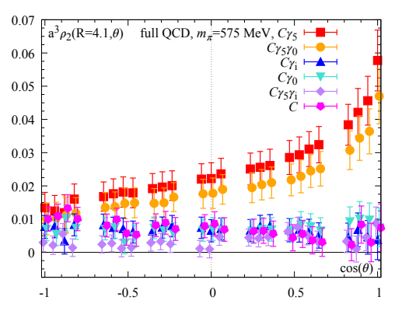
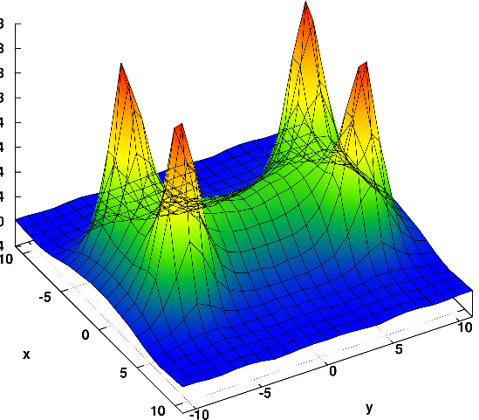
Diquarks
Attraction and repulsion in 1-gluon exchange approximation is given by
$$R=\frac{1}{2}\left(C_{2}\left(R_{12}\right)−C_{2}\left(R_{1}\right)−C_{2}\left(R_{2}\right)\right)$$
$$R_{1}=−\frac{4}{3}, R_{8}=+\frac{1}{6}$$
$$R_{3}=−\frac{2}{3}, R_{6}=+\frac{1}{3}$$
$$j$$
$$l$$
$$3_{c}×3_{c}∈{\overline{3}}_{c}$$
$$T_{ij}^{a}$$
$$T_{kl}^{a}$$
$$i$$
$$k$$
Francis et al. 2106.09080
H-shape with a 4 quark system
Cardoso, Cardoso, Bicudo, PRD84, 054508
A. Pilloni – Hadron Spectroscopy

Slide 16
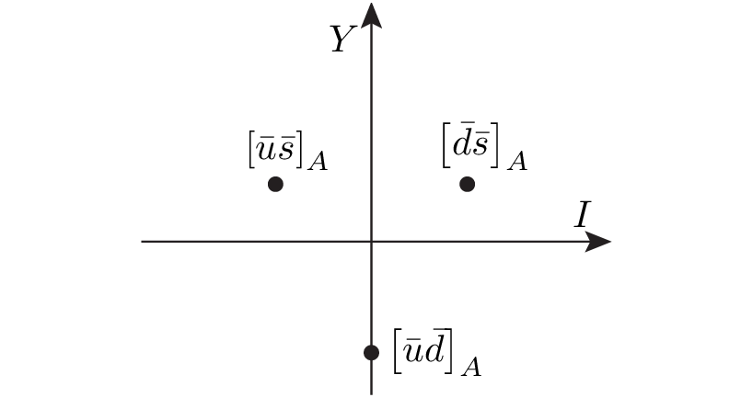
Diquarks
Attraction and repulsion in 1-gluon exchange approximation is given by
$$3_{c}×3_{c}∈{\overline{3}}_{c}$$
Now the two quarks are identical particles, they obey Fermi statistics
If we restrict to the ground state in S-wave, we have two options
$${\overline{3}}_{color}\left(A\right)×{\overline{3}}_{flavor}\left(A\right)×1_{spin}\left(A\right)$$
«Good» diquark
$${\overline{3}}_{color}\left(A\right)×6_{flavor}\left(S\right)×3_{spin}\left(S\right)$$
«Bad» diquark
Because of spin-spin interaction, good diquark are lighter, and easier to produce From the flavor point of view, it behaves like an antiquark
A. Pilloni – Hadron Spectroscopy

Slide 17
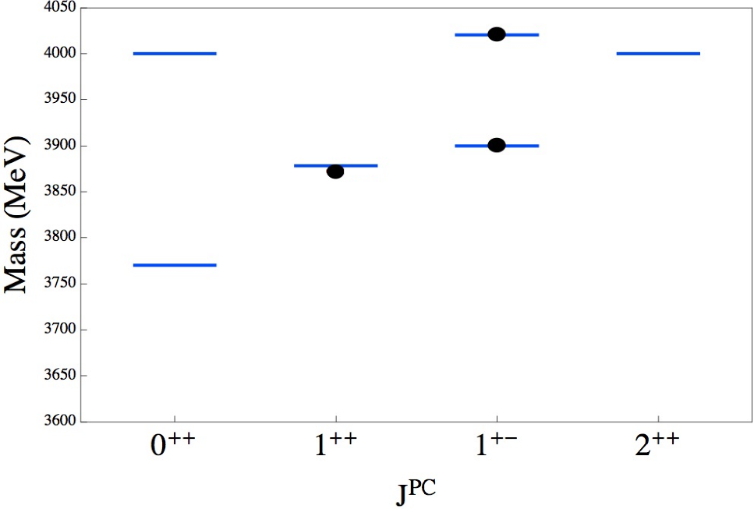
Tetraquarks
$${\overline{3}}_{c}$$
$$\overline{c}$$
$$c$$
In a constituent quark model, we can think of a
diquark-antidiquark compact state
$$3_{c}$$
$$q$$
$${\left[cq\right]}_{S=0,1}{\left[\overline{c}\overline{q}′\right]}_{S=0,1}$$
$$\overline{q}$$
Maiani, Piccinini, Polosa, Riquer PRD89 114010
Simplified spectrum with color-spin hamiltonian:
$$H=\sum_{dq}{m_{dq}}+2\sum_{i<j}{κ_{ij} \vec{S_{i}}∙\vec{S_{j}} \frac{λ_{i}^{a}}{2}\frac{λ_{j}^{a}}{2}}$$
Decay pattern mostly driven by HQSS ✓
Fair understanding of existing spectrum ✓
A full nonet for each level is expected ✗
A. Pilloni – Hadron Spectroscopy
Notes:
Y(4260), M=4263 +- 5, Gamma = 95+-14
D_1(2420)^0, M=2421.3 ±0.6, Gamma =27.1 ±2.7
D_1(2420)^+-, M=2423.4 ±3.1, Gamma =25 ±6
I D_1 hanno J^P = 1^+
La molecola D_1 D sta 22 MeV sotto
Se la Y è D_1 D, il pione lega fortemente, come fa la Y a essere così larga?
Come funziona lo scambio del pione???
Close propone che la Y è D_1 D^* col pione scambiato in onda S,
La Y però non va in Ds come se fosse tetraquark

Slide 18
Barionio
Baryonium
C. Sabelli
a structure $\left[cq\right][\overline{c}\overline{q}]$ can explain the dominance of baryon channel
Isospin violation expected,
$$α_{s}\left(m_{c}\right)≪1$$
Rossi, Veneziano, NPB 123, 507;
Phys.Rept. 63, 149;
PLB70, 255;
JHEP 1606, 041
$$\frac{B\left(Y\left(4660\right)→Λ_{c}^{+}Λ_{c}^{−}\right)}{B\left(Y\left(4660\right)→ψ\left(2S\right)ππ\right)}=25±7$$
Cotugno, Faccini, Polosa, Sabelli,
PRL 104, 132005
A. Pilloni – Hadron Spectroscopy
Notes:
2 slides su Zc, a Bes e a Belle
2 slide su tetraquark model: dall’hamiltoniana di Jaffe al calcolo delle masse
1 slide su molecular models, dove sono i carichi? (non in Tornqvist, si in Hanhart, vedere Braaten, citare Nefediev)
2 slides su decay channels, dove si dovrebbe vedere, e a seconda del modello, vedere qualche plot
1 slide su Y(4260), tetraquark? C’è lo strano (si vede la f0)
1 slide su Zc a cleo (anche il neutro)

Slide 19
Molecules
Tornqvist, Z.Phys. C61, 525
Braaten and Kusunoki, PRD69 074005
Swanson, Phys.Rept. 429 243-305
$$D^{0}$$
$$X\left(3872\right)∼{\overline{D}}^{0}D^{∗0}$$
$$Z_{c}\left(3900\right)∼{\overline{D}}^{0}D^{∗+}$$
$$Z_{c}^{′}\left(4020\right)∼{\overline{D}}^{∗0}D^{∗+}$$
$$Y\left(4260\right)∼\overline{D}D_{1}$$
$$π^{0}$$
$$\overline{D^{0∗}}$$
A deuteron-like meson pair, the interaction is mediated by the exchange of light mesons
Good description of decay patterns (mostly to constituents) and $X\left(3872\right)$ isospin violation ✓
States appear close to thresholds ✓ Binding energy varies from $−70$to $−0.1 \text{MeV}$ ✗
Unclear spectrum (a state for each threshold?) – depends on potential models ✗
Some non-predictive model-independent relations (Weinberg’s theorem) ✓
$$V_{π}\left(r\right)=\frac{g_{πN}^{2}}{3}\left(\vec{τ_{1}}⋅\vec{τ_{2}}\right)\left\{\left[3\left(\vec{σ_{1}}⋅\hat{r}\right)\left(\vec{σ_{2}}⋅\hat{r}\right)−\left(\vec{σ_{1}}⋅\vec{σ_{2}}\right)\right]\left(1+\frac{3}{{\left(m_{π}r\right)}^{2}}+\frac{3}{m_{π}r}\right)+\left(\vec{σ_{1}}⋅\vec{σ_{2}}\right)\right\}\frac{e^{−m_{π}r}}{r}$$
Needs regularization, cutoff dependence
A. Pilloni – Hadron Spectroscopy

Slide 20
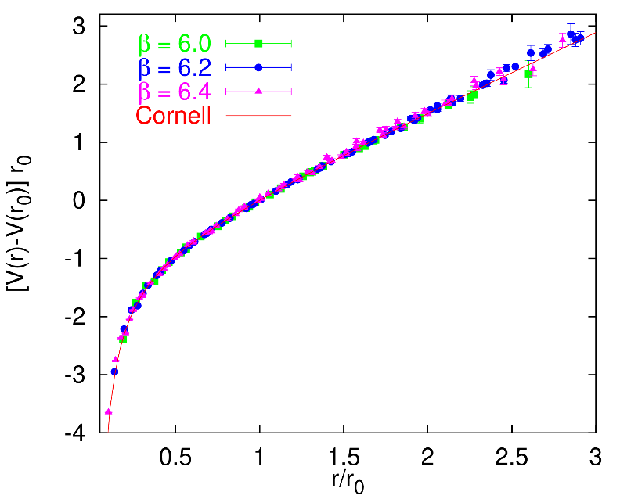
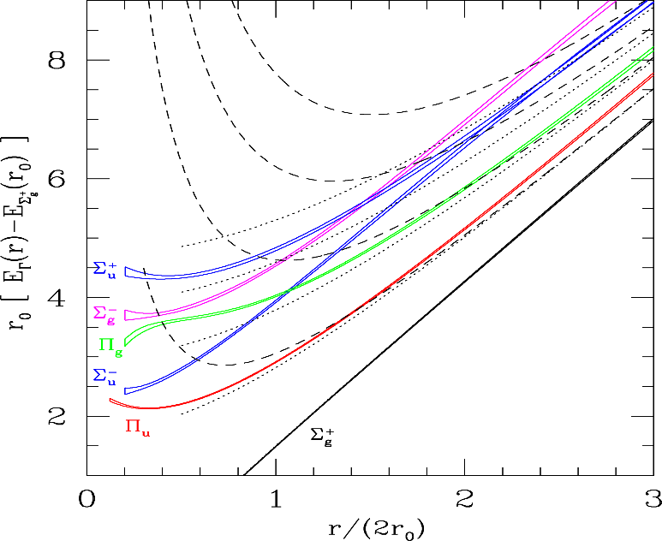
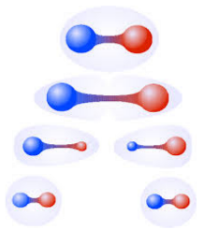
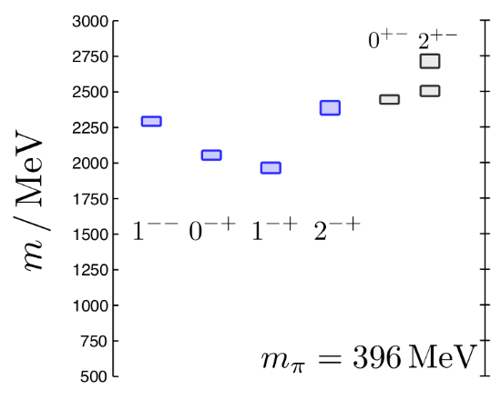
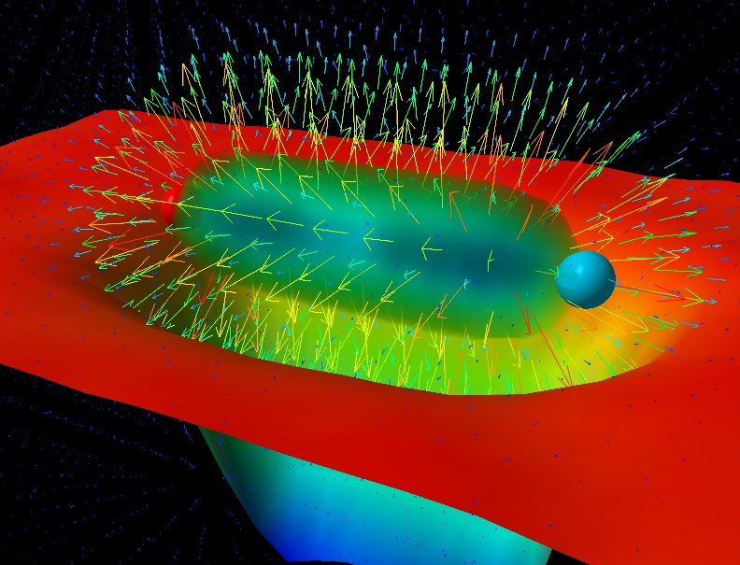
Learning about confinement
If quarks were infinitely heavy, gluonic field is confined in a string
Linear rising potential
What is a constituent gluon?
vibration of the string? → degenerate $J^{PC}={\left(0,1,2\right)}^{−+},{\left(0,1,2\right)}^{+−}$
excitation of a quasiparticle? → degenerate $J^{PC}={\left(0,1,2\right)}^{−+},1^{−−}$
G. Bali
C. Morningstar
J. Dudek
excitation of a quasiparticle! → degenerate $J^{PC}={\left(0,1,2\right)}^{−+},1^{−−}$ says Lattice QCD...
What about real data?
D. Leinweber
A. Pilloni – Hadron Spectroscopy
Notes:
Controlla la parte su Regge

Slide 21
Triangle singularity
Unitarized isobar models contain rescattering diagrams as this
In special kinematical conditions,
the amplitude develops a logarithmic branch point in the physical region, that can simulate a resonant behavior
Coleman and Norton, Nuovo Cim. 38, 438
$$π$$
$$D_{1}$$
$$Y(4260)$$
$$D^{∗}$$
$$π$$
$$\overline{D}$$
$$J/ψ$$
However, this effects cancels in Dalitz projections, no peaks Schmid, Phys.Rev. 154, 1363
...but the cancellation can be spread in different channels, you might still see peaks in other channels only!
A. Pilloni – Amplitude analysis and exotic states

Slide 22
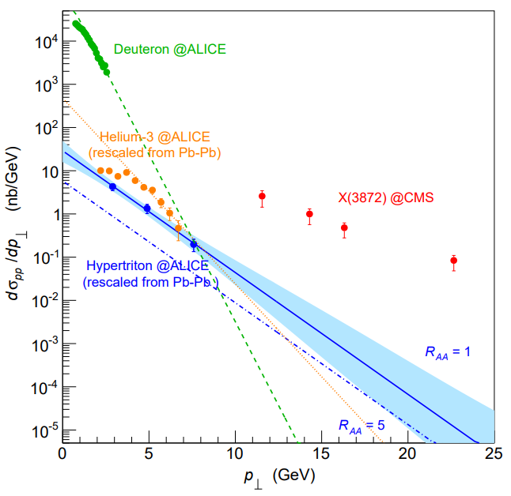
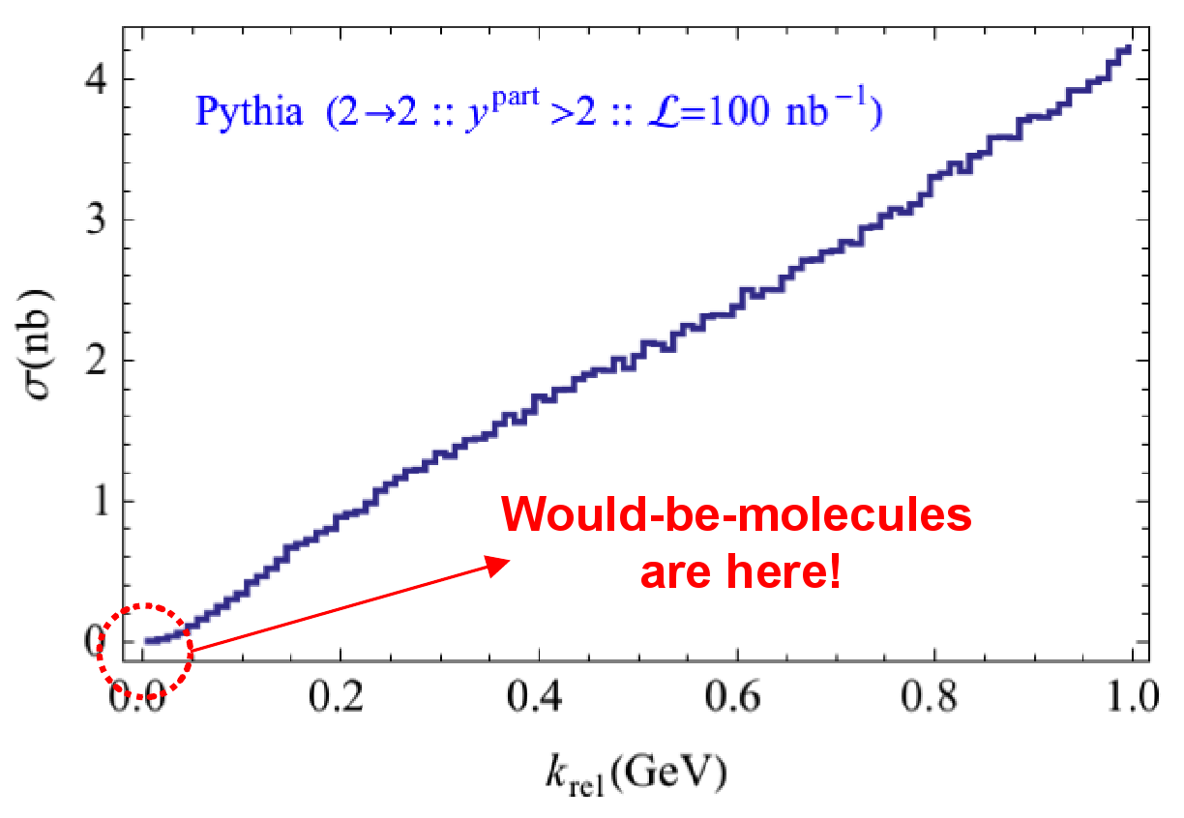
Prompt production of $X(3872)$
However, the applicability of Watson theorem is challenged by the presence of pions that interfere with $DD^{∗}$ propagation
$$D^{∗}$$
$$π$$
$$π$$
(CDF acceptance)
$$π$$
$$π$$
$$π$$
$$\overline{D^{0}}$$
A solution can be FSI (rescattering of $DD^{∗}$), which allow $k_{max}$ to be as large as $5m_{π}$, $σ\left(p\overline{p}→DD^{∗}|k<k_{max}\right)≈230 \text{nb}$
Artoisenet and Braaten, PRD81, 114018
However, this is controversial because of the presence of comover that interfere with $DD^{∗}$ propagation
Bignamini et al. PLB684, 228-230
Esposito, Piccinini, AP, Polosa, JMP 4, 1569
Guerrieri, Piccinini, AP, Polosa, PRD90, 034003
$$σ_{MC}\left(p\overline{p}→DD^{∗}|k<k_{max}\right)≈0.1 \text{nb}$$
$σ_{exp}\left(p\overline{p}→X(3872)\right)≈30−70 \text{nb}$!!!
The comparison of production of other light nuclei suggests a different behavior
Esposito, Guerrieri, Maiani, Piccinini, AP, Polosa, Riquer, PRD92 (2015) 3, 034028
Bignamini et al. PRL103 (2009) 162001
A. Pilloni – Hadron Spectroscopy
Notes:
2 slides su Zc, a Bes e a Belle
2 slide su tetraquark model: dall’hamiltoniana di Jaffe al calcolo delle masse
1 slide su molecular models, dove sono i carichi? (non in Tornqvist, si in Hanhart, vedere Braaten, citare Nefediev)
2 slides su decay channels, dove si dovrebbe vedere, e a seconda del modello, vedere qualche plot
1 slide su Y(4260), tetraquark? C’è lo strano (si vede la f0)
1 slide su Zc a cleo (anche il neutro)

Slide 23
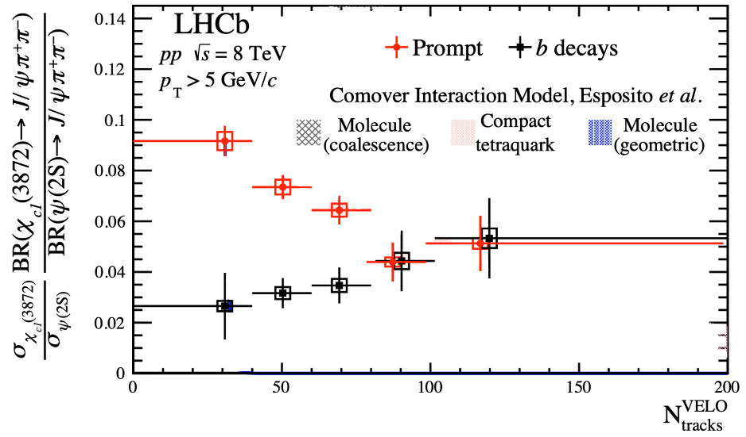
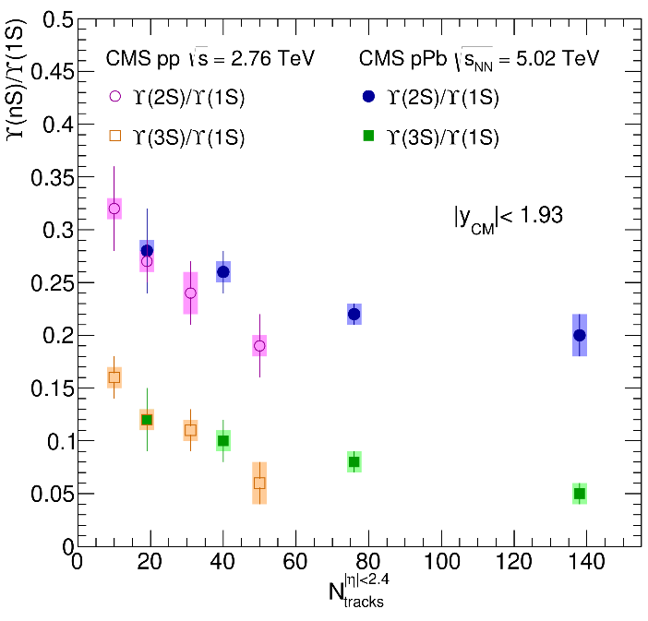
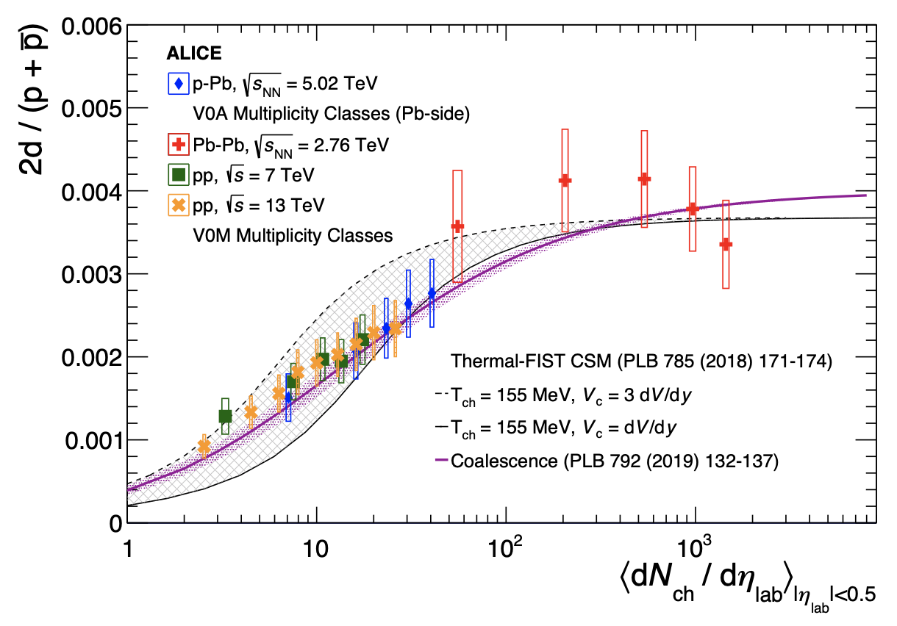
Multiplicity dependence
The $X(3872)$is more and more suppressed wrt $ψ(2S)$when more comovers are present Does it make the $X(3872)$a fragile molecule?
The $X(3872)$is more and more suppressed wrt $ψ(2S)$when more comovers are present Does it make the $X(3872)$a fragile molecule? No.
LHCb 2009.06619
Deuteron is a molecule, but it increases
CMS JHEP04(2014), 103
ALICE EPJC80, 9, 889
$Υ(2S)$ and $Υ\left(3S\right)$ are not molecules, but they decrease
$Υ(2S)$ and $Υ\left(3S\right)$ are not molecules, but they decrease
A. Pilloni – Hadron Spectroscopy
Notes:
2 slides su Zc, a Bes e a Belle
2 slide su tetraquark model: dall’hamiltoniana di Jaffe al calcolo delle masse
1 slide su molecular models, dove sono i carichi? (non in Tornqvist, si in Hanhart, vedere Braaten, citare Nefediev)
2 slides su decay channels, dove si dovrebbe vedere, e a seconda del modello, vedere qualche plot
1 slide su Y(4260), tetraquark? C’è lo strano (si vede la f0)
1 slide su Zc a cleo (anche il neutro)

Slide 24
The comover model
The interaction with final state comoving particles can help create/destroy a hadron
Baym PLB138, 18
For a compact state in 𝑝𝑝 collisions the number evolves following
hadron yield
destruction cross section
$$τ\frac{dN_{𝒬}}{dτ}=−⟨vσ⟩_{𝒬}ρ_{c}N_{𝒬}$$
comover density at initial time (Glauber model) $∝N_{ch}$
In the Comover Interaction Model one takes $⟨vσ⟩_{𝒬}∼πr_{𝒬}^{2}$
This has proved to be successful at describing 𝑝Pb and PbPb data
Ferreiro PLB749, 98
Ferreiro, Lansberg JHEP10(2018), 94
A. Pilloni – Hadron Spectroscopy
Notes:
2 slides su Zc, a Bes e a Belle
2 slide su tetraquark model: dall’hamiltoniana di Jaffe al calcolo delle masse
1 slide su molecular models, dove sono i carichi? (non in Tornqvist, si in Hanhart, vedere Braaten, citare Nefediev)
2 slides su decay channels, dove si dovrebbe vedere, e a seconda del modello, vedere qualche plot
1 slide su Y(4260), tetraquark? C’è lo strano (si vede la f0)
1 slide su Zc a cleo (anche il neutro)

Slide 25
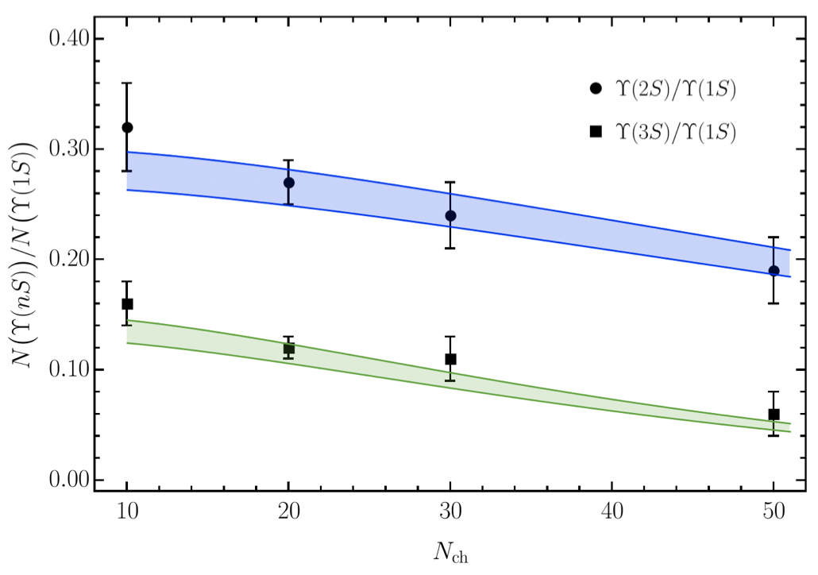
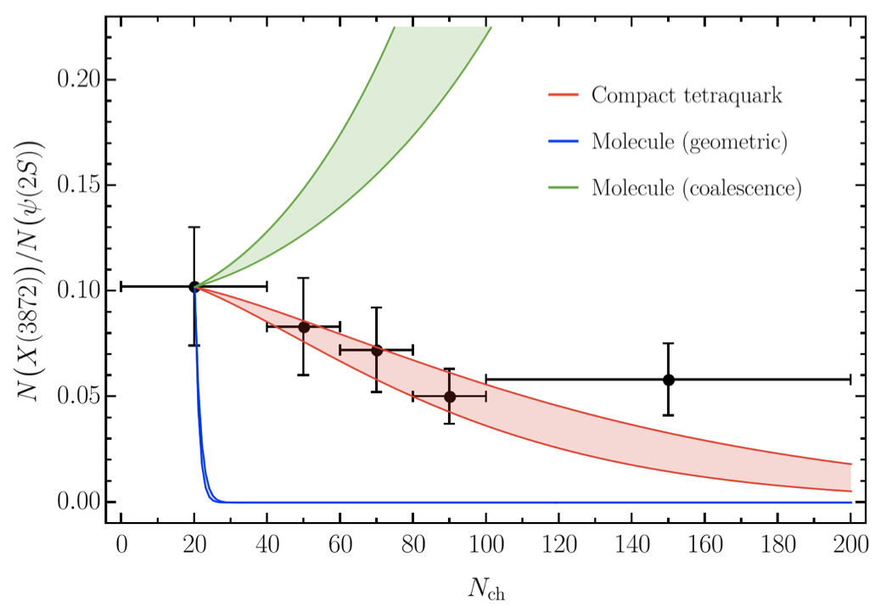
Bottomonia & $X(3872)$
Further validate the model using CMS $pp$ data Using same cross sections as in 𝑝Pb and PbPb
Same model for a compact $X(3872)$
Esposito, Ferreiro, AP, Polosa, Salgado EPJC 81 (2021) 7, 669
A. Pilloni – Hadron Spectroscopy
Notes:
2 slides su Zc, a Bes e a Belle
2 slide su tetraquark model: dall’hamiltoniana di Jaffe al calcolo delle masse
1 slide su molecular models, dove sono i carichi? (non in Tornqvist, si in Hanhart, vedere Braaten, citare Nefediev)
2 slides su decay channels, dove si dovrebbe vedere, e a seconda del modello, vedere qualche plot
1 slide su Y(4260), tetraquark? C’è lo strano (si vede la f0)
1 slide su Zc a cleo (anche il neutro)

Slide 26
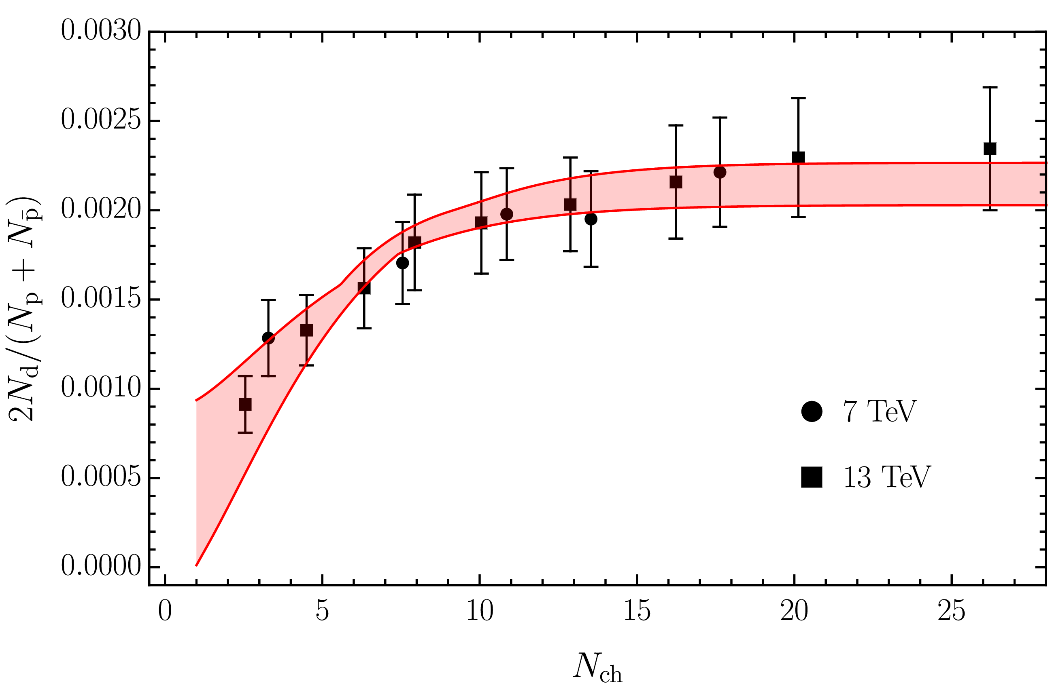
Deuteron in coalescence model
Solution of the evolution equation with recombination
$$\frac{N_{m}}{N_{h}}=\frac{{\left\langle vσ\right\rangle }_{m}}{{\left\langle vσ\right\rangle }_{m}+{\left\langle vσ\right\rangle }_{hh}}+\left(\frac{N_{m}^{0}}{N_{h}^{0}}−\frac{{\left\langle vσ\right\rangle }_{m}}{{\left\langle vσ\right\rangle }_{m}+{\left\langle vσ\right\rangle }_{hh}}\right)e^{−\left({\left\langle vσ\right\rangle }_{m}+{\left\langle vσ\right\rangle }_{hh}\right)ρ_{c}\ln\left(ρ_{c}/ρ_{c}^{pp}\right)}$$
Numbers of molecule at $t=0$,
$≈0$ in Pythia
The coalescence momentum for deuteron is known to be $Λ=50 ÷200 \text{MeV}$
Cross sections calculated from scattering of constituents
A. Pilloni – Hadron Spectroscopy
Notes:
2 slides su Zc, a Bes e a Belle
2 slide su tetraquark model: dall’hamiltoniana di Jaffe al calcolo delle masse
1 slide su molecular models, dove sono i carichi? (non in Tornqvist, si in Hanhart, vedere Braaten, citare Nefediev)
2 slides su decay channels, dove si dovrebbe vedere, e a seconda del modello, vedere qualche plot
1 slide su Y(4260), tetraquark? C’è lo strano (si vede la f0)
1 slide su Zc a cleo (anche il neutro)

Slide 27
$X(3872)$ again
The coalescence momentum for the $X(3872)$ is $Λ=30 ÷300 \text{MeV}$
Controversies for $N_{m}/N_{h}$: How is the 𝑋 produced?
Through ${\overline{D}}^{0}D^{∗0}$: $N_{m}/N_{h}≈0$
Through $χ_{c1}(2P)$: $N_{m}/N_{h}≈1$
The difference shown with a green band
A. Pilloni – Hadron Spectroscopy
Notes:
2 slides su Zc, a Bes e a Belle
2 slide su tetraquark model: dall’hamiltoniana di Jaffe al calcolo delle masse
1 slide su molecular models, dove sono i carichi? (non in Tornqvist, si in Hanhart, vedere Braaten, citare Nefediev)
2 slides su decay channels, dove si dovrebbe vedere, e a seconda del modello, vedere qualche plot
1 slide su Y(4260), tetraquark? C’è lo strano (si vede la f0)
1 slide su Zc a cleo (anche il neutro)

Slide 28
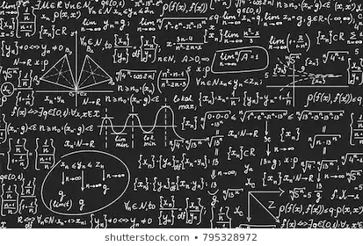
Bottom-up approach
Less predictive power ✗
Some physical interpretation ✗ Minimally biased ✓
You extract physics
You choose a set of generic amplitudes at the hadron level
You start with data
A. Pilloni – Hadron Spectroscopy

Slide 29
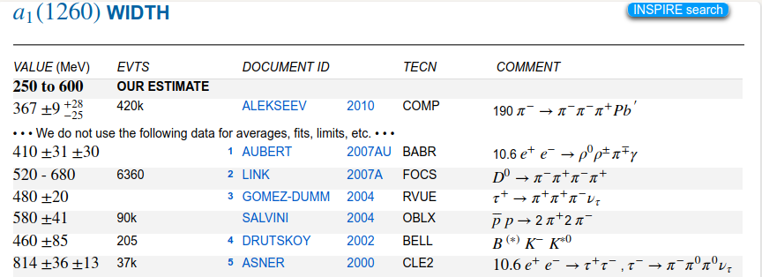
Life is not easy...
A. Pilloni – Hadron Spectroscopy
Notes:
2 slides su Zc, a Bes e a Belle
2 slide su tetraquark model: dall’hamiltoniana di Jaffe al calcolo delle masse
1 slide su molecular models, dove sono i carichi? (non in Tornqvist, si in Hanhart, vedere Braaten, citare Nefediev)
2 slides su decay channels, dove si dovrebbe vedere, e a seconda del modello, vedere qualche plot
1 slide su Y(4260), tetraquark? C’è lo strano (si vede la f0)
1 slide su Zc a cleo (anche il neutro)

Slide 30
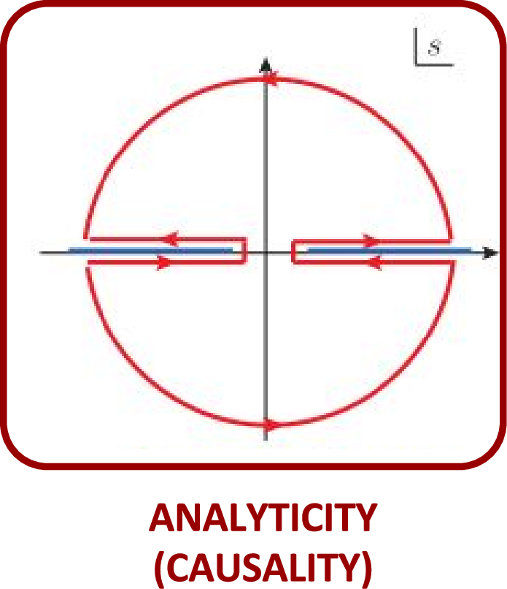
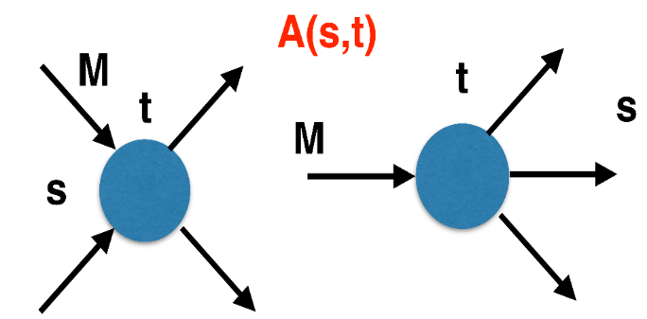
The S-Matrix principles
Future cannot change the past
100%, something will happen
The anti-particle is an anti-particle and not just a different particle
(analyticity)
(unitarity)
(crossing symmetry)
Sherlock Holmes, QFT
Analyticity
Unitarity
Crossing
Parametrize your ignorance.
Build a model.
Fit data.
Have fun.
A. Pilloni – Hadron Spectroscopy

Slide 31
$S$-Matrix principles
$$t_{l}\left(s\right)=\lim_{ε→0}t_{l}(s+iε)⁡$$
Analyticity
$$\text{Im} t_{l}=ρ_{l}{\left|t_{l}\right|}^{2} ⁡$$
These are constraints the amplitudes have to satisfy, but do not fix the dynamics
They can be imposed with an increasing amount of rigor, to extract robust physics information
The «background» phenomena can be effectively parameterized in a controlled way
+ Lorentz, discrete & global symmetries
A. Pilloni – Hadron Spectroscopy
Notes:
Controlla la parte su Regge

Slide 32
Crossing symmetry
$$π^{+}$$
$$K^{+}$$
$$π^{+}$$
$$K^{−}$$
$$π^{+}$$
$$K^{+}$$
$$π^{−}$$
$$K^{−}$$
$$π^{+}$$
$$K^{−}$$
$$π^{+}$$
$$K^{+}$$
All these processes are not independent, but are described by the same amplitude!
Simplification – Complication!
It also relates a $1→3$ decay to $2→2$ scattering
A. Pilloni – Hadron Spectroscopy
Notes:
Controlla la parte su Regge

Slide 33
Analyticity
Complex analytic functions are extremely regular and smooth
Integrals are easy (Cauchy theorem)
If you know the function in a region, you can extend it in a unique way everywhere
Complex functions are characterized by its non-analyticities (poles and cuts)
Analyticity
If I turn on an interaction at $t=0$, and I want nothing happens f$or t<0$, I cannot have singularities in the upper plane
$$f\left(t\right)=\int_{−∞}^{+∞}{e^{−iωt}f\left(ω\right) dω}=2πi\sum_{>/<}{{\text{Res}}_{\text{i}} }$$
A. Pilloni – Hadron Spectroscopy
Notes:
Controlla la parte su Regge

Slide 34
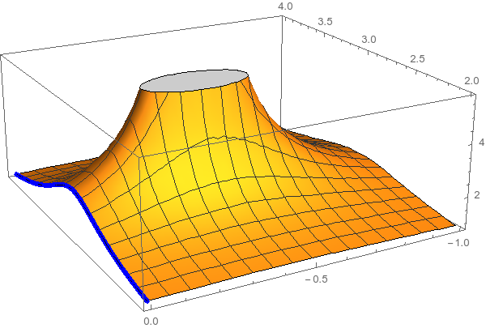
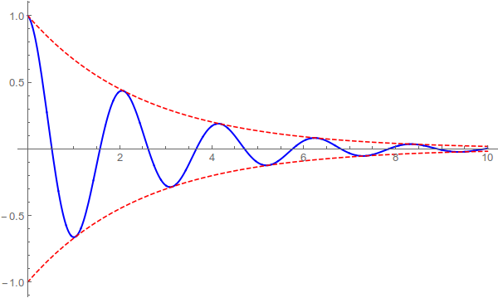
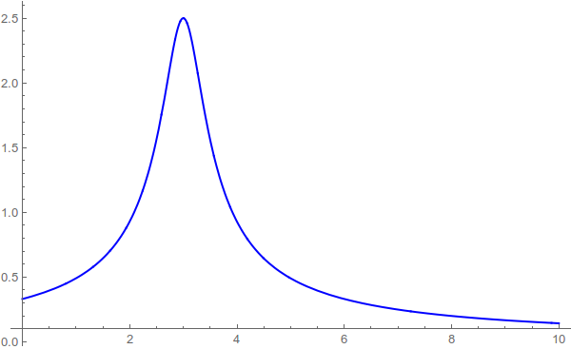
Resonances = Unstable states
$$ψ(t)=e^{−i E_{0} t} e^{− \frac{Γ}{2} t }$$
$$ψ(E)=\frac{1}{E−E_{0}+i\frac{Γ}{2}}$$
The function explodes for value of energy $E=E_{0}−i\frac{Γ}{2}$
Resonances are poles in the complex energy plane
$ψ_{out}\left(r\right)∼e^{i k z}+\frac{f\left(E,θ\right)}{r} e^{ikr}$
Excited states are unstable
They manifest as resonant peaks
A. Pilloni – Hadron Spectroscopy

Slide 35
Unitarity
$S$ is the scattering operator ($∝$ time evolution from $−∞$ to $+∞$)
We isolate the «nothing happens» part $S=1+i A$
$$\text{Im} A_{i→f}=\frac{1}{2}\sum_{n}{A_{i→n}A_{f→n}^{†}}$$
$$SS^{†}=1$$
Below threshold there are no available states in the sum, so $\text{Im} A(E<E_{\text{thr}})=0$
If a function is nonsingular on the real axis, it admits an analytic continuation using Schwartz reflection principle, $A\left(z^{∗}\right)=A^{∗}(z)$. Above threshold close to the real axis,
$$\text{Im} A\left(E+i ε\right)=\frac{1}{2i}\left[A\left(E+iε\right)−A^{∗}(E+iε)\right]=\frac{1}{2i}\left[A\left(E+iε\right)−A(E−iε)\right]>0$$
So a cut opens on the real axis at threshold
A. Pilloni – Hadron Spectroscopy
Notes:
Controlla la parte su Regge

Slide 36
Partial waves in $2→2$ scattering
Let us consider the elastic scattering of two equal mass spinless particles
$s={\left(p_{1}+p_{2}\right)}^{2}=$ energy squared
$t={\left(p_{1}−p_{3}\right)}^{2}∝\cos{θ}=$ momentum transferred
$$3$$
$$1$$
$$θ$$
$$2$$
$$4$$
Legendre polynomial
$$A\left(s,t\right)=\sum_{l}{A_{l}\left(s\right)P_{l}(\cos{θ})}$$
$$\text{Im} A_{l}\left(s\right)=ρ\left(s\right){\left|A_{l}\left(s\right)\right|}^{2}$$
Phase space (known)
Partial wave
Partial waves diagonalize unitarity: each one statisfy a separate equation Each partial wave has definite orbital angular momentum = spin
Remember: I can only measure cross section (amplitude squared)
A. Pilloni – Hadron Spectroscopy

Slide 37
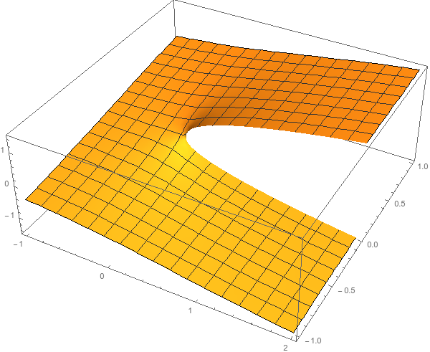
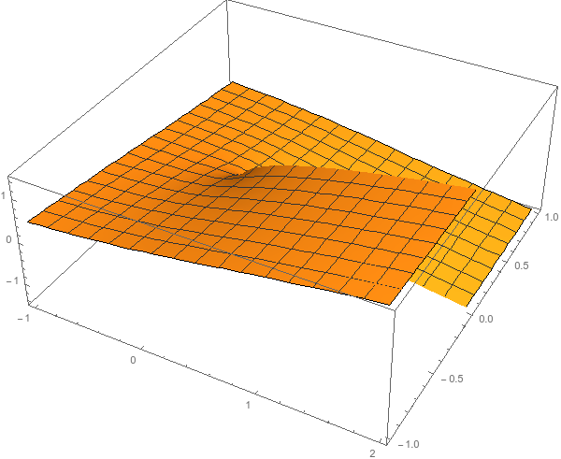
Unitarity
$$\text{Im} A_{i→f}=\frac{1}{2}\sum_{n}{A_{i→n}A_{f→n}^{†}}$$
I have different values of $A$ across the real axis
$$i\sqrt{e^{iπ}}=−1$$
$$i\sqrt{e^{iπ}}=1$$
$$i\sqrt{1}=i$$
Example: $i\sqrt{E}$
$$i\sqrt{e^{2iπ}}=i$$
$$i\sqrt{e^{2iπ}}=−i$$
$$i\sqrt{1}=−i$$
...but I can decide to get the negative solution
I sheet
II sheet
A. Pilloni – Hadron Spectroscopy
Notes:
Controlla la parte su Regge

Slide 38
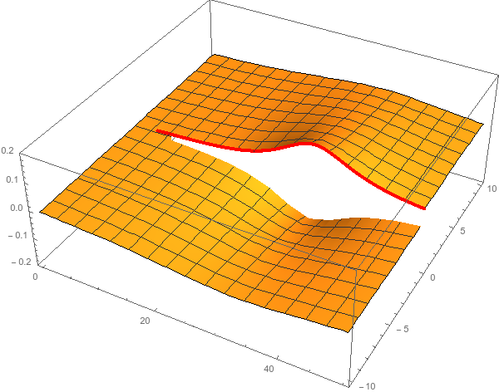
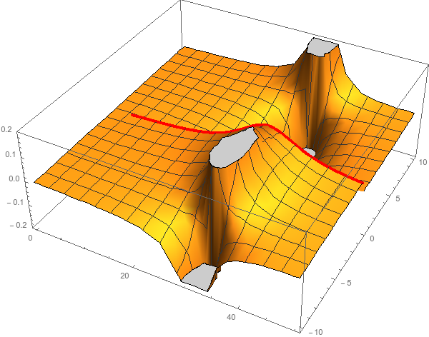
Unitarity & Pole hunting
Unitarity creates a branch cut on the real axis, two sheets continuosly connected
I sheet
II sheet
Finding resonances means writing analytic amplitude, and hunting for poles in the complex plane
A. Pilloni – Hadron Spectroscopy
Notes:
Controlla la parte su Regge

Slide 39
You shall not sum!
The simplest ansatz for a PW amplitude is the Breit-Wigner
What if I have two resonances? Can I add two BWs?
$$A_{l}\left(s\right)=\frac{g^{2}}{m^{2}−s−i g^{2}ρ(s)}$$
$$A_{l}\left(s\right)=\frac{g_{1}^{2}}{m_{1}^{2}−s−i g_{1}^{2}ρ(s)}+\frac{g_{2}^{2} e^{iα}}{m_{2}^{2}−s−i g_{2}^{2}ρ(s)}$$
Unitarity is broken, $\text{Im} A_{l}\left(s\right)≠ρ\left(s\right){\left|A_{l}\left(s\right)\right|}^{2}$
Unitarity is saturated, $\text{Im} A_{l}\left(s\right)=\text{Im}\frac{m^{2}−s+i g^{2}ρ(s)}{{\left|m^{2}−s−i g^{2}ρ\left(s\right)\right|}^{2}}=ρ\left(s\right){\left|A_{l}\left(s\right)\right|}^{2}$
But that’s precisely what experimentalists do! (no offense)
Phases take partially into account the modifications of unitarity due to inelastic channels. However, when we shoot for precision, we need better ansätze (will show examples in the next lectures)
Of course they are not stupid, this works if the two resonances are well isolated. Unfortunately we have no simple alternative solution that can work in all situation, we have to proceed case by case and we live on different timescales
A. Pilloni – Hadron Spectroscopy
Notes:
Controlla la parte su Regge

Slide 40
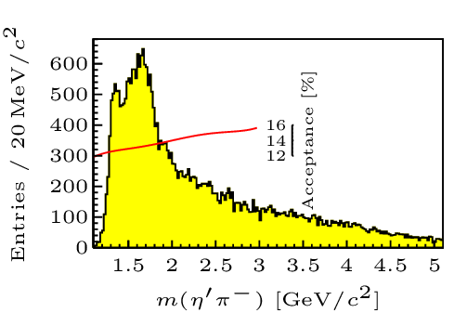
Hybrid hunting
J. Dudek
Excited gluon, $$J^{PC}=1^{+−}$$ mass $∼1.0\text{−}1.5 \text{GeV}$
$$\overline{r}$$
$$\overline{g}$$
$$r$$
excitation of a quasiparticle? → degenerate $J^{PC}={\left(0,1,2\right)}^{−+},1^{−−}$
$$g$$
Look for a $π_{1}$ state with $J^{PC}=1^{−+}$
decaying into $\left\{\begin{matrix}η π \text{and} η^{′}π \\ ρ π→3π \\ b_{1}π→5π\end{matrix}\right.$
Small signal in data
A. Pilloni – Hadron Spectroscopy
Notes:
2 slides su Zc, a Bes e a Belle
2 slide su tetraquark model: dall’hamiltoniana di Jaffe al calcolo delle masse
1 slide su molecular models, dove sono i carichi? (non in Tornqvist, si in Hanhart, vedere Braaten, citare Nefediev)
2 slides su decay channels, dove si dovrebbe vedere, e a seconda del modello, vedere qualche plot
1 slide su Y(4260), tetraquark? C’è lo strano (si vede la f0)
1 slide su Zc a cleo (anche il neutro)

Slide 41
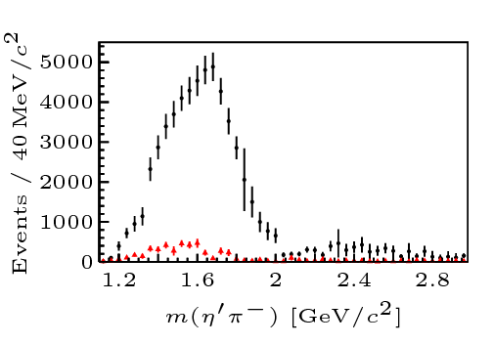
Two hybrid states???
Neither lattice nor models predict two $1^{−+}$ states in this region!
A hybrid meson ($8$) cannot decay into $ηπ$ in the SU(3) limit
Tetraquark ($10⊕\overline{10}$)? Requires doubly charged
A. Pilloni – Hadron Spectroscopy
Notes:
2 slides su Zc, a Bes e a Belle
2 slide su tetraquark model: dall’hamiltoniana di Jaffe al calcolo delle masse
1 slide su molecular models, dove sono i carichi? (non in Tornqvist, si in Hanhart, vedere Braaten, citare Nefediev)
2 slides su decay channels, dove si dovrebbe vedere, e a seconda del modello, vedere qualche plot
1 slide su Y(4260), tetraquark? C’è lo strano (si vede la f0)
1 slide su Zc a cleo (anche il neutro)

Slide 42
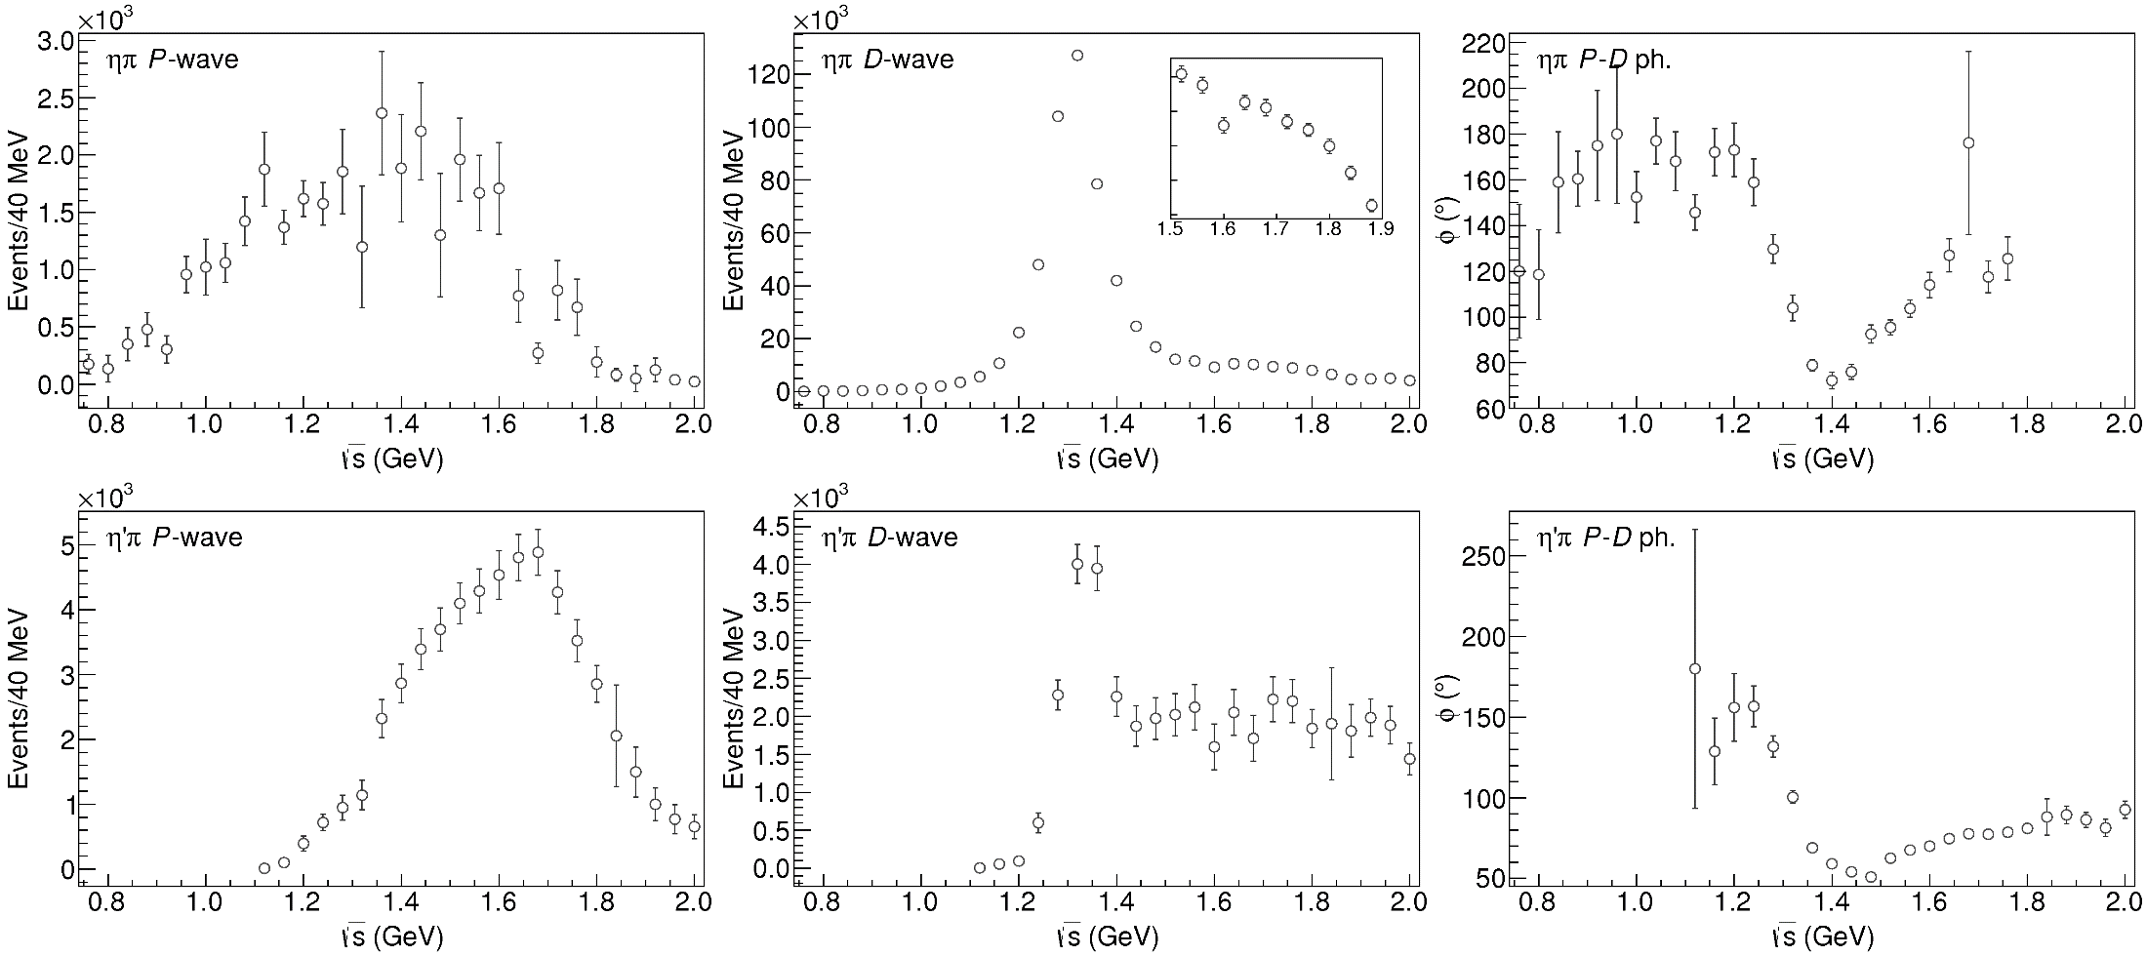
Data in $η^{(′)}π$
( data)
$$π_{1}\left(1400\right)?$$
$$a_{2}\left(1320\right)$$
$$a_{2}^{′}\left(1700\right)$$
$$π_{1}\left(1600\right)?$$
$$a_{2}\left(1320\right)$$
$$a_{2}^{′}\left(1700\right)$$
$$J^{PC}=1^{−+}$$
$$J^{PC}=2^{++}$$
A. Pilloni – Hadron Spectroscopy
Notes:
Controlla la parte su Regge

Slide 43
Amplitudes for $η^{(′)}π$
We build the partial wave amplitudes according to the $N/D$ method
Jackura, Mikhasenko, AP et al. (JPAC & COMPASS), PLB
Rodas, AP et al. (JPAC), PRL
$$a\left(s\right)=\frac{n\left(s\right)}{D\left(s\right)}$$
$$D(s)$$
$$n(s)$$
The $n\left(s\right)$ → background physics, process-dependent, smooth
The $D(s)$ contains all the Final State Interactions constrained by unitarity → universal
A. Pilloni – Hadron Spectroscopy
Notes:
Controlla la parte su Regge

Slide 44
Coupled channel: the model
A. Rodas, AP et al. (JPAC) PRL122, 042002
Two channels, $i,k=ηπ, η^{′}π$ Two waves, $J=P,D$ 37 fit parameters
1 K-matrix pole for the P-wave
2 K-matrix poles for the D-wave
Left-hand scale (Blatt-Weisskopf radius) $s_{R}=s_{0}=1 {\text{GeV}}^{2}$
$α=2$, 3rd order polynomial for $n_{k}^{J}(s)$
A. Pilloni – Hadron Spectroscopy
Notes:
Controlla la parte su Regge

Slide 45
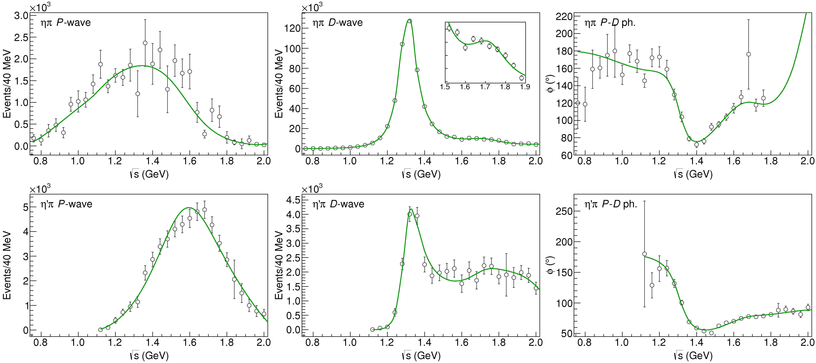
Fit to $η^{(′)}π$
( data)
$$π_{1}\left(1400\right)?$$
$$a_{2}\left(1320\right)$$
$$a_{2}^{′}\left(1700\right)$$
$$π_{1}\left(1600\right)?$$
$$a_{2}\left(1320\right)$$
$$a_{2}^{′}\left(1700\right)$$
$$J^{PC}=1^{−+}$$
$$J^{PC}=2^{++}$$
A. Pilloni – Hadron Spectroscopy
Notes:
Controlla la parte su Regge

Slide 46
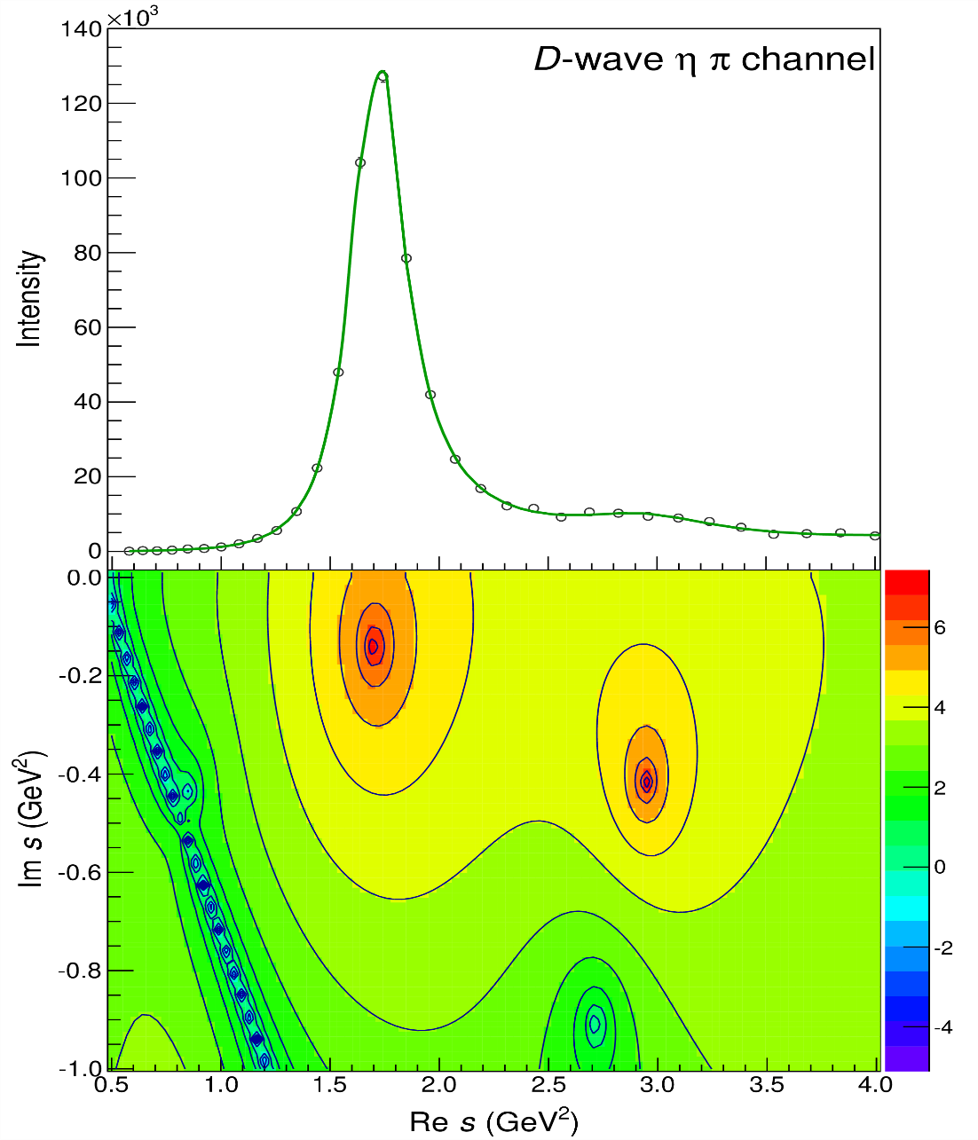
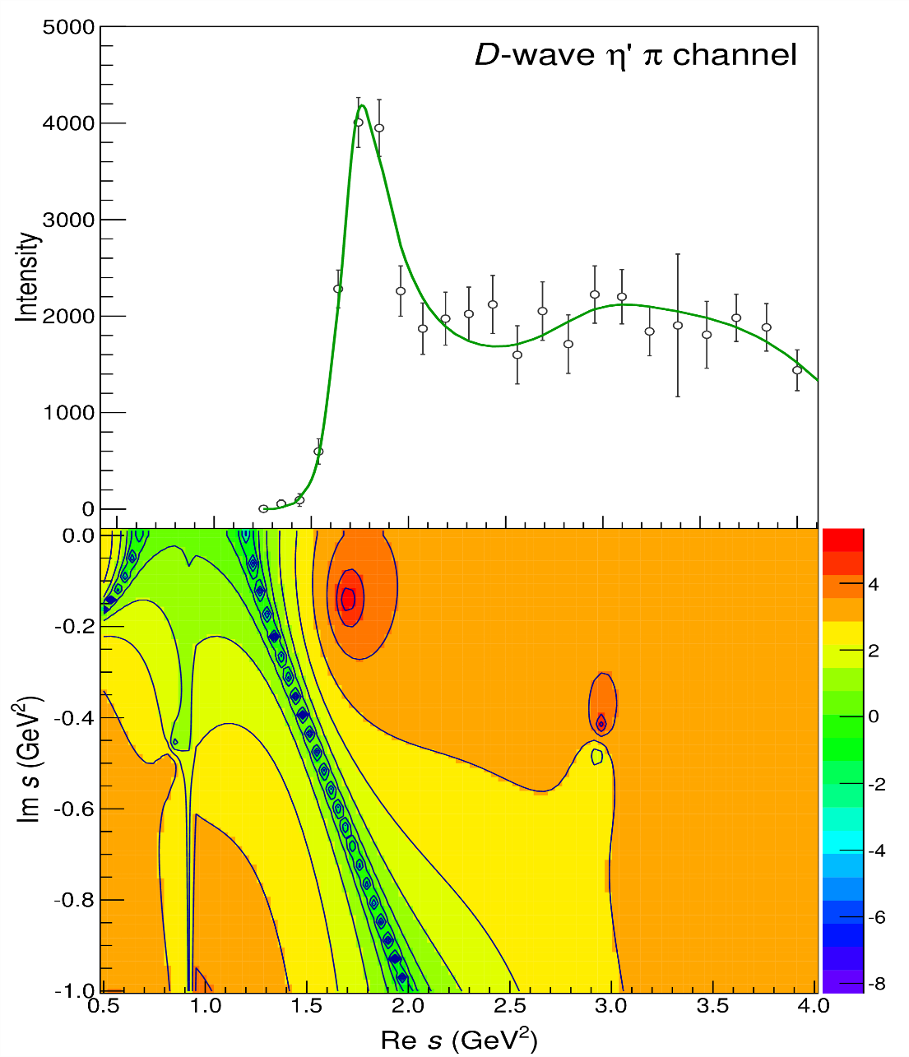
Pole hunting
$$a_{2}^{′}\left(1700\right)$$
$$a_{2}^{′}\left(1700\right)$$
$$a_{2}\left(1320\right)$$
$$a_{2}\left(1320\right)$$
A. Pilloni – Hadron Spectroscopy
Notes:
Controlla la parte su Regge

Slide 47
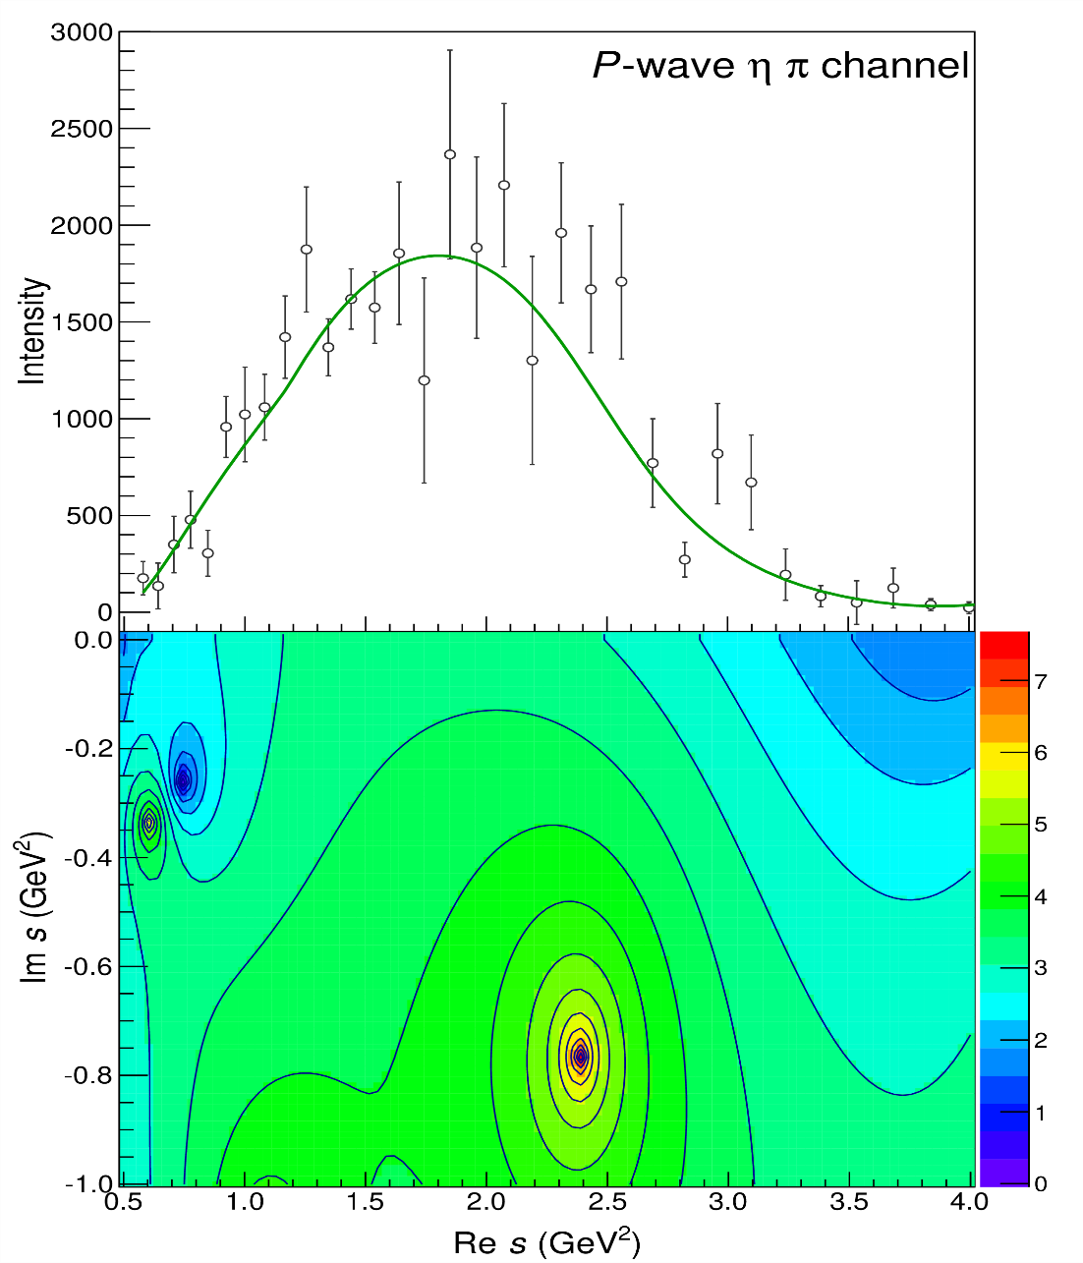
Pole hunting
$$π_{1}$$
$$π_{1}$$
A. Pilloni – Hadron Spectroscopy
Notes:
Controlla la parte su Regge

Slide 48
Final results
Agreement with Lattice is restored
That’s the most rigorous extraction of an exotic meson available so far!
A. Pilloni – Hadron Spectroscopy
Notes:
Controlla la parte su Regge

Slide 49
Bound and virtual states
Decreasing the potential strength, the pole reaches threshold
The pole jumps on the 2nd sheet (dineutron), it becomes a virtual state
Example from $pn$ scattering Bound state on the real axis 1st sheet (deuteron)
$$V(r)$$
$$\text{Im} E$$
$$r$$
$$V$$
Deuteron
$$\text{Re} E$$
$${}_{}^{1}S$$
Deuteron pole
Dineutron pole
$${}_{}^{3}S$$
A. Pilloni – Hadron Spectroscopy
Notes:
Controlla la parte su Regge

Slide 50
Weinberg’s criterion and lineshapes
Let us imagine to have a theory with a bound state with a binding momentum much smaller than the inverse of the range of the potential
The potential is just a delta function, we calculate the $2→2$ scattering amplitude
+
+
+ …
$$A(E)=\frac{1}{1/a−i\sqrt{2μE}}$$
This has a pole at $E=−E_{B}=−\frac{1}{2μa^{2}}$ and residue $g^{2}=\sqrt{\frac{2E_{B}}{μ}}$
A. Pilloni – Hadron Spectroscopy
Notes:
Controlla la parte su Regge

Slide 51
Weinberg’s criterion and lineshapes
Now let us consider the propagation of a bare intermediate state
+
+
+ …
$$A\left(E\right)=\frac{g_{0}^{2}}{E_{0}−E−ig_{0}^{2}\sqrt{2μE}}=\frac{g_{0}^{2}}{{−E}_{B}−E−ig_{0}^{2}\sqrt{2μE}−g_{0}^{2}\sqrt{2μE_{B}}}$$
This has a pole at $E_{B}$ and residue $g^{2}=\sqrt{\frac{2E_{B}}{μ}}\left(1−Z\right)$ where $Z$ is the w.f. renormalization, $Z={\left(1+g_{0}^{2}\sqrt{\frac{μ}{2E_{B}}}\right)}^{−1}$= overlap between the bare state and the continuum
A. Pilloni – Hadron Spectroscopy
Notes:
Controlla la parte su Regge

Slide 52
Weinberg’s criterion and lineshapes
The amplitude can be rewritten as
$$A\left(E\right)=\frac{1}{\frac{1}{a}+\frac{1}{2}r_{0}k^{2}−ik}$$
Thus identifying $a=−2 \frac{1−Z}{2−Z}\frac{1}{\sqrt{2μE_{B}}}$, $r_{0}=−\frac{Z}{1−Z}\frac{1}{\sqrt{2μE_{B}}}$
So a negative $r_{0}$ points to a short range component in the wave function
This is true up to corrections of the order of the range of the potential, which btw are positive under general assumptions
Esposito, Maiani, Pilloni, Polosa, Riquer, 105 (2022) 3, L031503
A. Pilloni – Hadron Spectroscopy
Notes:
Controlla la parte su Regge

Slide 53
L. Maiani
A. Pilloni – Hadron Spectroscopy
Notes:
Controlla la parte su Regge

Slide 54
L. Maiani
A. Pilloni – Hadron Spectroscopy
Notes:
Controlla la parte su Regge

Slide 55
The lineshape of the $X(3872)$
Blue line is $D^{0}\overline{D^{∗0}}$,
$D^{+}D^{∗−}$ is $δ=8.2 \text{MeV}$
heavier
Because of experimental resolution, different lineshapes are indistinguishable
Unitary parametrizations tend to be narrower, $Γ_{BW}=1.39±0.24±0.10 \text{MeV}$, $Γ_{fl}={0.22}_{−0.06−0.13}^{+0.07+0.11} \text{MeV}$
A. Pilloni – Hadron Spectroscopy
Notes:
Controlla la parte su Regge

Slide 56
The lineshape of the $X(3872)$
Esposito, Maiani, AP, Polosa, Riquer, PRD 105 (2022) 3, L031503
LHCb data is fitted with the Flatte’ parametrization
The $D^{0}\overline{D^{∗0}}$ threshold
Two options: a) I set $δ=0$ b) I expand at threshold
The $D^{+}D^{∗−}$ threshold
The $J/ψ ρ,ω,$ and other unknown channels
This considers coupled channel, but Weinberg’s criterion applies to single channel bound states only
A. Pilloni – Hadron Spectroscopy
Notes:
Controlla la parte su Regge

Slide 57
The lineshape of the $X(3872)$
Esposito, Maiani, AP, Polosa, Riquer, PRD 105 (2022) 3, L031503
Option b)
Option a)
According to Weinberg’s, the first result points to a sizeable short-range structure of the X(3872)
Still disagreement on how to perform the extraction though
A. Pilloni – Hadron Spectroscopy
Notes:
Controlla la parte su Regge

Slide 58
Pentaquarks
The lowest $P_{c}(4312)$ appears as an isolated peak at the $Σ_{c}^{+}{\overline{D}}^{0}$ threshold
A detailed study of the lineshape provides insight on its nature
Bottom-up: DON’T YOU DARE describing everything!!! Focus on the peak region
A. Pilloni – Hadron Spectroscopy
Notes:
Controlla la parte su Regge

Slide 59
The $P_{c}\left(4312\right):$ Bound and virtual states
We focus on now the $P_{c}(4312)$, which is seen as an isolated peak over a smooth background. In this simple setup, model dependence can be reduced
Virtual state
Bound state
Resonance
A. Pilloni – Hadron Spectroscopy
Notes:
Controlla la parte su Regge

Slide 60
Minimal(istic) model
Fernandez-Ramirez, AP et al. (JPAC), PRL 123, 092001
Model-independent expansion at the $Σ_{c}\overline{D^{0}}$ threshold
$$c_{ii}=0$$
Finite $c_{ii}$
A. Pilloni – Hadron Spectroscopy
Notes:
2 slides su Zc, a Bes e a Belle
2 slide su tetraquark model: dall’hamiltoniana di Jaffe al calcolo delle masse
1 slide su molecular models, dove sono i carichi? (non in Tornqvist, si in Hanhart, vedere Braaten, citare Nefediev)
2 slides su decay channels, dove si dovrebbe vedere, e a seconda del modello, vedere qualche plot
1 slide su Y(4260), tetraquark? C’è lo strano (si vede la f0)
1 slide su Zc a cleo (anche il neutro)

Slide 61
Minimal(istic) model
Model-independent expansion at the $Σ_{c}\overline{D^{0}}$ threshold
$$c_{ii}=0$$
Finite $c_{ii}$
A. Pilloni – Hadron Spectroscopy
Notes:
2 slides su Zc, a Bes e a Belle
2 slide su tetraquark model: dall’hamiltoniana di Jaffe al calcolo delle masse
1 slide su molecular models, dove sono i carichi? (non in Tornqvist, si in Hanhart, vedere Braaten, citare Nefediev)
2 slides su decay channels, dove si dovrebbe vedere, e a seconda del modello, vedere qualche plot
1 slide su Y(4260), tetraquark? C’è lo strano (si vede la f0)
1 slide su Zc a cleo (anche il neutro)

Slide 62
Minimal(istic) model
Model-independent expansion at the $Σ_{c}\overline{D^{0}}$ threshold
Points to a virtual state
$$c_{ii}=0$$
Finite $c_{ii}$
A. Pilloni – Hadron Spectroscopy
Notes:
2 slides su Zc, a Bes e a Belle
2 slide su tetraquark model: dall’hamiltoniana di Jaffe al calcolo delle masse
1 slide su molecular models, dove sono i carichi? (non in Tornqvist, si in Hanhart, vedere Braaten, citare Nefediev)
2 slides su decay channels, dove si dovrebbe vedere, e a seconda del modello, vedere qualche plot
1 slide su Y(4260), tetraquark? C’è lo strano (si vede la f0)
1 slide su Zc a cleo (anche il neutro)

Slide 63
Minimal(istic) model
Model-independent expansion at the $Σ_{c}\overline{D^{0}}$ threshold
Points to a virtual state
Doesn’t point to a resonance
$$c_{ii}=0$$
Finite $c_{ii}$
A. Pilloni – Hadron Spectroscopy
Notes:
2 slides su Zc, a Bes e a Belle
2 slide su tetraquark model: dall’hamiltoniana di Jaffe al calcolo delle masse
1 slide su molecular models, dove sono i carichi? (non in Tornqvist, si in Hanhart, vedere Braaten, citare Nefediev)
2 slides su decay channels, dove si dovrebbe vedere, e a seconda del modello, vedere qualche plot
1 slide su Y(4260), tetraquark? C’è lo strano (si vede la f0)
1 slide su Zc a cleo (anche il neutro)

Slide 64
Minimal(istic) model
Model-independent expansion at the $Σ_{c}\overline{D^{0}}$ threshold
Points to a virtual state
Doesn’t point to a resonance
$$c_{ii}=0$$
Finite $c_{ii}$
A. Pilloni – Hadron Spectroscopy
Notes:
2 slides su Zc, a Bes e a Belle
2 slide su tetraquark model: dall’hamiltoniana di Jaffe al calcolo delle masse
1 slide su molecular models, dove sono i carichi? (non in Tornqvist, si in Hanhart, vedere Braaten, citare Nefediev)
2 slides su decay channels, dove si dovrebbe vedere, e a seconda del modello, vedere qualche plot
1 slide su Y(4260), tetraquark? C’è lo strano (si vede la f0)
1 slide su Zc a cleo (anche il neutro)

Slide 65
Minimal(istic) model with ANN
Ng, et al. (JPAC), PRD 105, L091501
Same conclusion reached if the analysis is performed with a Deep Neural Network
The peak region has the largest impact for the decision
Highest probability for a virtual state in the IV sheet
A. Pilloni – Hadron Spectroscopy
Notes:
2 slides su Zc, a Bes e a Belle
2 slide su tetraquark model: dall’hamiltoniana di Jaffe al calcolo delle masse
1 slide su molecular models, dove sono i carichi? (non in Tornqvist, si in Hanhart, vedere Braaten, citare Nefediev)
2 slides su decay channels, dove si dovrebbe vedere, e a seconda del modello, vedere qualche plot
1 slide su Y(4260), tetraquark? C’è lo strano (si vede la f0)
1 slide su Zc a cleo (anche il neutro)

Slide 66
Epilogue
Why all this is interesting?
Because it’s hard! Nature challenges us constantly
Bottom-up: analytic methods can improve the rigour and robustness in the extraction of the spectrum
Top-down: models have been reviled in favor of rigorous calculations, but they make us understand the dynamics: this makes the path less regular and systematic, more fantasy is needed
Lattice QCD, experiments, etc. are needed to provide further observables to disentangle the various pictures
Thank you!
A. Pilloni – Hadron Spectroscopy
Notes:
2 slides su Zc, a Bes e a Belle
2 slide su tetraquark model: dall’hamiltoniana di Jaffe al calcolo delle masse
1 slide su molecular models, dove sono i carichi? (non in Tornqvist, si in Hanhart, vedere Braaten, citare Nefediev)
2 slides su decay channels, dove si dovrebbe vedere, e a seconda del modello, vedere qualche plot
1 slide su Y(4260), tetraquark? C’è lo strano (si vede la f0)
1 slide su Zc a cleo (anche il neutro)

