Slide 1
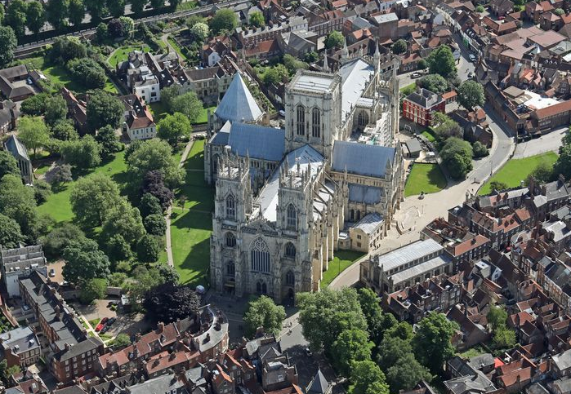
Amplitude analysis and exotic states
Alessandro Pilloni
York, December 12th, 2019

Slide 2
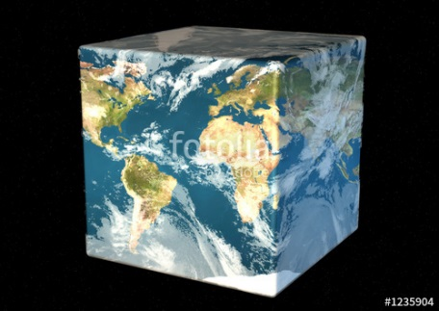
Hadron Spectroscopy
Hybrids
Tetraquark
Meson
Baryon
Glueball
$$π$$
$$π$$
$$J/ψ$$
$$π$$
Hadroquarkonium
Molecule
Experiment
Data
Amplitude analysis
Properties,
Model building
Lattice QCD
Interpretations on the spectrum leads to understanding fundamental laws of nature

Slide 3
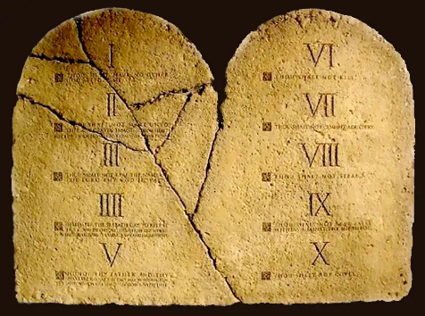
The flowchart(s)
You are given a model/theory
$$f(s)$$
You calculate the amplitude
You compare with data. Or you don’t.
Predictive power ✓
Physical interpretation ✓ (within the model! ✗) Biased by the input ✗
A. Pilloni – Amplitude analysis and exotic states

Slide 4
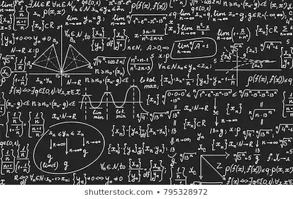
The flowchart(s)
Less predictive power ✗
Some physical interpretation ✗ Minimally biased ✓
You extract physics
You choose a set of generic amplitudes
You start with data
A. Pilloni – Amplitude analysis and exotic states

Slide 5
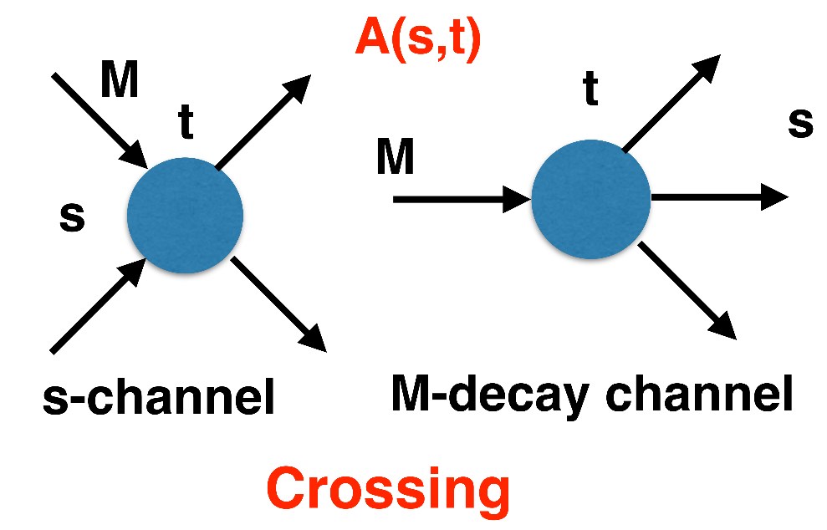
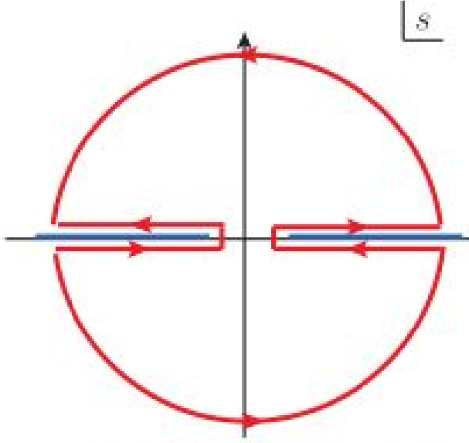
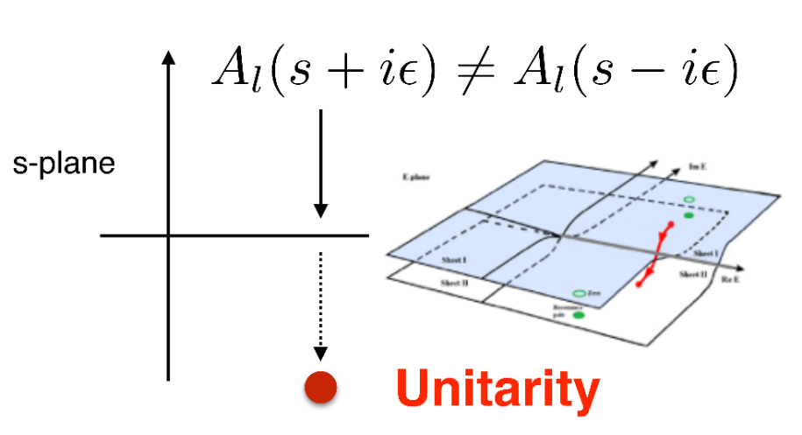
$S$-Matrix principles
$$t_{l}\left(s\right)=\lim_{ε→0}t_{l}(s+iε)⁡$$
Analyticity
$$\text{Im} t_{l}=ρ_{l}{\left|t_{l}\right|}^{2} ⁡$$
These are constraints the amplitudes have to satisfy, but do not fix the dynamics
They can be imposed with an increasing amount of rigor, to extract robust physics information
The «background» phenomena can be effectively parameterized in a controlled way
+ Lorentz, discrete & global symmetries
A. Pilloni – Amplitude analysis and exotic states
Notes:
Controlla la parte su Regge

Slide 6
Bound and virtual states
Decreasing the potential strength, the pole reaches threshold
The pole jumps on the 2nd sheet (dineutron), it becomes a virtual state
Example from $pn$ scattering Bound state on the real axis 1st sheet (deuteron)
$$V(r)$$
$$\text{Im} E$$
$$r$$
$$V$$
Deuteron
$$\text{Re} E$$
$${}_{}^{1}S$$
Deuteron pole
Dineutron pole
$${}_{}^{3}S$$
A. Pilloni – Amplitude analysis and exotic states
Notes:
Controlla la parte su Regge

Slide 7
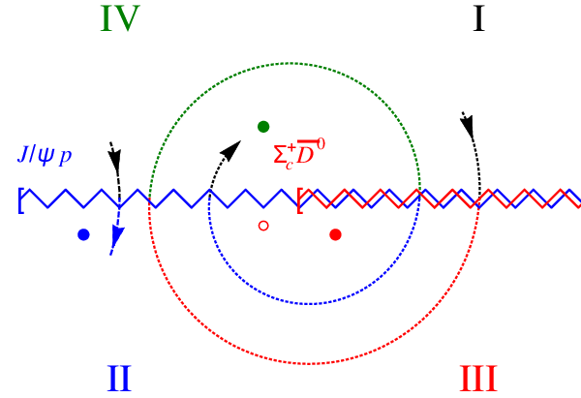
Bound and virtual states
The situation is more complicated when more channels are open
Virtual state
Bound state
Resonance
A. Pilloni – Amplitude analysis and exotic states
Notes:
Controlla la parte su Regge

Slide 8
Triangle singularity
$$π$$
$$D_{1}$$
Logarithmic branch points can simulate a resonant behavior, only in very special kinematical conditions
Coleman and Norton, Nuovo Cim. 38, 438
$$Y(4260)$$
$$D^{∗}$$
$$π$$
$$\overline{D}$$
$$J/ψ$$
However, this effects cancels in Dalitz projections, no peaks Schmid, Phys.Rev. 154, 1363
Szczepaniak, PLB747, 410-416
Szczepaniak, PLB757, 61-64
Guo, Meissner, Wang, Yang PRD92, 071502
...but the cancellation can be spread in different channels, you might still see peaks in other channels only!
A. Pilloni – Amplitude analysis and exotic states

Slide 9
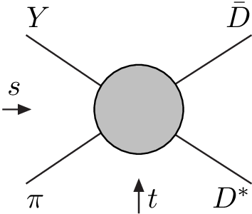
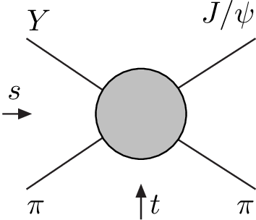
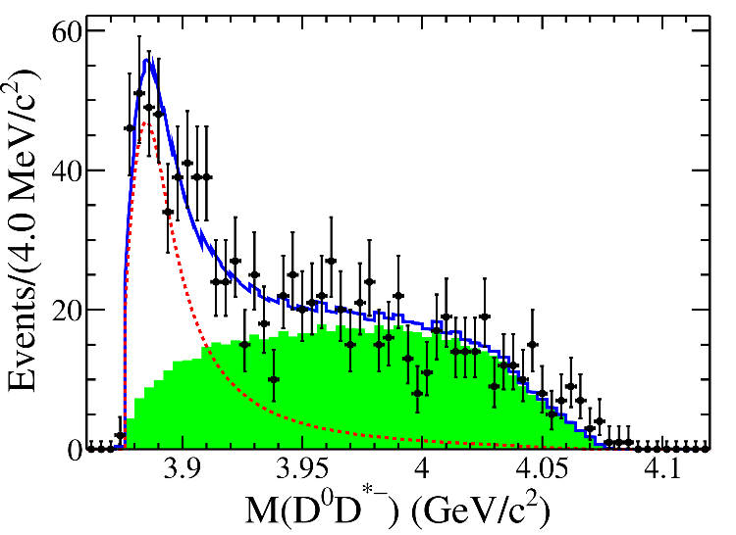
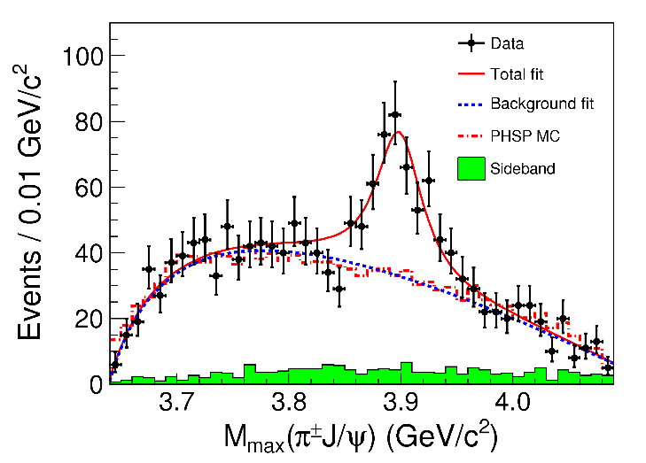
Amplitude analysis for $Z_{c}(3900)$
One can test different parametrizations of the amplitude, different singularities → different natures
AP et al. (JPAC), PLB772, 200
A. Pilloni – Amplitude analysis and exotic states
Notes:
Controlla la parte su Regge

Slide 10
Amplitude model
$$Z_{c}\left(3900\right)?$$
$${u: D}_{0}(2400)$$
$${u:Z}_{c}\left(3900\right)?$$
$$"σ, f_{0}(980)"$$
$$D_{1}(2420)$$
A. Pilloni – Amplitude analysis and exotic states

Slide 11
Testing scenarios
We approximate all the particles to be scalar – this affects the value of couplings, which are not normalized anyway – but not the position of singularities. This also limits the number of free parameters
The scattering matrix is parametrized as ${\left(t^{−1}\right)}_{ij}=K_{ij}−i ρ_{i} δ_{ij}$
Four different scenarios considered:
«III»: the K matrix is $\frac{g_{i} g_{j}}{M^{2}−s}$, this generates a pole in the closest unphysical sheet the rescattering integral is set to zero
«III+tr.»: same, but with the correct value of the rescattering integral
«IV+tr.»: the K matrix is constant, this generates a virtual state pole in the IV sheet
«tr.»: same, but the pole is pushed far away by adding a penalty in the $χ^{2}$
A. Pilloni – Amplitude analysis and exotic states

Slide 12
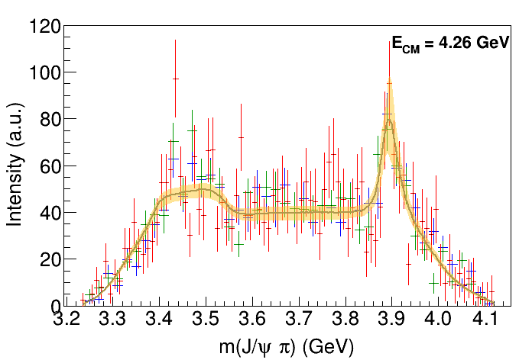
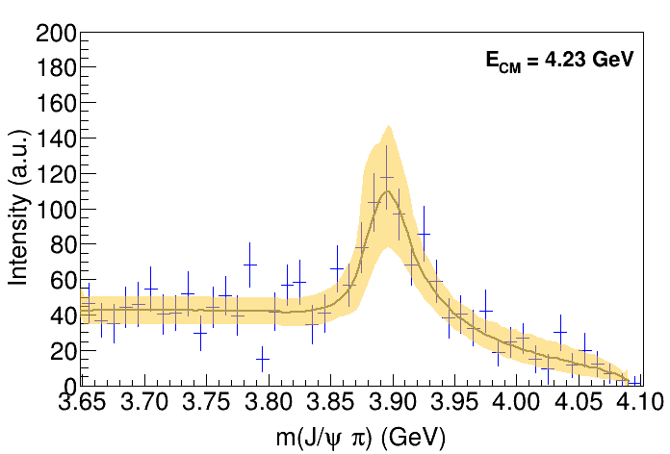
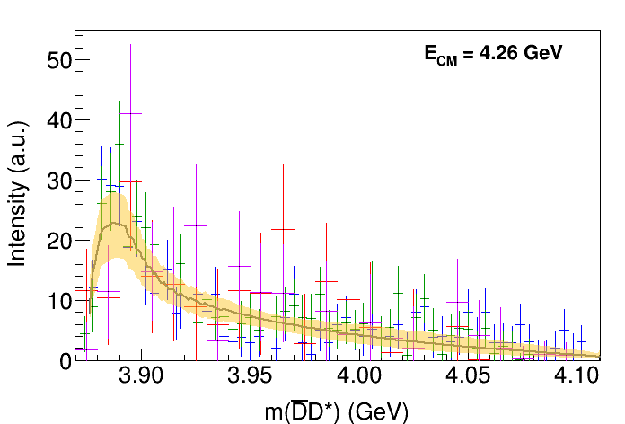
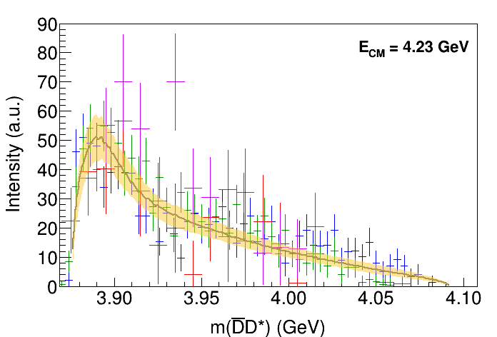
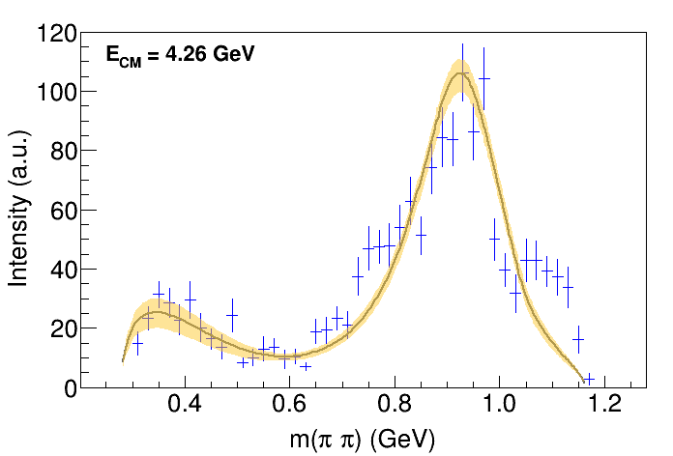
Fit: III
( data)
A. Pilloni – Amplitude analysis and exotic states
Notes:
Controlla la parte su Regge

Slide 13
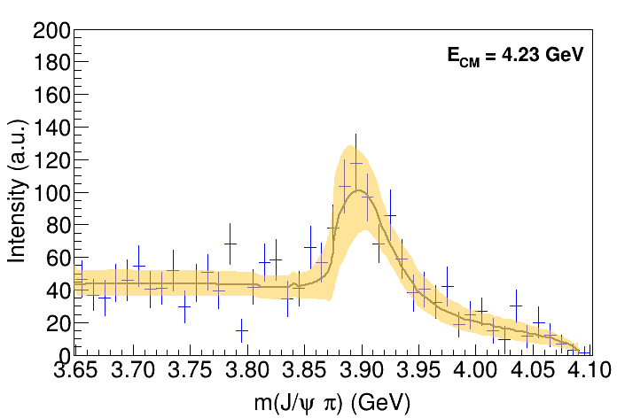
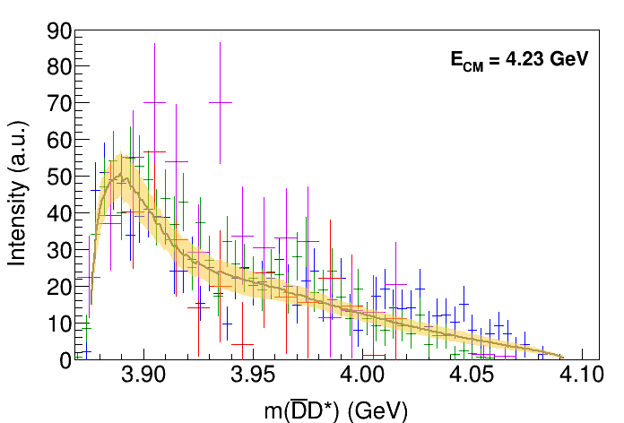
Fit: III+tr.
( data)
A. Pilloni – Amplitude analysis and exotic states
Notes:
Controlla la parte su Regge

Slide 14
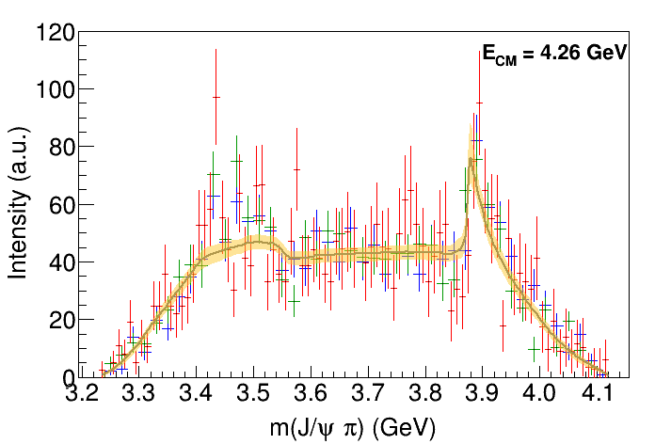
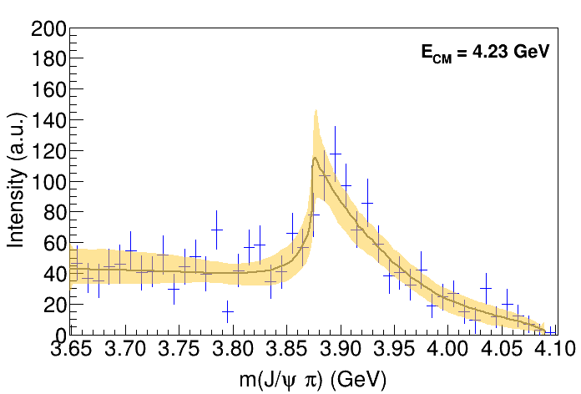
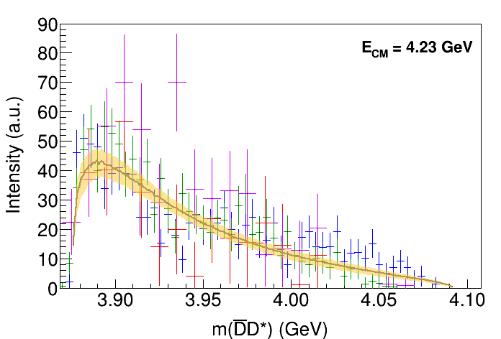
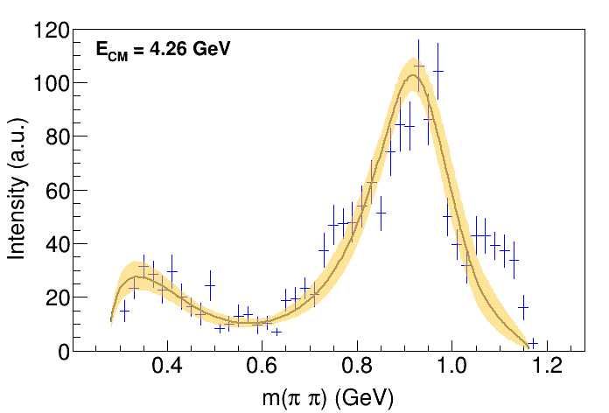
Fit: IV+tr.
( data)
A. Pilloni – Amplitude analysis and exotic states
Notes:
Controlla la parte su Regge

Slide 15
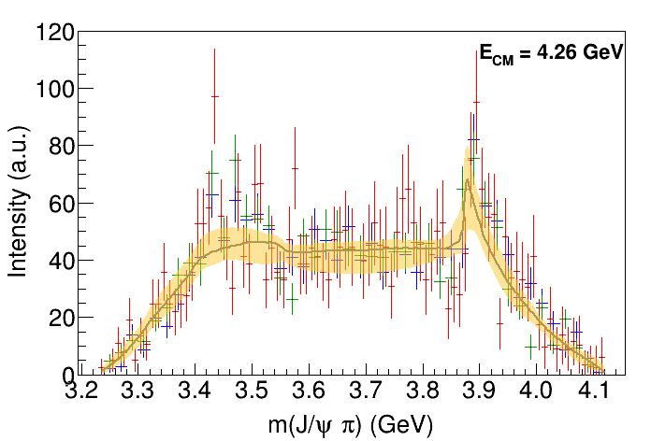
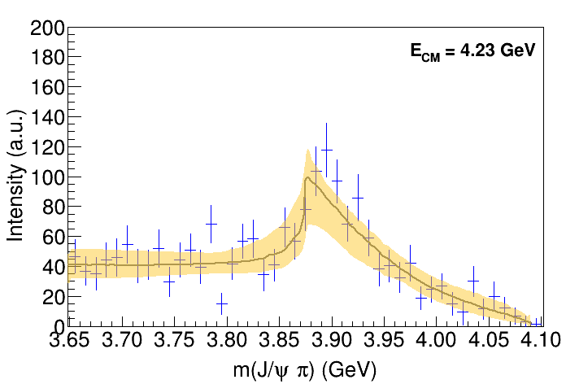
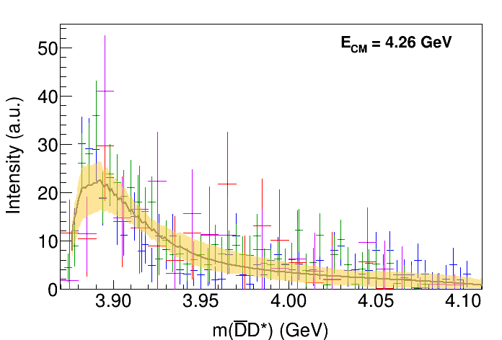
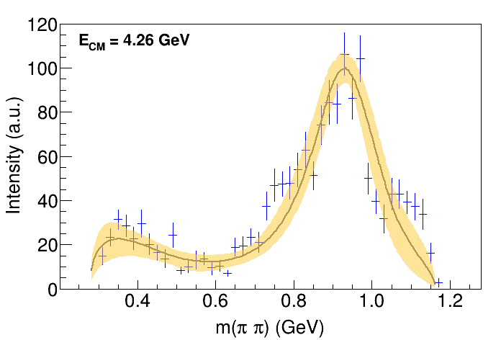
Fit: tr.
( data)
A. Pilloni – Amplitude analysis and exotic states
Notes:
Controlla la parte su Regge

Slide 16
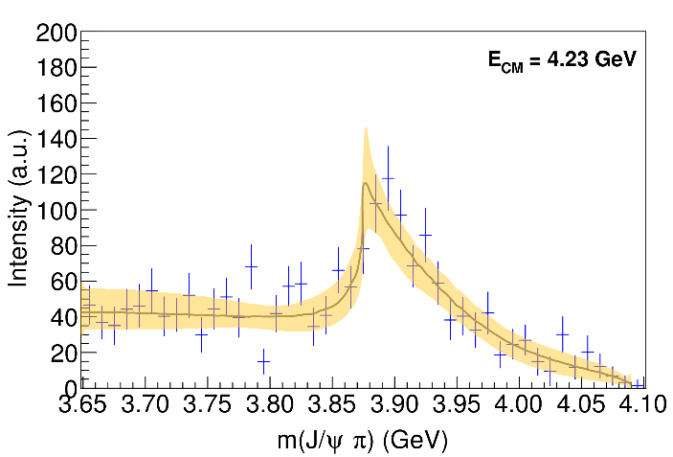
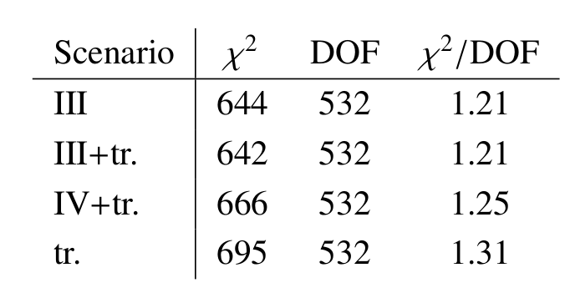
Fit summary
III
IV+tr.
III+tr.
tr.
Naive loglikelihood ratio test give a $∼4σ$ significance of the scenario III+tr. over IV+tr., looking at plots it looks too much – better using some more solid test
A. Pilloni – Amplitude analysis and exotic states
Notes:
Controlla la parte su Regge

Slide 17
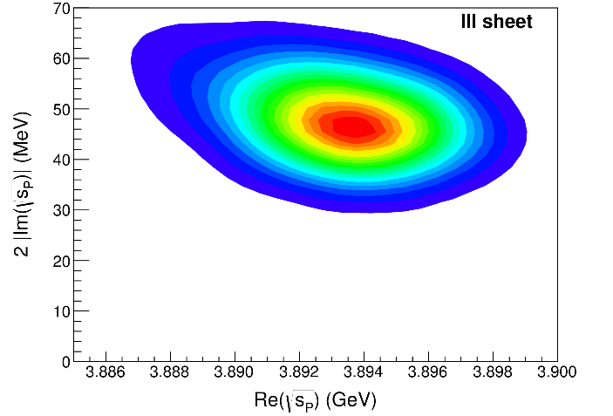
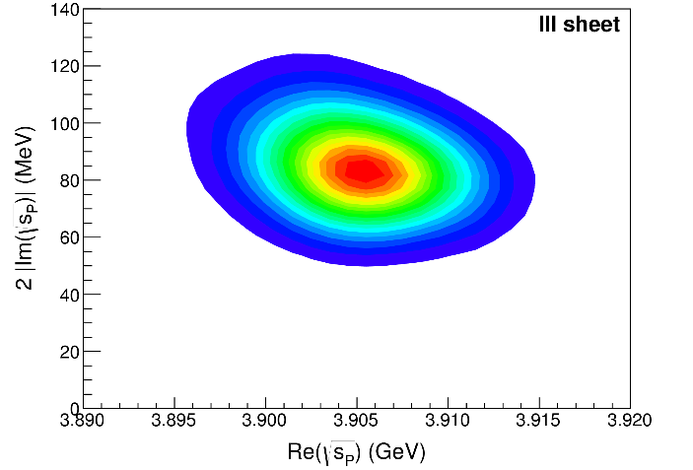
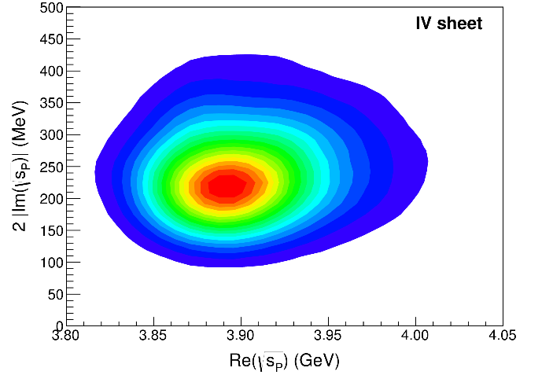
Pole extraction
III
III+tr.
IV+tr.
A. Pilloni – Amplitude analysis and exotic states
Not conclusive at this stage
Notes:
Controlla la parte su Regge

Slide 18
New pentaquarks discovered
LHCb, PRL 122, 222001
A higher statistics 1D analysis is able to resolve the fine structure of the $P_{c}(4450)$ peak.
Moreover, a new isolated $P_{c}(4312)$ at the $Σ_{c}^{+}{\overline{D}}^{0}$ threshold appears
The old assignment of quantum numbers might be jeopardized by this new finding
A. Pilloni – Amplitude analysis and exotic states
Notes:
Controlla la parte su Regge

Slide 19
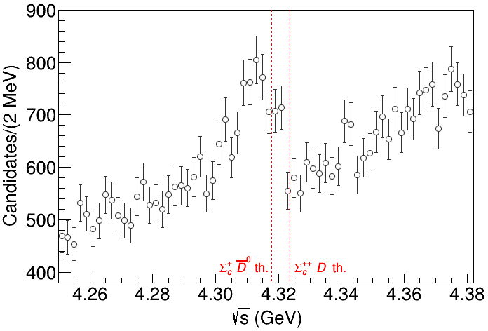
Minimal(istic) model
Fernandez-Ramirez, AP et al. (JPAC), PRL 123, 092001
Local analysis of the $P_{c}(4312)$ region Three datasets (different cuts) studied
Experimental resolution $σ=2.3 \text{MeV}$ included
Width ${Γ(Σ}_{c}^{+})=1.9 \text{MeV}$ neglected
( data)
A. Pilloni – Amplitude analysis and exotic states
Notes:
2 slides su Zc, a Bes e a Belle
2 slide su tetraquark model: dall’hamiltoniana di Jaffe al calcolo delle masse
1 slide su molecular models, dove sono i carichi? (non in Tornqvist, si in Hanhart, vedere Braaten, citare Nefediev)
2 slides su decay channels, dove si dovrebbe vedere, e a seconda del modello, vedere qualche plot
1 slide su Y(4260), tetraquark? C’è lo strano (si vede la f0)
1 slide su Zc a cleo (anche il neutro)

Slide 20
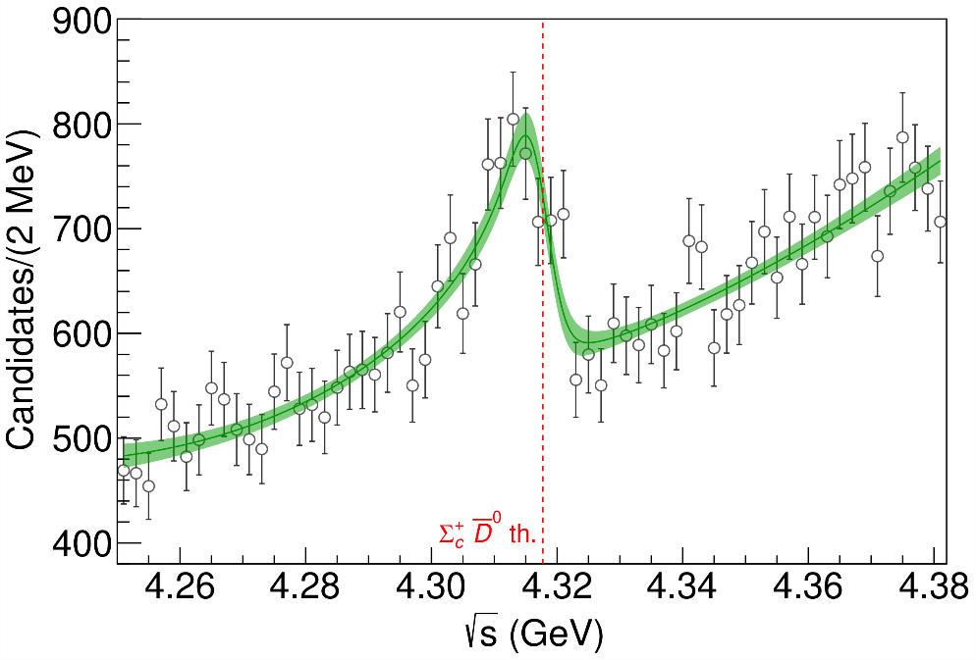
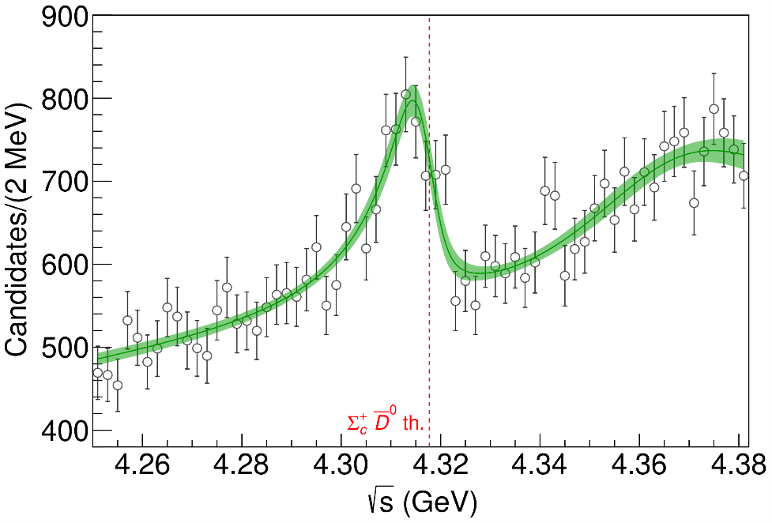
Minimal(istic) model
( data)
Fernandez-Ramirez, AP et al. (JPAC), PRL 123, 092001
Effective range expansion We can set $c_{ii}=0$ to reduce to the scattering length approximation
$$c_{ii}=0$$
Finite $c_{ii}$
A. Pilloni – Amplitude analysis and exotic states
Notes:
2 slides su Zc, a Bes e a Belle
2 slide su tetraquark model: dall’hamiltoniana di Jaffe al calcolo delle masse
1 slide su molecular models, dove sono i carichi? (non in Tornqvist, si in Hanhart, vedere Braaten, citare Nefediev)
2 slides su decay channels, dove si dovrebbe vedere, e a seconda del modello, vedere qualche plot
1 slide su Y(4260), tetraquark? C’è lo strano (si vede la f0)
1 slide su Zc a cleo (anche il neutro)

Slide 21
Minimal(istic) model
Effective range expansion We can set $c_{ii}=0$ to reduce to the scattering length approximation
$$c_{ii}=0$$
Finite $c_{ii}$
A. Pilloni – Amplitude analysis and exotic states
Notes:
2 slides su Zc, a Bes e a Belle
2 slide su tetraquark model: dall’hamiltoniana di Jaffe al calcolo delle masse
1 slide su molecular models, dove sono i carichi? (non in Tornqvist, si in Hanhart, vedere Braaten, citare Nefediev)
2 slides su decay channels, dove si dovrebbe vedere, e a seconda del modello, vedere qualche plot
1 slide su Y(4260), tetraquark? C’è lo strano (si vede la f0)
1 slide su Zc a cleo (anche il neutro)

Slide 22
Minimal(istic) model
Effective range expansion We can set $c_{ii}=0$ to reduce to the scattering length approximation
Points to a virtual state
$$c_{ii}=0$$
Finite $c_{ii}$
A. Pilloni – Amplitude analysis and exotic states
Notes:
2 slides su Zc, a Bes e a Belle
2 slide su tetraquark model: dall’hamiltoniana di Jaffe al calcolo delle masse
1 slide su molecular models, dove sono i carichi? (non in Tornqvist, si in Hanhart, vedere Braaten, citare Nefediev)
2 slides su decay channels, dove si dovrebbe vedere, e a seconda del modello, vedere qualche plot
1 slide su Y(4260), tetraquark? C’è lo strano (si vede la f0)
1 slide su Zc a cleo (anche il neutro)

Slide 23
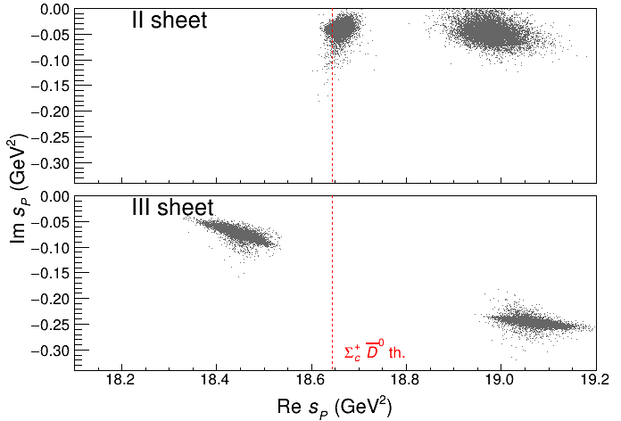
Minimal(istic) model
Effective range expansion We can set $c_{ii}=0$ to reduce to the scattering length approximation
Points to a virtual state
Doesn’t point to a resonance
$$c_{ii}=0$$
Finite $c_{ii}$
A. Pilloni – Amplitude analysis and exotic states
Notes:
2 slides su Zc, a Bes e a Belle
2 slide su tetraquark model: dall’hamiltoniana di Jaffe al calcolo delle masse
1 slide su molecular models, dove sono i carichi? (non in Tornqvist, si in Hanhart, vedere Braaten, citare Nefediev)
2 slides su decay channels, dove si dovrebbe vedere, e a seconda del modello, vedere qualche plot
1 slide su Y(4260), tetraquark? C’è lo strano (si vede la f0)
1 slide su Zc a cleo (anche il neutro)

Slide 24
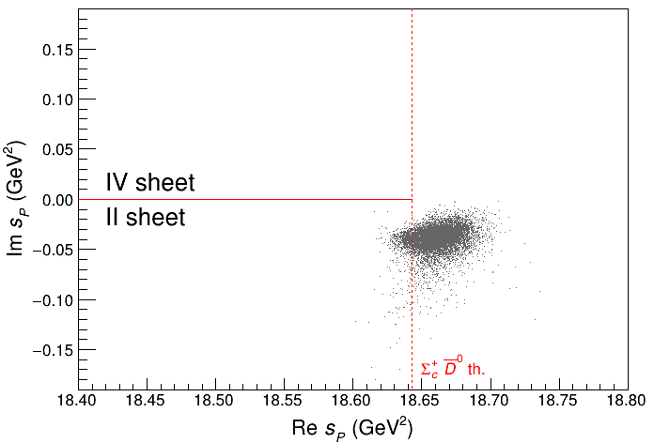
Minimal(istic) model
Effective range expansion We can set $c_{ii}=0$ to reduce to the scattering length approximation
Points to a virtual state
Doesn’t point to a resonance
$$c_{ii}=0$$
Finite $c_{ii}$
A. Pilloni – Amplitude analysis and exotic states
Notes:
2 slides su Zc, a Bes e a Belle
2 slide su tetraquark model: dall’hamiltoniana di Jaffe al calcolo delle masse
1 slide su molecular models, dove sono i carichi? (non in Tornqvist, si in Hanhart, vedere Braaten, citare Nefediev)
2 slides su decay channels, dove si dovrebbe vedere, e a seconda del modello, vedere qualche plot
1 slide su Y(4260), tetraquark? C’è lo strano (si vede la f0)
1 slide su Zc a cleo (anche il neutro)

Slide 25
$P_{c}$ photoproduction
To exclude any rescattering mechanism, we propose to search the $P_{c}$s in photoproduction.
Karliner & Rosner, PLB752, 329
Hiller Blin, AP et al. (JPAC), PRD94, 034002
D. Winney, C. Fanelli, AP et al. (JPAC) PRD100, 034019
We assume equal hadronic helicity couplings, extracted from the unknown partial width
Vector meson dominance relates the radiative width to the hadronic width
A. Pilloni – Amplitude analysis and exotic states
Notes:
Controlla la parte su Regge

Slide 26
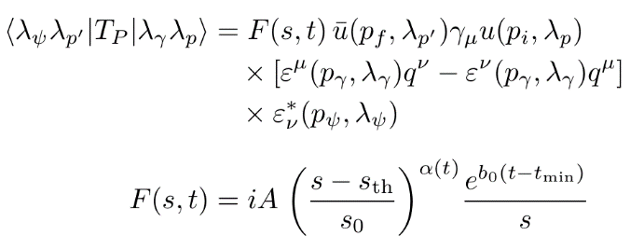
Background parameterization
The background is described via an Effective Vector Pomeron
A. Pilloni – Amplitude analysis and exotic states
Notes:
Controlla la parte su Regge

Slide 27
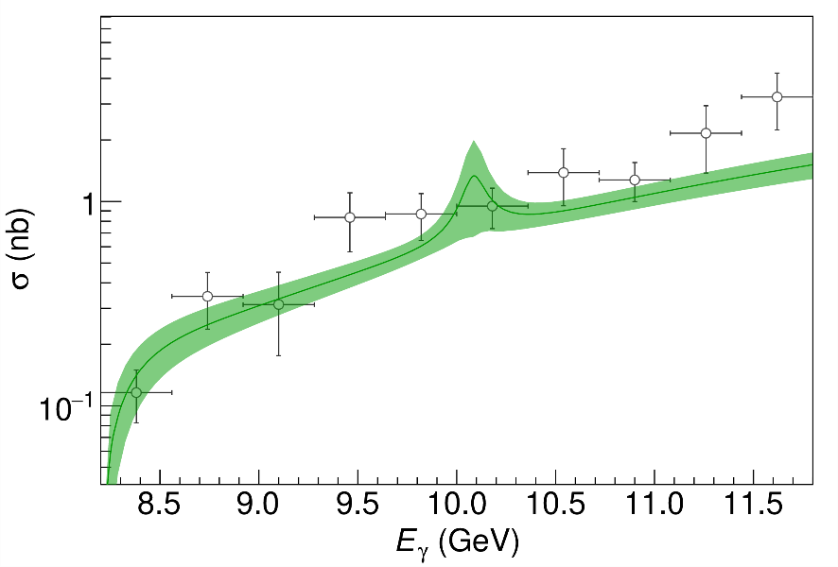
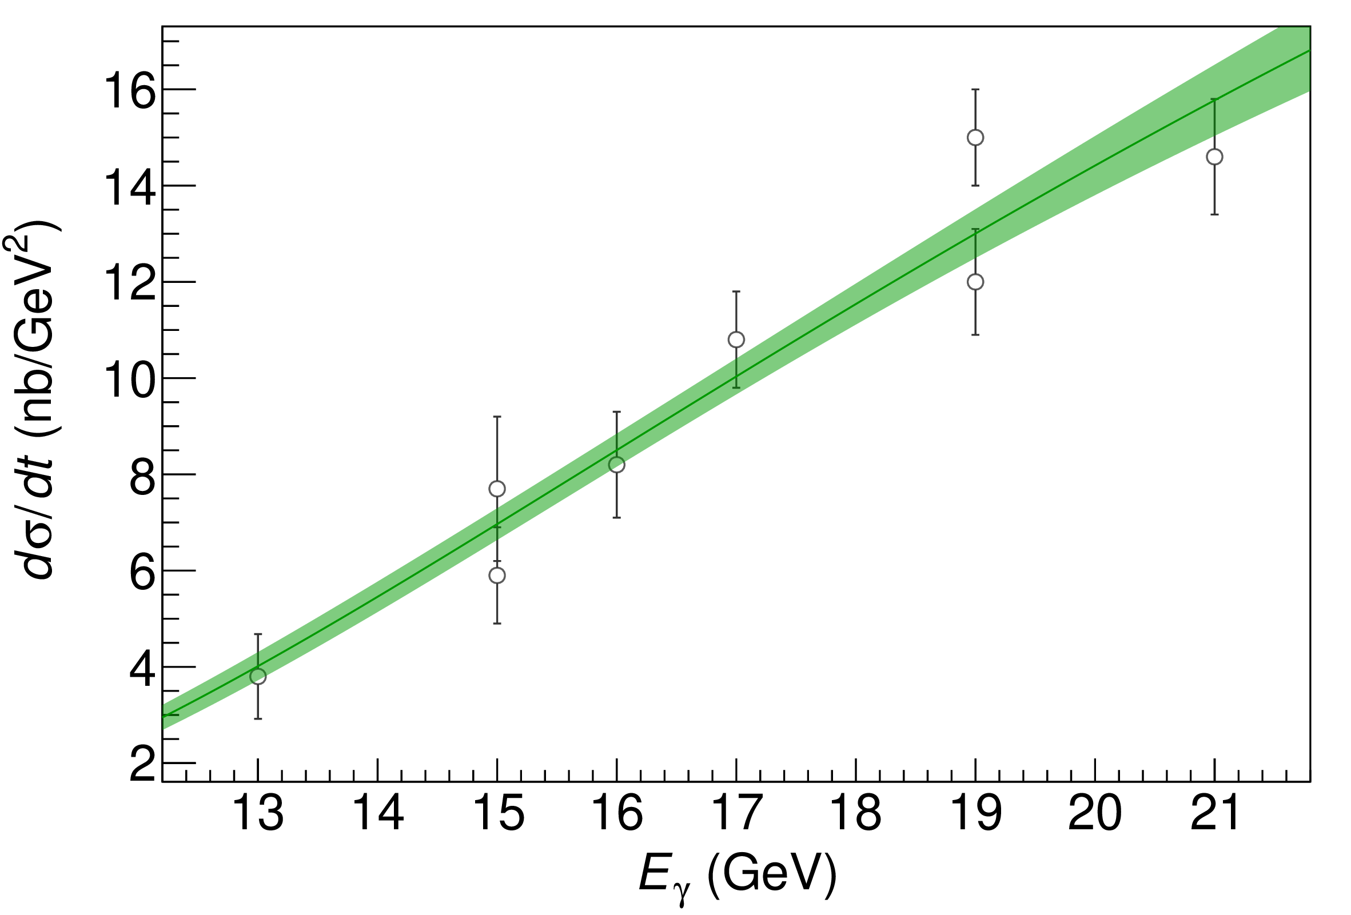
$P_{c}$ photoproduction
A. Pilloni – Amplitude analysis and exotic states
Notes:
Controlla la parte su Regge

Slide 28
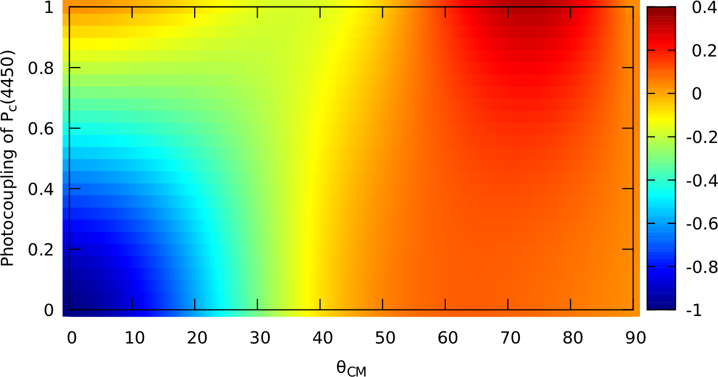
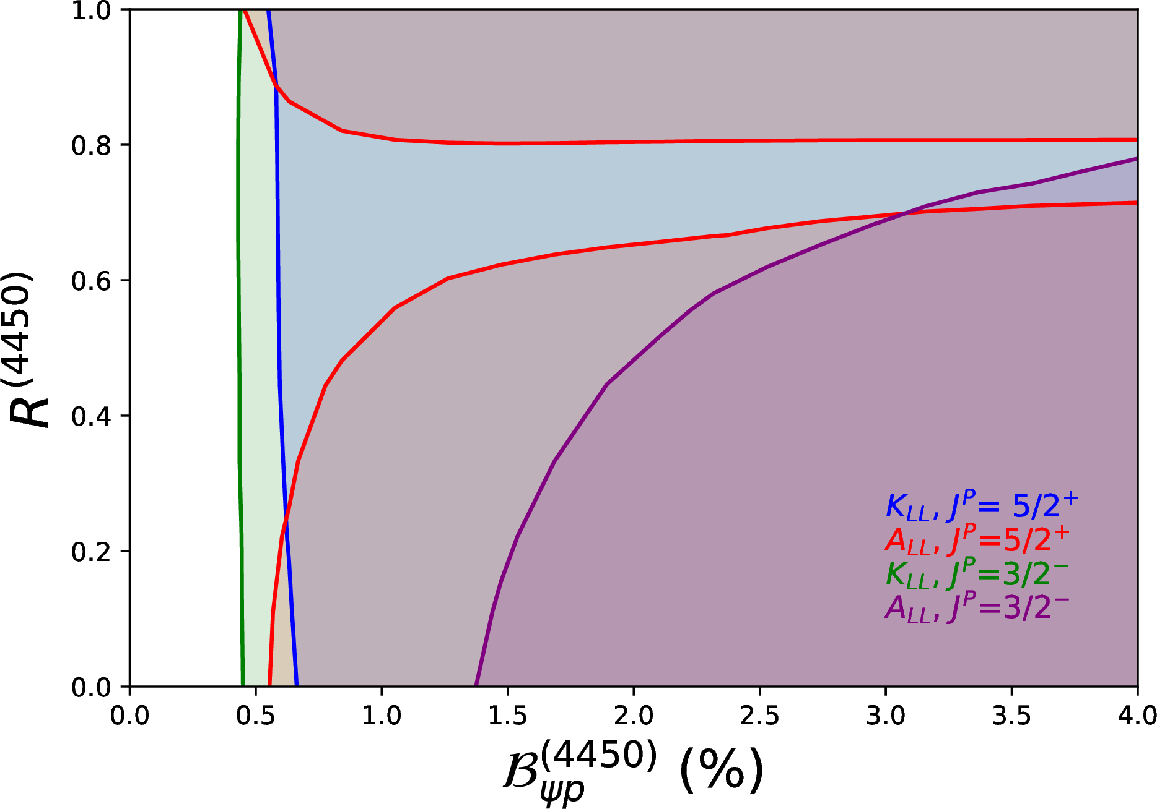
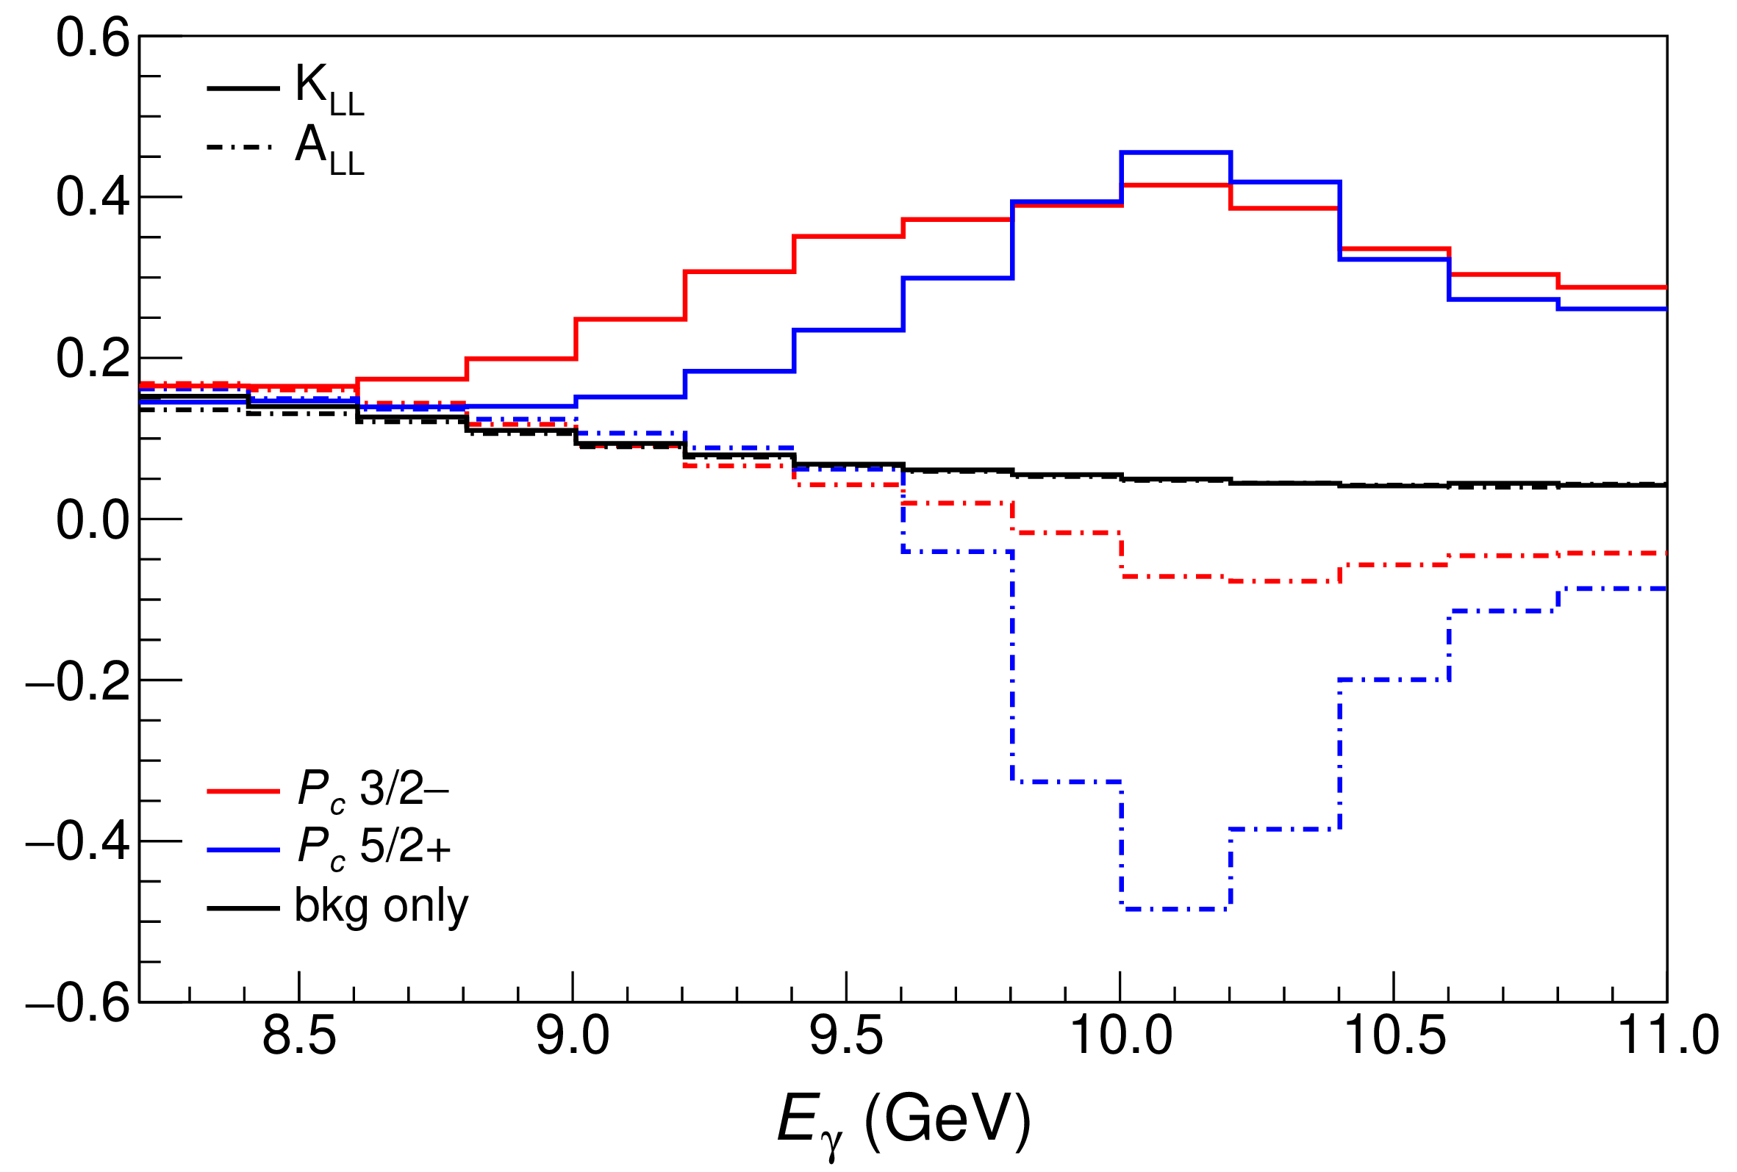
Polarization observables
One can take advantage of the polarized beam at Jlab Need polarized target ($A_{LL}$) or polarization of recoiling proton ($K_{LL}$)
$$K_{LL}$$
(in SBS acceptance)
A. Pilloni – Amplitude analysis and exotic states
Notes:
Controlla la parte su Regge

Slide 29
Conclusions
Bottom-up approaches are important!
They allow us to get the most out of high statistics data!
The study of analytic stuctrures offer insights ino the nature of resonances
Dispersive methods can improve the rigour and robustness in the extraction of the spectrum
Thank you!
A. Pilloni – Amplitude analysis and exotic states
Notes:
2 slides su Zc, a Bes e a Belle
2 slide su tetraquark model: dall’hamiltoniana di Jaffe al calcolo delle masse
1 slide su molecular models, dove sono i carichi? (non in Tornqvist, si in Hanhart, vedere Braaten, citare Nefediev)
2 slides su decay channels, dove si dovrebbe vedere, e a seconda del modello, vedere qualche plot
1 slide su Y(4260), tetraquark? C’è lo strano (si vede la f0)
1 slide su Zc a cleo (anche il neutro)

Slide 30
Joint Physics Analysis Center
Joint effort between theorists and experimentalists in support of experimental data from JLab12 and other accelerator laboratories
Cooperation between JPAC and experiments: co-authoring papers
http://ceem.indiana.edu/jpac
See also talk by A. Szczepaniak tomorrow
A. Pilloni – Amplitude analysis and exotic states

Slide 31
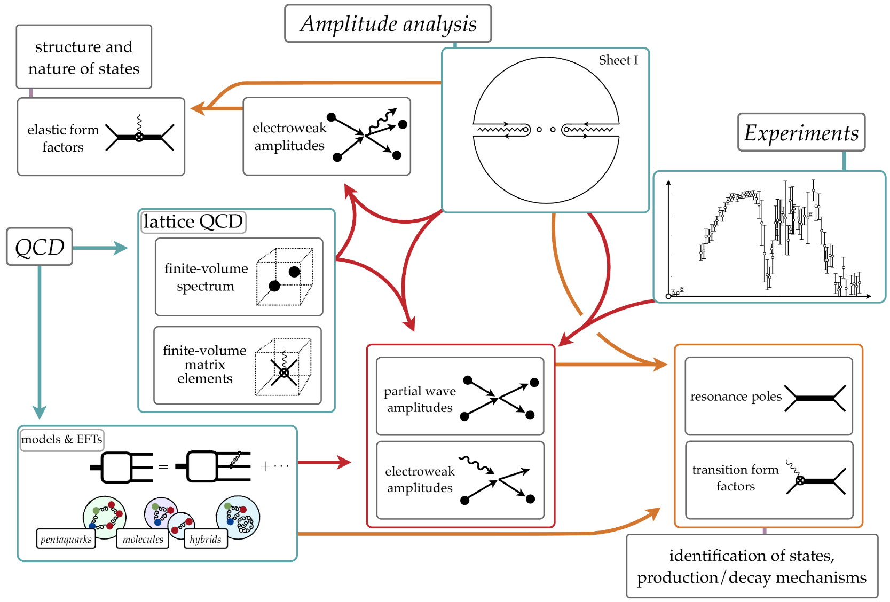
INT Program : «Accessing and Understanding the QCD spectrum» August 17-September 18, 2020
http://www.int.washington.edu/ PROGRAMS/20-2c/
Briceno [ODU]
Notes:
2 slides su Zc, a Bes e a Belle
2 slide su tetraquark model: dall’hamiltoniana di Jaffe al calcolo delle masse
1 slide su molecular models, dove sono i carichi? (non in Tornqvist, si in Hanhart, vedere Braaten, citare Nefediev)
2 slides su decay channels, dove si dovrebbe vedere, e a seconda del modello, vedere qualche plot
1 slide su Y(4260), tetraquark? C’è lo strano (si vede la f0)
1 slide su Zc a cleo (anche il neutro)

Slide 32
Backup

Slide 33
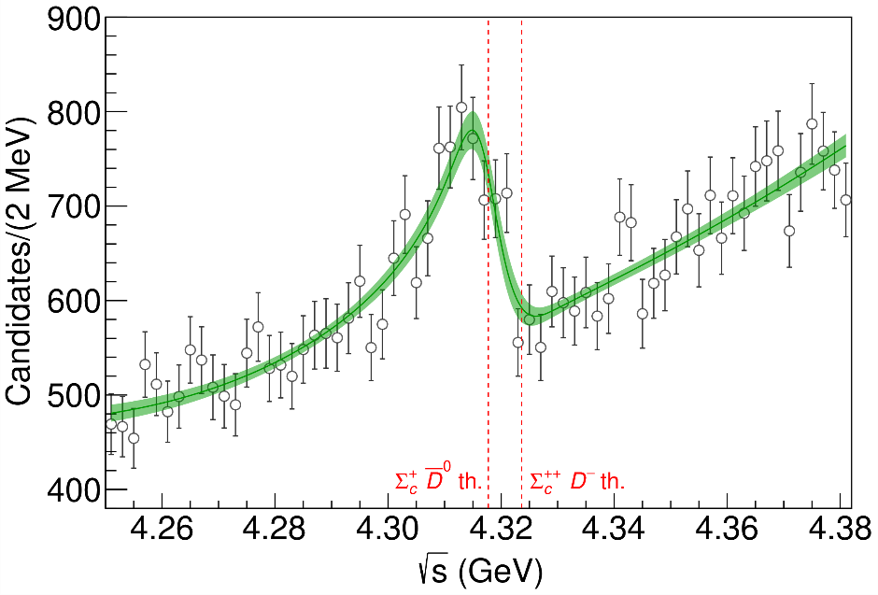
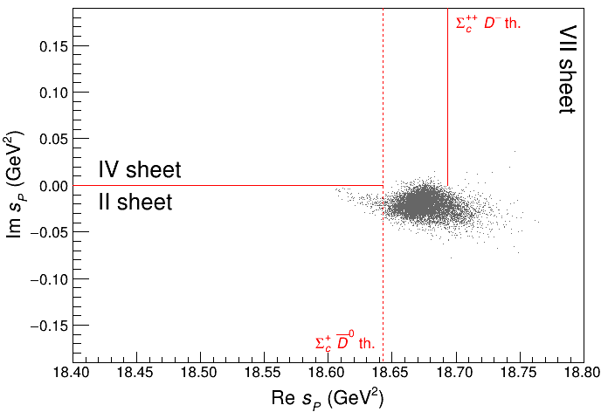
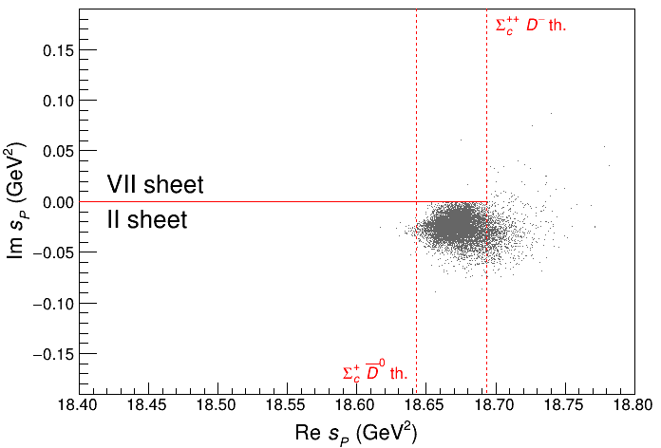
3 channels
A. Pilloni – Amplitude analysis and exotic states
Notes:
2 slides su Zc, a Bes e a Belle
2 slide su tetraquark model: dall’hamiltoniana di Jaffe al calcolo delle masse
1 slide su molecular models, dove sono i carichi? (non in Tornqvist, si in Hanhart, vedere Braaten, citare Nefediev)
2 slides su decay channels, dove si dovrebbe vedere, e a seconda del modello, vedere qualche plot
1 slide su Y(4260), tetraquark? C’è lo strano (si vede la f0)
1 slide su Zc a cleo (anche il neutro)

Slide 34
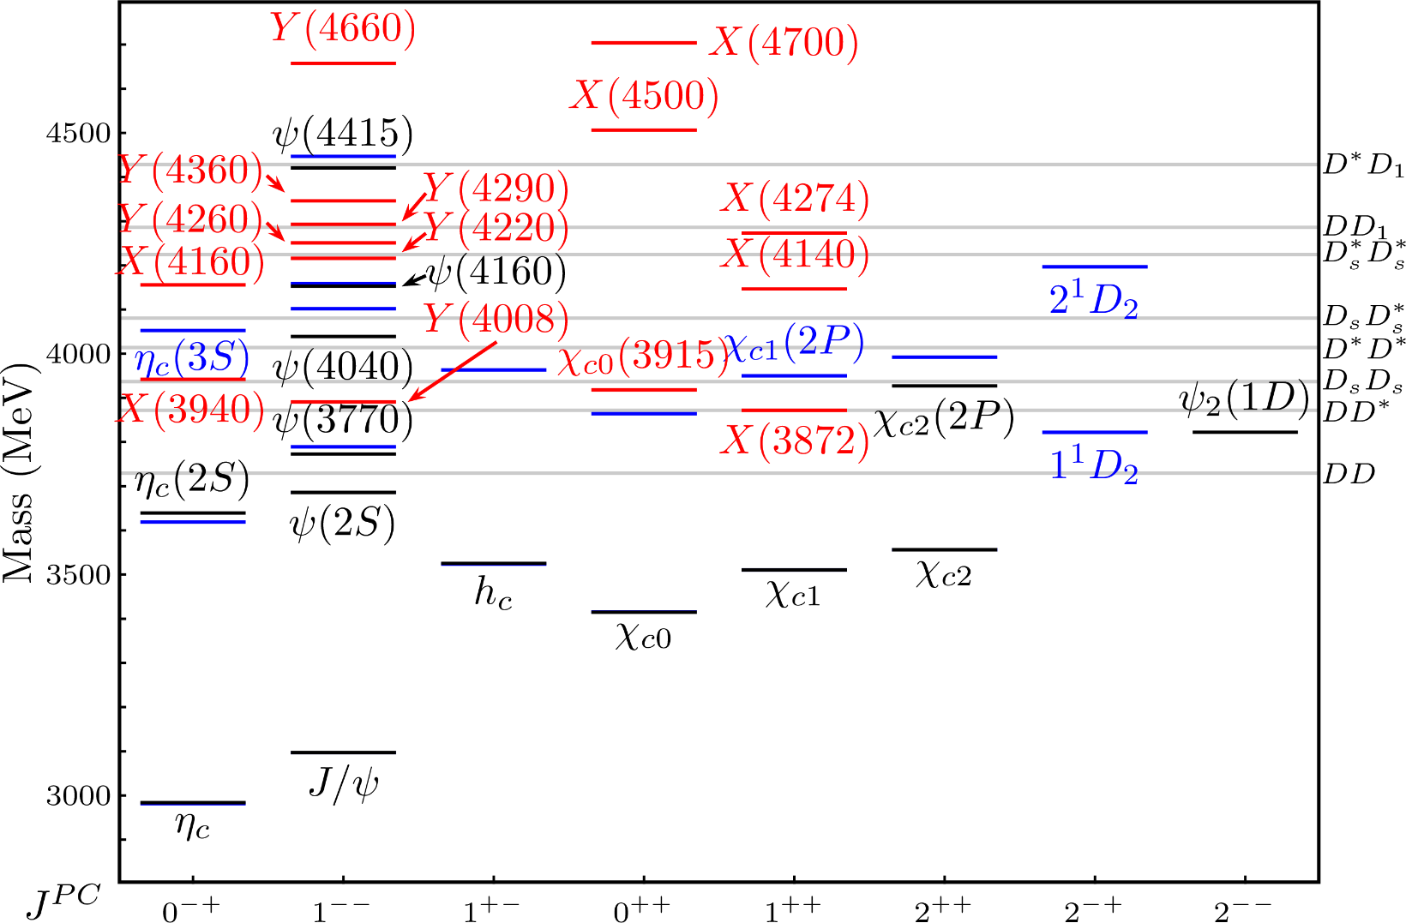
Exotic landscape
Esposito, AP, Polosa, Phys.Rept. 668
A host of unexpected resonances have appeared
decaying mostly into charmonium + light
Hardly reconciled with usual charmonium interpretation
A. Pilloni – Amplitude analysis and exotic states
Notes:
2 slides su Zc, a Bes e a Belle
2 slide su tetraquark model: dall’hamiltoniana di Jaffe al calcolo delle masse
1 slide su molecular models, dove sono i carichi? (non in Tornqvist, si in Hanhart, vedere Braaten, citare Nefediev)
2 slides su decay channels, dove si dovrebbe vedere, e a seconda del modello, vedere qualche plot
1 slide su Y(4260), tetraquark? C’è lo strano (si vede la f0)
1 slide su Zc a cleo (anche il neutro)

Slide 35
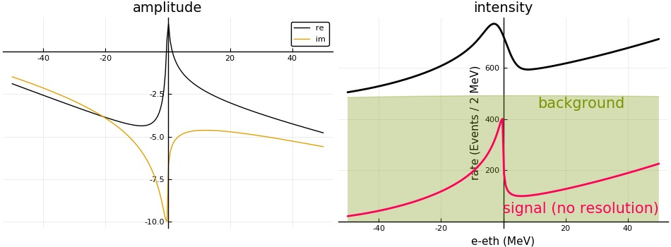
3 channels
A. Pilloni – Amplitude analysis and exotic states
Notes:
2 slides su Zc, a Bes e a Belle
2 slide su tetraquark model: dall’hamiltoniana di Jaffe al calcolo delle masse
1 slide su molecular models, dove sono i carichi? (non in Tornqvist, si in Hanhart, vedere Braaten, citare Nefediev)
2 slides su decay channels, dove si dovrebbe vedere, e a seconda del modello, vedere qualche plot
1 slide su Y(4260), tetraquark? C’è lo strano (si vede la f0)
1 slide su Zc a cleo (anche il neutro)

Slide 36
How to improve the model
Molnar, Danilkin, Vanderhaeghen, PLB 797, 134851
Ex. $e^{+}e^{−}→ψ^{′}ππ$
Khuri-Treiman with spin, Omnès function for $ππ$
A. Pilloni – Amplitude analysis and exotic states
Notes:
2 slides su Zc, a Bes e a Belle
2 slide su tetraquark model: dall’hamiltoniana di Jaffe al calcolo delle masse
1 slide su molecular models, dove sono i carichi? (non in Tornqvist, si in Hanhart, vedere Braaten, citare Nefediev)
2 slides su decay channels, dove si dovrebbe vedere, e a seconda del modello, vedere qualche plot
1 slide su Y(4260), tetraquark? C’è lo strano (si vede la f0)
1 slide su Zc a cleo (anche il neutro)

Slide 37
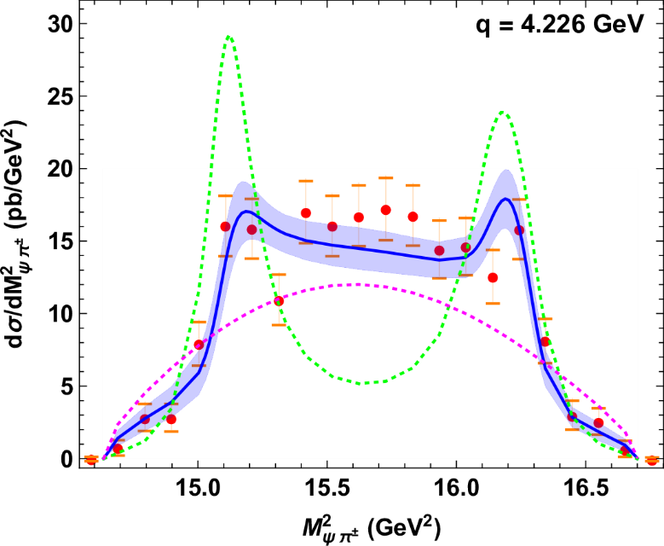
How to improve the model
Molnar, Danilkin, Vanderhaeghen, PLB 797, 134851
$$Z_{c}(3900)$$
$$Z_{c}(3900)$$
Notes:
2 slides su Zc, a Bes e a Belle
2 slide su tetraquark model: dall’hamiltoniana di Jaffe al calcolo delle masse
1 slide su molecular models, dove sono i carichi? (non in Tornqvist, si in Hanhart, vedere Braaten, citare Nefediev)
2 slides su decay channels, dove si dovrebbe vedere, e a seconda del modello, vedere qualche plot
1 slide su Y(4260), tetraquark? C’è lo strano (si vede la f0)
1 slide su Zc a cleo (anche il neutro)

Slide 38
How to improve the model
Molnar, Danilkin, Vanderhaeghen, PLB 797, 134851
No $Z_{c}$
B$road Z_{c}′$
Notes:
2 slides su Zc, a Bes e a Belle
2 slide su tetraquark model: dall’hamiltoniana di Jaffe al calcolo delle masse
1 slide su molecular models, dove sono i carichi? (non in Tornqvist, si in Hanhart, vedere Braaten, citare Nefediev)
2 slides su decay channels, dove si dovrebbe vedere, e a seconda del modello, vedere qualche plot
1 slide su Y(4260), tetraquark? C’è lo strano (si vede la f0)
1 slide su Zc a cleo (anche il neutro)

