Slide 1
Challenges in Hadron Spectroscopy
Alessandro Pilloni
University of Manitoba, October 5th, 2018

Slide 2
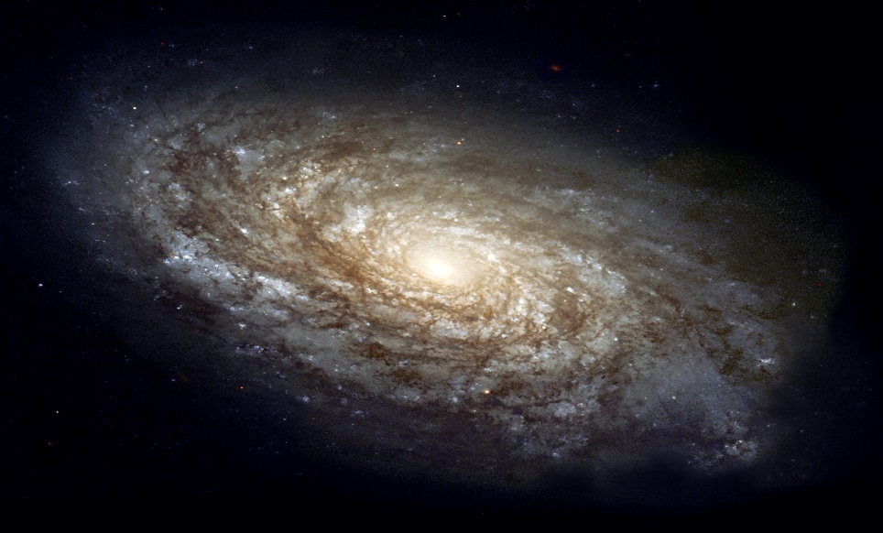
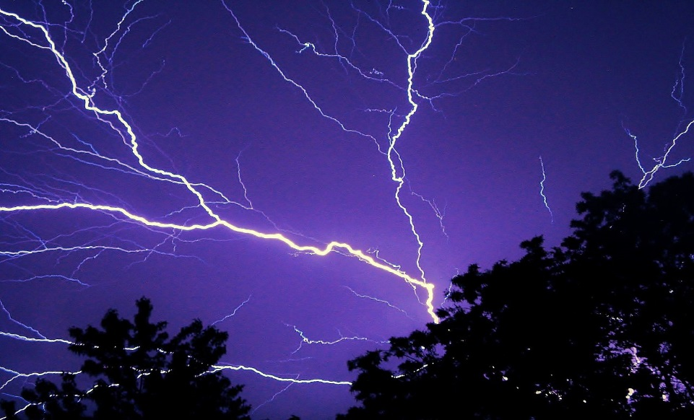
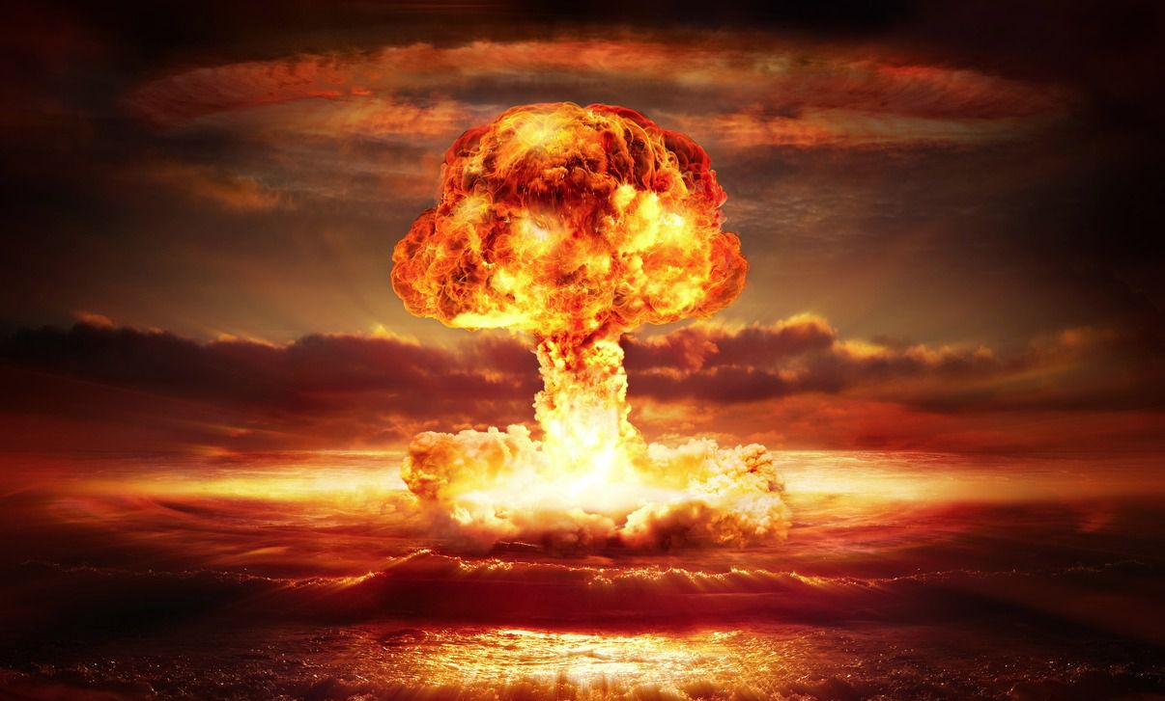
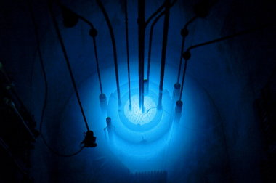
The four forces
$$U∼\frac{m_{1}m_{2}}{r}$$
$$U∼\frac{q_{1}q_{2}}{r}$$
$$U∼\frac{g_{s1}g_{s2}}{r}e^{−r/λ_{s}}$$
$$λ_{s}∼1.4 \text{fm}$$
$$U∼\frac{g_{w1}g_{w2}}{r}e^{−r/λ_{w}}$$
$$λ_{w}∼2.5×{10}^{−3} \text{fm}$$
A. Pilloni – Challenges in Hadron Spectroscopy
Notes:
2 slides su Zc, a Bes e a Belle
2 slide su tetraquark model: dall’hamiltoniana di Jaffe al calcolo delle masse
1 slide su molecular models, dove sono i carichi? (non in Tornqvist, si in Hanhart, vedere Braaten, citare Nefediev)
2 slides su decay channels, dove si dovrebbe vedere, e a seconda del modello, vedere qualche plot
1 slide su Y(4260), tetraquark? C’è lo strano (si vede la f0)
1 slide su Zc a cleo (anche il neutro)

Slide 3
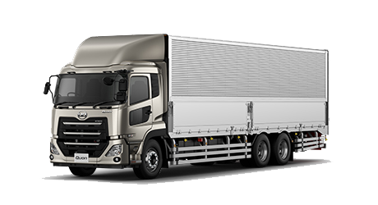
The strong force
It binds protons and neutrons inside nuclei
It is relevant at short distances only
Particles interacting via the strong force are called hadrons
Hadrons are composite objects, formed by quarks, and bound by gluons (the mediators of the strong force)
Quarks cannot be isolated (confinement)
Strong means strong: the force between two quarks in a hadron is roughly the same as the weight of a truck
A. Pilloni – Challenges in Hadron Spectroscopy
Notes:
2 slides su Zc, a Bes e a Belle
2 slide su tetraquark model: dall’hamiltoniana di Jaffe al calcolo delle masse
1 slide su molecular models, dove sono i carichi? (non in Tornqvist, si in Hanhart, vedere Braaten, citare Nefediev)
2 slides su decay channels, dove si dovrebbe vedere, e a seconda del modello, vedere qualche plot
1 slide su Y(4260), tetraquark? C’è lo strano (si vede la f0)
1 slide su Zc a cleo (anche il neutro)

Slide 4
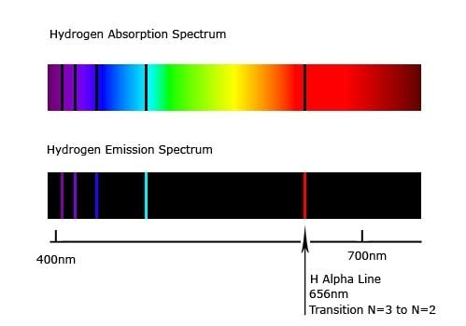
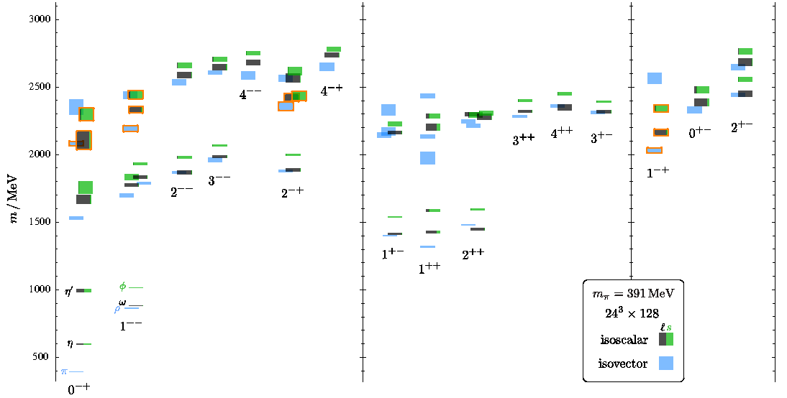
Hydrogen vs. Hadron Spectrum
If you solve the spectrum of the Hydrogen atom, you pass Quantum Mechanics 101
If you solve the strong interaction spectrum you win a Nobel Prize, the Clay Millennium Prize, etc. etc. etc...
A. Pilloni – Challenges in Hadron Spectroscopy

Slide 5
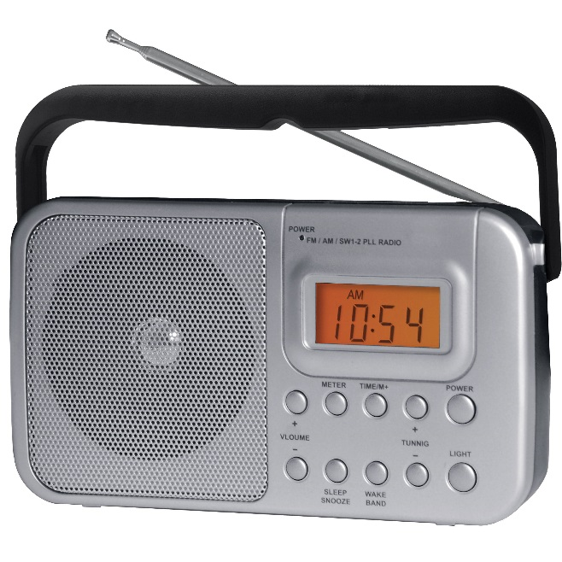
We have E&M theory: QED
Any electromagnetic process is described by this equation (in principle)
At the classical level it’s linear → Maxwell equations
A. Pilloni – Challenges in Hadron Spectroscopy

Slide 6
We have E&M theory: QED
Observables can be Taylor expanded, because the electric charge is small (perturbation theory)
$$σ∼\frac{e^{2}}{4π}σ_{0}+{\left(\frac{e^{2}}{4π}\right)}^{2}σ_{1}+{\left(\frac{e^{2}}{4π}\right)}^{3}σ_{2}+{\left(\frac{e^{2}}{4π}\right)}^{4}σ_{3}+…$$
$$\frac{e^{2}}{4π}∼\frac{1}{137}≪1$$
A. Pilloni – Challenges in Hadron Spectroscopy

Slide 7
We have strong theory: QCD
It looks similar, but it’s a matrix equation:
Quarks appear in 3 different colors $r,g,b$
Gluons appear in 8 different color-anticolor combinations
$r\overline{g},r\overline{b},b\overline{g}$, $b\overline{r}$,$g\overline{b}$, $g\overline{r}$, $$r\overline{r}−b\overline{b},r\overline{r}+b\overline{b}−2g\overline{g}$$
Gluons carry color and interact with each other → Equations are nonlinear even at the classical level
A. Pilloni – Challenges in Hadron Spectroscopy

Slide 8
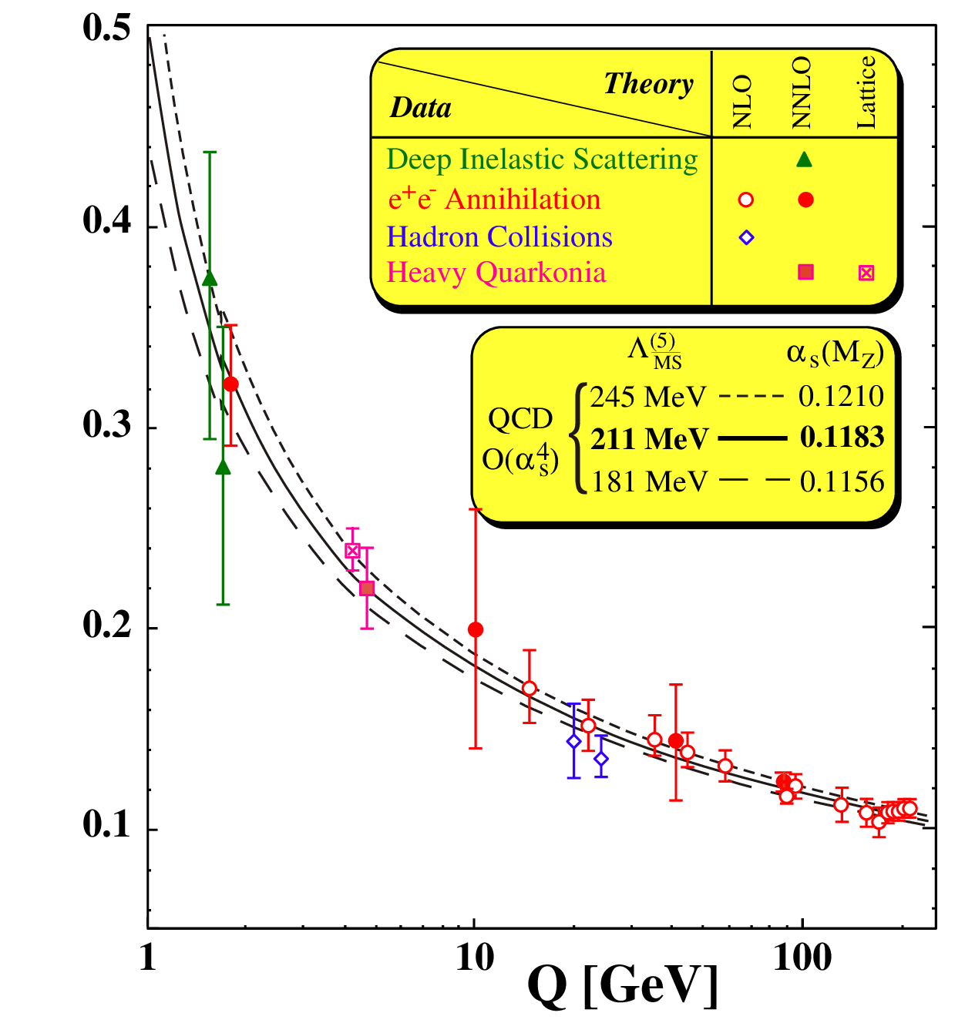
Asymptotic freedom
At high energies, the coupling $\frac{g_{s}^{2}}{4π}≪0.1$ perturbation theory works
$\frac{g_{s}^{2}}{4π}(Q)$
A. Pilloni – Challenges in Hadron Spectroscopy

Slide 9
At low energies?
At low energies, the coupling $\frac{g_{s}^{2}}{4π}>1$ thinking in terms of quarks and gluons make no sense anymore;
They «arrange» themselves in a incalculable way into colourless hadrons (confinement)
$\frac{g_{s}^{2}}{4π}(Q)$
A. Pilloni – Challenges in Hadron Spectroscopy

Slide 10
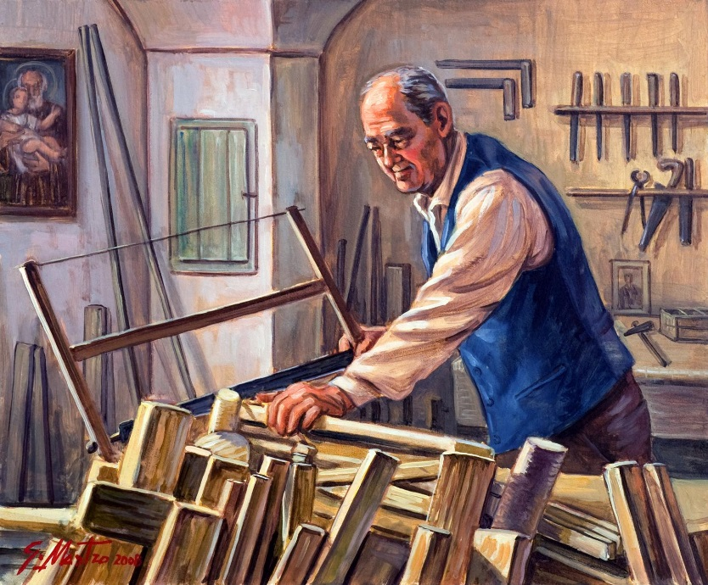
QCD has no solution. Don’t panic (yet) /1
We can build models to describe the spectrum. They can grasp some aspects of QCD, and give insights on what’s going on
Quark models
Effective Field Theories
Lattice QCD (not a model but...)
Some artisanal work required
The excited spectrum is populated by unstable states, whose lifetime is $∼{10}^{−24} s$
They don’t live enough to tell us what they are!
A. Pilloni – Challenges in Hadron Spectroscopy

Slide 11
Hadron Spectroscopy
Hybrids
Tetraquark
Meson
Baryon
Glueball
$$π$$
$$π$$
$$J/ψ$$
$$π$$
Hadroquarkonium
Molecule
Experiment
?
Data
Properties,
Model building
Lattice QCD
A. Pilloni – Challenges in Hadron Spectroscopy

Slide 12
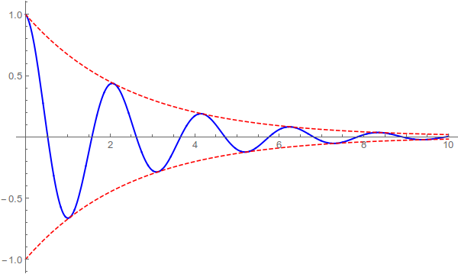
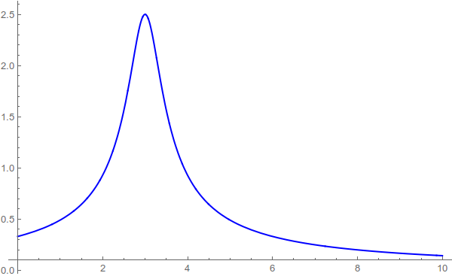
Resonances = Unstable states
The wave function of an unstable state is
$$ψ(t)=e^{−i E_{0} t} e^{− \frac{Γ}{2} t }$$
In Fourier transform, that is
$$ψ(E)=\frac{1}{E−E_{0}+i\frac{Γ}{2}}$$
A. Pilloni – Challenges in Hadron Spectroscopy

Slide 13
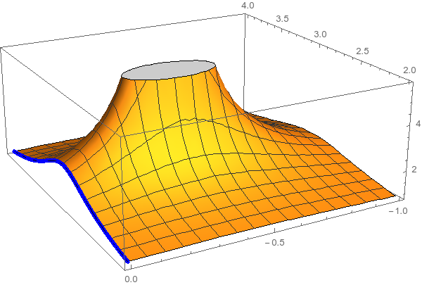
Resonances = Unstable states
$$ψ(E)=\frac{1}{E−E_{0}+i\frac{Γ}{2}}$$
The function explodes for value of energy $E=E_{0}−i\frac{Γ}{2}$
Resonances are poles in the complex energy plane
A. Pilloni – Challenges in Hadron Spectroscopy

Slide 14
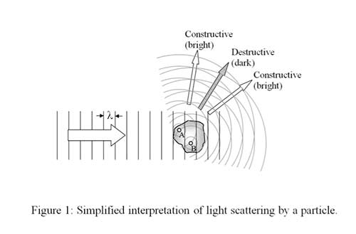
What is an amplitude?
$ψ_{in}\left(r\right)∼e^{i k z}$
$ψ_{out}\left(r\right)∼e^{i k z}+\frac{f\left(E\right)}{r} e^{ikr}$
$f\left(E\right)$ is the amplitude. Remember that I can measure only ${\left|f\left(E\right)\right|}^{2}$
(The $S$-matrix is $S\left(E\right)=1+2ik f(E)$)
A. Pilloni – Challenges in Hadron Spectroscopy

Slide 15
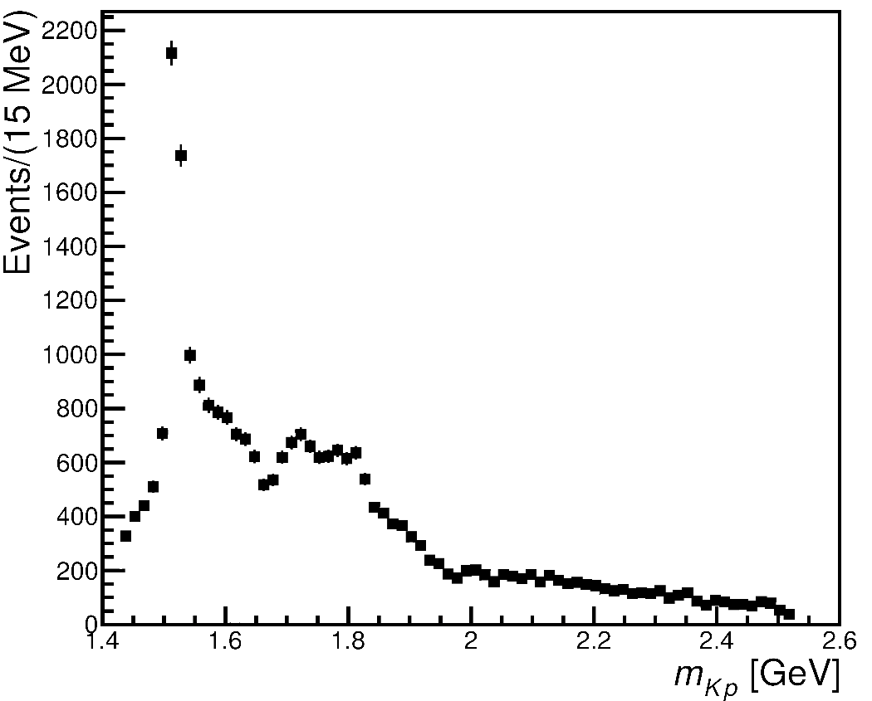
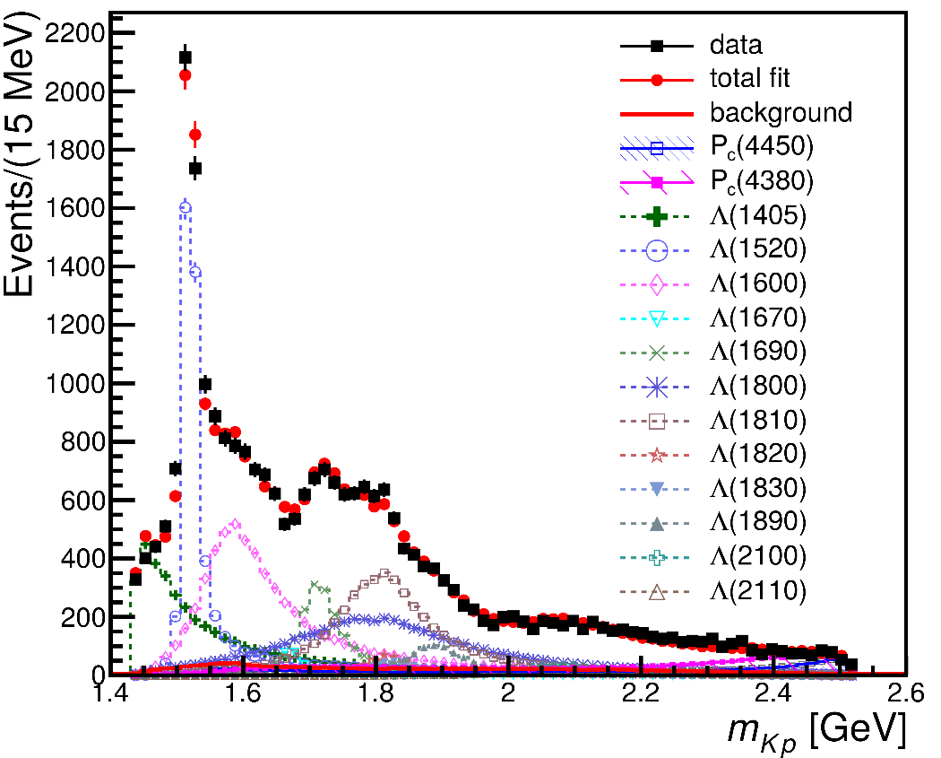
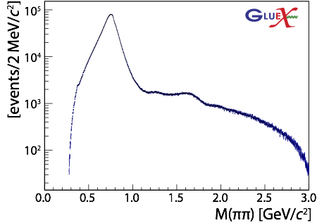
From data to the spectrum
Wow!
Wow!
Mmh...?
$$ρ(770)$$
Mmh...?
$$ρ(1700)$$
The connection between data and resonances is not easy!
If you use unconstrained functions, you risk to get random results!
A. Pilloni – Challenges in Hadron Spectroscopy

Slide 16
Hadron Spectroscopy
A. Pilloni – Challenges in Hadron Spectroscopy

Slide 17
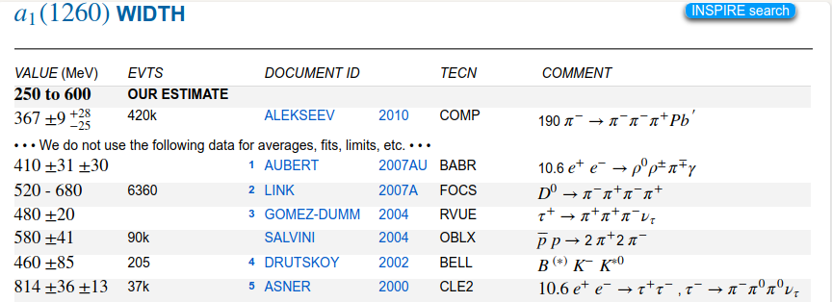
Hadron Spectroscopy
A. Pilloni – Challenges in Hadron Spectroscopy
Notes:
2 slides su Zc, a Bes e a Belle
2 slide su tetraquark model: dall’hamiltoniana di Jaffe al calcolo delle masse
1 slide su molecular models, dove sono i carichi? (non in Tornqvist, si in Hanhart, vedere Braaten, citare Nefediev)
2 slides su decay channels, dove si dovrebbe vedere, e a seconda del modello, vedere qualche plot
1 slide su Y(4260), tetraquark? C’è lo strano (si vede la f0)
1 slide su Zc a cleo (anche il neutro)

Slide 18
Hadron Spectroscopy
Hybrids
Tetraquark
Meson
Baryon
Glueball
$$π$$
$$π$$
$$J/ψ$$
$$π$$
Hadroquarkonium
Molecule
Experiment
Data
Amplitude analysis
Properties,
Model building
Lattice QCD
With great statistics comes great responsibility!
Peter Parker, PhD
A. Pilloni – Challenges in Hadron Spectroscopy

Slide 19
QCD has no solution. Don’t panic (yet) /2
When you are desperate, look for symmetries:
Symmetries are beautiful (and group theory is fun!)
Symmetries constrain your results no matter how complicated your theory is
Luckily, strong interactions are the ones with most symmetries:
Under Parity
Under Charge Conjugation
Under Time reversal
Conserve Flavor (isospin, strangeness...)
Conserve electric charge and baryonic number
Moreover, there are some generic properties that any interaction has to satisfy
A. Pilloni – Challenges in Hadron Spectroscopy

Slide 20
The S-Matrix principles
Future cannot change the past
100%, something will happen
The anti-particle is an anti-particle and not just a different particle
(analyticity)
(unitarity)
(crossing symmetry)
Sherlock Holmes, QFT
Even though these look so obvious, there is no amplitude which is known to satisfy all these principles at the same time
In the ‘60s, people tried to guess how the real solution looks like, just by implementing these principles. It did not work. Now we have QCD, but it doesn’t work either
Imposing those in a clever way allow us to constrain as much as possible the arbitrariness of choosing a model to extract physics from experiments
Parametrize your ignorance. Build a reasonable model. Fit data. Have fun.
A. Pilloni – Challenges in Hadron Spectroscopy

Slide 21
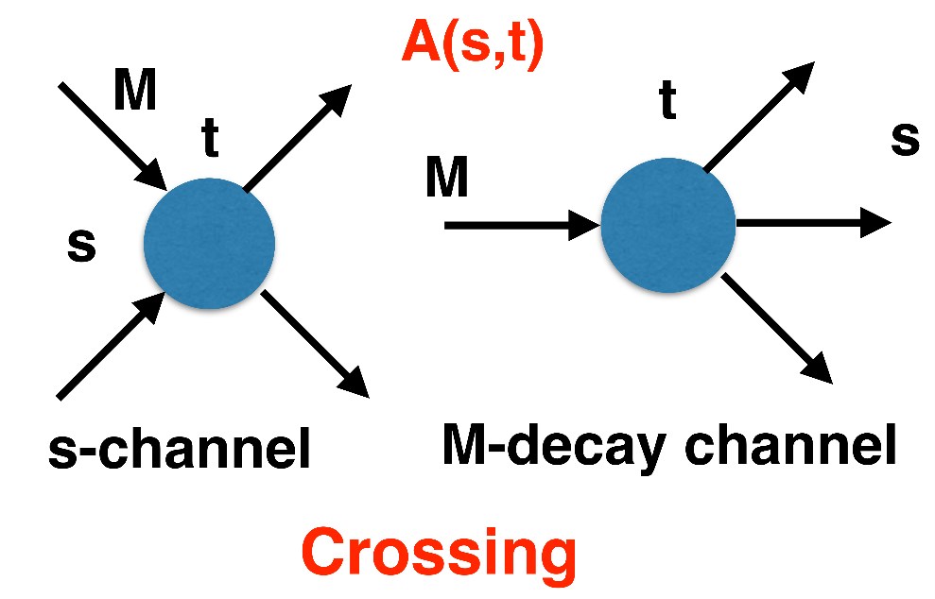
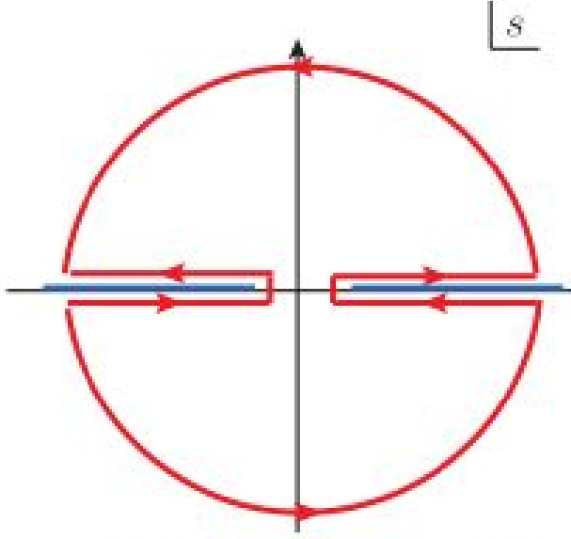
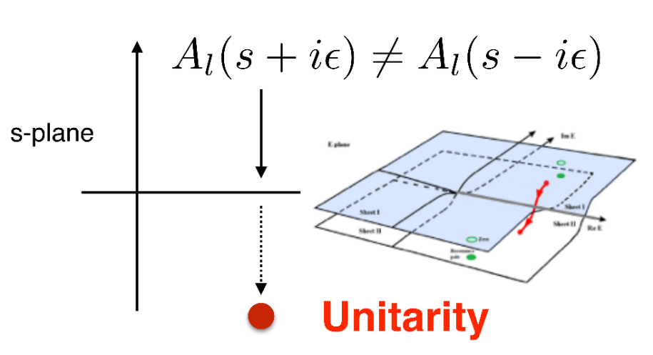
$S$-Matrix principles
$$f_{l}\left(E\right)=\lim_{ε→0}f_{l}(E+iε)⁡$$
Analyticity
These are constraints the amplitudes have to satisfy, but do not fix the dynamics
Need for complex analysis
+ Lorentz, discrete & global symmetries
A. Pilloni – Challenges in Hadron Spectroscopy
Notes:
Controlla la parte su Regge

Slide 22
Analyticity & Crossing
Complex analytic functions are extremely regular and smooth
If you know the function in a region, you can extend it in a unique way everywhere
Complex functions are characterized by its non-analyticities (poles and cuts)
Analyticity
Crossing
All these processes are not independent, but are described by the same amplitude!
$$π^{+}$$
$$K^{+}$$
$$π^{+}$$
$$K^{−}$$
$$π^{−}$$
$$K^{−}$$
$$π^{+}$$
$$K^{−}$$
A. Pilloni – Challenges in Hadron Spectroscopy
Notes:
Controlla la parte su Regge

Slide 23
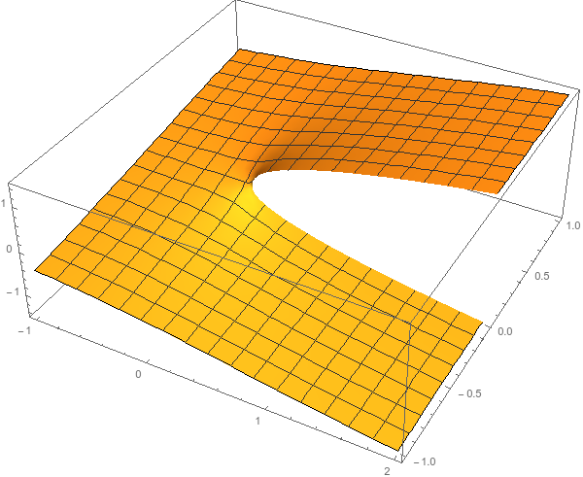
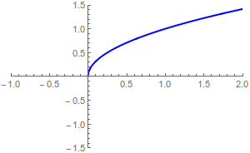
Unitarity
Probability conservation implies ${\left|S\left(E\right)\right|}^{2}=1$
For the amplitude, this turns into
$$f\left(E+iε\right)−f\left(E−iε\right)≠0$$
Branch cut!
Example: $i\sqrt{E}$...
$$i\sqrt{e^{iπ}}=−1$$
$$i\sqrt{1}=i$$
$$i\sqrt{e^{2iπ}}=−i$$
A. Pilloni – Challenges in Hadron Spectroscopy
Notes:
Controlla la parte su Regge

Slide 24
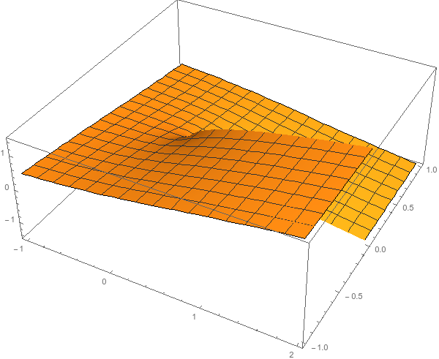
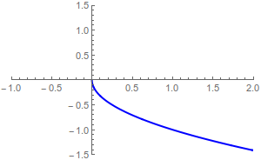
Unitarity
Probability conservation implies ${\left|S\left(E\right)\right|}^{2}=1$
For the amplitude, this turns into
$$f\left(E+iε\right)−f\left(E−iε\right)≠0$$
Branch cut!
Example: $i\sqrt{E}$...
$$i\sqrt{e^{iπ}}=1$$
...but I can decide to get the negative solution
$$i\sqrt{e^{2iπ}}=i$$
$$i\sqrt{1}=−i$$
A. Pilloni – Challenges in Hadron Spectroscopy
Notes:
Controlla la parte su Regge

Slide 25
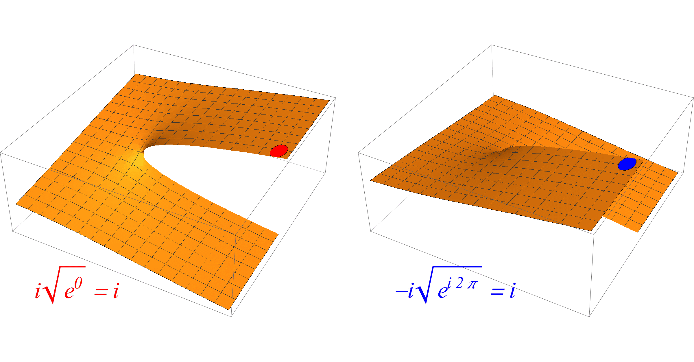
Unitarity
The two sheets are continuosly connected
A. Pilloni – Challenges in Hadron Spectroscopy
Notes:
Controlla la parte su Regge

Slide 26
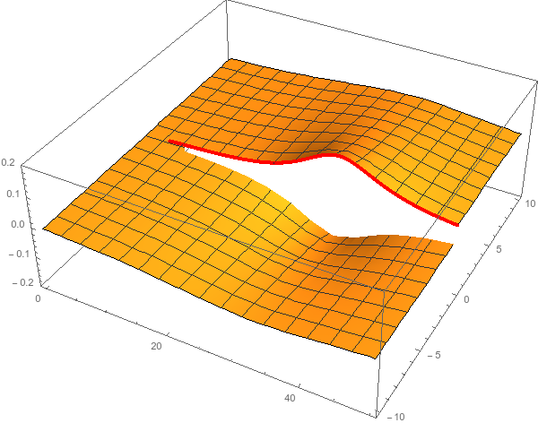
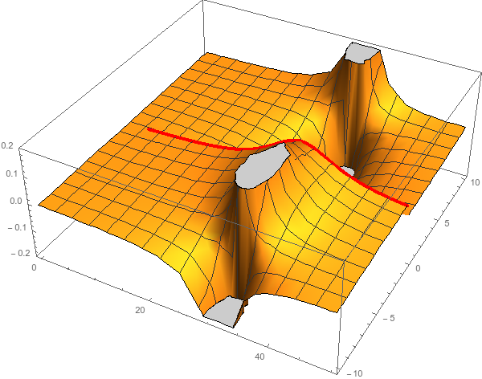
Pole hunting
I sheet
II sheet
Finding resonances means writing an analytic amplitude, and hunting for its poles in the complex plane
A. Pilloni – Challenges in Hadron Spectroscopy
Notes:
Controlla la parte su Regge

Slide 27
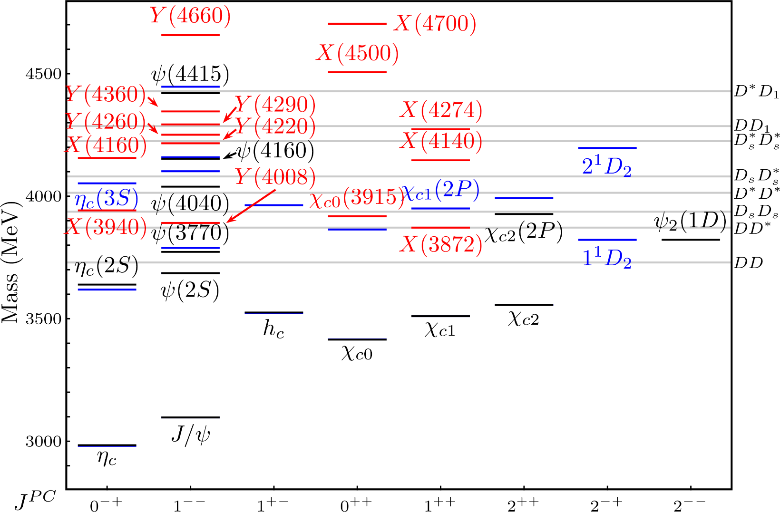
Exotic landscape
Esposito, AP, Polosa, Phys.Rept. 668
A host of unexpected resonances have appeared
decaying mostly into charmonium + light
Hardly reconciled with usual charmonium interpretation
A. Pilloni – Challenges for Hadron Spectroscopy
Notes:
2 slides su Zc, a Bes e a Belle
2 slide su tetraquark model: dall’hamiltoniana di Jaffe al calcolo delle masse
1 slide su molecular models, dove sono i carichi? (non in Tornqvist, si in Hanhart, vedere Braaten, citare Nefediev)
2 slides su decay channels, dove si dovrebbe vedere, e a seconda del modello, vedere qualche plot
1 slide su Y(4260), tetraquark? C’è lo strano (si vede la f0)
1 slide su Zc a cleo (anche il neutro)

Slide 28
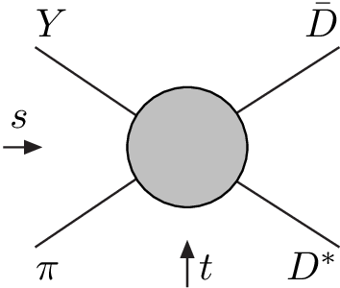
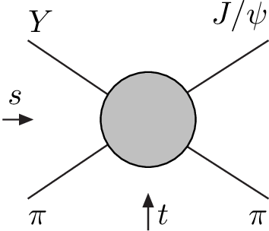
Amplitude analysis for $Z_{c}(3900)$
One can test different parametrizations of the amplitude, which correspond to different singularities → different natures
AP et al. (JPAC), PLB772, 200
$$Z_{c}\left(3900\right)?$$
$${u: D}_{0}(2400)$$
$${u:Z}_{c}\left(3900\right)?$$
$$"σ, f_{0}(980)"$$
$$D_{1}(2420)$$
Triangle rescattering, logarithmic branching point
(anti)bound state, II/IV sheet pole
(«molecule»)
Resonance, III sheet pole
(«compact state»)
$$π$$
$$D_{1}$$
$$Y$$
$$D^{∗}$$
$$π$$
$$\overline{D}$$
$$J/ψ$$
Tornqvist, Z.Phys. C61, 525
Swanson, Phys.Rept. 429
Hanhart et al. PRL111, 132003
Maiani et al., PRD71, 014028
Faccini et al., PRD87, 111102
Esposito et al., Phys.Rept. 668
Szczepaniak, PLB747, 410
A. Pilloni – Challenges for Hadron Spectroscopy
Notes:
Controlla la parte su Regge

Slide 29
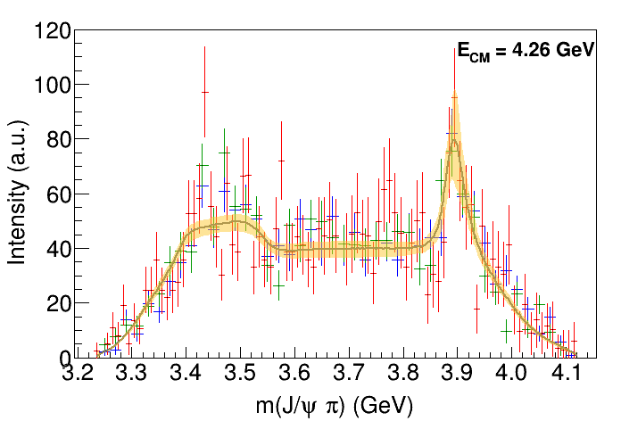
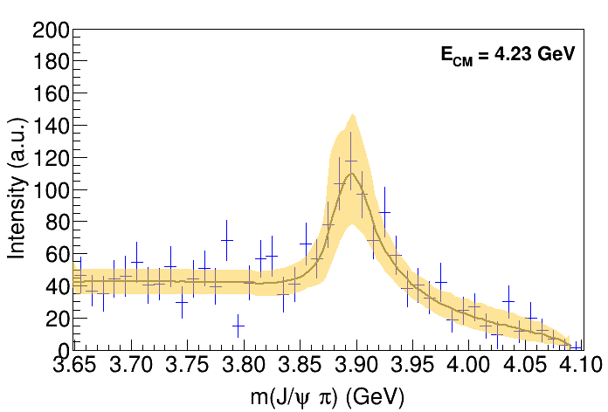
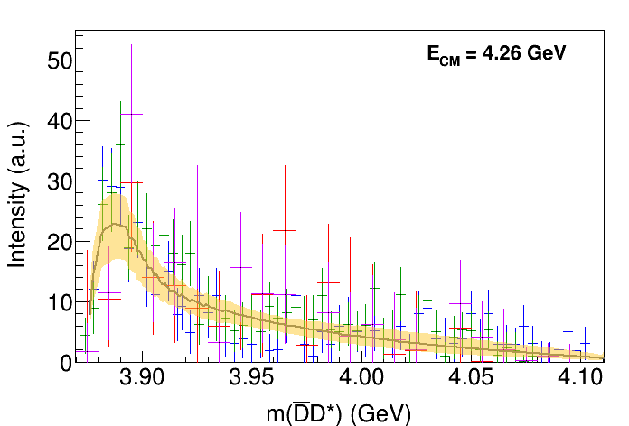
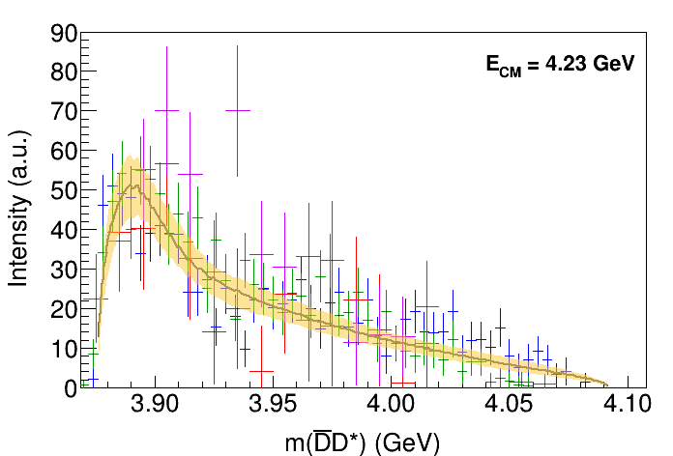
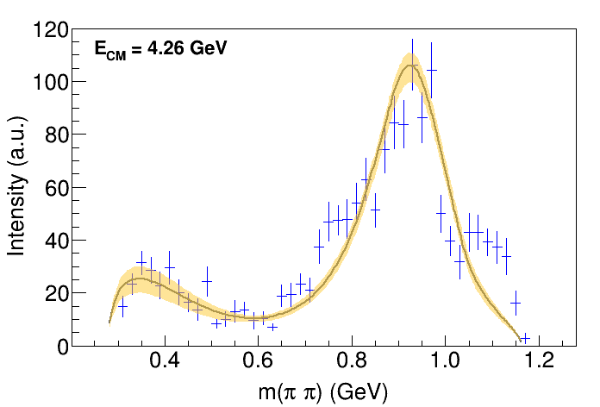
Fit: III
A. Pilloni – Challenges for Hadron Spectroscopy
Notes:
Controlla la parte su Regge

Slide 30
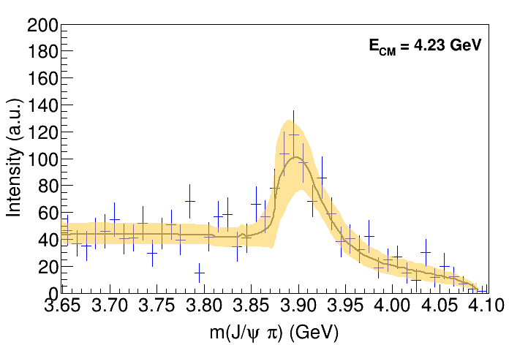
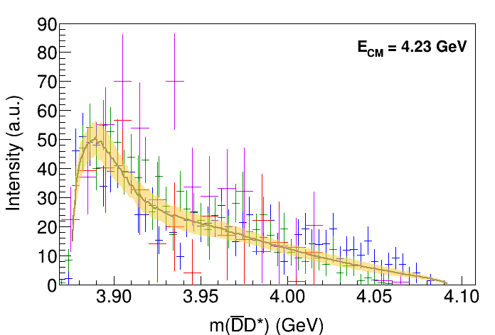
Fit: III+tr.
A. Pilloni – Challenges for Hadron Spectroscopy
Notes:
Controlla la parte su Regge

Slide 31
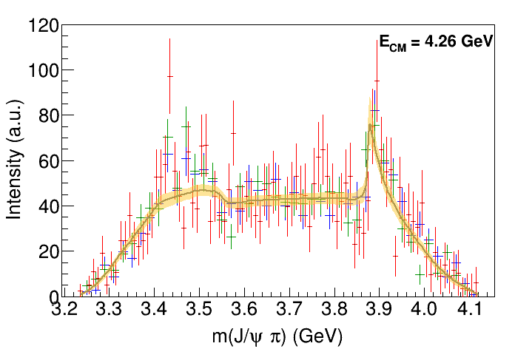
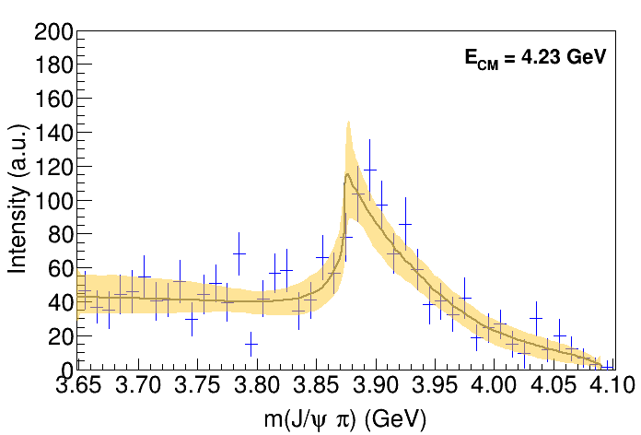
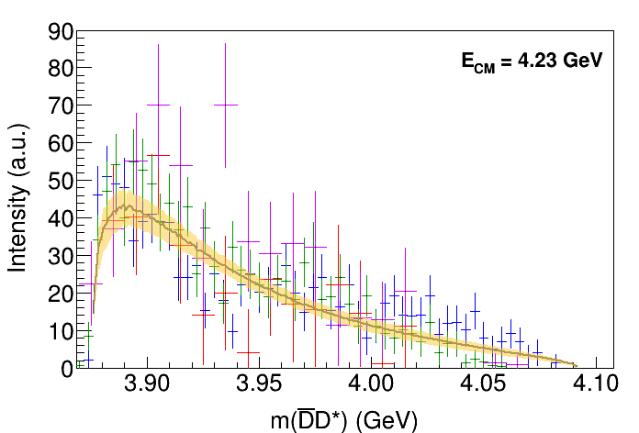
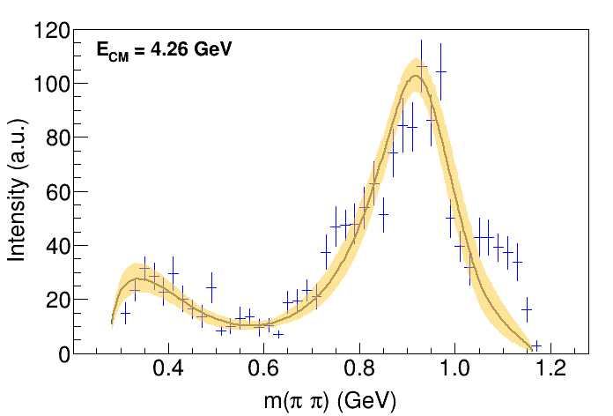
Fit: IV+tr.
A. Pilloni – Challenges for Hadron Spectroscopy
Notes:
Controlla la parte su Regge

Slide 32
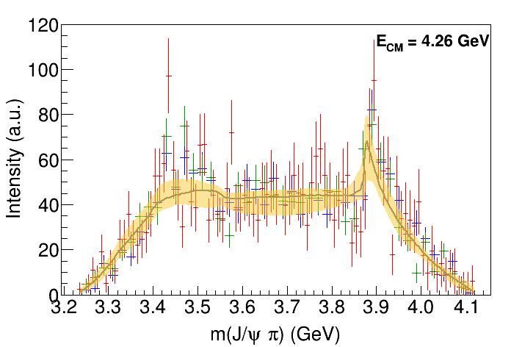
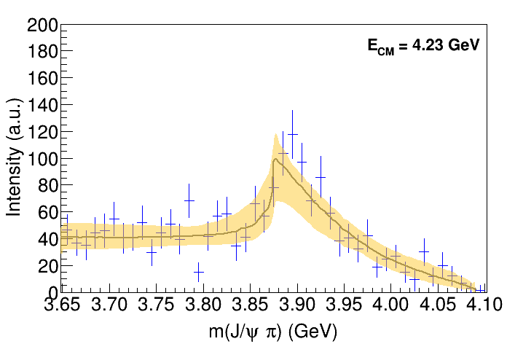
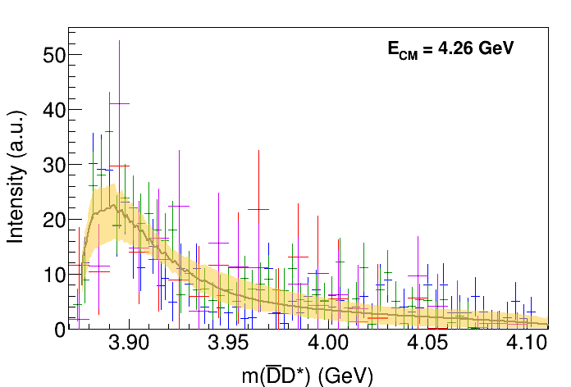
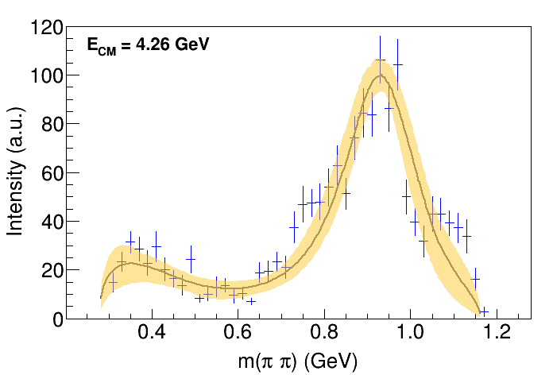
Fit: tr.
A. Pilloni – Challenges for Hadron Spectroscopy
Notes:
Controlla la parte su Regge

Slide 33
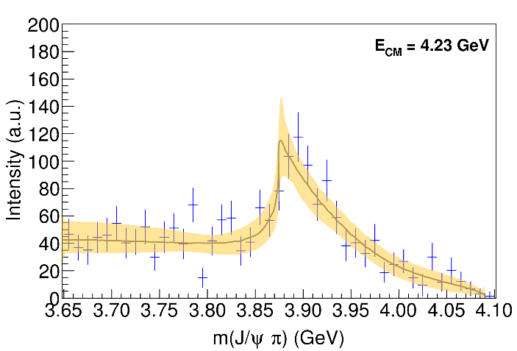
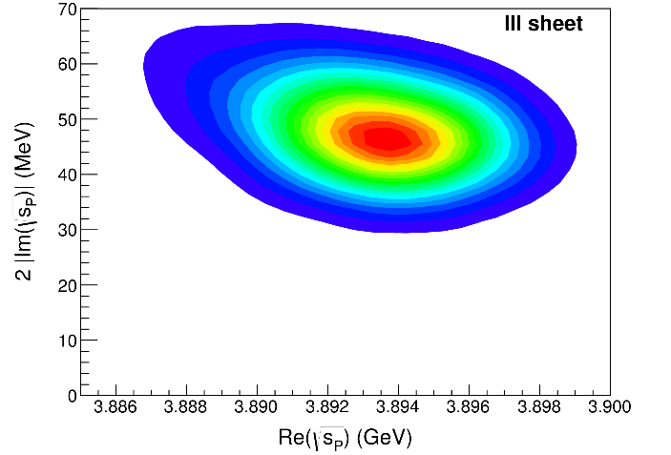
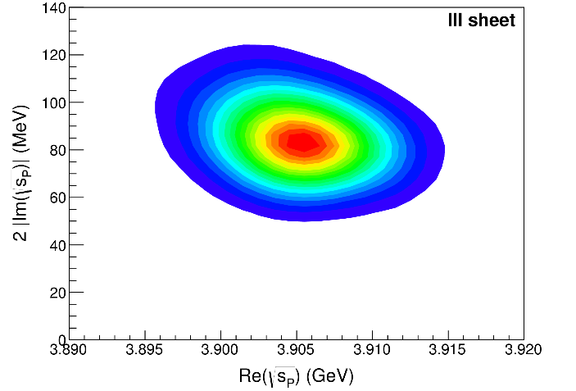
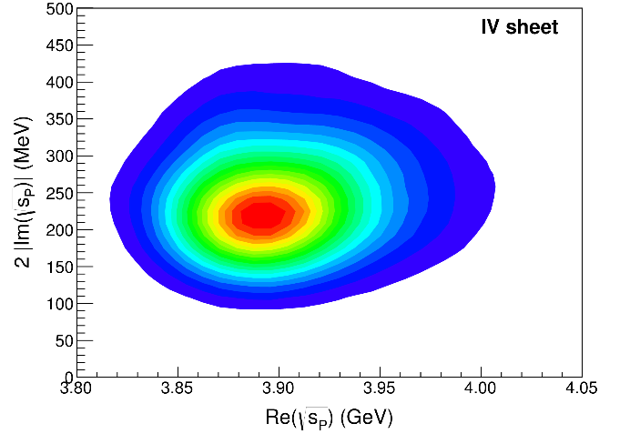
Pole extraction
III
III+tr.
IV+tr.
Not conclusive at this stage, call for new data!
A. Pilloni – Challenges for Hadron Spectroscopy
Notes:
Controlla la parte su Regge

Slide 34
Another example: the $π_{1}(1600)$ in $η^{(′)}π$
A. Rodas, AP et al., to appear
$$π_{1}\left(1400\right)?$$
$$a_{2}\left(1320\right)$$
$$a_{2}^{′}\left(1700\right)$$
$$π_{1}\left(1600\right)?$$
$$a_{2}\left(1320\right)$$
$$a_{2}^{′}\left(1700\right)$$
Two displaced peak appear in $ηπ$ and $η^{′}π$. Is it the same state?
A. Pilloni – Challenges in Hadron Spectroscopy
Notes:
Controlla la parte su Regge

Slide 35
Bootstrap for $π_{1}(1600)$
Two stable isolated poles are indentifiable in the D-wave Only one is stable in the P-wave
A. Pilloni – Challenges in Hadron Spectroscopy
Notes:
Controlla la parte su Regge

Slide 36
Final results for $π_{1}(1600)$
That’s the most rigorous extraction of an exotic meson available so far!
A. Pilloni – Challenges in Hadron Spectroscopy
Notes:
Controlla la parte su Regge

Slide 37
Have fun!
AP et al., Phys.Lett. B772, 200
Pole
Triangle
Esposito, AP, Polosa, Phys.Rept. 668
Jackura, AP et al., PLB779, 464
A. Pilloni – Challenges in Hadron Spectroscopy
Notes:
2 slides su Zc, a Bes e a Belle
2 slide su tetraquark model: dall’hamiltoniana di Jaffe al calcolo delle masse
1 slide su molecular models, dove sono i carichi? (non in Tornqvist, si in Hanhart, vedere Braaten, citare Nefediev)
2 slides su decay channels, dove si dovrebbe vedere, e a seconda del modello, vedere qualche plot
1 slide su Y(4260), tetraquark? C’è lo strano (si vede la f0)
1 slide su Zc a cleo (anche il neutro)

Slide 38
Epilogue
Why do we care about hadron spectroscopy?
Because it allows us to understand how the QCD degrees of freedom manifest in nature. The role of models is crucial
Because we need a better understanding of hadron amplitudes if we want to reduce the «hadronic uncertainties» in precision physics (e.g. $τ$ EDM, $g_{μ}−2$, CPV in hadronic $B$ decays...)
(the honest answer would be «because we are nerds and we like it», but we cannot reply like this to funding agencies)
Thank you!
A. Pilloni – Challenges in Hadron Spectroscopy
Notes:
2 slides su Zc, a Bes e a Belle
2 slide su tetraquark model: dall’hamiltoniana di Jaffe al calcolo delle masse
1 slide su molecular models, dove sono i carichi? (non in Tornqvist, si in Hanhart, vedere Braaten, citare Nefediev)
2 slides su decay channels, dove si dovrebbe vedere, e a seconda del modello, vedere qualche plot
1 slide su Y(4260), tetraquark? C’è lo strano (si vede la f0)
1 slide su Zc a cleo (anche il neutro)

Slide 39
Backup

Slide 40
How we probe the forces
We smash particles against each other, the best way of creating new particles
It’s like if in a car accident, the pieces of the collision would create new fancy, expensive cars
(Do not try with your car. Believe me, it’s a bad idea)
A. Pilloni – Challenges in Hadron Spectroscopy

Slide 41
How we probe the forces at CERN
LHC collides protons at $13 \text{TeV}$ (kinetic energy of a mosquito)
A. Pilloni – Challenges in Hadron Spectroscopy

Slide 42
How we probe the forces at JLab
Electrons at $12 \text{GeV}$
$v=99.9999999\% c$
Hydrogen target (mostly),
Clean (?) physics
A. Pilloni – Challenges in Hadron Spectroscopy

Slide 43
Standard Model Constituents
Standard model is a remarkable simple theory
The particle in the spectrum can easily fit in a table
Lightest massive particle $<3 μ\text{eV}$
Heaviest particle $∼175 \text{GeV}$ (gold atom)
Masses span 17 orders of magnitude
H
Higgs
"Higgs interaction"
125,000
A. Pilloni – Challenges in Hadron Spectroscopy

Slide 44
Standard Model Constituents
According to relativity, the interaction cannot be instantaneous, but is mediated by fields that propagate with finite speed
In relativistic quantum mechanichs, these fields are quantized in particles
The range of the interaction depend on the mass of the mediator,
$λ∼\frac{ℏc}{m}$ (Compton wavelength)
H
Higgs
"Higgs interaction"
125,000
A. Pilloni – Challenges in Hadron Spectroscopy

Slide 45
Quantum ChromoDynamics (QCD)
Quarks appear in 6 flavors, with (very) different masses
Each quark can be in 3 identical colors
$$r,g,b$$
Each gluon can be in 8 colors
$r\overline{g},r\overline{b},b\overline{g}$, $b\overline{r}$,$g\overline{b}$, $g\overline{r}$, $$r\overline{r}−b\overline{b},r\overline{r}+b\overline{b}−2g\overline{g}$$
H
Higgs
"Higgs interaction"
125,000
Gluon is massless. Long range?
Have you ever observed a quark?
A. Pilloni – Challenges in Hadron Spectroscopy

Slide 46
Welcome to Hell
Review of Particle Physics
Only white particles have been observed so far, forming an extremly rich zoo of hadrons
A. Pilloni – Challenges in Hadron Spectroscopy

Slide 47
Flavor symmetry
Hadron appear in approximate degenerate multiplets (group theory needed)
This observation led to the discovery of quark constituents without observing a single quark!
Amplitudes of particles in the same multiplet are related (Wigner-Eckart theorem)
A. Pilloni – Challenges in Hadron Spectroscopy

Slide 48
Pole hunting
I sheet
Bound states on the real axis 1st sheet
Not-so-bound (virtual) states on the real axis 2nd sheet
II sheet
A. Pilloni – Challenges in Hadron Spectroscopy
Notes:
Controlla la parte su Regge

Slide 49
Crossing symmetry
$$π^{+}$$
$$K^{+}$$
$$π^{+}$$
$$K^{−}$$
$$π^{+}$$
$$K^{+}$$
$$π^{−}$$
$$K^{−}$$
$$π^{+}$$
$$K^{−}$$
$$π^{+}$$
$$K^{+}$$
All these processes are not independent, but are described by the same amplitude!
Simplification – Complication!
A. Pilloni – Challenges in Hadron Spectroscopy
Notes:
Controlla la parte su Regge

Slide 50
Searching for resonances in $ηπ$
The $ηπ$ system is one of the golden modes for hunting hybrid mesons
We test against the $D$-wave data, where the $a_{2}$ and the $a_{2}^{′}$ show up
A. Jackura, AP, et al. (JPAC & COMPASS), accepted on PLB
A. Pilloni – Challenges in Hadron Spectroscopy
Notes:
Controlla la parte su Regge

Slide 51
Searching for resonances in $ηπ$
Smooth «background»
Precise determination of pole position
Notes:
Controlla la parte su Regge

Slide 52
Searching for resonances in $ηπ$
$$a_{2}(1320)$$
$$π_{1}\left(1600\right)?$$
$$a_{2}^{′}(1700)$$
Preliminary
$$γ$$
The extention to the JLab production mechanism and kinematics is also ongoing
$$ρ,ω,b,h$$
A. Pilloni – Challenges in Hadron Spectroscopy
Notes:
Controlla la parte su Regge

Slide 53
Quarkonium orthodoxy
$$Q$$
$$\overline{Q}$$
Potential models
(meaningful when $M_{Q}$ large)
$$α_{s}\left(M_{Q}\right)∼0.3$$
(perturbative regime)
Solve NR Schrödinger eq. → spectrum
A. Pilloni – Challenges in Hadron Spectroscopy
Notes:
2 slides su Zc, a Bes e a Belle
2 slide su tetraquark model: dall’hamiltoniana di Jaffe al calcolo delle masse
1 slide su molecular models, dove sono i carichi? (non in Tornqvist, si in Hanhart, vedere Braaten, citare Nefediev)
2 slides su decay channels, dove si dovrebbe vedere, e a seconda del modello, vedere qualche plot
1 slide su Y(4260), tetraquark? C’è lo strano (si vede la f0)
1 slide su Zc a cleo (anche il neutro)

Slide 54
Example: The charged $Z_{c}\left(3900\right)$
A charged charmonium-like resonance has been claimed by BESIII in 2013.
$e^{+}e^{−}→Z_{c}{\left(3900\right)}^{+}π^{−}→J/ψ{ π}^{+}π^{−}$ and $→{\left(DD^{∗}\right)}^{+}π^{−}$ $M=3888.7±3.4$MeV, $Γ=35±7$ MeV
Such a state would require a minimal 4q content and would be manifestly exotic
A. Pilloni – Challenges in Hadron Spectroscopy
Notes:
Y(4260), M=4263 +- 5, Gamma = 95+-14
D_1(2420)^0, M=2421.3 ±0.6, Gamma =27.1 ±2.7
D_1(2420)^+-, M=2423.4 ±3.1, Gamma =25 ±6
I D_1 hanno J^P = 1^+
La molecola D_1 D sta 22 MeV sotto
Se la Y è D_1 D, il pione lega fortemente, come fa la Y a essere così larga?
Come funziona lo scambio del pione???

Slide 55
Amplitude analysis for $Z_{c}(3900)$
One can test different parametrizations of the amplitude, which correspond to different singularities → different natures
AP et al. (JPAC), PLB772, 200
$$Z_{c}\left(3900\right)?$$
$${u: D}_{0}(2400)$$
$${u:Z}_{c}\left(3900\right)?$$
$$"σ, f_{0}(980)"$$
$$D_{1}(2420)$$
Triangle rescattering, logarithmic branching point
(anti)bound state, II/IV sheet pole
(«molecule»)
Resonance, III sheet pole
(«compact state»)
$$π$$
$$D_{1}$$
$$Y$$
$$D^{∗}$$
$$π$$
$$\overline{D}$$
$$J/ψ$$
Tornqvist, Z.Phys. C61, 525
Swanson, Phys.Rept. 429
Hanhart et al. PRL111, 132003
Maiani et al., PRD71, 014028
Faccini et al., PRD87, 111102
Esposito et al., Phys.Rept. 668
Szczepaniak, PLB747, 410
A. Pilloni – Challenges in Hadron Spectroscopy
Notes:
Controlla la parte su Regge

Slide 56
Fit: III
A. Pilloni – Challenges in Hadron Spectroscopy
Notes:
Controlla la parte su Regge

Slide 57
Fit: III+tr.
A. Pilloni – Challenges in Hadron Spectroscopy
Notes:
Controlla la parte su Regge

Slide 58
Fit: IV+tr.
A. Pilloni – Challenges in Hadron Spectroscopy
Notes:
Controlla la parte su Regge

Slide 59
Fit: tr.
A. Pilloni – Challenges in Hadron Spectroscopy
Notes:
Controlla la parte su Regge

Slide 60
Pole extraction
III
III+tr.
IV+tr.
A. Pilloni – Challenges in Hadron Spectroscopy
Not conclusive at this stage
Notes:
Controlla la parte su Regge

Slide 61
Finite energy sum rules
PWA in the low energy region
Resonance extraction
Analytically connected
Regge exchanges at high energy
A. Pilloni – Challenges in Hadron Spectroscopy
Notes:
Controlla la parte su Regge

Slide 62
Pole hunting
I sheet
Extracting physics information means to hunt for poles in the complex plane
Pole position → Mass and width
Residues → Couplings
Virtual state
II sheet
Bound state
Resonance
A. Pilloni – Challenges in Hadron Spectroscopy
Notes:
Controlla la parte su Regge

Slide 63
$X(3872)$
Discovered in $B→K X→K J/ψ ππ$
Quantum numbers $1^{++}$
Very close to $DD^{∗}$ threshold
Too narrow for an above-treshold charmonium
Isospin violation too big $\frac{Γ\left(X→J/ψ ω\right)}{Γ\left(X→J/ψ ρ\right)}\sim 0.8±0.3$
Mass prediction not compatible with $χ_{c1}(2P)$
$M=3871.68±0.17$MeV
$$M_{X}−M_{DD^{∗}}=−3±192 \text{keV}$$
$Γ<1.2 \text{MeV}\text{ @90\%}$
A. Pilloni – Challenges in Hadron Spectroscopy

Slide 64
$X(3872)$
Large prompt production at hadron colliders
$$σ_{B}/σ_{TOT}=\left(26.3±2.3±1.6\right)\%$$
$$σ_{PR}×B(X→J/ψππ)=\left(1.06±0.11±0.15\right) \text{nb}$$
CMS, JHEP 1304, 154
A. Pilloni – Challenges in Hadron Spectroscopy

Slide 65
Vector $Y$ states
Lots of unexpected ${J^{PC}=1}^{−−}$ states found in ISR/direct production (and nowhere else!)
Seen in few final states, mostly $J/ψ ππ$ and $ψ\left(2S\right) ππ$
Not seen decaying into open charm pairs
Large HQSS violation
Belle $J/ψππ$
BES $h_{c}ππ$
A. Pilloni – Challenges in Hadron Spectroscopy
Notes:
Y(4260), M=4263 +- 5, Gamma = 95+-14
D_1(2420)^0, M=2421.3 ±0.6, Gamma =27.1 ±2.7
D_1(2420)^+-, M=2423.4 ±3.1, Gamma =25 ±6
I D_1 hanno J^P = 1^+
La molecola D_1 D sta 22 MeV sotto
Se la Y è D_1 D, il pione lega fortemente, come fa la Y a essere così larga?
Come funziona lo scambio del pione???

Slide 66
Vector $Y$ states in BESIII
BESIII, PRL118, 092002 (2017)
BESIII, PRL118, 092001 (2017)
$$e^{+}e^{−}→J/ψ ππ$$
$$e^{+}e^{−}→h_{c} ππ$$
New BESIII data show a peculiar lineshape for the $Y(4260)$
The state appear lighter and narrower, compatible with the ones in $h_{c}ππ$ and $χ_{c0}ω$
A broader old-fashioned $Y(4260)$ is appearing in $\overline{D}D^{∗}π$, maybe indicating a ${\overline{D}D}_{1}$
dominance
$$e^{+}e^{−}→π^{+}D^{0}D^{∗−}$$
A. Pilloni – Challenges in Hadron Spectroscopy
Notes:
Y(4260), M=4263 +- 5, Gamma = 95+-14
D_1(2420)^0, M=2421.3 ±0.6, Gamma =27.1 ±2.7
D_1(2420)^+-, M=2423.4 ±3.1, Gamma =25 ±6
I D_1 hanno J^P = 1^+
La molecola D_1 D sta 22 MeV sotto
Se la Y è D_1 D, il pione lega fortemente, come fa la Y a essere così larga?
Come funziona lo scambio del pione???
Close propone che la Y è D_1 D^* col pione scambiato in onda S,
La Y però non va in Ds come se fosse tetraquark

Slide 67
Charged $Z$ states: $Z_{c}\left(3900\right), Z_{c}^{′}(4020)$
Charged quarkonium-like resonances have been found, 4q needed
Two states $J^{PC}=1^{+−}$ appear slightly above $D^{(∗)}D^{∗}$ thresholds
$e^{+}e^{−}→Z_{c}{\left(3900\right)}^{+}π^{−}→J/ψ{ π}^{+}π^{−}$ and $→{\left(DD^{∗}\right)}^{+}π^{−}$ $M=3888.7±3.4$MeV, $Γ=35±7$ MeV
$e^{+}e^{−}→Z_{c}^{′}{\left(4020\right)}^{+}π^{−}→h_{c}{ π}^{+}π^{−}$ and $→{\overline{D}}^{∗0}D^{∗+}π^{−}$
$M=4023.9±2.4$MeV, $Γ=10±6$ MeV
A. Pilloni – Challenges in Hadron Spectroscopy
Notes:
Y(4260), M=4263 +- 5, Gamma = 95+-14
D_1(2420)^0, M=2421.3 ±0.6, Gamma =27.1 ±2.7
D_1(2420)^+-, M=2423.4 ±3.1, Gamma =25 ±6
I D_1 hanno J^P = 1^+
La molecola D_1 D sta 22 MeV sotto
Se la Y è D_1 D, il pione lega fortemente, come fa la Y a essere così larga?
Come funziona lo scambio del pione???

Slide 68
Charged $Z$ states: $Z_{b}\left(10610\right), Z_{b}^{′}(10650)$
Anomalous dipion width in $Υ\left(5S\right)$,
2 orders of magnitude larger than $Υ\left(nS\right)$
Moreover, observed $Υ\left(5S\right)→h_{b}\left(nP\right)ππ$ which violates HQSS
$Υ\left(5S\right)→Z_{b}{\left(10610\right)}^{+}π^{−}→Υ\left(nS\right){ π}^{+}π^{−},h_{b}\left(nP\right){ π}^{+}π^{−}$ and $→{\left(BB^{∗}\right)}^{+}π^{−}$ $M=10607.2±2.0$MeV, $Γ=18.4±2.4$ MeV
$Υ\left(5S\right)→Z_{b}^{′}{\left(10650\right)}^{+}π^{−}→Υ\left(nS\right){ π}^{+}π^{−},h_{b}\left(nP\right){ π}^{+}π^{−}$ and $→{\overline{B}}^{∗0}B^{∗+}π^{−}$
$M=10652.2±1.5$MeV, $Γ=11.5±2.2$ MeV
2 twin resonances!
A. Pilloni – Challenges in Hadron Spectroscopy
Notes:
Y(4260), M=4263 +- 5, Gamma = 95+-14
D_1(2420)^0, M=2421.3 ±0.6, Gamma =27.1 ±2.7
D_1(2420)^+-, M=2423.4 ±3.1, Gamma =25 ±6
I D_1 hanno J^P = 1^+
La molecola D_1 D sta 22 MeV sotto
Se la Y è D_1 D, il pione lega fortemente, come fa la Y a essere così larga?
Come funziona lo scambio del pione???

Slide 69
Pentaquarks!
LHCb, PRL 115, 072001
LHCb, PRL 117, 082003
Two states seen in $Λ_{b}→\left(J/ψ p\right) K^{−}$,
evidence in $Λ_{b}→\left(J/ψ p\right) π^{−}$
$$M_{1}=4380±8±29 \text{MeV} \\ Γ_{1}=205±18±86 \text{MeV}$$
$$M_{2}=4449.8±1.7±2.5 \text{MeV} \\ Γ_{2}=39±5±19 \text{MeV}$$
Quantum numbers $$J^{P}=\left({\frac{3}{2}}^{−},{\frac{5}{2}}^{+}\right) \text{or}\left({\frac{3}{2}}^{+},{\frac{5}{2}}^{−}\right)\text{or}\left({\frac{5}{2}}^{+},{\frac{3}{2}}^{−}\right)$$
Opposite parities needed for the interference to correctly describe angular distributions, low mass region contaminated by $Λ^{∗}$ (model dependence?)
No obvious threshold nearby
A. Pilloni – Challenges in Hadron Spectroscopy
Notes:
Y(4260), M=4263 +- 5, Gamma = 95+-14
D_1(2420)^0, M=2421.3 ±0.6, Gamma =27.1 ±2.7
D_1(2420)^+-, M=2423.4 ±3.1, Gamma =25 ±6
I D_1 hanno J^P = 1^+
La molecola D_1 D sta 22 MeV sotto
Se la Y è D_1 D, il pione lega fortemente, come fa la Y a essere così larga?
Come funziona lo scambio del pione???

Slide 70
Pentaquarks!
LHCb, PRL 115, 072001
LHCb, PRL 117, 082003
Two states seen in $Λ_{b}→\left(J/ψ p\right) K^{−}$,
evidence in $Λ_{b}→\left(J/ψ p\right) π^{−}$
$$M_{1}=4380±8±29 \text{MeV} \\ Γ_{1}=205±18±86 \text{MeV}$$
$$M_{2}=4449.8±1.7±2.5 \text{MeV} \\ Γ_{2}=39±5±19 \text{MeV}$$
Quantum numbers $$J^{P}=\left({\frac{3}{2}}^{−},{\frac{5}{2}}^{+}\right) \text{or}\left({\frac{3}{2}}^{+},{\frac{5}{2}}^{−}\right)\text{or}\left({\frac{5}{2}}^{+},{\frac{3}{2}}^{−}\right)$$
Opposite parities needed for the interference to correctly describe angular distributions, low mass region contaminated by $Λ^{∗}$ (model dependence?)
No obvious threshold nearby
MC simul.
A. Pilloni – Challenges in Hadron Spectroscopy
Notes:
Y(4260), M=4263 +- 5, Gamma = 95+-14
D_1(2420)^0, M=2421.3 ±0.6, Gamma =27.1 ±2.7
D_1(2420)^+-, M=2423.4 ±3.1, Gamma =25 ±6
I D_1 hanno J^P = 1^+
La molecola D_1 D sta 22 MeV sotto
Se la Y è D_1 D, il pione lega fortemente, come fa la Y a essere così larga?
Come funziona lo scambio del pione???

Slide 71
Reminder
$$1 \text{eV}\text{(/}c^{2}\text{)} =1.6×{10}^{−19} \text{J}\text{(/}c^{2}\text{)}=1.8×{10}^{−35} \text{kg}$$
1 proton = $\text{939 }\text{MeV}$ = $1.6×{10}^{−27} \text{kg}$
1 proton : 1 pound = 1 ounce : 1 Earth
In the following $ℏ=c=1$, [energy] = [mass] = [1/length]
A. Pilloni – Challenges in Hadron Spectroscopy

Slide 72
Why strong interactions are strong
We don’t experience strong interactions in everyday life*. They happen on much shorter scales
Gravity $V\left(r\right)=G\frac{M_{1}M_{2}}{r}, G∼{10}^{−39}m_{p}^{−2}$
Electromagnetism, $V\left(r\right)=α\frac{1}{r}, α∼\frac{1}{137}$
$NN$ interaction, $V\left(r\right)∼\frac{f_{πNN}^{2}}{4π}\frac{1}{r}\exp\left(−\frac{r}{r_{0}}\right),$ $\frac{f_{πNN}^{2}}{4π}∼0.075, r_{0}∼1 \text{fm}∼m_{π}^{−1}$ (Rutherford)
$πN$ interaction, $\frac{g_{πN}^{2}}{4π}∼14$
*At least, out of office/class/lab hours

Slide 73
Why strong interactions are strong
In nonrelativistic quantum mechanics I can define an interaction radius
$$f\left(k,θ\right)=\sum_{l}{\left(2l+1\right)f_{l}\left(k\right)P_{l}(\cos{θ})}$$
$$f_{l}\left(x\right)∼\left\{\begin{aligned}1, l∼kr_{0} \\ &0, l≫kr_{0}\end{aligned}\right.$$
$$r_{0}∼1 \text{fm}∼m_{π}^{−1}$$

Slide 74
Why strong interactions are strong
In nonrelativistic quantum mechanics I can define an interaction radius
$$f\left(k,θ\right)=\sum_{l}{\left(2l+1\right)f_{l}\left(k\right)P_{l}(\cos{θ})}$$
$$f_{l}\left(x\right)∼\left\{\begin{aligned}1, l∼kr_{0} \\ &0, l≫kr_{0}\end{aligned}\right.$$
$$r_{0}∼1 \text{fm}∼m_{π}^{−1}$$
$σ(νp)$ is $∼10 \text{f}\text{b}∼{10}^{−8} {\text{fm}}^{2}$; $σ(pp)$ is $∼50 \text{mb}∼5 {\text{fm}}^{2}$;
$$σ≪πr_{0}^{2}$$
Weak interaction
$$σ∼πr_{0}^{2}$$
Strong interaction

Slide 75
Symmetries of strong interactions
Discrete symmetries:
Parity
Charge conjugation
Time reversal
First two give rise to multiplicative quantum numbers which strong interaction conserve
They reduce the number of independent amplitudes we need
Continuous symmetries:
Poincaré transformations (translation, rotations, boosts)
Baryon number and Electric Charge
Flavor conservation
Isospin (or more), approximate
Internal $U\left(1\right)$ symmetries give rise to additive quantum numbers
Common to any interaction
Flavor conservation is a $U{\left(1\right)}^{6}$ symmetry,
Separate conservation of flavor quantum numbers
Consequence: particles with open flavor are created in pairs

Slide 76
Charge conjugation and $G$-parity
Totally neutral particles are eigenstate of charge conjugation
I can add a rotation of $π$ in isospin space
$$e^{−i π I_{y}}C\left|\left.π^{0}\right\rangle \right.=+e^{−i π I_{y}}\left|\left.π^{z}\right\rangle =\right.−\left|\left.π^{z}\right\rangle \right.=−\left|\left.π^{0}\right\rangle \right.$$
$$e^{−i π I_{y}}C\left|\left.π^{+}\right\rangle \right.=+e^{−i π I_{y}}\left|\left.π^{−}\right\rangle =\right.+e^{−i π I_{y}}\left(\left|\left.π^{x}\right\rangle \right.−i\left|\left.π^{y}\right\rangle \right.\right)=+e^{−i π I_{y}}\left(−\left|\left.π^{x}\right\rangle \right.−i\left|\left.π^{y}\right\rangle \right.\right)=−\left|\left.π^{+}\right\rangle \right.$$
$$e^{−i π I_{y}}C\left|\left.π^{−}\right\rangle \right.=+e^{−i π I_{y}}\left|\left.π^{+}\right\rangle =\right.+e^{−i π I_{y}}\left(\left|\left.π^{x}\right\rangle \right.+i\left|\left.π^{y}\right\rangle \right.\right)=+e^{−i π I_{y}}\left(−\left|\left.π^{x}\right\rangle \right.+i\left|\left.π^{y}\right\rangle \right.\right)=−\left|\left.π^{−}\right\rangle \right.$$
$$C\left|\left.π^{0}\right\rangle \right.=+\left|\left.π^{0}\right\rangle \right.$$
$$C\left|\left.π^{+}\right\rangle \right.=+\left|\left.π^{−}\right\rangle \right.$$
$$C\left|\left.π^{−}\right\rangle \right.=+\left|\left.π^{+}\right\rangle \right.$$
$$C\left|\left.ρ^{0}\right\rangle \right.=−\left|\left.ρ^{0}\right\rangle \right.$$
$$C\left|\left.ρ^{+}\right\rangle \right.=−\left|\left.ρ^{−}\right\rangle \right.$$
$$C\left|\left.{ρ }^{−}\right\rangle \right.=−\left|\left.ρ^{+}\right\rangle \right.$$
Unflavored mesons are eigenstates of $G$ parity
$$ρ^{0} \left(I^{G}=1^{+}\right)→π^{+}π^{−}$$
$$ω^{0} \left(I^{G}=0^{−}\right)→π^{+}π^{−}$$

Slide 77
Isospin breaking
Isospin violation is due to a) electromagnetic interactions, $Q\left(u\right)=\frac{2}{3},Q\left(d\right)=−1/3,$ b) unequal quark masses, $m_{u}≠m_{d}$
Mass corrections cancel out at lowest order, pure electromagnetic effect
$$m_{π^{+}}−m_{π^{0}}≃4 \text{MeV}$$
EM corrections cancel out at lowest order, pure mass difference effect
$$η→π^{+}π^{−}π^{0}$$
Both are present and give different sign contributions, mass difference roughly 2 times EM effect pure mass difference effect
$$m_{p}−m_{n}≃−1.3 \text{MeV}$$
(if you forget this sign, we all die)

Slide 78
Ingredients we need
First we need to define the states, and their transformation properties
We define the scattering problem and introduce the $S$-matrix
We relate the $S$-matrix to observables

Slide 79
Amplitude model
$$Z_{c}\left(3900\right)?$$
$${u: D}_{0}(2400)$$
$${u:Z}_{c}\left(3900\right)?$$
$$"σ, f_{0}(980)"$$
$$D_{1}(2420)$$
Khuri-Treiman
A. Pilloni – Challenges in Hadron Spectroscopy

Slide 80
Triangle singularity
$$π$$
$$D_{1}$$
$$Y(4260)$$
$$D^{∗}$$
$$π$$
$$\overline{D}$$
$$J/ψ$$
Logarithmic branch points due to exchanges in the cross channels can simulate a resonant behavior, only in very special kinematical conditions (Coleman and Norton, Nuovo Cim. 38, 438),
However, this effects cancels in Dalitz projections, no peaks (Schmid, Phys.Rev. 154, 1363)
Szczepaniak, PLB747, 410-416
Szczepaniak, PLB757, 61-64
Guo, Meissner, Wang, Yang PRD92, 071502
...but the cancellation can be spread in different channels, you might still see peaks in other channels only!
A. Pilloni – Challenges in Hadron Spectroscopy

Slide 81
Testing scenarios
We approximate all the particles to be scalar – this affects the value of couplings, which are not normalized anyway – but not the position of singularities. This also limits the number of free parameters
The scattering matrix is parametrized as ${\left(t^{−1}\right)}_{ij}=K_{ij}−i ρ_{i} δ_{ij}$
Four different scenarios considered:
«III»: the K matrix is $\frac{g_{i} g_{j}}{M^{2}−s}$, this generates a pole in the closest unphysical sheet the rescattering integral is set to zero
«III+tr.»: same, but with the correct value of the rescattering integral
«IV+tr.»: the K matrix is constant, this generates a pole in the IV sheet
«tr.»: same, but the pole is pushed far away by adding a penalty in the $χ^{2}$
A. Pilloni – Challenges in Hadron Spectroscopy

Slide 82
Singularities and lineshapes
Different lineshapes according to different singularities
III+tr.
III sheet pole
Triangle
IV+tr.
tr.
IV sheet pole
no pole
Triangle
Triangle
A. Pilloni – Challenges in Hadron Spectroscopy
Notes:
Controlla la parte su Regge

Slide 83
Dictionary – Quark model
$L=$orbital angular momentum
$S=$spin $q+\overline{q}$
$J=$total angular momentum
= exp. measured spin
$I=$isospin = 0 for quarkonia
$$q$$
$$L−S≤J≤L+S$$
$$P={\left(−1\right)}^{L+1}, C={\left(−1\right)}^{L+S}$$
$$G={\left(−1\right)}^{L+S+I}$$
$$\overline{q}$$
A. Pilloni – Challenges in Hadron Spectroscopy
Notes:
2 slides su Zc, a Bes e a Belle
2 slide su tetraquark model: dall’hamiltoniana di Jaffe al calcolo delle masse
1 slide su molecular models, dove sono i carichi? (non in Tornqvist, si in Hanhart, vedere Braaten, citare Nefediev)
2 slides su decay channels, dove si dovrebbe vedere, e a seconda del modello, vedere qualche plot
1 slide su Y(4260), tetraquark? C’è lo strano (si vede la f0)
1 slide su Zc a cleo (anche il neutro)

Slide 84
Charged $Z$ states: $Z(4430)$
$$Z{\left(4430\right)}^{+}→ψ(2S){ π}^{+} \\ {I^{G}J}^{PC}=1^{+}1^{+−}$$
$M=4475±7_{−25}^{+15}$MeV
$Γ=172±{13}_{−34}^{+37}$MeV
Far from open charm thresholds
If the amplitude is a free complex number, in each bin of $m_{ψ^{′}π^{−}}^{2}$, the resonant behaviour appears as well
A. Pilloni – Challenges in Hadron Spectroscopy
Notes:
Y(4260), M=4263 +- 5, Gamma = 95+-14
D_1(2420)^0, M=2421.3 ±0.6, Gamma =27.1 ±2.7
D_1(2420)^+-, M=2423.4 ±3.1, Gamma =25 ±6
I D_1 hanno J^P = 1^+
La molecola D_1 D sta 22 MeV sotto
Se la Y è D_1 D, il pione lega fortemente, come fa la Y a essere così larga?
Come funziona lo scambio del pione???

Slide 85
Other beasts
$X(3915)$, seen in $B→X K→J/ψ ω$ and $γγ→X→J/ψ ω$
$J^{PC}=0^{++}$, candidate for $χ_{c0}(2P)$
But $X\left(3915\right)→D\overline{D}$ as expected, and the hyperfine splitting $M\left(2^{++}\right)−M\left(0^{++}\right)$ too small
One/two peaks seen in $B→XK→J/ψ φ K$, close to threshold
A. Pilloni – Challenges in Hadron Spectroscopy
Notes:
Y(4260), M=4263 +- 5, Gamma = 95+-14
D_1(2420)^0, M=2421.3 ±0.6, Gamma =27.1 ±2.7
D_1(2420)^+-, M=2423.4 ±3.1, Gamma =25 ±6
I D_1 hanno J^P = 1^+
La molecola D_1 D sta 22 MeV sotto
Se la Y è D_1 D, il pione lega fortemente, come fa la Y a essere così larga?
Come funziona lo scambio del pione???

Slide 86
$Y\left(4260\right)→\overline{D}D_{1}?$
A. Pilloni – Challenges in Hadron Spectroscopy
Notes:
Y(4260), M=4263 +- 5, Gamma = 95+-14
D_1(2420)^0, M=2421.3 ±0.6, Gamma =27.1 ±2.7
D_1(2420)^+-, M=2423.4 ±3.1, Gamma =25 ±6
I D_1 hanno J^P = 1^+
La molecola D_1 D sta 22 MeV sotto
Se la Y è D_1 D, il pione lega fortemente, come fa la Y a essere così larga?
Come funziona lo scambio del pione???
Close propone che la Y è D_1 D^* col pione scambiato in onda S,
La Y però non va in Ds come se fosse tetraquark

Slide 87
Flavored $X(5568)$
A flavored state seen in $B_{s}^{0} π$ invariant mass by D0 (both $B_{s}^{0}→J/ψ φ$ and $→D_{s}μν$),
not confermed by LHCb or CMS
(different kinematics? Compare differential distributions)
Controversy to be solved
A. Pilloni – Challenges in Hadron Spectroscopy
Notes:
Y(4260), M=4263 +- 5, Gamma = 95+-14
D_1(2420)^0, M=2421.3 ±0.6, Gamma =27.1 ±2.7
D_1(2420)^+-, M=2423.4 ±3.1, Gamma =25 ±6
I D_1 hanno J^P = 1^+
La molecola D_1 D sta 22 MeV sotto
Se la Y è D_1 D, il pione lega fortemente, come fa la Y a essere così larga?
Come funziona lo scambio del pione???

Slide 88
Tetraquark: the $c\overline{c}s\overline{s}$ states
Good description of the spectrum but one has to assume the axial assignment for the $X\left(4274\right)$ to be incorrect (two unresolved states with $0^{++}$ and $2^{++}$)
Maiani, Polosa and Riquer, PRD 94, 054026
Much narrower than LHCb! Look for prompt!
Notes:
Y(4260), M=4263 +- 5, Gamma = 95+-14
D_1(2420)^0, M=2421.3 ±0.6, Gamma =27.1 ±2.7
D_1(2420)^+-, M=2423.4 ±3.1, Gamma =25 ±6
I D_1 hanno J^P = 1^+
La molecola D_1 D sta 22 MeV sotto
Se la Y è D_1 D, il pione lega fortemente, come fa la Y a essere così larga?
Come funziona lo scambio del pione???
Close propone che la Y è D_1 D^* col pione scambiato in onda S,
La Y però non va in Ds come se fosse tetraquark

Slide 89
Guerrieri, AP, Piccinini, Polosa,
IJMPA 30, 1530002
A. Pilloni – Challenges in Hadron Spectroscopy
Notes:
Y(4260), M=4263 +- 5, Gamma = 95+-14
D_1(2420)^0, M=2421.3 ±0.6, Gamma =27.1 ±2.7
D_1(2420)^+-, M=2423.4 ±3.1, Gamma =25 ±6
I D_1 hanno J^P = 1^+
La molecola D_1 D sta 22 MeV sotto
Se la Y è D_1 D, il pione lega fortemente, come fa la Y a essere così larga?
Come funziona lo scambio del pione???

Slide 90
Joint Physics Analysis Center
Joint effort between theorists and experimentalists to work together to make the best use of the next generation of very precise data taken at JLab and in the world
Created in 2013 by JLab & IU agreement
It is engaged in education of further generations of hadron physics practitioners
Insight on QCD dynamics
Effective Field Theories Analyticity+Unitarity
Dispersion Relations Regge Theory
Fundamental parameters Resonances, exotic states
Experiments CLAS, GlueX, BESIII, COMPASS, LHCb, BaBar, Belle II, KLOE, MAMI Lattice
A. Pilloni – JPAC program for Hadron Spectroscopy

Slide 91
Joint Physics Analysis Center
L. Bibzrycki, R. Kaminski (Krakow)
A. Jackura, N. Sherrill, G. Fox, T. Londergan (IU), E. Passemar, A. Szczepaniak (IU/JLab)
J. Nys (Ghent U.)
M. Mikhasenko (Bonn U.) L. Dai (FZ Julich)
R. Workman (GWU), M. Döring (GWU/JLab)
I. Danilkin, A. Hiller Blin (Mainz U.)
V. Mathieu, V. Pauk, A. Pilloni, V. Mokeev (JLab)
A. Celentano (INFN-GE)
P. Guo (Cal. State U.)
M. Albaladejo (Valencia U.)
J. Castro, C. Fernandez-Ramirez (UNAM)
Students, Postdocs, Faculties
A. Pilloni – JPAC program for Hadron Spectroscopy

Slide 92
Interactive tools
Completed projects are fully documented on interactive portals
These include description on physics, conventions, formalism, etc.
The web pages contain source codes with detailed explanation how to use them. Users can run codes online, change parameters, display results.
http://www.indiana.edu/~jpac/
A. Pilloni – Challenges in Hadron Spectroscopy
Notes:
2 slides su Zc, a Bes e a Belle
2 slide su tetraquark model: dall’hamiltoniana di Jaffe al calcolo delle masse
1 slide su molecular models, dove sono i carichi? (non in Tornqvist, si in Hanhart, vedere Braaten, citare Nefediev)
2 slides su decay channels, dove si dovrebbe vedere, e a seconda del modello, vedere qualche plot
1 slide su Y(4260), tetraquark? C’è lo strano (si vede la f0)
1 slide su Zc a cleo (anche il neutro)

Slide 93
Strategy
AP et al. (JPAC), arXiv:1612.06490
We fit the following invariant mass distributions:
BESIII PRL110, 252001 $J/ψ π^{+}$, $J/ψ π^{−}$, $π^{+}π^{−}$ at $E_{CM}=4.26 \text{GeV}$
BESIII PRL110, 252001 $J/ψ π^{0}$ at $E_{CM}=4.23, 4.26, 4.36 \text{GeV}$
BESIII PRD92, 092006 $\overline{D^{0}}D^{∗+}$, $\overline{D^{∗0}}D^{+}$ (double tag) at $E_{CM}=4.23, 4.26 \text{GeV}$
BESIII PRL115, 222002 $\overline{D^{0}}D^{∗0}$, $\overline{D^{∗0}}D^{0}$ at $E_{CM}=4.23, 4.26 \text{GeV}$
BESIII PRL112, 022001 $\overline{D^{0}}D^{∗+}$, $\overline{D^{∗0}}D^{+}$ (single tag) at $E_{CM}=4.26 \text{GeV}$
Belle PRL110, 252002 $J/ψ π^{±}$ at $E_{CM}=4.26 \text{GeV}$
CLEO-c data PLB727, 366 $J/ψ π^{±}$, $J/ψ π^{0}$ at at $E_{CM}=4.17 \text{GeV}$
Published data are not efficiency/acceptance corrected, → we are not able to give the absolute normalization of the amplitudes
No given dependence on $E_{CM}$ is assumed – the couplings at different $E_{CM}$ are independent parameters
A. Pilloni – Challenges in Hadron Spectroscopy
Notes:
Controlla la parte su Regge

Slide 94
Strategy
AP et al. (JPAC), arXiv:1612.06490
Reducible (incoherent) backgrounds are pretty flat and do not influence the analysis, except the peaking background in $\overline{D^{0}}D^{∗0}$, $\overline{D^{∗0}}D^{0}$ (subtracted)
Some information about angular distributions has been published, but it’s not constraining enough → we do not include in the fit
Because of that, we approximate all the particles to be scalar – this affects the value of couplings, which are not normalized anyway – but not the position of singularities. This also limits the number of free parameters
A. Pilloni – Challenges in Hadron Spectroscopy
Notes:
Controlla la parte su Regge

Slide 95
Lineshapes at 4260
A. Pilloni – Challenges in Hadron Spectroscopy
Notes:
Controlla la parte su Regge

Slide 96
Lineshapes at 4230
A. Pilloni – Challenges in Hadron Spectroscopy
Notes:
Controlla la parte su Regge

Slide 97
Statistical analysis
Toy experiments according to the different hypotheses, to estimate the relative rejection of various scenarios
Not conclusive at this stage
A. Pilloni – Challenges in Hadron Spectroscopy
Notes:
Controlla la parte su Regge

Slide 98
Searching for resonances in $ηπ$
The $ηπ$ system is one of the golden modes for hunting hybrid mesons
We build the partial waves amplitude according to the $N/D$ method
A. Jackura, et al. (JPAC & COMPASS), 1707.02848
Production amplitude
$$D(s)$$
$$n(s)$$
Scattering amplitude
The denominator $D(s)$ contains all the Final State Interactions constrained by unitarity → universal
The numerator $n(s)$ depends on the exchanges → process-dependent, smooth
$$D(s)$$
$$N(s)$$
A. Pilloni – Challenges in Hadron Spectroscopy
Notes:
Controlla la parte su Regge

Slide 99
Searching for resonances in $ηπ$
The denominator $D(s)$ contains all the FSI constrained by unitarity → universal
Standard K matrix, with usual trick for vanishing determinant
The numerator $n(s)$ depends on the exchanges → process-dependent, smooth
A. Pilloni – Challenges in Hadron Spectroscopy
Notes:
Controlla la parte su Regge

Slide 100
Searching for resonances in $ηπ$
Smooth «background»
Precise determination of pole position
Notes:
Controlla la parte su Regge

Slide 101
Searching for resonances in $ηπ$
The coupled channel analysis involving the $ηπ$ and $η′π$ for $P$- and $D$-wave is ongoing
$$a_{2}(1320)$$
$$π_{1}\left(1600\right)?$$
$$a_{2}^{′}(1700)$$
Preliminary
$$γ$$
The extention to the GlueX production mechanism and kinematics is also ongoing
Same $D(s)$, different numerator
$$ρ,ω,b,h$$
A. Pilloni – Challenges in Hadron Spectroscopy
Notes:
Controlla la parte su Regge

