Slide 1
Challenges in Hadron Spectroscopy
Alessandro Pilloni
College of William & Mary, February 6th, 2019

Slide 2
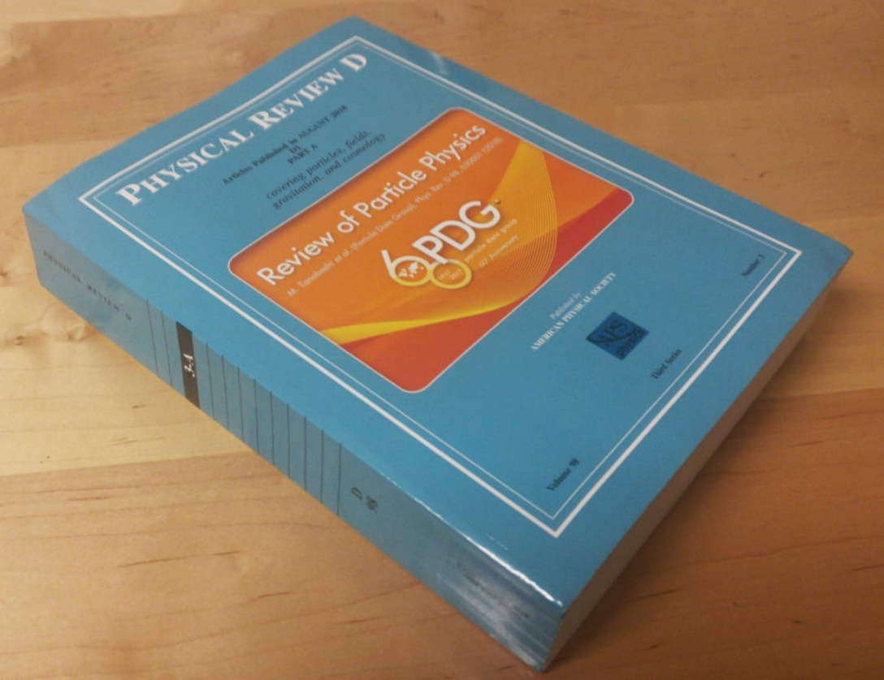
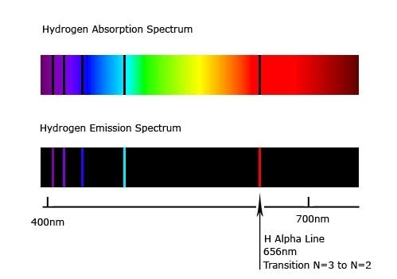
Accessing the spectrum is key to understand the theories
The Hydrogen spectrum helped us discover Quantum Mechanics
We know the levels with remarkable precision
Solve the Hydrogen spectrum, pass Quantum Mechanics 101
Solve the strong interaction spectrum, win a Prize, etc. etc. etc...
A. Pilloni – Challenges in Hadron Spectroscopy

Slide 3
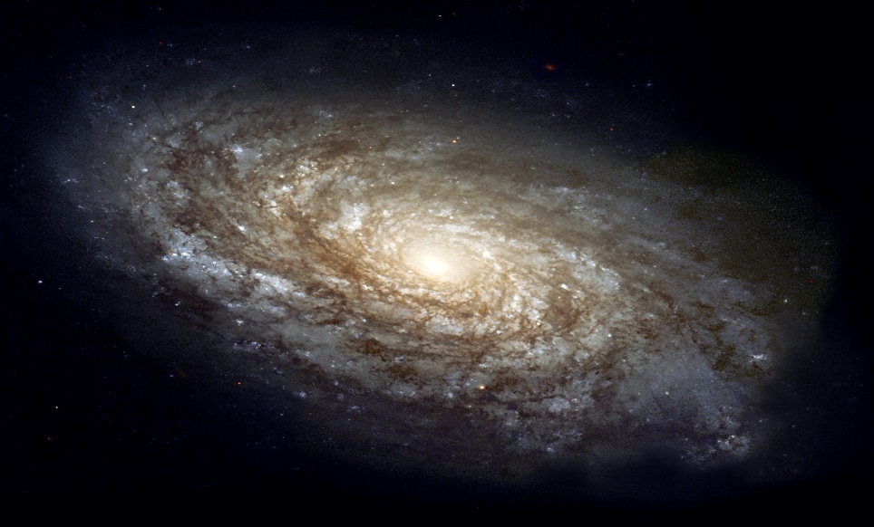
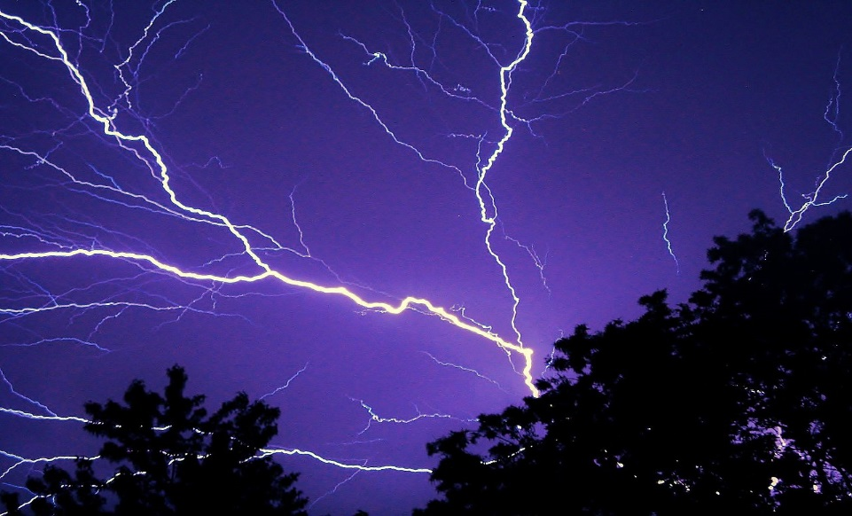
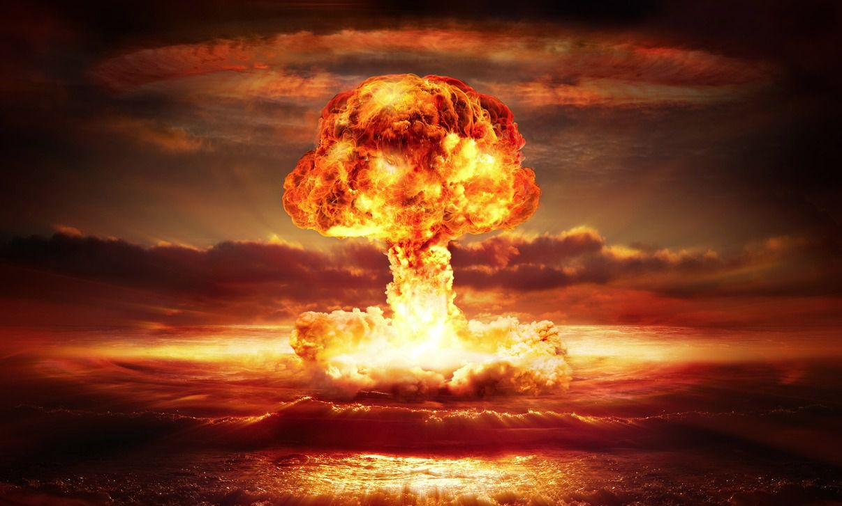
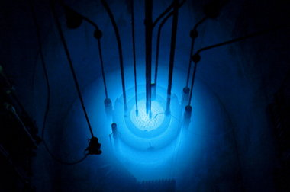
The four forces
Standard model Works from ${10}^{3}$ to ${10}^{−18} \text{m}$
$$U∼\frac{m_{1}m_{2}}{r}$$
$$U∼\frac{q_{1}q_{2}}{r}$$
$$U∼\frac{g_{s1}g_{s2}}{r}e^{−r/λ_{s}}$$
$$λ_{s}∼1.4×{10}^{−15} \text{m}$$
$$U∼\frac{g_{w1}g_{w2}}{r}e^{−r/λ_{w}}$$
$$λ_{w}∼2.5×{10}^{−18} \text{m}$$
A. Pilloni – Challenges in Hadron Spectroscopy
Notes:
2 slides su Zc, a Bes e a Belle
2 slide su tetraquark model: dall’hamiltoniana di Jaffe al calcolo delle masse
1 slide su molecular models, dove sono i carichi? (non in Tornqvist, si in Hanhart, vedere Braaten, citare Nefediev)
2 slides su decay channels, dove si dovrebbe vedere, e a seconda del modello, vedere qualche plot
1 slide su Y(4260), tetraquark? C’è lo strano (si vede la f0)
1 slide su Zc a cleo (anche il neutro)

Slide 4
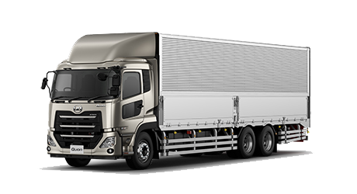
The strong force
It binds protons and neutrons inside nuclei
It is relevant at short distances only
Particles interacting via the strong force are called hadrons
Hadrons are composite objects, formed by quarks, and bound by gluons (the mediators of the strong force)
Quarks are confined inside hadrons
Strong means strong: the force between two quarks in a hadron is roughly the same as the weight of a truck
A. Pilloni – Challenges in Hadron Spectroscopy
Notes:
2 slides su Zc, a Bes e a Belle
2 slide su tetraquark model: dall’hamiltoniana di Jaffe al calcolo delle masse
1 slide su molecular models, dove sono i carichi? (non in Tornqvist, si in Hanhart, vedere Braaten, citare Nefediev)
2 slides su decay channels, dove si dovrebbe vedere, e a seconda del modello, vedere qualche plot
1 slide su Y(4260), tetraquark? C’è lo strano (si vede la f0)
1 slide su Zc a cleo (anche il neutro)

Slide 5
Three quarks for Muster Mark
Quarks appear in 3 colors
Antiquarks appear in 3 anticolors
$$π^{0}$$
$$\overline{g}$$
$$g$$
$$\overline{r}$$
$$r$$
$$\overline{b}$$
$$b$$
Quarks appear in 6 flavors
$q\overline{q}$ pairs form a meson
Hadrons must be white:
A. Pilloni – Challenges in Hadron Spectroscopy
Notes:
2 slides su Zc, a Bes e a Belle
2 slide su tetraquark model: dall’hamiltoniana di Jaffe al calcolo delle masse
1 slide su molecular models, dove sono i carichi? (non in Tornqvist, si in Hanhart, vedere Braaten, citare Nefediev)
2 slides su decay channels, dove si dovrebbe vedere, e a seconda del modello, vedere qualche plot
1 slide su Y(4260), tetraquark? C’è lo strano (si vede la f0)
1 slide su Zc a cleo (anche il neutro)

Slide 6
Three quarks for Muster Mark
Quarks appear in 3 colors
Antiquarks appear in 3 anticolors
$$\overline{g}$$
$$g$$
$$\overline{Λ}$$
$$\overline{r}$$
$$r$$
$$p$$
$$\overline{b}$$
$$b$$
$qqq$ triplets form a baryon
Hadrons must be white:
$\overline{q}\overline{q}\overline{q}$ triplets form an antibaryon
A. Pilloni – Challenges in Hadron Spectroscopy
Notes:
2 slides su Zc, a Bes e a Belle
2 slide su tetraquark model: dall’hamiltoniana di Jaffe al calcolo delle masse
1 slide su molecular models, dove sono i carichi? (non in Tornqvist, si in Hanhart, vedere Braaten, citare Nefediev)
2 slides su decay channels, dove si dovrebbe vedere, e a seconda del modello, vedere qualche plot
1 slide su Y(4260), tetraquark? C’è lo strano (si vede la f0)
1 slide su Zc a cleo (anche il neutro)

Slide 7
Three quarks for Muster Mark
Gluons appear in 8 color-anticolor combinations
$$\overline{r}$$
$$\overline{b}$$
$$g$$
$$\overline{g}$$
$$r$$
$$b$$
$$b$$
$$\overline{g}$$
$$r$$
$$\overline{b}$$
They mediate the interaction between quarks
A. Pilloni – Challenges in Hadron Spectroscopy
Notes:
2 slides su Zc, a Bes e a Belle
2 slide su tetraquark model: dall’hamiltoniana di Jaffe al calcolo delle masse
1 slide su molecular models, dove sono i carichi? (non in Tornqvist, si in Hanhart, vedere Braaten, citare Nefediev)
2 slides su decay channels, dove si dovrebbe vedere, e a seconda del modello, vedere qualche plot
1 slide su Y(4260), tetraquark? C’è lo strano (si vede la f0)
1 slide su Zc a cleo (anche il neutro)

Slide 8
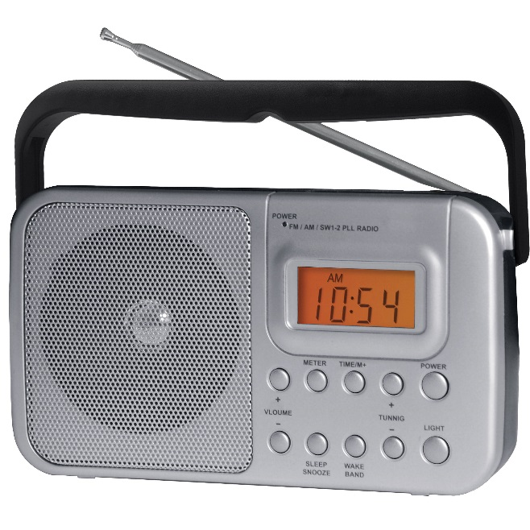
We have E&M theory: QED
Linear at the classical level → Maxwell equations
Any electromagnetic process is described by this equation (in principle)
A. Pilloni – Challenges in Hadron Spectroscopy

Slide 9
We have E&M theory: QED
The electric charge is small, «Taylor» expansion
$$f∼\frac{e^{2}}{4π}f_{0}+{\left(\frac{e^{2}}{4π}\right)}^{2}f_{1}+{\left(\frac{e^{2}}{4π}\right)}^{3}f_{2}+{\left(\frac{e^{2}}{4π}\right)}^{4}f_{3}+…$$
$$\frac{e^{2}}{4π}∼\frac{1}{137}≪1$$
A. Pilloni – Challenges in Hadron Spectroscopy

Slide 10
We have strong theory: QCD
Matrix equation
Gluons self-interact → Nonlinear even at classical level
A. Pilloni – Challenges in Hadron Spectroscopy

Slide 11
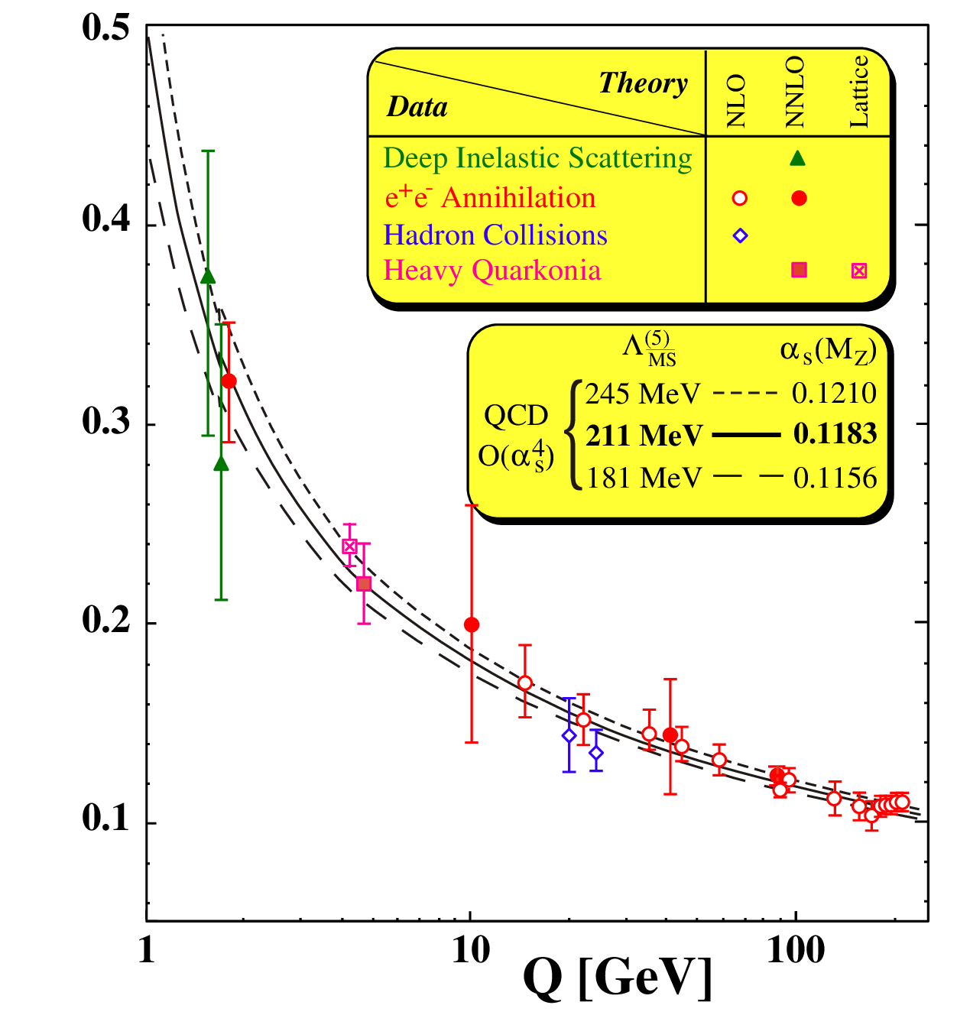
Asymptotic freedom
$\frac{g_{s}^{2}}{4π}(Q)$
At high energies $\frac{g_{s}^{2}}{4π}≪0.1$
A. Pilloni – Challenges in Hadron Spectroscopy

Slide 12
At low energies?
At low energies $\frac{g_{s}^{2}}{4π}>1$, no hierarchy
Emerging properties: Confinement; Mass generation
No calculable solution yet
$\frac{g_{s}^{2}}{4π}(Q)$
A. Pilloni – Challenges in Hadron Spectroscopy

Slide 13
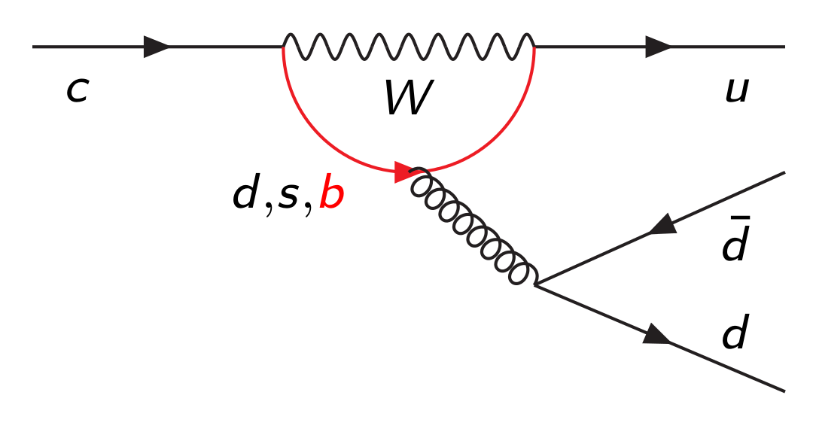
Hadrons are everywhere
$$D^{0}$$
$$\overline{u}$$
$$π^{+}$$
$$π^{+}$$
$$c$$
$$u$$
$$π^{−}$$
$$\overline{d}$$
$$π^{−}$$
$$π^{0}$$
$$d$$
$$π^{0}$$
A. Pilloni – Challenges in Hadron Spectroscopy
Notes:
2 slides su Zc, a Bes e a Belle
2 slide su tetraquark model: dall’hamiltoniana di Jaffe al calcolo delle masse
1 slide su molecular models, dove sono i carichi? (non in Tornqvist, si in Hanhart, vedere Braaten, citare Nefediev)
2 slides su decay channels, dove si dovrebbe vedere, e a seconda del modello, vedere qualche plot
1 slide su Y(4260), tetraquark? C’è lo strano (si vede la f0)
1 slide su Zc a cleo (anche il neutro)

Slide 14
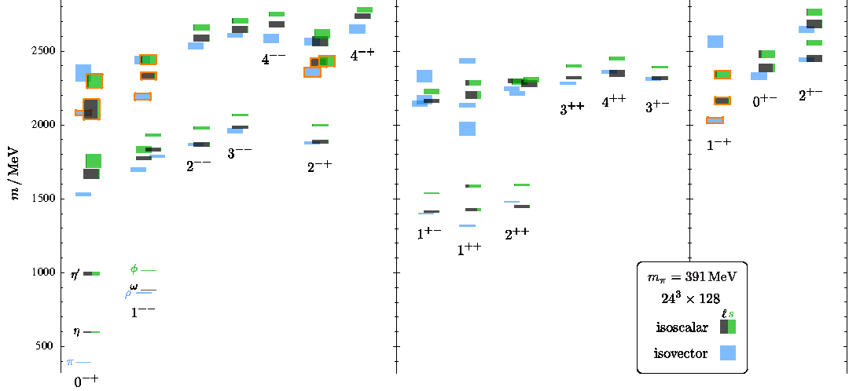
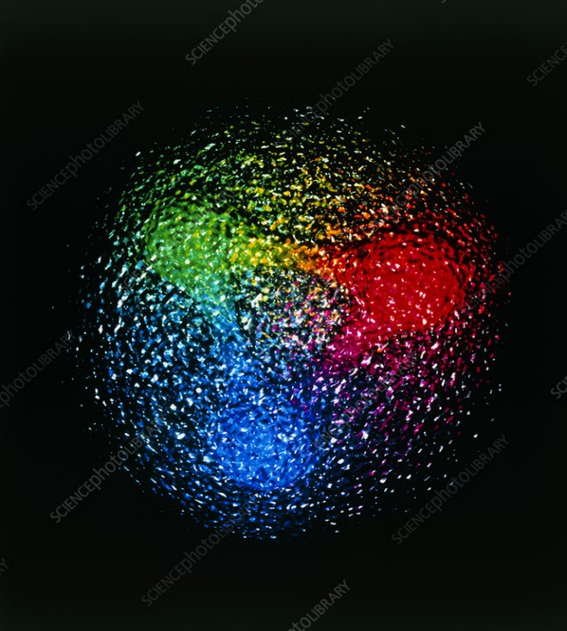
QCD has no solution. Don’t panic /1
Plan of attack
Collect data
Identify states
Compare with expectations
Answer big questions
We can build models to describe the spectrum. Grasp some aspects of QCD, get insights
Analytical methods
Lattice QCD (not a model but...)
The excited spectrum is populated by unstable states, is $∼{10}^{−24} s$
Feedback from experiments
A. Pilloni – Challenges in Hadron Spectroscopy

Slide 15
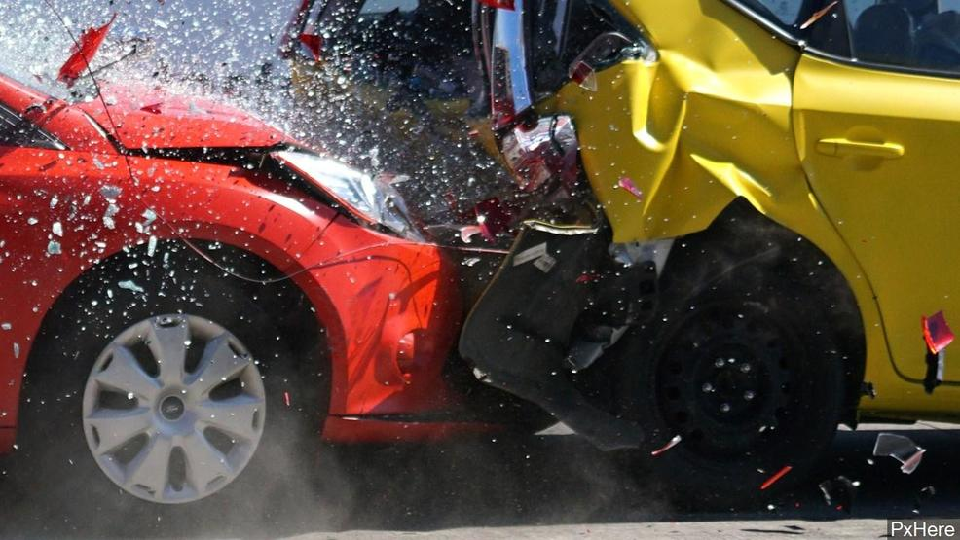
Unraveling QCD
Beam
Target
Products
A. Pilloni – Challenges in Hadron Spectroscopy

Slide 16
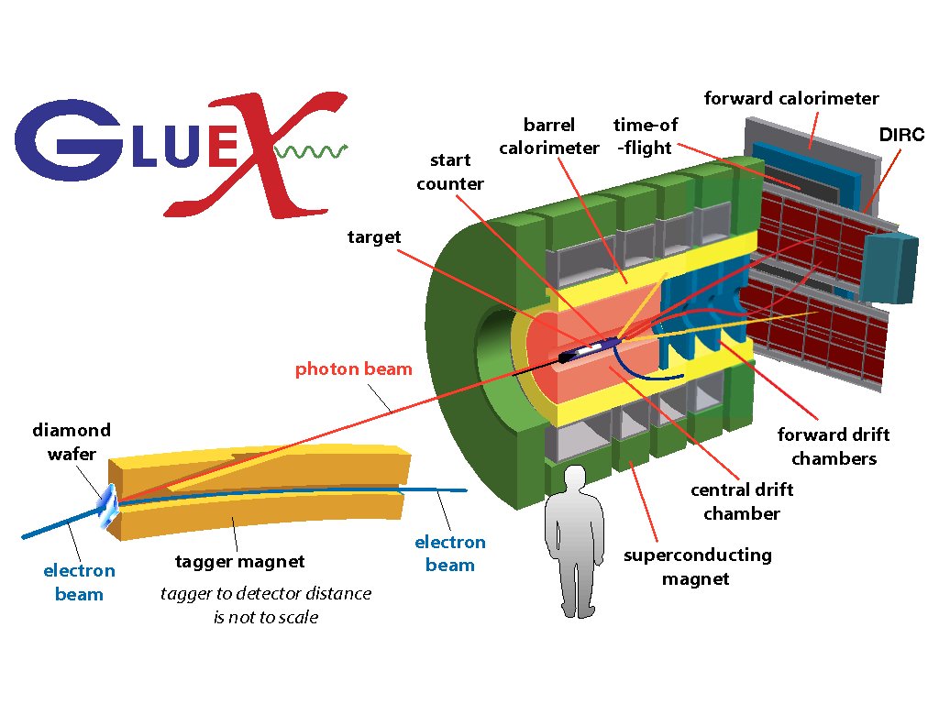
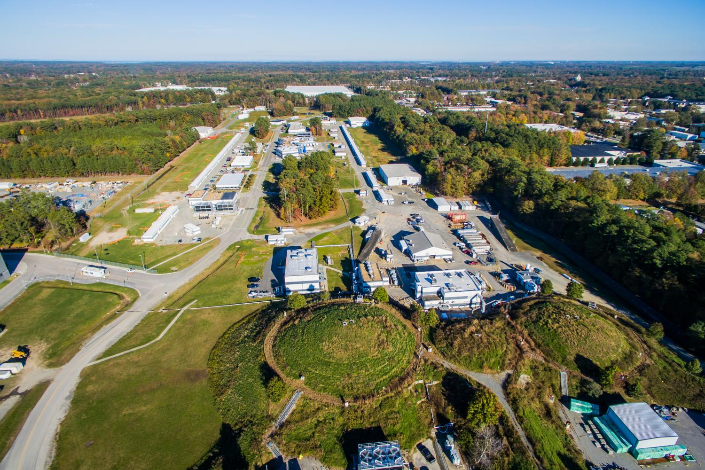
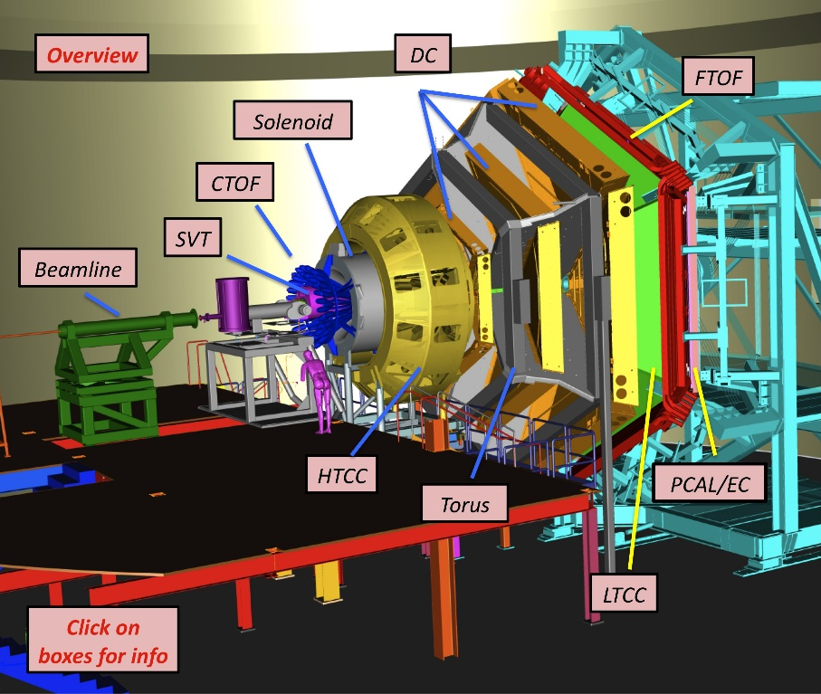
Unraveling QCD at JLab
Electrons at $12 \text{GeV}$
$v=99.9999999\% c$
Hydrogen target (mostly),
Clean (?) physics
A. Pilloni – Challenges in Hadron Spectroscopy

Slide 17
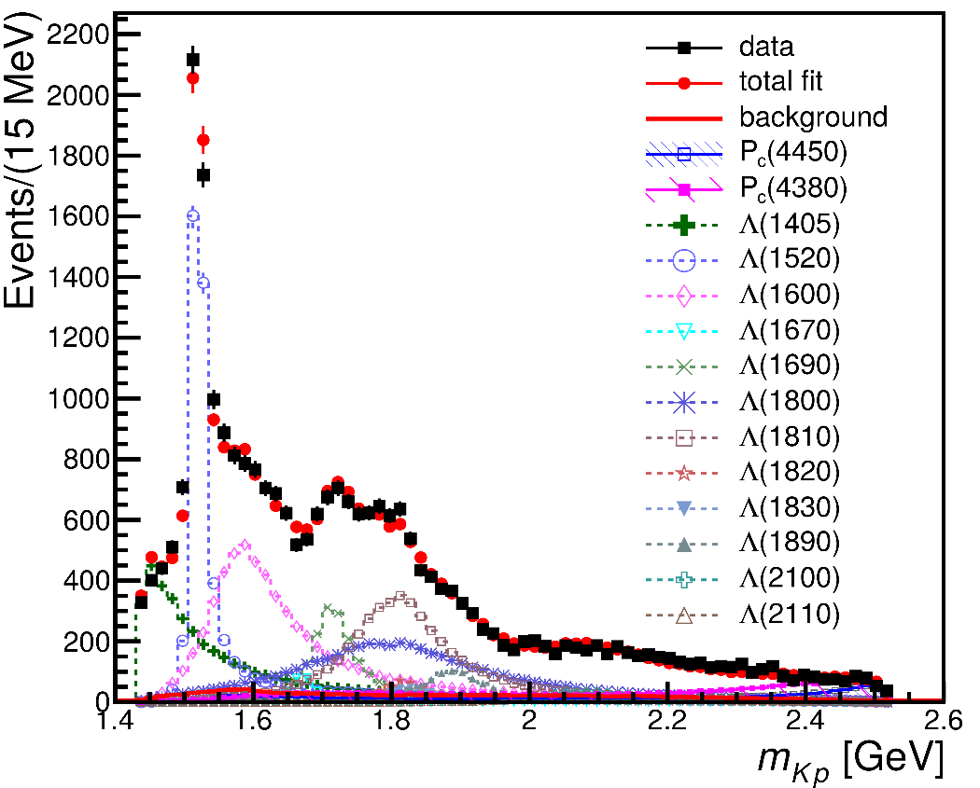
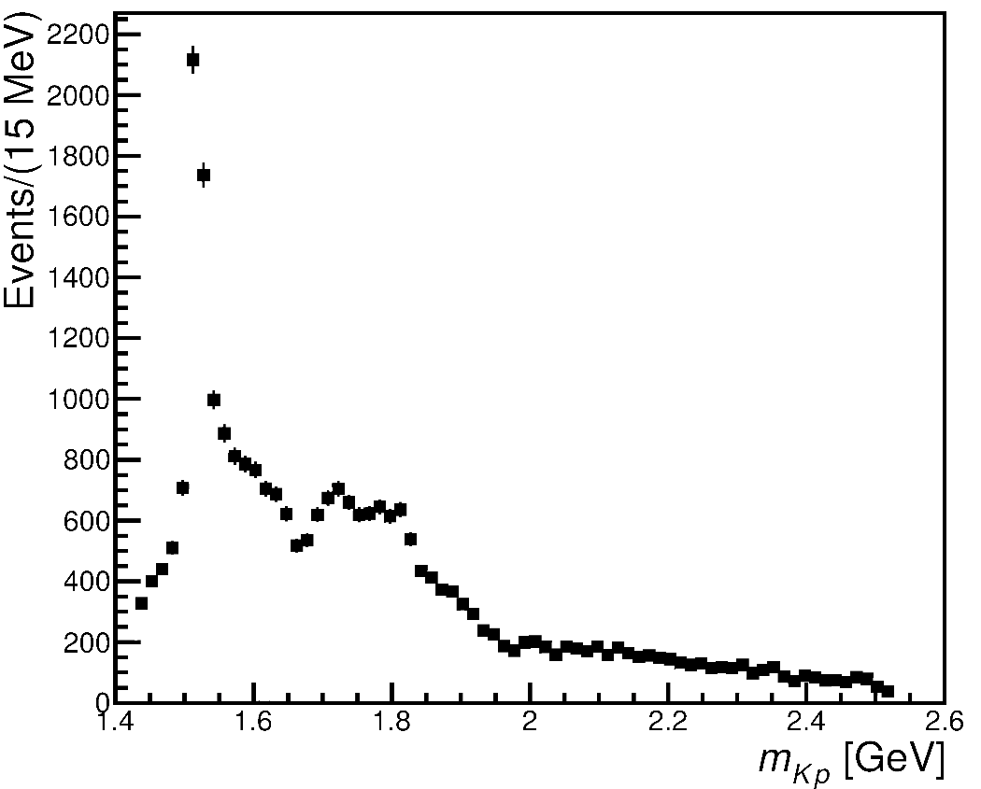
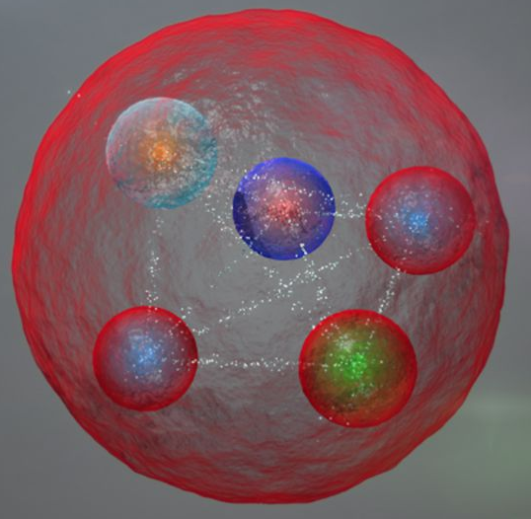
From data to the spectrum
Wow!
Mmh...?
The connection between data and hadrons is not easy!
A. Pilloni – Challenges in Hadron Spectroscopy

Slide 18
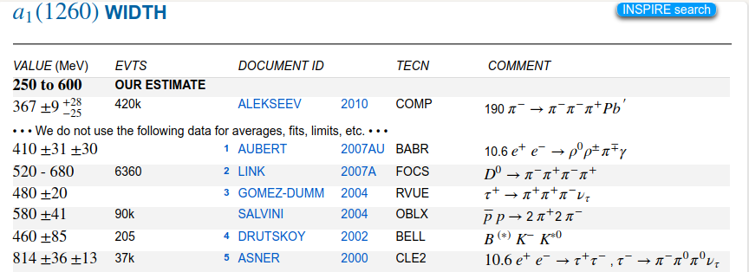
Life is not easy...
A. Pilloni – Challenges in Hadron Spectroscopy
Notes:
2 slides su Zc, a Bes e a Belle
2 slide su tetraquark model: dall’hamiltoniana di Jaffe al calcolo delle masse
1 slide su molecular models, dove sono i carichi? (non in Tornqvist, si in Hanhart, vedere Braaten, citare Nefediev)
2 slides su decay channels, dove si dovrebbe vedere, e a seconda del modello, vedere qualche plot
1 slide su Y(4260), tetraquark? C’è lo strano (si vede la f0)
1 slide su Zc a cleo (anche il neutro)

Slide 19
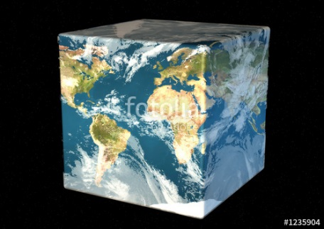
The Richness of the Spectrum
Meson
Baryon
Glueball
Hybrids
Tetraquark
Molecule
Experiment
Data
Amplitude analysis
QCD
Lattice QCD
With great statistics comes great responsibility!
Peter Parker, PhD
A. Pilloni – Challenges in Hadron Spectroscopy

Slide 20
QCD has no solution. Don’t panic /2
When you are desperate, look for symmetries:
Symmetries are beautiful (and group theory is fun!)
Symmetries constrain your results no matter how complicated your theory is
Look for general properties of interactions
Luckily, strong interactions are the ones with most symmetries
A. Pilloni – Challenges in Hadron Spectroscopy

Slide 21
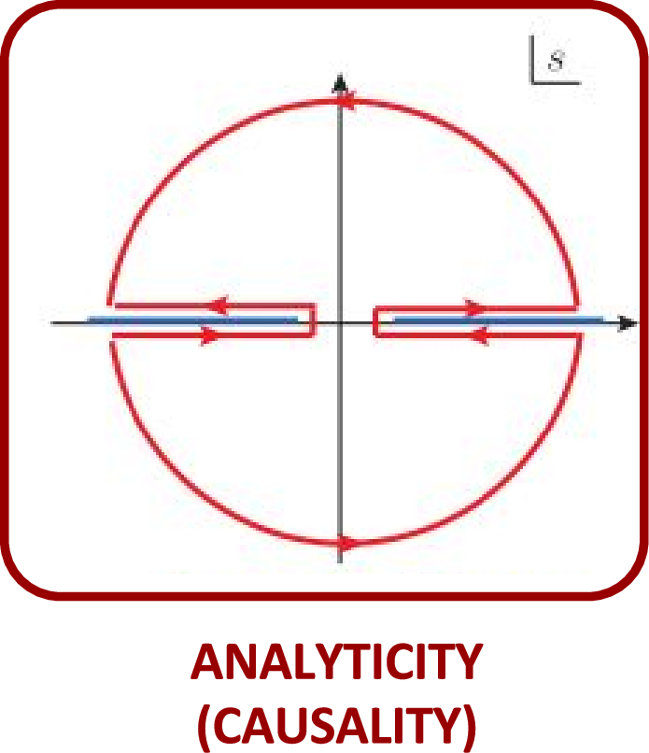
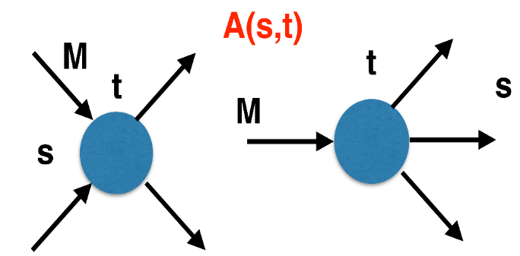
The S-Matrix principles
Future cannot change the past
100%, something will happen
The anti-particle is an anti-particle and not just a different particle
(analyticity)
(unitarity)
(crossing symmetry)
Sherlock Holmes, QFT
Analyticity
Unitarity
Crossing
Parametrize your ignorance.
Build a model.
Fit data.
Have fun.
A. Pilloni – Challenges in Hadron Spectroscopy

Slide 22
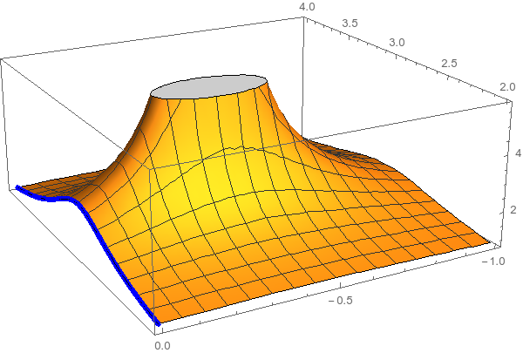
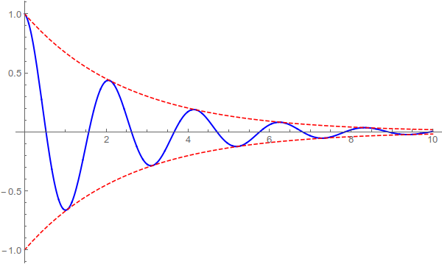
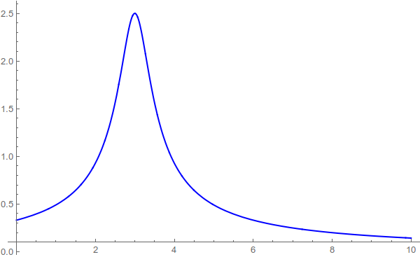
Resonances = Unstable states
$$ψ(t)=e^{−i E_{0} t} e^{− \frac{Γ}{2} t }$$
$$ψ(E)=\frac{1}{E−E_{0}+i\frac{Γ}{2}}$$
The function explodes for value of energy $E=E_{0}−i\frac{Γ}{2}$
Resonances are poles in the complex energy plane
Excited states are unstable
They manifest as resonant peaks
A. Pilloni – Challenges in Hadron Spectroscopy

Slide 23
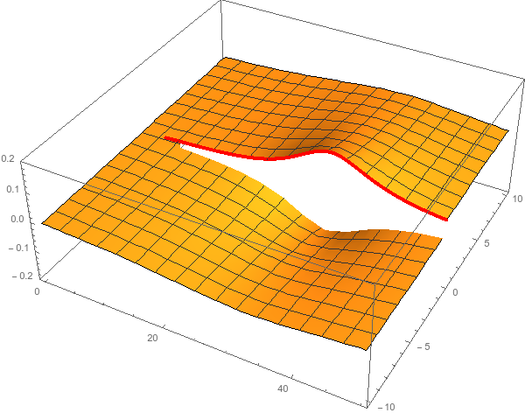
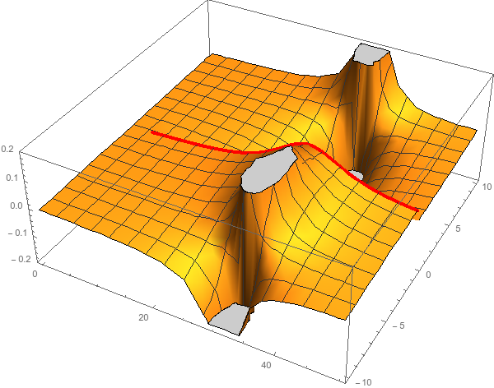
Unitarity & Pole hunting
Unitarity creates a branch cut on the real axis, two sheets continuosly connected
I sheet
II sheet
Finding resonances means writing analytic amplitude, and hunting for poles in the complex plane
A. Pilloni – Challenges in Hadron Spectroscopy
Notes:
Controlla la parte su Regge

Slide 24
Hybrid mesons
Can gluons be constituent of mesons?
Can gluons be constituent of mesons?
$$g$$
$$b$$
$$r$$
$$\overline{b}$$
$$r$$
$$\overline{g}$$
$$\overline{g}$$
$$b$$
$$\overline{r}$$
$$b$$
$$\overline{g}$$
More quantum numbers allowed wrt $q\overline{q}$ states: smoking gun of exotics
A. Pilloni – Challenges in Hadron Spectroscopy
Notes:
2 slides su Zc, a Bes e a Belle
2 slide su tetraquark model: dall’hamiltoniana di Jaffe al calcolo delle masse
1 slide su molecular models, dove sono i carichi? (non in Tornqvist, si in Hanhart, vedere Braaten, citare Nefediev)
2 slides su decay channels, dove si dovrebbe vedere, e a seconda del modello, vedere qualche plot
1 slide su Y(4260), tetraquark? C’è lo strano (si vede la f0)
1 slide su Zc a cleo (anche il neutro)

Slide 25
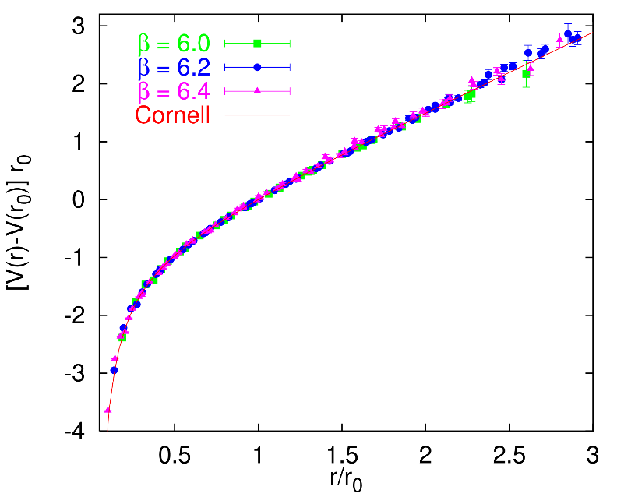
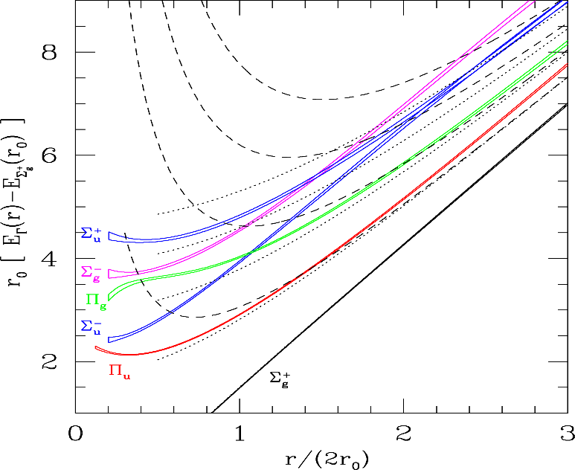
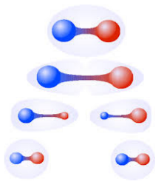
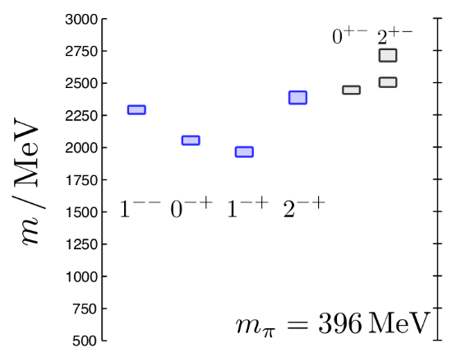
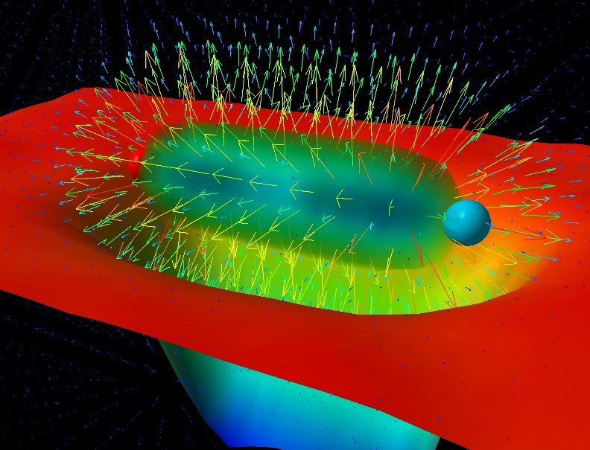
Learning about confinement
If quarks were infinitely heavy, gluonic field is confined in a string
Linear rising potential
What is a constituent gluon?
vibration of the string? → degenerate $J^{PC}={\left(0,1,2\right)}^{−+},{\left(0,1,2\right)}^{+−}$
excitation of a quasiparticle? → degenerate $J^{PC}={\left(0,1,2\right)}^{−+},1^{−−}$
G. Bali
C. Morningstar
J. Dudek
excitation of a quasiparticle! → degenerate $J^{PC}={\left(0,1,2\right)}^{−+},1^{−−}$ says Lattice QCD...
What about real data?
D. Leinweber
A. Pilloni – Challenges in Hadron Spectroscopy
Notes:
Controlla la parte su Regge

Slide 26
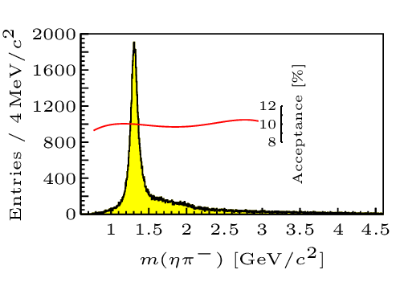
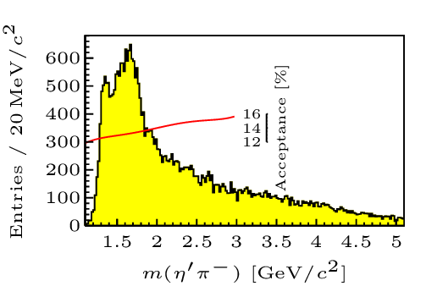
Hybrid hunting
Excited gluon, $$J^{PC}=1^{+−}$$ mass $∼1.0\text{−}1.5 \text{GeV}$
$$\overline{r}$$
$$\overline{g}$$
$$r$$
$$g$$
Look for a $π_{1}$ state with $J^{PC}=1^{−+}$
decaying into $\left\{\begin{matrix}η π \text{and} η^{′}π \\ ρ π→3π \\ b_{1}π→5π\end{matrix}\right.$
Small signal in data
A. Pilloni – Challenges in hadron spectroscopy
Notes:
2 slides su Zc, a Bes e a Belle
2 slide su tetraquark model: dall’hamiltoniana di Jaffe al calcolo delle masse
1 slide su molecular models, dove sono i carichi? (non in Tornqvist, si in Hanhart, vedere Braaten, citare Nefediev)
2 slides su decay channels, dove si dovrebbe vedere, e a seconda del modello, vedere qualche plot
1 slide su Y(4260), tetraquark? C’è lo strano (si vede la f0)
1 slide su Zc a cleo (anche il neutro)

Slide 27
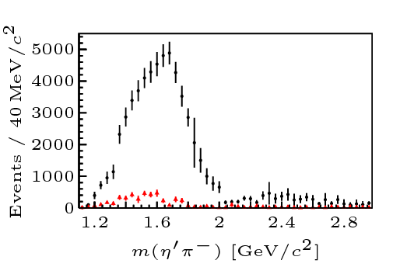
Two hybrid states???
Neither lattice nor models predict two $1^{−+}$ states in this region!
A. Pilloni – Challenges in Hadron Spectroscopy
Notes:
2 slides su Zc, a Bes e a Belle
2 slide su tetraquark model: dall’hamiltoniana di Jaffe al calcolo delle masse
1 slide su molecular models, dove sono i carichi? (non in Tornqvist, si in Hanhart, vedere Braaten, citare Nefediev)
2 slides su decay channels, dove si dovrebbe vedere, e a seconda del modello, vedere qualche plot
1 slide su Y(4260), tetraquark? C’è lo strano (si vede la f0)
1 slide su Zc a cleo (anche il neutro)

Slide 28
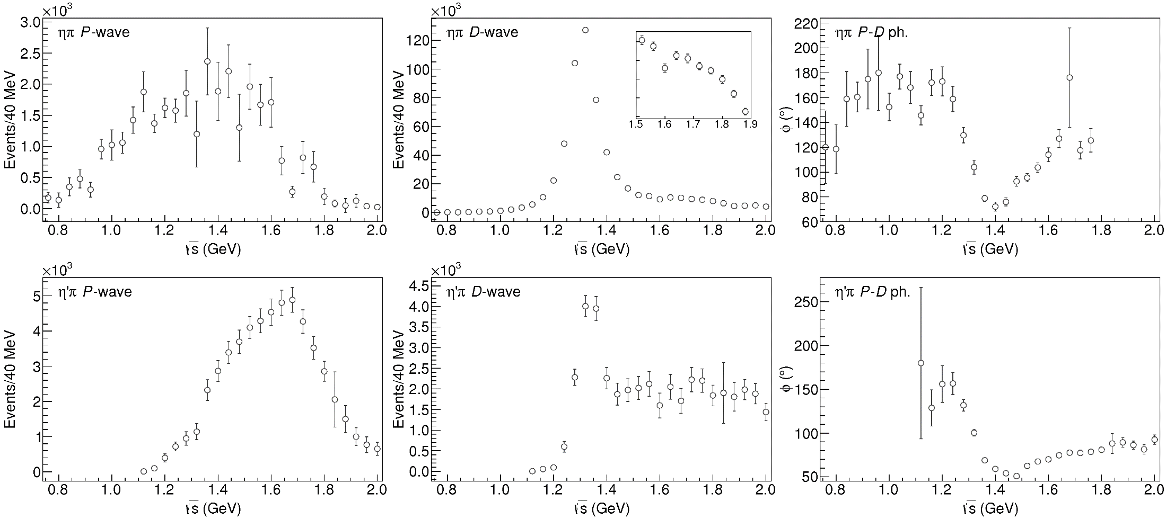
Data in $η^{(′)}π$
$$π_{1}\left(1400\right)?$$
$$a_{2}\left(1320\right)$$
$$a_{2}^{′}\left(1700\right)$$
$$π_{1}\left(1600\right)?$$
$$a_{2}\left(1320\right)$$
$$a_{2}^{′}\left(1700\right)$$
$$J^{PC}=1^{−+}$$
$$J^{PC}=2^{++}$$
A. Pilloni – Challenges in Hadron Spectroscopy
Notes:
Controlla la parte su Regge

Slide 29
Amplitudes for $η^{(′)}π$
We build the partial wave amplitudes according to the $N/D$ method
Jackura, Mikhasenko, AP et al. (JPAC & COMPASS), PLB
Rodas, AP et al. (JPAC), PRL
$$a\left(s\right)=\frac{n\left(s\right)}{D\left(s\right)}$$
$$D(s)$$
$$n(s)$$
The $n\left(s\right)$ → background physics, process-dependent, smooth
The $D(s)$ contains all the Final State Interactions constrained by unitarity → universal
A. Pilloni – Prospects for Hadron Spectroscopy at JLab
Notes:
Controlla la parte su Regge

Slide 30
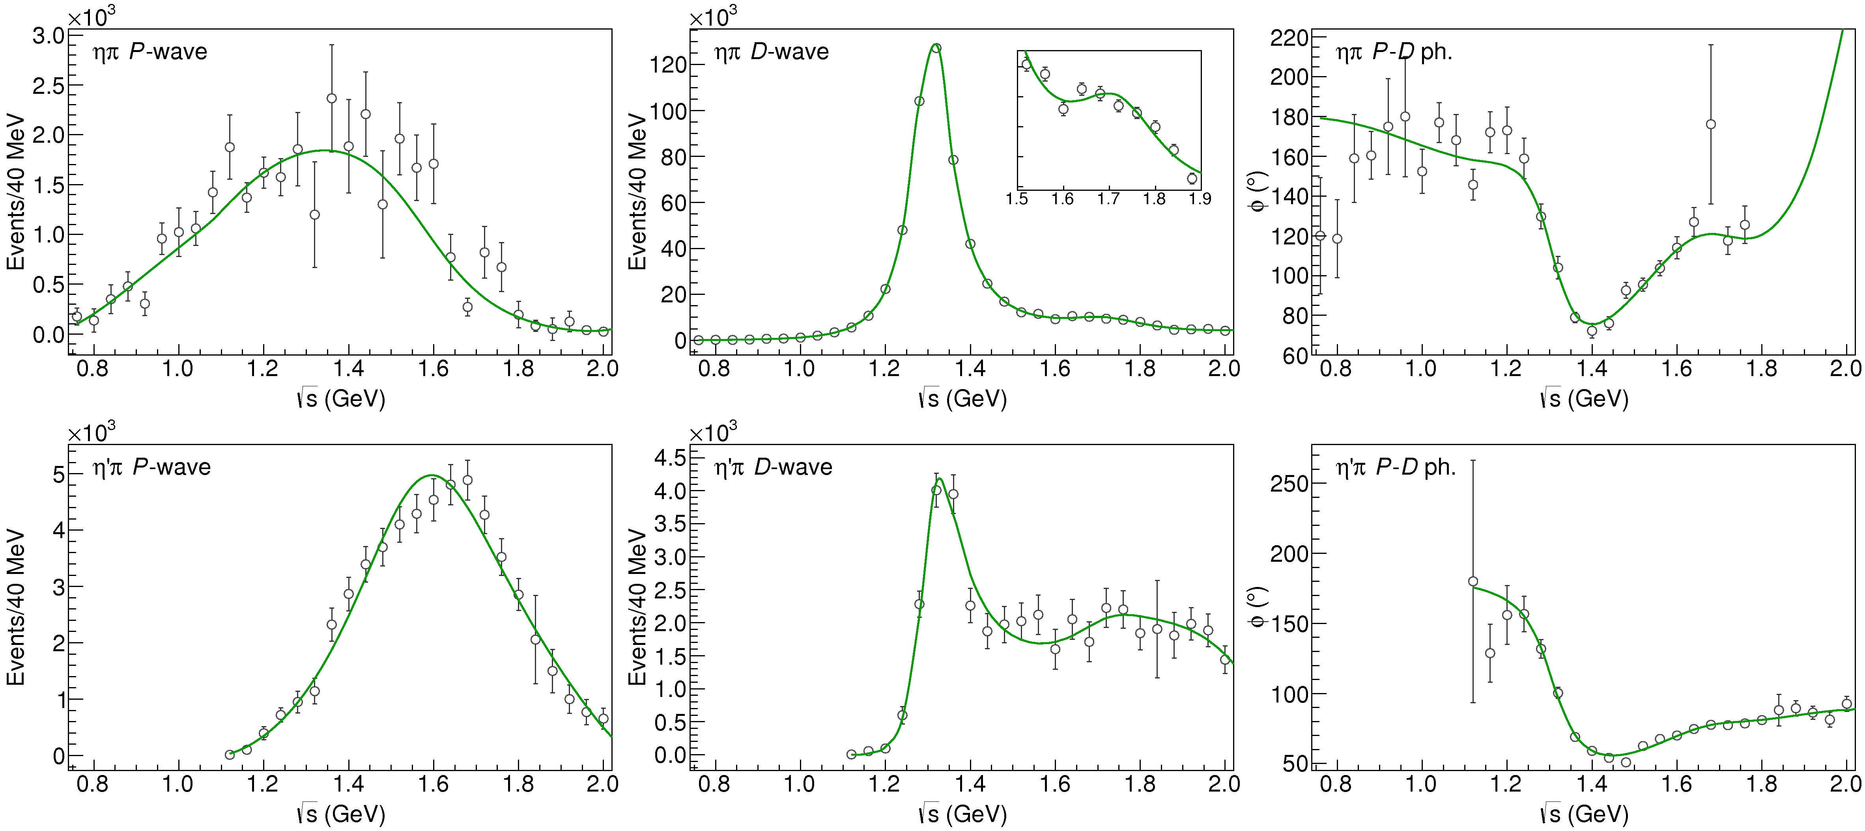
Fit to $η^{(′)}π$
$$π_{1}\left(1400\right)?$$
$$a_{2}\left(1320\right)$$
$$a_{2}^{′}\left(1700\right)$$
$$π_{1}\left(1600\right)?$$
$$a_{2}\left(1320\right)$$
$$a_{2}^{′}\left(1700\right)$$
$$J^{PC}=1^{−+}$$
$$J^{PC}=2^{++}$$
A. Pilloni – Challenges in Hadron Spectroscopy
Notes:
Controlla la parte su Regge

Slide 31
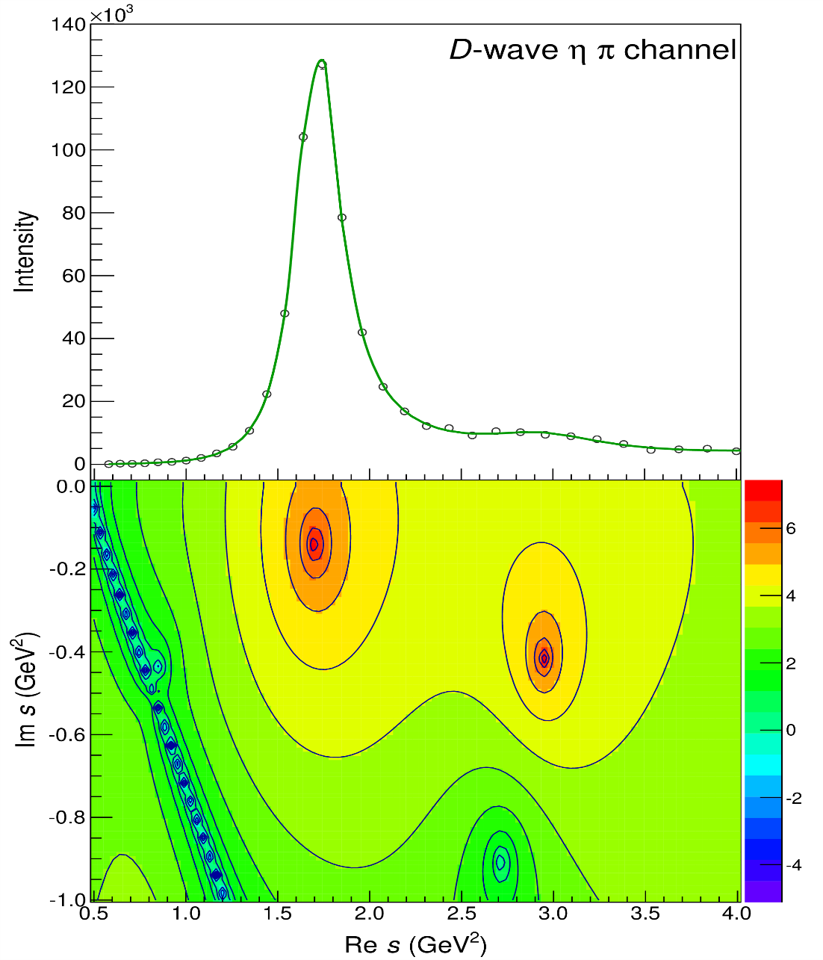
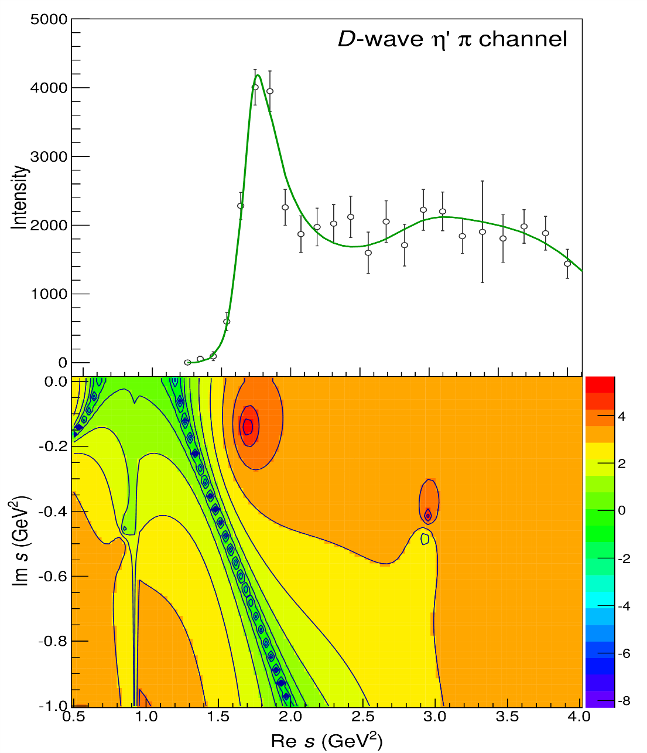
Pole hunting
$$a_{2}^{′}\left(1700\right)$$
$$a_{2}^{′}\left(1700\right)$$
$$a_{2}\left(1320\right)$$
$$a_{2}\left(1320\right)$$
A. Pilloni – Challenges in Hadron Spectroscopy
Notes:
Controlla la parte su Regge

Slide 32
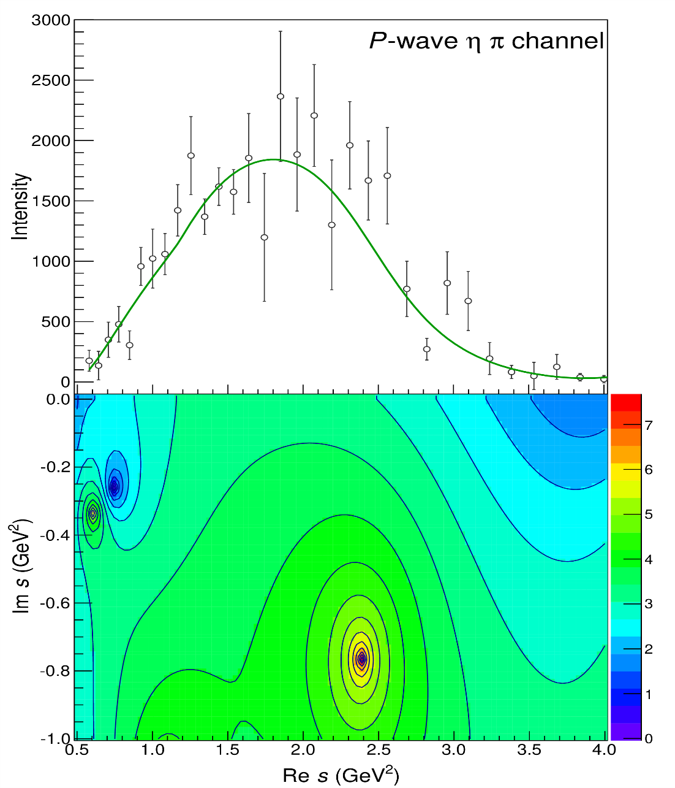
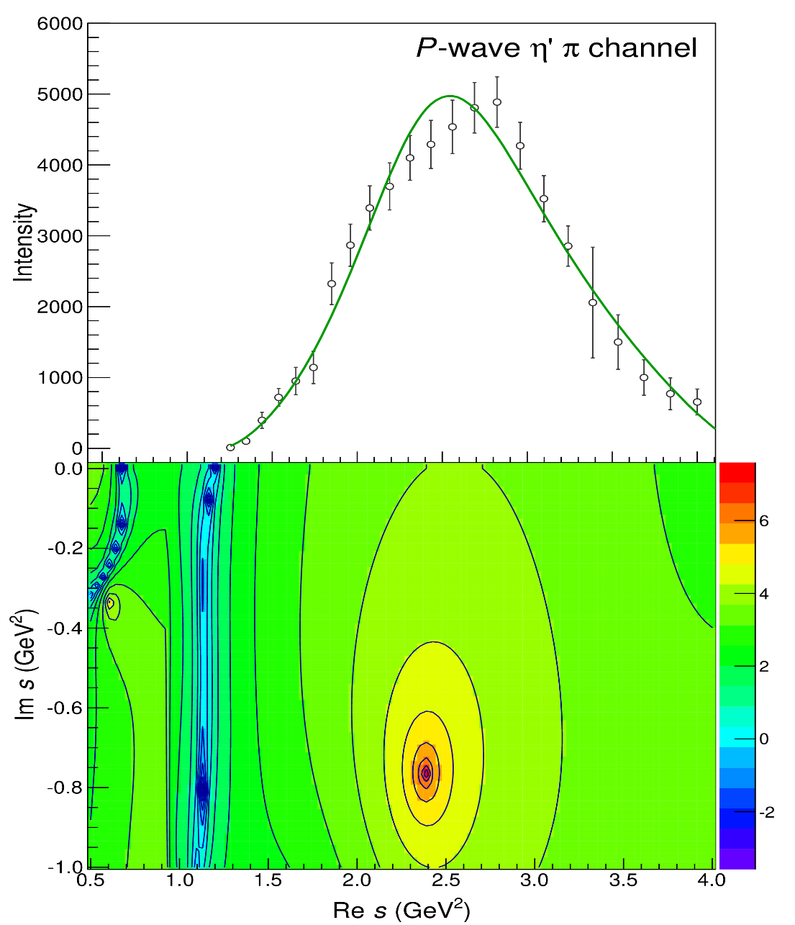
Pole hunting
$$π_{1}$$
$$π_{1}$$
A. Pilloni – Challenges in Hadron Spectroscopy
Notes:
Controlla la parte su Regge

Slide 33
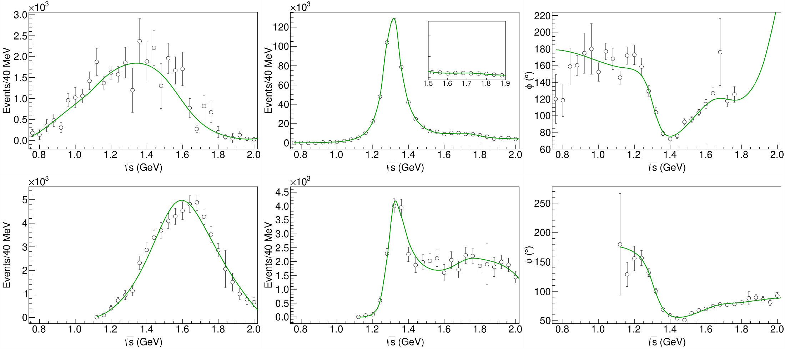
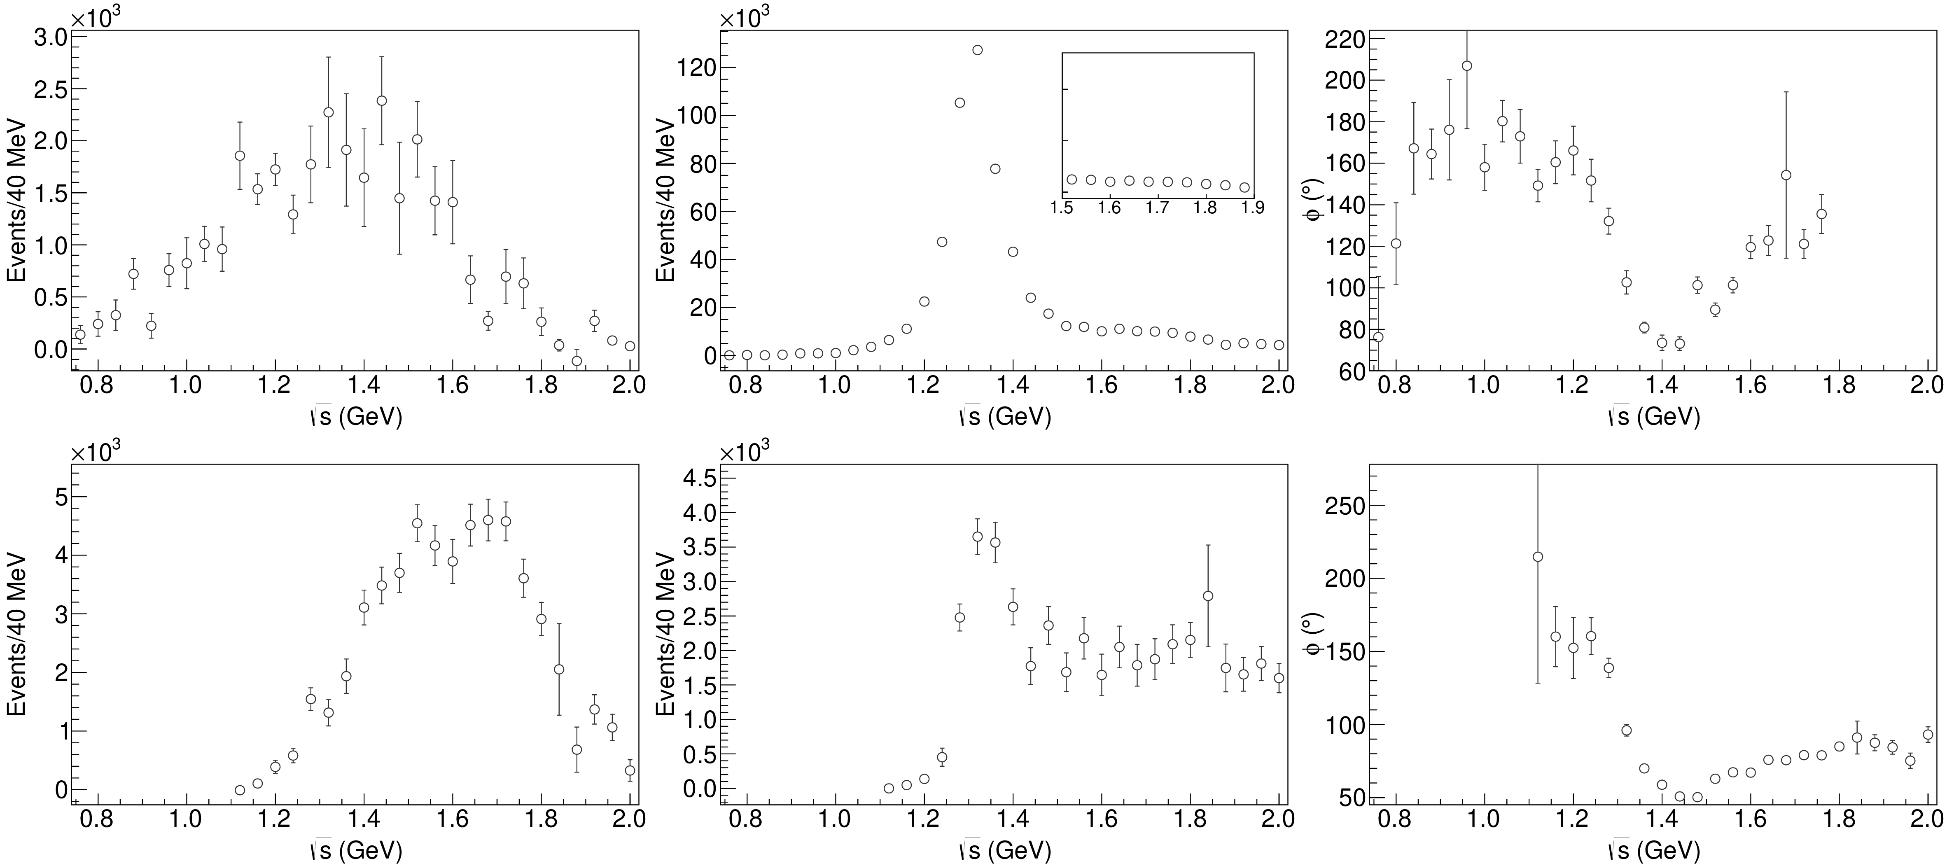
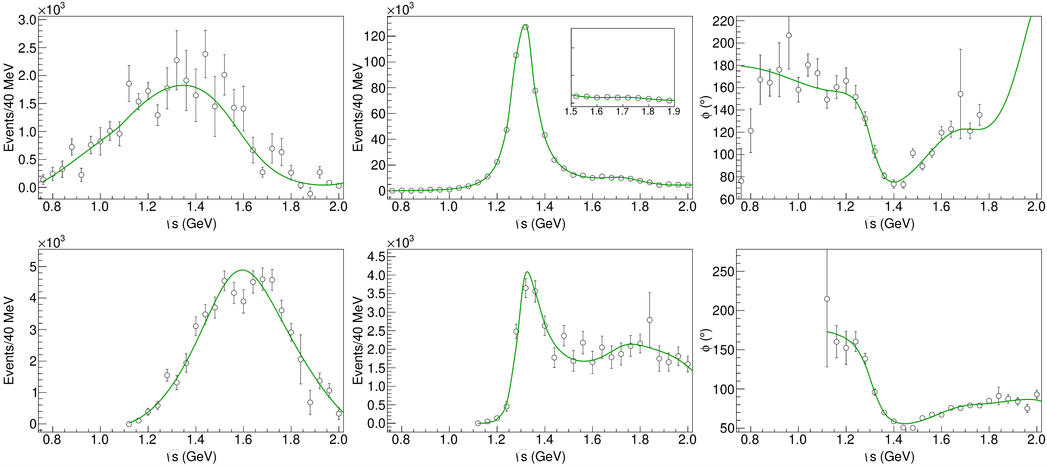
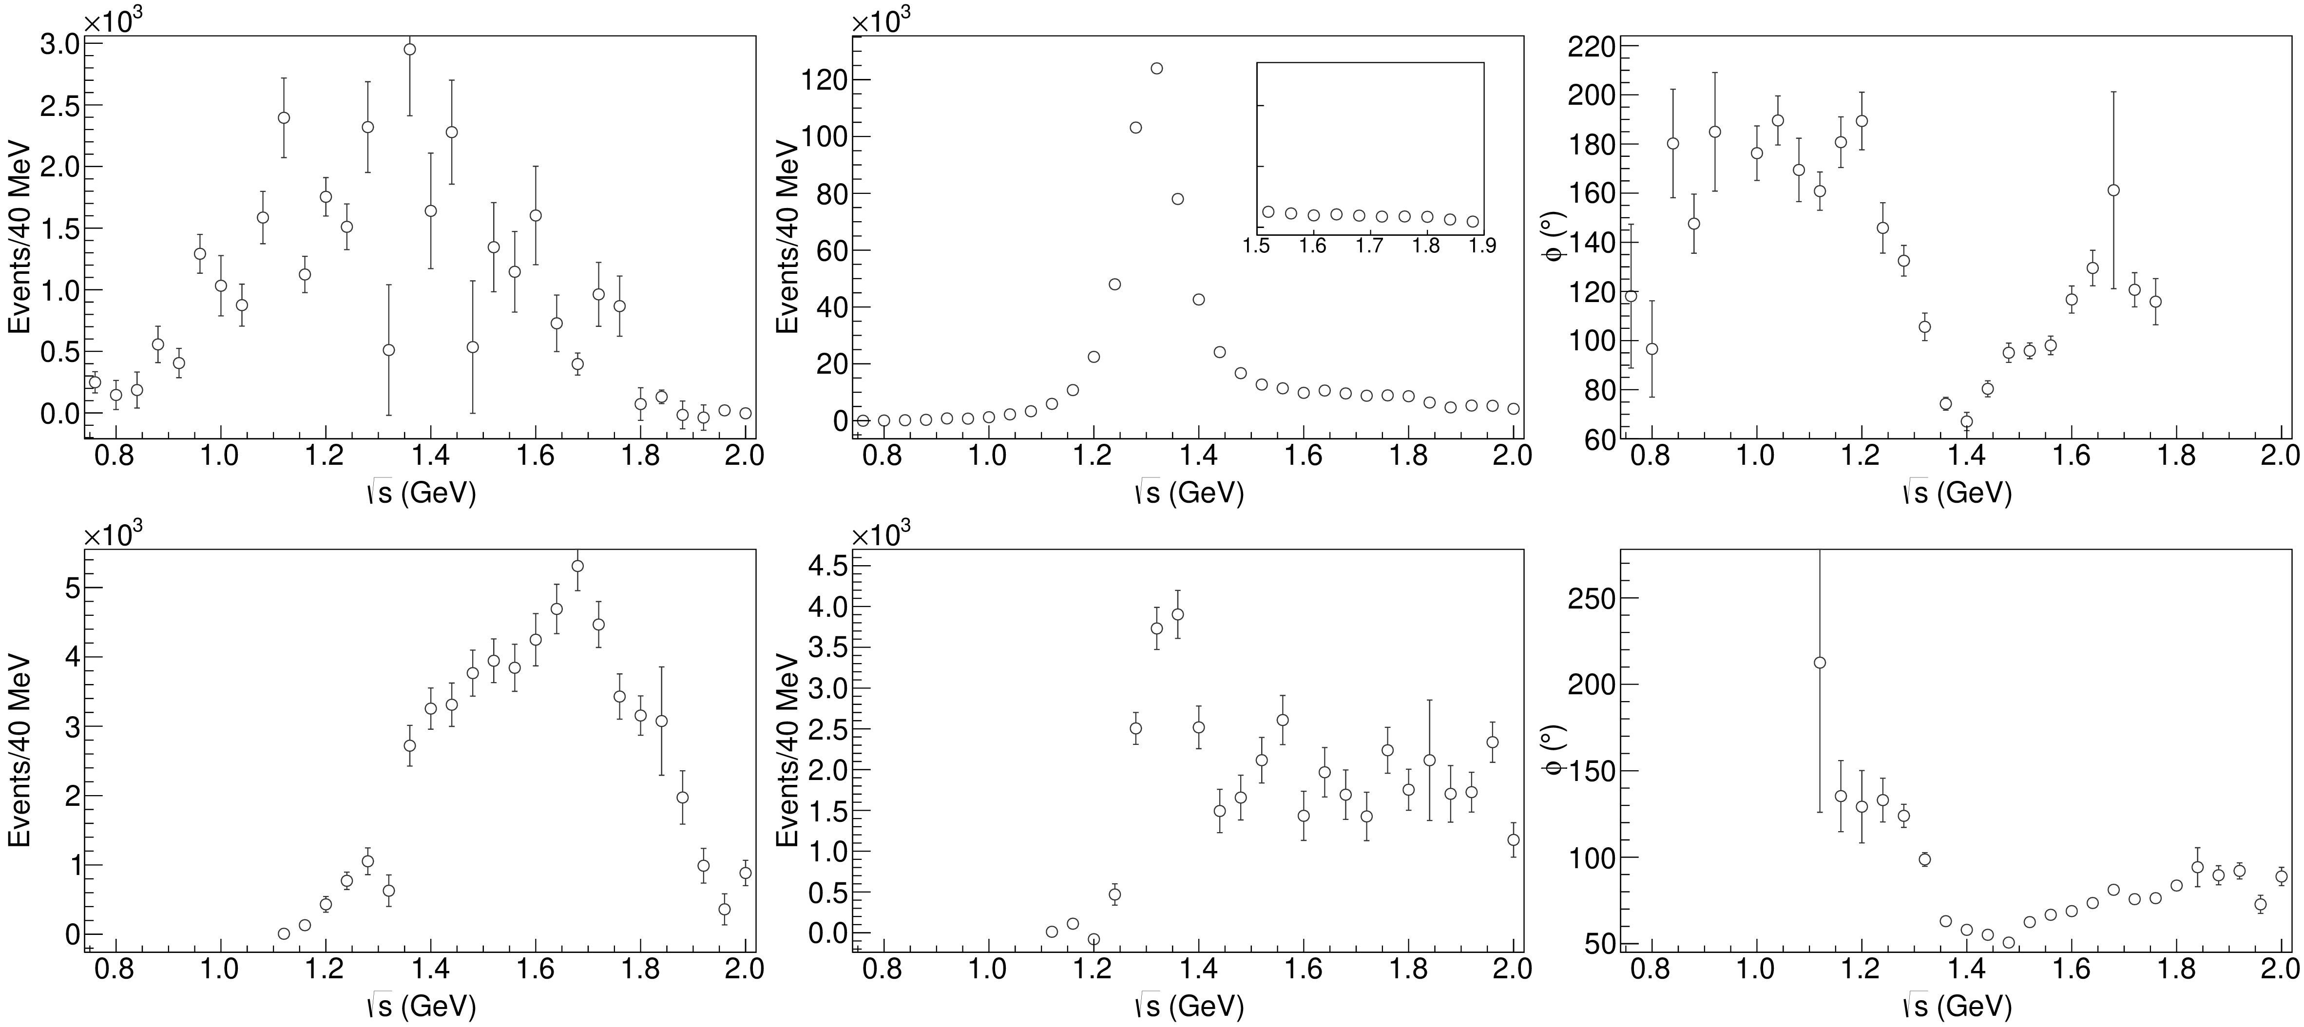
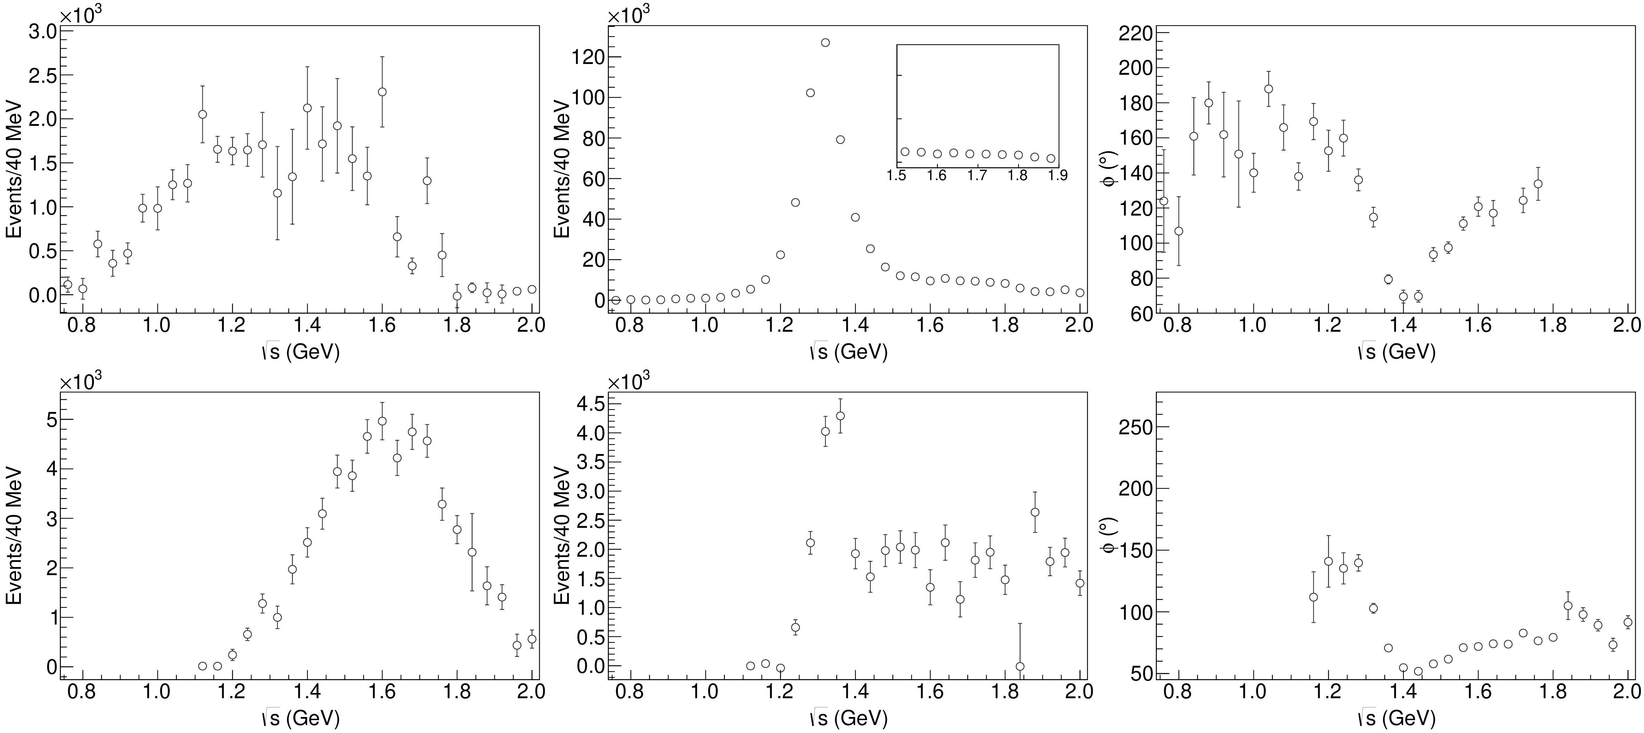
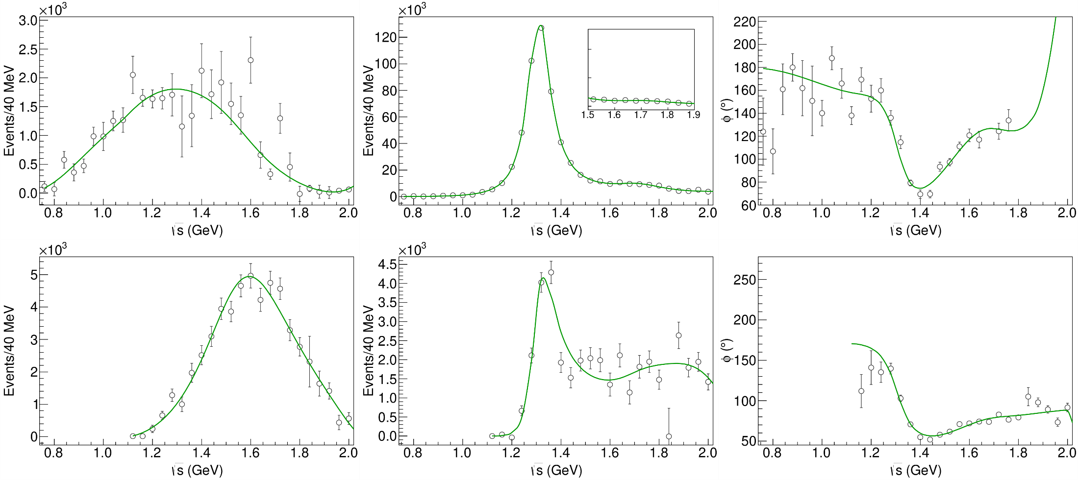
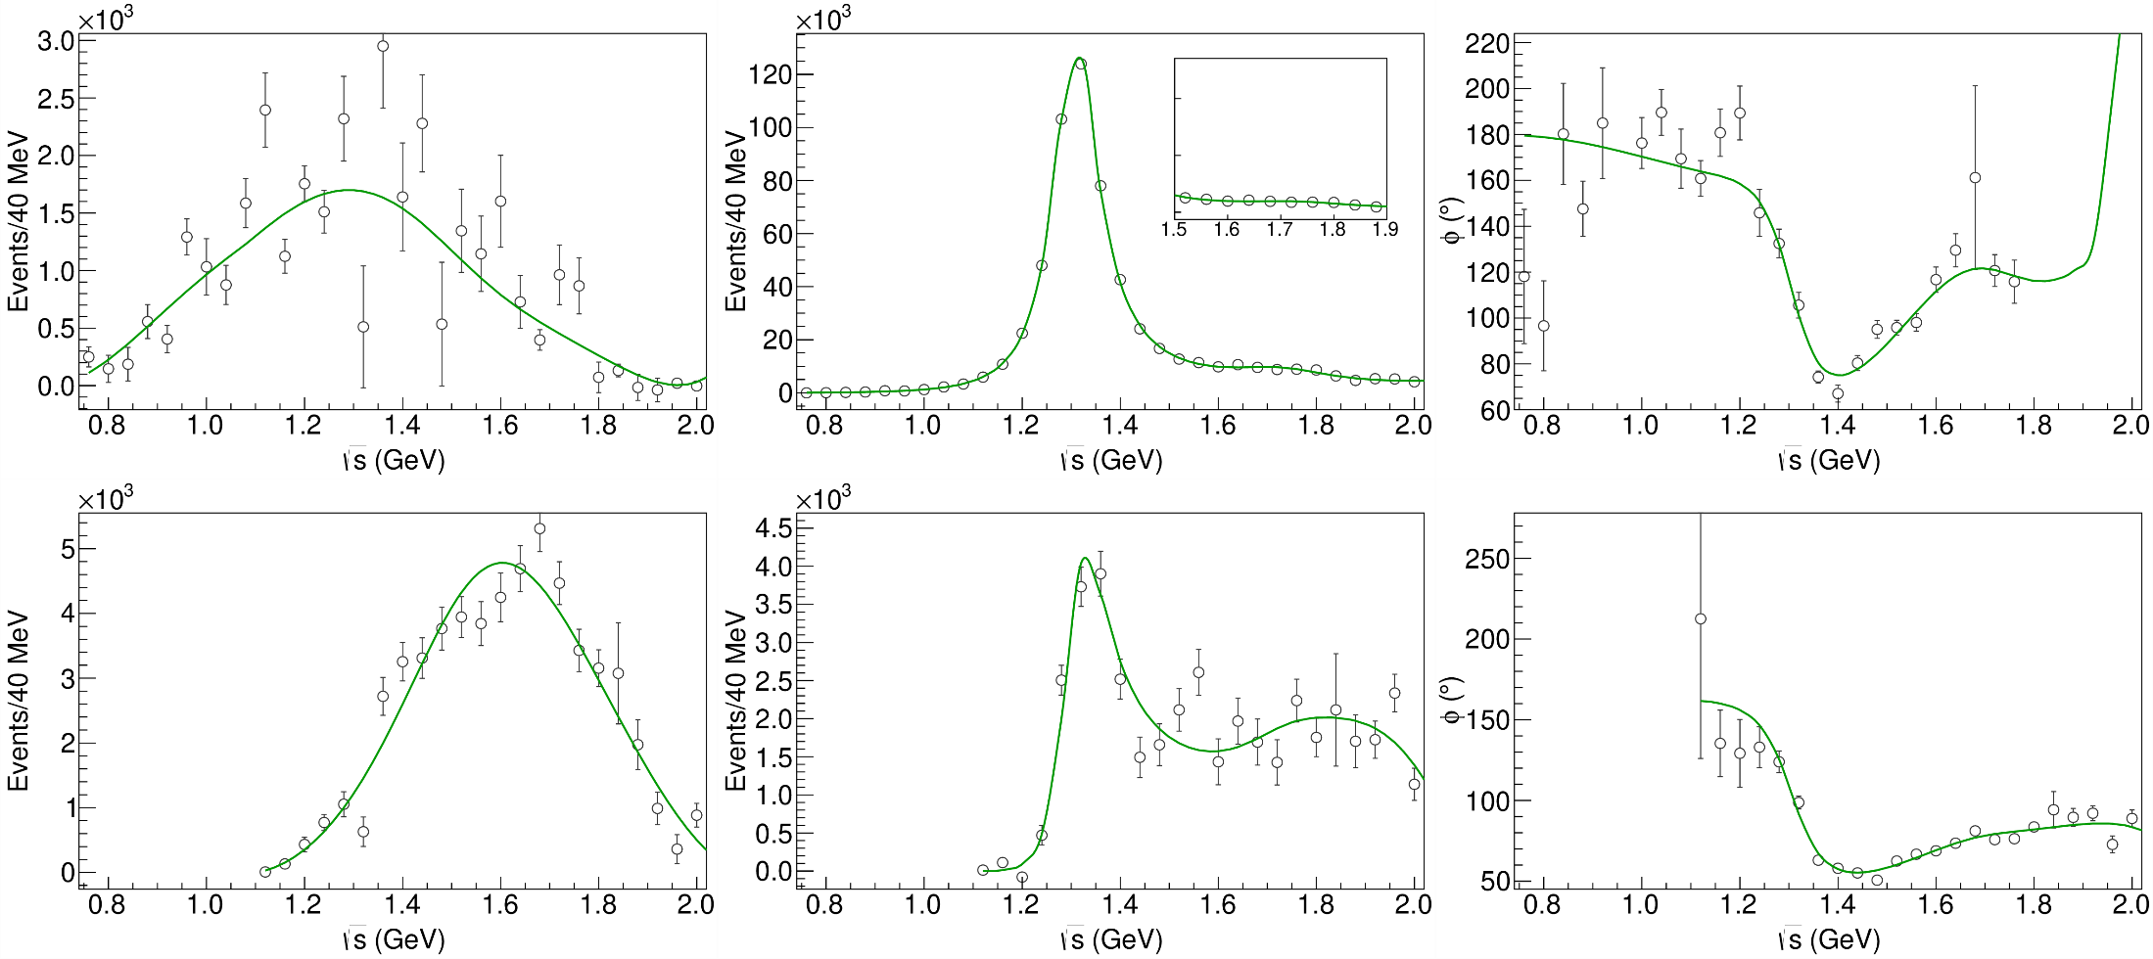
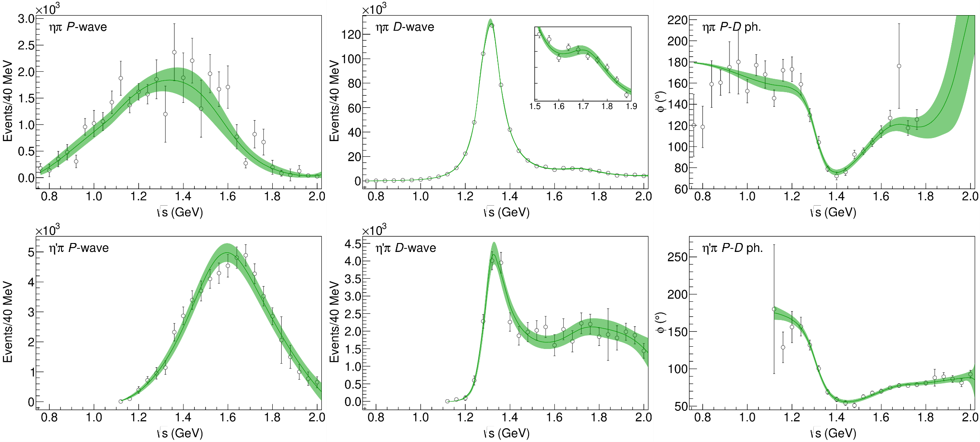
Statistical Bootstrap
A. Pilloni – Challenges in Hadron Spectroscopy
Notes:
Controlla la parte su Regge

Slide 34
Statistical Bootstrap
For each fit, we search poles: two clusters in D-wave: $a_{2}\left(1320\right)$ and $a_{2}^{′}\left(1700\right)$
A. Pilloni – Challenges in Hadron Spectroscopy
Notes:
Controlla la parte su Regge

Slide 35
Statistical Bootstrap
Only one stable cluster in $P$-wave: a single $π_{1}$
A. Pilloni – Challenges in Hadron Spectroscopy
Notes:
Controlla la parte su Regge

Slide 36
Final results
Agreement with Lattice is restored
That’s the most rigorous extraction of an exotic meson available so far!
A. Pilloni – Challenges in Hadron Spectroscopy
Notes:
Controlla la parte su Regge

Slide 37
Open challenges: the $XYZ$ states
AP et al., PLB
Pole
Triangle
Esposito, AP, Polosa, Phys.Rept.
A. Pilloni – Challenges in Hadron Spectroscopy
Notes:
2 slides su Zc, a Bes e a Belle
2 slide su tetraquark model: dall’hamiltoniana di Jaffe al calcolo delle masse
1 slide su molecular models, dove sono i carichi? (non in Tornqvist, si in Hanhart, vedere Braaten, citare Nefediev)
2 slides su decay channels, dove si dovrebbe vedere, e a seconda del modello, vedere qualche plot
1 slide su Y(4260), tetraquark? C’è lo strano (si vede la f0)
1 slide su Zc a cleo (anche il neutro)

Slide 38
Epilogue
Why hadron spectroscopy is important?
To infer the dynamics of QCD building blocks
To reduce the «hadronic uncertainties» in precision physics (e.g. $τ$ EDM, $g_{μ}−2$, CPV in hadronic $B$ decays...)
To answer fundamental questions about confinement and mass generation
Thank you!
A. Pilloni – Challenges in Hadron Spectroscopy
Notes:
2 slides su Zc, a Bes e a Belle
2 slide su tetraquark model: dall’hamiltoniana di Jaffe al calcolo delle masse
1 slide su molecular models, dove sono i carichi? (non in Tornqvist, si in Hanhart, vedere Braaten, citare Nefediev)
2 slides su decay channels, dove si dovrebbe vedere, e a seconda del modello, vedere qualche plot
1 slide su Y(4260), tetraquark? C’è lo strano (si vede la f0)
1 slide su Zc a cleo (anche il neutro)

Slide 39
Backup

Slide 40
Joint Physics Analysis Center
A. Pilloni – The pole hunter

Slide 41
How we probe the forces
We smash particles against each other, the best way of creating new particles
It’s like if in a car accident, the pieces of the collision would create new fancy, expensive cars
(Do not try with your car. Believe me, it’s a bad idea)
A. Pilloni – Challenges in Hadron Spectroscopy

Slide 42
How we probe the forces at CERN
LHC collides protons at $13 \text{TeV}$ (kinetic energy of a mosquito)
A. Pilloni – Challenges in Hadron Spectroscopy

Slide 43
Standard Model Constituents
Standard model is a remarkable simple theory
The particle in the spectrum can easily fit in a table
Lightest massive particle $<3 μ\text{eV}$
Heaviest particle $∼175 \text{GeV}$ (gold atom)
Masses span 17 orders of magnitude
H
Higgs
"Higgs interaction"
125,000
A. Pilloni – Challenges in Hadron Spectroscopy

Slide 44
Standard Model Constituents
According to relativity, the interaction cannot be instantaneous, but is mediated by fields that propagate with finite speed
In relativistic quantum mechanichs, these fields are quantized in particles
The range of the interaction depend on the mass of the mediator,
$λ∼\frac{ℏc}{m}$ (Compton wavelength)
H
Higgs
"Higgs interaction"
125,000
A. Pilloni – Challenges in Hadron Spectroscopy

Slide 45
Quantum ChromoDynamics (QCD)
Quarks appear in 6 flavors, with (very) different masses
Each quark can be in 3 identical colors
$$r,g,b$$
Each gluon can be in 8 colors
$r\overline{g},r\overline{b},b\overline{g}$, $b\overline{r}$,$g\overline{b}$, $g\overline{r}$, $$r\overline{r}−b\overline{b},r\overline{r}+b\overline{b}−2g\overline{g}$$
H
Higgs
"Higgs interaction"
125,000
Gluon is massless. Long range?
Have you ever observed a quark?
A. Pilloni – Challenges in Hadron Spectroscopy

Slide 46
Welcome to Hell
Review of Particle Physics
Only white particles have been observed so far, forming an extremly rich zoo of hadrons
A. Pilloni – Challenges in Hadron Spectroscopy

Slide 47
Flavor symmetry
Hadron appear in approximate degenerate multiplets (group theory needed)
This observation led to the discovery of quark constituents without observing a single quark!
Amplitudes of particles in the same multiplet are related (Wigner-Eckart theorem)
A. Pilloni – Challenges in Hadron Spectroscopy

Slide 48
Pole hunting
I sheet
Bound states on the real axis 1st sheet
Not-so-bound (virtual) states on the real axis 2nd sheet
II sheet
A. Pilloni – Challenges in Hadron Spectroscopy
Notes:
Controlla la parte su Regge

Slide 49
Unitarity
Probability conservation implies ${\left|S\left(E\right)\right|}^{2}=1$
For the amplitude, this turns into
$$f\left(E+iε\right)−f\left(E−iε\right)≠0$$
Branch cut!
Example: $i\sqrt{E}$...
$$i\sqrt{e^{iπ}}=−1$$
$$i\sqrt{1}=i$$
$$i\sqrt{e^{2iπ}}=−i$$
A. Pilloni – Challenges in Hadron Spectroscopy
Notes:
Controlla la parte su Regge

Slide 50
Unitarity
Probability conservation implies ${\left|S\left(E\right)\right|}^{2}=1$
For the amplitude, this turns into
$$f\left(E+iε\right)−f\left(E−iε\right)≠0$$
Branch cut!
Example: $i\sqrt{E}$...
$$i\sqrt{e^{iπ}}=1$$
...but I can decide to get the negative solution
$$i\sqrt{e^{2iπ}}=i$$
$$i\sqrt{1}=−i$$
A. Pilloni – Challenges in Hadron Spectroscopy
Notes:
Controlla la parte su Regge

Slide 51
Unitarity
Probability conservation a branch cut on the real axis, two sheets continuosly connected
A. Pilloni – Challenges in Hadron Spectroscopy
Notes:
Controlla la parte su Regge

Slide 52
Crossing symmetry
$$π^{+}$$
$$K^{+}$$
$$π^{+}$$
$$K^{−}$$
$$π^{+}$$
$$K^{+}$$
$$π^{−}$$
$$K^{−}$$
$$π^{+}$$
$$K^{−}$$
$$π^{+}$$
$$K^{+}$$
All these processes are not independent, but are described by the same amplitude!
Simplification – Complication!
A. Pilloni – Challenges in Hadron Spectroscopy
Notes:
Controlla la parte su Regge

Slide 53
Searching for resonances in $ηπ$
Smooth «background»
Precise determination of pole position
Notes:
Controlla la parte su Regge

Slide 54
Systematic studies
For each class, the maximum deviation of mass and width is taken as a systematic error Deviation smaller than the statistical error are neglected Systematic of different classes are summed in quadrature
A. Pilloni – Determination of the lightest hybrid meson pole
Notes:
Controlla la parte su Regge

Slide 55
Quarkonium orthodoxy
$$Q$$
$$\overline{Q}$$
Potential models
(meaningful when $M_{Q}$ large)
$$α_{s}\left(M_{Q}\right)∼0.3$$
(perturbative regime)
Solve NR Schrödinger eq. → spectrum
A. Pilloni – Challenges in Hadron Spectroscopy
Notes:
2 slides su Zc, a Bes e a Belle
2 slide su tetraquark model: dall’hamiltoniana di Jaffe al calcolo delle masse
1 slide su molecular models, dove sono i carichi? (non in Tornqvist, si in Hanhart, vedere Braaten, citare Nefediev)
2 slides su decay channels, dove si dovrebbe vedere, e a seconda del modello, vedere qualche plot
1 slide su Y(4260), tetraquark? C’è lo strano (si vede la f0)
1 slide su Zc a cleo (anche il neutro)

Slide 56
Example: The charged $Z_{c}\left(3900\right)$
A charged charmonium-like resonance has been claimed by BESIII in 2013.
$e^{+}e^{−}→Z_{c}{\left(3900\right)}^{+}π^{−}→J/ψ{ π}^{+}π^{−}$ and $→{\left(DD^{∗}\right)}^{+}π^{−}$ $M=3888.7±3.4$MeV, $Γ=35±7$ MeV
Such a state would require a minimal 4q content and would be manifestly exotic
A. Pilloni – Challenges in Hadron Spectroscopy
Notes:
Y(4260), M=4263 +- 5, Gamma = 95+-14
D_1(2420)^0, M=2421.3 ±0.6, Gamma =27.1 ±2.7
D_1(2420)^+-, M=2423.4 ±3.1, Gamma =25 ±6
I D_1 hanno J^P = 1^+
La molecola D_1 D sta 22 MeV sotto
Se la Y è D_1 D, il pione lega fortemente, come fa la Y a essere così larga?
Come funziona lo scambio del pione???

Slide 57
Amplitude analysis for $Z_{c}(3900)$
One can test different parametrizations of the amplitude, which correspond to different singularities → different natures
AP et al. (JPAC), PLB772, 200
$$Z_{c}\left(3900\right)?$$
$${u: D}_{0}(2400)$$
$${u:Z}_{c}\left(3900\right)?$$
$$"σ, f_{0}(980)"$$
$$D_{1}(2420)$$
Triangle rescattering, logarithmic branching point
(anti)bound state, II/IV sheet pole
(«molecule»)
Resonance, III sheet pole
(«compact state»)
$$π$$
$$D_{1}$$
$$Y$$
$$D^{∗}$$
$$π$$
$$\overline{D}$$
$$J/ψ$$
Tornqvist, Z.Phys. C61, 525
Swanson, Phys.Rept. 429
Hanhart et al. PRL111, 132003
Maiani et al., PRD71, 014028
Faccini et al., PRD87, 111102
Esposito et al., Phys.Rept. 668
Szczepaniak, PLB747, 410
A. Pilloni – Challenges in Hadron Spectroscopy
Notes:
Controlla la parte su Regge

Slide 58
Fit: III
A. Pilloni – Challenges in Hadron Spectroscopy
Notes:
Controlla la parte su Regge

Slide 59
Fit: III+tr.
A. Pilloni – Challenges in Hadron Spectroscopy
Notes:
Controlla la parte su Regge

Slide 60
Fit: IV+tr.
A. Pilloni – Challenges in Hadron Spectroscopy
Notes:
Controlla la parte su Regge

Slide 61
Fit: tr.
A. Pilloni – Challenges in Hadron Spectroscopy
Notes:
Controlla la parte su Regge

Slide 62
Pole extraction
III
III+tr.
IV+tr.
A. Pilloni – Challenges in Hadron Spectroscopy
Not conclusive at this stage
Notes:
Controlla la parte su Regge

Slide 63
Finite energy sum rules
PWA in the low energy region
Resonance extraction
Analytically connected
Regge exchanges at high energy
A. Pilloni – Challenges in Hadron Spectroscopy
Notes:
Controlla la parte su Regge

Slide 64
Pole hunting
I sheet
Extracting physics information means to hunt for poles in the complex plane
Pole position → Mass and width
Residues → Couplings
Virtual state
II sheet
Bound state
Resonance
A. Pilloni – Challenges in Hadron Spectroscopy
Notes:
Controlla la parte su Regge

Slide 65
$X(3872)$
Discovered in $B→K X→K J/ψ ππ$
Quantum numbers $1^{++}$
Very close to $DD^{∗}$ threshold
Too narrow for an above-treshold charmonium
Isospin violation too big $\frac{Γ\left(X→J/ψ ω\right)}{Γ\left(X→J/ψ ρ\right)}\sim 0.8±0.3$
Mass prediction not compatible with $χ_{c1}(2P)$
$M=3871.68±0.17$MeV
$$M_{X}−M_{DD^{∗}}=−3±192 \text{keV}$$
$Γ<1.2 \text{MeV}\text{ @90\%}$
A. Pilloni – Challenges in Hadron Spectroscopy

Slide 66
$X(3872)$
Large prompt production at hadron colliders
$$σ_{B}/σ_{TOT}=\left(26.3±2.3±1.6\right)\%$$
$$σ_{PR}×B(X→J/ψππ)=\left(1.06±0.11±0.15\right) \text{nb}$$
CMS, JHEP 1304, 154
A. Pilloni – Challenges in Hadron Spectroscopy

Slide 67
Vector $Y$ states
Lots of unexpected ${J^{PC}=1}^{−−}$ states found in ISR/direct production (and nowhere else!)
Seen in few final states, mostly $J/ψ ππ$ and $ψ\left(2S\right) ππ$
Not seen decaying into open charm pairs
Large HQSS violation
Belle $J/ψππ$
BES $h_{c}ππ$
A. Pilloni – Challenges in Hadron Spectroscopy
Notes:
Y(4260), M=4263 +- 5, Gamma = 95+-14
D_1(2420)^0, M=2421.3 ±0.6, Gamma =27.1 ±2.7
D_1(2420)^+-, M=2423.4 ±3.1, Gamma =25 ±6
I D_1 hanno J^P = 1^+
La molecola D_1 D sta 22 MeV sotto
Se la Y è D_1 D, il pione lega fortemente, come fa la Y a essere così larga?
Come funziona lo scambio del pione???

Slide 68
Vector $Y$ states in BESIII
BESIII, PRL118, 092002 (2017)
BESIII, PRL118, 092001 (2017)
$$e^{+}e^{−}→J/ψ ππ$$
$$e^{+}e^{−}→h_{c} ππ$$
New BESIII data show a peculiar lineshape for the $Y(4260)$
The state appear lighter and narrower, compatible with the ones in $h_{c}ππ$ and $χ_{c0}ω$
A broader old-fashioned $Y(4260)$ is appearing in $\overline{D}D^{∗}π$, maybe indicating a ${\overline{D}D}_{1}$
dominance
$$e^{+}e^{−}→π^{+}D^{0}D^{∗−}$$
A. Pilloni – Challenges in Hadron Spectroscopy
Notes:
Y(4260), M=4263 +- 5, Gamma = 95+-14
D_1(2420)^0, M=2421.3 ±0.6, Gamma =27.1 ±2.7
D_1(2420)^+-, M=2423.4 ±3.1, Gamma =25 ±6
I D_1 hanno J^P = 1^+
La molecola D_1 D sta 22 MeV sotto
Se la Y è D_1 D, il pione lega fortemente, come fa la Y a essere così larga?
Come funziona lo scambio del pione???
Close propone che la Y è D_1 D^* col pione scambiato in onda S,
La Y però non va in Ds come se fosse tetraquark

Slide 69
Charged $Z$ states: $Z_{c}\left(3900\right), Z_{c}^{′}(4020)$
Charged quarkonium-like resonances have been found, 4q needed
Two states $J^{PC}=1^{+−}$ appear slightly above $D^{(∗)}D^{∗}$ thresholds
$e^{+}e^{−}→Z_{c}{\left(3900\right)}^{+}π^{−}→J/ψ{ π}^{+}π^{−}$ and $→{\left(DD^{∗}\right)}^{+}π^{−}$ $M=3888.7±3.4$MeV, $Γ=35±7$ MeV
$e^{+}e^{−}→Z_{c}^{′}{\left(4020\right)}^{+}π^{−}→h_{c}{ π}^{+}π^{−}$ and $→{\overline{D}}^{∗0}D^{∗+}π^{−}$
$M=4023.9±2.4$MeV, $Γ=10±6$ MeV
A. Pilloni – Challenges in Hadron Spectroscopy
Notes:
Y(4260), M=4263 +- 5, Gamma = 95+-14
D_1(2420)^0, M=2421.3 ±0.6, Gamma =27.1 ±2.7
D_1(2420)^+-, M=2423.4 ±3.1, Gamma =25 ±6
I D_1 hanno J^P = 1^+
La molecola D_1 D sta 22 MeV sotto
Se la Y è D_1 D, il pione lega fortemente, come fa la Y a essere così larga?
Come funziona lo scambio del pione???

Slide 70
Charged $Z$ states: $Z_{b}\left(10610\right), Z_{b}^{′}(10650)$
Anomalous dipion width in $Υ\left(5S\right)$,
2 orders of magnitude larger than $Υ\left(nS\right)$
Moreover, observed $Υ\left(5S\right)→h_{b}\left(nP\right)ππ$ which violates HQSS
$Υ\left(5S\right)→Z_{b}{\left(10610\right)}^{+}π^{−}→Υ\left(nS\right){ π}^{+}π^{−},h_{b}\left(nP\right){ π}^{+}π^{−}$ and $→{\left(BB^{∗}\right)}^{+}π^{−}$ $M=10607.2±2.0$MeV, $Γ=18.4±2.4$ MeV
$Υ\left(5S\right)→Z_{b}^{′}{\left(10650\right)}^{+}π^{−}→Υ\left(nS\right){ π}^{+}π^{−},h_{b}\left(nP\right){ π}^{+}π^{−}$ and $→{\overline{B}}^{∗0}B^{∗+}π^{−}$
$M=10652.2±1.5$MeV, $Γ=11.5±2.2$ MeV
2 twin resonances!
A. Pilloni – Challenges in Hadron Spectroscopy
Notes:
Y(4260), M=4263 +- 5, Gamma = 95+-14
D_1(2420)^0, M=2421.3 ±0.6, Gamma =27.1 ±2.7
D_1(2420)^+-, M=2423.4 ±3.1, Gamma =25 ±6
I D_1 hanno J^P = 1^+
La molecola D_1 D sta 22 MeV sotto
Se la Y è D_1 D, il pione lega fortemente, come fa la Y a essere così larga?
Come funziona lo scambio del pione???

Slide 71
Pentaquarks!
LHCb, PRL 115, 072001
LHCb, PRL 117, 082003
Two states seen in $Λ_{b}→\left(J/ψ p\right) K^{−}$,
evidence in $Λ_{b}→\left(J/ψ p\right) π^{−}$
$$M_{1}=4380±8±29 \text{MeV} \\ Γ_{1}=205±18±86 \text{MeV}$$
$$M_{2}=4449.8±1.7±2.5 \text{MeV} \\ Γ_{2}=39±5±19 \text{MeV}$$
Quantum numbers $$J^{P}=\left({\frac{3}{2}}^{−},{\frac{5}{2}}^{+}\right) \text{or}\left({\frac{3}{2}}^{+},{\frac{5}{2}}^{−}\right)\text{or}\left({\frac{5}{2}}^{+},{\frac{3}{2}}^{−}\right)$$
Opposite parities needed for the interference to correctly describe angular distributions, low mass region contaminated by $Λ^{∗}$ (model dependence?)
No obvious threshold nearby
A. Pilloni – Challenges in Hadron Spectroscopy
Notes:
Y(4260), M=4263 +- 5, Gamma = 95+-14
D_1(2420)^0, M=2421.3 ±0.6, Gamma =27.1 ±2.7
D_1(2420)^+-, M=2423.4 ±3.1, Gamma =25 ±6
I D_1 hanno J^P = 1^+
La molecola D_1 D sta 22 MeV sotto
Se la Y è D_1 D, il pione lega fortemente, come fa la Y a essere così larga?
Come funziona lo scambio del pione???

Slide 72
Pentaquarks!
LHCb, PRL 115, 072001
LHCb, PRL 117, 082003
Two states seen in $Λ_{b}→\left(J/ψ p\right) K^{−}$,
evidence in $Λ_{b}→\left(J/ψ p\right) π^{−}$
$$M_{1}=4380±8±29 \text{MeV} \\ Γ_{1}=205±18±86 \text{MeV}$$
$$M_{2}=4449.8±1.7±2.5 \text{MeV} \\ Γ_{2}=39±5±19 \text{MeV}$$
Quantum numbers $$J^{P}=\left({\frac{3}{2}}^{−},{\frac{5}{2}}^{+}\right) \text{or}\left({\frac{3}{2}}^{+},{\frac{5}{2}}^{−}\right)\text{or}\left({\frac{5}{2}}^{+},{\frac{3}{2}}^{−}\right)$$
Opposite parities needed for the interference to correctly describe angular distributions, low mass region contaminated by $Λ^{∗}$ (model dependence?)
No obvious threshold nearby
MC simul.
A. Pilloni – Challenges in Hadron Spectroscopy
Notes:
Y(4260), M=4263 +- 5, Gamma = 95+-14
D_1(2420)^0, M=2421.3 ±0.6, Gamma =27.1 ±2.7
D_1(2420)^+-, M=2423.4 ±3.1, Gamma =25 ±6
I D_1 hanno J^P = 1^+
La molecola D_1 D sta 22 MeV sotto
Se la Y è D_1 D, il pione lega fortemente, come fa la Y a essere così larga?
Come funziona lo scambio del pione???

