Slide 1
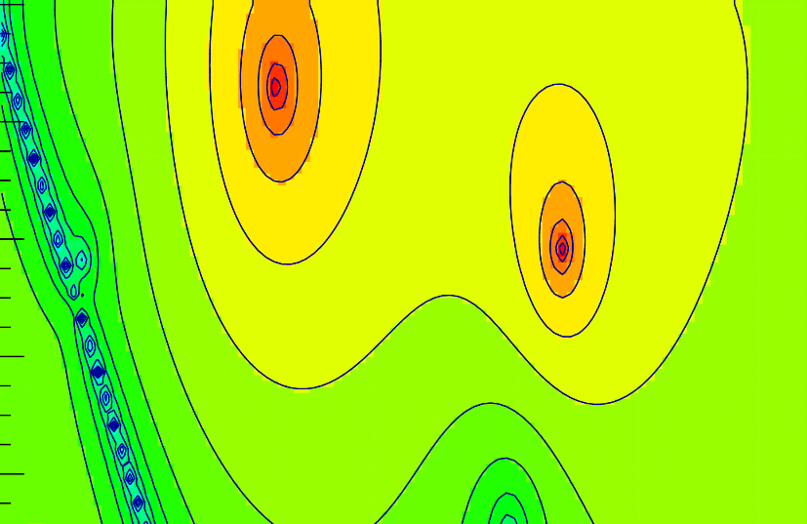
Alessandro Pilloni
ECT*, February 20th 2019
THE POLE HUNTER

Slide 2
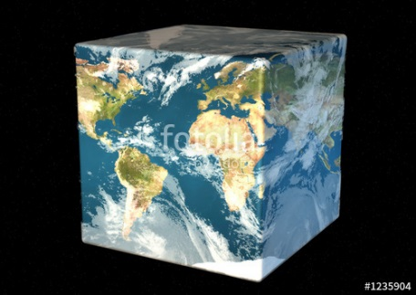
Hadron Spectroscopy
Hybrids
Tetraquark
Meson
Baryon
Glueball
$$π$$
$$π$$
$$J/ψ$$
$$π$$
Hadroquarkonium
Molecule
Experiment
Data
Amplitude analysis
Properties,
Model building
Lattice QCD
Interpretations on the spectrum leads to understanding fundamental laws of nature

Slide 3
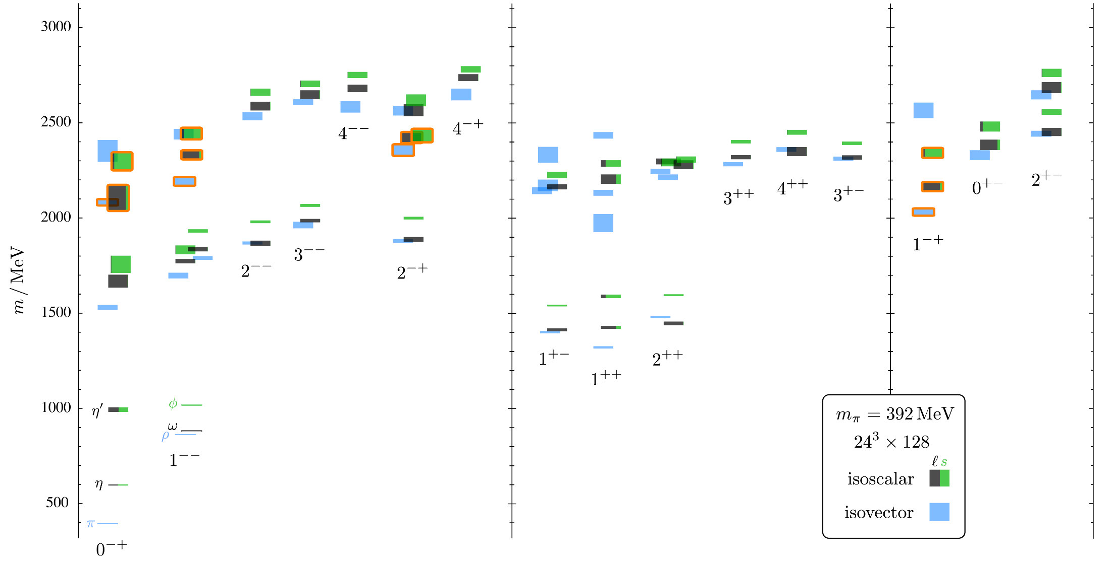
Light spectrum (1-particle correlators)
HadSpec PRD88, 094505
$$π_{1}(1600)$$
The higher the mass, the more channels open
$$a_{1}(1260)$$
A. Pilloni – The pole hunter
Notes:
2 slides su Zc, a Bes e a Belle
2 slide su tetraquark model: dall’hamiltoniana di Jaffe al calcolo delle masse
1 slide su molecular models, dove sono i carichi? (non in Tornqvist, si in Hanhart, vedere Braaten, citare Nefediev)
2 slides su decay channels, dove si dovrebbe vedere, e a seconda del modello, vedere qualche plot
1 slide su Y(4260), tetraquark? C’è lo strano (si vede la f0)
1 slide su Zc a cleo (anche il neutro)

Slide 4
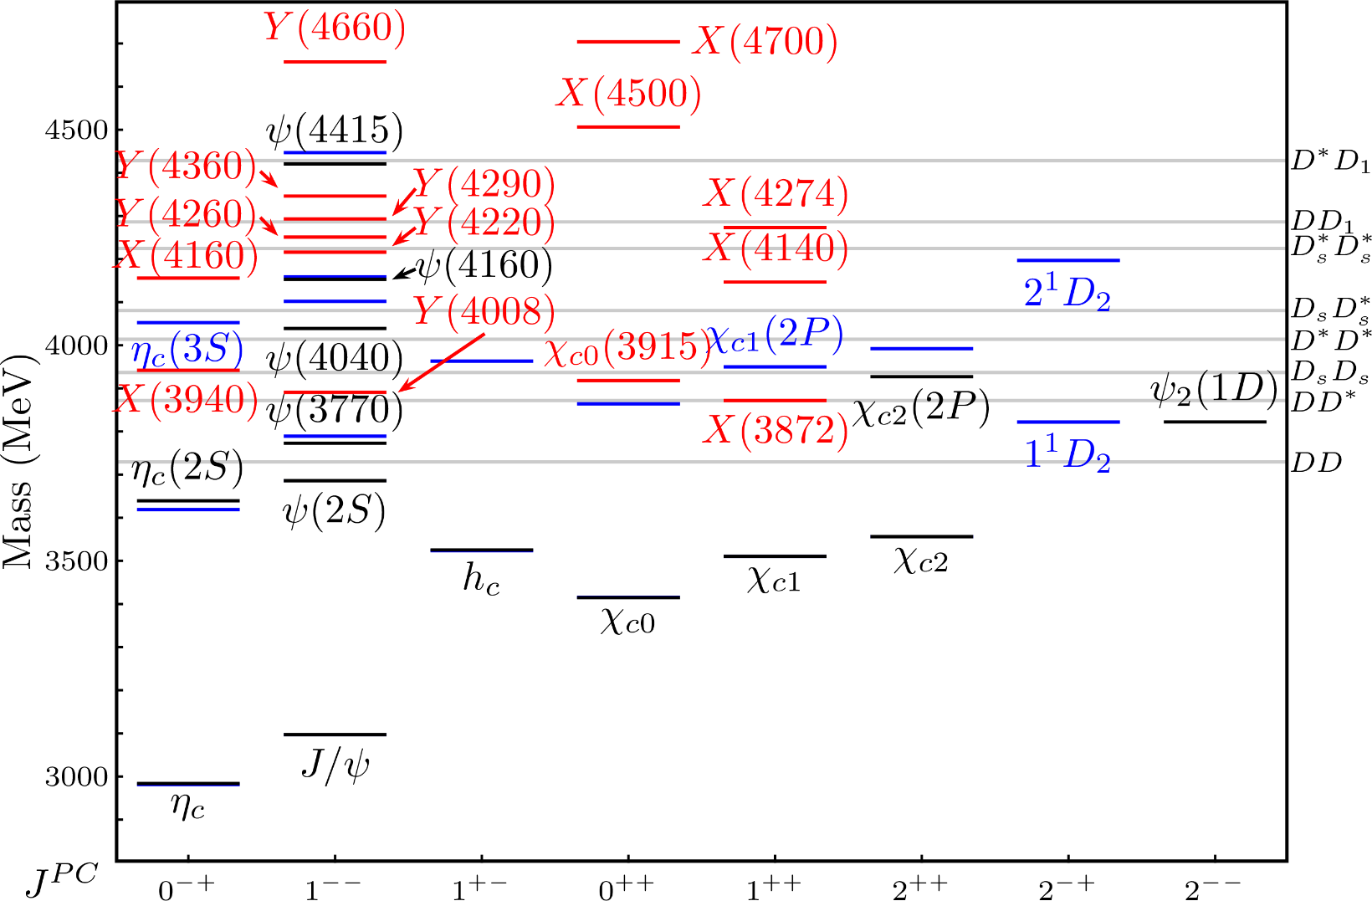
The heavy sector: XYZ states
Esposito, AP, Polosa, Phys.Rept. 668
A host of unexpected resonances have appeared
decaying mostly into charmonium + light
Hardly reconciled with usual charmonium interpretation
A. Pilloni – The pole hunter
Notes:
2 slides su Zc, a Bes e a Belle
2 slide su tetraquark model: dall’hamiltoniana di Jaffe al calcolo delle masse
1 slide su molecular models, dove sono i carichi? (non in Tornqvist, si in Hanhart, vedere Braaten, citare Nefediev)
2 slides su decay channels, dove si dovrebbe vedere, e a seconda del modello, vedere qualche plot
1 slide su Y(4260), tetraquark? C’è lo strano (si vede la f0)
1 slide su Zc a cleo (anche il neutro)

Slide 5
A. Pilloni – Challenges in Hadron Spectroscopy

Slide 6
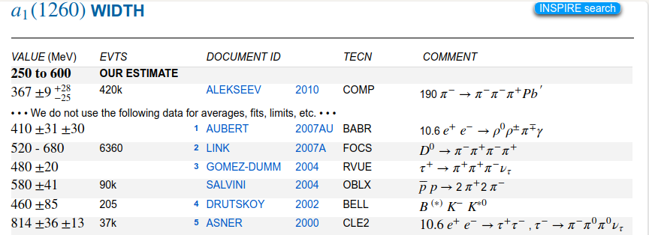
A. Pilloni – Challenges in Hadron Spectroscopy
Notes:
2 slides su Zc, a Bes e a Belle
2 slide su tetraquark model: dall’hamiltoniana di Jaffe al calcolo delle masse
1 slide su molecular models, dove sono i carichi? (non in Tornqvist, si in Hanhart, vedere Braaten, citare Nefediev)
2 slides su decay channels, dove si dovrebbe vedere, e a seconda del modello, vedere qualche plot
1 slide su Y(4260), tetraquark? C’è lo strano (si vede la f0)
1 slide su Zc a cleo (anche il neutro)

Slide 7
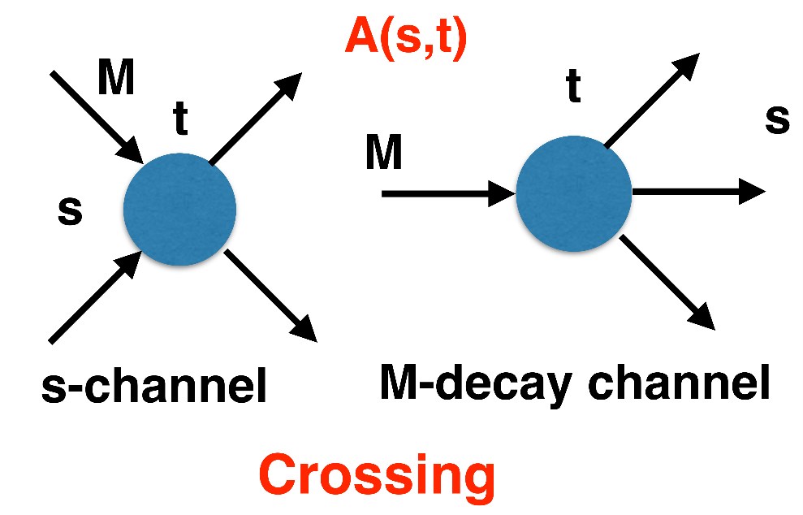
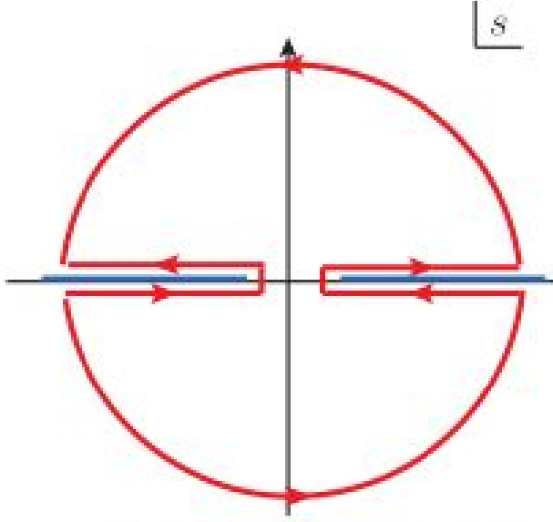
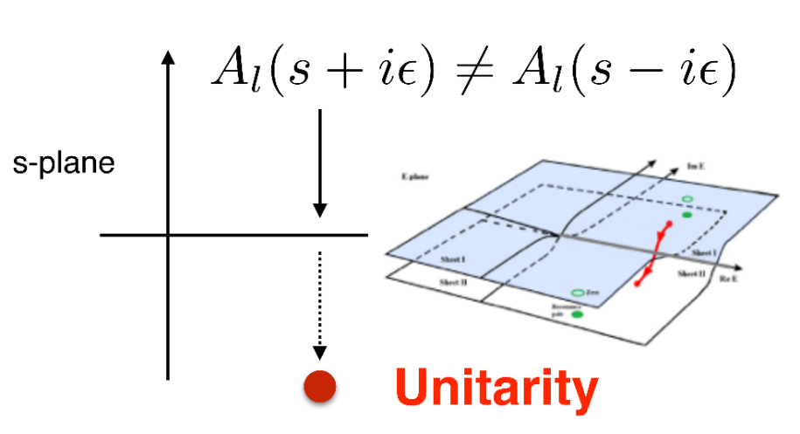
$S$-Matrix principles
$$t_{l}\left(s\right)=\lim_{ε→0}t_{l}(s+iε)⁡$$
Analyticity
$$\text{Im} t_{l}=ρ_{l}{\left|t_{l}\right|}^{2} ⁡$$
Unitarity opens a cut on the real axis
Resonances (QCD states) are poles in the unphysical Riemann sheets
Unitarity controls the interference pattern between resonances and background
+ Lorentz, discrete & global symmetries
A. Pilloni – The pole hunter
Notes:
Controlla la parte su Regge

Slide 8
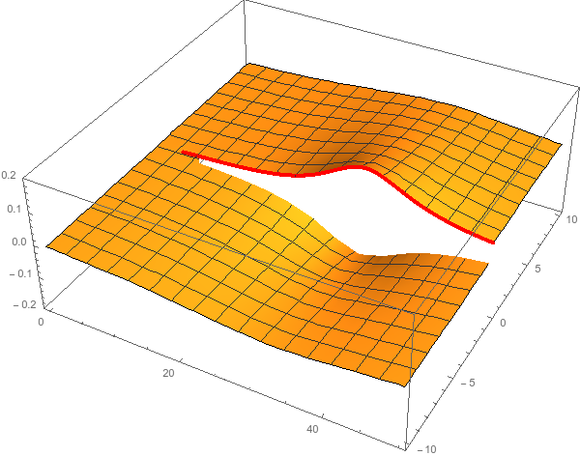
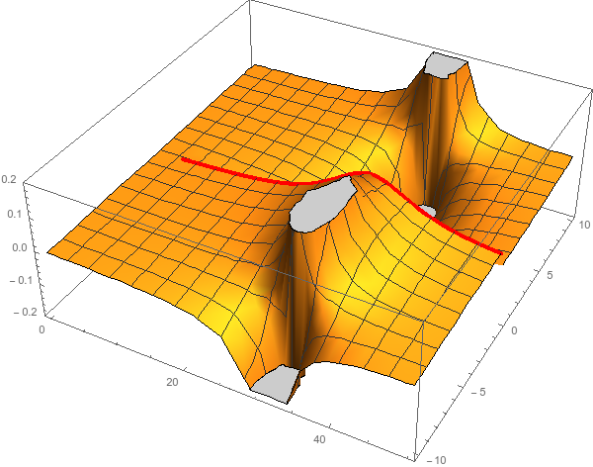
Unitarity & Pole hunting
Unitarity creates a branch cut on the real axis, two sheets continuosly connected
I sheet
II sheet
Finding resonances means writing analytic amplitude, and hunting for poles in the complex plane
A. Pilloni – Challenges in Hadron Spectroscopy
Notes:
Controlla la parte su Regge

Slide 9
The hybrid $π_{1}$
A. Pilloni – The pole hunter
Notes:
2 slides su Zc, a Bes e a Belle
2 slide su tetraquark model: dall’hamiltoniana di Jaffe al calcolo delle masse
1 slide su molecular models, dove sono i carichi? (non in Tornqvist, si in Hanhart, vedere Braaten, citare Nefediev)
2 slides su decay channels, dove si dovrebbe vedere, e a seconda del modello, vedere qualche plot
1 slide su Y(4260), tetraquark? C’è lo strano (si vede la f0)
1 slide su Zc a cleo (anche il neutro)

Slide 10
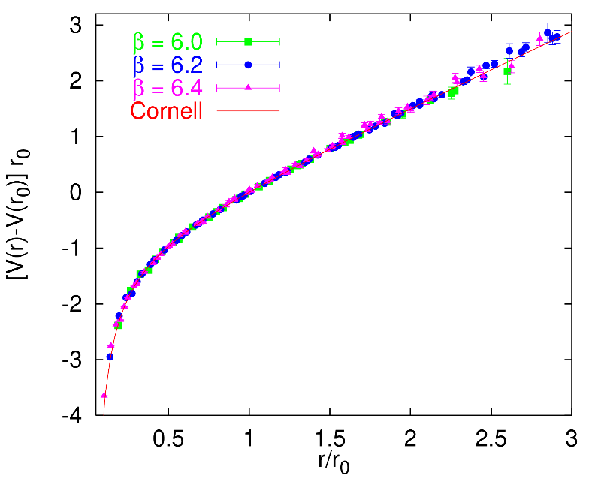
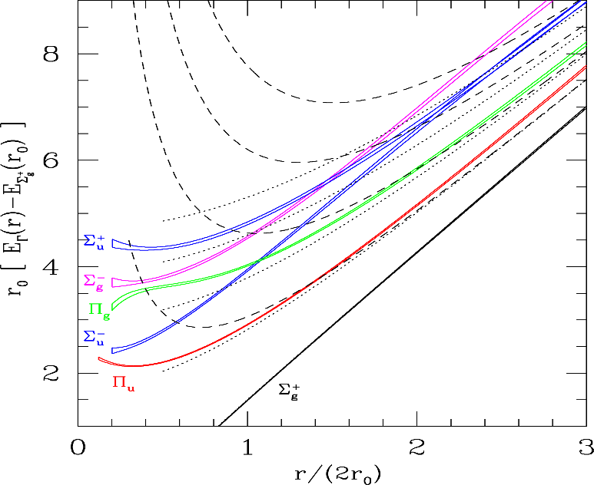
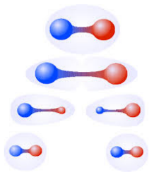
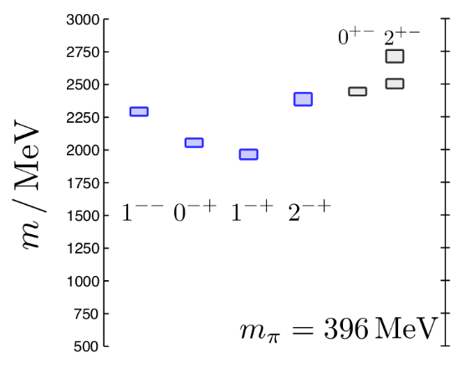
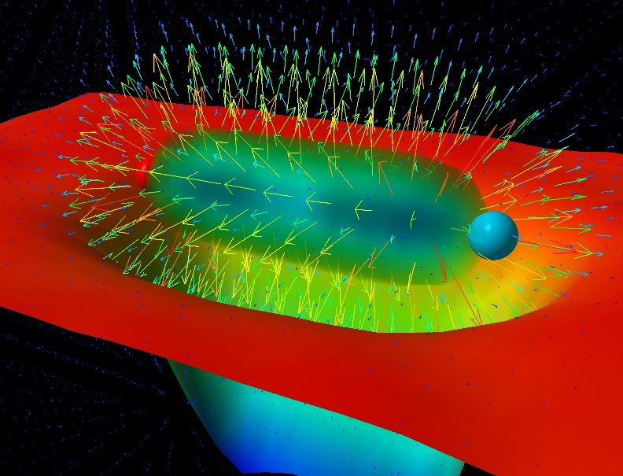
Learning about confinement
If quarks were infinitely heavy, gluonic field is confined in a string
Linear rising potential
What is a constituent gluon?
vibration of the string? → degenerate $J^{PC}={\left(0,1,2\right)}^{−+},{\left(0,1,2\right)}^{+−}$
excitation of a quasiparticle? → degenerate $J^{PC}={\left(0,1,2\right)}^{−+},1^{−−}$
G. Bali
C. Morningstar
J. Dudek
excitation of a quasiparticle! → degenerate $J^{PC}={\left(0,1,2\right)}^{−+},1^{−−}$ says Lattice QCD...
What about real data?
D. Leinweber
A. Pilloni – Challenges in Hadron Spectroscopy
Notes:
Controlla la parte su Regge

Slide 11
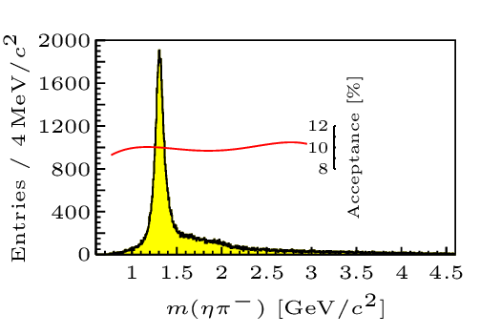
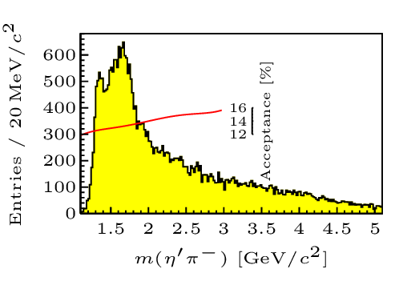
Hybrid hunting
Excited gluon, $$J^{PC}=1^{+−}$$ mass $∼1.0\text{−}1.5 \text{GeV}$
$$\overline{r}$$
$$\overline{g}$$
$$r$$
$$g$$
Look for a $π_{1}$ state with $J^{PC}=1^{−+}$
decaying into $\left\{\begin{matrix}η π \text{and} η^{′}π \\ ρ π→3π \\ b_{1}π→5π\end{matrix}\right.$
Small signal in data
A. Pilloni – Challenges in hadron spectroscopy
Notes:
2 slides su Zc, a Bes e a Belle
2 slide su tetraquark model: dall’hamiltoniana di Jaffe al calcolo delle masse
1 slide su molecular models, dove sono i carichi? (non in Tornqvist, si in Hanhart, vedere Braaten, citare Nefediev)
2 slides su decay channels, dove si dovrebbe vedere, e a seconda del modello, vedere qualche plot
1 slide su Y(4260), tetraquark? C’è lo strano (si vede la f0)
1 slide su Zc a cleo (anche il neutro)

Slide 12
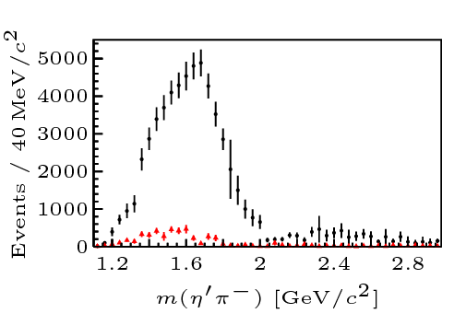
Two hybrid states???
A hybrid meson ($8⊗8$) cannot decay into $ηπ$ in the SU(3) limit
Tetraquark ($10⊕\overline{10}$)? Requires doubly charged
A. Pilloni – Challenges in Hadron Spectroscopy
Notes:
2 slides su Zc, a Bes e a Belle
2 slide su tetraquark model: dall’hamiltoniana di Jaffe al calcolo delle masse
1 slide su molecular models, dove sono i carichi? (non in Tornqvist, si in Hanhart, vedere Braaten, citare Nefediev)
2 slides su decay channels, dove si dovrebbe vedere, e a seconda del modello, vedere qualche plot
1 slide su Y(4260), tetraquark? C’è lo strano (si vede la f0)
1 slide su Zc a cleo (anche il neutro)

Slide 13
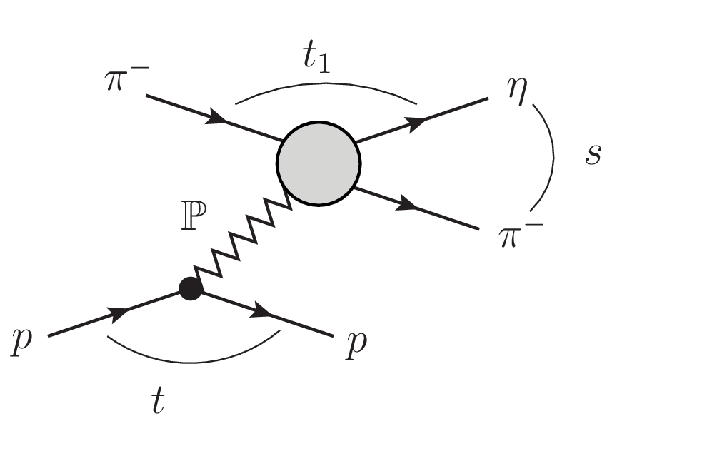
Amplitudes for $η^{(′)}π$
We build the partial wave amplitudes according to the $N/D$ method
Production amplitude $a(s)$
Scattering amplitude $t(s)$
$$\text{Im} a\left(s\right)=ρ a\left(s\right){ t}^{∗}\left(s\right)$$
$$\frac{dσ}{d\sqrt{s}}∝\frac{ρ}{\sqrt{s}}{\left|p^{L}q^{L−1} a\left(s\right)\right|}^{2}$$
A. Pilloni – The pole hunter
Notes:
Controlla la parte su Regge

Slide 14
Amplitudes for $η^{(′)}π$
We build the partial wave amplitudes according to the $N/D$ method
Production amplitude $a(s)$
$a(s)$ is an effective $2→2$ process, where the Pomeron is treated as a vector quasi-particle with virtuality $t_{\text{eff}}=−0.1 {\text{GeV}}^{2}$
Scattering amplitude $t(s)$
A. Pilloni – The pole hunter
Notes:
Controlla la parte su Regge

Slide 15
Amplitudes for $η^{(′)}π$
We build the partial wave amplitudes according to the $N/D$ method
Production amplitude $a(s)$
$$t\left(s\right)=\frac{N\left(s\right)}{D\left(s\right)},a\left(s\right)=\frac{n\left(s\right)}{D\left(s\right)}$$
$$D(s)$$
$$n(s)$$
Scattering amplitude $t(s)$
The $D(s)$ has only right hand cuts;
it contains all the Final State Interactions constrained by unitarity → universal
$$\text{Im} D\left(s\right)=−ρ N(s)$$
$$D(s)$$
$$N(s)$$
A. Pilloni – The pole hunter
Notes:
Controlla la parte su Regge

Slide 16
Amplitudes for $η^{(′)}π$
We build the partial wave amplitudes according to the $N/D$ method
Production amplitude $a(s)$
$$t\left(s\right)=\frac{N\left(s\right)}{D\left(s\right)},a\left(s\right)=\frac{n\left(s\right)}{D\left(s\right)}$$
$$D(s)$$
$$n(s)$$
Scattering amplitude $t(s)$
The $n\left(s\right),N(s)$ have left hand cuts only, they depend on the exchanges → process-dependent, smooth
$$D(s)$$
$$N(s)$$
A. Pilloni – The pole hunter
Notes:
Controlla la parte su Regge

Slide 17
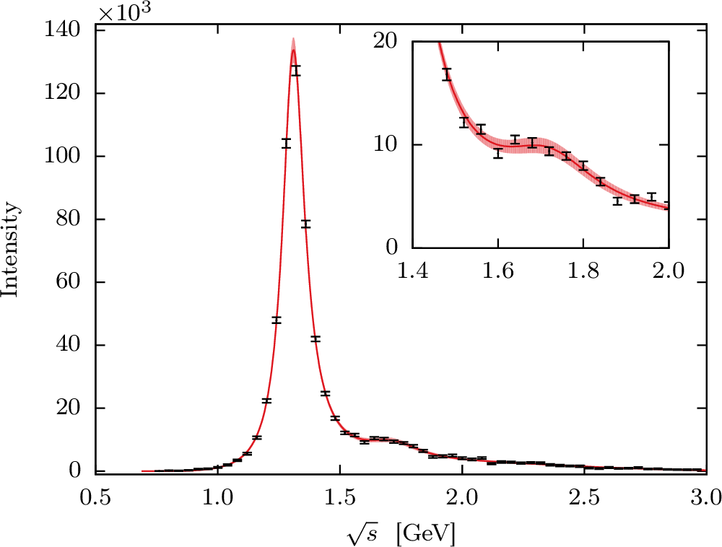
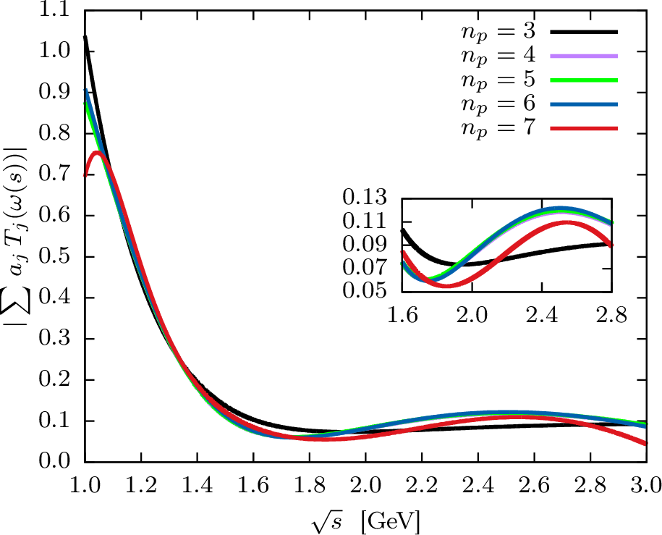
Recap: single channel $ηπ$
Test against the $D$-wave $ηπ$data, where the $a_{2}$ and the $a_{2}^{′}$ show up
A. Jackura, M. Mikhasenko, AP et al. (JPAC & COMPASS), PLB
Smooth «background»
Precise determination of pole position
Notes:
Controlla la parte su Regge

Slide 18
Coupled channel: the model
A. Rodas, AP et al. PRL
Two channels, $i,k=ηπ, η^{′}π$ Two waves, $J=P,D$ 37 fit parameters
1 K-matrix pole for the P-wave
2 K-matrix poles for the D-wave
Left-hand scale (Blatt-Weisskopf radius) $s_{R}=s_{0}=1 {\text{GeV}}^{2}$
$α=2$ as in the single channel, 3rd order polynomial for $n_{k}^{J}(s)$
A. Pilloni – The pole hunter
Notes:
Controlla la parte su Regge

Slide 19
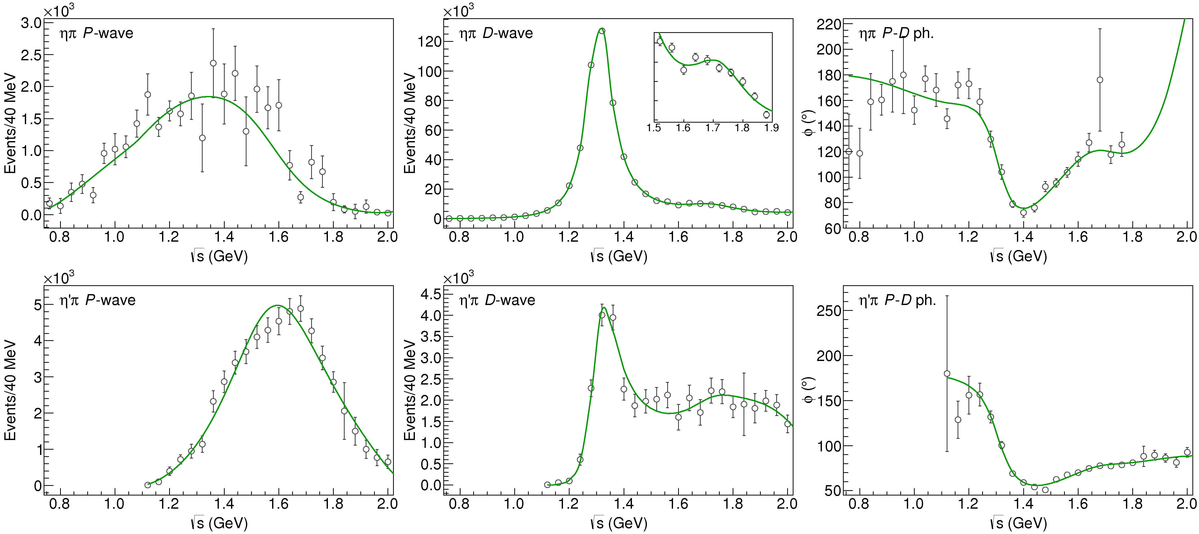
Fit to $η^{(′)}π$
$$π_{1}\left(1400\right)?$$
$$a_{2}\left(1320\right)$$
$$a_{2}^{′}\left(1700\right)$$
$$π_{1}\left(1600\right)?$$
$$a_{2}\left(1320\right)$$
$$a_{2}^{′}\left(1700\right)$$
$$J^{PC}=1^{−+}$$
$$J^{PC}=2^{++}$$
$$χ^{2}/\text{dof}=162/122∼1.3$$
A. Pilloni – Challenges in Hadron Spectroscopy
Notes:
Controlla la parte su Regge

Slide 20
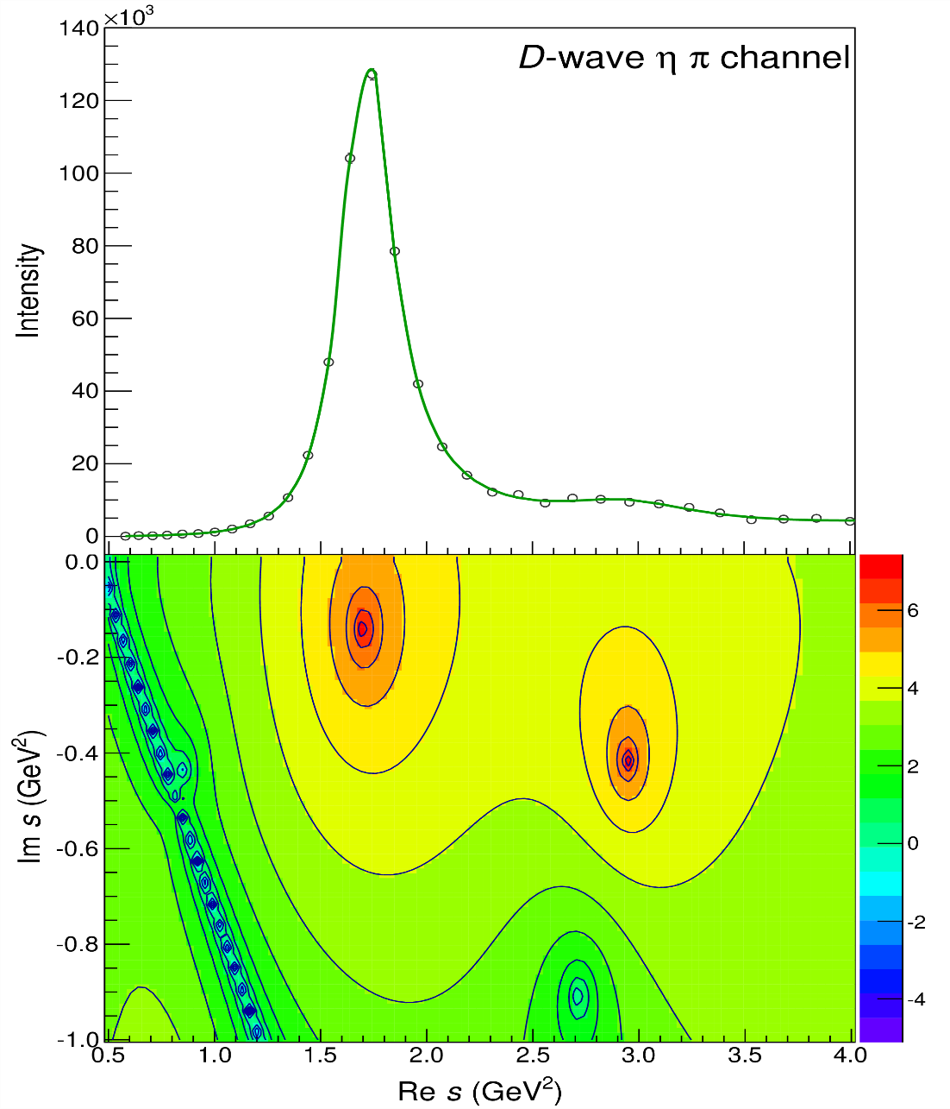
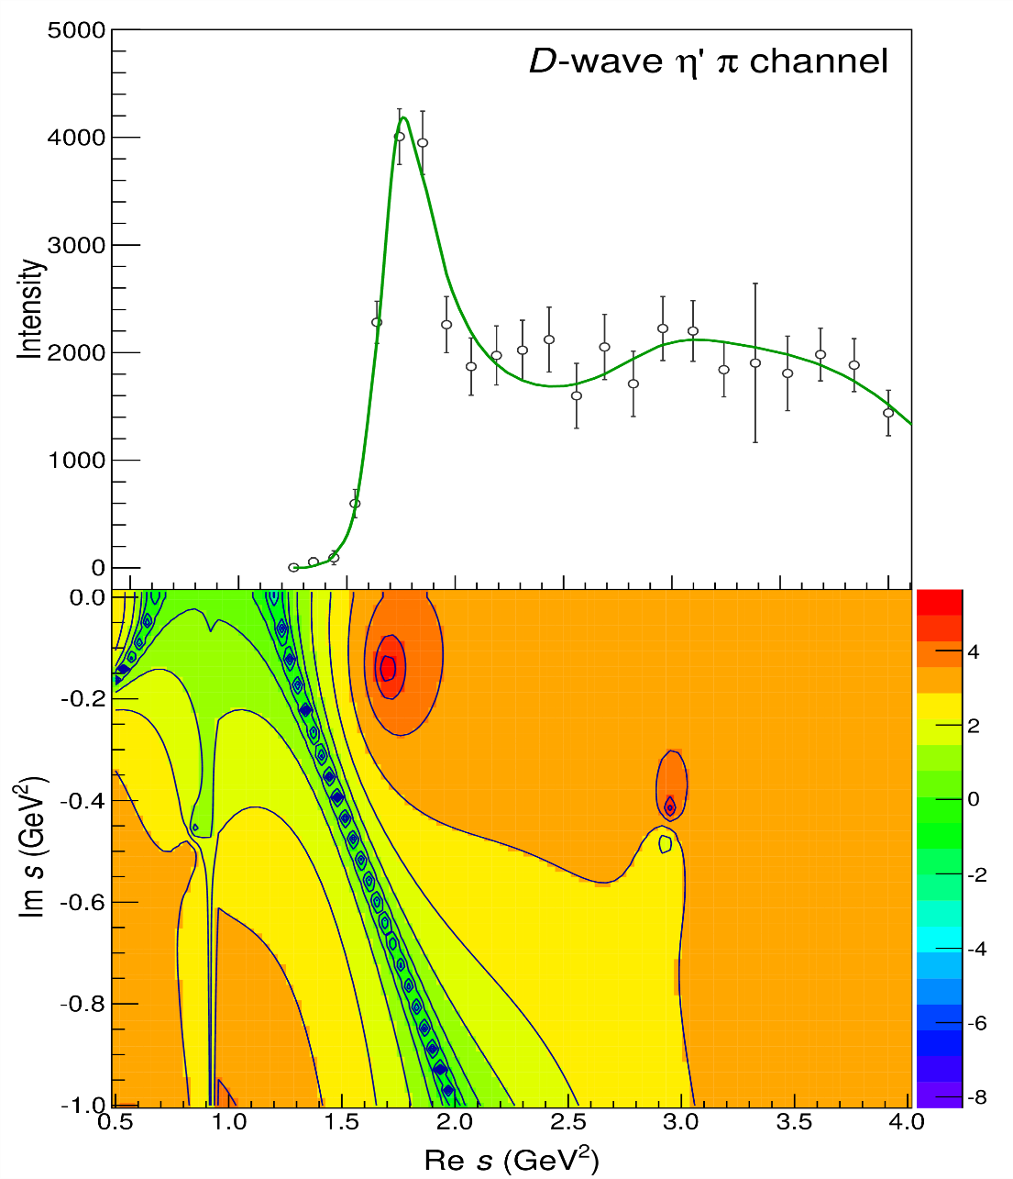
Pole hunting
$$a_{2}^{′}\left(1700\right)$$
$$a_{2}^{′}\left(1700\right)$$
$$a_{2}\left(1320\right)$$
$$a_{2}\left(1320\right)$$
A. Pilloni – Challenges in Hadron Spectroscopy
Notes:
Controlla la parte su Regge

Slide 21
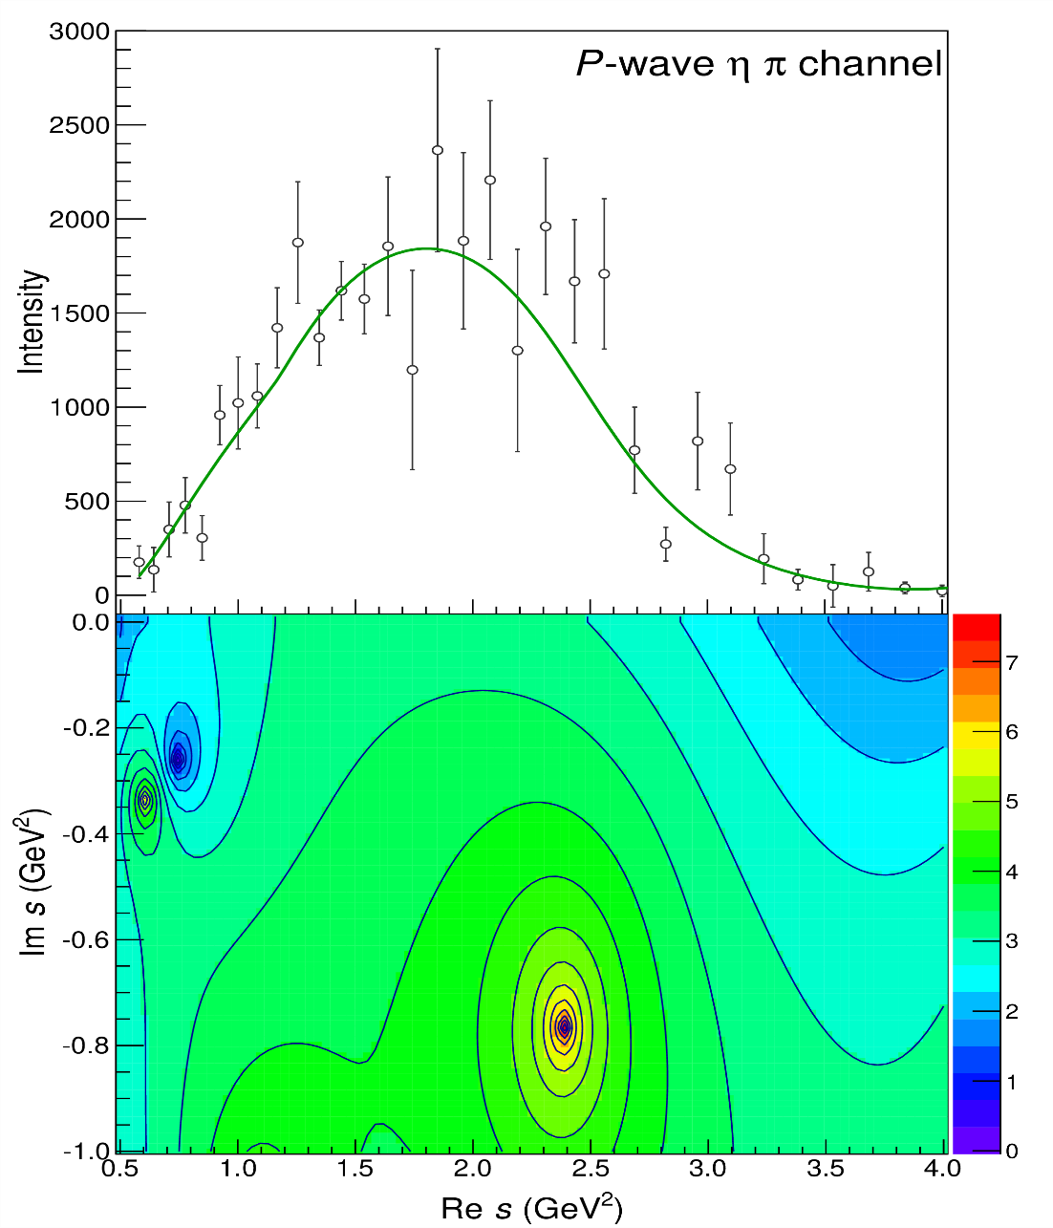
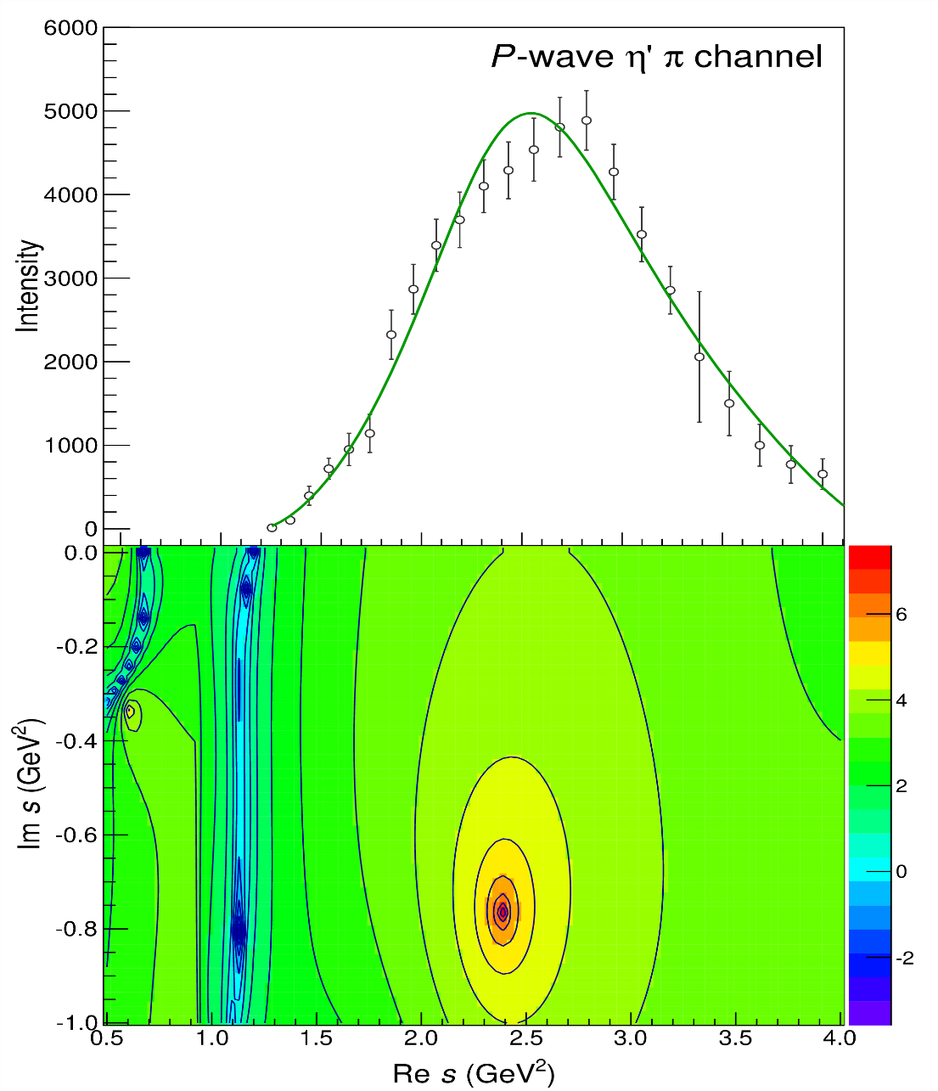
Pole hunting
$$π_{1}$$
$$π_{1}$$
A. Pilloni – Challenges in Hadron Spectroscopy
Notes:
Controlla la parte su Regge

Slide 22
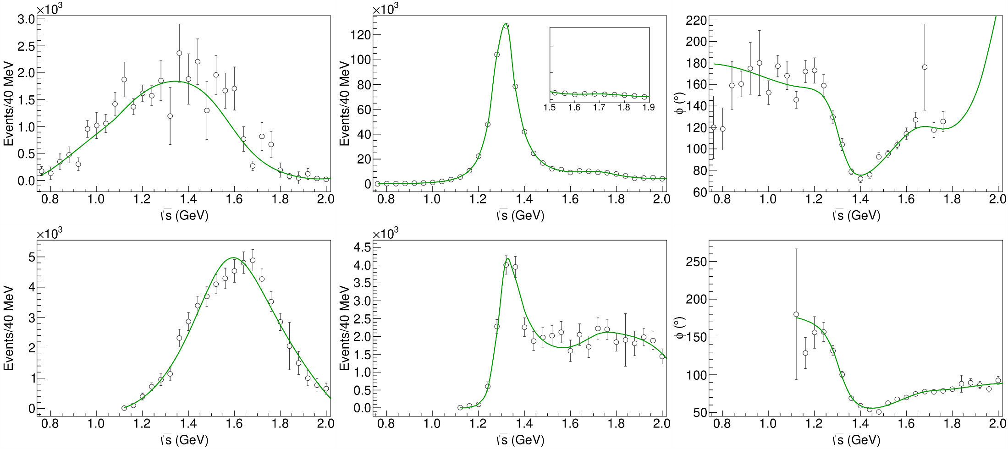
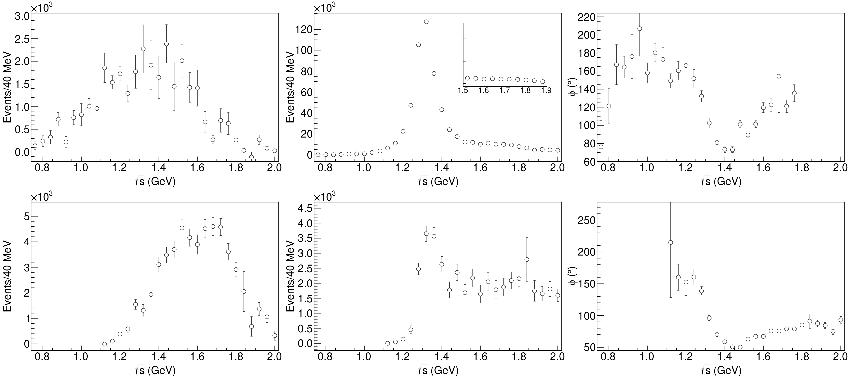
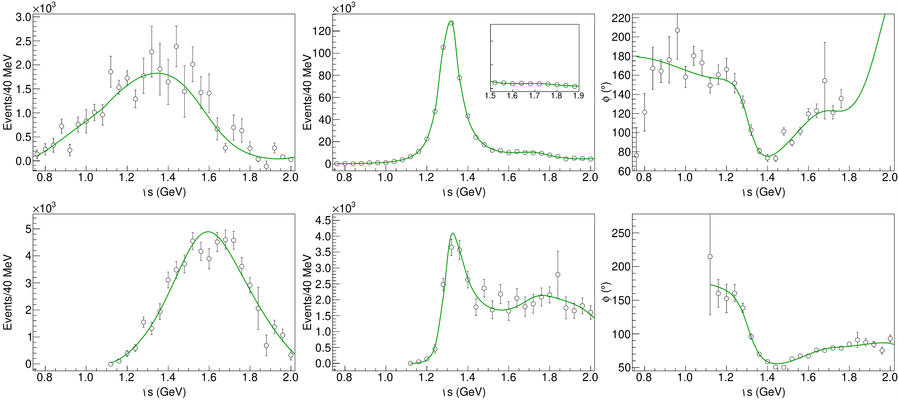
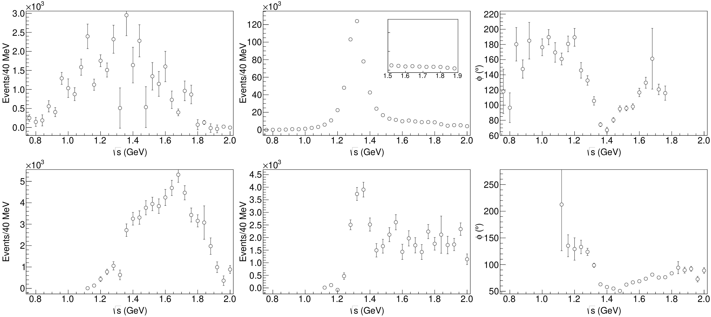
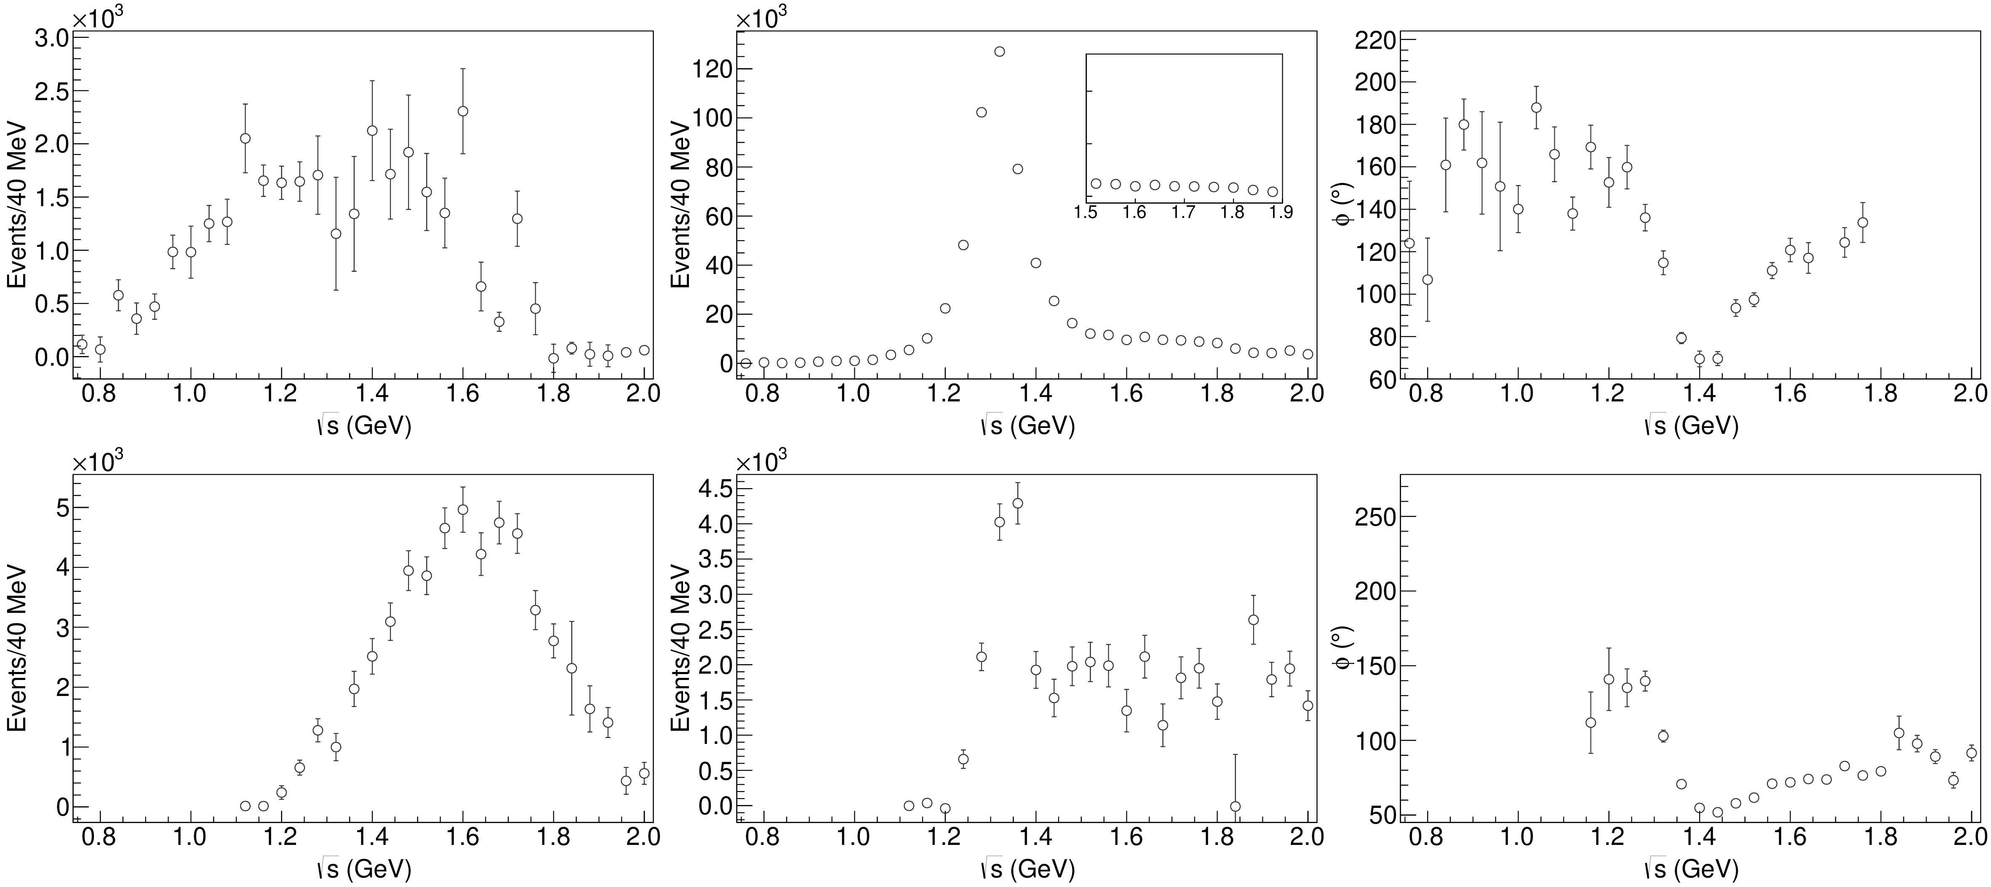
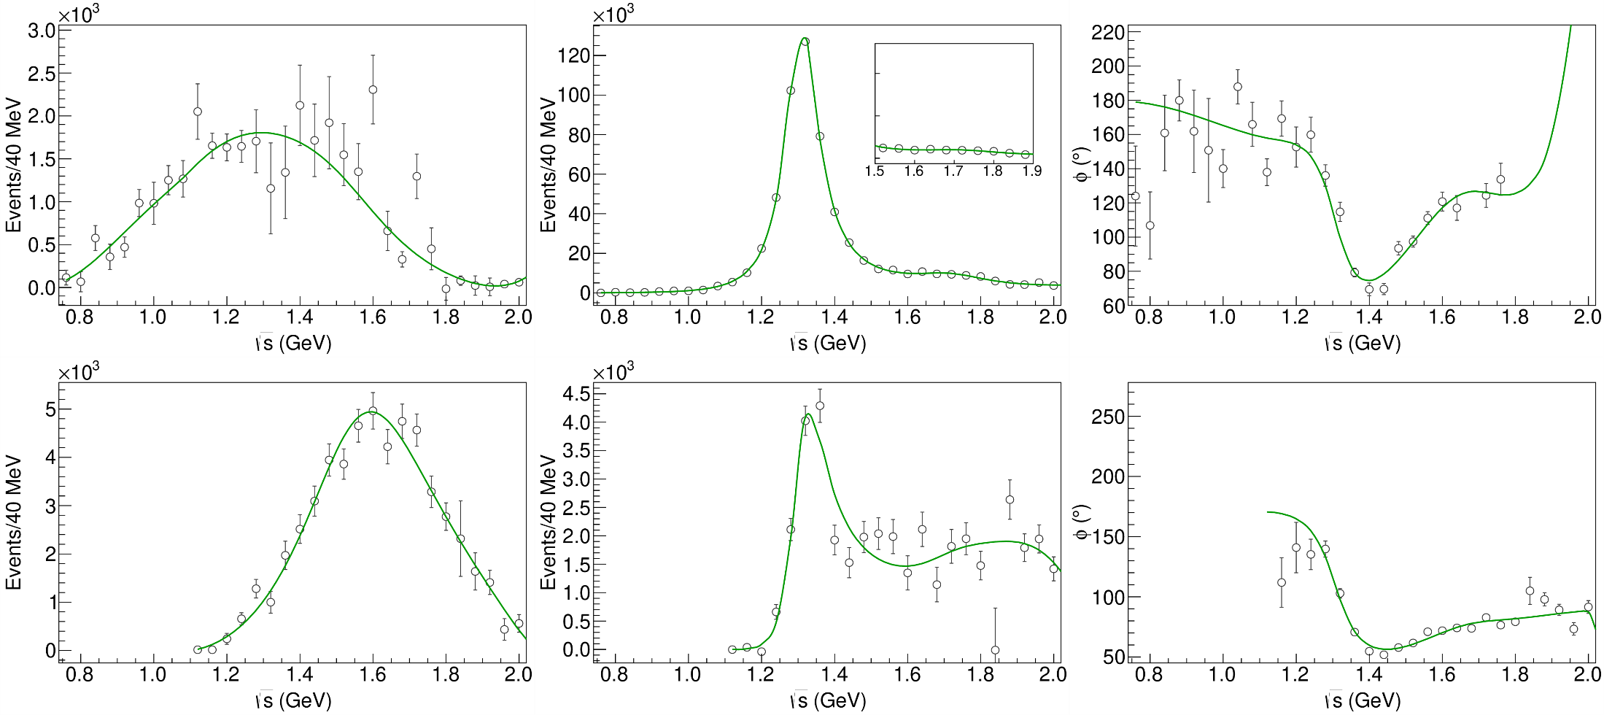
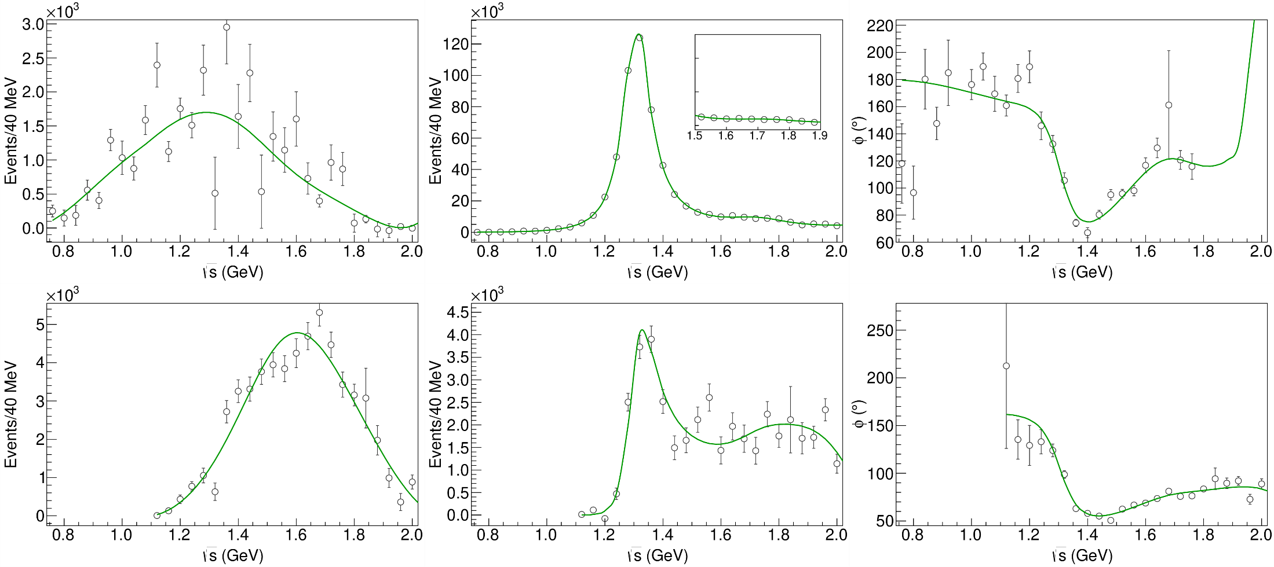
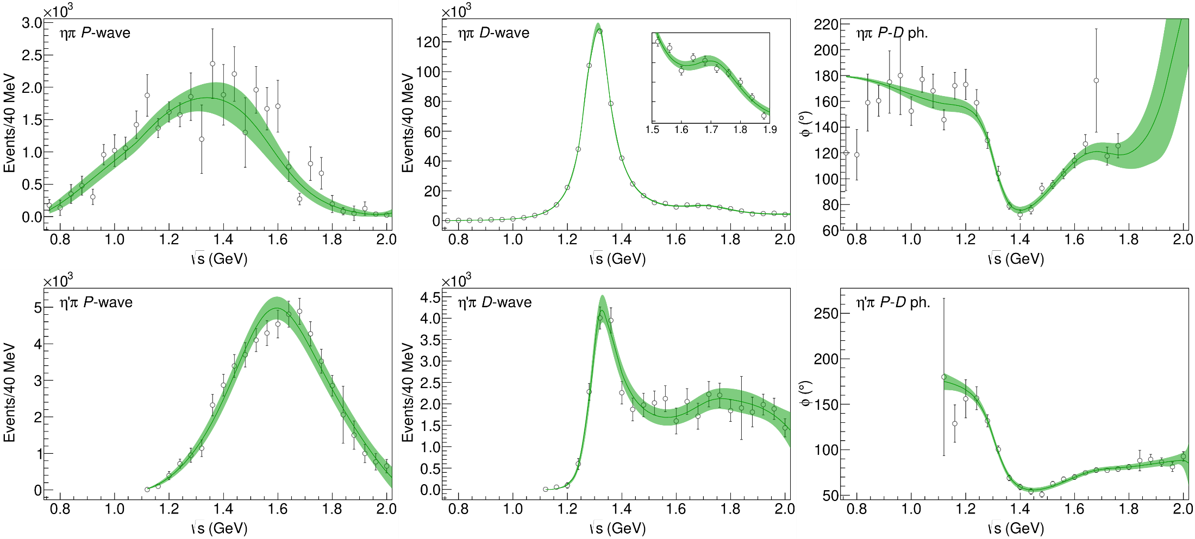
Statistical Bootstrap
Statistical error estimated via 50k bootstraps, bands show the $2σ$ error
A. Pilloni – Challenges in Hadron Spectroscopy
Notes:
Controlla la parte su Regge

Slide 23
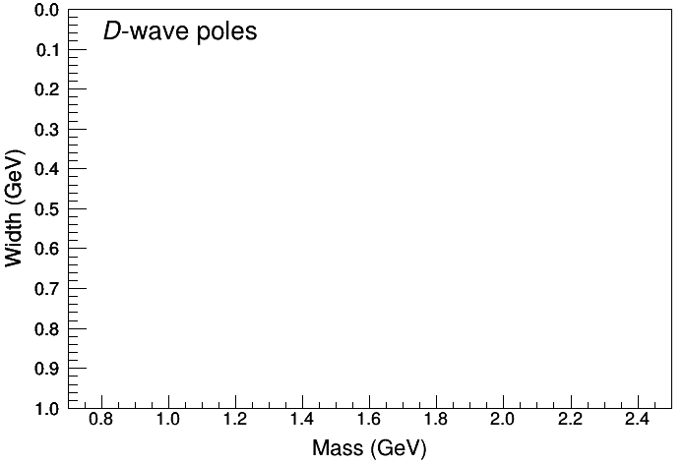
Statistical Bootstrap
For each fit, we search poles: two clusters in D-wave: $a_{2}\left(1320\right)$ and $a_{2}^{′}\left(1700\right)$
A. Pilloni – Challenges in Hadron Spectroscopy
Notes:
Controlla la parte su Regge

Slide 24
Statistical Bootstrap
Only one stable cluster in $P$-wave: a single $π_{1}$
A. Pilloni – Challenges in Hadron Spectroscopy
Notes:
Controlla la parte su Regge

Slide 25
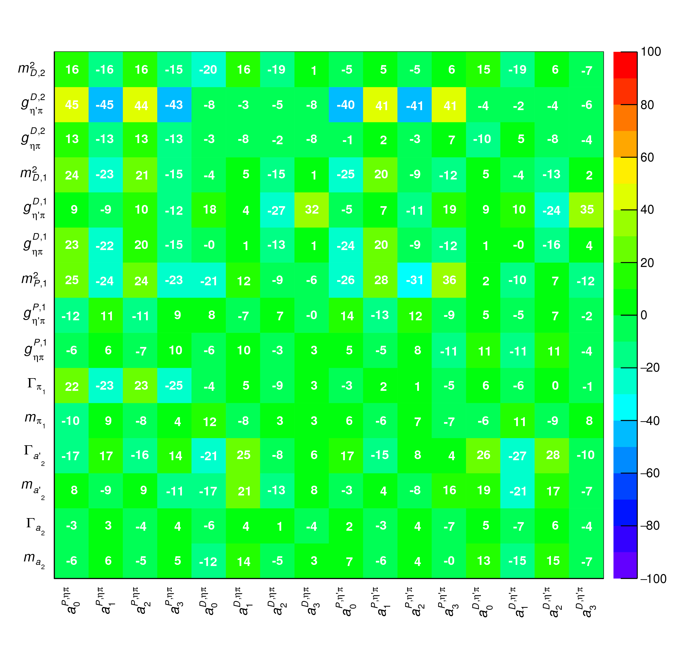
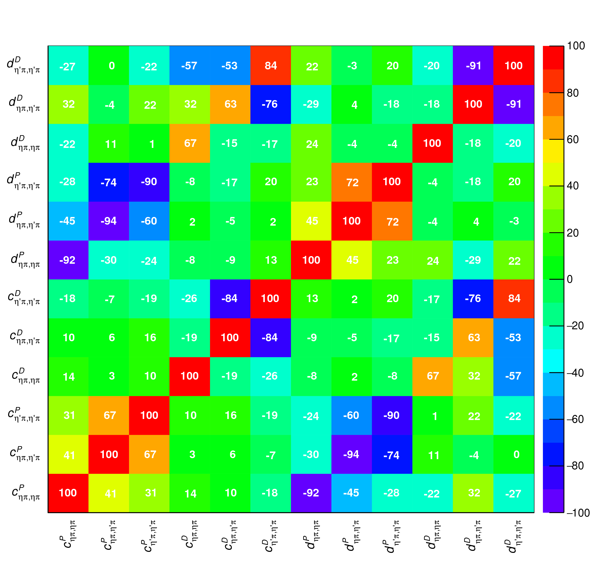
Correlations
Denominator parameters uncorrelated with the numerator ones ✓
Denominator parameters uncorrelated between P- and D-wave ✓
Production (numerator) parameters
K-matrix «bkg» parameters
K-matrix «pole» parameters
K-matrix «bkg» parameters
A. Pilloni – The pole hunter
Notes:
Controlla la parte su Regge

Slide 26
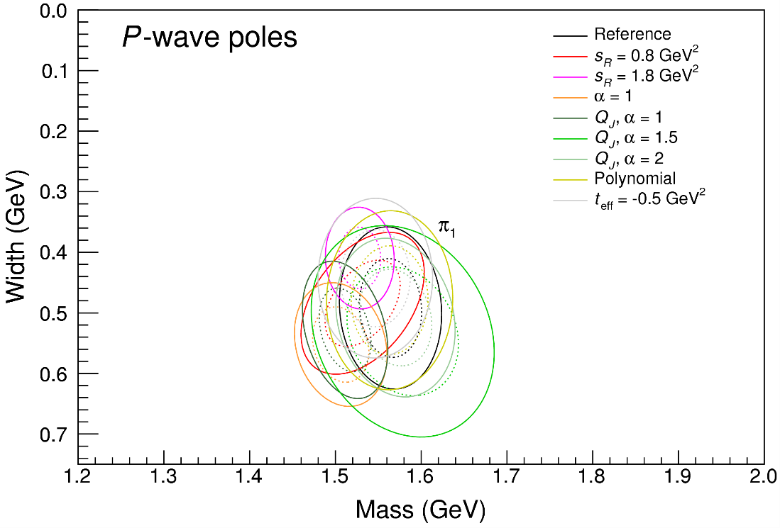
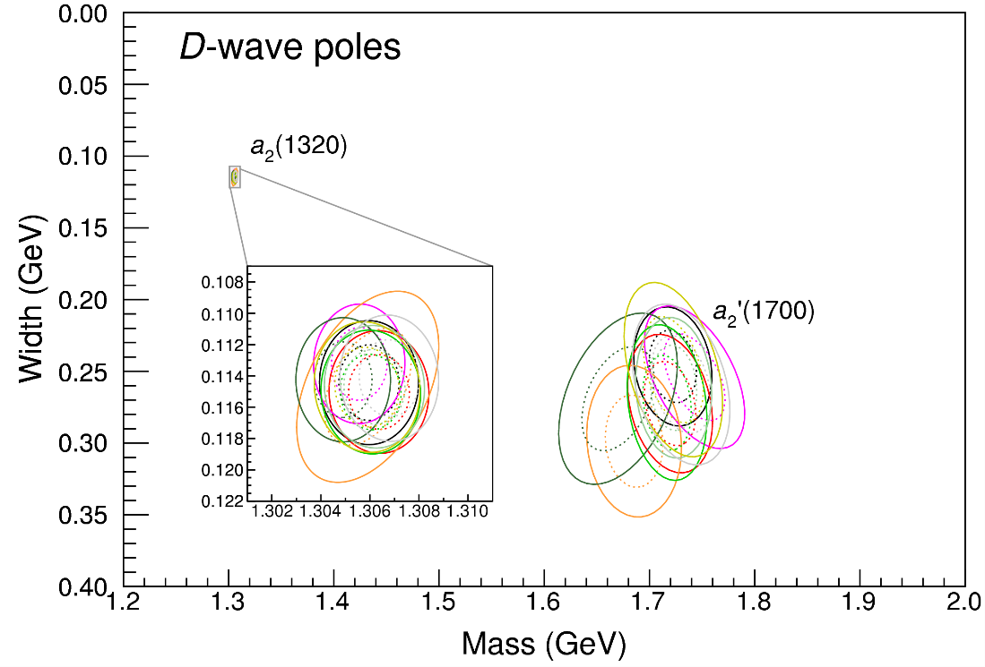
Systematic studies
For each class, the maximum deviation of mass and width is taken as a systematic error Deviation smaller than the statistical error are neglected Systematic of different classes are summed in quadrature
A. Pilloni – The pole hunter
Notes:
Controlla la parte su Regge

Slide 27
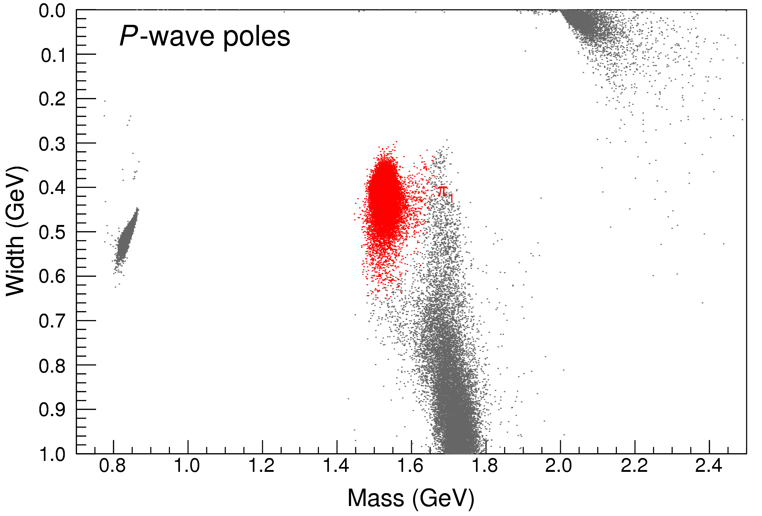
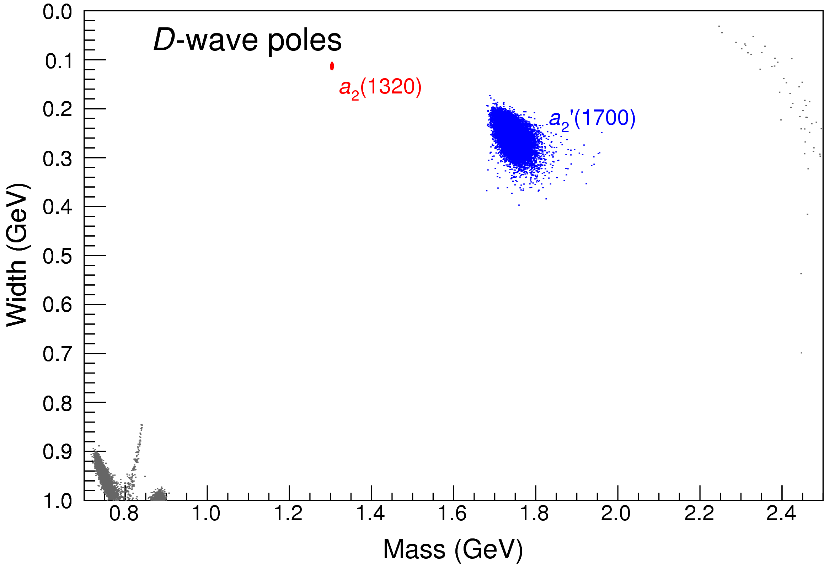
Bootstrap for $s_{R}=1.8 {\text{GeV}}^{2}$
Our skepticism about a second pole in the relevant region is confirmed:
It is unstable and not trustable
A. Pilloni – The pole hunter
Notes:
Controlla la parte su Regge

Slide 28
Final results
A. Pilloni – The pole hunter
Notes:
Controlla la parte su Regge

Slide 29
The $a_{1}$
A. Pilloni – The pole hunter
Notes:
2 slides su Zc, a Bes e a Belle
2 slide su tetraquark model: dall’hamiltoniana di Jaffe al calcolo delle masse
1 slide su molecular models, dove sono i carichi? (non in Tornqvist, si in Hanhart, vedere Braaten, citare Nefediev)
2 slides su decay channels, dove si dovrebbe vedere, e a seconda del modello, vedere qualche plot
1 slide su Y(4260), tetraquark? C’è lo strano (si vede la f0)
1 slide su Zc a cleo (anche il neutro)

Slide 30
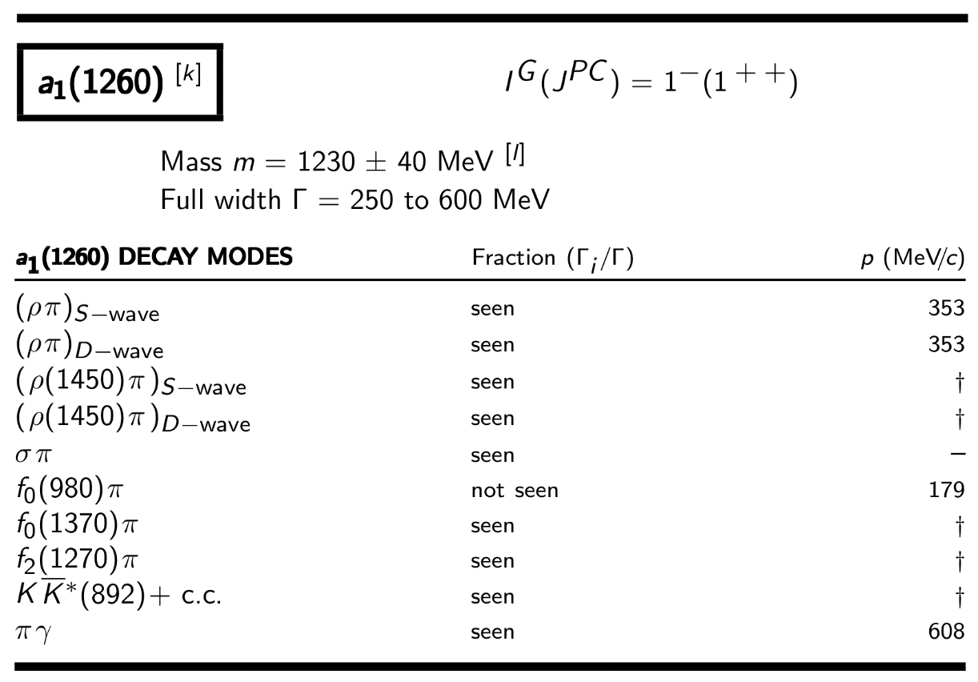
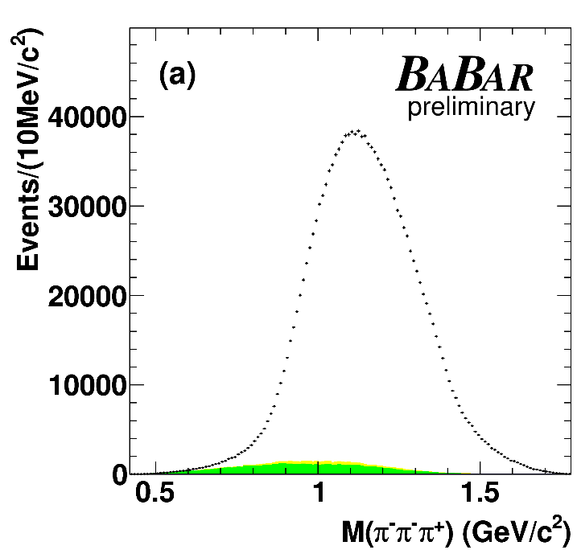
The $a_{1}(1260)$
$3π$ final states
Despite it has been known since forever, the resonance parameters of the $a_{1}\left(1260\right)$ are poorly determined
The production (and model) dependence is affecting their extraction
A. Pilloni – The pole hunter
Notes:
2 slides su Zc, a Bes e a Belle
2 slide su tetraquark model: dall’hamiltoniana di Jaffe al calcolo delle masse
1 slide su molecular models, dove sono i carichi? (non in Tornqvist, si in Hanhart, vedere Braaten, citare Nefediev)
2 slides su decay channels, dove si dovrebbe vedere, e a seconda del modello, vedere qualche plot
1 slide su Y(4260), tetraquark? C’è lo strano (si vede la f0)
1 slide su Zc a cleo (anche il neutro)

Slide 31
3-body stuff
Having a $3π$ final state requires implementing 3-body unitarity
A. Jackura
M. Mai, B. Hu, M. Doring, AP, A. Szczepaniak, EPJA
A. Jackura, AP, et al., EPJC
A. Pilloni – The pole hunter

Slide 32
Factorizable model
M. Mikhasenko, AP, et al., PRD
One can amputate the 2-body amplitude from the inital and final state
A. Pilloni – The pole hunter
Notes:
Y(4260), M=4263 +- 5, Gamma = 95+-14
D_1(2420)^0, M=2421.3 ±0.6, Gamma =27.1 ±2.7
D_1(2420)^+-, M=2423.4 ±3.1, Gamma =25 ±6
I D_1 hanno J^P = 1^+
La molecola D_1 D sta 22 MeV sotto
Se la Y è D_1 D, il pione lega fortemente, come fa la Y a essere così larga?
Come funziona lo scambio del pione???
Close propone che la Y è D_1 D^* col pione scambiato in onda S,
La Y però non va in Ds come se fosse tetraquark

Slide 33
Factorizable model
M. Mikhasenko, AP, et al., PRD
One can amputate the 2-body amplitude from the inital and final state
If one neglects the effect of the disconnected diagrams to unitarity, is it possible to suppress the dependence of the reduced amplitude on the 2-body invariant masses
A. Pilloni – The pole hunter
Notes:
Y(4260), M=4263 +- 5, Gamma = 95+-14
D_1(2420)^0, M=2421.3 ±0.6, Gamma =27.1 ±2.7
D_1(2420)^+-, M=2423.4 ±3.1, Gamma =25 ±6
I D_1 hanno J^P = 1^+
La molecola D_1 D sta 22 MeV sotto
Se la Y è D_1 D, il pione lega fortemente, come fa la Y a essere così larga?
Come funziona lo scambio del pione???
Close propone che la Y è D_1 D^* col pione scambiato in onda S,
La Y però non va in Ds come se fosse tetraquark

Slide 34
Factorizable model
M. Mikhasenko, AP, et al., PRD
The unitarity equation is now algebraic and easier to handle
Integral over the Dalitz plot (aka quasi 2-body)
A. Pilloni – The pole hunter
Notes:
Y(4260), M=4263 +- 5, Gamma = 95+-14
D_1(2420)^0, M=2421.3 ±0.6, Gamma =27.1 ±2.7
D_1(2420)^+-, M=2423.4 ±3.1, Gamma =25 ±6
I D_1 hanno J^P = 1^+
La molecola D_1 D sta 22 MeV sotto
Se la Y è D_1 D, il pione lega fortemente, come fa la Y a essere così larga?
Come funziona lo scambio del pione???
Close propone che la Y è D_1 D^* col pione scambiato in onda S,
La Y però non va in Ds come se fosse tetraquark

Slide 35
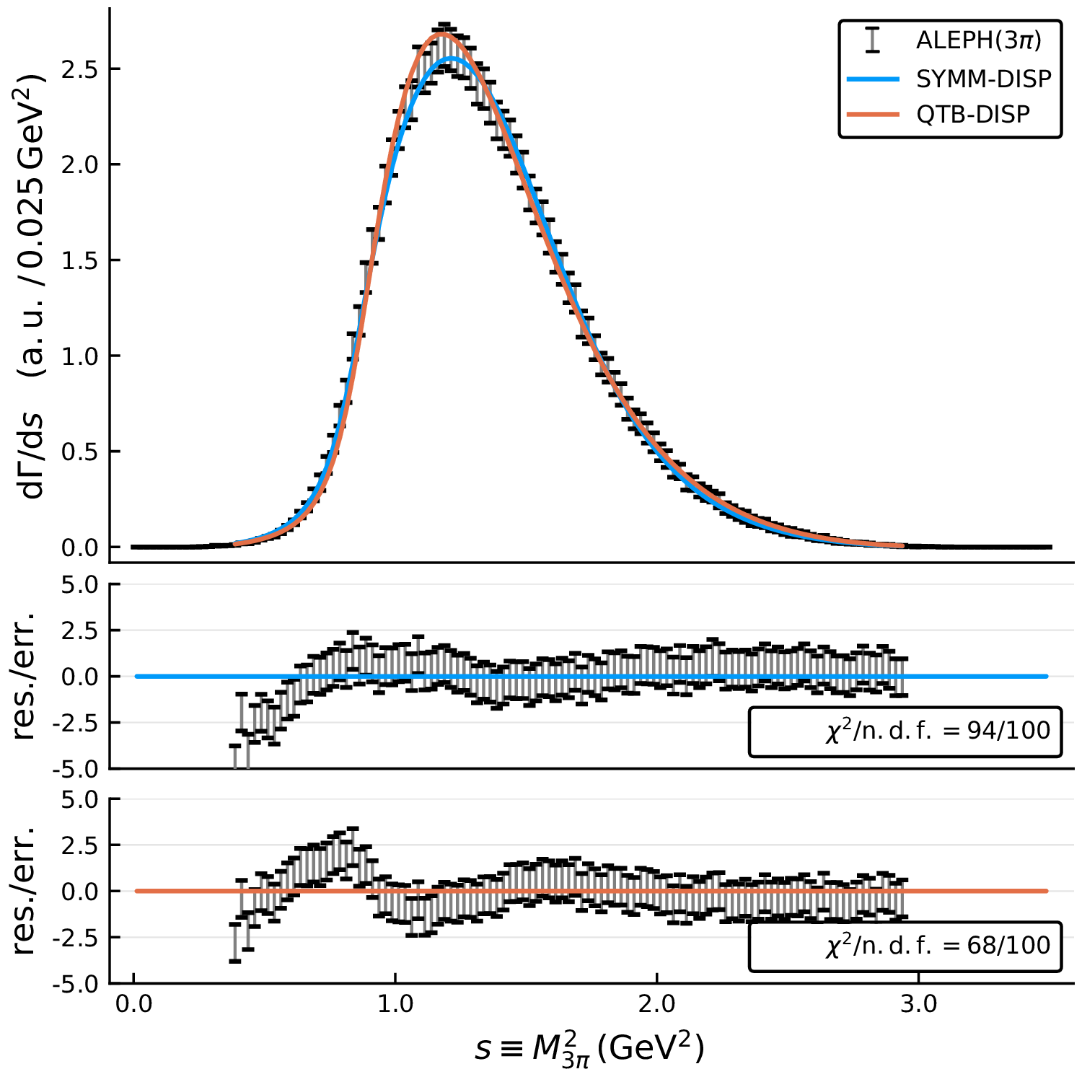
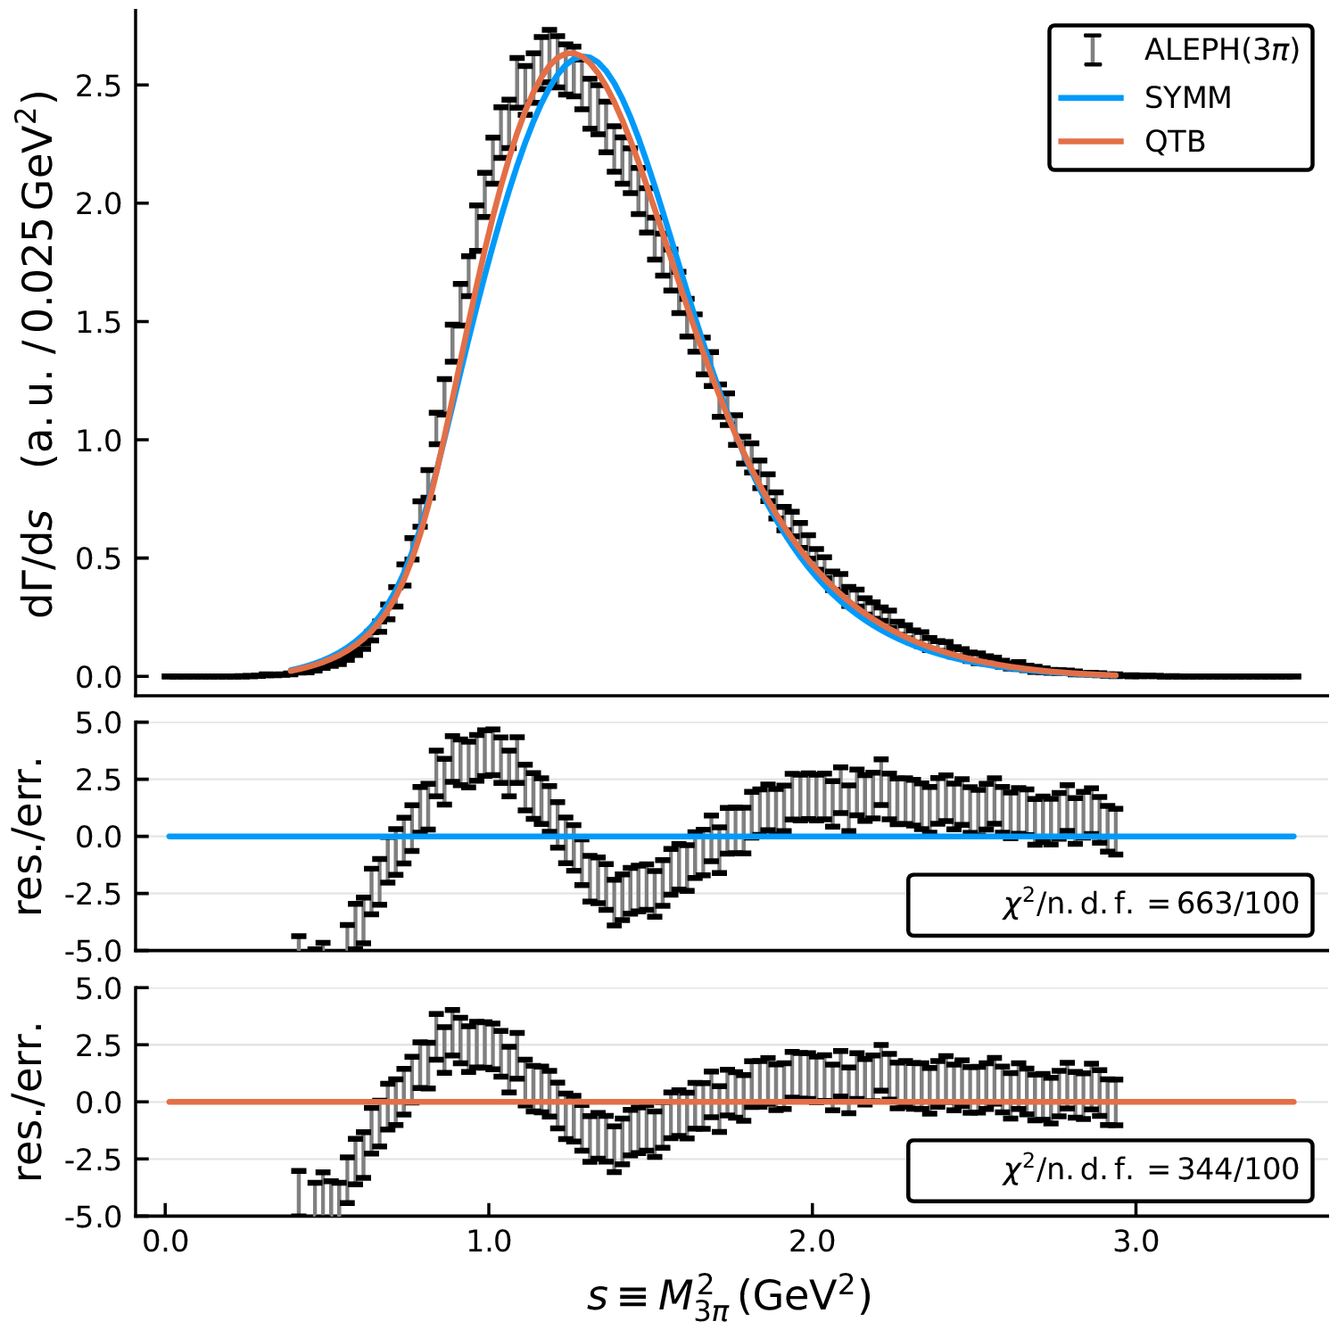
Fit to data
Dispersive models look better
A. Pilloni – The pole hunter
Notes:
Y(4260), M=4263 +- 5, Gamma = 95+-14
D_1(2420)^0, M=2421.3 ±0.6, Gamma =27.1 ±2.7
D_1(2420)^+-, M=2423.4 ±3.1, Gamma =25 ±6
I D_1 hanno J^P = 1^+
La molecola D_1 D sta 22 MeV sotto
Se la Y è D_1 D, il pione lega fortemente, come fa la Y a essere così larga?
Come funziona lo scambio del pione???
Close propone che la Y è D_1 D^* col pione scambiato in onda S,
La Y però non va in Ds come se fosse tetraquark

Slide 36
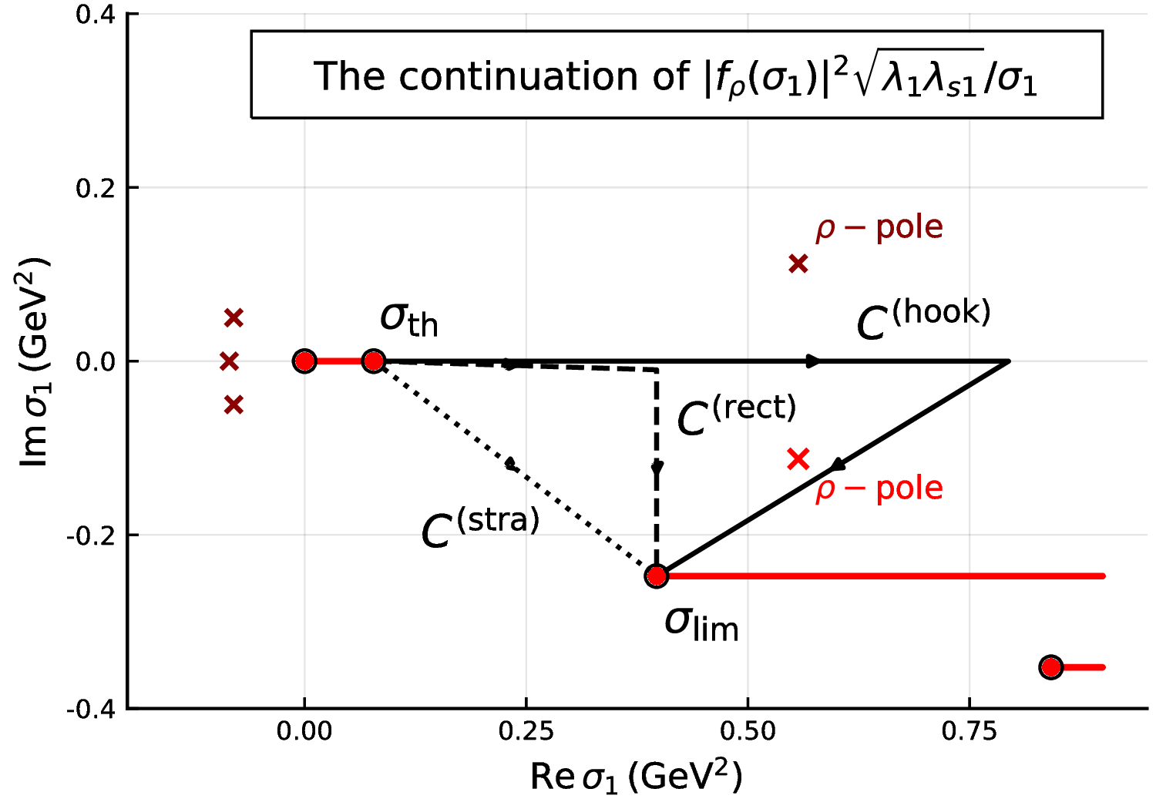
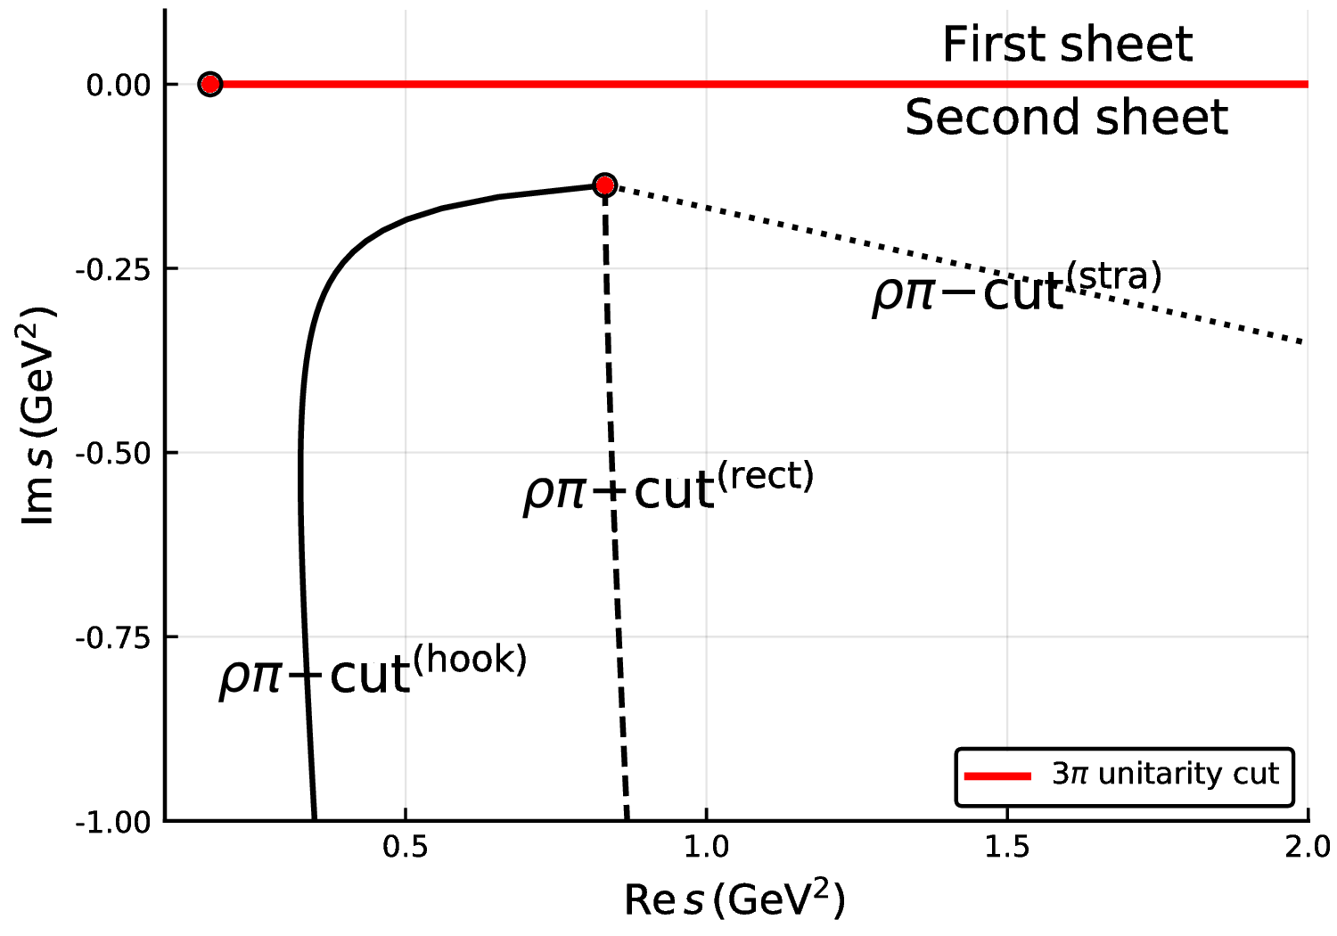
Analytic continuation
Going to complex s means making the integration path complex
When the integration boundary hits the $ρ$ pole in $f\left(σ_{1}\right)$, the woolly cut opens
A. Pilloni – The pole hunter
Notes:
Y(4260), M=4263 +- 5, Gamma = 95+-14
D_1(2420)^0, M=2421.3 ±0.6, Gamma =27.1 ±2.7
D_1(2420)^+-, M=2423.4 ±3.1, Gamma =25 ±6
I D_1 hanno J^P = 1^+
La molecola D_1 D sta 22 MeV sotto
Se la Y è D_1 D, il pione lega fortemente, come fa la Y a essere così larga?
Come funziona lo scambio del pione???
Close propone che la Y è D_1 D^* col pione scambiato in onda S,
La Y però non va in Ds come se fosse tetraquark

Slide 37
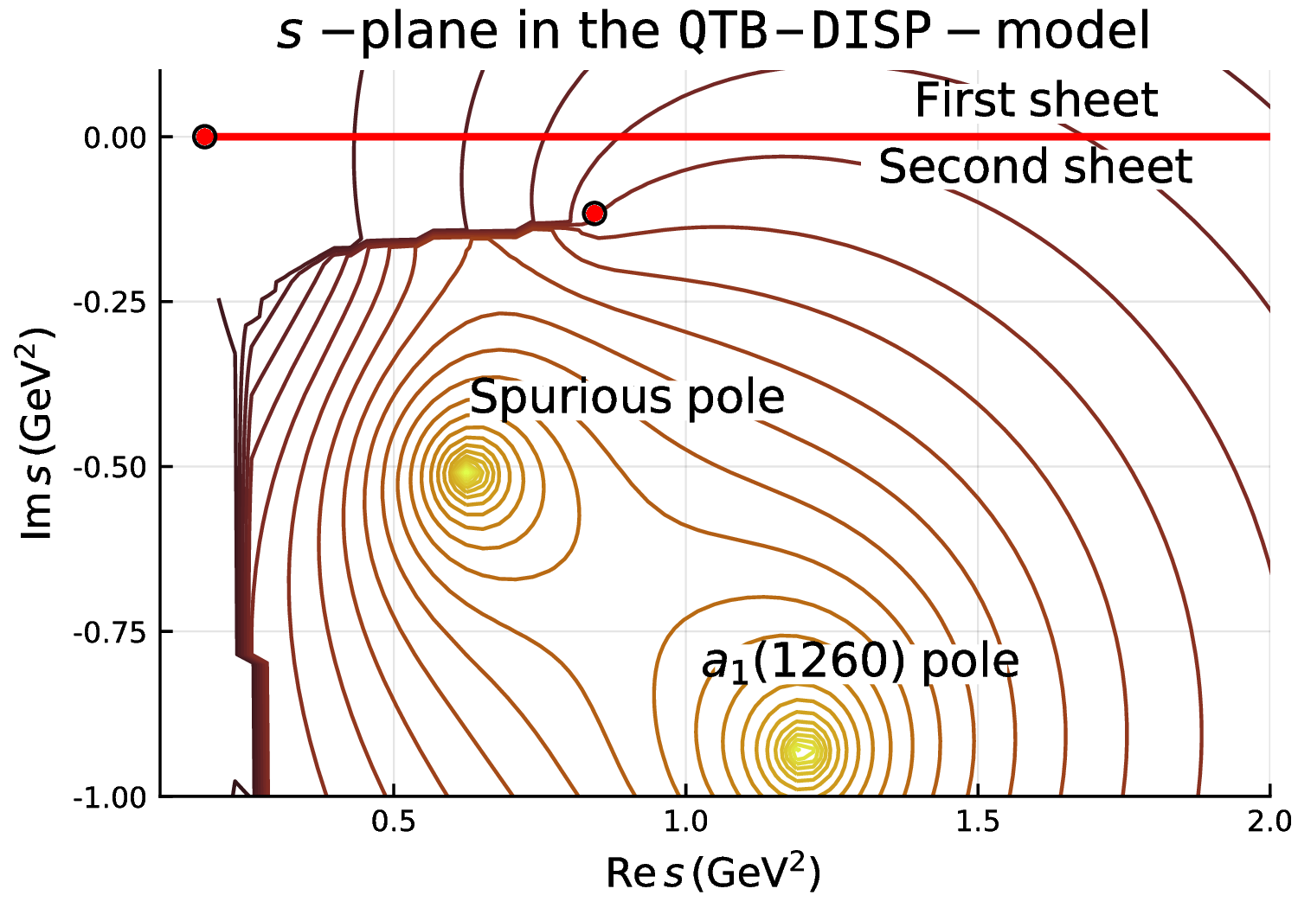
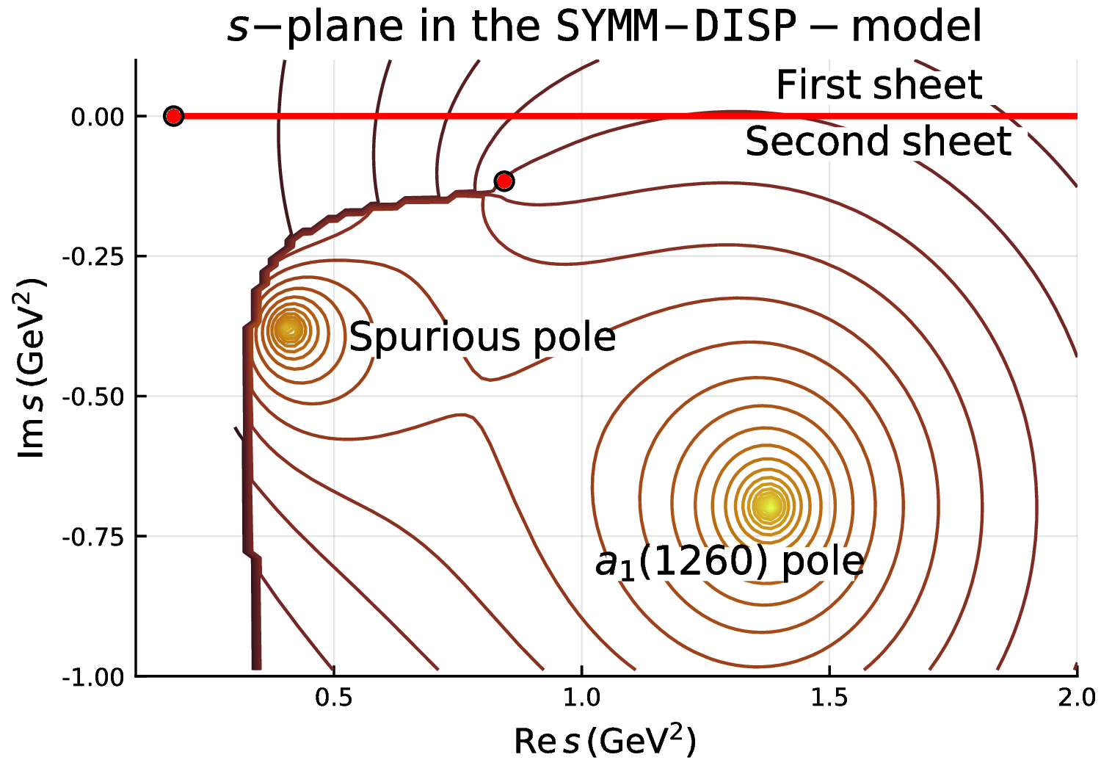
Analytic continuation
An additional pole appear, almost hidden under the woolly cut
It can be traced back to the $1/s$ factor of the phase space
A. Pilloni – The pole hunter
Notes:
Y(4260), M=4263 +- 5, Gamma = 95+-14
D_1(2420)^0, M=2421.3 ±0.6, Gamma =27.1 ±2.7
D_1(2420)^+-, M=2423.4 ±3.1, Gamma =25 ±6
I D_1 hanno J^P = 1^+
La molecola D_1 D sta 22 MeV sotto
Se la Y è D_1 D, il pione lega fortemente, come fa la Y a essere così larga?
Come funziona lo scambio del pione???
Close propone che la Y è D_1 D^* col pione scambiato in onda S,
La Y però non va in Ds come se fosse tetraquark

Slide 38
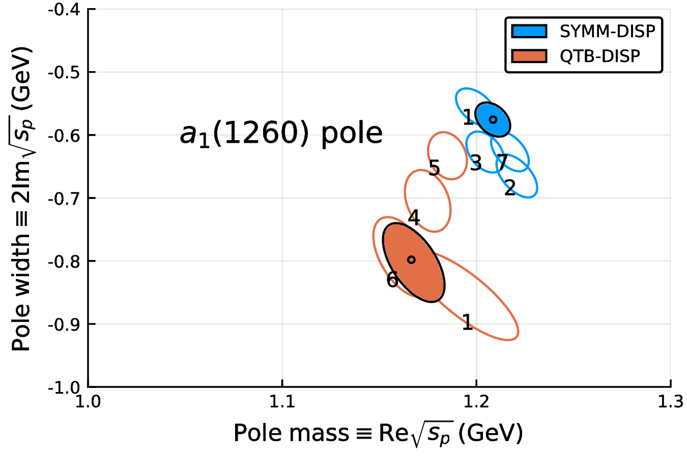
Systematics
A. Pilloni – The pole hunter
Notes:
Y(4260), M=4263 +- 5, Gamma = 95+-14
D_1(2420)^0, M=2421.3 ±0.6, Gamma =27.1 ±2.7
D_1(2420)^+-, M=2423.4 ±3.1, Gamma =25 ±6
I D_1 hanno J^P = 1^+
La molecola D_1 D sta 22 MeV sotto
Se la Y è D_1 D, il pione lega fortemente, come fa la Y a essere così larga?
Come funziona lo scambio del pione???
Close propone che la Y è D_1 D^* col pione scambiato in onda S,
La Y però non va in Ds come se fosse tetraquark

Slide 39
Conclusions
We perform a coupled-channel analysis to the $η^{(′)}π$ COMPASS data
We can describe data with a model which generates a single stable pole in the relevant region of the P-wave
The pole position is sufficiently stable upon changes of the model We also extract the resonant parameters of $a_{2}^{(′)}$
We perform the analysis of $τ→3πν$ ALEPH data
We consider a simplified quasi 2-body model, with a reduced unitarity equation easier to handle
The $a_{1}\left(1260\right)$ pole position is determined
A. Pilloni – The pole hunter
Notes:
Controlla la parte su Regge

Slide 40
Epilogue
Why bother about hadron spectroscopy?
Because it allows us to understand how the QCD degrees of freedom manifest in nature. The role of models is crucial
Because we need a better understanding of hadron amplitudes if we want to reduce the «hadronic uncertainties» in precision physics (e.g. $τ$ EDM, $g_{μ}−2$, CPV in hadronic $B$ decays...)
(the honest answer would be «because we are nerds and we like it», but we cannot answer like this to funding agencies)
A. Pilloni – Challenges in Hadron Spectroscopy
Notes:
2 slides su Zc, a Bes e a Belle
2 slide su tetraquark model: dall’hamiltoniana di Jaffe al calcolo delle masse
1 slide su molecular models, dove sono i carichi? (non in Tornqvist, si in Hanhart, vedere Braaten, citare Nefediev)
2 slides su decay channels, dove si dovrebbe vedere, e a seconda del modello, vedere qualche plot
1 slide su Y(4260), tetraquark? C’è lo strano (si vede la f0)
1 slide su Zc a cleo (anche il neutro)

Slide 41
Joint Physics Analysis Center
A. Pilloni – The pole hunter

Slide 42
Backup

Slide 43
Amplitude analysis for $Z_{c}(3900)$
One can test different parametrizations of the amplitude, which correspond to different singularities → different natures
AP et al. (JPAC), PLB772, 200
$$Z_{c}\left(3900\right)?$$
$${u: D}_{0}(2400)$$
$${u:Z}_{c}\left(3900\right)?$$
$$"σ, f_{0}(980)"$$
$$D_{1}(2420)$$
Triangle rescattering, logarithmic branching point
(anti)bound state, II/IV sheet pole
(«molecule»)
Resonance, III sheet pole
(«compact state»)
$$π$$
$$D_{1}$$
$$Y$$
$$D^{∗}$$
$$π$$
$$\overline{D}$$
$$J/ψ$$
Tornqvist, Z.Phys. C61, 525
Swanson, Phys.Rept. 429
Hanhart et al. PRL111, 132003
Maiani et al., PRD71, 014028
Faccini et al., PRD87, 111102
Esposito et al., Phys.Rept. 668
Szczepaniak, PLB747, 410
A. Pilloni – Experimental motivation for multihadrons on the lattice
Notes:
Controlla la parte su Regge

Slide 44
Fit: III
A. Pilloni – Experimental motivation for multihadrons on the lattice
Notes:
Controlla la parte su Regge

Slide 45
Fit: III+tr.
A. Pilloni – Experimental motivation for multihadrons on the lattice
Notes:
Controlla la parte su Regge

Slide 46
Fit: IV+tr.
A. Pilloni – Experimental motivation for multihadrons on the lattice
Notes:
Controlla la parte su Regge

Slide 47
Fit: tr.
A. Pilloni – Experimental motivation for multihadrons on the lattice
Notes:
Controlla la parte su Regge

Slide 48
Joint Physics Analysis Center
We aim at developing new theoretical tools, to get insight on QCD using first principles of QFT (unitarity, analyticity, crossing symmetry, low and high energy constraints,…) to extract the physics out of the data
Many other ongoing projects (both for meson and baryon spectroscopy, and for high energy observables), with a particular attention to producing complete reaction models for the golden channels in exotic meson searches
A. Jackura, N. Sherrill, D. Winney, G. Fox, T. Londergan (IU), E. Passemar, A. Szczepaniak (IU/JLab)
R. Workman (GWU), M. Döring (GWU/JLab)
J. Nys (Ghent U.)
L. Bibzrycki, R. Kaminski (Krakow)
M. Mikhasenko (Bonn U.) L. Dai (FZ Julich)
M. Albaladejo, V. Mathieu, A. Pilloni, V. Mokeev (JLab)
I. Danilkin, A. Hiller Blin (Mainz U.)
A. Celentano (INFN-GE)
P. Guo (Cal. State U.)
A. Rodas (Complutense U.)
J. Castro, C. Fernandez-Ramirez (UNAM)
Students, Postdocs, Faculties
A. Pilloni – The pole hunter

Slide 49
Formalism
A. Pilloni – The pole hunter
Notes:
Controlla la parte su Regge

Slide 50
Analytic continuation
A. Pilloni – The pole hunter
Notes:
Controlla la parte su Regge

Slide 51
Correlations
Production (numerator) parameters
Denominator parameters not very correlated with the numerator ones ✓
K-matrix «bkg» parameters
A. Pilloni – The pole hunter
Notes:
Controlla la parte su Regge

Slide 52
Correlations
K-matrix «bkg» parameters
Denominator parameters uncorrelated between P- and D-wave ✓
K-matrix «pole» parameters
A. Pilloni – The pole hunter
Notes:
Controlla la parte su Regge

Slide 53
$ρπ$ channel and Deck amplitude
$$R_{ππ}$$
IP
The production allows for a nonresonant component (Deck effect) The singularity is close to the physical region, peaking background
We do not include this channel
(Deck)
(Deck)
A. Pilloni – The pole hunter
Notes:
2 slides su Zc, a Bes e a Belle
2 slide su tetraquark model: dall’hamiltoniana di Jaffe al calcolo delle masse
1 slide su molecular models, dove sono i carichi? (non in Tornqvist, si in Hanhart, vedere Braaten, citare Nefediev)
2 slides su decay channels, dove si dovrebbe vedere, e a seconda del modello, vedere qualche plot
1 slide su Y(4260), tetraquark? C’è lo strano (si vede la f0)
1 slide su Zc a cleo (anche il neutro)

Slide 54
Polynomial in the numerator
The numerator should be smooth and have variation milder that the typical resonance width This happens indeed
A. Pilloni – The pole hunter
Notes:
Controlla la parte su Regge

Slide 55
Result (stat. error only)
The variance of the bootstrapped poles gives the statistical error
A. Pilloni – The pole hunter
Notes:
Controlla la parte su Regge

Slide 56
Again into the complex plane
The strength of the pole propagates differently in the two channels
In $ηπ$ the strength move to lighter values
A. Pilloni – The pole hunter
Notes:
Controlla la parte su Regge

Slide 57
Systematic studies
Change of functional form and parameters in the denominator
Default: $s_{R}=1 {\text{GeV}}^{2}$. We try $s_{R}=0.8, 1.8 {\text{GeV}}^{2}$
Default: $α=2$. We try $α=1$
We also try a different function: with $α=2, 1.5, 1$
Change of parameters in the numerator
Default: $t_{\text{eff}}=−0.1 {\text{GeV}}^{2}$. We try$t_{\text{eff}}=−0.5 {\text{GeV}}^{2}$
Default: 3rd order polynomial. We try 4th
A. Pilloni – The pole hunter
Notes:
Controlla la parte su Regge

Slide 58
Formalism
A. Pilloni – The pole hunter
Notes:
Controlla la parte su Regge

Slide 59
Systematic studies
A. Pilloni – The pole hunter
Notes:
Controlla la parte su Regge

Slide 60
Systematic studies
A. Pilloni – The pole hunter
Notes:
Controlla la parte su Regge

Slide 61
Formalism
A. Pilloni – The pole hunter
Notes:
Controlla la parte su Regge

Slide 62
Searching for resonances in $ηπ$
Notes:
Controlla la parte su Regge

Slide 63
Hybrids
Hadron Spectrum coll., PRD82, 034508
Signatures as $J^{PC}=1^{− +}$ are not allowed in the quark model, Coulomb gauge QCD and flux tube predict glue excitation to be a quasi-particle with $J^{PC}=1^{+ −}, q\overline{q}g$ states expected
Need some constraint to draw robust conclusions about the existence of exotic states
A. Pilloni – Challenges in the analysis of meson-spectroscopy data: Theory
Notes:
Controlla la parte su Regge

Slide 64
Recap: single channel $ηπ$
The denominator $D(s)$ contains all the FSI constrained by unitarity → universal
OR
A. Pilloni – The pole hunter
Notes:
Controlla la parte su Regge

Slide 65
Recap: single channel $ηπ$
The denominator $D(s)$ contains all the FSI constrained by unitarity → universal
K-matrix more QFT motivated poles on the 1st sheet unlikely
CDD parameterization more S-matrix motivated poles on the 1st sheet impossible
OR
A. Pilloni – The pole hunter
Notes:
Controlla la parte su Regge

Slide 66
Recap: single channel $ηπ$
The denominator $D(s)$ contains all the FSI constrained by unitarity → universal
Numerator functions know about crossed channel dynamics unconstrained, we use a smooth model
OR
A. Pilloni – The pole hunter
Notes:
Controlla la parte su Regge

Slide 67
Searching for resonances in $ηπ$
The coupled channel analysis involving the exotic $P$-wave is ongoing, as well as the extention to the GlueX production mechanism and kinematics
$$a_{2}(1320)$$
$$π_{1}\left(1600\right)?$$
$$a_{2}^{′}(1700)$$
Preliminary
A. Pilloni – The pole hunter
Notes:
Controlla la parte su Regge

Slide 68
Correlations
Polynomial parameters uncorrelated between P- and D-wave ✓
A. Pilloni – The pole hunter
Notes:
Controlla la parte su Regge

Slide 69
Correlations
A. Pilloni – The pole hunter
Notes:
Controlla la parte su Regge

Slide 70
Complex plane
For the best fit solution, we look at the closest Riemann sheet in the complex plane We see a limited amount of poles in the relevant region
We also see some close-to-threshold poles, which are artifacts of the model for $N(s)$
How to distinguish the two?
A. Pilloni – The pole hunter
Notes:
Controlla la parte su Regge

Slide 71
Complex plane
For the best fit solution, we look at the closest Riemann sheet in the complex plane We see a limited amount of poles in the relevant region
We also see some close-to-threshold poles, which are artifacts of the model for $N(s)$
How to distinguish the two?
A. Pilloni – The pole hunter
Notes:
Controlla la parte su Regge

Slide 72
$π_{1}\left(1600\right)→ρπ→πππ$
The strength of the Deck effect depends on the momentum transferred $t$, but the precise estimates rely on the model for the Deck amplitude
(Deck)
(Deck)
A. Pilloni – The pole hunter
Notes:
2 slides su Zc, a Bes e a Belle
2 slide su tetraquark model: dall’hamiltoniana di Jaffe al calcolo delle masse
1 slide su molecular models, dove sono i carichi? (non in Tornqvist, si in Hanhart, vedere Braaten, citare Nefediev)
2 slides su decay channels, dove si dovrebbe vedere, e a seconda del modello, vedere qualche plot
1 slide su Y(4260), tetraquark? C’è lo strano (si vede la f0)
1 slide su Zc a cleo (anche il neutro)

Slide 73
Pole hunting
I sheet
More complicated structure when more thresholds arise: two sheets for each new threshold
III sheet: usual resonances
IV sheet: cusps (virtual states)
$$\text{Im} s$$
$$\text{Re} s$$
Virtual state
II sheet
Bound state
Resonance
$$\text{Im} s$$
$$\text{Re} s$$
A. Pilloni – The pole hunter
Notes:
Controlla la parte su Regge

Slide 74
Complex plane
For the best fit solution, we look at the closest Riemann sheet in the complex plane We see a limited amount of poles in the relevant region
We also see some close-to-threshold poles, which are artifacts of the model for $N(s)$
How to distinguish the two?
A. Pilloni – The pole hunter
Notes:
Controlla la parte su Regge

Slide 75
Regge exchange
Resonances are poles in $s$ for fixed $l$ dominate low energy region
Reggeons are poles in $l$ for fixed $s$
dominate high energy region
$$A_{l}∼\frac{g_{1}g_{2}}{s_{p}−s}$$
$$A∼∑{ s}^{l}∼g_{1}\left(t\right)g_{2}\left(t\right)s^{α_{±}(t)}\left(−\frac{e^{iπα^{±}\left(t\right)}±1 }{\sin{π α^{±}(t)}}\right)$$
A. Pilloni – Challenges in the analysis of meson-spectroscopy data: Theory
Notes:
Controlla la parte su Regge

Slide 76
Finite energy sum rules
$$π$$
$$ν=\frac{s−u}{2}$$
$$\frac{1}{Λ^{n}}\int_{ν_{th}}^{Λ}{Im A\left(ν,t\right) ν^{n}dν}=\frac{β\left(t\right)Λ^{α\left(t\right)+1}}{α\left(t\right)+n+1}$$
A. Pilloni – Challenges in the analysis of meson-spectroscopy data: Theory
Notes:
Controlla la parte su Regge

Slide 77
$ηπ$ production
V. Pauk (JPAC), in progress
A. Pilloni – Challenges in the analysis of meson-spectroscopy data: Theory
Notes:
Controlla la parte su Regge

Slide 78
Model dependence and physics
III+tr.
IV+tr.
Understanding the model dependence is mandatory: models with similar fit qualities can lead to dramatically different physical interpretations
E.g. $e^{+}e^{−}→J/ψ ππ$ and the $Z_{c}(3900)$
AP et al. (JPAC), PLB772, 200
A. Pilloni – The pole hunter
Notes:
Controlla la parte su Regge

Slide 79
Recipes to build an amplitude
M. Mikhasenko, AP, J. Nys et al. (JPAC), EPJC78, 3, 229
A. Pilloni – The pole hunter

Slide 80
How helicity formalism works
Each set of angles is defined in a different reference frame
A. Pilloni – The pole hunter

Slide 81
How tensor formalism works
A. Pilloni – The pole hunter

Slide 82
What do we know?
A. Pilloni – The pole hunter

Slide 83
Kinematics
A. Pilloni – The pole hunter

Slide 84
$B→ψ πK$
A. Pilloni – The pole hunter

Slide 85
$B→ψ πK$
A. Pilloni – The pole hunter

Slide 86
$B→ψ πK$
A. Pilloni – The pole hunter

Slide 87
Helicity amplitudes
A. Pilloni – The pole hunter

Slide 88
Identify covariants
A. Pilloni – The pole hunter

Slide 89
General expression and comparison
There is no unique recipe to build the right amplitude, but
one can ensure the right singularities to be respected
A. Pilloni – The pole hunter

Slide 90
General expression and comparison
A. Pilloni – The pole hunter

Slide 91
Interactive tools
Completed projects are fully documented on interactive portals
These include description on physics, conventions, formalism, etc.
The web pages contain source codes with detailed explanation how to use them. Users can run codes online, change parameters, display results.
http://www.indiana.edu/~jpac/
A. Pilloni – The pole hunter
Notes:
2 slides su Zc, a Bes e a Belle
2 slide su tetraquark model: dall’hamiltoniana di Jaffe al calcolo delle masse
1 slide su molecular models, dove sono i carichi? (non in Tornqvist, si in Hanhart, vedere Braaten, citare Nefediev)
2 slides su decay channels, dove si dovrebbe vedere, e a seconda del modello, vedere qualche plot
1 slide su Y(4260), tetraquark? C’è lo strano (si vede la f0)
1 slide su Zc a cleo (anche il neutro)

Slide 92
More about the model
We consider ALEPH data of $τ^{−}→π^{−}π^{+}π^{−}ν_{τ}$
CLEO estimated the dominant decay mode to be $a_{1}\left(1260\right)→ρ π$ in S-wave
This statement is model dependent, and would be desiderable to perform a combined fit of the subchannels. However, no data are available → we consider $ρ^{0} π^{−}$ S-wave only
The faible $π^{−}π^{−}$ interaction is neglected
Standard P-wave Breit-Wigner with Blatt-Weisskopf barrier factors
Standard S-wave Breit-Wigner with modified phase space
A. Pilloni – The pole hunter
Notes:
Y(4260), M=4263 +- 5, Gamma = 95+-14
D_1(2420)^0, M=2421.3 ±0.6, Gamma =27.1 ±2.7
D_1(2420)^+-, M=2423.4 ±3.1, Gamma =25 ±6
I D_1 hanno J^P = 1^+
La molecola D_1 D sta 22 MeV sotto
Se la Y è D_1 D, il pione lega fortemente, come fa la Y a essere così larga?
Come funziona lo scambio del pione???
Close propone che la Y è D_1 D^* col pione scambiato in onda S,
La Y però non va in Ds come se fosse tetraquark

Slide 93
More about the model
We consider ALEPH data of $τ^{−}→π^{−}π^{+}π^{−}ν_{τ}$
A. Pilloni – The pole hunter
Notes:
Y(4260), M=4263 +- 5, Gamma = 95+-14
D_1(2420)^0, M=2421.3 ±0.6, Gamma =27.1 ±2.7
D_1(2420)^+-, M=2423.4 ±3.1, Gamma =25 ±6
I D_1 hanno J^P = 1^+
La molecola D_1 D sta 22 MeV sotto
Se la Y è D_1 D, il pione lega fortemente, come fa la Y a essere così larga?
Come funziona lo scambio del pione???
Close propone che la Y è D_1 D^* col pione scambiato in onda S,
La Y però non va in Ds come se fosse tetraquark

Slide 94
Analytic continuation
Going to complex s means making the integration path complex
2nd Riemann sheep
When the integration boundary hits the $ρ$ pole in $f\left(σ_{1}\right)$, the woolly cut opens
A. Pilloni – The pole hunter
Notes:
Y(4260), M=4263 +- 5, Gamma = 95+-14
D_1(2420)^0, M=2421.3 ±0.6, Gamma =27.1 ±2.7
D_1(2420)^+-, M=2423.4 ±3.1, Gamma =25 ±6
I D_1 hanno J^P = 1^+
La molecola D_1 D sta 22 MeV sotto
Se la Y è D_1 D, il pione lega fortemente, come fa la Y a essere così larga?
Come funziona lo scambio del pione???
Close propone che la Y è D_1 D^* col pione scambiato in onda S,
La Y però non va in Ds come se fosse tetraquark

