Slide 1
Amplitude analysis for hadron spectroscopy
Alessandro Pilloni
Graz, June 1-2, 2023

Slide 2
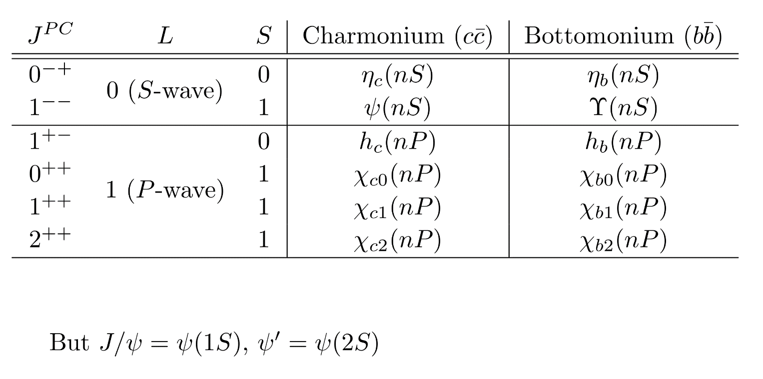
Dictionary – Quark model
$L=$orbital angular momentum
$S=$spin $q+\overline{q}$
$J=$total angular momentum
= exp. measured spin
$I=$isospin = 0 for quarkonia
$$q$$
$$L−S≤J≤L+S$$
$$P={\left(−1\right)}^{L+1}, C={\left(−1\right)}^{L+S}$$
$$G={\left(−1\right)}^{L+S+I}$$
$$\overline{q}$$
$$D$$
Charm ($c\overline{q}$)
Beauty ($\overline{b}q$)
$$D$$
$$B$$
$$D^{∗}$$
$$B^{∗}$$
A. Pilloni – Amplitude analysis for hadron spectroscopy
Notes:
2 slides su Zc, a Bes e a Belle
2 slide su tetraquark model: dall’hamiltoniana di Jaffe al calcolo delle masse
1 slide su molecular models, dove sono i carichi? (non in Tornqvist, si in Hanhart, vedere Braaten, citare Nefediev)
2 slides su decay channels, dove si dovrebbe vedere, e a seconda del modello, vedere qualche plot
1 slide su Y(4260), tetraquark? C’è lo strano (si vede la f0)
1 slide su Zc a cleo (anche il neutro)

Slide 3
Definition of exotics
Despite it’s wrong, the vaste majority of hadrons obeys QM
Whatever is beyond $q\overline{q}$ for mesons and $qqq$ for baryons is exotic
Flavor exotics: e.g. doubly charged meson, baryon with positive strangeness Ex.: $T_{cc}^{+}$ ; if OZI rule enforced, $Z_{c,b}$, $P_{c}$…
Spin exotics: $J^{PC}$ not allowed in QM Ex.: $π_{1}(1600)$ with $J^{PC}=1^{−+}$
Criptoexotics: $J^{PC}$ allowed, but properties not compatible with QM expectations Ex.: $Y(4260)$, $Λ(1405)$, hybrid baryons, $X(3872)$
A. Pilloni – Amplitude analysis for hadron spectroscopy
Notes:
2 slides su Zc, a Bes e a Belle
2 slide su tetraquark model: dall’hamiltoniana di Jaffe al calcolo delle masse
1 slide su molecular models, dove sono i carichi? (non in Tornqvist, si in Hanhart, vedere Braaten, citare Nefediev)
2 slides su decay channels, dove si dovrebbe vedere, e a seconda del modello, vedere qualche plot
1 slide su Y(4260), tetraquark? C’è lo strano (si vede la f0)
1 slide su Zc a cleo (anche il neutro)

Slide 4
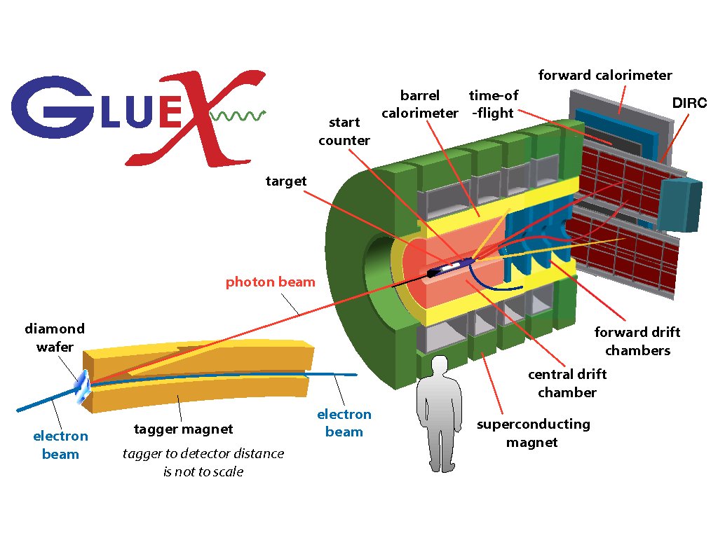
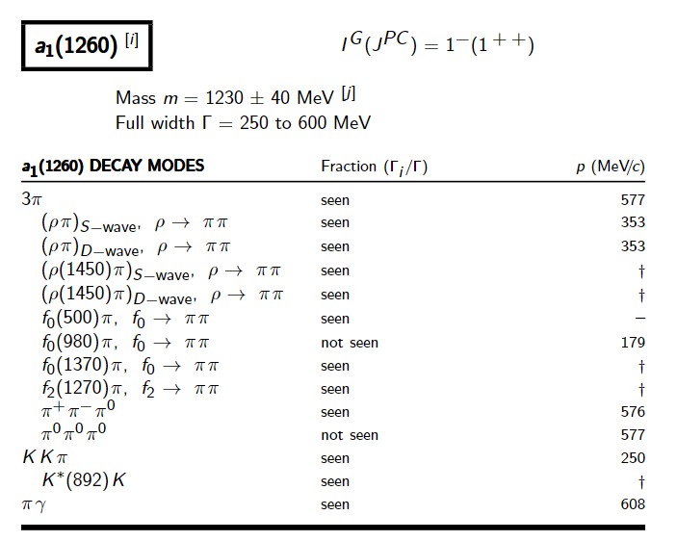
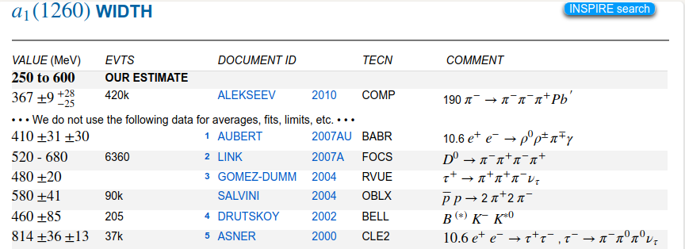
How theorists think of experiments
All the information about hadrons is collected by the Particle Data Group
$$G$$
Changing beam and target, you can change the font
P
D
What theorists see…
What experimentalists present…
A. Pilloni – Amplitude analysis for hadron spectroscopy

Slide 5
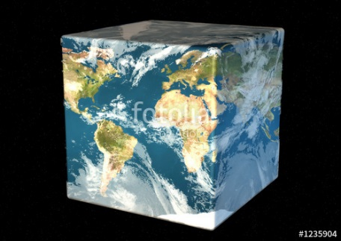
The Richness of the Spectrum
Meson
Baryon
Glueball
Hybrids
Tetraquark
Molecule
Experiment
Data
Amplitude analysis
QCD
Lattice QCD
With great statistics comes great responsibility!
Peter Parker, PhD
For theorists, this is an experimental business
For experimentalists, this is grandma’s recipe
A. Pilloni – Amplitude analysis for hadron spectroscopy

Slide 6
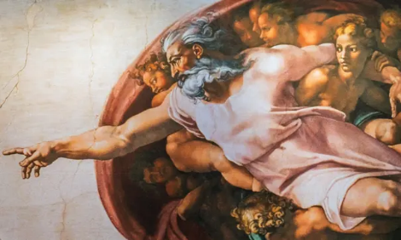
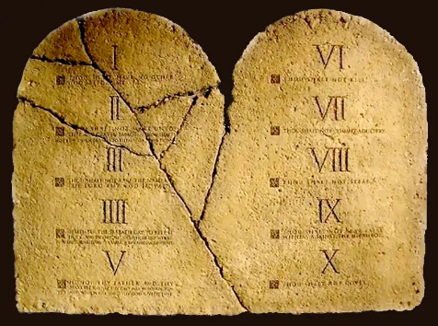
Top-down approach
You are given a model/theory
$$f(s)$$
You calculate the amplitude
You compare with data. Or you don’t.
Predictive power ✓
Physical interpretation ✓ (within the model! ✗) Biased by the input ✗
A. Pilloni – Amplitude analysis for hadron spectroscopy

Slide 7
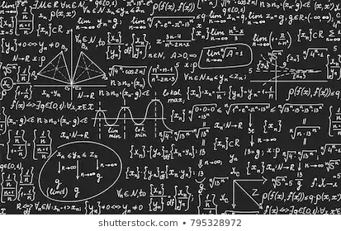
Bottom-up approach
Less predictive power ✗
Some physical interpretation ✗ Minimally biased ✓
You extract physics
You choose a set of generic amplitudes at the hadron level
You start with data
A. Pilloni – Amplitude analysis for hadron spectroscopy

Slide 8
Life is not easy...
A. Pilloni – Amplitude analysis for hadron spectroscopy
Notes:
2 slides su Zc, a Bes e a Belle
2 slide su tetraquark model: dall’hamiltoniana di Jaffe al calcolo delle masse
1 slide su molecular models, dove sono i carichi? (non in Tornqvist, si in Hanhart, vedere Braaten, citare Nefediev)
2 slides su decay channels, dove si dovrebbe vedere, e a seconda del modello, vedere qualche plot
1 slide su Y(4260), tetraquark? C’è lo strano (si vede la f0)
1 slide su Zc a cleo (anche il neutro)

Slide 9
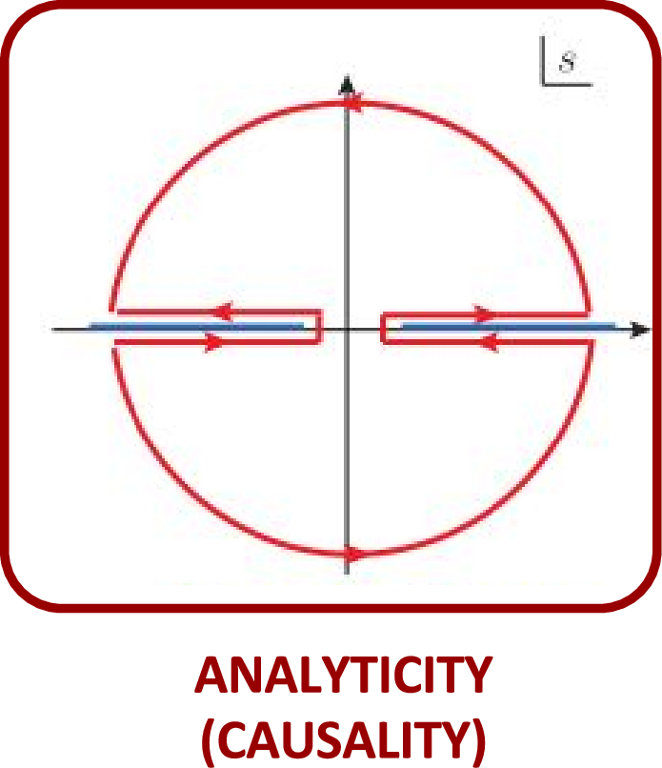
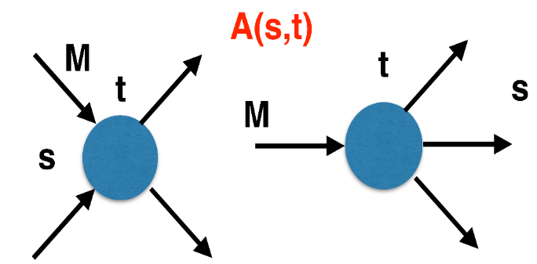
The S-Matrix principles
Future cannot change the past
100%, something will happen
The anti-particle is an anti-particle and not just a different particle
(analyticity)
(unitarity)
(crossing symmetry)
Sherlock Holmes, QFT
Analyticity
Unitarity
Crossing
Parametrize your ignorance.
Build a model.
Fit data.
Have fun.
A. Pilloni – Amplitude analysis for hadron spectroscopy

Slide 10
$S$-Matrix principles
$$t_{l}\left(s\right)=\lim_{ε→0}t_{l}(s+iε)⁡$$
Analyticity
$$\text{Im} t_{l}=ρ_{l}{\left|t_{l}\right|}^{2} ⁡$$
These are constraints the amplitudes have to satisfy, but do not fix the dynamics
They can be imposed with an increasing amount of rigor, to extract robust physics information
The «background» phenomena can be effectively parameterized in a controlled way
+ Lorentz, discrete & global symmetries
A. Pilloni – Amplitude analysis for hadron spectroscopy
Notes:
Controlla la parte su Regge

Slide 11
Crossing symmetry
$$π^{+}$$
$$K^{+}$$
$$π^{+}$$
$$K^{−}$$
$$π^{+}$$
$$K^{+}$$
$$π^{−}$$
$$K^{−}$$
$$π^{+}$$
$$K^{−}$$
$$π^{+}$$
$$K^{+}$$
All these processes are not independent, but are described by the same amplitude!
Simplification – Complication!
It also relates a $1→3$ decay to $2→2$ scattering
A. Pilloni – Amplitude analysis for hadron spectroscopy
Notes:
Controlla la parte su Regge

Slide 12
Analyticity
Complex analytic functions are extremely regular and smooth
Integrals are easy (Cauchy theorem)
If you know the function in a region, you can extend it in a unique way everywhere
Complex functions are characterized by its non-analyticities (poles and cuts)
Analyticity
If I turn on an interaction at $t=0$, and I want nothing happens f$or t<0$, I cannot have singularities in the upper plane
$$f\left(t\right)=\int_{−∞}^{+∞}{e^{−iωt}f\left(ω\right) dω}=2πi\sum_{>/<}{{\text{Res}}_{\text{i}} }$$
A. Pilloni – Amplitude analysis for hadron spectroscopy
Notes:
Controlla la parte su Regge

Slide 13
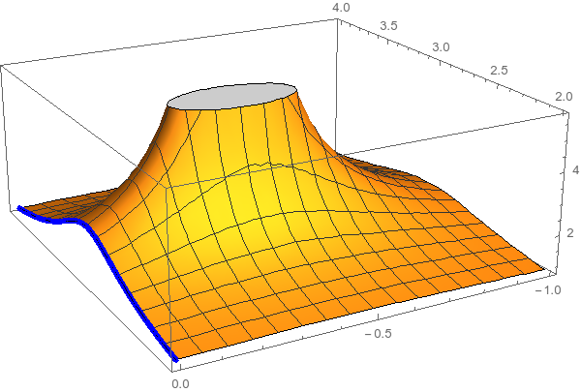
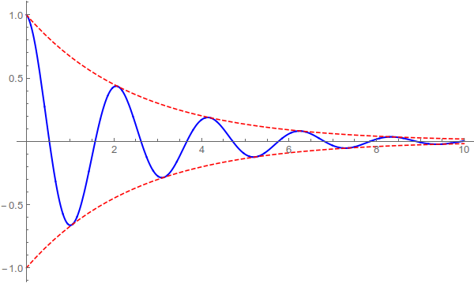
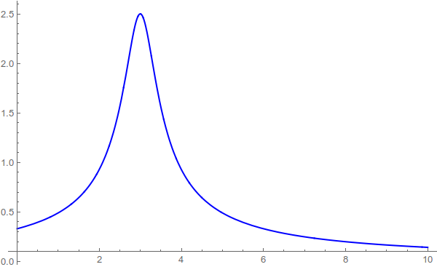
Resonances = Unstable states
$$ψ(t)=e^{−i E_{0} t} e^{− \frac{Γ}{2} t }$$
$$ψ(E)=\frac{1}{E−E_{0}+i\frac{Γ}{2}}$$
The function explodes for value of energy $E=E_{0}−i\frac{Γ}{2}$
Resonances are poles in the complex energy plane
$ψ_{out}\left(r\right)∼e^{i k z}+\frac{f\left(E,θ\right)}{r} e^{ikr}$
Excited states are unstable
They manifest as resonant peaks
A. Pilloni – Amplitude analysis for hadron spectroscopy

Slide 14
Unitarity
$S$ is the scattering operator ($∝$ time evolution from $−∞$ to $+∞$)
We isolate the «nothing happens» part $S=1+i A$
$$\text{Im} A_{i→f}=\frac{1}{2}\sum_{n}{A_{i→n}A_{f→n}^{†}}$$
$$SS^{†}=1$$
Below threshold there are no available states in the sum, so $\text{Im} A(E<E_{\text{thr}})=0$
If a function is nonsingular on the real axis, it admits an analytic continuation using Schwartz reflection principle, $A\left(z^{∗}\right)=A^{∗}(z)$. Above threshold close to the real axis,
$$\text{Im} A\left(E+i ε\right)=\frac{1}{2i}\left[A\left(E+iε\right)−A^{∗}(E+iε)\right]=\frac{1}{2i}\left[A\left(E+iε\right)−A(E−iε)\right]>0$$
So a cut opens on the real axis at threshold
A. Pilloni – Amplitude analysis for hadron spectroscopy
Notes:
Controlla la parte su Regge

Slide 15
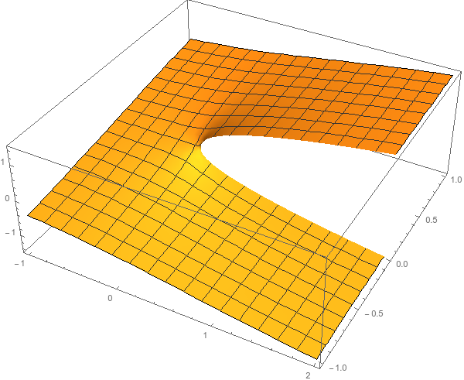
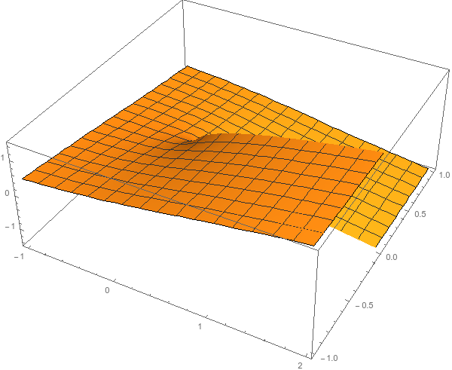
Unitarity
$$\text{Im} A_{i→f}=\frac{1}{2}\sum_{n}{A_{i→n}A_{f→n}^{†}}$$
I have different values of $A$ across the real axis
$$i\sqrt{e^{iπ}}=−1$$
$$i\sqrt{e^{iπ}}=1$$
$$i\sqrt{1}=i$$
Example: $i\sqrt{E}$
$$i\sqrt{e^{2iπ}}=i$$
$$i\sqrt{e^{2iπ}}=−i$$
$$i\sqrt{1}=−i$$
...but I can decide to get the negative solution
I sheet
II sheet
A. Pilloni – Amplitude analysis for hadron spectroscopy
Notes:
Controlla la parte su Regge

Slide 16
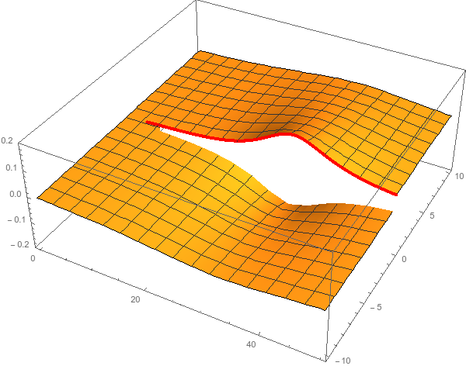
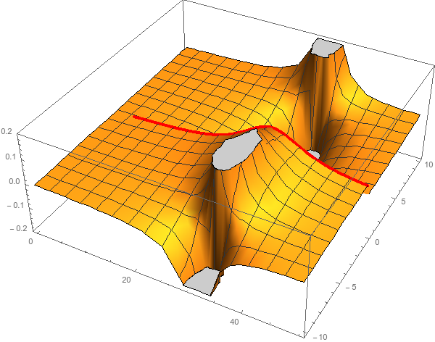
Unitarity & Pole hunting
Unitarity creates a branch cut on the real axis, two sheets continuosly connected
I sheet
II sheet
Finding resonances means writing analytic amplitude, and hunting for poles in the complex plane
A. Pilloni – Amplitude analysis for hadron spectroscopy
Notes:
Controlla la parte su Regge

Slide 17
Partial waves in $2→2$ scattering
Let us consider the elastic scattering of two equal mass spinless particles
$s={\left(p_{1}+p_{2}\right)}^{2}=$ energy squared
$t={\left(p_{1}−p_{3}\right)}^{2}∝\cos{θ}=$ momentum transferred
$$3$$
$$1$$
$$θ$$
$$2$$
$$4$$
Legendre polynomial
$$A\left(s,t\right)=\sum_{l}{A_{l}\left(s\right)P_{l}(\cos{θ})}$$
$$\text{Im} A_{l}\left(s\right)=ρ\left(s\right){\left|A_{l}\left(s\right)\right|}^{2}$$
Phase space (known)
Partial wave
Partial waves diagonalize unitarity: each one statisfy a separate equation Each partial wave has definite orbital angular momentum = spin
Remember: I can only measure cross section (amplitude squared)
A. Pilloni – Amplitude analysis for hadron spectroscopy

Slide 18
The $1→3$ decay chains
Each set of angles is defined in a different reference frame
A. Pilloni – Amplitude analysis for hadron spectroscopy

Slide 19
What do we know?
A. Pilloni – Amplitude analysis for hadron spectroscopy

Slide 20
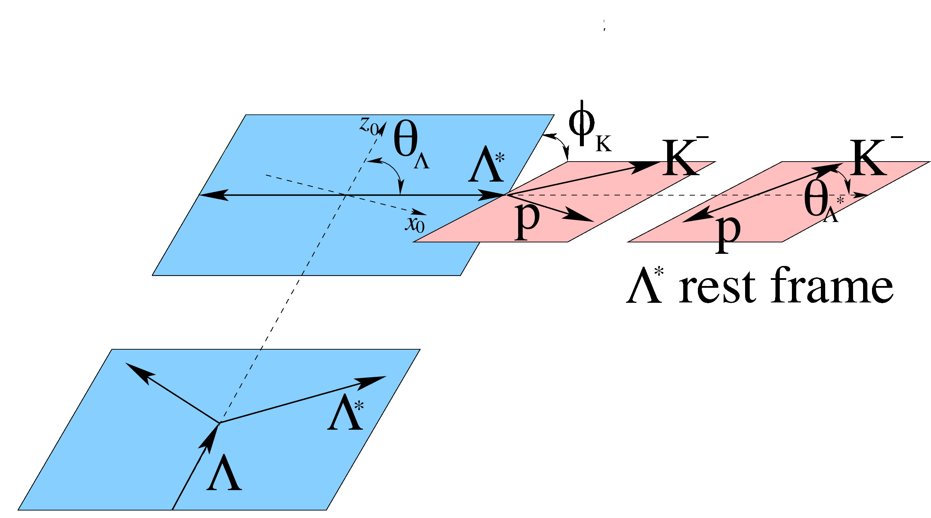
Polarization vs. decay observables
$$\text{π}$$
c
$$\text{π}$$
Measurements of EDM/MDM require the reconstruction of the spin polarization of the heavy baryon
c
$${\text{ϕ}}_{Λ_{\text{c}}}=0$$
lab frame
I discuss the $Λ_{c}^{+}→p K^{−}π^{+}$ 3-body decay
2 Dalitz variables ($m_{Kp},θ_{Λ^{∗}}$) : encode resonance dynamics
3 Euler angles ($φ_{Λ_{c}},θ_{Λ_{c}},φ_{K}$) : encode information about polarization
A. Pilloni – Amplitude analysis for hadron spectroscopy

Slide 21
$Λ_{c}^{+}→p K^{−}π^{+}$
Belle, PRL117, 011801
The dynamics in the Dalitz is extremely rich Resonances appear in all subchannels
$$Λ_{c}^{+}→\left\{\begin{matrix}K^{∗0} p \\ Δ^{++}K^{−} \\ Λ^{∗0}π^{+}\end{matrix}\right\}→pK^{−}π^{+}$$
Each chain prefers a variable choice A proper amplitude analysis is mandatory
A. Pilloni – Amplitude analysis for hadron spectroscopy

Slide 22
Wigner rotations
Let’s analyze the process in the decay plane
$${\vec{p}}_{2}$$
$${\vec{p}}_{0},Λ′$$
$${\vec{p}}_{2}$$
$${\vec{p}}_{1},λ$$
$${\vec{p}}_{0},Λ$$
$${\vec{p}}_{3}$$
Boost in the ${\vec{p}}_{12}$ direction
$${\vec{p}}_{1},λ′$$
$${\vec{p}}_{3}$$
(23) rest frame
(12) rest frame
Helicities are not Lorentz invariant A boost disaligned with the momentum mixes (rotates) the helicities
↓
Additional $d$-functions: Wigner rotations
A. Pilloni – Amplitude analysis for hadron spectroscopy

Slide 23
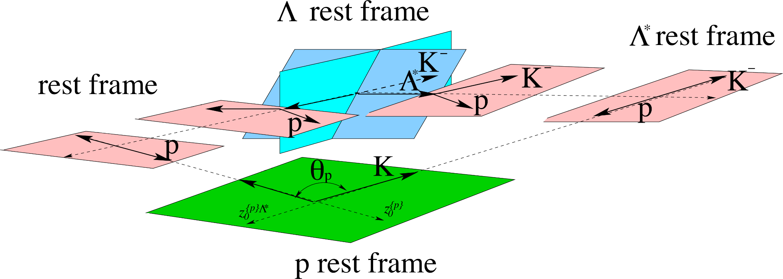
Wigner rotations
c
$$Δ$$
$$Δ$$
$$\text{π}$$
$$\text{π}$$
$$Δ$$
The new rotation is about the $y$ axis, the angle is defined in the rest frame of the $p$ or $Λ_{c}$
A. Pilloni – Amplitude analysis for hadron spectroscopy

Slide 24
The Breit-Wigner
$$A_{i→f}\left(s\right)=\frac{g_{i}g_{f}}{m^{2}−s−i \sum_{f}{g_{f}^{2}ρ_{f}(s)}}$$
$$=\frac{1}{\sqrt{ρ_{i}(m^{2})ρ_{f}(m^{2})}}\frac{Γ\left(m^{2}\right) \sqrt{BR_{i}BR_{f}}}{m^{2}−s−i m Γ(s) }$$
Usually one calls $m$ the BW mass and $Γ\left(m^{2}\right)=g^{2}ρ(m^{2})$ the BW width and states $\sum_{f}{BR_{f}}=1$. If the resonance is narrow, the energy dependence of the width can be neglected, $Γ\left(s\right)≃Γ(m^{2})$
However:
Unitarity is a property of PW and not of a single resonance
The amplitude does not have a pole at $s=m^{2}−i m Γ(m^{2})$
If the resonance is narrow and far from threshold this is ok
A. Pilloni – Amplitude analysis for hadron spectroscopy
Notes:
Controlla la parte su Regge

Slide 25
You shall not sum!
The simplest ansatz for a PW amplitude is the Breit-Wigner
What if I have two resonances? Can I add two BWs?
$$A_{l}\left(s\right)=\frac{g^{2}}{m^{2}−s−i g^{2}ρ(s)}$$
$$A_{l}\left(s\right)=\frac{g_{1}^{2}}{m_{1}^{2}−s−i g_{1}^{2}ρ(s)}+\frac{g_{2}^{2} e^{iα}}{m_{2}^{2}−s−i g_{2}^{2}ρ(s)}$$
Unitarity is broken, $\text{Im} A_{l}\left(s\right)≠ρ\left(s\right){\left|A_{l}\left(s\right)\right|}^{2}$
Unitarity is saturated, $\text{Im} A_{l}\left(s\right)=\text{Im}\frac{m^{2}−s+i g^{2}ρ(s)}{{\left|m^{2}−s−i g^{2}ρ\left(s\right)\right|}^{2}}=ρ\left(s\right){\left|A_{l}\left(s\right)\right|}^{2}$
But that’s precisely what experimentalists do!
Phases take partially into account the modifications of unitarity due to inelastic channels. However, when we shoot for precision, we need better ansätze
Of course they are not stupid, this works if the two resonances are well isolated. Unfortunately we have no simple alternative solution that can work in all situation, we have to proceed case by case and we live on different timescales
A. Pilloni – Amplitude analysis for hadron spectroscopy
Notes:
Controlla la parte su Regge

Slide 26
Bound and virtual states
Decreasing the potential strength, the pole reaches threshold
The pole jumps on the 2nd sheet (dineutron), it becomes a virtual state
Example from $pn$ scattering Bound state on the real axis 1st sheet (deuteron)
$$V(r)$$
$$\text{Im} E$$
$$r$$
$$V$$
Deuteron
$$\text{Re} E$$
$${}_{}^{1}S$$
Deuteron pole
Dineutron pole
$${}_{}^{3}S$$
A. Pilloni – Amplitude analysis for hadron spectroscopy
Notes:
Controlla la parte su Regge

Slide 27
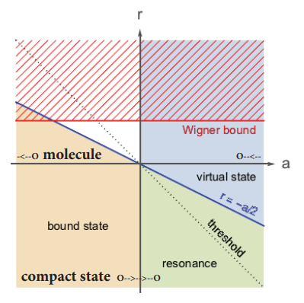
Bound and virtual states
The amplitude close to threshold can be expanded as
$$A\left(E\right)=\frac{1}{\frac{1}{a}+\frac{1}{2}r_{0}k^{2}−ik+O\left(k^{4}\right)}$$
$a$ is the scattering length
$r_{0}$is the effective range
The sign of $a$ controls whether we have a bound or virtual state
A. Pilloni – Amplitude analysis for hadron spectroscopy
Notes:
Controlla la parte su Regge

Slide 28
Weinberg’s criterion and lineshapes
Let us imagine to have a theory with a bound state with a binding momentum much smaller than the inverse of the range of the potential
The potential is just a delta function, we calculate the $2→2$ scattering amplitude
+
+
+ …
$$A(E)=\frac{1}{1/a−i\sqrt{2μE}}$$
This has a pole at $E=−E_{B}=−\frac{1}{2μa^{2}}$ and residue $g^{2}=\sqrt{\frac{2E_{B}}{μ}}$
A. Pilloni – Amplitude analysis for hadron spectroscopy
Notes:
Controlla la parte su Regge

Slide 29
Weinberg’s criterion and lineshapes
Now let us consider the propagation of a bare intermediate state
+
+
+ …
$$A\left(E\right)=\frac{g_{0}^{2}}{E_{0}−E−ig_{0}^{2}\sqrt{2μE}}=\frac{g_{0}^{2}}{{−E}_{B}−E−ig_{0}^{2}\sqrt{2μE}−g_{0}^{2}\sqrt{2μE_{B}}}$$
This has a pole at $E_{B}$ and residue $g^{2}=\sqrt{\frac{2E_{B}}{μ}}\left(1−Z\right)$ where $Z$ is the w.f. renormalization, $Z={\left(1+g_{0}^{2}\sqrt{\frac{μ}{2E_{B}}}\right)}^{−1}$= overlap between the bare state and the continuum
A. Pilloni – Amplitude analysis for hadron spectroscopy
Notes:
Controlla la parte su Regge

Slide 30
Weinberg’s criterion and lineshapes
The amplitude can be rewritten as
$$A\left(E\right)=\frac{1}{\frac{1}{a}+\frac{1}{2}r_{0}k^{2}−ik}$$
Thus identifying $a=−2 \frac{1−Z}{2−Z}\frac{1}{\sqrt{2μE_{B}}}$, $r_{0}=−\frac{Z}{1−Z}\frac{1}{\sqrt{2μE_{B}}}$
So a negative $r_{0}$ points to a short range component in the wave function
This is true up to corrections of the order of the range of the potential, which btw are positive under general assumptions
Esposito, Maiani, Pilloni, Polosa, Riquer, 105 (2022) 3, L031503
A. Pilloni – Amplitude analysis for hadron spectroscopy
Notes:
Controlla la parte su Regge

Slide 31
L. Maiani
A. Pilloni – Amplitude analysis for hadron spectroscopy
Notes:
Controlla la parte su Regge

Slide 32
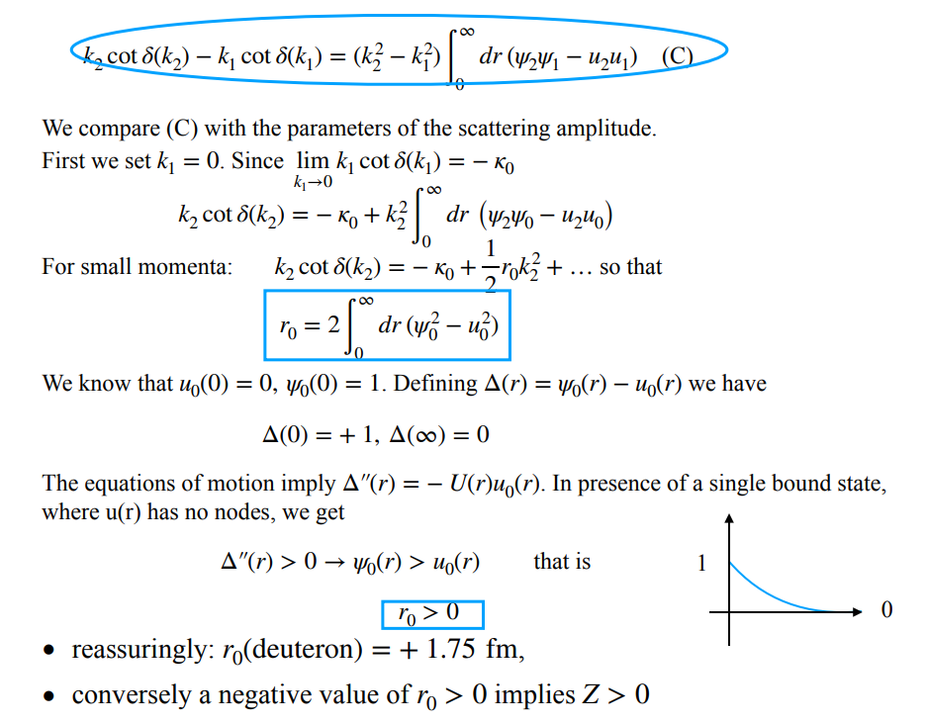
L. Maiani
A. Pilloni – Amplitude analysis for hadron spectroscopy
Notes:
Controlla la parte su Regge

Slide 33
Coupled channels
For coupled channels, $2→2$ unitarity gets easily generalized from
$$\text{Im} A_{l}^{−1}\left(s\right)=−ρ\left(s\right)=−\left(\begin{matrix}ρ_{1}(s) & 0 & 0 \\ 0 & ρ_{2}(s) & 0 \\ 0 & 0 & ⋱\end{matrix}\right)$$
With two channels, a simple form is given by Flatté,
$$A_{l}^{−1}\left(s\right)∝det {\left(K^{−1}−i ρ\left(s\right)\right)}^{−1}∝m^{2}−s−i g_{1}^{2}ρ_{1}\left(s\right)−g_{2}^{2}ρ_{2}\left(s\right)$$
Having two channels, I have two Riemann sheets for each phase space function, so 4 Riemann sheets
A. Pilloni – Amplitude analysis for hadron spectroscopy
Notes:
Controlla la parte su Regge

Slide 34
Coupled channels
$ρ_{ψp}(s):$ +
$ρ_{ΣD}(s):$ +
$ρ_{ψp}(s):$ −
$ρ_{ΣD}(s):$ +
$ρ_{ψp}(s):$ −
$ρ_{ΣD}(s):$ −
$ρ_{ψp}(s):$ +
$ρ_{ΣD}(s):$ −
I sheet
II sheet
III sheet
IV sheet
Virtual state
$$J/ψ p$$
$$Σ_{c}^{+}\overline{D^{0}}$$
?
?
Bound state
Compact state
Diving under the first cut one access the II sheet, where generally bound states appear
Diving under both cuts one access the III sheet, where generally compact states appear
Diving twice one access the IV sheet, where virtual states appear poles only relevant close to the higher threshold
Data live above the real axis on the I sheet
A. Pilloni – Amplitude analysis for hadron spectroscopy
Notes:
Controlla la parte su Regge

Slide 35
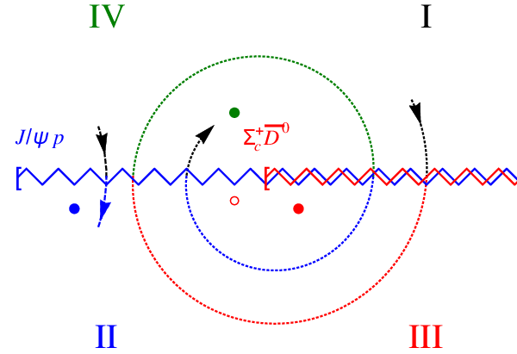
Coupled channels
Virtual state
Bound state
Resonance
A. Pilloni – Amplitude analysis for hadron spectroscopy
Notes:
Controlla la parte su Regge

Slide 36
Next lecture
Whatever is left from this lecture
The light exotics: the scalar nonet, hybrids and glueballs
Thank you
A. Pilloni – Amplitude analysis for hadron spectroscopy
Notes:
2 slides su Zc, a Bes e a Belle
2 slide su tetraquark model: dall’hamiltoniana di Jaffe al calcolo delle masse
1 slide su molecular models, dove sono i carichi? (non in Tornqvist, si in Hanhart, vedere Braaten, citare Nefediev)
2 slides su decay channels, dove si dovrebbe vedere, e a seconda del modello, vedere qualche plot
1 slide su Y(4260), tetraquark? C’è lo strano (si vede la f0)
1 slide su Zc a cleo (anche il neutro)

Slide 37
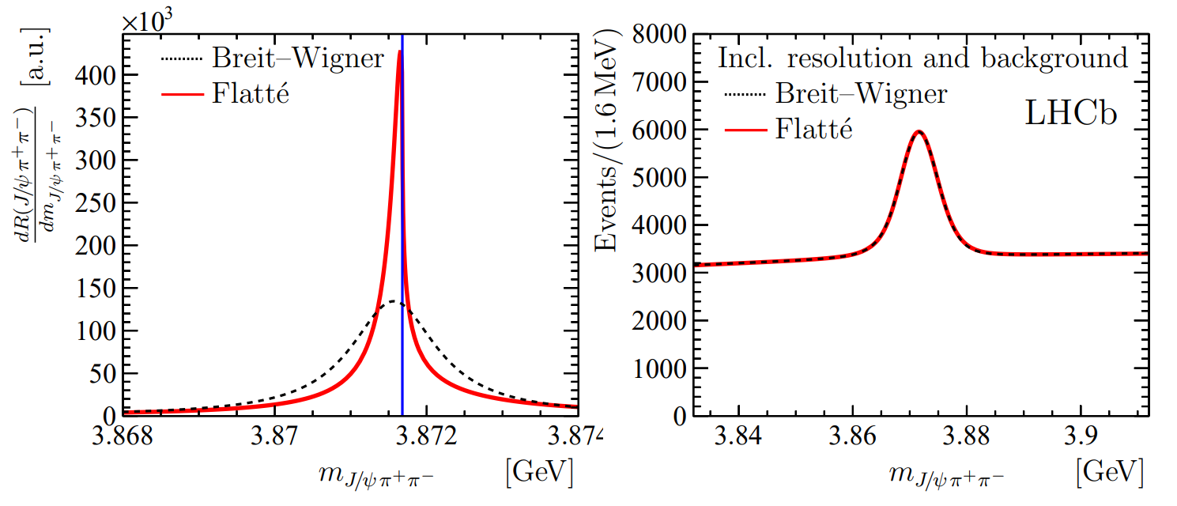
The lineshape of the $X(3872)$
Blue line is $D^{0}\overline{D^{∗0}}$,
$D^{+}D^{∗−}$ is $δ=8.2 \text{MeV}$
heavier
Because of experimental resolution, different lineshapes are indistinguishable
Unitary parametrizations tend to be narrower, $Γ_{BW}=1.39±0.24±0.10 \text{MeV}$, $Γ_{fl}={0.22}_{−0.06−0.13}^{+0.07+0.11} \text{MeV}$
A. Pilloni – Amplitude analysis for hadron spectroscopy
Notes:
Controlla la parte su Regge

Slide 38
The lineshape of the $X(3872)$
Esposito, Maiani, AP, Polosa, Riquer, PRD 105 (2022) 3, L031503
LHCb data is fitted with the Flatte’ parametrization
The $D^{0}\overline{D^{∗0}}$ threshold
Two options: a) I set $δ=0$ b) I expand at threshold
The $D^{+}D^{∗−}$ threshold
The $J/ψ ρ,ω,$ and other unknown channels
This considers coupled channel, but Weinberg’s criterion applies to single channel bound states only
A. Pilloni – Amplitude analysis for hadron spectroscopy
Notes:
Controlla la parte su Regge

Slide 39
The lineshape of the $X(3872)$
Esposito, Maiani, AP, Polosa, Riquer, PRD 105 (2022) 3, L031503
Option b)
Option a)
According to Weinberg’s, the first result points to a sizeable short-range structure of the X(3872)
Still disagreement on how to perform the extraction though
A. Pilloni – Amplitude analysis for hadron spectroscopy
Notes:
Controlla la parte su Regge

Slide 40
New pentaquarks discovered
The lowest $P_{c}(4312)$ appears as an isolated peak at the $Σ_{c}^{+}{\overline{D}}^{0}$ threshold
A detailed study of the lineshape provides insight on its nature
Bottom-up: DON’T YOU DARE describing everything!!! Focus on the peak region
A. Pilloni – Amplitude analysis for hadron spectroscopy
Notes:
Controlla la parte su Regge

Slide 41
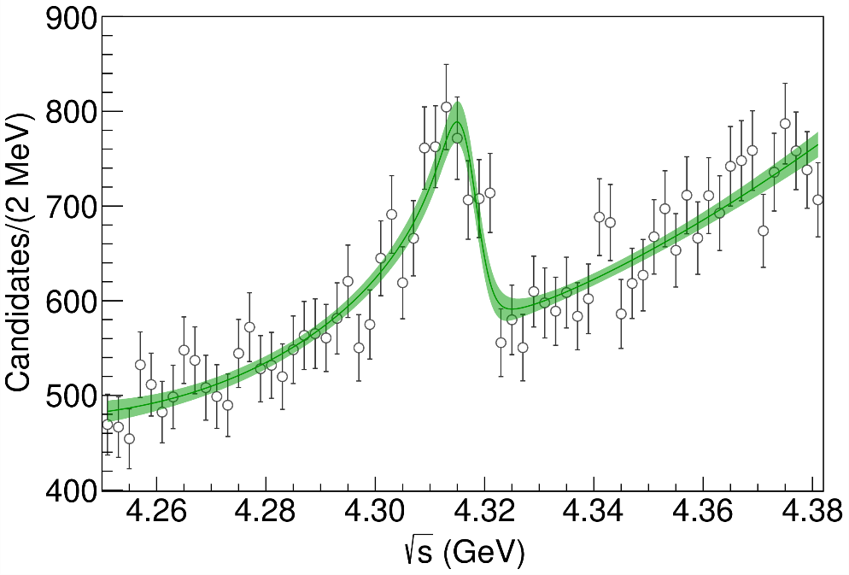
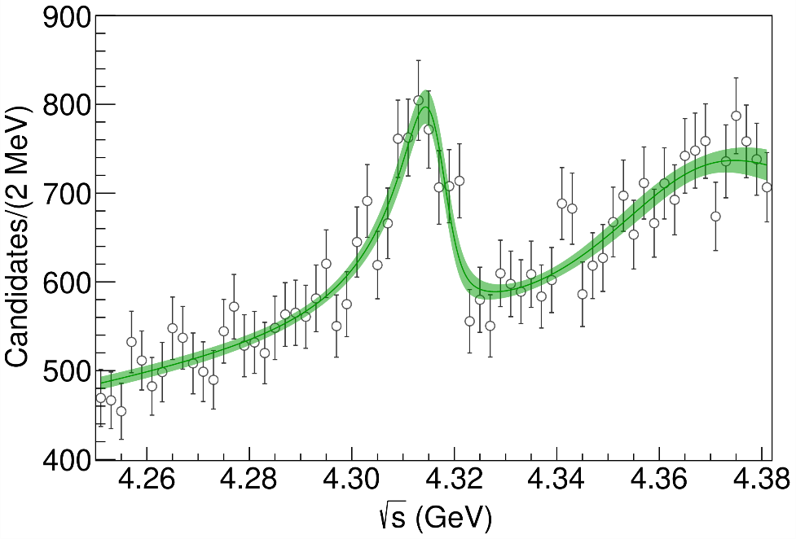
Minimal(istic) model for $P_{c}(4312)$
( data)
Fernandez-Ramirez, AP et al. (JPAC), PRL 123, 092001
Effective range expansion We can set $c_{ii}=0$ to reduce to the scattering length approximation
$$c_{ii}=0$$
Finite $c_{ii}$
A. Pilloni – Amplitude analysis for hadron spectroscopy
Notes:
2 slides su Zc, a Bes e a Belle
2 slide su tetraquark model: dall’hamiltoniana di Jaffe al calcolo delle masse
1 slide su molecular models, dove sono i carichi? (non in Tornqvist, si in Hanhart, vedere Braaten, citare Nefediev)
2 slides su decay channels, dove si dovrebbe vedere, e a seconda del modello, vedere qualche plot
1 slide su Y(4260), tetraquark? C’è lo strano (si vede la f0)
1 slide su Zc a cleo (anche il neutro)

Slide 42
Minimal(istic) model for $P_{c}(4312)$
Effective range expansion We can set $c_{ii}=0$ to reduce to the scattering length approximation
$$c_{ii}=0$$
Finite $c_{ii}$
A. Pilloni – Amplitude analysis for hadron spectroscopy
Notes:
2 slides su Zc, a Bes e a Belle
2 slide su tetraquark model: dall’hamiltoniana di Jaffe al calcolo delle masse
1 slide su molecular models, dove sono i carichi? (non in Tornqvist, si in Hanhart, vedere Braaten, citare Nefediev)
2 slides su decay channels, dove si dovrebbe vedere, e a seconda del modello, vedere qualche plot
1 slide su Y(4260), tetraquark? C’è lo strano (si vede la f0)
1 slide su Zc a cleo (anche il neutro)

Slide 43
Minimal(istic) model for $P_{c}(4312)$
Effective range expansion We can set $c_{ii}=0$ to reduce to the scattering length approximation
Points to a virtual state
$$c_{ii}=0$$
Finite $c_{ii}$
A. Pilloni – Amplitude analysis for hadron spectroscopy
Notes:
2 slides su Zc, a Bes e a Belle
2 slide su tetraquark model: dall’hamiltoniana di Jaffe al calcolo delle masse
1 slide su molecular models, dove sono i carichi? (non in Tornqvist, si in Hanhart, vedere Braaten, citare Nefediev)
2 slides su decay channels, dove si dovrebbe vedere, e a seconda del modello, vedere qualche plot
1 slide su Y(4260), tetraquark? C’è lo strano (si vede la f0)
1 slide su Zc a cleo (anche il neutro)

Slide 44
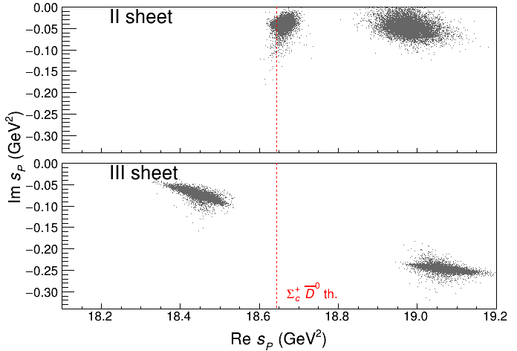
Minimal(istic) model for $P_{c}(4312)$
Effective range expansion We can set $c_{ii}=0$ to reduce to the scattering length approximation
Points to a virtual state
Doesn’t point to a resonance
$$c_{ii}=0$$
Finite $c_{ii}$
A. Pilloni – Amplitude analysis for hadron spectroscopy
Notes:
2 slides su Zc, a Bes e a Belle
2 slide su tetraquark model: dall’hamiltoniana di Jaffe al calcolo delle masse
1 slide su molecular models, dove sono i carichi? (non in Tornqvist, si in Hanhart, vedere Braaten, citare Nefediev)
2 slides su decay channels, dove si dovrebbe vedere, e a seconda del modello, vedere qualche plot
1 slide su Y(4260), tetraquark? C’è lo strano (si vede la f0)
1 slide su Zc a cleo (anche il neutro)

Slide 45
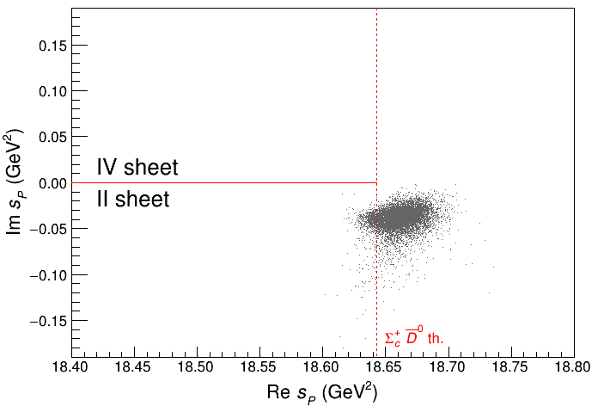
Minimal(istic) model for $P_{c}(4312)$
Effective range expansion We can set $c_{ii}=0$ to reduce to the scattering length approximation
Points to a virtual state
Doesn’t point to a resonance
$$c_{ii}=0$$
Finite $c_{ii}$
A. Pilloni – Amplitude analysis for hadron spectroscopy
Notes:
2 slides su Zc, a Bes e a Belle
2 slide su tetraquark model: dall’hamiltoniana di Jaffe al calcolo delle masse
1 slide su molecular models, dove sono i carichi? (non in Tornqvist, si in Hanhart, vedere Braaten, citare Nefediev)
2 slides su decay channels, dove si dovrebbe vedere, e a seconda del modello, vedere qualche plot
1 slide su Y(4260), tetraquark? C’è lo strano (si vede la f0)
1 slide su Zc a cleo (anche il neutro)

Slide 46
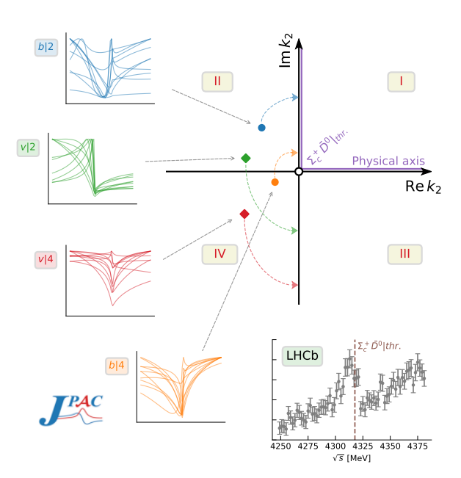
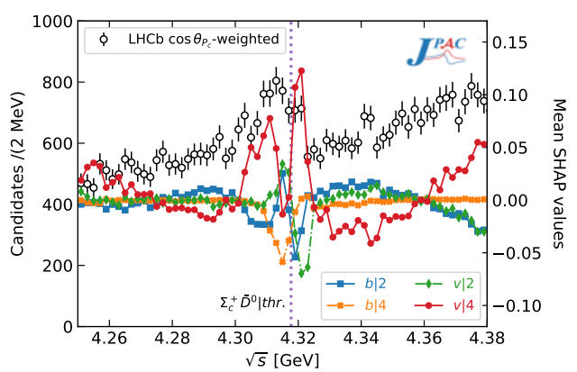
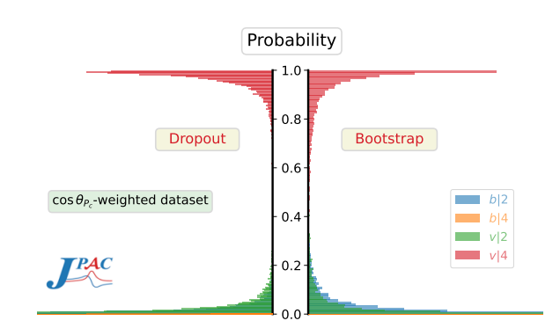
Minimal(istic) model with ANN
Ng, et al. (JPAC), PRD 105, L091501
Same conclusion reached if the analysis is performed with a Deep Neural Network
The peak region has the largest impact for the decision
Highest probability for a virtual state in the IV sheet
A. Pilloni – Amplitude analysis for hadron spectroscopy
Notes:
2 slides su Zc, a Bes e a Belle
2 slide su tetraquark model: dall’hamiltoniana di Jaffe al calcolo delle masse
1 slide su molecular models, dove sono i carichi? (non in Tornqvist, si in Hanhart, vedere Braaten, citare Nefediev)
2 slides su decay channels, dove si dovrebbe vedere, e a seconda del modello, vedere qualche plot
1 slide su Y(4260), tetraquark? C’è lo strano (si vede la f0)
1 slide su Zc a cleo (anche il neutro)

Slide 47
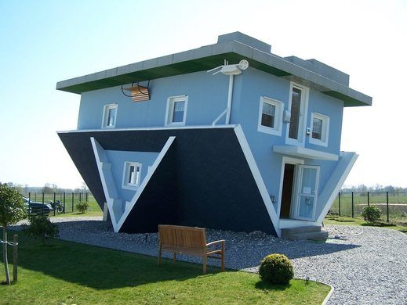
The lightest scalars
$$0^{++}$$
A. Pilloni – Amplitude analysis for hadron spectroscopy
Notes:
2 slides su Zc, a Bes e a Belle
2 slide su tetraquark model: dall’hamiltoniana di Jaffe al calcolo delle masse
1 slide su molecular models, dove sono i carichi? (non in Tornqvist, si in Hanhart, vedere Braaten, citare Nefediev)
2 slides su decay channels, dove si dovrebbe vedere, e a seconda del modello, vedere qualche plot
1 slide su Y(4260), tetraquark? C’è lo strano (si vede la f0)
1 slide su Zc a cleo (anche il neutro)

Slide 48
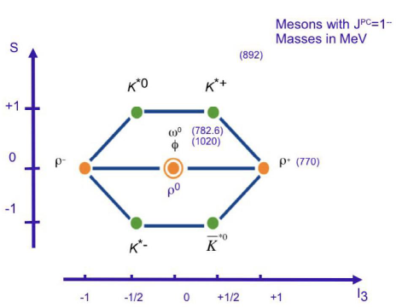
The light vector nonet
$$L=0, S=1$$
$$d\overline{s}$$
$$u\overline{s}$$
$$φ$$
$$2m_{s}$$
$$u\overline{u}+d\overline{d}$$
$$s\overline{s}$$
$$K^{∗}$$
$$m_{s}+m_{q}$$
$$d\overline{u}$$
$$u\overline{d}$$
$$u\overline{u}−d\overline{d}$$
$$ρ,ω$$
$$2m_{q}$$
$$s\overline{u}$$
$$s\overline{d}$$
A. Pilloni – Amplitude analysis for hadron spectroscopy

Slide 49
The light scalar nonet/1
$$L=1, S=1$$
$$0^{++}$$
$$κ^{0}$$
$$κ^{+}(700)$$
$$a_{0},f_{0}$$
$$??$$
$$f_{0}(980)$$
$$σ(500)$$
$$a_{0}^{−}$$
$$a_{0}^{+}(980)$$
$$κ$$
$$??$$
$$a_{0}^{0}$$
$$σ$$
$$??$$
$$κ^{−}$$
$$\overline{κ^{0}}$$
A. Pilloni – Amplitude analysis for hadron spectroscopy

Slide 50
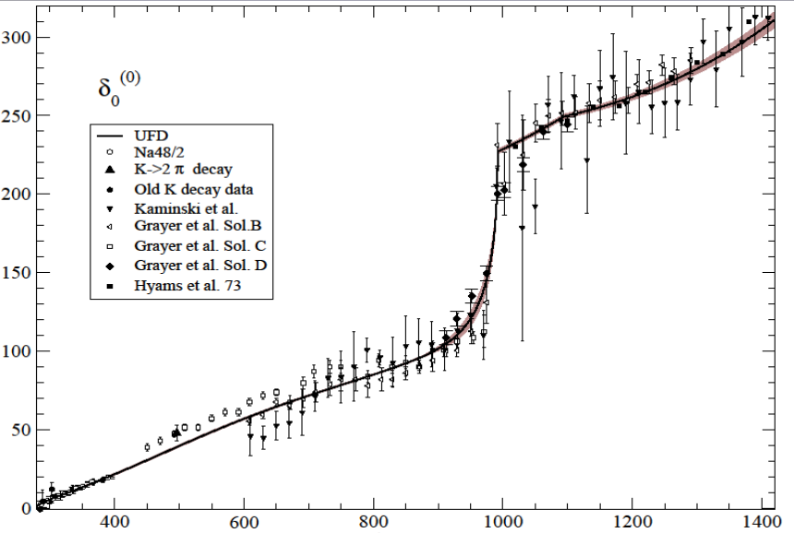
But where is the $σ$?
$$f_{0}(980)$$
The Adler zero is a zero of the $S$-wave amplitude due to chiral symmetry In UχPT it most often generate a pole identified as the $σ$
$$σ???$$
$ππ$ scattering shift for $L=0,I=0$
Really, really need amplitude analysis to get something meaningful about the $σ$
A. Pilloni – Amplitude analysis for hadron spectroscopy

Slide 51
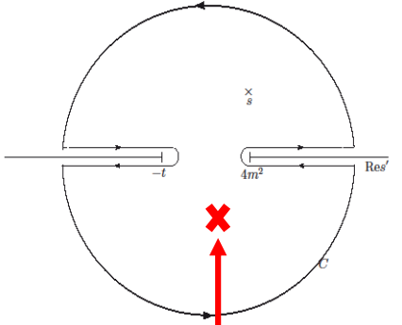
Roy equations (sketched)
1) You use the analytic properties of the amplitude and write Cauchy theorem
2) You use crossing symmetry to rewrite the integral of the left-hand cut as an integral of the right-hand cut
3) You expand the amplitude in partial waves
$$T\left(s,t\right)=\sum_{l}{t_{l}\left(s\right)P_{l}(\cos{θ})}$$
The dispersive integral helps the analytic continuation
Don’t be scared, you’ll have Astrid’s lectures…
A. Pilloni – Amplitude analysis for hadron spectroscopy

Slide 52
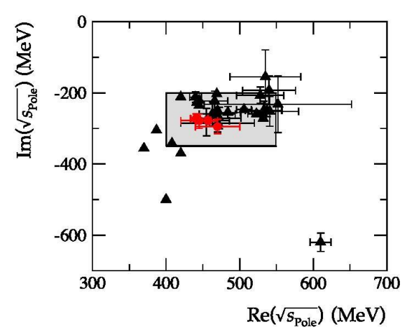
Results
Colangelo, Gasser, Leutwyler, NPB603, 125 (2001)
Caprini, Colangelo, Leutwyler, PRL 96, 132001 (2006)
Garcia-Martin, Kaminski, Peláez, Ruiz de Elvira, PRL107, 072001(2011)
Moussallam, EPJC71, 1814 (2011)
Masjuan, Ruiz de Elvira, Sanz-Cillero, PRD90, 097901 (2014)
Peláez, Phys.Rept. 658 (2016)
Descotes-Genon, Moussallam, EPJC48, 553 (2006)
Peláez, Rodas, arXiv:2010.11222
A. Pilloni – Amplitude analysis for hadron spectroscopy

Slide 53
The hybrid $π_{1}$
A. Pilloni – The pole hunter
Notes:
2 slides su Zc, a Bes e a Belle
2 slide su tetraquark model: dall’hamiltoniana di Jaffe al calcolo delle masse
1 slide su molecular models, dove sono i carichi? (non in Tornqvist, si in Hanhart, vedere Braaten, citare Nefediev)
2 slides su decay channels, dove si dovrebbe vedere, e a seconda del modello, vedere qualche plot
1 slide su Y(4260), tetraquark? C’è lo strano (si vede la f0)
1 slide su Zc a cleo (anche il neutro)

Slide 54
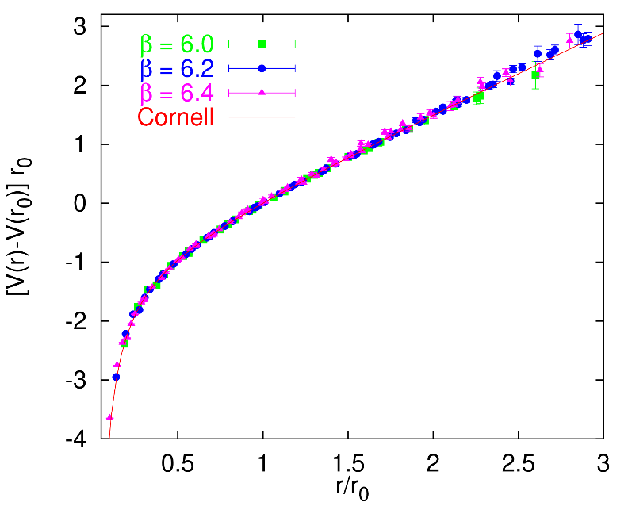
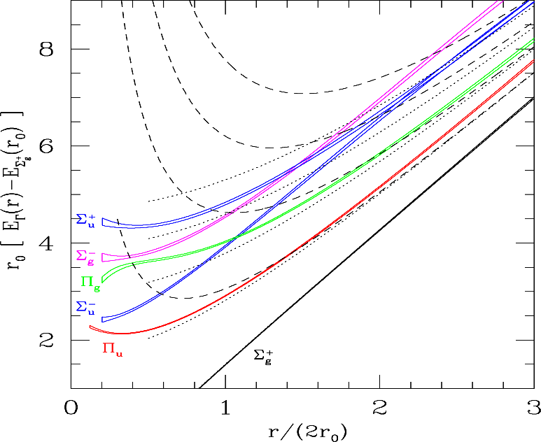
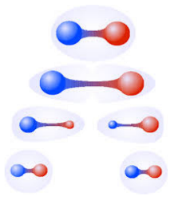
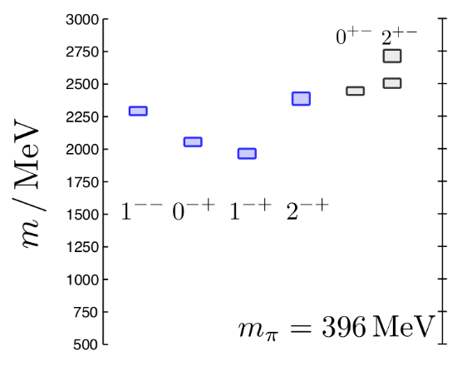
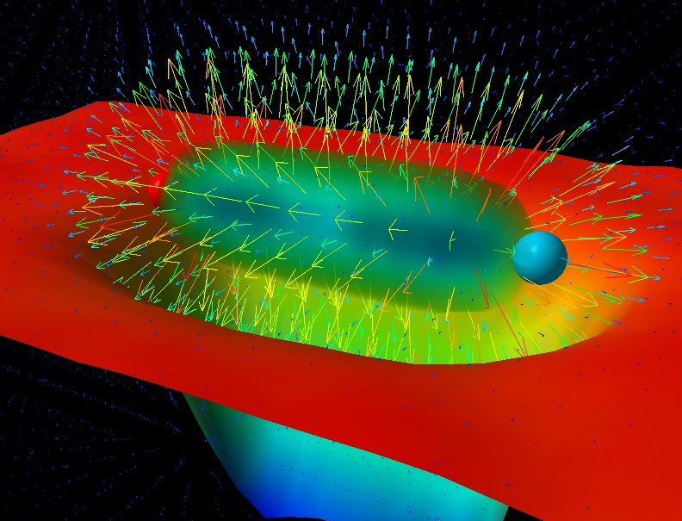
Learning about confinement
If quarks were infinitely heavy, gluonic field is confined in a string
Linear rising potential
What is a constituent gluon?
vibration of the string? → degenerate $J^{PC}={\left(0,1,2\right)}^{−+},{\left(0,1,2\right)}^{+−}$
excitation of a quasiparticle? → degenerate $J^{PC}={\left(0,1,2\right)}^{−+},1^{−−}$
G. Bali
C. Morningstar
J. Dudek
excitation of a quasiparticle! → degenerate $J^{PC}={\left(0,1,2\right)}^{−+},1^{−−}$ says Lattice QCD...
What about real data?
D. Leinweber
A. Pilloni – Amplitude analysis for hadron spectroscopy
Notes:
Controlla la parte su Regge

Slide 55
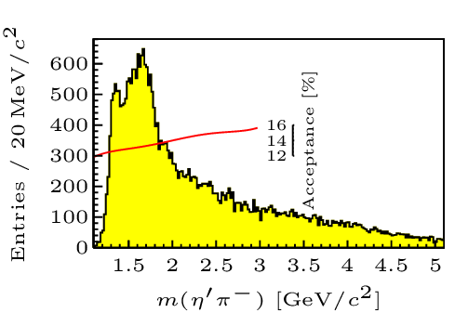
Hybrid hunting
J. Dudek
Excited gluon, $$J^{PC}=1^{+−}$$ mass $∼1.0\text{−}1.5 \text{GeV}$
$$\overline{r}$$
$$\overline{g}$$
$$r$$
excitation of a quasiparticle? → degenerate $J^{PC}={\left(0,1,2\right)}^{−+},1^{−−}$
$$g$$
Look for a $π_{1}$ state with $J^{PC}=1^{−+}$
decaying into $\left\{\begin{matrix}η π \text{and} η^{′}π \\ ρ π→3π \\ b_{1}π→5π\end{matrix}\right.$
Small signal in data
A. Pilloni – Amplitude analysis for hadron spectroscopy
Notes:
2 slides su Zc, a Bes e a Belle
2 slide su tetraquark model: dall’hamiltoniana di Jaffe al calcolo delle masse
1 slide su molecular models, dove sono i carichi? (non in Tornqvist, si in Hanhart, vedere Braaten, citare Nefediev)
2 slides su decay channels, dove si dovrebbe vedere, e a seconda del modello, vedere qualche plot
1 slide su Y(4260), tetraquark? C’è lo strano (si vede la f0)
1 slide su Zc a cleo (anche il neutro)

Slide 56
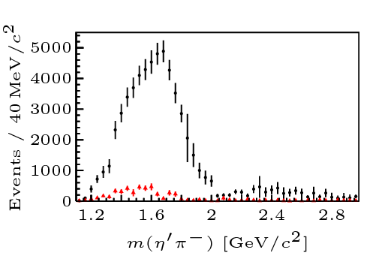
Two hybrid states???
Neither lattice nor models predict two $1^{−+}$ states in this region!
A hybrid meson ($8$) cannot decay into $ηπ$ in the SU(3) limit
Tetraquark ($10⊕\overline{10}$)? Requires doubly charged
A. Pilloni – Amplitude analysis for hadron spectroscopy
Notes:
2 slides su Zc, a Bes e a Belle
2 slide su tetraquark model: dall’hamiltoniana di Jaffe al calcolo delle masse
1 slide su molecular models, dove sono i carichi? (non in Tornqvist, si in Hanhart, vedere Braaten, citare Nefediev)
2 slides su decay channels, dove si dovrebbe vedere, e a seconda del modello, vedere qualche plot
1 slide su Y(4260), tetraquark? C’è lo strano (si vede la f0)
1 slide su Zc a cleo (anche il neutro)

Slide 57
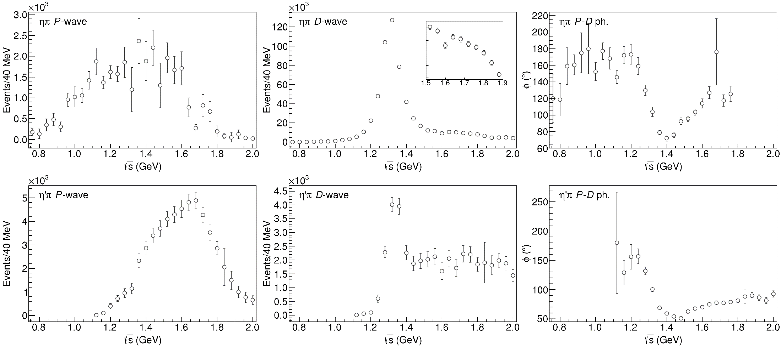
Data in $η^{(′)}π$
( data)
$$π_{1}\left(1400\right)?$$
$$a_{2}\left(1320\right)$$
$$a_{2}^{′}\left(1700\right)$$
$$π_{1}\left(1600\right)?$$
$$a_{2}\left(1320\right)$$
$$a_{2}^{′}\left(1700\right)$$
$$J^{PC}=1^{−+}$$
$$J^{PC}=2^{++}$$
A. Pilloni – Amplitude analysis for hadron spectroscopy
Notes:
Controlla la parte su Regge

Slide 58
Amplitudes for $η^{(′)}π$
We build the partial wave amplitudes according to the $N/D$ method
Jackura, Mikhasenko, AP et al. (JPAC & COMPASS), PLB
Rodas, AP et al. (JPAC), PRL
$$a\left(s\right)=\frac{n\left(s\right)}{D\left(s\right)}$$
$$D(s)$$
$$n(s)$$
The $n\left(s\right)$ → background physics, process-dependent, smooth
The $D(s)$ contains all the Final State Interactions constrained by unitarity → universal
A. Pilloni – Amplitude analysis for hadron spectroscopy
Notes:
Controlla la parte su Regge

Slide 59
Coupled channel: the model
A. Rodas, AP et al. (JPAC) PRL122, 042002
Two channels, $i,k=ηπ, η^{′}π$ Two waves, $J=P,D$ 37 fit parameters
1 K-matrix pole for the P-wave
2 K-matrix poles for the D-wave
Left-hand scale (Blatt-Weisskopf radius) $s_{R}=s_{0}=1 {\text{GeV}}^{2}$
$α=2$, 3rd order polynomial for $n_{k}^{J}(s)$
A. Pilloni – Amplitude analysis for hadron spectroscopy
Notes:
Controlla la parte su Regge

Slide 60
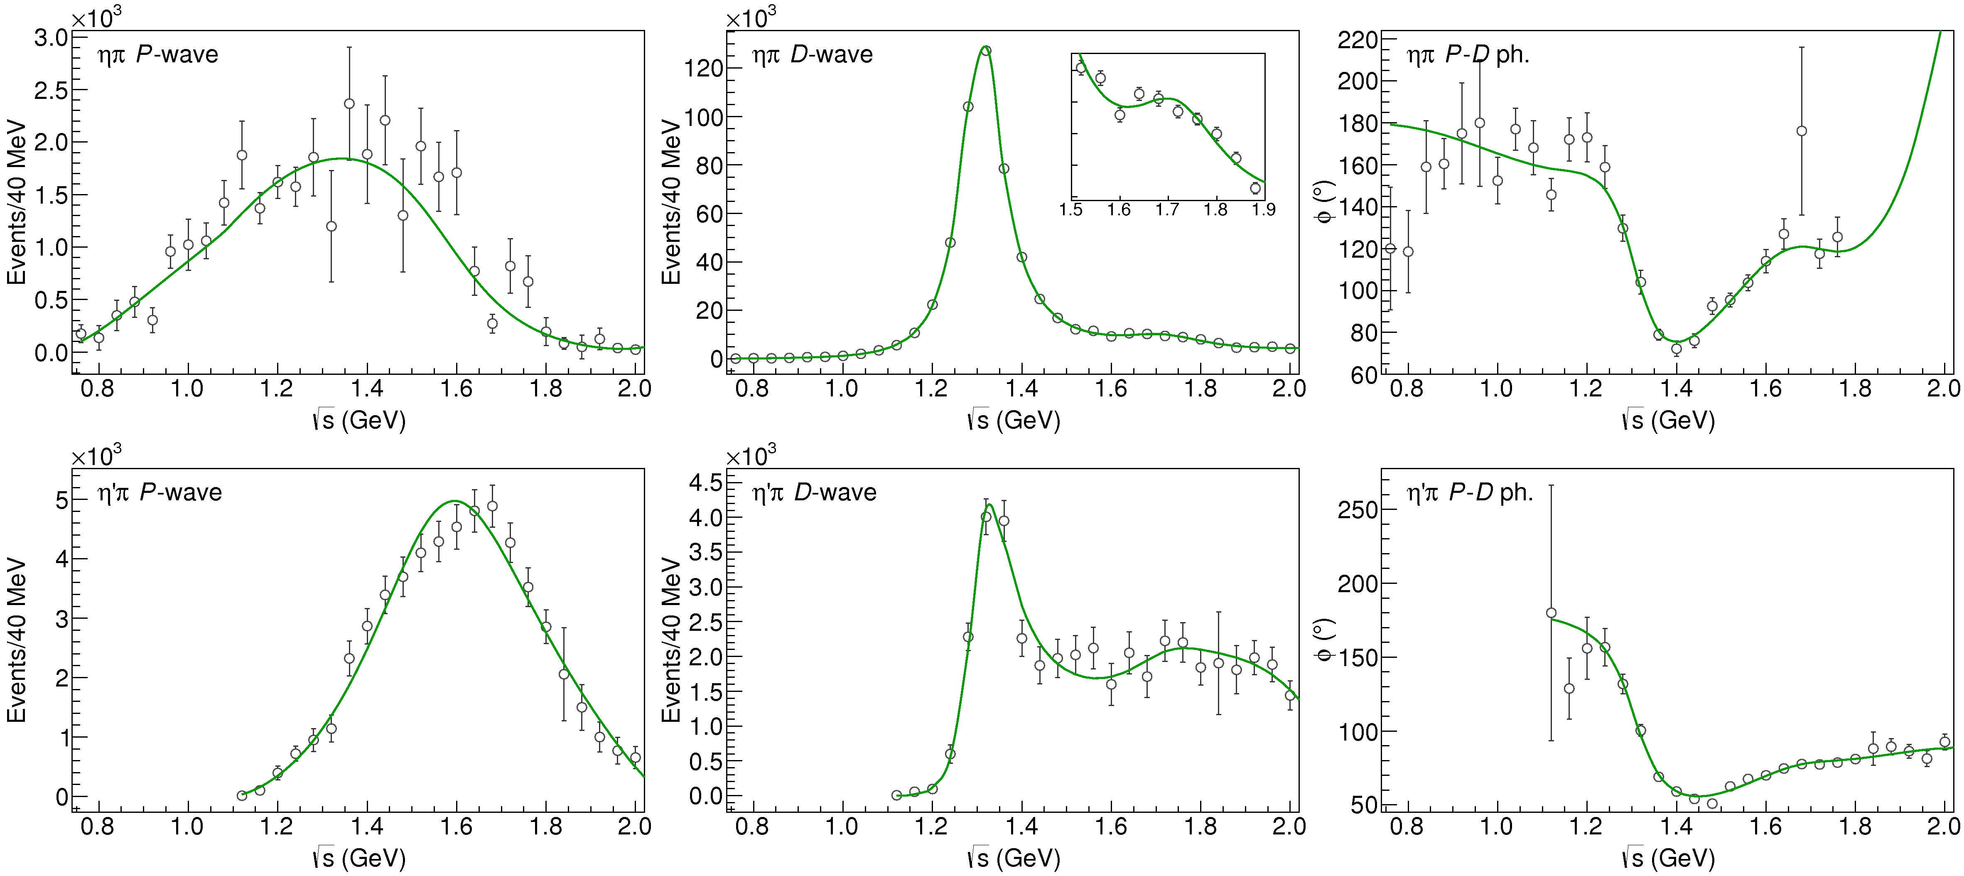
Fit to $η^{(′)}π$
( data)
$$π_{1}\left(1400\right)?$$
$$a_{2}\left(1320\right)$$
$$a_{2}^{′}\left(1700\right)$$
$$π_{1}\left(1600\right)?$$
$$a_{2}\left(1320\right)$$
$$a_{2}^{′}\left(1700\right)$$
$$J^{PC}=1^{−+}$$
$$J^{PC}=2^{++}$$
A. Pilloni – Amplitude analysis for hadron spectroscopy
Notes:
Controlla la parte su Regge

Slide 61
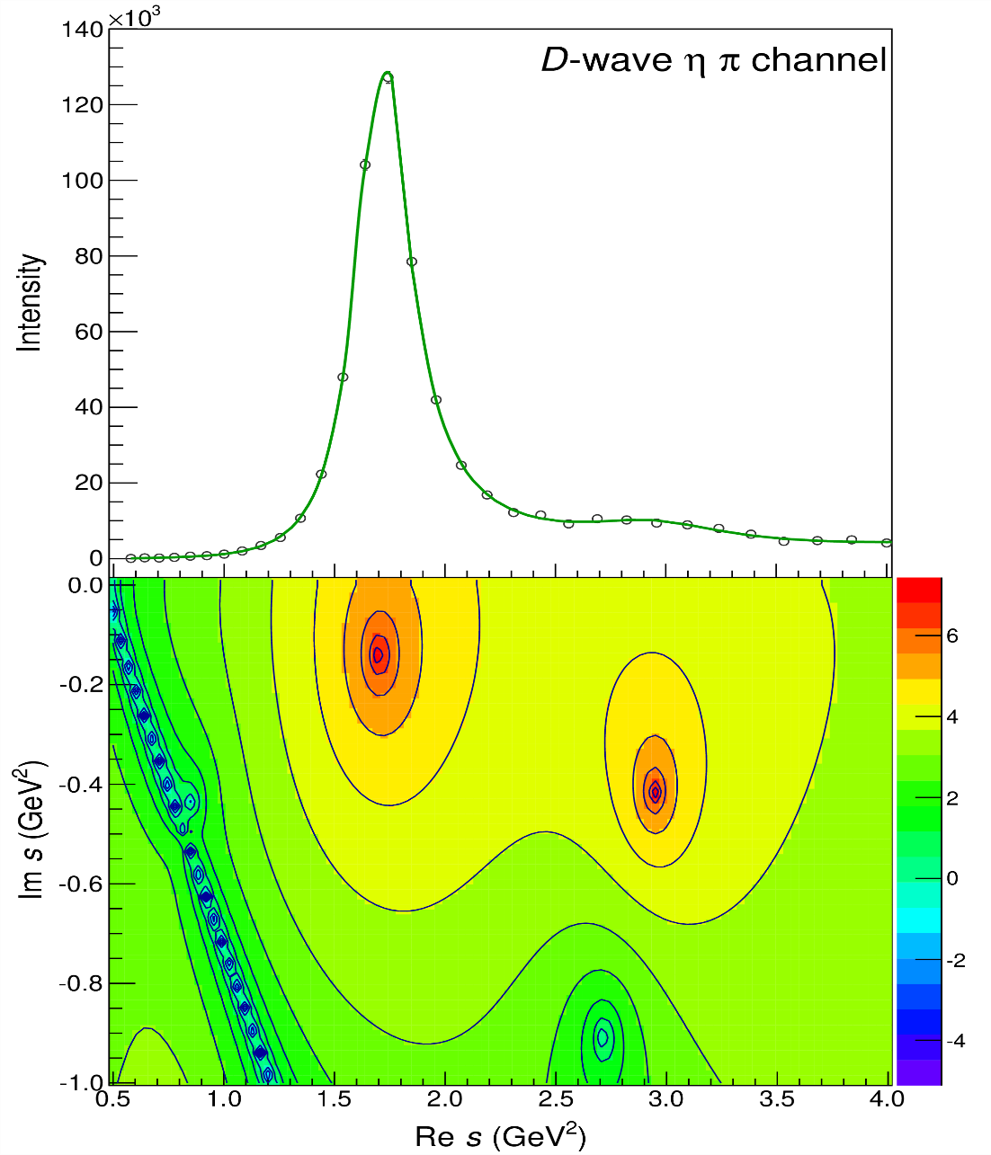
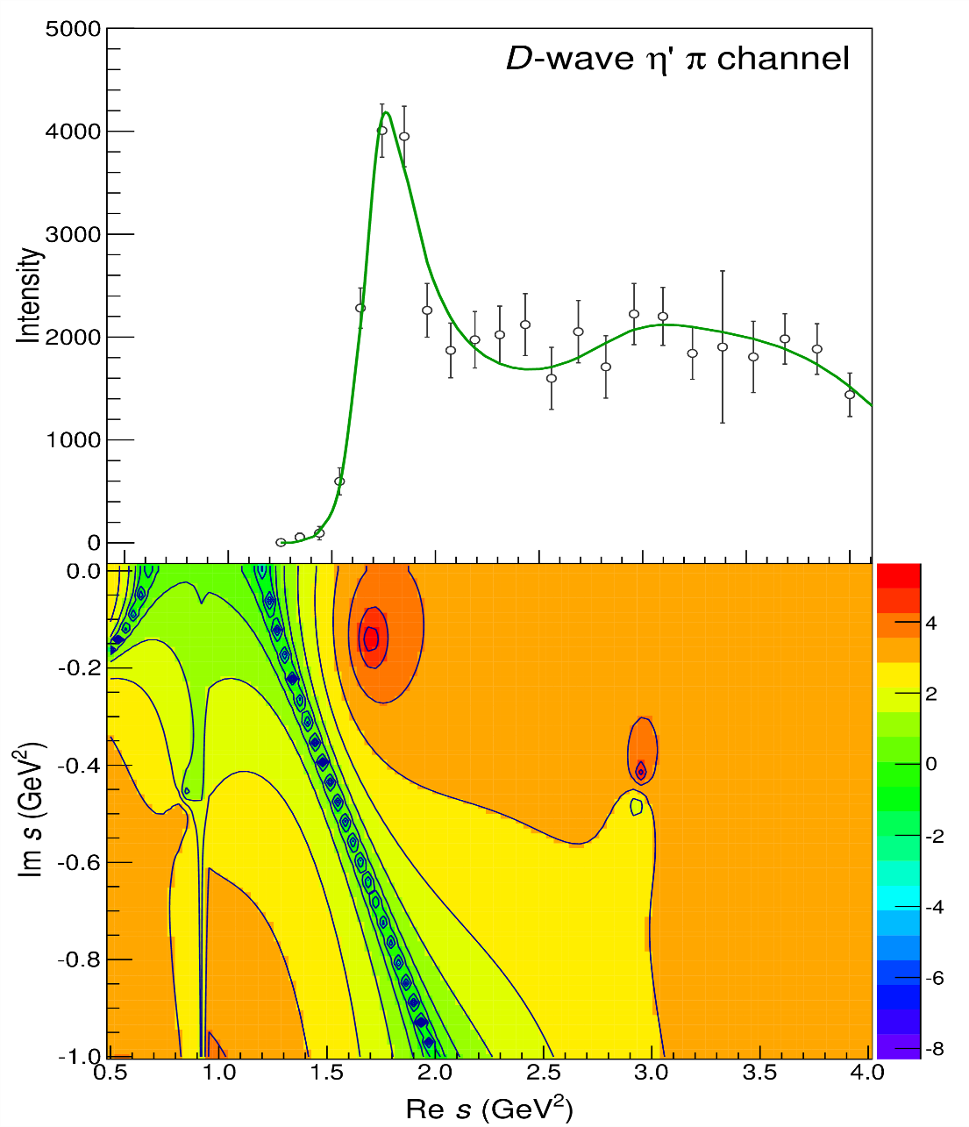
Pole hunting
$$a_{2}^{′}\left(1700\right)$$
$$a_{2}^{′}\left(1700\right)$$
$$a_{2}\left(1320\right)$$
$$a_{2}\left(1320\right)$$
A. Pilloni – Amplitude analysis for hadron spectroscopy
Notes:
Controlla la parte su Regge

Slide 62
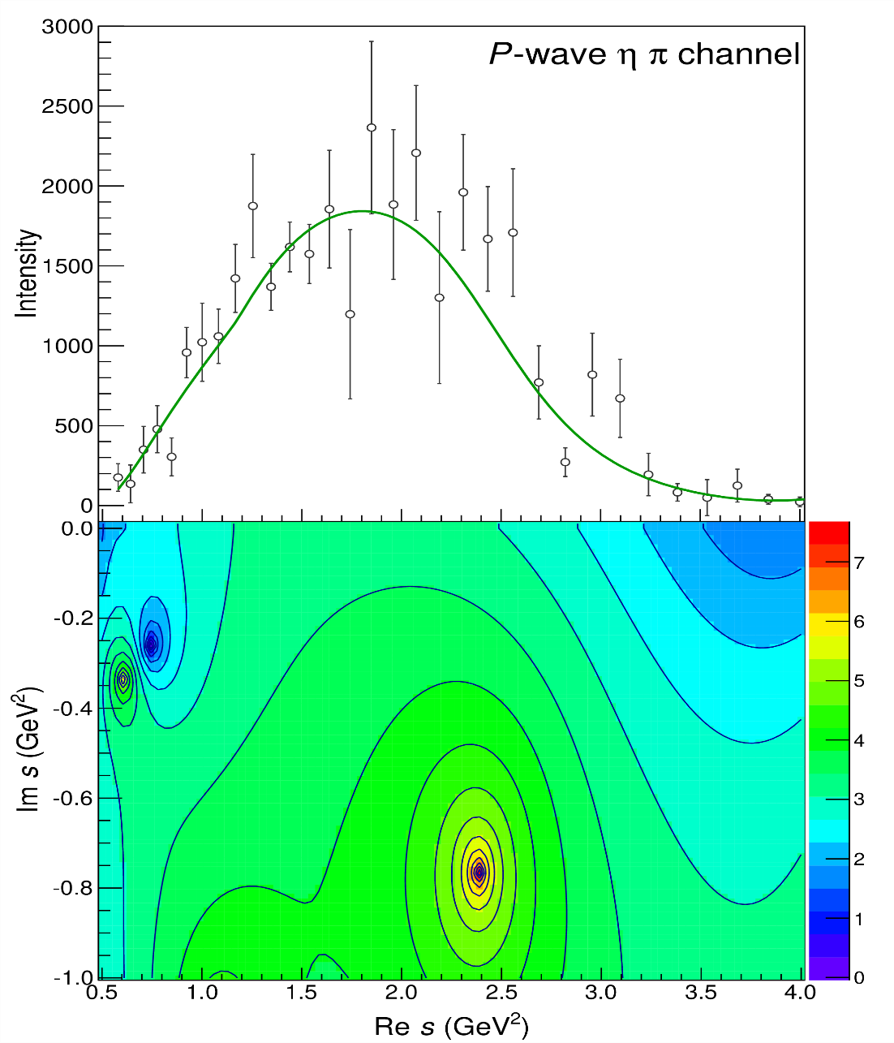
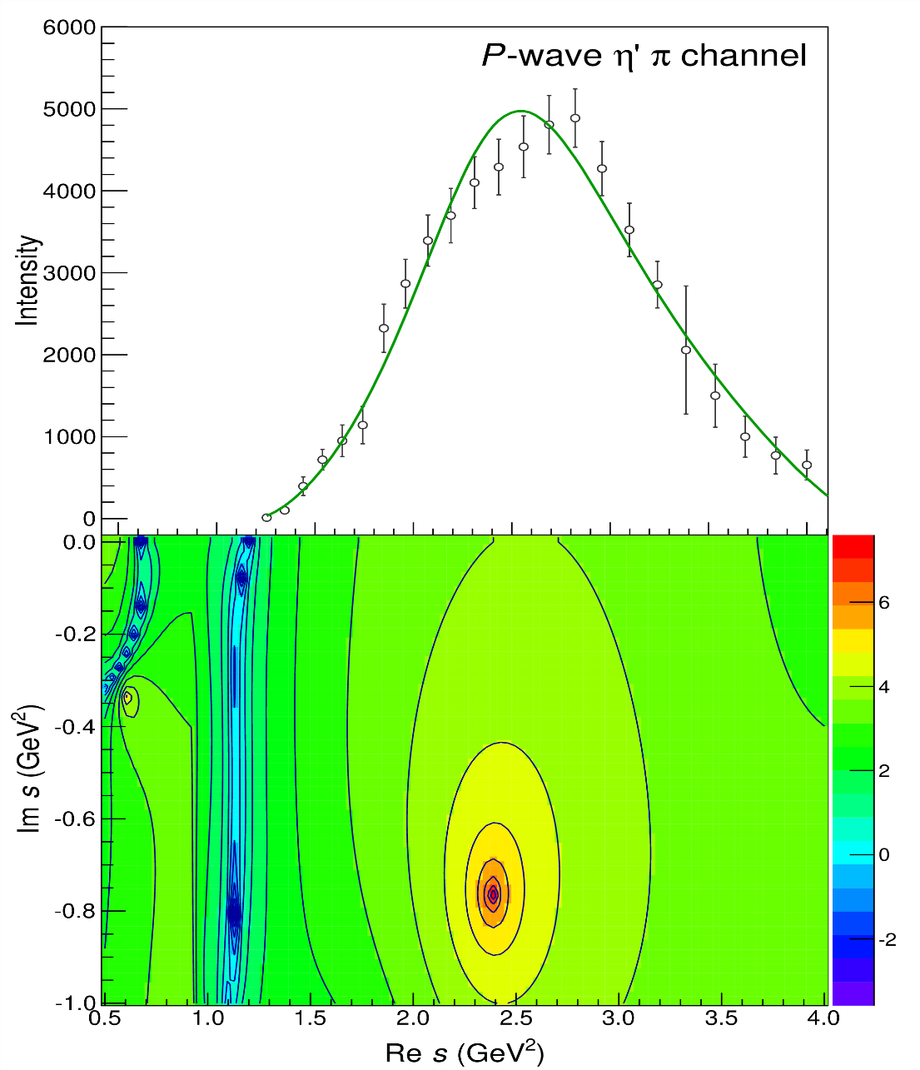
Pole hunting
$$π_{1}$$
$$π_{1}$$
A. Pilloni – Amplitude analysis for hadron spectroscopy
Notes:
Controlla la parte su Regge

Slide 63
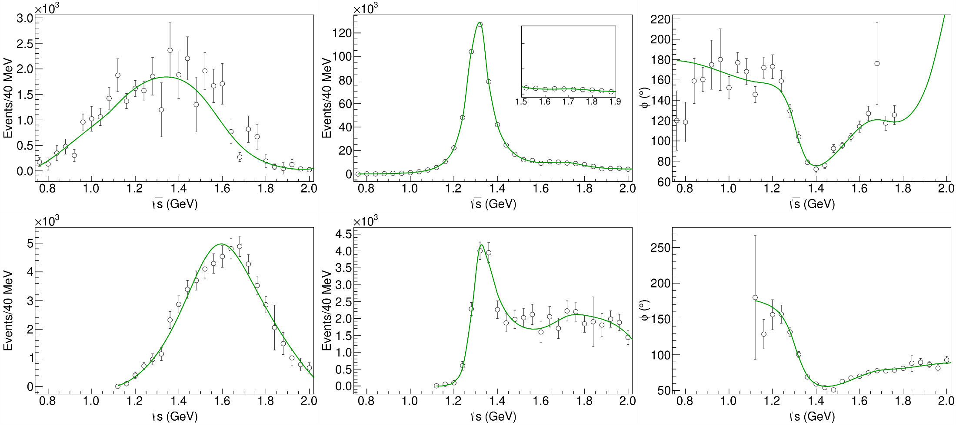
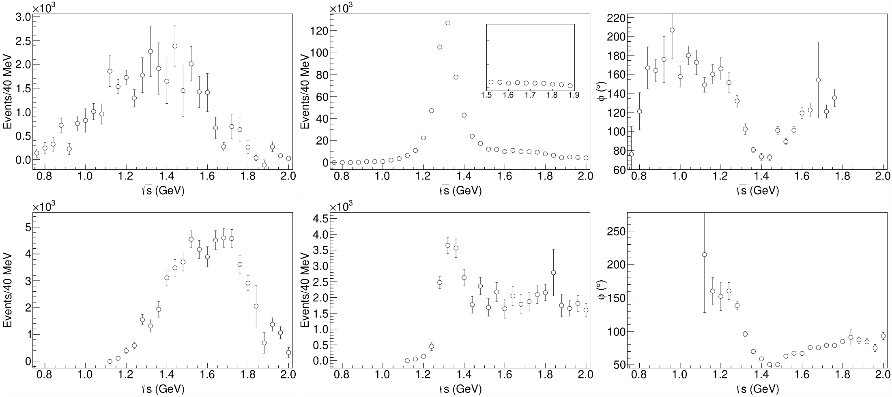
Statistical Bootstrap
A. Pilloni – Amplitude analysis for hadron spectroscopy
Notes:
Controlla la parte su Regge

Slide 64
Correlations
Denominator parameters uncorrelated with the numerator ones ✓
Denominator parameters uncorrelated between P- and D-wave ✓
Production (numerator) parameters
K-matrix «bkg» parameters
K-matrix «pole» parameters
K-matrix «bkg» parameters
A. Pilloni – Amplitude analysis for hadron spectroscopy
Notes:
Controlla la parte su Regge

Slide 65
Statistical Bootstrap
For each fit, we search poles: two clusters in D-wave: $a_{2}\left(1320\right)$ and $a_{2}^{′}\left(1700\right)$
A. Pilloni – Challenges in Hadron Spectroscopy
Notes:
Controlla la parte su Regge

Slide 66
Statistical Bootstrap
Only one stable cluster in $P$-wave: a single $π_{1}$
A. Pilloni – Challenges in Hadron Spectroscopy
Notes:
Controlla la parte su Regge

Slide 67
Systematic studies
For each class, the maximum deviation of mass and width is taken as a systematic error Deviation smaller than the statistical error are neglected Systematic of different classes are summed in quadrature
A. Pilloni – Amplitude analysis for hadron spectroscopy
Notes:
Controlla la parte su Regge

Slide 68
Bootstrap for $s_{R}=1.8 {\text{GeV}}^{2}$
Our skepticism about a second pole in the relevant region is confirmed:
It is unstable and not trustable
A. Pilloni – Amplitude analysis for hadron spectroscopy
Notes:
Controlla la parte su Regge

Slide 69
Final results
Agreement with Lattice is restored
That’s the most rigorous extraction of an exotic meson available so far!
A. Pilloni – Amplitude analysis for hadron spectroscopy
Notes:
Controlla la parte su Regge

Slide 70
An isoscalar $η_{1}$?
There is a recent claim by BESIII in $J/ψ→γ η η′$ of resonant activity in P-wave
Not enough information to perform a similar analysis but… stay tuned!
BW parameters:
$$M=1855±9_{−1}^{+6} \text{MeV}, \\ Γ=188±{18}_{−8}^{+3} \text{MeV}$$
A. Pilloni – Amplitude analysis for hadron spectroscopy
Notes:
2 slides su Zc, a Bes e a Belle
2 slide su tetraquark model: dall’hamiltoniana di Jaffe al calcolo delle masse
1 slide su molecular models, dove sono i carichi? (non in Tornqvist, si in Hanhart, vedere Braaten, citare Nefediev)
2 slides su decay channels, dove si dovrebbe vedere, e a seconda del modello, vedere qualche plot
1 slide su Y(4260), tetraquark? C’è lo strano (si vede la f0)
1 slide su Zc a cleo (anche il neutro)

Slide 71
The scalar glueball
$$0^{++}$$
A. Pilloni – Amplitude analysis for hadron spectroscopy
Notes:
2 slides su Zc, a Bes e a Belle
2 slide su tetraquark model: dall’hamiltoniana di Jaffe al calcolo delle masse
1 slide su molecular models, dove sono i carichi? (non in Tornqvist, si in Hanhart, vedere Braaten, citare Nefediev)
2 slides su decay channels, dove si dovrebbe vedere, e a seconda del modello, vedere qualche plot
1 slide su Y(4260), tetraquark? C’è lo strano (si vede la f0)
1 slide su Zc a cleo (anche il neutro)

Slide 72
Glueballs
The clearest sign of confinement in pure Yang-Mills The worst state to search in real life
Morningstar and Peardon PRD60, 034509
Gregory et al. JHEP1210, 170
A. Pilloni – Amplitude analysis for hadron spectroscopy

Slide 73
How to identify a glueball
You don’t. Since it mixes with light isoscalars, there is no model-independent way of saying which state is (mostly) the glueball. Only suggestions:
There is one too many wrt QM. Indeed, $f_{0}\left(1370\right),f_{0}\left(1500\right),$ $f_{0}\left(1710\right)$
A glueball couples to photons only throughout mixing, so radiative widths should be small
Their production is enhanced in gluon-rich processes, as $J/ψ$ radiative decays
It couples equally to mesons of all flavors (?)
$$c$$
However, an argument based on chiral symmetry claims the coupling proportional to quark mass
$$J/ψ$$
$$\overline{c}$$
G
A. Pilloni – Amplitude analysis for hadron spectroscopy

Slide 74
$J/ψ→γ π^{0}π^{0} and→γ K_{S}^{0}K_{S}^{0}$
We consider the $S$ and $D$ wave by BESIII to use the information about their relative phase.
The D-wave is populated by two almost elastic resonances: the $f_{2}(1270)$ and $f_{2}′(1525)$
$f_{2}(1270)$
$f_{2}′(1525)$
A. Pilloni – Amplitude analysis of $J/ψ→γ π^{0}π^{0}$

Slide 75
Same model as before
A. Rodas, AP et al. (JPAC) EPJC82, 1, 80 (2022)
Two/three channels, $i,k=ππ, KK$, $ρρ$ Two waves, $J=S,D$ 40-56 parameters
3 K-matrix pole for the S-wave
3 K-matrix poles for the D-wave
A. Pilloni – Amplitude analysis for hadron spectroscopy
Notes:
Controlla la parte su Regge

Slide 76
$J/ψ→γ π^{0}π^{0} and→γ K_{S}^{0}K_{S}^{0}$
The fit is decent, but it’s struggling in getting the $f_{2}′$ right Being quasi-elastic, it’s too constrained
Fit quality and local description improve when a third $ρρ$ channel is added
( data)
A. Pilloni – Amplitude analysis for hadron spectroscopy

Slide 77
Pole extraction
A. Pilloni – Amplitude analysis for hadron spectroscopy

Slide 78
Looking at the residues
Despite the large systematics, the $f_{0}\left(1710\right)$ couples to kaons more than the $f_{0}\left(1500\right)$
Also, the $f_{0}\left(1710\right)$ couples to the initial gluon-rich state more than the $f_{0}\left(1500\right)$
Both these fact suggest a sizeable glueball component for the $f_{0}\left(1710\right)$
A. Pilloni – Amplitude analysis for hadron spectroscopy

Slide 79
Conclusions
Lots of unexpected stuff happening!
Needs rigorous methods, as well as fantasy
Thank you
A. Pilloni – Amplitude analysis for hadron spectroscopy
Notes:
2 slides su Zc, a Bes e a Belle
2 slide su tetraquark model: dall’hamiltoniana di Jaffe al calcolo delle masse
1 slide su molecular models, dove sono i carichi? (non in Tornqvist, si in Hanhart, vedere Braaten, citare Nefediev)
2 slides su decay channels, dove si dovrebbe vedere, e a seconda del modello, vedere qualche plot
1 slide su Y(4260), tetraquark? C’è lo strano (si vede la f0)
1 slide su Zc a cleo (anche il neutro)

Slide 80
Backup

Slide 81
Diquarks
Attraction and repulsion in 1-gluon exchange approximation is given by
$$3_{c}×3_{c}∈{\overline{3}}_{c}$$
Now the two quarks are identical particles, they obey Fermi statistics
If we restrict to the ground state in S-wave, we have two options
$${\overline{3}}_{color}\left(A\right)×{\overline{3}}_{flavor}\left(A\right)×1_{spin}\left(A\right)$$
«Good» diquark
$${\overline{3}}_{color}\left(A\right)×6_{flavor}\left(S\right)×3_{spin}\left(S\right)$$
«Bad» diquark
Because of spin-spin interaction, good diquark are lighter, and easier to produce From the flavor point of view, it behaves like an antiquark
A. Pilloni – Amplitude analysis for hadron spectroscopy

Slide 82
The light scalar nonet/2
$$L=1, S=1$$
$$0^{++}$$
This also explain the affinity of the $f_{0}(980)$ to kaons
$$κ^{0}$$
$$κ^{+}(700)$$
$$[qs][\overline{q}\overline{s}]$$
$$a_{0},f_{0}$$
$$??$$
$$f_{0}(980)$$
$$σ(500)$$
$$a_{0}^{−}$$
$$a_{0}^{+}(980)$$
$$κ$$
$$[qs][\overline{u}\overline{d}]$$
$$??$$
$$a_{0}^{0}$$
$$σ$$
$$[ud][\overline{u}\overline{d}]$$
$$??$$
$$κ^{−}$$
$$\overline{κ^{0}}$$
A. Pilloni – Amplitude analysis for hadron spectroscopy

Slide 83
Reference frames
M. Mikhasenko, AP et al. (JPAC), to appear
The 5 variables of each chain can be expressed in terms of the variables of another chain
A. Pilloni – Amplitude analysis for hadron spectroscopy

Slide 84
Isobar model in the helicity formalism
The natural choice for the amplitude looks
with the cross section given by the trace with the spin-density matrix
No! The helicities have not the same meaning in the different chains!
A. Pilloni – Amplitude analysis for hadron spectroscopy

Slide 85
Wigner rotations
Let’s analyze the process in the decay plane
$${\vec{p}}_{2}$$
$${\vec{p}}_{0},Λ′$$
$${\vec{p}}_{2}$$
$${\vec{p}}_{1},λ$$
$${\vec{p}}_{0},Λ$$
$${\vec{p}}_{3}$$
Boost in the ${\vec{p}}_{12}$ direction
$${\vec{p}}_{1},λ′$$
$${\vec{p}}_{3}$$
(23) rest frame
(12) rest frame
Helicities are not Lorentz invariant A boost disaligned with the momentum mixes (rotates) the helicities
↓
Additional $d$-functions: Wigner rotations
A. Pilloni – Amplitude analysis for hadron spectroscopy

Slide 86
Wigner rotations
c
$$Δ$$
$$Δ$$
$$\text{π}$$
$$\text{π}$$
$$Δ$$
The new rotation is about the $y$ axis, the angle is defined in the rest frame of the $p$ or $Λ_{c}$
A. Pilloni – Amplitude analysis for hadron spectroscopy

Slide 87
Isobar model in the decay plane
The natural choice for the amplitude looks
$ζ_{2(1)}^{1}$ is the angle between $π$ and $Λ_{c}$ in the $p$ rest frame
$ζ_{3(1)}^{1}$ is the angle between $K$ and $Λ_{c}$ in the $p$ rest frame
${\hat{θ}}_{2(1)}$ is the angle between $K$ and $p$ in the $Λ_{c}$ rest frame
${\hat{θ}}_{3(1)}$is the angle between $π$ and $p$ in the $Λ_{c}$ rest frame
A. Pilloni – Amplitude analysis for hadron spectroscopy

Slide 88
Isobar model in the decay plane
The natural choice for the amplitude looks
All the angles are polar: no azimuthal phases all these functions can be expressed in term of the Mandelstam variables $σ_{1}=m_{Kπ}^{2},$ $σ_{2}=m_{pπ}^{2},$ $σ_{3}=m_{pK}^{2}$
Now all the spins are aligned correctly
$ζ_{2(1)}^{1}$ is the angle between $π$ and $Λ_{c}$ in the $p$ rest frame
$ζ_{3(1)}^{1}$ is the angle between $K$ and $Λ_{c}$ in the $p$ rest frame
${\hat{θ}}_{2(1)}$ is the angle between $K$ and $p$ in the $Λ_{c}$ rest frame
${\hat{θ}}_{3(1)}$is the angle between $π$ and $p$ in the $Λ_{c}$ rest frame
A. Pilloni – Amplitude analysis for hadron spectroscopy

Slide 89
Isobar model out of the decay plane
Now that everything is aligned with the $K^{∗}$ chain, we can use the Euler angles of chain 1 for the full thing
In this form it is straightforward to check that, for unpolarized $Λ_{c}$, the cross section does not depend on the 3 Euler angles
A. Pilloni – Amplitude analysis for hadron spectroscopy

Slide 90
Amplitude model
$$Z_{c}\left(3900\right)?$$
$${u: D}_{0}(2400)$$
$${u:Z}_{c}\left(3900\right)?$$
$$"σ, f_{0}(980)"$$
$$D_{1}(2420)$$
Logarithmic branch points simulate resonant behavior, only in special kinematics
Coleman and Norton, Nuovo Cim. 38, 438
Schmid, Phys.Rev. 154, 1363
Szczepaniak, PLB747, 410-416
Szczepaniak, PLB757, 61-64
Guo, Nucl.Phys.Rev.37, 406
$$π$$
Isobars
Rescattering
$$D_{1}$$
$$Y(4260)$$
$$D^{∗}$$
$$π$$
$$\overline{D}$$
$$J/ψ$$
Triangle singularity?
A. Pilloni – Amplitude analysis for hadron spectroscopy

Slide 91
Fit: III
( data)
A. Pilloni – Amplitude analysis for hadron spectroscopy
Notes:
Controlla la parte su Regge

Slide 92
Fit: III+tr.
( data)
A. Pilloni – Amplitude analysis for hadron spectroscopy
Notes:
Controlla la parte su Regge

Slide 93
Fit: IV+tr.
( data)
A. Pilloni – Amplitude analysis for hadron spectroscopy
Notes:
Controlla la parte su Regge

Slide 94
Fit: tr.
( data)
A. Pilloni – Amplitude analysis for hadron spectroscopy
Notes:
Controlla la parte su Regge

Slide 95
Pole extraction
III
III+tr.
IV+tr.
A. Pilloni – Amplitude analysis for hadron spectroscopy
Not conclusive at this stage
Notes:
Controlla la parte su Regge

Slide 96
Triangle singularity
$$π$$
$$D_{1}$$
Logarithmic branch points can simulate a resonant behavior, only in very special kinematical conditions
Coleman and Norton, Nuovo Cim. 38, 438
$$Y(4260)$$
$$D^{∗}$$
$$π$$
$$\overline{D}$$
$$J/ψ$$
However, this effects cancels in Dalitz projections, no peaks Schmid, Phys.Rev. 154, 1363
Szczepaniak, PLB747, 410-416
Szczepaniak, PLB757, 61-64
Guo, Meissner, Wang, Yang PRD92, 071502
...but the cancellation can be spread in different channels, you might still see peaks in other channels only!
A. Pilloni – Amplitude analysis for hadron spectroscopy

