Slide 1


New particles XYZ: an overview on tetraquark spectroscopy
Alessandro Pilloni
Pavia – June 9th, 2015
in coll. w/ Esposito, Faccini, Guerrieri, Maiani, Papinutto, Piccinini, Polosa, Riquer, Tantalo

Slide 2
Outline
«Exotic landscape»
Compact tetraquarks
Other models
Production of exotics at LHC
Feshbach resonances
Conclusions
A. Pilloni – New particles XYZ: an overview over tetraquark spectroscopy
Notes:
2 slides su Zc, a Bes e a Belle
2 slide su tetraquark model: dall’hamiltoniana di Jaffe al calcolo delle masse
1 slide su molecular models, dove sono i carichi? (non in Tornqvist, si in Hanhart, vedere Braaten, citare Nefediev)
2 slides su decay channels, dove si dovrebbe vedere, e a seconda del modello, vedere qualche plot
1 slide su Y(4260), tetraquark? C’è lo strano (si vede la f0)
1 slide su Zc a cleo (anche il neutro)

Slide 3


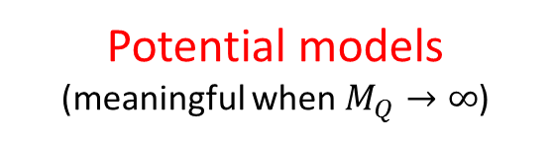
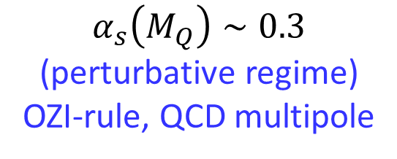

Quarkonium orthodoxy
$$q$$
Heavy quarkonium sector is extremely useful
for the understanding of QCD
$$\overline{q}$$
Potential models
(meaningful when $M_{Q}→∞$)
$$V\left(r\right)=−\frac{C_{F}α_{s}}{r}+σr$$
(Cornell potential)
$$α_{s}\left(M_{Q}\right)∼0.3$$
(perturbative regime)
OZI-rule, QCD multipole
Solve NR Schrödinger eq. → spectrum
Effective theories
(HQET, NRQCD...)
Spin flip suppressed by heavy quark mass,
approximate heavy quark spin symmetry (HQSS)
Integrate out heavy DOF
↓
(spectrum), decay & production rates
A. Pilloni – New particles XYZ: an overview over tetraquark spectroscopy
Notes:
2 slides su Zc, a Bes e a Belle
2 slide su tetraquark model: dall’hamiltoniana di Jaffe al calcolo delle masse
1 slide su molecular models, dove sono i carichi? (non in Tornqvist, si in Hanhart, vedere Braaten, citare Nefediev)
2 slides su decay channels, dove si dovrebbe vedere, e a seconda del modello, vedere qualche plot
1 slide su Y(4260), tetraquark? C’è lo strano (si vede la f0)
1 slide su Zc a cleo (anche il neutro)

Slide 4
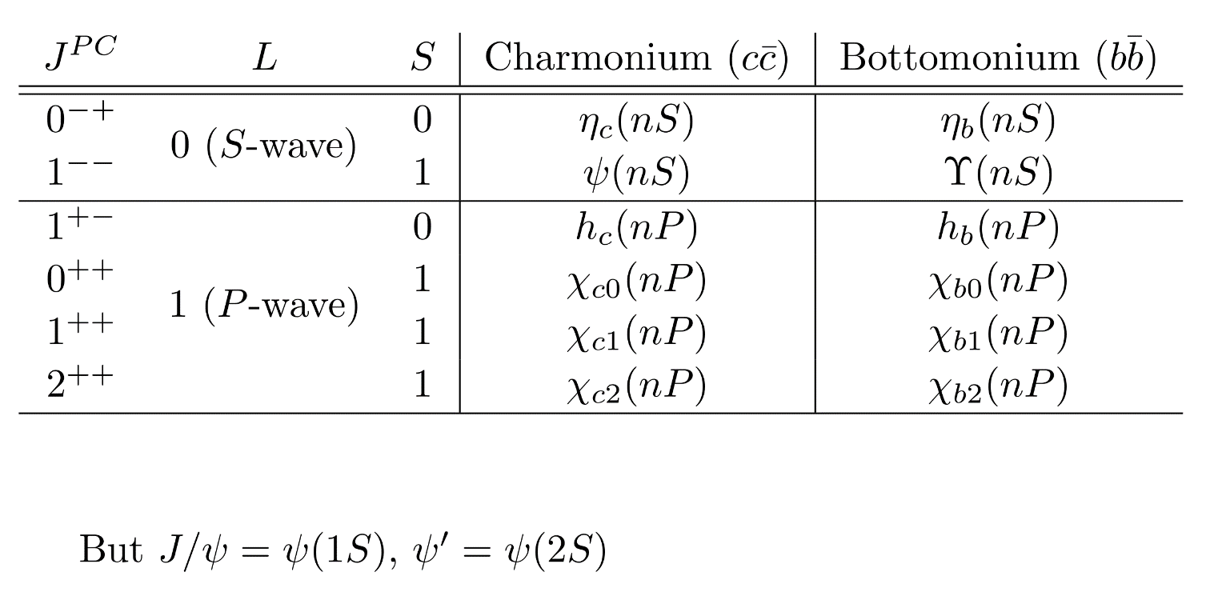
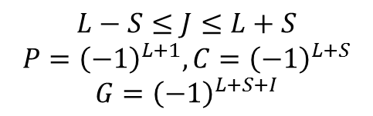
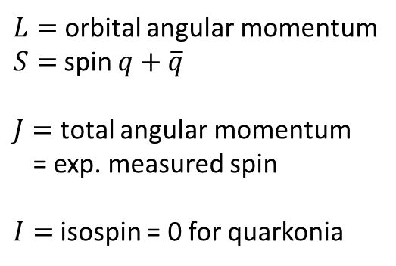
Dictionary – Quark model
$L=$orbital angular momentum
$S=$spin $q+\overline{q}$
$J=$total angular momentum
= exp. measured spin
$I=$isospin = 0 for quarkonia
$$q$$
$$L−S≤J≤L+S$$
$$P={\left(−1\right)}^{L+1}, C={\left(−1\right)}^{L+S}$$
$$G={\left(−1\right)}^{L+S+I}$$
$$\overline{q}$$
A. Pilloni – New particles XYZ: an overview over tetraquark spectroscopy
Notes:
2 slides su Zc, a Bes e a Belle
2 slide su tetraquark model: dall’hamiltoniana di Jaffe al calcolo delle masse
1 slide su molecular models, dove sono i carichi? (non in Tornqvist, si in Hanhart, vedere Braaten, citare Nefediev)
2 slides su decay channels, dove si dovrebbe vedere, e a seconda del modello, vedere qualche plot
1 slide su Y(4260), tetraquark? C’è lo strano (si vede la f0)
1 slide su Zc a cleo (anche il neutro)

Slide 5
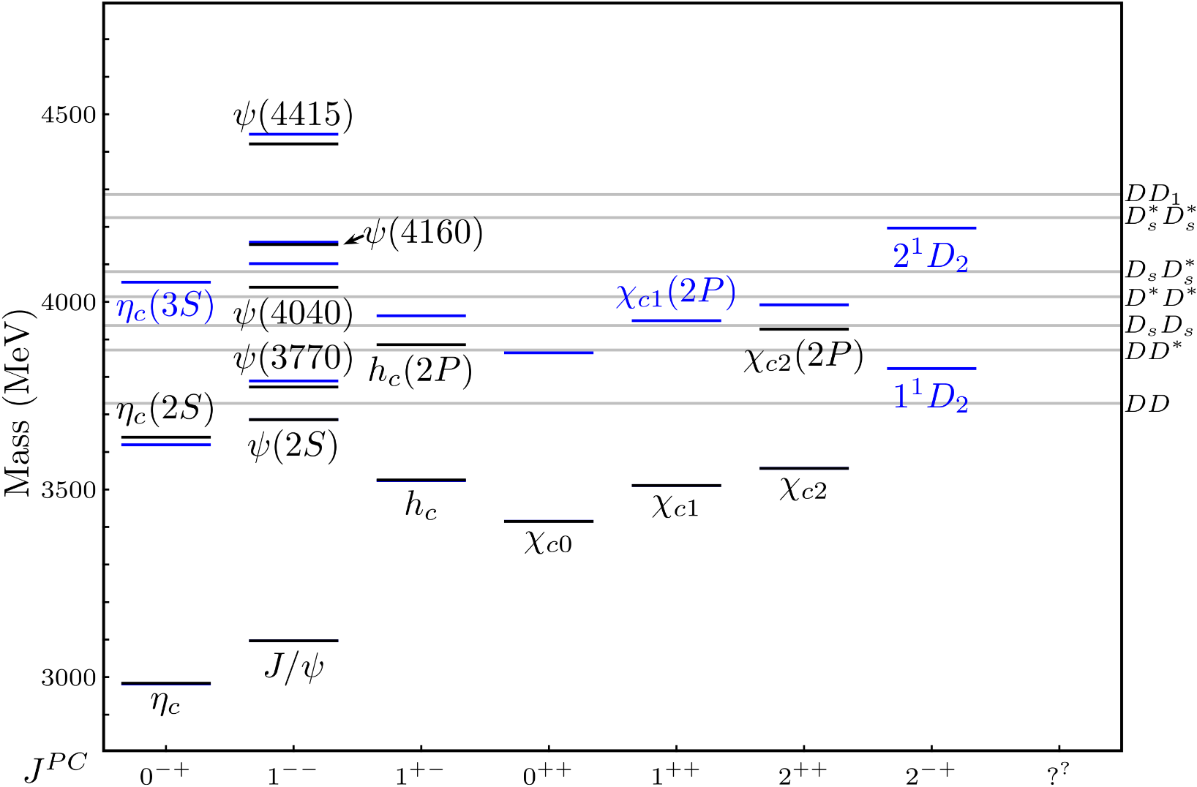
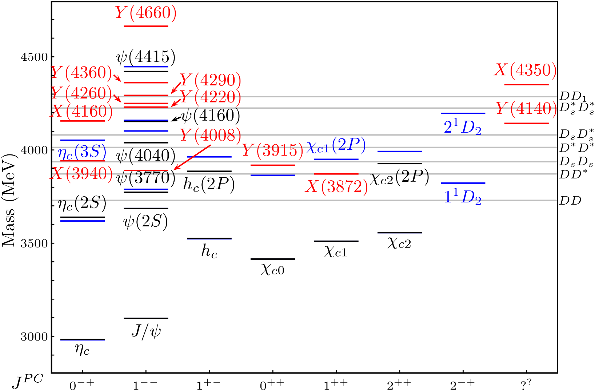
Quarkonium orthodoxy
?
A host of unexpected resonances have appeared
decaying mostly into
charmonium + light
Hardly reconciled with usual charmonium interpretation
A. Pilloni – New particles XYZ: an overview over tetraquark spectroscopy
Notes:
2 slides su Zc, a Bes e a Belle
2 slide su tetraquark model: dall’hamiltoniana di Jaffe al calcolo delle masse
1 slide su molecular models, dove sono i carichi? (non in Tornqvist, si in Hanhart, vedere Braaten, citare Nefediev)
2 slides su decay channels, dove si dovrebbe vedere, e a seconda del modello, vedere qualche plot
1 slide su Y(4260), tetraquark? C’è lo strano (si vede la f0)
1 slide su Zc a cleo (anche il neutro)

Slide 6
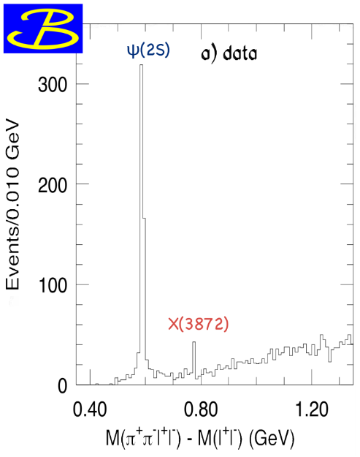
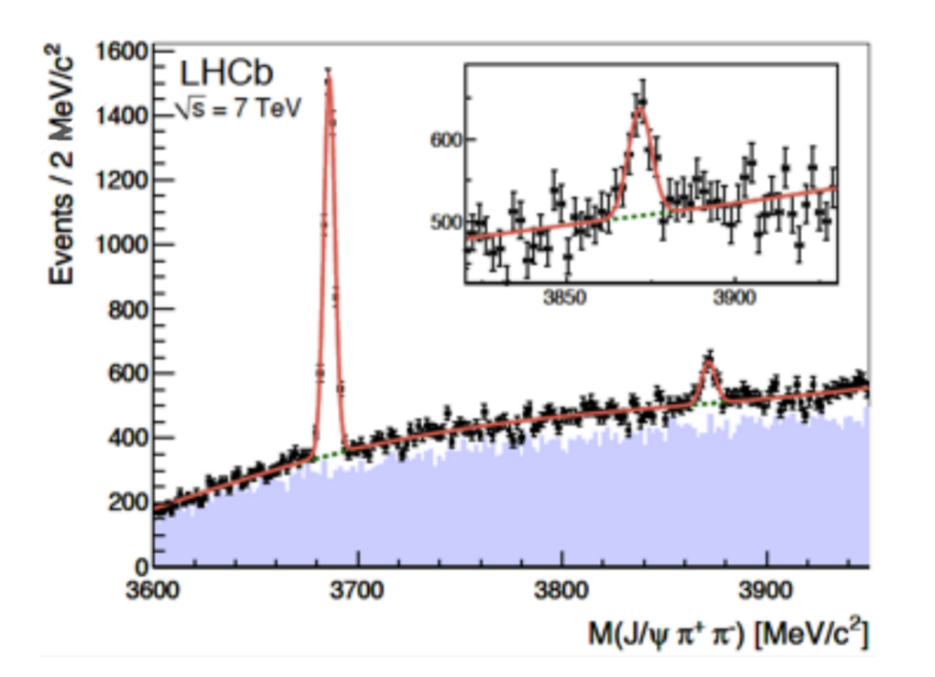
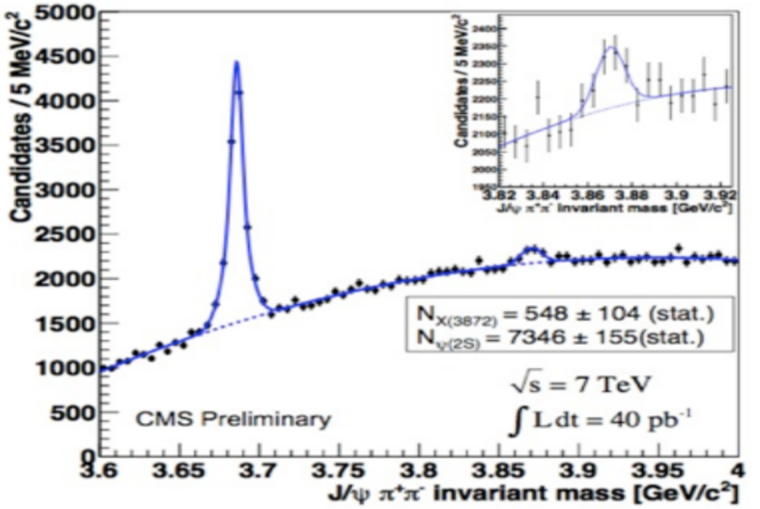
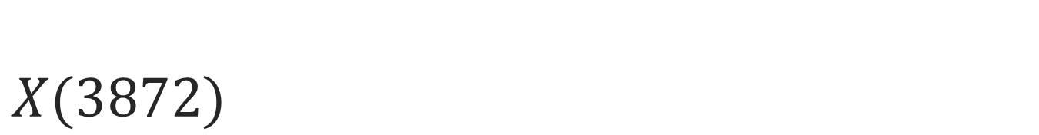
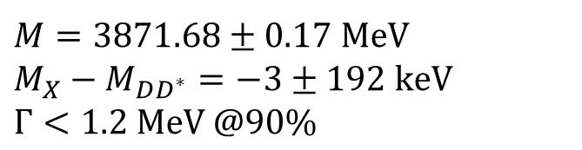
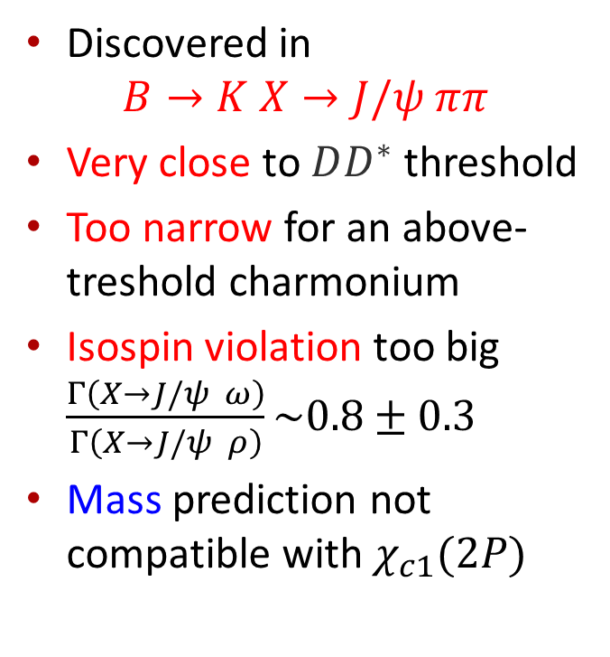
$X(3872)$
Discovered in
$B→K X→J/ψ ππ$
Very close to $DD^{∗}$ threshold
Too narrow for an above-treshold charmonium
Isospin violation too big $\frac{Γ\left(X→J/ψ ω\right)}{Γ\left(X→J/ψ ρ\right)}\sim 0.8±0.3$
Mass prediction not compatible with $χ_{c1}(2P)$
$M=3871.68±0.17$MeV
$$M_{X}−M_{DD^{∗}}=−3±192 \text{keV}$$
$Γ<1.2 \text{MeV}\text{ @90\%}$
A. Pilloni – New particles XYZ: an overview over tetraquark spectroscopy

Slide 7
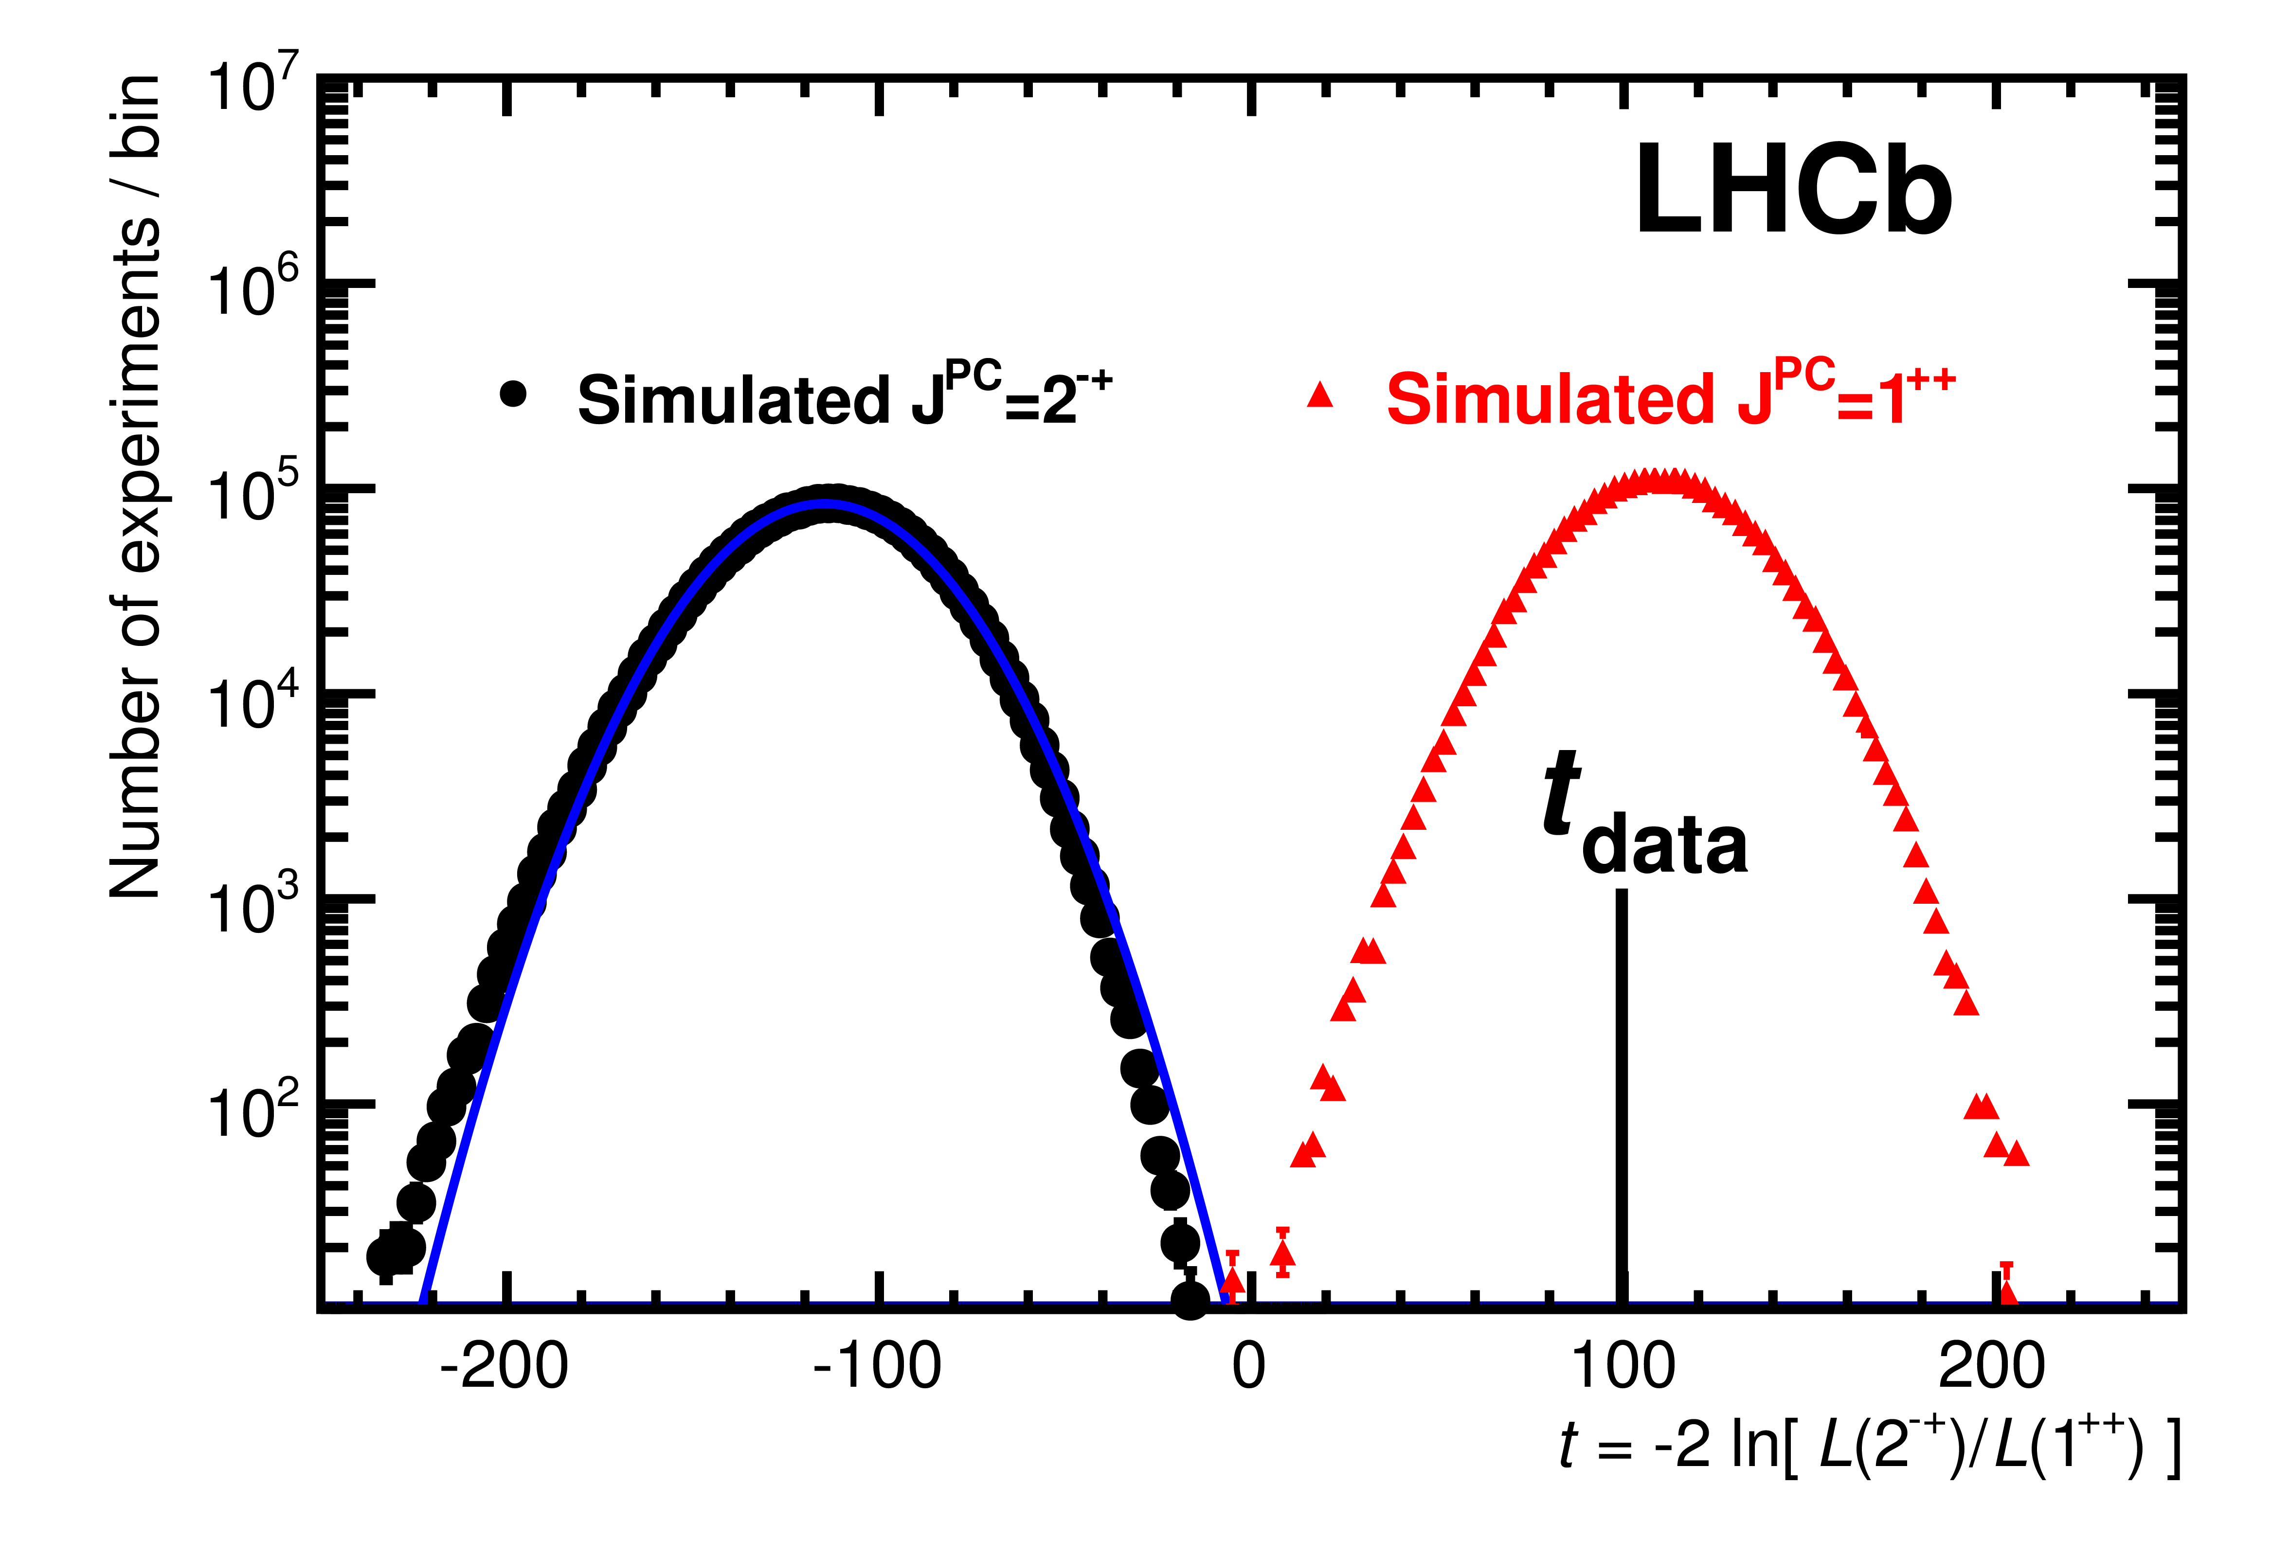
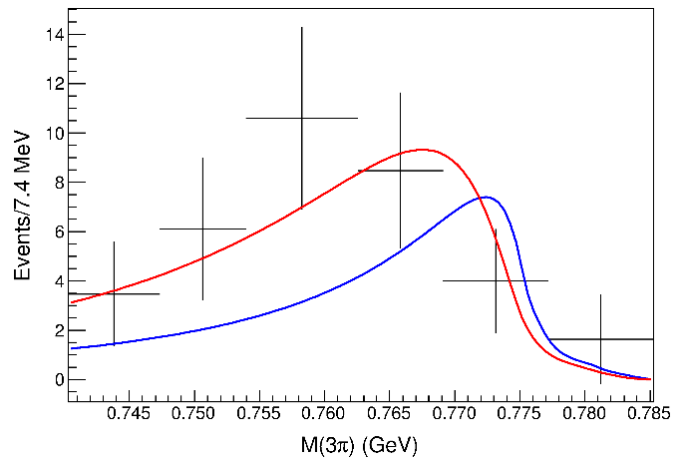
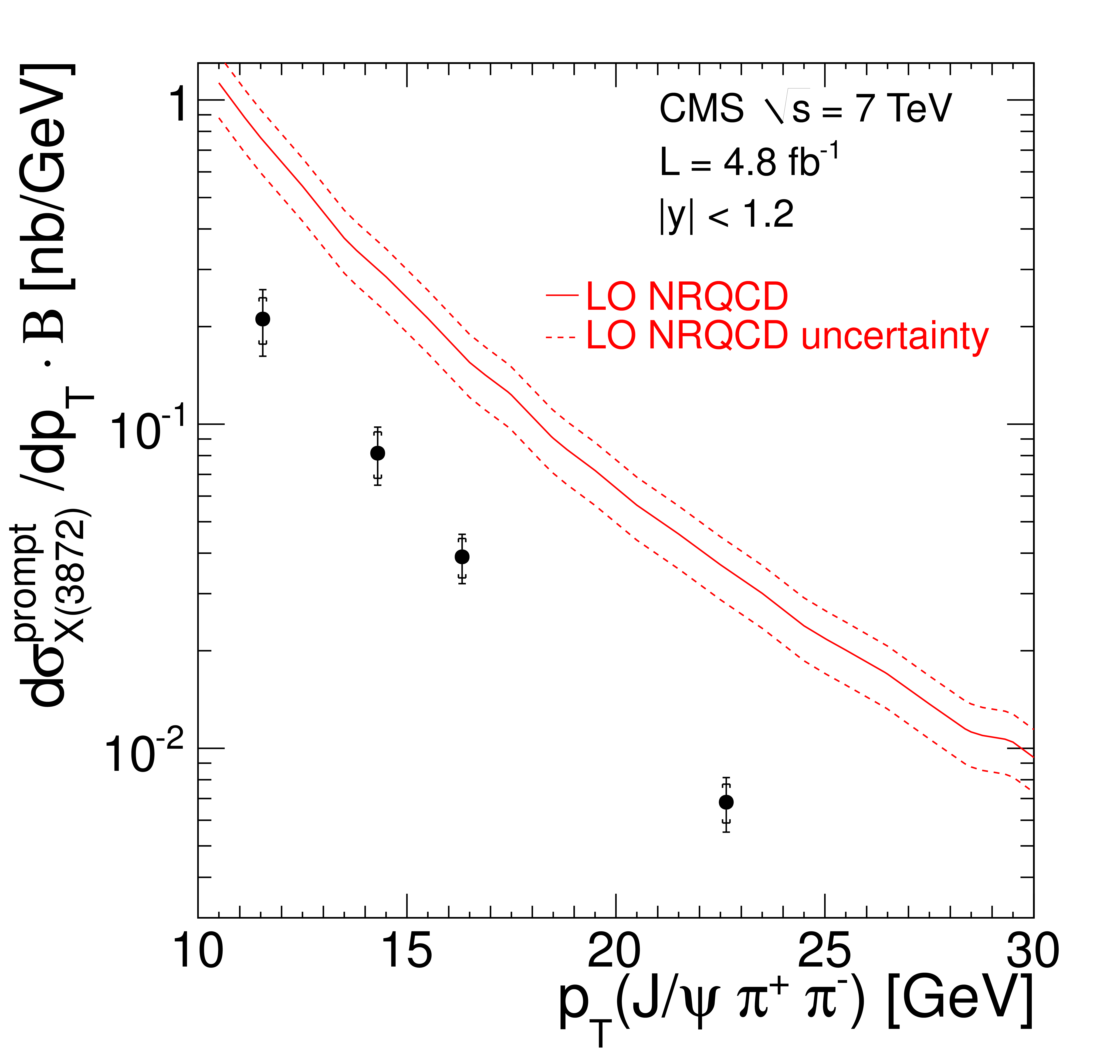
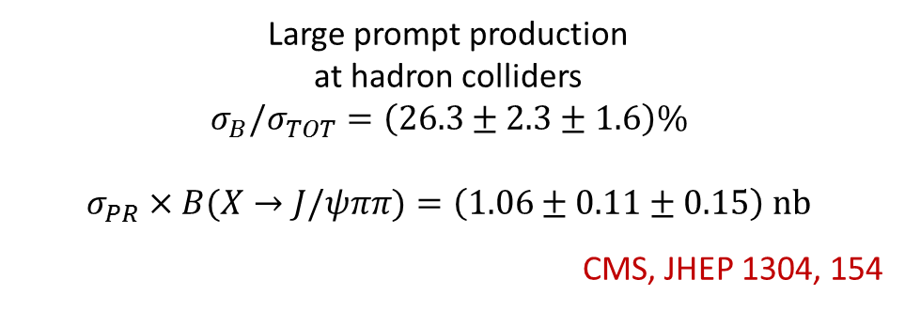
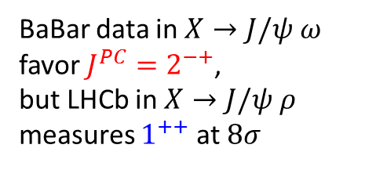
$X(3872)$
BaBar data in $X→J/ψ ω$ favor $J^{PC}=2^{−+}$,
but LHCb in $X→J/ψ ρ$ measures $1^{++}$ at $8σ$
Faccini, AP, Piccinini, Polosa
PRD 86, 054012
LHCb, PRL 110, 222001
Large prompt production
at hadron colliders
$$σ_{B}/σ_{TOT}=\left(26.3±2.3±1.6\right)\%$$
$$σ_{PR}×B(X→J/ψππ)=\left(1.06±0.11±0.15\right) \text{nb}$$
CMS, JHEP 1304, 154
A. Pilloni – New particles XYZ: an overview over tetraquark spectroscopy

Slide 8
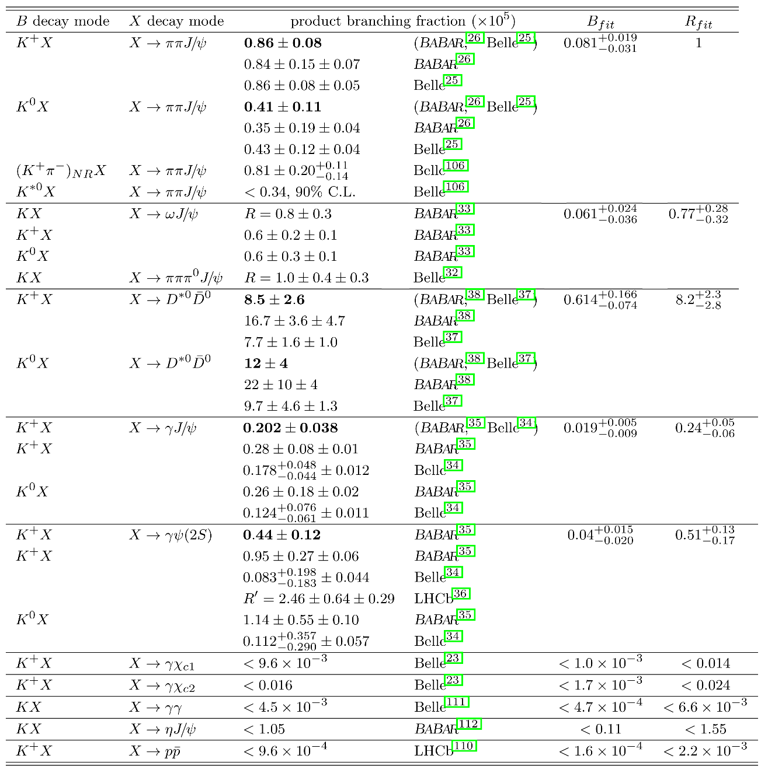
$X(3872)$
A. Pilloni – New particles XYZ: an overview over tetraquark spectroscopy

Slide 9
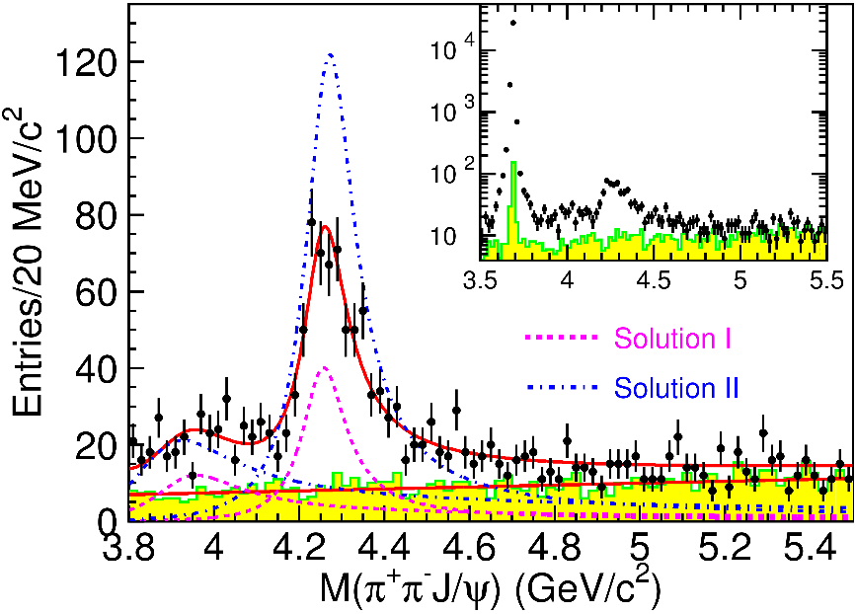

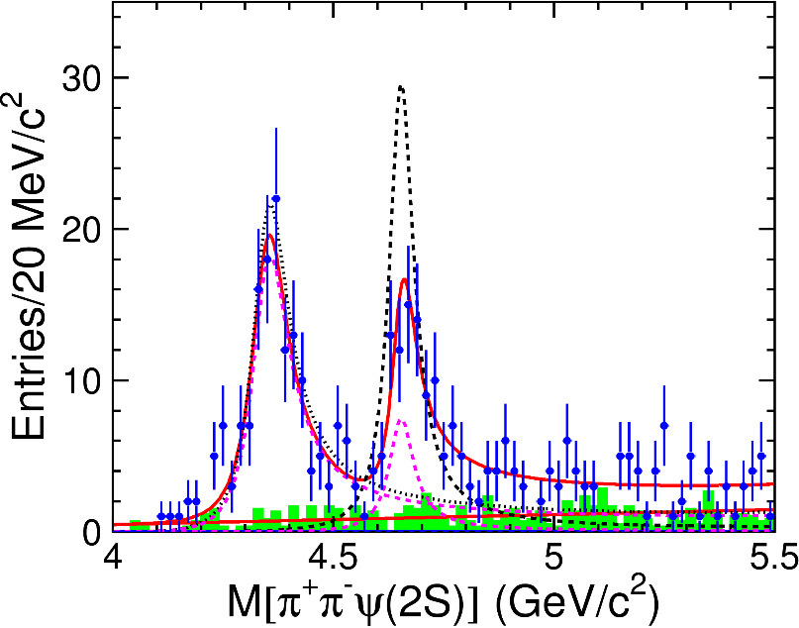
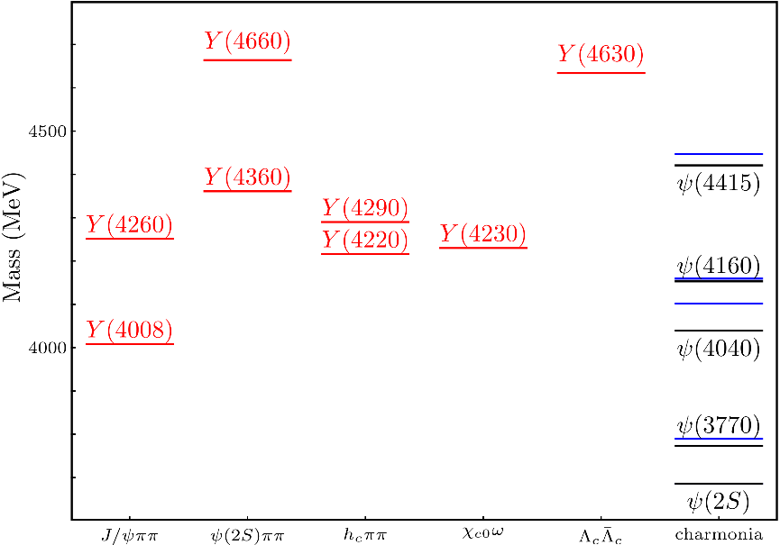
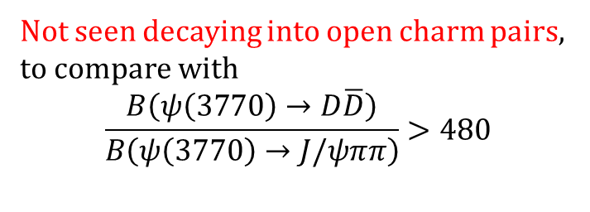

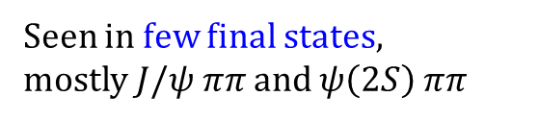
Vector $Y$ states
Lots of unexpected ${J^{PC}=1}^{−−}$ states found in ISR analyses (and nowhere else!)
Seen in few final states,
mostly $J/ψ ππ$ and $ψ\left(2S\right) ππ$
Not seen decaying into open charm pairs, to compare with
$$\frac{B\left(ψ\left(3770\right)→D\overline{D}\right)}{B\left(ψ\left(3770\right)→J/ψππ\right)}>480$$
A. Pilloni – New particles XYZ: an overview over tetraquark spectroscopy
Notes:
Y(4260), M=4263 +- 5, Gamma = 95+-14
D_1(2420)^0, M=2421.3 ±0.6, Gamma =27.1 ±2.7
D_1(2420)^+-, M=2423.4 ±3.1, Gamma =25 ±6
I D_1 hanno J^P = 1^+
La molecola D_1 D sta 22 MeV sotto
Se la Y è D_1 D, il pione lega fortemente, come fa la Y a essere così larga?
Come funziona lo scambio del pione???

Slide 10
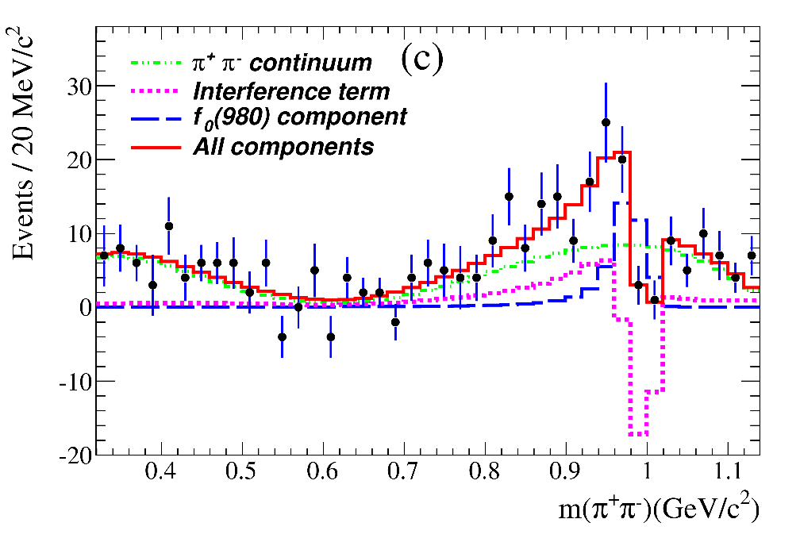
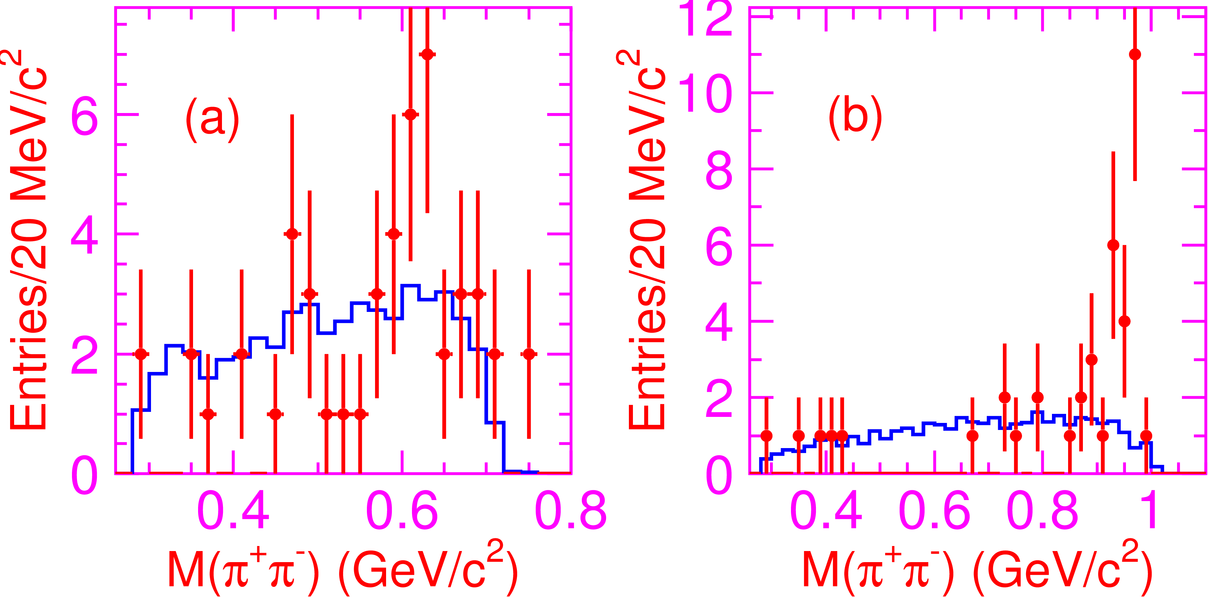
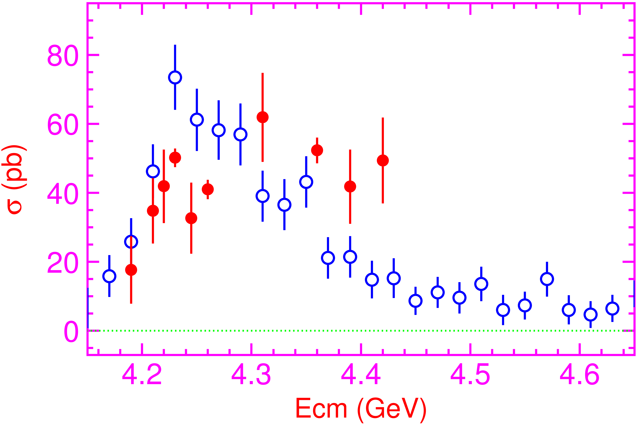

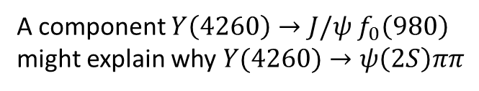
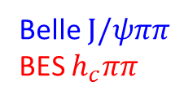
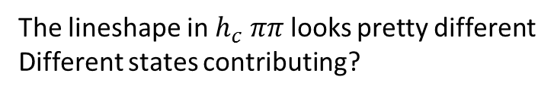

Vector $Y$ states
A component $Y\left(4260\right)→J/ψ f_{0}\left(980\right)$
might explain why $Y(4260)→ψ\left(2S\right)ππ$
$$Y(4360)$$
$$Y(4660)$$
Belle $J/ψππ$
BES $h_{c}ππ$
The lineshape in $h_{c} ππ$ looks pretty different
Different states contributing?
A. Pilloni – New particles XYZ: an overview over tetraquark spectroscopy
Notes:
Y(4260), M=4263 +- 5, Gamma = 95+-14
D_1(2420)^0, M=2421.3 ±0.6, Gamma =27.1 ±2.7
D_1(2420)^+-, M=2423.4 ±3.1, Gamma =25 ±6
I D_1 hanno J^P = 1^+
La molecola D_1 D sta 22 MeV sotto
Se la Y è D_1 D, il pione lega fortemente, come fa la Y a essere così larga?
Come funziona lo scambio del pione???

Slide 11
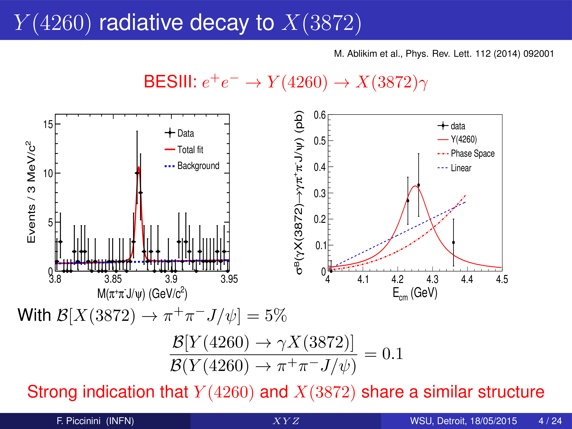
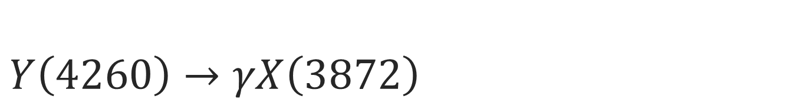
$Y\left(4260\right)→γX\left(3872\right)$
F. Piccinini
A. Pilloni – New particles XYZ: an overview over tetraquark spectroscopy
Notes:
Y(4260), M=4263 +- 5, Gamma = 95+-14
D_1(2420)^0, M=2421.3 ±0.6, Gamma =27.1 ±2.7
D_1(2420)^+-, M=2423.4 ±3.1, Gamma =25 ±6
I D_1 hanno J^P = 1^+
La molecola D_1 D sta 22 MeV sotto
Se la Y è D_1 D, il pione lega fortemente, come fa la Y a essere così larga?
Come funziona lo scambio del pione???

Slide 12
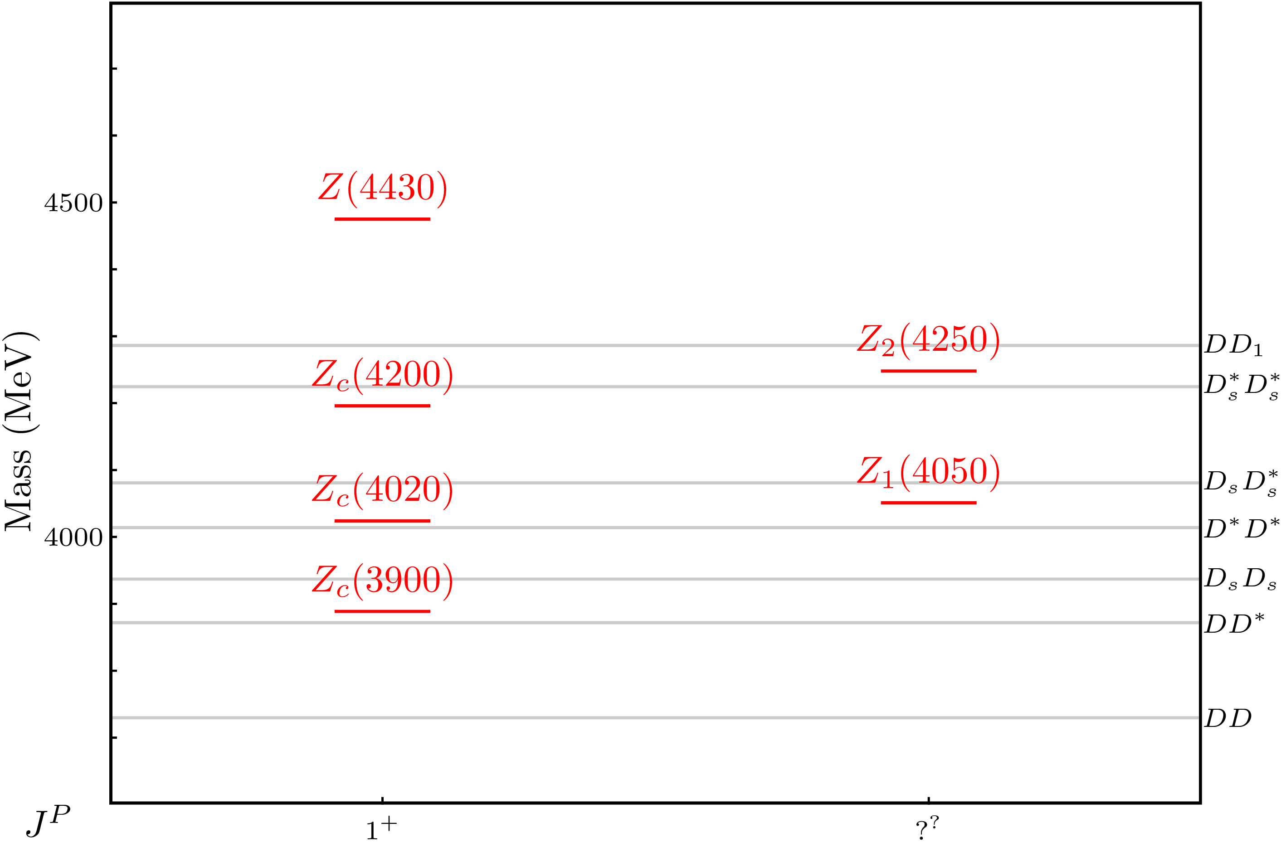
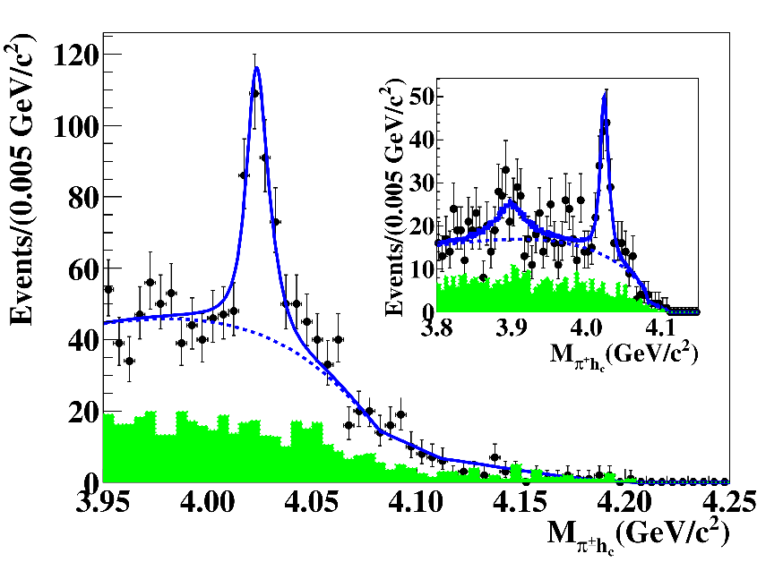
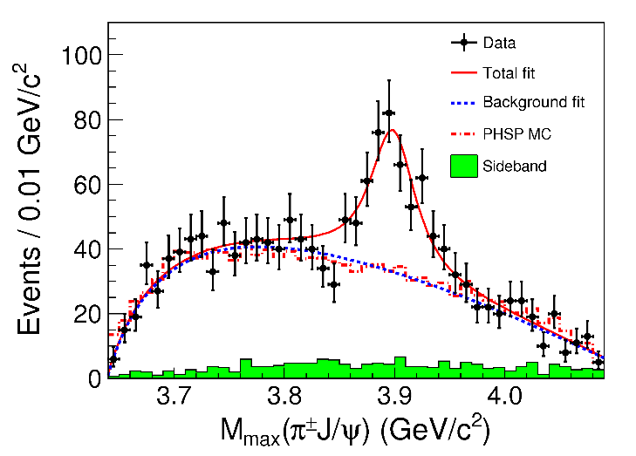

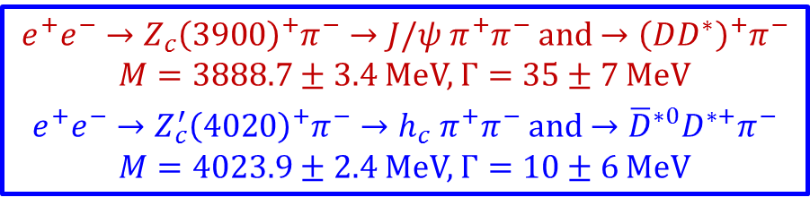
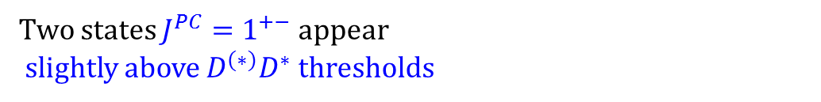
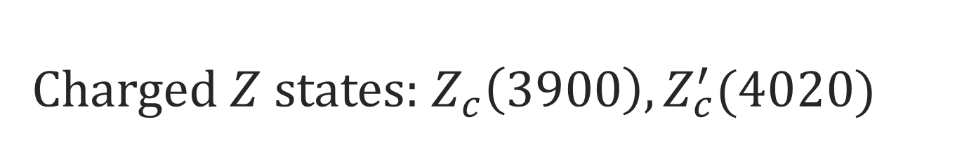
Charged $Z$ states: $Z_{c}\left(3900\right), Z_{c}^{′}(4020)$
Charged quarkonium-like resonances have been found, 4q needed
Two states $J^{PC}=1^{+−}$ appear
slightly above $D^{(∗)}D^{∗}$ thresholds
$e^{+}e^{−}→Z_{c}{\left(3900\right)}^{+}π^{−}→J/ψ{ π}^{+}π^{−}$ and $→{\left(DD^{∗}\right)}^{+}π^{−}$
$M=3888.7±3.4$MeV, $Γ=35±7$ MeV
$e^{+}e^{−}→Z_{c}^{′}{\left(4020\right)}^{+}π^{−}→h_{c}{ π}^{+}π^{−}$ and $→{\overline{D}}^{∗0}D^{∗+}π^{−}$
$M=4023.9±2.4$MeV, $Γ=10±6$ MeV
A. Pilloni – New particles XYZ: an overview over tetraquark spectroscopy
Notes:
Y(4260), M=4263 +- 5, Gamma = 95+-14
D_1(2420)^0, M=2421.3 ±0.6, Gamma =27.1 ±2.7
D_1(2420)^+-, M=2423.4 ±3.1, Gamma =25 ±6
I D_1 hanno J^P = 1^+
La molecola D_1 D sta 22 MeV sotto
Se la Y è D_1 D, il pione lega fortemente, come fa la Y a essere così larga?
Come funziona lo scambio del pione???

Slide 13
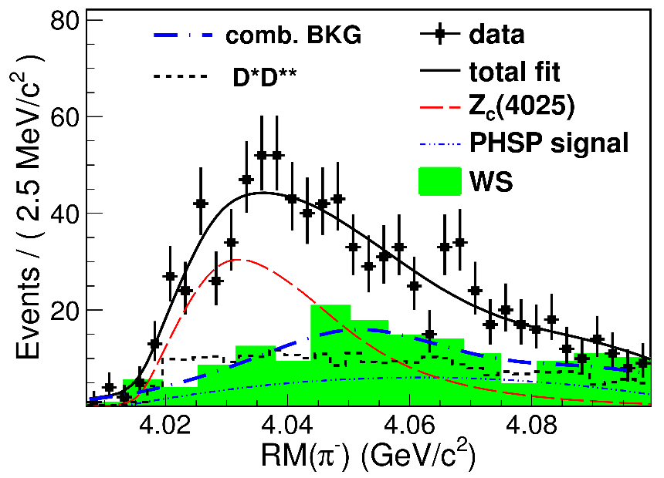
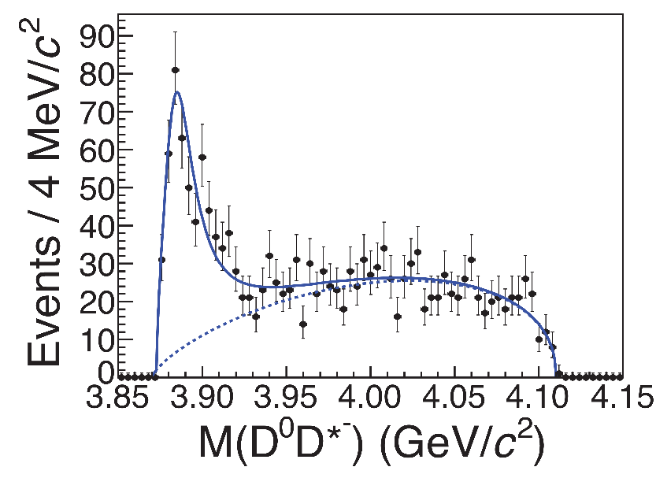
Charged $Z$ states: $Z_{c}\left(3900\right), Z_{c}^{′}(4020)$
Charged quarkonium-like resonances have been found, 4q needed
Two states $J^{PC}=1^{+−}$ appear
slightly above $D^{(∗)}D^{∗}$ thresholds
$e^{+}e^{−}→Z_{c}{\left(3900\right)}^{+}π^{−}→J/ψ{ π}^{+}π^{−}$ and $→{\left(DD^{∗}\right)}^{+}π^{−}$
$M=3888.7±3.4$MeV, $Γ=35±7$ MeV
$e^{+}e^{−}→Z_{c}^{′}{\left(4020\right)}^{+}π^{−}→h_{c}{ π}^{+}π^{−}$ and $→{\overline{D}}^{∗0}D^{∗+}π^{−}$
$M=4023.9±2.4$MeV, $Γ=10±6$ MeV
A. Pilloni – New particles XYZ: an overview over tetraquark spectroscopy
Notes:
Y(4260), M=4263 +- 5, Gamma = 95+-14
D_1(2420)^0, M=2421.3 ±0.6, Gamma =27.1 ±2.7
D_1(2420)^+-, M=2423.4 ±3.1, Gamma =25 ±6
I D_1 hanno J^P = 1^+
La molecola D_1 D sta 22 MeV sotto
Se la Y è D_1 D, il pione lega fortemente, come fa la Y a essere così larga?
Come funziona lo scambio del pione???

Slide 14
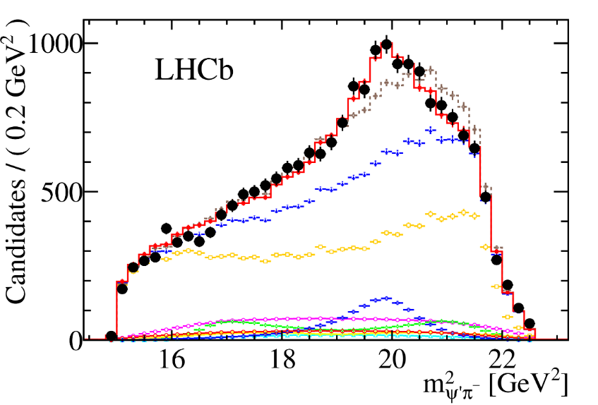
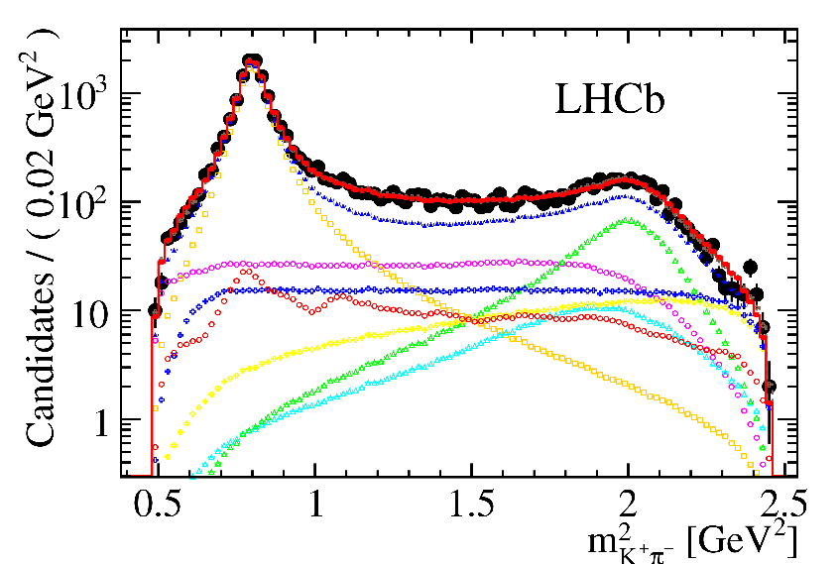
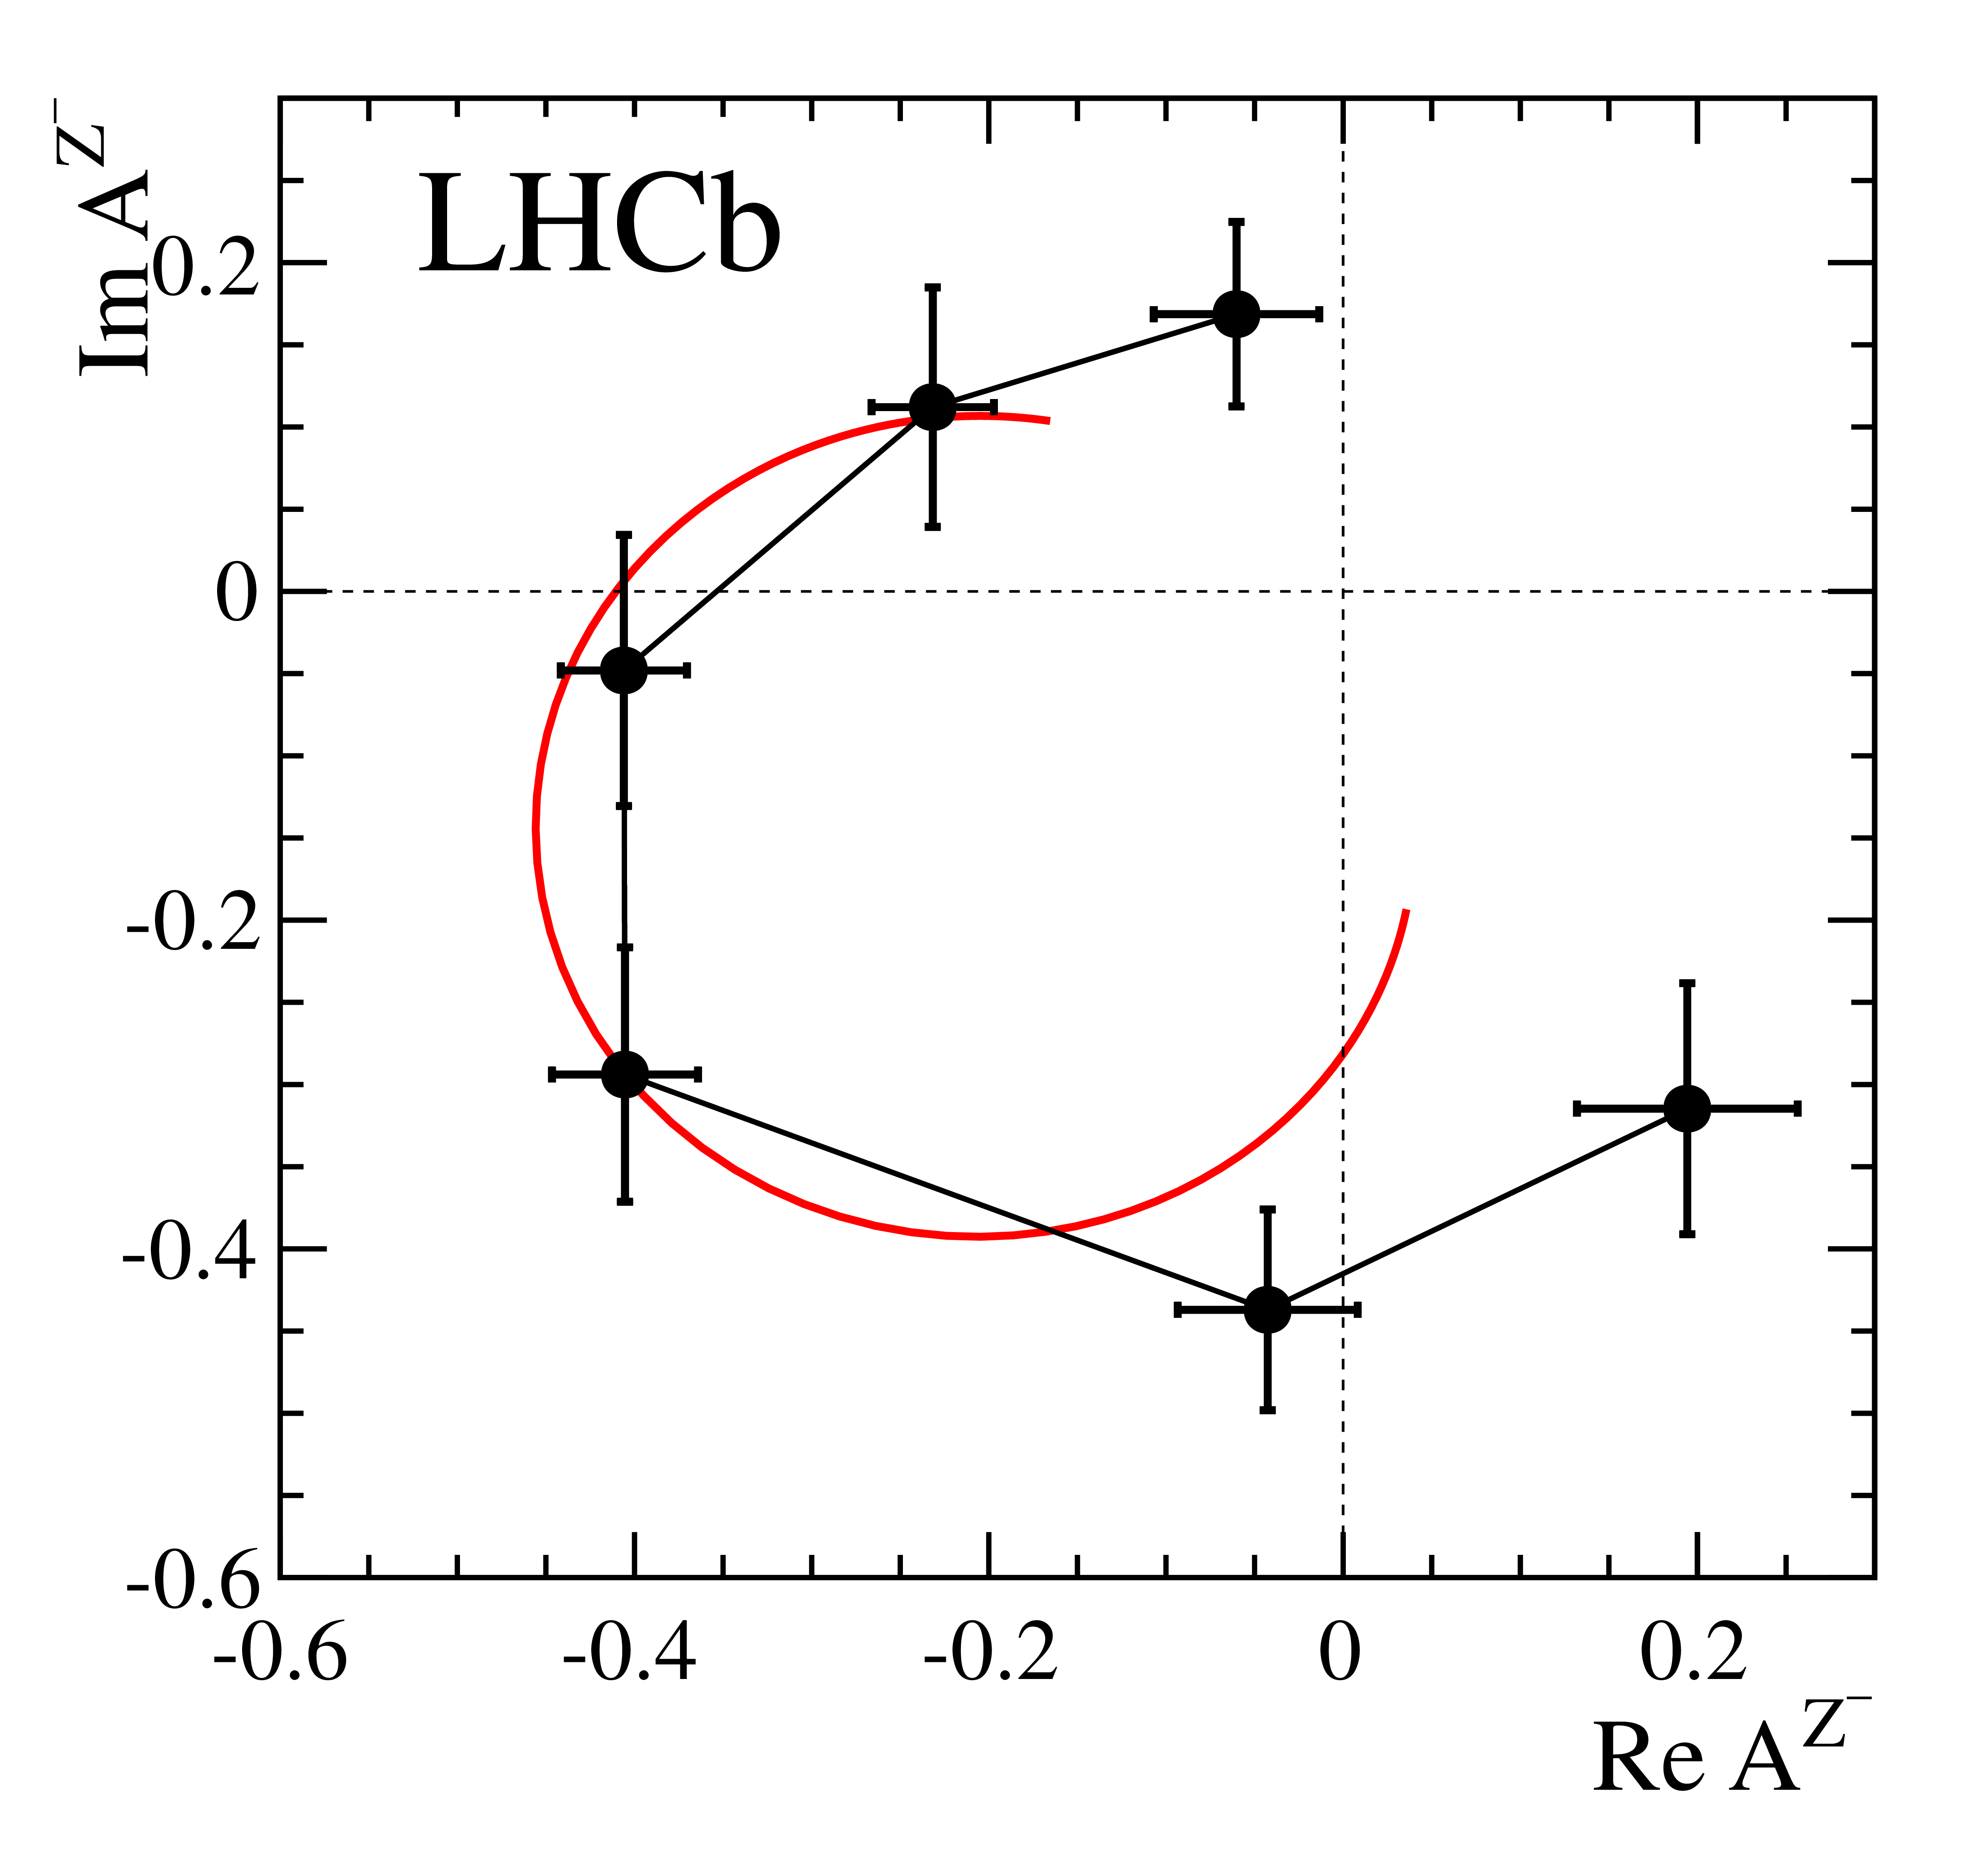

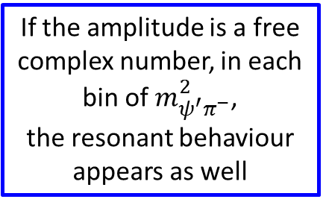
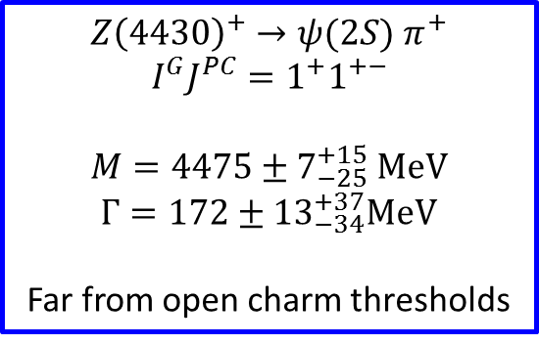
Charged $Z$ states: $Z(4430)$
$$Z{\left(4430\right)}^{+}→ψ(2S){ π}^{+} \\ {I^{G}J}^{PC}=1^{+}1^{+−}$$
$M=4475±7_{−25}^{+15}$MeV
$Γ=172±{13}_{−34}^{+37}$MeV
Far from open charm thresholds
If the amplitude is a free complex number, in each bin of $m_{ψ^{′}π^{−}}^{2}$,
the resonant behaviour appears as well
A. Pilloni – New particles XYZ: an overview over tetraquark spectroscopy
Notes:
Y(4260), M=4263 +- 5, Gamma = 95+-14
D_1(2420)^0, M=2421.3 ±0.6, Gamma =27.1 ±2.7
D_1(2420)^+-, M=2423.4 ±3.1, Gamma =25 ±6
I D_1 hanno J^P = 1^+
La molecola D_1 D sta 22 MeV sotto
Se la Y è D_1 D, il pione lega fortemente, come fa la Y a essere così larga?
Come funziona lo scambio del pione???

Slide 15
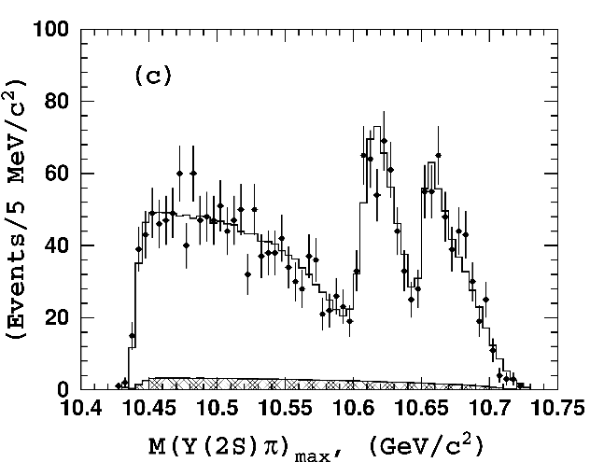
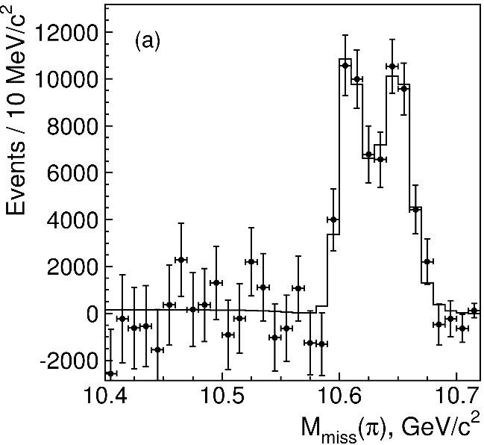
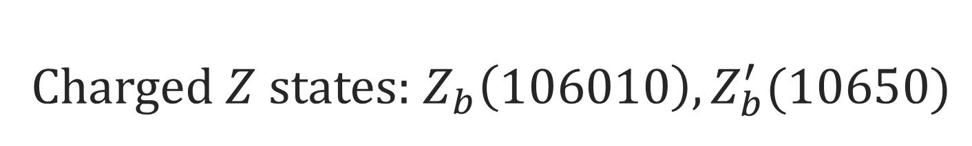
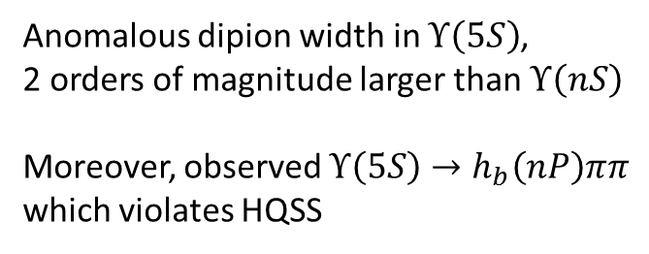
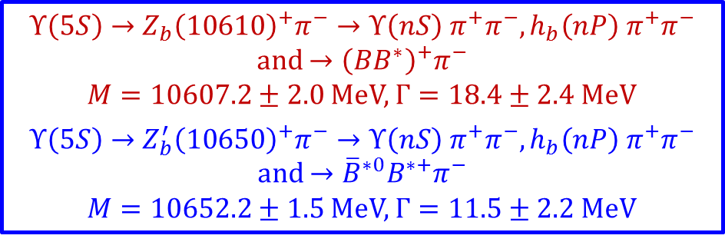
Charged $Z$ states: $Z_{b}\left(106010\right), Z_{b}^{′}(10650)$
Anomalous dipion width in $Υ\left(5S\right)$,
2 orders of magnitude larger than $Υ\left(nS\right)$
Moreover, observed $Υ\left(5S\right)→h_{b}\left(nP\right)ππ$
which violates HQSS
$Υ\left(5S\right)→Z_{b}{\left(10610\right)}^{+}π^{−}→Υ\left(nS\right){ π}^{+}π^{−},h_{b}\left(nP\right){ π}^{+}π^{−}$ and $→{\left(BB^{∗}\right)}^{+}π^{−}$
$M=10607.2±2.0$MeV, $Γ=18.4±2.4$ MeV
$Υ\left(5S\right)→Z_{b}^{′}{\left(10650\right)}^{+}π^{−}→Υ\left(nS\right){ π}^{+}π^{−},h_{b}\left(nP\right){ π}^{+}π^{−}$ and $→{\overline{B}}^{∗0}B^{∗+}π^{−}$
$M=10652.2±1.5$MeV, $Γ=11.5±2.2$ MeV
2 twin resonances!
A. Pilloni – New particles XYZ: an overview over tetraquark spectroscopy
Notes:
Y(4260), M=4263 +- 5, Gamma = 95+-14
D_1(2420)^0, M=2421.3 ±0.6, Gamma =27.1 ±2.7
D_1(2420)^+-, M=2423.4 ±3.1, Gamma =25 ±6
I D_1 hanno J^P = 1^+
La molecola D_1 D sta 22 MeV sotto
Se la Y è D_1 D, il pione lega fortemente, come fa la Y a essere così larga?
Come funziona lo scambio del pione???

Slide 16




Other beasts
$X(3915)$, seen in $B→X K→J/ψ ω$
and $γγ→X→J/ψ ω$
$J^{PC}=0^{++}$, candidate for $χ_{c0}(2P)$
But $X\left(3915\right)→D\overline{D}$ as expected,
and the hyperfine splitting
$M\left(2^{++}\right)−M\left(0^{++}\right)$ too small
One/two peaks seen in $B→XK→J/ψ φ K$,
close to threshold
A. Pilloni – New particles XYZ: an overview over tetraquark spectroscopy
Notes:
Y(4260), M=4263 +- 5, Gamma = 95+-14
D_1(2420)^0, M=2421.3 ±0.6, Gamma =27.1 ±2.7
D_1(2420)^+-, M=2423.4 ±3.1, Gamma =25 ±6
I D_1 hanno J^P = 1^+
La molecola D_1 D sta 22 MeV sotto
Se la Y è D_1 D, il pione lega fortemente, come fa la Y a essere così larga?
Come funziona lo scambio del pione???

Slide 17


Guerrieri, AP, Piccinini, Polosa,
IJMPA 30, 1530002
A. Pilloni – New particles XYZ: an overview over tetraquark spectroscopy
Notes:
Y(4260), M=4263 +- 5, Gamma = 95+-14
D_1(2420)^0, M=2421.3 ±0.6, Gamma =27.1 ±2.7
D_1(2420)^+-, M=2423.4 ±3.1, Gamma =25 ±6
I D_1 hanno J^P = 1^+
La molecola D_1 D sta 22 MeV sotto
Se la Y è D_1 D, il pione lega fortemente, come fa la Y a essere così larga?
Come funziona lo scambio del pione???

Slide 18















Proposed models
Molecule of hadrons (loosely bound)
$${\overline{3}}_{c}$$
$$3_{c}$$
$$1_{c}$$
$$1_{c}$$
$$3_{c}×{\overline{3}}_{c}∈1_{c}$$
Diquark-antidiquark (tetraquark)
$$8_{c}$$
Glueball, Hybrids
(with valence gluons),
Born-Oppenheimer 4q
$$8_{c}$$
Hadrocharmonium
(Van der Waals forces)
$$8_{c}×8_{c}∈1_{c}$$
Cusp (kinematical effect)
$$π$$
$$π$$
$$J/ψ$$
$$π$$
A. Pilloni – New particles XYZ: an overview over tetraquark spectroscopy
$$1_{c}×1_{c}∈1_{c}$$

Slide 19










Diquarks
Attraction and repulsion in 1-gluon exchange approximation is given by
$$R=\frac{1}{2}\left(C_{2}\left(R_{12}\right)−C_{2}\left(R_{1}\right)−C_{2}\left(R_{2}\right)\right)$$
$$R_{1}=−\frac{4}{3}, R_{8}=+\frac{1}{6}$$
$$R_{3}=−\frac{2}{3}, R_{6}=+\frac{1}{3}$$
$$j$$
$$l$$
$$T_{ij}^{a}$$
$$T_{kl}^{a}$$
$$i$$
$$k$$
The singlet $1_{c}$ is an attractive combination
A diquark in ${\overline{3}}_{c}$is an attractive combination
A diquark is colored, so it can stay into hadrons
but cannot be an asymptotic state
Evidence (?) of diquarks in lattice QCD,
Alexandrou, de Forcrand, Lucini, PRL 97, 222002
$$3_{c}×3_{c}∈{\overline{3}}_{c}$$
diquark
A. Pilloni – New particles XYZ: an overview over tetraquark spectroscopy

Slide 20










Tetraquark
$${\overline{3}}_{c}$$
$$\overline{c}$$
$$c$$
In a constituent quark model, we can think of a
diquark-antidiquark compact state
$$3_{c}$$
$$q$$
$${\left[cq\right]}_{S=0}{\left[\overline{c}\overline{q}\right]}_{S=1}+h.c.$$
$$\overline{q}$$
Maiani, Piccinini, Polosa, Riquer PRD71 014028
Spectrum according to color-spin hamiltonian:
$$H=\sum_{dq}{m_{dq}}+2\sum_{i<j}{κ_{ij} \vec{S_{i}}∙\vec{S_{j}} \frac{λ_{i}^{a}}{2}\frac{λ_{j}^{a}}{2}}$$
Decay pattern mostly driven by HQSS ✓
Fair understanding of existing spectrum ✓
A full nonet for each level is expected ✗
$$κ_{q\overline{q}}=315 \text{MeV}\text{,} κ_{c\overline{c}}=59 \text{MeV}\text{,}$$
$$κ_{cq}=22 \text{MeV}\text{,} κ_{c\overline{q}}=72 \text{MeV}$$
A. Pilloni – New particles XYZ: an overview over tetraquark spectroscopy
Notes:
Y(4260), M=4263 +- 5, Gamma = 95+-14
D_1(2420)^0, M=2421.3 ±0.6, Gamma =27.1 ±2.7
D_1(2420)^+-, M=2423.4 ±3.1, Gamma =25 ±6
I D_1 hanno J^P = 1^+
La molecola D_1 D sta 22 MeV sotto
Se la Y è D_1 D, il pione lega fortemente, come fa la Y a essere così larga?
Come funziona lo scambio del pione???
Close propone che la Y è D_1 D^* col pione scambiato in onda S,
La Y però non va in Ds come se fosse tetraquark

Slide 21




Barionio
Baryonium
C. Sabelli
a structure $\left[cq\right][\overline{c}\overline{q}]$ can explain the dominance
of baryon channel
Isospin violation expected,
$$α_{s}\left(m_{c}\right)≪1$$
Rossi, Veneziano,
NPB 123, 507;
Phys.Rept. 63, 149;
PLB70, 255
$$\frac{B\left(Y\left(4660\right)→Λ_{c}^{+}Λ_{c}^{−}\right)}{B\left(Y\left(4660\right)→ψ\left(2S\right)ππ\right)}=25±7$$
Cotugno, Faccini, Polosa, Sabelli,
PRL 104, 132005
A. Pilloni – New particles XYZ: an overview over tetraquark spectroscopy
Notes:
2 slides su Zc, a Bes e a Belle
2 slide su tetraquark model: dall’hamiltoniana di Jaffe al calcolo delle masse
1 slide su molecular models, dove sono i carichi? (non in Tornqvist, si in Hanhart, vedere Braaten, citare Nefediev)
2 slides su decay channels, dove si dovrebbe vedere, e a seconda del modello, vedere qualche plot
1 slide su Y(4260), tetraquark? C’è lo strano (si vede la f0)
1 slide su Zc a cleo (anche il neutro)

Slide 22



Tetraquark: new ansatz
$${\overline{3}}_{c}$$
$$\overline{c}$$
$$c$$
Type I-model predicts no $Z_{c}^{′}(4020)$,
and disfavors $Z_{c}\left(3900\right)→J/ψπ$
$$3_{c}$$
$$q$$
$$\overline{q}$$
Maiani, Piccinini, Polosa, Riquer PRD89 114010
New ansatz: the diquarks are compact objects
spacially separated from each other,
only $κ_{cq}≠0$
Existing spectrum is fitted if $κ_{cq}=67 \text{MeV}$
A. Pilloni – New particles XYZ: an overview over tetraquark spectroscopy
Notes:
Y(4260), M=4263 +- 5, Gamma = 95+-14
D_1(2420)^0, M=2421.3 ±0.6, Gamma =27.1 ±2.7
D_1(2420)^+-, M=2423.4 ±3.1, Gamma =25 ±6
I D_1 hanno J^P = 1^+
La molecola D_1 D sta 22 MeV sotto
Se la Y è D_1 D, il pione lega fortemente, come fa la Y a essere così larga?
Come funziona lo scambio del pione???
Close propone che la Y è D_1 D^* col pione scambiato in onda S,
La Y però non va in Ds come se fosse tetraquark

Slide 23





Tetraquark: new ansatz
Maiani, Piccinini, Polosa, Riquer PRD89 114010
Radial excitations
$$Z\left(2S\right)=Z\left(4430\right)$$
$$Y_{1}\left(2P\right)=Y\left(4360\right)$$
$$Y_{2}\left(2P\right)=Y\left(4660\right)$$
Decay in $ψ\left(2S\right)$ preferably
$$L=1$$
$$H=2m_{dq}−2κ_{cq} \left(\vec{S_{c}}∙\vec{S_{q}}+\vec{S_{\overline{c}}}∙\vec{S_{\overline{q}}}\right)+\frac{B_{c}{\vec{L}}^{2}}{2}−2a \vec{L}⋅\vec{S}$$
A. Pilloni – New particles XYZ: an overview over tetraquark spectroscopy
Notes:
Y(4260), M=4263 +- 5, Gamma = 95+-14
D_1(2420)^0, M=2421.3 ±0.6, Gamma =27.1 ±2.7
D_1(2420)^+-, M=2423.4 ±3.1, Gamma =25 ±6
I D_1 hanno J^P = 1^+
La molecola D_1 D sta 22 MeV sotto
Se la Y è D_1 D, il pione lega fortemente, come fa la Y a essere così larga?
Come funziona lo scambio del pione???
Close propone che la Y è D_1 D^* col pione scambiato in onda S,
La Y però non va in Ds come se fosse tetraquark

Slide 24







Tetraquark: the $Y(4220)$
A state apparently breaking HQSS has been observed
Compatible to be the $Y_{3}$ state
Faccini, Filaci, Guerrieri, AP, Polosa, PRD 91, 117501
A. Pilloni – Exotic Hadron Spectroscopy
Notes:
Y(4260), M=4263 +- 5, Gamma = 95+-14
D_1(2420)^0, M=2421.3 ±0.6, Gamma =27.1 ±2.7
D_1(2420)^+-, M=2423.4 ±3.1, Gamma =25 ±6
I D_1 hanno J^P = 1^+
La molecola D_1 D sta 22 MeV sotto
Se la Y è D_1 D, il pione lega fortemente, come fa la Y a essere così larga?
Come funziona lo scambio del pione???
Close propone che la Y è D_1 D^* col pione scambiato in onda S,
La Y però non va in Ds come se fosse tetraquark

Slide 25




Tetraquark: radial excitations
Maiani, Piccinini, Polosa, Riquer PRD89 114010
Radial excitations
$$Z\left(2S\right)=Z\left(4430\right)$$
$$Y_{1}\left(2P\right)=Y\left(4360\right)$$
$$Y_{2}\left(2P\right)=Y\left(4660\right)$$
Decay in $ψ\left(2S\right)$ preferably
$$χ_{cJ}\left(2P\right)−χ_{cJ}\left(1P\right)∼437 \text{MeV}$$
$$χ_{bJ}\left(2P\right)−χ_{bJ}\left(1P\right)∼360 \text{MeV}$$
Use the same splittings for tetraquarks
$$M\left(Z\left(4430\right)\right)−M(Z_{c}\left(3900\right)={586}_{−26}^{+17} \text{MeV}$$
A. Pilloni – New particles XYZ: an overview over tetraquark spectroscopy
Notes:
Y(4260), M=4263 +- 5, Gamma = 95+-14
D_1(2420)^0, M=2421.3 ±0.6, Gamma =27.1 ±2.7
D_1(2420)^+-, M=2423.4 ±3.1, Gamma =25 ±6
I D_1 hanno J^P = 1^+
La molecola D_1 D sta 22 MeV sotto
Se la Y è D_1 D, il pione lega fortemente, come fa la Y a essere così larga?
Come funziona lo scambio del pione???
Close propone che la Y è D_1 D^* col pione scambiato in onda S,
La Y però non va in Ds come se fosse tetraquark

Slide 26



Tetraquark: the $b$ sector
Ali, Maiani, Piccinini, Polosa, Riquer PRD91 017502
$$M\left(Z_{b}^{′}\right)−M\left(Z_{b}\right)=2κ_{b}$$
$$M\left(Z_{c}^{′}\right)−M\left(Z_{c}\right)=2κ_{c}∼120 \text{MeV}$$
$$κ_{b} :κ_{c}=M_{c} :M_{b}∼0.30$$
$${2κ}_{b} ∼36 \text{MeV}\text{, }\text{vs}\text{. 45 }\text{MeV}\text{ (}\text{exp}\text{.)}$$
$$Z_{b}=\frac{α \left|\left.1_{q\overline{q}}0_{b\overline{b}}\right\rangle \right.−β \left|\left.0_{q\overline{q}}1_{b\overline{b}}\right\rangle \right.}{\sqrt{2}}$$
$$Z_{b}^{′}=\frac{α \left|\left.1_{q\overline{q}}0_{b\overline{b}}\right\rangle \right.+β \left|\left.0_{q\overline{q}}1_{b\overline{b}}\right\rangle \right.}{\sqrt{2}}$$
Data on $Υ\left(5S\right)→Υ\left(nS\right)ππ$ and $Υ\left(5S\right)→h_{b}\left(nP\right)ππ$ strongly favor $α=β$
A. Pilloni – New particles XYZ: an overview over tetraquark spectroscopy
Notes:
Y(4260), M=4263 +- 5, Gamma = 95+-14
D_1(2420)^0, M=2421.3 ±0.6, Gamma =27.1 ±2.7
D_1(2420)^+-, M=2423.4 ±3.1, Gamma =25 ±6
I D_1 hanno J^P = 1^+
La molecola D_1 D sta 22 MeV sotto
Se la Y è D_1 D, il pione lega fortemente, come fa la Y a essere così larga?
Come funziona lo scambio del pione???
Close propone che la Y è D_1 D^* col pione scambiato in onda S,
La Y però non va in Ds come se fosse tetraquark

Slide 27
Dynamical movie
Brodsky, Hwang, Lebed PRL 113 112001
A dynamical picture
of tetraquark formation/decay
has been recently proposed
c
b
s
W─
d̄
c̄
Animation courtesy of R. Lebed
A. Pilloni – New particles XYZ: an overview over tetraquark spectroscopy

Slide 28

Dynamical movie
Brodsky, Hwang, Lebed PRL 113 112001
u
A dynamical picture
of tetraquark formation/decay
has been recently proposed
ū
cu
c
s
K^{(*)‾}
d̄
c̄
c̄d̄
Animation courtesy of R. Lebed
A. Pilloni – New particles XYZ: an overview over tetraquark spectroscopy

Slide 29
Dynamical movie
The two diquarks fly apart with large momentum, but are still bound together by confinement
They must somehow hadronize as one
ū
cu
s
K^{(*)‾}
c̄d̄
A. Pilloni – New particles XYZ: an overview over tetraquark spectroscopy

Slide 30




Dynamical movie
c̄
d̄
c
u
Ψ(2S)
Z⁺(4430)
π⁺
Since this is still a $3⟷\overline{3}$ color interaction, just use the Cornell potential:
$V\left(r\right)=−\frac{4}{3}\frac{α_{s}}{r}+br+\frac{32πα_{s}}{9m_{cq}^{2} }{\left(\frac{σ}{\sqrt{π}}\right)}^{3}e^{−σ^{2}r^{2}}S_{cq}∙S_{\overline{cq}},$
e.g. Barnes et al., PRD 72, 054026
Use that the kinetic energy released in ${\overline{B}}^{0}⟶K^{−}Z^{+}(4430)$ converts
into potential energy until the diquarks come to rest
Hadronization most effective at this point (WKB turning point)
$$\frac{B\left(Z^{−}(4430)→ψ(2S)π^{−}\right)}{B\left(Z^{−}\left(4430\right)→J/ψ π^{−}\right)}∼72$$
$$(>10 \text{exp}\text{.)}$$
$$r_{Z}=1.16 fm,\left\langle r_{ψ(2S)}\right\rangle =0.80 fm,\left\langle r_{J/ψ}\right\rangle =0.39 fm$$
A. Pilloni – New particles XYZ: an overview over tetraquark spectroscopy
$$\left\langle r_{J/ψ}\right\rangle =0.39 fm$$

Slide 31

Counting rules
Brodsky, Lebed, 1505.00803
Exotic states can be produced in threshold regions in $e^{+}e^{−}$ (BES, Belle), electroproduction (JLab 12), hadronic beam facilities (P̄ANDA at FAIR, AFTER@LHC) and are best characterized by cross section ratios
Two examples:
  $\frac{σ(e^{+}e^{−}→Z_{c}^{+} π^{−})}{σ(e^{+}e^{−}→μ^{+}μ^{−})}∝\frac{1}{s^{6}}$ as $s→∞$
  $\frac{σ(e^{+}e^{−}→Z_{c}^{+}\left(\overline{c}c\overline{d}u\right)+π^{−}\left(\overline{u}d\right))}{σ(e^{+}e^{−}→Λ_{c}\left(cud\right)+{\overline{Λ}}_{c}\left(\overline{c} \overline{u}\overline{d}\right))}→const$as $s→∞$
  Ratio numerically smaller if Z_{c} behaves like weakly-bound dimeson molecule instead of diquark-antidiquark bound state due to weaker meson color van der Waals forces
A. Pilloni – New particles XYZ: an overview over tetraquark spectroscopy
$$\left\langle r_{J/ψ}\right\rangle =0.39 fm$$

Slide 32





Hadro-charmonium
Dubynskiy, Voloshin, PLB 666, 344
Dubynskiy, Voloshin, PLB 671, 82
Li, Voloshin, MPLA29, 1450060
$$π$$
$$π$$
$$J/ψ$$
Born in the context of QCD multipole expansion
$$H_{eff}=−\frac{1}{2}a_{ψ}E_{i}^{a}E_{i}^{a}$$
$$a_{ψ}=\left\langle \left.ψ\right|\left(t_{c}^{a}−t_{\overline{c}}^{a}\right)r_{i} G r_{i}\left(t_{c}^{a}−t_{\overline{c}}^{a}\right)\left|\left.ψ\right\rangle \right.\right.$$
the chromoelectric field interacts with soft light matter (highly excited light hadrons)
$$π$$
A bound state can occur via Van der Waals-like interactions
Expected to decay into core charmonium + light hadrons,
Decay into open charm exponentially suppressed
A. Pilloni – New particles XYZ: an overview over tetraquark spectroscopy

Slide 33





Molecule
Tornqvist, Z.Phys. C61, 525
Braaten and Kusunoki, PRD69 074005
Swanson, Phys.Rept. 429 243-305
$$D^{0}$$
$$X\left(3872\right)∼{\overline{D}}^{0}D^{∗0}$$
$$Z_{c}\left(3900\right)∼{\overline{D}}^{0}D^{∗+}$$
$$Z_{c}^{′}\left(4020\right)∼{\overline{D}}^{∗0}D^{∗+}$$
$$Y\left(4260\right)∼\overline{D}D_{1}$$
$$π^{0}$$
$$\overline{D^{0∗}}$$
A deuteron-like meson pair, the interaction is mediated by the exchange of light mesons
Some model-independent relations (Weinberg’s theorem) ✓
Good description of decay patterns (mostly to constituents) and $X\left(3872\right)$ isospin violation ✓
States appear close to thresholds ✓ (but $Z\left(4430\right)$ ✗)
Lifetime of costituents has to be $≫1/m_π$, (but why $Γ_{Y}≫Γ_{D_1}$?)
Binding energy varies from $−70$to $−0.1 \text{MeV}$, or even positive (repulsive interaction) ✗
Unclear spectrum (a state for each threshold?) – depends on potential models ✗
$$V_{π}\left(r\right)=\frac{g_{πN}^{2}}{3}\left(\vec{τ_{1}}⋅\vec{τ_{2}}\right)\left\{\left[3\left(\vec{σ_{1}}⋅\hat{r}\right)\left(\vec{σ_{2}}⋅\hat{r}\right)−\left(\vec{σ_{1}}⋅\vec{σ_{2}}\right)\right]\left(1+\frac{3}{{\left(m_{π}r\right)}^{2}}+\frac{3}{m_{π}r}\right)+\left(\vec{σ_{1}}⋅\vec{σ_{2}}\right)\right\}\frac{e^{−m_{π}r}}{r}$$
Needs regularization, cutoff dependence
A. Pilloni – New particles XYZ: an overview over tetraquark spectroscopy

Slide 34


Weinberg theorem
Resonant scattering amplitude
$$f\left(ab→c→ab\right)=−\frac{1}{8π E_{CM}}g^{2}\frac{1}{{\left(p_{a}+p_{b}\right)}^{2}−m_{c}^{2}}$$
with $m_{c}=m_{a}+m_{b}−B$, and $B,T≪m_{a,b}$
$$f\left(ab→c→ab\right)=−\frac{1}{16π{\left(m_{a}+m_{b}\right)}^{2}}g^{2}\frac{1}{B+T}$$
This has to be compared with the potential scattering for slow particles ($kR≪1$, being $R∼1/m_{π}$ the range of interaction)
in an attractive potential $U$ with a superficial level at $−B$
$$f\left(ab→ab\right)=−\frac{1}{\sqrt{2μ}}\frac{\sqrt{B}−i\sqrt{T}}{B+T}$$
$$B=\frac{g^{4}}{512π^{2}}\frac{μ^{5}}{{\left(m_{a}m_{b}\right)}^{2}}$$
Weinberg, PR 130, 776
Weinberg, PR 137, B672
Polosa, PLB 746, 248
A. Pilloni – New particles XYZ: an overview over tetraquark spectroscopy

Slide 35

Weinberg theorem
$$B=\frac{g^{4}}{512π^{2}}\frac{μ^{5}}{{\left(m_{a}m_{b}\right)}^{2}}, kR≪1$$
This has to be fulfilled by EVERY molecular state, but:
$X(3872)$, $B=0, g≠0$
$Zs$, $B<0$, repulsive interaction!
$Y(4260)$, $kR∼1.4$
Weinberg, PR 130, 776
Weinberg, PR 137, B672
Polosa, PLB 746, 248
A. Pilloni – New particles XYZ: an overview over tetraquark spectroscopy

Slide 36


$Y\left(4260\right)→\overline{D}D_{1}?$
S. Olsen
A. Pilloni – New particles XYZ: an overview over tetraquark spectroscopy
Notes:
Y(4260), M=4263 +- 5, Gamma = 95+-14
D_1(2420)^0, M=2421.3 ±0.6, Gamma =27.1 ±2.7
D_1(2420)^+-, M=2423.4 ±3.1, Gamma =25 ±6
I D_1 hanno J^P = 1^+
La molecola D_1 D sta 22 MeV sotto
Se la Y è D_1 D, il pione lega fortemente, come fa la Y a essere così larga?
Come funziona lo scambio del pione???
Close propone che la Y è D_1 D^* col pione scambiato in onda S,
La Y però non va in Ds come se fosse tetraquark

Slide 37





$Z_{c}\left(3900\right)→η_{c}ρ$
Esposito, Guerrieri, AP, PLB 746, 194-201
If tetraquark
If molecule
Kinematics with PHS and HQSS
Dynamics estimated according to
Brodsky, Hwang, Lebed, PRL113, 112001
Non-Relativistic Effective Theory
HQET and Hidden gauge Lagrangian
A. Pilloni – New particles XYZ: an overview over tetraquark spectroscopy
Notes:
Y(4260), M=4263 +- 5, Gamma = 95+-14
D_1(2420)^0, M=2421.3 ±0.6, Gamma =27.1 ±2.7
D_1(2420)^+-, M=2423.4 ±3.1, Gamma =25 ±6
I D_1 hanno J^P = 1^+
La molecola D_1 D sta 22 MeV sotto
Se la Y è D_1 D, il pione lega fortemente, come fa la Y a essere così larga?
Come funziona lo scambio del pione???
Close propone che la Y è D_1 D^* col pione scambiato in onda S,
La Y però non va in Ds come se fosse tetraquark

Slide 38









Prompt production of $X(3872)$
$X(3872)$ is the Queen of exotic resonances, the most popular interpretation is a $D^{0}{\overline{D}}^{0∗}$ molecule (bound state, pole in the 1st Riemann sheet?)
We aim to evaluate prompt production cross section at hadron colliders via Monte-Carlo simulations
Q. What is a molecule in MC? A. «Coalescence» model
$$D^{0}$$
Potential
$$D^{0}$$
$$X(3872)$$
All pairs with $k<k_{max}$
$$X(3872)$$
$${\overline{D}}^{0∗}$$
Real world
$${\overline{D}}^{0∗}$$
Monte-Carlo
$$σ\left(p\overline{p}→X\left(3872\right)\right)∼\int{d^{3}k {\left|\left\langle X | D{\overline{D}}^{∗}\right\rangle \left\langle D{\overline{D}}^{∗} | p\overline{p}\right\rangle \right|}^{2}<}\int_{k<k_{max}}^{ }{d^{3}k {\left|\left\langle D{\overline{D}}^{∗} | p\overline{p}\right\rangle \right|}^{2}}$$
This should provide an upper bound for the cross section
Bignamini, Piccinini, Polosa, Sabelli PRL103 (2009) 162001
Kadastic, Raidan, Strumia PLB683 (2010) 248
Notes:
2 slides su Zc, a Bes e a Belle
2 slide su tetraquark model: dall’hamiltoniana di Jaffe al calcolo delle masse
1 slide su molecular models, dove sono i carichi? (non in Tornqvist, si in Hanhart, vedere Braaten, citare Nefediev)
2 slides su decay channels, dove si dovrebbe vedere, e a seconda del modello, vedere qualche plot
1 slide su Y(4260), tetraquark? C’è lo strano (si vede la f0)
1 slide su Zc a cleo (anche il neutro)

Slide 39


Estimating $k_{max}$
The binding energy is $E_{B}≈−0.16±0.31 \text{MeV}$: very small!
In a simple square well model this corresponds to:
$\sqrt{\left\langle k^{2}\right\rangle }≈50 \text{MeV}$, $\sqrt{\left\langle r^{2}\right\rangle }≈10 \text{fm}$
binding energy reported in Kamal Seth’s talk is $E_{B}≈−0.013±0.192 \text{MeV}$: $\sqrt{\left\langle k^{2}\right\rangle }≈30 \text{MeV}$, $\sqrt{\left\langle r^{2}\right\rangle }≈30 \text{fm}$
to compare with deuteron: $E_{B}=−2.2 \text{MeV}$
$\sqrt{\left\langle k^{2}\right\rangle }≈80 \text{MeV}$, $\sqrt{\left\langle r^{2}\right\rangle }≈4 \text{fm}$
We assume $k_{max}∼\sqrt{\left\langle k^{2}\right\rangle }≈50 \text{MeV}$, some other choices are commented later
A. Pilloni – New particles XYZ: an overview over tetraquark spectroscopy
Notes:
2 slides su Zc, a Bes e a Belle
2 slide su tetraquark model: dall’hamiltoniana di Jaffe al calcolo delle masse
1 slide su molecular models, dove sono i carichi? (non in Tornqvist, si in Hanhart, vedere Braaten, citare Nefediev)
2 slides su decay channels, dove si dovrebbe vedere, e a seconda del modello, vedere qualche plot
1 slide su Y(4260), tetraquark? C’è lo strano (si vede la f0)
1 slide su Zc a cleo (anche il neutro)

Slide 40



2009 results
We tune our MC to reproduce CDF distribution of $\frac{dσ}{dΔφ}(p\overline{p}→D^{0}D^{∗−})$
We get $σ\left(p\overline{p}→DD^{∗}|k<k_{max}\right)≈0.1 \text{nb}$ @$\sqrt{s}=1.96 \text{TeV}$
Experimentally $σ\left(p\overline{p}→X(3872)\right)≈30−70 \text{nb}$!!!
Bignamini, Piccinini, Polosa, Sabelli PRL103 (2009) 162001
A. Pilloni – New particles XYZ: an overview over tetraquark spectroscopy
Notes:
2 slides su Zc, a Bes e a Belle
2 slide su tetraquark model: dall’hamiltoniana di Jaffe al calcolo delle masse
1 slide su molecular models, dove sono i carichi? (non in Tornqvist, si in Hanhart, vedere Braaten, citare Nefediev)
2 slides su decay channels, dove si dovrebbe vedere, e a seconda del modello, vedere qualche plot
1 slide su Y(4260), tetraquark? C’è lo strano (si vede la f0)
1 slide su Zc a cleo (anche il neutro)

Slide 41











Estimating $k_{max}$
$$D^{∗}$$
A solution can be FSI (rescattering of $DD^{∗}$) , which allow $k_{max}$
to be as large as $5m_{π}∼700 \text{MeV}$
$σ\left(p\overline{p}→DD^{∗}|k<k_{max}\right)≈230 \text{nb}$
Artoisenet and Braaten, PRD81, 114018
$$π$$
$$π$$
$$π$$
$$π$$
$$π$$
$$\overline{D^{0}}$$
However, the applicability of Watson theorem is challenged by the presence of pions that interfere with $DD^{∗}$ propagation
Bignamini, Grinstein, Piccinini, Polosa, Riquer, Sabelli, PLB684, 228-230
FSI saturate unitarity bound? Influence of pions small?
Artoisenet and Braaten, PRD83, 014019
Guo, Meissner, Wang, Yang, JHEP 1405, 138; EPJC74 9, 3063; CTP 61 354
use $E_{max}=M_{X}+Γ_{X}$ for above-threshold unstable states
With different choices, 2 orders of magnitude uncertainty,
limits on predictive power
A. Pilloni – New particles XYZ: an overview over tetraquark spectroscopy
Notes:
2 slides su Zc, a Bes e a Belle
2 slide su tetraquark model: dall’hamiltoniana di Jaffe al calcolo delle masse
1 slide su molecular models, dove sono i carichi? (non in Tornqvist, si in Hanhart, vedere Braaten, citare Nefediev)
2 slides su decay channels, dove si dovrebbe vedere, e a seconda del modello, vedere qualche plot
1 slide su Y(4260), tetraquark? C’è lo strano (si vede la f0)
1 slide su Zc a cleo (anche il neutro)

Slide 42








A new mechanism?
In a more billiard-like point of view, the comoving pions can elastically interact
with $D(D^{∗})$, and slow down the pairs $DD^{∗}$
Esposito, Piccinini, AP, Polosa, JMP 4, 1569
Guerrieri, Piccinini, AP, Polosa, PRD90, 034003
The mechanism also implies: $D$ mesons actually “pushed”
inside the potential well (the classical 3-body problem!)
$X(3872)$ is a real, negative energy bound state (stable)
It also explains a small width $Γ_{X}∼Γ_{D^{∗}}∼100 \text{keV}$
$$3π$$
By comparing hadronization times of heavy and light mesons, we estimate up to $∼3$ collisions can occur before the heavy pair to fly apart
$$1π$$
$$0π$$
We get $σ\left(p\overline{p}→X\left(3872\right)\right)∼5 \text{nb}$, still not sufficient
to explain all the experimental cross section
A. Pilloni – New particles XYZ: an overview over tetraquark spectroscopy
Notes:
2 slides su Zc, a Bes e a Belle
2 slide su tetraquark model: dall’hamiltoniana di Jaffe al calcolo delle masse
1 slide su molecular models, dove sono i carichi? (non in Tornqvist, si in Hanhart, vedere Braaten, citare Nefediev)
2 slides su decay channels, dove si dovrebbe vedere, e a seconda del modello, vedere qualche plot
1 slide su Y(4260), tetraquark? C’è lo strano (si vede la f0)
1 slide su Zc a cleo (anche il neutro)

Slide 43






$X\left(3872\right)∼$Deuteron?
Guerrieri, Piccinini, AP, Polosa, PRD90, 034003
If $X(3872)$ is a deuteron-like molecule, we can compare production cross sections
We use antideuteron ALICE data and use MC simulations to extrapolate at high $p_{T}$
Since $p_{Tmin}∼1 \text{GeV}$, total cross section is exploding, we cannot normalize data
we choose a $K$ factor to fit data: no dependence on $k_{max}$
3 orders of magnitude smaller than CMS $X\left(3872\right)$ data!
Are they similar objects?
$\overline{d}$ @ALICE
$X(3872)$@CMS
A. Pilloni – New particles XYZ: an overview over tetraquark spectroscopy
Notes:
2 slides su Zc, a Bes e a Belle
2 slide su tetraquark model: dall’hamiltoniana di Jaffe al calcolo delle masse
1 slide su molecular models, dove sono i carichi? (non in Tornqvist, si in Hanhart, vedere Braaten, citare Nefediev)
2 slides su decay channels, dove si dovrebbe vedere, e a seconda del modello, vedere qualche plot
1 slide su Y(4260), tetraquark? C’è lo strano (si vede la f0)
1 slide su Zc a cleo (anche il neutro)

Slide 44




$X\left(3872\right)∼$Deuteron?
Guerrieri, Piccinini, AP, Polosa, PRD90, 034003
We can go backwards by normalizing to CMS $X(3872)$ data, prediction for antideuteron is much larger than previous one
ALICE data are preliminary
  MC is not reliable in the $p_{T}∼1 \text{GeV}$
  Dependence on hadronization models
  Different fragmentation functions to be considered
Do not trust MC (yet)!
We wait for data!!!
ALICE should be able to reach $5−8 \text{GeV}$ in next future
More work is needed to tune properly MC for such exclusive observables
A. Pilloni – New particles XYZ: an overview over tetraquark spectroscopy
Notes:
2 slides su Zc, a Bes e a Belle
2 slide su tetraquark model: dall’hamiltoniana di Jaffe al calcolo delle masse
1 slide su molecular models, dove sono i carichi? (non in Tornqvist, si in Hanhart, vedere Braaten, citare Nefediev)
2 slides su decay channels, dove si dovrebbe vedere, e a seconda del modello, vedere qualche plot
1 slide su Y(4260), tetraquark? C’è lo strano (si vede la f0)
1 slide su Zc a cleo (anche il neutro)

Slide 45






Feshbach resonances
Braaten and Kusunoki, PRD69, 074005
Papinutto, Piccinini, AP, Polosa, Tantalo arXiv:1311.7374
Guerrieri, Piccinini, AP, Polosa, PRD90, 034003
In cold atoms there is a mechanism that occurs when two atoms can interact with
two potentials, resp. with continuum (molecule) and discrete (4q) spectrum
e.g. $DD^{∗}$ has the same quantum numbers as $\left[cu\right]\left[\overline{c}\overline{u}\right]$, the operators mix under renormalization
We add an interaction Hamiltonian $H_{QP}$
$$a≃a_{P}+C\sum{\frac{{\left|\left\langle ψ_{i}\left|H_{QP}\right|ψ_{th}\right\rangle \right|}^{2}}{E_{th}−E_{i}}}≃a_{NR}−C\frac{{\left|\left\langle ψ_{res}\left|H_{QP}\right|ψ_{th}\right\rangle \right|}^{2}}{ν}$$
Broad resonance ($Z_{c}$)
$$ν$$
Narrow resonance ($X(3872)$)
Open channel threshold
no resonance ($X^{±}$)
A. Pilloni – New particles XYZ: an overview over tetraquark spectroscopy
Notes:
2 slides su Zc, a Bes e a Belle
2 slide su tetraquark model: dall’hamiltoniana di Jaffe al calcolo delle masse
1 slide su molecular models, dove sono i carichi? (non in Tornqvist, si in Hanhart, vedere Braaten, citare Nefediev)
2 slides su decay channels, dove si dovrebbe vedere, e a seconda del modello, vedere qualche plot
1 slide su Y(4260), tetraquark? C’è lo strano (si vede la f0)
1 slide su Zc a cleo (anche il neutro)

Slide 46


Feshbach resonances
We impose a cutoff on $ν<100 \text{MeV}$
$X(3872)$ should be a $I=0$ state, but $M\left(1^{++}\right)<M(D^{+∗}D^{−})$
No charged component, isospin violation!
If we assume $Γ=A\sqrt{ν}$, we can use $Z_{c}(3900)$ as input to extract $A=10±5 {\text{MeV}}^{1/2}$
This value is compatible for all resonances (caveat: still large errors...)
Open channel | $M_{\text{4}\text{q}}$ (MeV) | $ν$ (MeV) | $Γ$ (MeV) | $$I^{G}J^{PC}$$ | name
$$D^{∗0}{\overline{D}}^{0}$$ | 3872 | 0 | 0 | $$1^{−}1^{++}$$ | $$X(3872)$$
$$D^{∗+}{\overline{D}}^{0}$$ | 3900 | 24 | 53 | $$1^{+}1^{+−}$$ | $$Z_{c}(3900)$$
$$D^{∗+}{\overline{D}}^{0}$$ | 4025 | 8 | 24 | $$1^{+}1^{+−}$$ | $$Z_{c}^{′}(4025)$$
$$η_{c}\left(2S\right)ρ^{+}$$ | 4475 | 75 | >150 | $$1^{+}1^{+−}$$ | $$Z(4430)$$
$$B^{∗+}{\overline{B}}^{0}$$ | 10610 | 3 | 18 | $$1^{+}1^{+−}$$ | $$Z_{b}(10610)$$
$$B^{∗+}{\overline{B}}^{∗0}$$ | 10650 | 1.8 | 11 | $$1^{+}1^{+−}$$ | $$Z_{b}^{′}(10650)$$
We remark that $Γ\left(Z_{b}^{′}\right)/Γ\left(Z_{b}\right)≈0.63,\sqrt{ν\left(Z_{b}^{′}\right)/ν\left(Z_{b}\right)}≈0.77$
Notes:
2 slides su Zc, a Bes e a Belle
2 slide su tetraquark model: dall’hamiltoniana di Jaffe al calcolo delle masse
1 slide su molecular models, dove sono i carichi? (non in Tornqvist, si in Hanhart, vedere Braaten, citare Nefediev)
2 slides su decay channels, dove si dovrebbe vedere, e a seconda del modello, vedere qualche plot
1 slide su Y(4260), tetraquark? C’è lo strano (si vede la f0)
1 slide su Zc a cleo (anche il neutro)

Slide 47



Production & Feshbach?
Going back to $pp(\overline{p})$ collisions, we can imagine hadronization to produce a state
$$\left|\left.ψ\right\rangle \right.=α{\left|\left.\left[qQ\right][\overline{q}\overline{Q}]\right\rangle \right.}_{C}+β{\left|\left.(\overline{q}q)(\overline{Q}Q)\right\rangle \right.}_{O}+γ{\left|\left.(\overline{q}Q)(\overline{Q}q)\right\rangle \right.}_{O}$$
If $β,γ≫α$, an initial tetraquark state is not likely to be produced
The open channel mesons fly apart (see MC simulations)
If Feshbach mechanism is at work, an open state can resonate in a closed one
No prompt production without Feshbach resonances!
For example, we compare the at-threshold $X(3872)$ with the below-threshold $Y(4260)$
CMS $X\left(3872\right)$ data: JHEP 1304, 154
$$\frac{σ\left(pp→X\left(3872\right)\right)×BR(X\left(3872\right)→J/ψ π^{+}π^{−})}{σ(pp→Y\left(4260\right))×BR(Y\left(4260\right)→J/ψ π^{+}π^{−})}∼{10}^{2}$$
A. Pilloni – New particles XYZ: an overview over tetraquark spectroscopy
Notes:
2 slides su Zc, a Bes e a Belle
2 slide su tetraquark model: dall’hamiltoniana di Jaffe al calcolo delle masse
1 slide su molecular models, dove sono i carichi? (non in Tornqvist, si in Hanhart, vedere Braaten, citare Nefediev)
2 slides su decay channels, dove si dovrebbe vedere, e a seconda del modello, vedere qualche plot
1 slide su Y(4260), tetraquark? C’è lo strano (si vede la f0)
1 slide su Zc a cleo (anche il neutro)

Slide 48
Conclusions & prospects
The study of exotic heavy quark sector is a challenging task
Experiments are very prolific! Constant feedback on predictions
Study of spectra and decay patterns will improve our understanding,
new data expected by JLab, BESIII, LHCb, Belle II
Waiting for ALICE data, more work is needed to improve the reliability of MC simulations (tuning of baryon pairs observables)
Feshbach mechanism is effective in reducing the number of states predicted by the tetraquark picture, and adds some interesting features of molecular description; it is worthwile to develop a solid framework
Thank you
A. Pilloni – New particles XYZ: an overview over tetraquark spectroscopy
Notes:
2 slides su Zc, a Bes e a Belle
2 slide su tetraquark model: dall’hamiltoniana di Jaffe al calcolo delle masse
1 slide su molecular models, dove sono i carichi? (non in Tornqvist, si in Hanhart, vedere Braaten, citare Nefediev)
2 slides su decay channels, dove si dovrebbe vedere, e a seconda del modello, vedere qualche plot
1 slide su Y(4260), tetraquark? C’è lo strano (si vede la f0)
1 slide su Zc a cleo (anche il neutro)

Slide 49
Backup

Slide 50
Tuning of MC
A. Esposito
Such distributions of charm mesons are available at Tevatron
No distribution has been published (yet) at LHC
Notes:
2 slides su Zc, a Bes e a Belle
2 slide su tetraquark model: dall’hamiltoniana di Jaffe al calcolo delle masse
1 slide su molecular models, dove sono i carichi? (non in Tornqvist, si in Hanhart, vedere Braaten, citare Nefediev)
2 slides su decay channels, dove si dovrebbe vedere, e a seconda del modello, vedere qualche plot
1 slide su Y(4260), tetraquark? C’è lo strano (si vede la f0)
1 slide su Zc a cleo (anche il neutro)

Slide 51













Tuning pions
This picture could spoil existing meson distributions used to tune MC
We verify this is not the case up to an overall $K$ factor
Guerrieri, Piccinini, AP, Polosa, PRD90, 034003
$$0π$$
$$1π$$
$$0π$$
Neither at CDF...
$$1π$$
$$1π$$
$$0π$$
...nor at ATLAS
$$0π$$
$$1π$$
Notes:
2 slides su Zc, a Bes e a Belle
2 slide su tetraquark model: dall’hamiltoniana di Jaffe al calcolo delle masse
1 slide su molecular models, dove sono i carichi? (non in Tornqvist, si in Hanhart, vedere Braaten, citare Nefediev)
2 slides su decay channels, dove si dovrebbe vedere, e a seconda del modello, vedere qualche plot
1 slide su Y(4260), tetraquark? C’è lo strano (si vede la f0)
1 slide su Zc a cleo (anche il neutro)

Slide 52


$$Z_{c}(3900)$$
mysterious particle
Notes:
Y(4260), M=4263 +- 5, Gamma = 95+-14
D_1(2420)^0, M=2421.3 ±0.6, Gamma =27.1 ±2.7
D_1(2420)^+-, M=2423.4 ±3.1, Gamma =25 ±6
I D_1 hanno J^P = 1^+
La molecola D_1 D sta 22 MeV sotto
Se la Y è D_1 D, il pione lega fortemente, come fa la Y a essere così larga?
Come funziona lo scambio del pione???

Slide 53



Doubly charmed states
For example, we proposed to look for doubly charmed states,
which in tetraquark model are ${\left[cc\right]}_{S=1}{\left[\overline{q}\overline{q}\right]}_{S=0,1}$
These states could be observed in $B_{c}$ decays @LHC and sought on the lattice
Esposito, Papinutto, AP, Polosa, Tantalo, PRD88 (2013) 054029
Preliminary results on spectrum for $m_{π}=490 \text{MeV}$, ${32}^{3}×64$ lattice, $a=0.075 \text{fm}$
Guerrieri, Papinutto, AP, Polosa, Tantalo, PoS LATTICE2014 106
Notes:
2 slides su Zc, a Bes e a Belle
2 slide su tetraquark model: dall’hamiltoniana di Jaffe al calcolo delle masse
1 slide su molecular models, dove sono i carichi? (non in Tornqvist, si in Hanhart, vedere Braaten, citare Nefediev)
2 slides su decay channels, dove si dovrebbe vedere, e a seconda del modello, vedere qualche plot
1 slide su Y(4260), tetraquark? C’è lo strano (si vede la f0)
1 slide su Zc a cleo (anche il neutro)

Slide 54







$T$ states production
$$\overline{D^{0}},D^{−},D_{s}^{−}$$
$$T_{s}^{+},T_{s}^{++},T_{ss}^{++}$$
$$T^{0},T^{+},T_{s}^{+}$$
$$p,n,Λ,Σ,Ξ…$$
Notes:
2 slides su Zc, a Bes e a Belle
2 slide su tetraquark model: dall’hamiltoniana di Jaffe al calcolo delle masse
1 slide su molecular models, dove sono i carichi? (non in Tornqvist, si in Hanhart, vedere Braaten, citare Nefediev)
2 slides su decay channels, dove si dovrebbe vedere, e a seconda del modello, vedere qualche plot
1 slide su Y(4260), tetraquark? C’è lo strano (si vede la f0)
1 slide su Zc a cleo (anche il neutro)

