Slide 1
Pentaquarks: new state of matter?
Alessandro Pilloni
Appunti di Fisica, February 1st, 2023

Slide 2
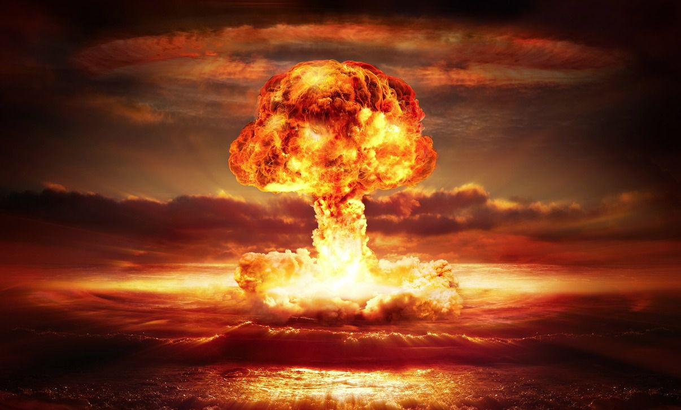
The strong force
It binds protons and neutrons inside nuclei
It is relevant at short distances only
Particles interacting via the strong force are called hadrons
Hadrons are composite objects, formed by quarks, and bound by gluons (the mediators of the strong force)
Quarks are confined inside hadrons
Strong means strong: the force between two quarks in a hadron is roughly the same as the weight of a truck
Natural units will be adopted, $ℏ=c=1$
A. Pilloni – Pentaquarks: new state of matter?
Notes:
2 slides su Zc, a Bes e a Belle
2 slide su tetraquark model: dall’hamiltoniana di Jaffe al calcolo delle masse
1 slide su molecular models, dove sono i carichi? (non in Tornqvist, si in Hanhart, vedere Braaten, citare Nefediev)
2 slides su decay channels, dove si dovrebbe vedere, e a seconda del modello, vedere qualche plot
1 slide su Y(4260), tetraquark? C’è lo strano (si vede la f0)
1 slide su Zc a cleo (anche il neutro)

Slide 3
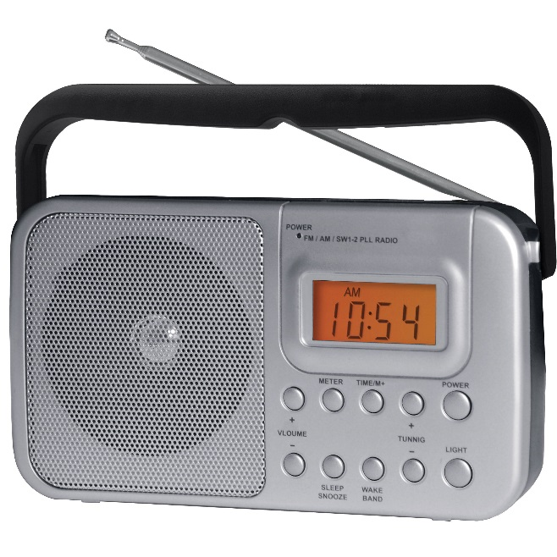
We have E&M theory: QED
Linear at the classical level → Maxwell equations
Any electromagnetic process is described by this equation (in principle)
A. Pilloni – Pentaquarks: new state of matter?

Slide 4
We have E&M theory: QED
The electric charge is small, «Taylor» expansion
$$f∼\frac{e^{2}}{4π}f_{0}+{\left(\frac{e^{2}}{4π}\right)}^{2}f_{1}+{\left(\frac{e^{2}}{4π}\right)}^{3}f_{2}+{\left(\frac{e^{2}}{4π}\right)}^{4}f_{3}+…$$
$$\frac{e^{2}}{4π}∼\frac{1}{137}≪1$$
A. Pilloni – Pentaquarks: new state of matter?

Slide 5
We have strong theory: QCD
Matrix equation
Gluons self-interact → Nonlinear even at classical level
A. Pilloni – Pentaquarks: new state of matter?

Slide 6
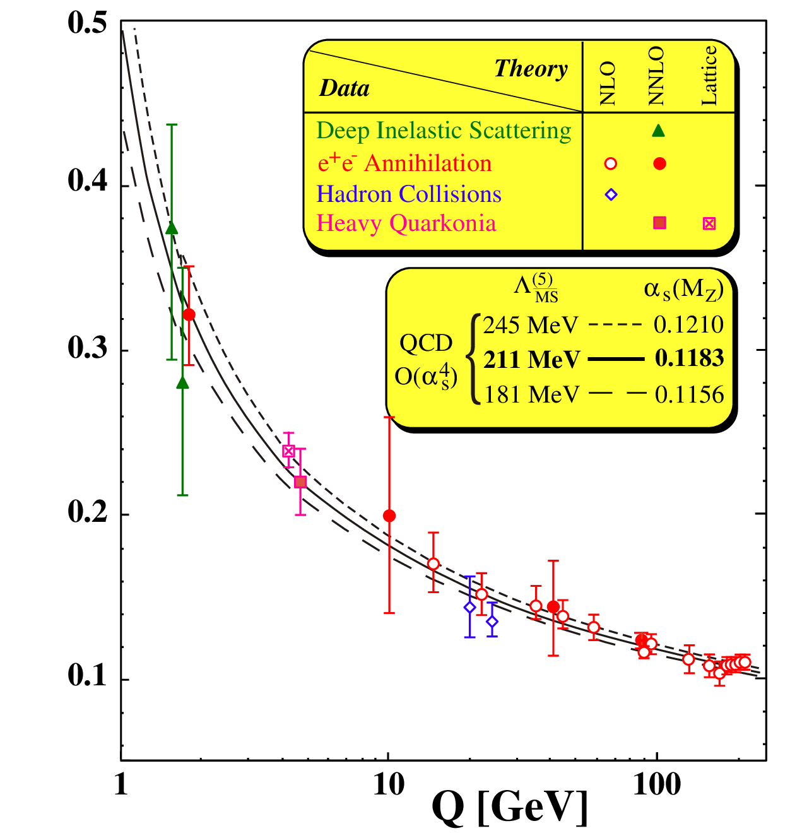
Asymptotic freedom
$\frac{g_{s}^{2}}{4π}(Q)$
At high energies $\frac{g_{s}^{2}}{4π}≪0.1$
A. Pilloni – Pentaquarks: new state of matter?

Slide 7
At low energies?
At low energies $\frac{g_{s}^{2}}{4π}>1$, no hierarchy
Emerging properties: Confinement; Mass generation
No calculable solution yet
$\frac{g_{s}^{2}}{4π}(Q)$
A. Pilloni – Pentaquarks: new state of matter?

Slide 8
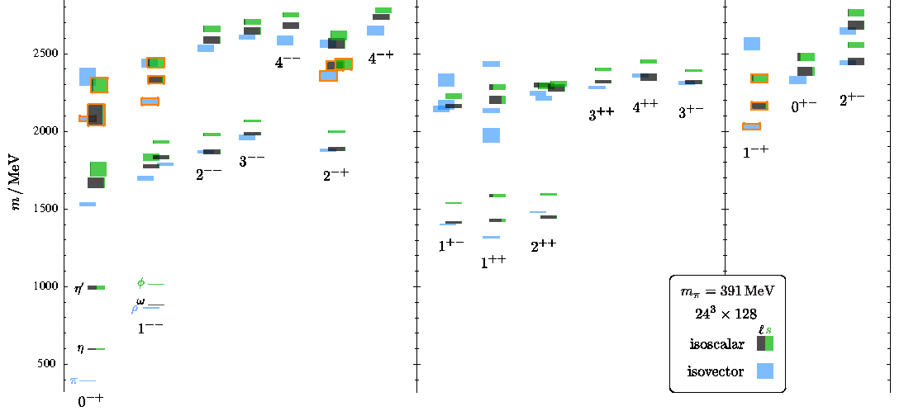
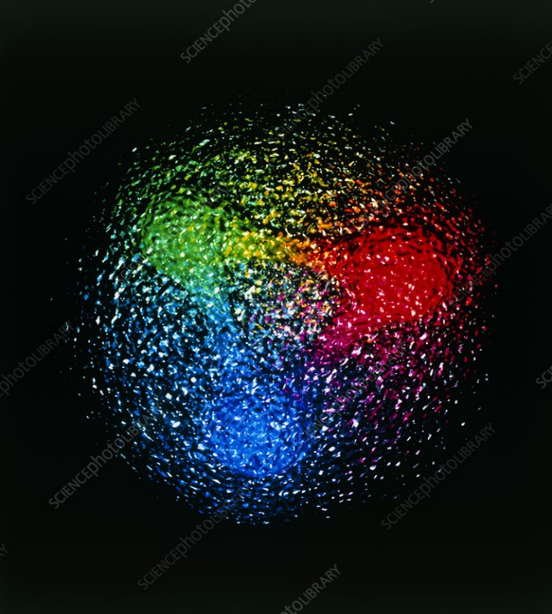
QCD has no solution. Don’t panic
Plan of attack
Collect data
Identify states
Compare with expectations
Answer big questions
We can build models to describe the spectrum. Grasp some aspects of QCD, get insights
Quark models
Lattice QCD (not a model but...)
The excited spectrum is populated by unstable states, is $∼{10}^{−24} s$
Feedback from experiments
A. Pilloni – Pentaquarks: new state of matter?

Slide 9
Three quarks for Muster Mark
Quarks appear in 3 colors
Antiquarks appear in 3 anticolors
$$π^{0}$$
$$\overline{g}$$
$$g$$
$$\overline{r}$$
$$r$$
$$\overline{b}$$
$$b$$
Quarks appear in 6 flavors
$q\overline{q}$ pairs form a meson
Hadrons must be white:
A. Pilloni – Pentaquarks: new state of matter?
Notes:
2 slides su Zc, a Bes e a Belle
2 slide su tetraquark model: dall’hamiltoniana di Jaffe al calcolo delle masse
1 slide su molecular models, dove sono i carichi? (non in Tornqvist, si in Hanhart, vedere Braaten, citare Nefediev)
2 slides su decay channels, dove si dovrebbe vedere, e a seconda del modello, vedere qualche plot
1 slide su Y(4260), tetraquark? C’è lo strano (si vede la f0)
1 slide su Zc a cleo (anche il neutro)

Slide 10
Three quarks for Muster Mark
Quarks appear in 3 colors
Antiquarks appear in 3 anticolors
$$\overline{g}$$
$$g$$
$$\overline{n}$$
$$\overline{r}$$
$$r$$
$$p$$
$$\overline{b}$$
$$b$$
$qqq$ triplets form a baryon
Hadrons must be white:
$\overline{q}\overline{q}\overline{q}$ triplets form an antibaryon
A. Pilloni – Pentaquarks: new state of matter?
Notes:
2 slides su Zc, a Bes e a Belle
2 slide su tetraquark model: dall’hamiltoniana di Jaffe al calcolo delle masse
1 slide su molecular models, dove sono i carichi? (non in Tornqvist, si in Hanhart, vedere Braaten, citare Nefediev)
2 slides su decay channels, dove si dovrebbe vedere, e a seconda del modello, vedere qualche plot
1 slide su Y(4260), tetraquark? C’è lo strano (si vede la f0)
1 slide su Zc a cleo (anche il neutro)

Slide 11
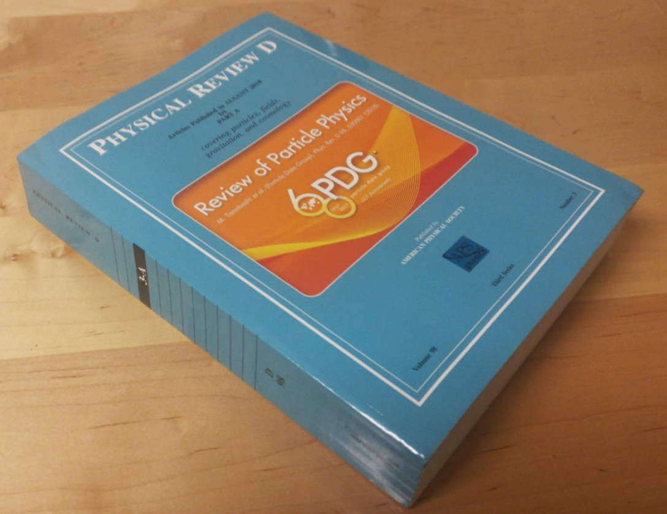
More quarks?
The Particle Data Group collects all the information from experiments about observed hadrons
Almost the totality of them can be understood as 2- or 3-quark states
A. Pilloni – Pentaquarks: new state of matter?
Notes:
2 slides su Zc, a Bes e a Belle
2 slide su tetraquark model: dall’hamiltoniana di Jaffe al calcolo delle masse
1 slide su molecular models, dove sono i carichi? (non in Tornqvist, si in Hanhart, vedere Braaten, citare Nefediev)
2 slides su decay channels, dove si dovrebbe vedere, e a seconda del modello, vedere qualche plot
1 slide su Y(4260), tetraquark? C’è lo strano (si vede la f0)
1 slide su Zc a cleo (anche il neutro)

Slide 12
More quarks?
I can keep adding $q\overline{q}$ pairs, the hadron is still white
$$g$$
$$P_{c}$$
$$\overline{r}$$
$$r$$
$$b$$
$$r$$
Pentaquarks with half-integer spin
…or in white groups (molecular pentaquarks)
The question is whether quark cluster in colored groups (compact pentaquarks)…
Tetraquarks with integer spin
A. Pilloni – Pentaquarks: new state of matter?
Notes:
2 slides su Zc, a Bes e a Belle
2 slide su tetraquark model: dall’hamiltoniana di Jaffe al calcolo delle masse
1 slide su molecular models, dove sono i carichi? (non in Tornqvist, si in Hanhart, vedere Braaten, citare Nefediev)
2 slides su decay channels, dove si dovrebbe vedere, e a seconda del modello, vedere qualche plot
1 slide su Y(4260), tetraquark? C’è lo strano (si vede la f0)
1 slide su Zc a cleo (anche il neutro)

Slide 13
Models for every taste
Compact
Hybrids
Containing gluonic degrees of freedom
Multiquark
Several (cluster) of valence quarks
Hadroquarkonium
Heavy core interacting with a light cloud via Van der Waals forces
$$π$$
$$π$$
$$J/ψ$$
$$π$$
Rescattering effects
Structures generated by cross-channel rescattering, very process-dependent
Molecule
Bound or virtual state generated by long-range exchange forces
Extended
A. Pilloni – Pentaquarks: new state of matter?

Slide 14
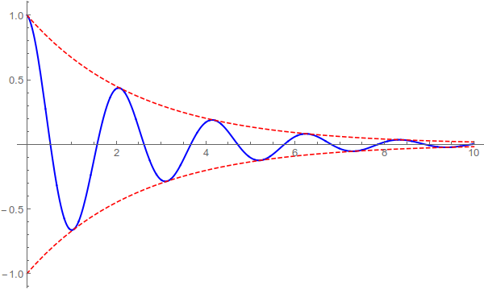
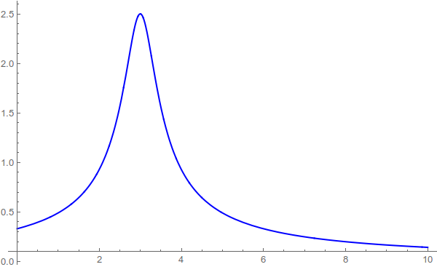
Resonances = Unstable states/1
$$ψ(t)=e^{−i E_{0} t} e^{− \frac{Γ}{2} t }$$
$$ψ(E)=\frac{1}{E−E_{0}+i\frac{Γ}{2}}$$
$$Γ$$
$${\left|ψ\left(t\right)\right|}^{2}=e^{− Γ t }$$
$$E_{0}$$
Excited states are unstable, lifetimes $τ∼{10}^{−24} \text{s}$
This is too short for their flight to be detected
They manifest as resonant peaks in the energy of their decay products, with widths $Γ∼ℏ/τ$
A. Pilloni – Pentaquarks: new state of matter?

Slide 15
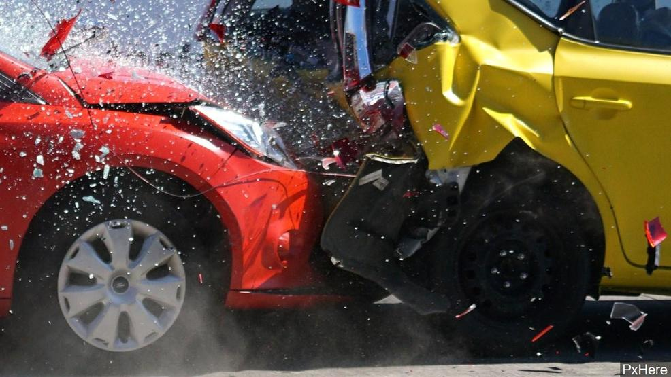
Unraveling QCD
Beam
Beam
Products
A. Pilloni – Pentaquarks: new state of matter?

Slide 16
Unraveling QCD at CERN
LHC
Protons at $450 \text{GeV}$
S$p$S
Two proton beams at $7000 \text{GeV}$
secondary pion beam at $190 \text{GeV}$, Liquid Hydrogen target
Study HEP + heavy hadrons
Study hadrons made of light quarks
A. Pilloni – Prospects for Hadron Spectroscopy

Slide 17
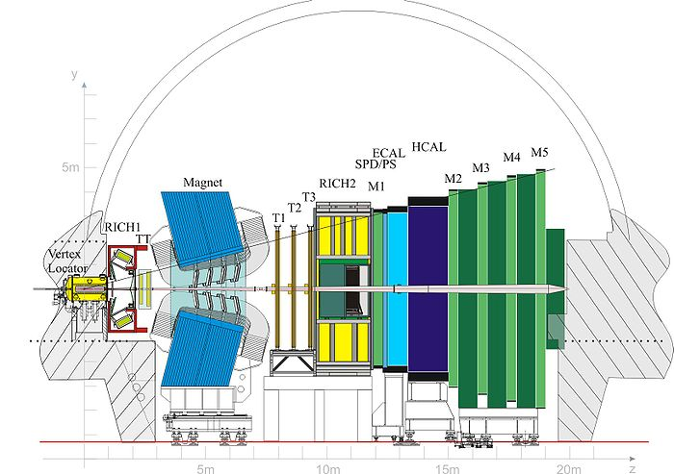
The LHCb detector
Forward arm spectrometer designed to study bottom and charm hadrons
Rapidity coverage $2.0 < y < 4.5$
Excellent particle identification:
Muons: $ε \sim 97\%$ for 1−3% $π→μ$ misidentification
Kaons: $ε \sim 95\%$ for 5% $π→K$ misidentification
Very good vertex resolution: $σ=20 μ\text{m}$ IP resolution
Momentum resolution $Δp/p=0.5−0.8\%$
A. Pilloni – Prospects for Hadron Spectroscopy

Slide 18
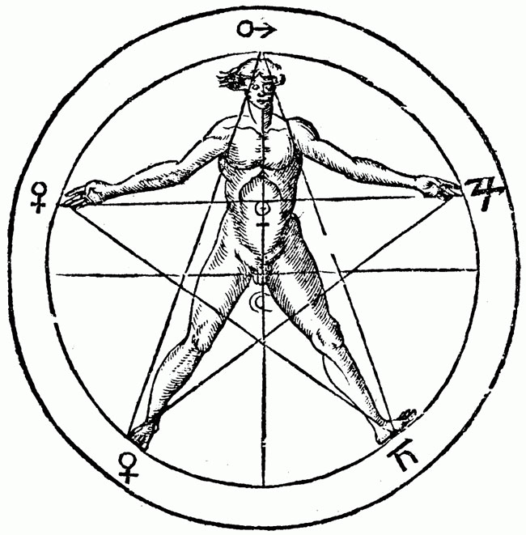
The (new) pentaquarks
$$u$$
$$c$$
$$\overline{c}$$
$$u$$
$$d$$
Notes:
2 slides su Zc, a Bes e a Belle
2 slide su tetraquark model: dall’hamiltoniana di Jaffe al calcolo delle masse
1 slide su molecular models, dove sono i carichi? (non in Tornqvist, si in Hanhart, vedere Braaten, citare Nefediev)
2 slides su decay channels, dove si dovrebbe vedere, e a seconda del modello, vedere qualche plot
1 slide su Y(4260), tetraquark? C’è lo strano (si vede la f0)
1 slide su Zc a cleo (anche il neutro)

Slide 19
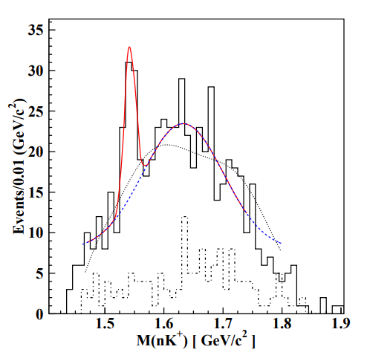
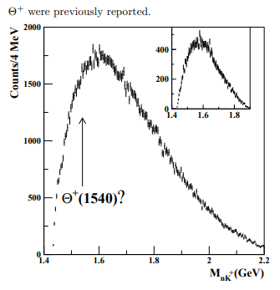
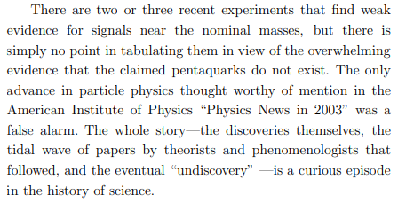
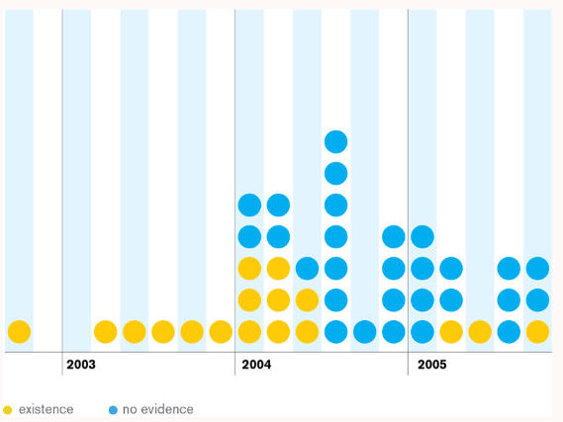
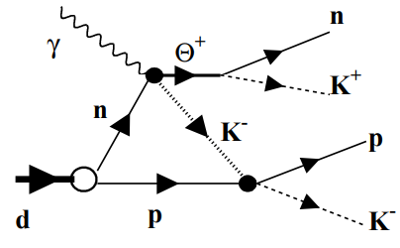
Preamble: the old pentaquark!
C.G. Wohl, PDG 2008
…and in time, the marvellous sword was forgotten.
2003, 5.8σ
2005, 0.0σ
$$(udd)$$
$$(u\overline{s})$$
$$(s\overline{u})$$
$$(uud)$$
A. Pilloni – Pentaquarks: new state of matter?
Notes:
Controlla la parte su Regge

Slide 20
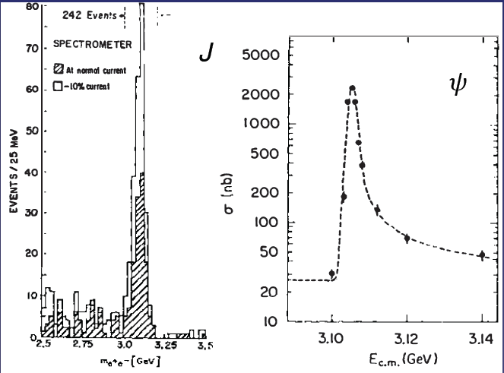
The heavy quarkonia
$$Q$$
$$\overline{Q}$$
Potential models
(meaningful when $M_{Q}→∞$)
$$V\left(r\right)=−\frac{C_{F}α_{s}}{r}+σr$$
(Cornell potential)
$$α_{s}\left(M_{Q}\right)∼0.3$$
(perturbative regime)
OZI-rule, QCD multipole
Solve NR Schrödinger eq. → spectrum
Effective theories
(HQET, NRQCD, pNRQCD...)
Heavy quark spin flip suppressed by quark mass, approximate heavy quark spin symmetry (HQSS)
Integrate out heavy DOF
↓
(spectrum), decay & production rates
A. Pilloni – Pentaquarks: new state of matter?
Notes:
2 slides su Zc, a Bes e a Belle
2 slide su tetraquark model: dall’hamiltoniana di Jaffe al calcolo delle masse
1 slide su molecular models, dove sono i carichi? (non in Tornqvist, si in Hanhart, vedere Braaten, citare Nefediev)
2 slides su decay channels, dove si dovrebbe vedere, e a seconda del modello, vedere qualche plot
1 slide su Y(4260), tetraquark? C’è lo strano (si vede la f0)
1 slide su Zc a cleo (anche il neutro)

Slide 21
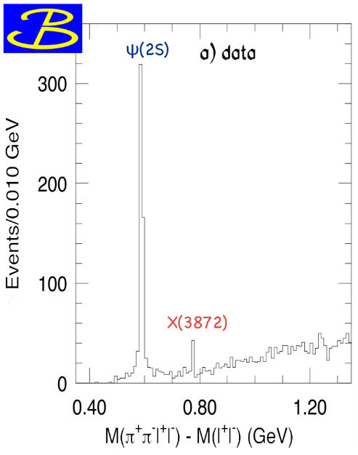
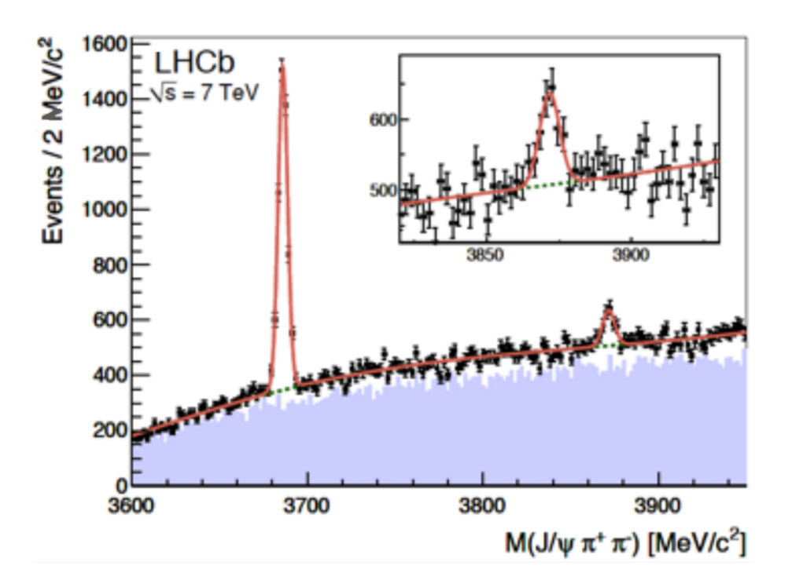
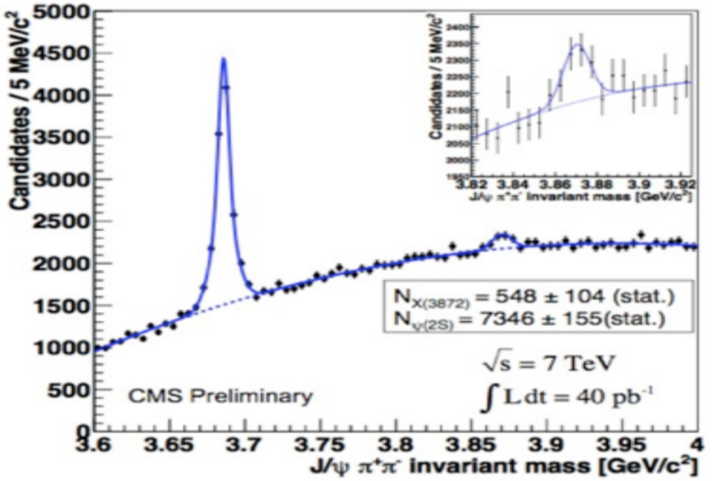
$X(3872)$
Discovered in 2003 $B→K X→K J/ψ ππ$
Very close to $\overline{D}D^{∗}$ threshold
Too narrow for an above-treshold charmonium
Isospin violation too big $\frac{Γ\left(X→J/ψ ω\right)}{Γ\left(X→J/ψ ρ\right)}\sim 1.1±0.4$
Mass prediction not compatible with $c\overline{c}$ calculations
A. Pilloni – Pentaquarks: new state of matter?

Slide 22
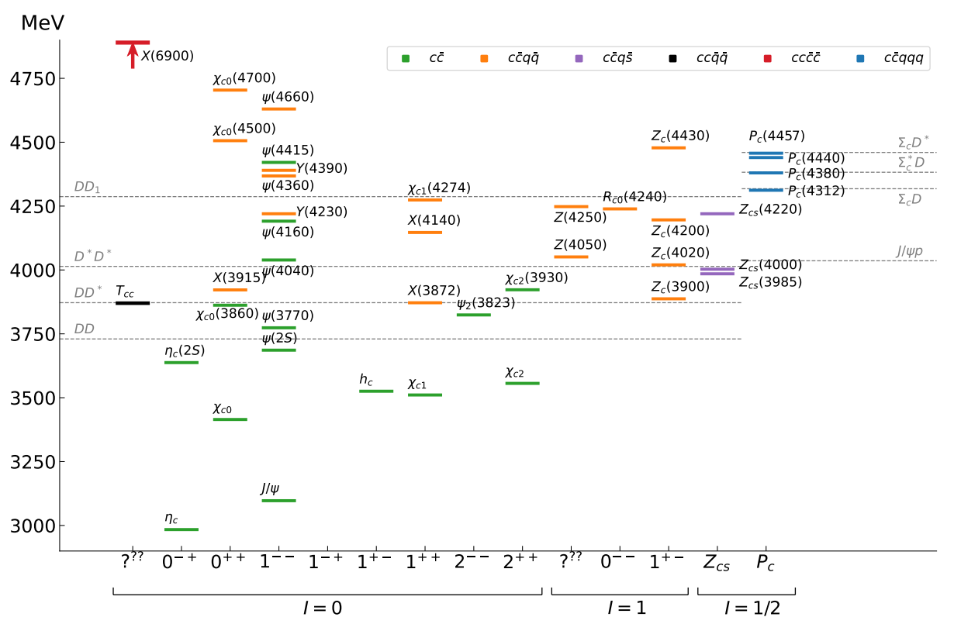
Lots of XYZ
Esposito, AP, Polosa, Phys.Rept. 668
PPNP 127, 103981
A host of unexpected resonances have appeared
decaying mostly into charmonium + light Hardly reconciled with usual $q\overline{q}$ pheno
A. Pilloni – Pentaquarks: new state of matter?
Notes:
2 slides su Zc, a Bes e a Belle
2 slide su tetraquark model: dall’hamiltoniana di Jaffe al calcolo delle masse
1 slide su molecular models, dove sono i carichi? (non in Tornqvist, si in Hanhart, vedere Braaten, citare Nefediev)
2 slides su decay channels, dove si dovrebbe vedere, e a seconda del modello, vedere qualche plot
1 slide su Y(4260), tetraquark? C’è lo strano (si vede la f0)
1 slide su Zc a cleo (anche il neutro)

Slide 23
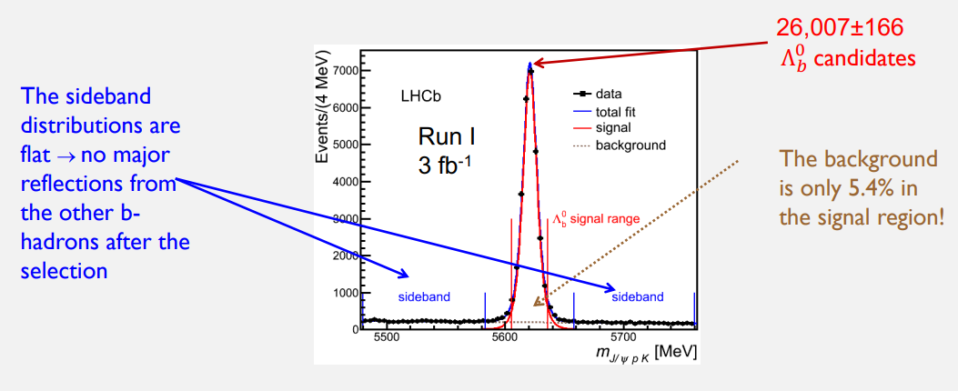
LHCb, 2015!
LHCb, 1507.03414
A decay mode of a bottom baryon was studied
$$Λ_{b}^{0}→J/ψ(→μ^{+}μ^{−}) p K^{−}$$
A. Pilloni – Pentaquarks: new state of matter?
Notes:
Controlla la parte su Regge

Slide 24
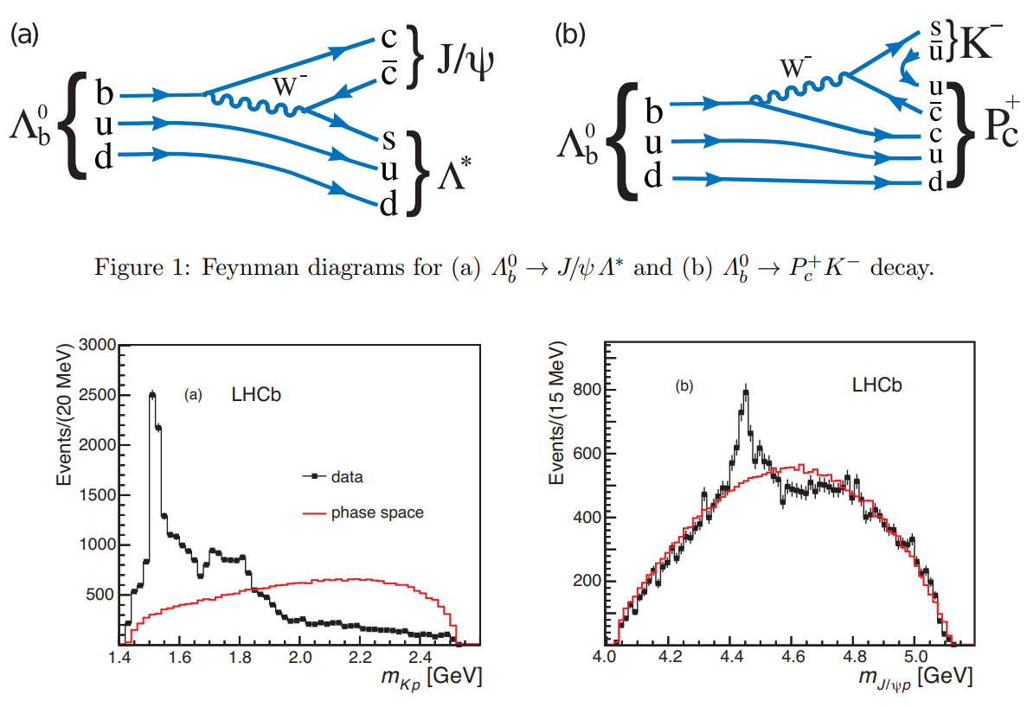
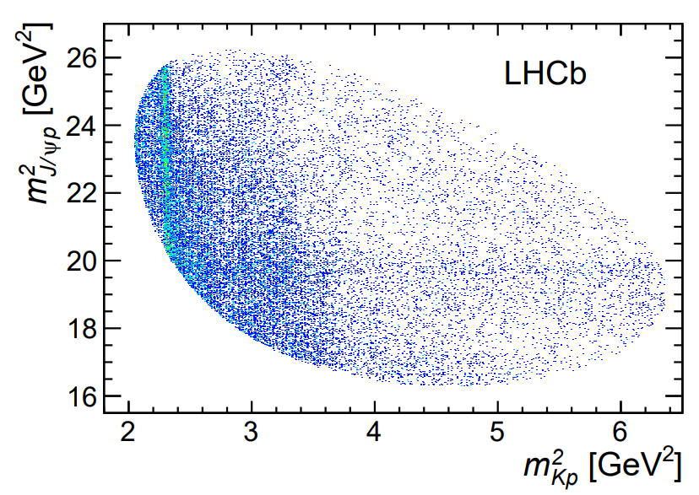
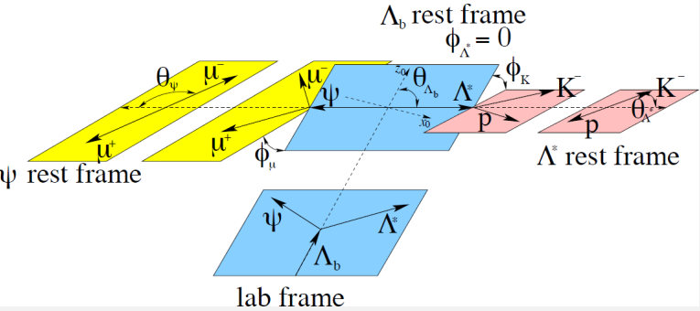
LHCb, 2015!
$$\text{s}$$
$${\text{K}}^{−}$$
$$\overline{\text{u}}$$
$$\text{u}$$
$$\text{u}$$
$$\text{p}$$
$$\text{d}$$
A. Pilloni – Pentaquarks: new state of matter?
Notes:
Controlla la parte su Regge

Slide 25
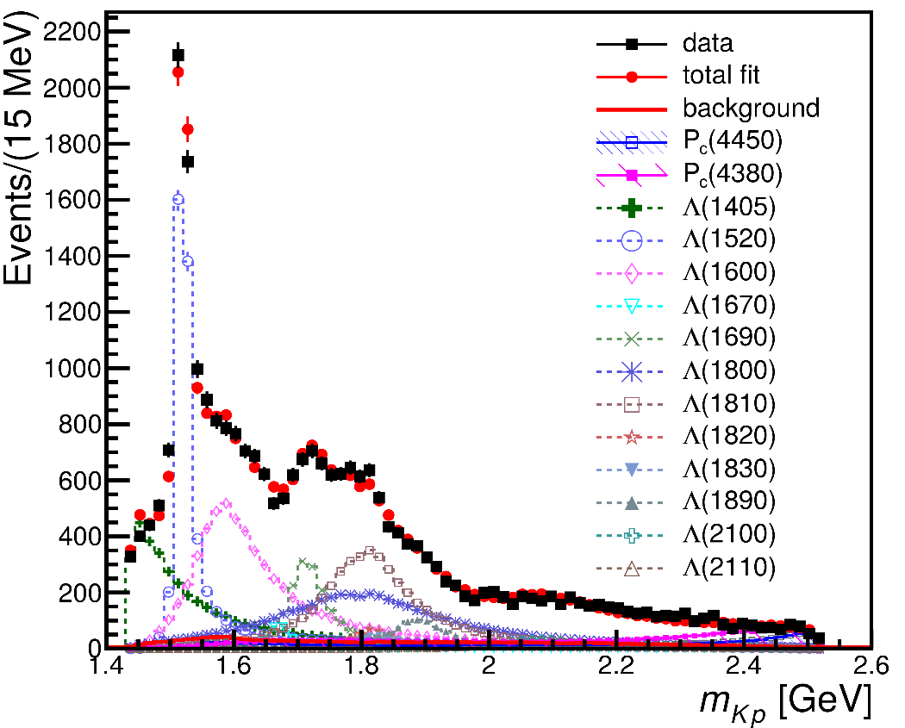
From data to the spectrum
6D multidimensional fit (all angles included) Each resonance parametrized with a Breit-Wigner lineshape, production couplings taken complex
A. Pilloni – Pentaquarks: new state of matter?

Slide 26
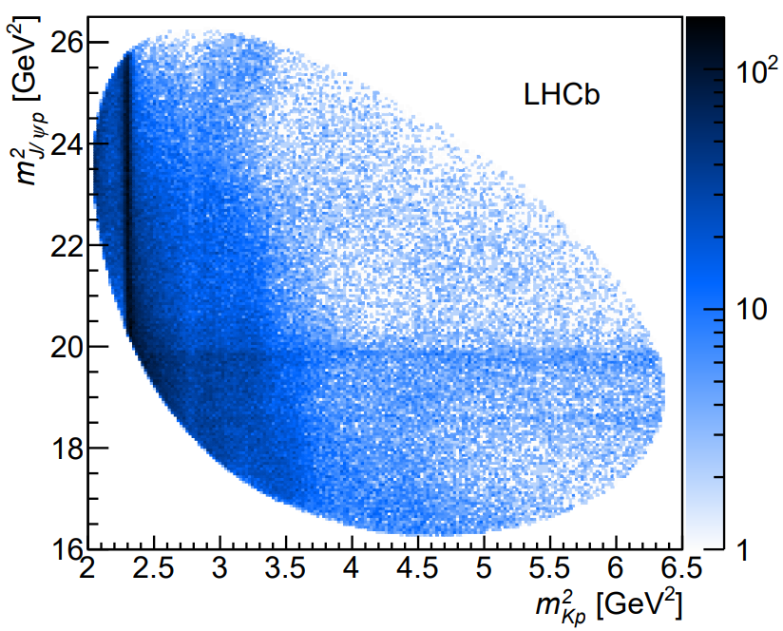
Update in 2019
LHCb & AP, 1904.03947
9x more statistics, 1D analysis
A new lowest $P_{c}(4312)$ appears as an isolated peak at the $Σ_{c}^{+}{\overline{D}}^{0}$ threshold
A detailed study of the lineshape provides insight on its nature
Composite structure of the higher peak is also resolved
A. Pilloni – Pentaquarks: new state of matter?
Notes:
Controlla la parte su Regge

Slide 27
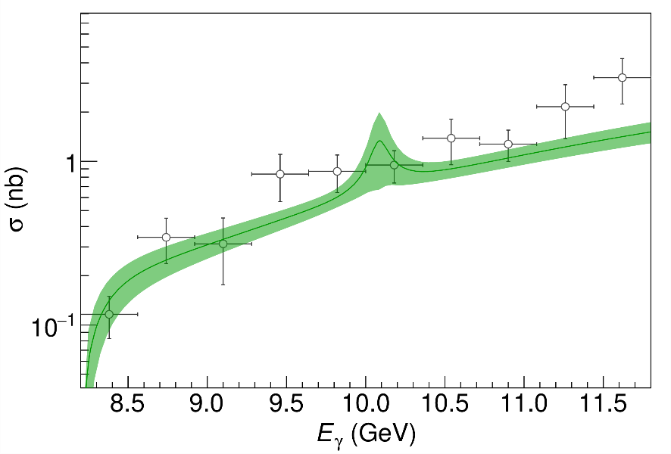
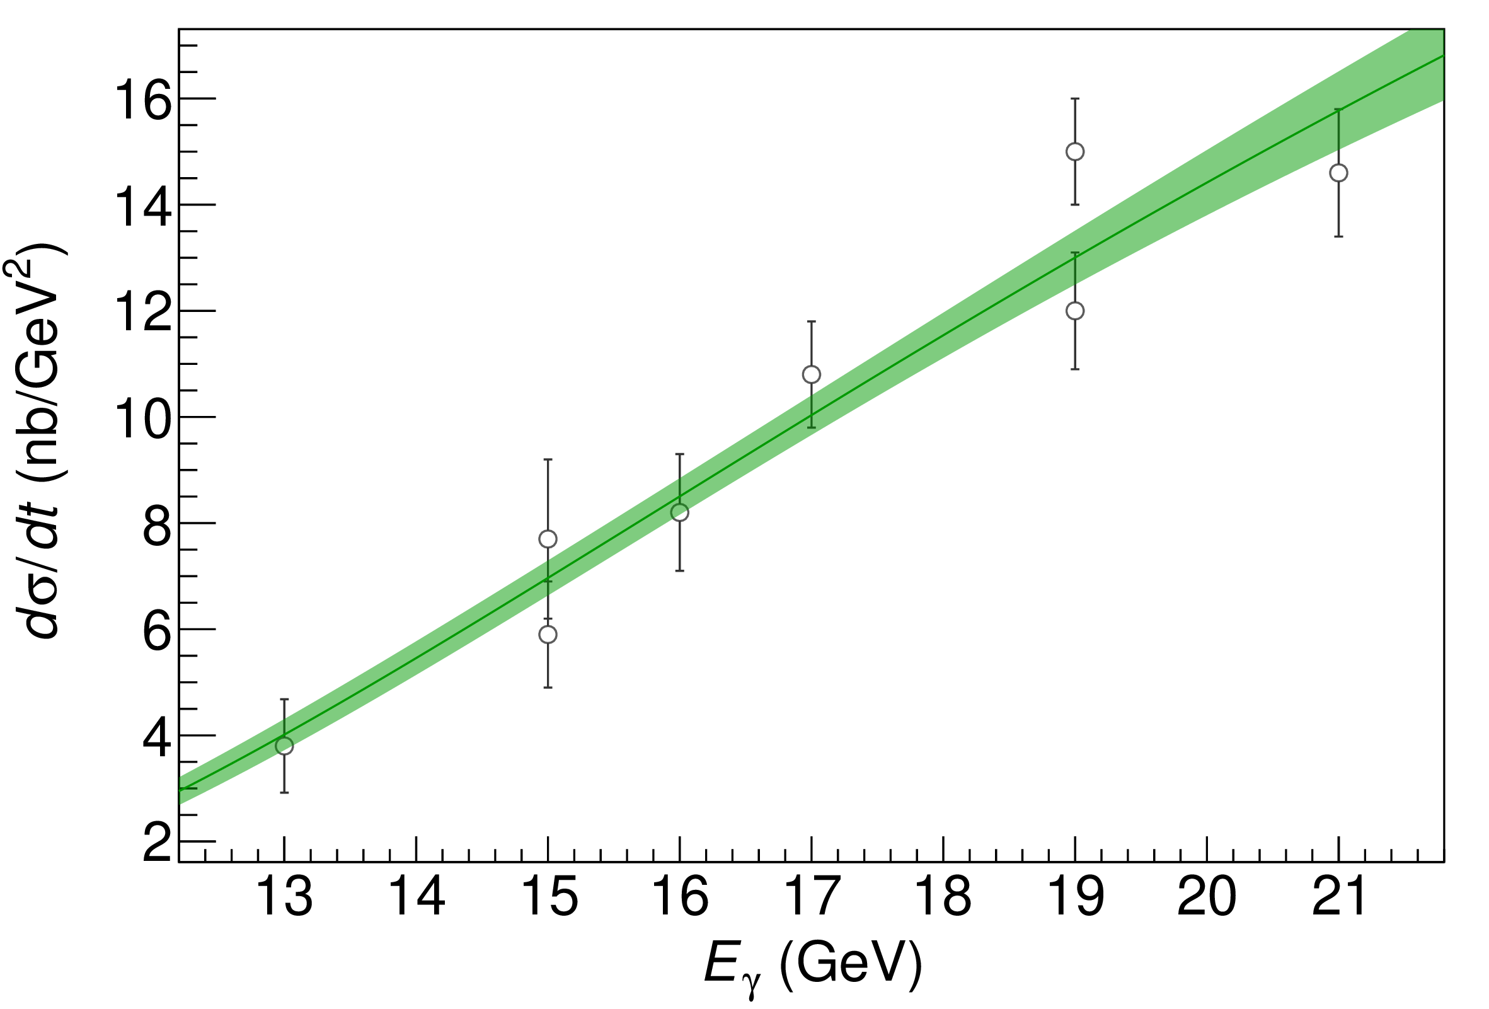
Searches in photoproduction
To exclude any rescattering mechanism, we search the $P_{c}$ in photoproduction at Jlab
No luck so far, new data under scrutiny
$$P_{c}$$
( data)
Hiller Blin, AP et al. (JPAC), 1606.08912
D. Winney, AP et al. (JPAC), 1907.09393
A. Pilloni – Pentaquarks: new state of matter?
Notes:
Controlla la parte su Regge

Slide 28
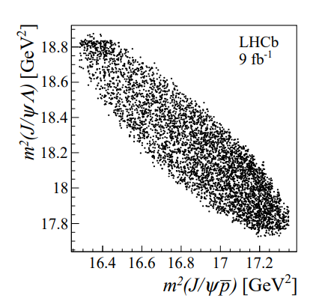
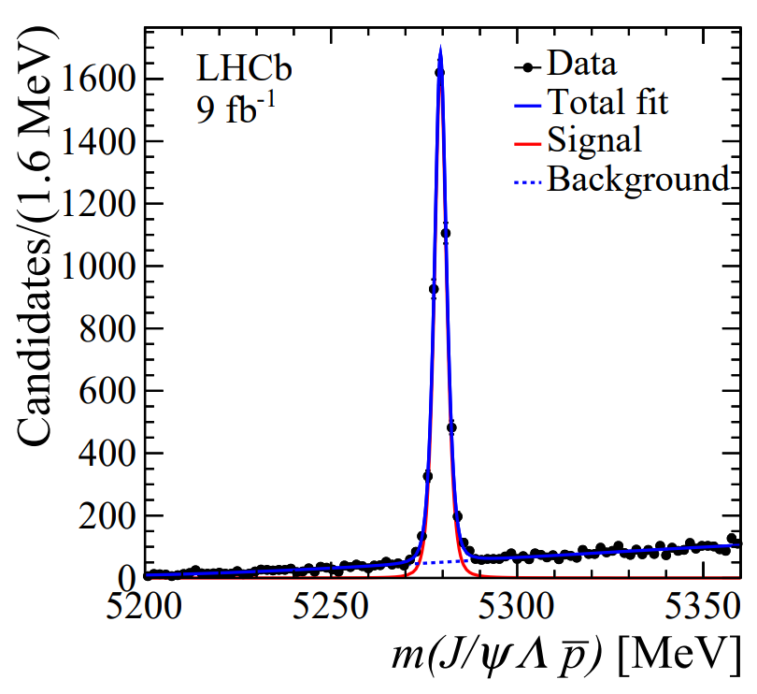
Strange pentaquarks?
LHCb & AP, 2210.10346
How about searching for pentaquarks in meson decays?
Phase space is smaller, less stuff going on
$$B^{−}→J/ψ\left(→μ^{+}μ^{−}\right)Λ^{0}\left(→pπ^{+}\right) \overline{p}$$
4k events, 93% purity
A. Pilloni – Pentaquarks: new state of matter?
Notes:
Controlla la parte su Regge

Slide 29
Strange pentaquarks?
Bingo! $P_{cs}$!
$$m=4338.2±0.7±0.4 \text{MeV}$$
$$Γ=7.0±1.2±1.3 \text{MeV}$$
It remains to be seen the connections with the nonstrange pentaquarks
No $K^{∗}$ expected in this $Λ^{0}\overline{p}$ mass region
None seen, mostly flat
A. Pilloni – Pentaquarks: new state of matter?
Notes:
Controlla la parte su Regge

Slide 30
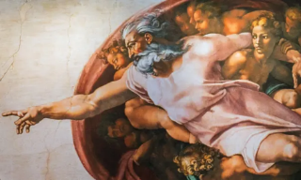
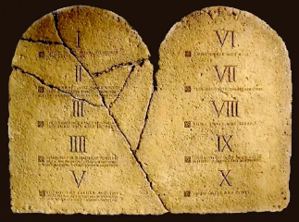
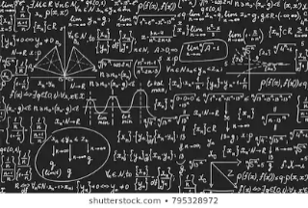
How to interpret this?
Top-down: you study models, and verify predictions
Bottom-up: you study data (lineshapes), and try and infer the physics
$$f(s)$$
A. Pilloni – Pentaquarks: new state of matter?
Notes:
Y(4260), M=4263 +- 5, Gamma = 95+-14
D_1(2420)^0, M=2421.3 ±0.6, Gamma =27.1 ±2.7
D_1(2420)^+-, M=2423.4 ±3.1, Gamma =25 ±6
I D_1 hanno J^P = 1^+
La molecola D_1 D sta 22 MeV sotto
Se la Y è D_1 D, il pione lega fortemente, come fa la Y a essere così larga?
Come funziona lo scambio del pione???

Slide 31
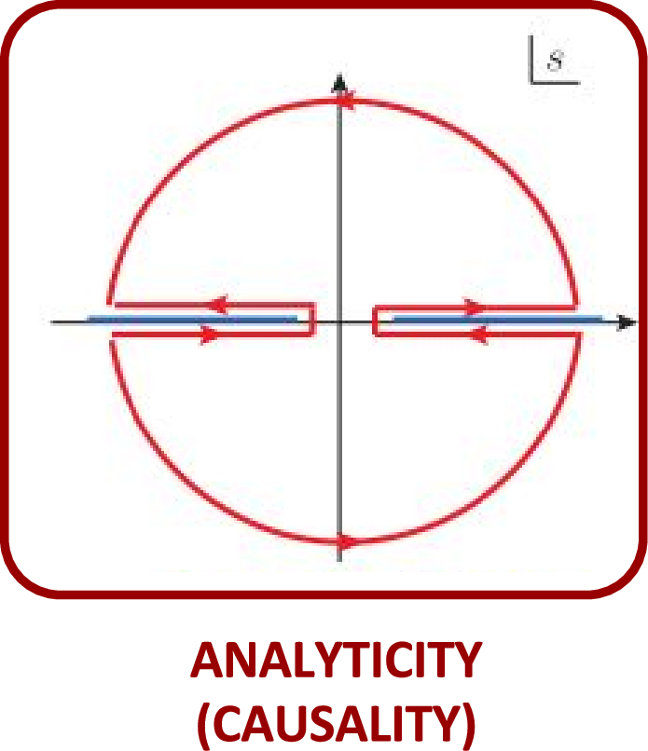
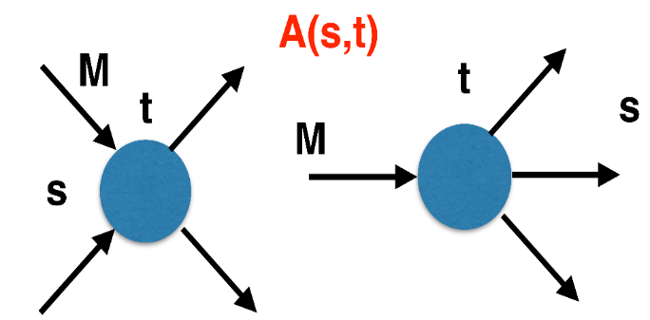
The S-Matrix principles
Future cannot change the past
100%, something will happen
The anti-particle is an anti-particle and not just a different particle
(analyticity)
(unitarity)
(crossing symmetry)
Sherlock Holmes, QFT
Analyticity
Unitarity
Crossing
Parametrize your ignorance.
Build a model.
Fit data.
Have fun.
A. Pilloni – Pentaquarks: new state of matter?

Slide 32
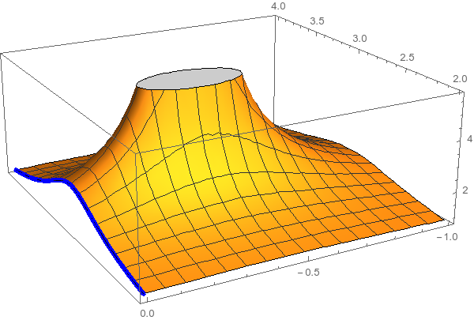
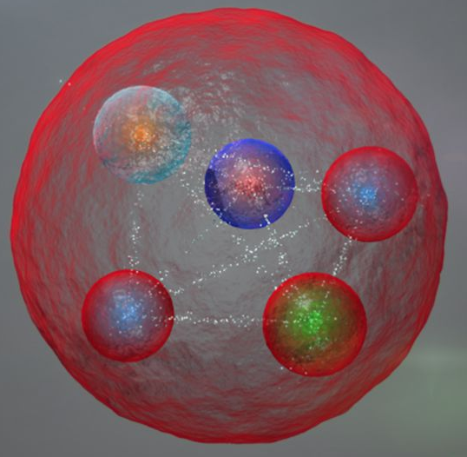
Resonances = Unstable states /2
$$ψ(t)=e^{−i E_{0} t} e^{− \frac{Γ}{2} t }$$
$$ψ(E)=\frac{1}{E−E_{0}+i\frac{Γ}{2}}$$
Excited states are unstable
Their lifetime is too short for their flight to be detected
They manifest as resonant peaks in the energy of their decay products
The function explodes for value of energy $E=E_{0}−i\frac{Γ}{2}$
Resonances are poles in the complex energy plane
A. Pilloni – Pentaquarks: new state of matter?

Slide 33
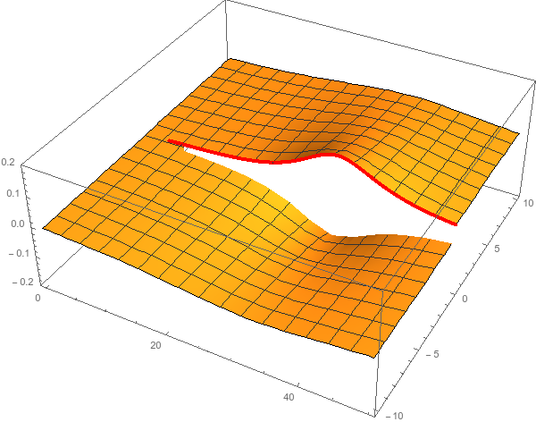
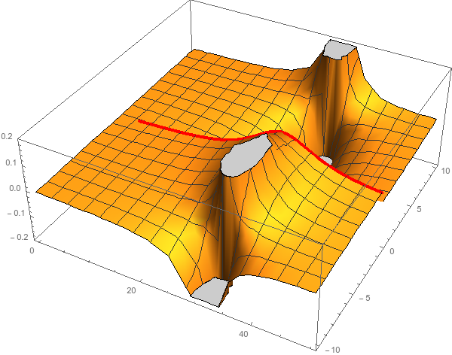
Unitarity & Pole hunting
Unitarity creates a branch cut on the real axis, two sheets continuosly connected
I sheet
II sheet
Finding resonances means writing analytic amplitude, and hunting for poles in the complex plane
A. Pilloni – Pentaquarks: new state of matter?
Notes:
Controlla la parte su Regge

Slide 34
Bound and virtual states
Decreasing the potential strength, the pole reaches threshold
The pole jumps on the 2nd sheet (dineutron), it becomes a virtual state
Example from $pn$ scattering Bound state on the real axis 1st sheet (deuteron)
$$V(r)$$
$$\text{Im} E$$
$$r$$
$$V$$
Deuteron
$$\text{Re} E$$
$${}_{}^{1}S$$
Deuteron pole
Dineutron pole
$${}_{}^{3}S$$
A. Pilloni – Pentaquarks: new state of matter?
Notes:
Controlla la parte su Regge

Slide 35
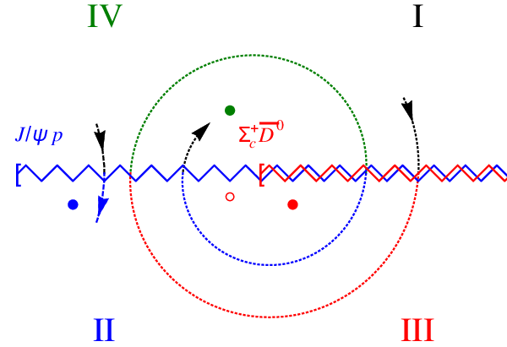
Bound and virtual states
The situation is more complicated when more channels are open
Virtual state
Bound state
Resonance
A. Pilloni – Pentaquarks: new state of matter?
Notes:
Controlla la parte su Regge

Slide 36
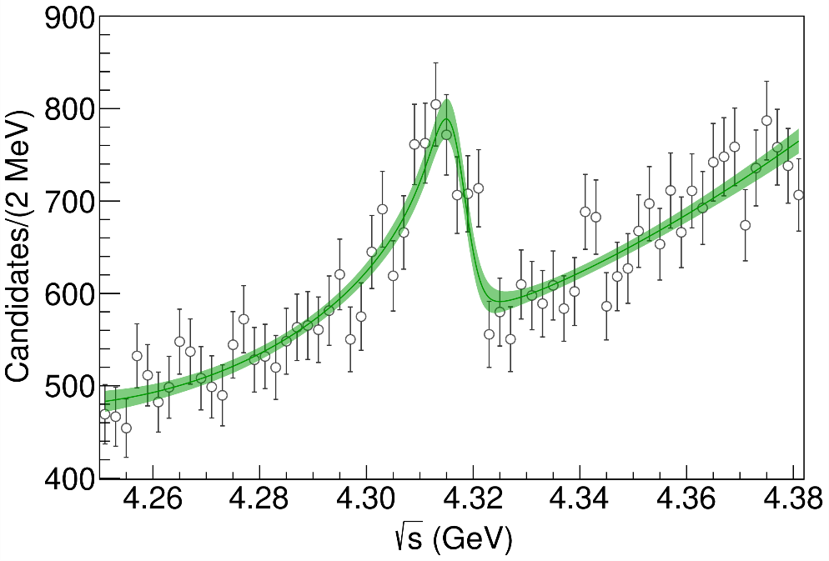
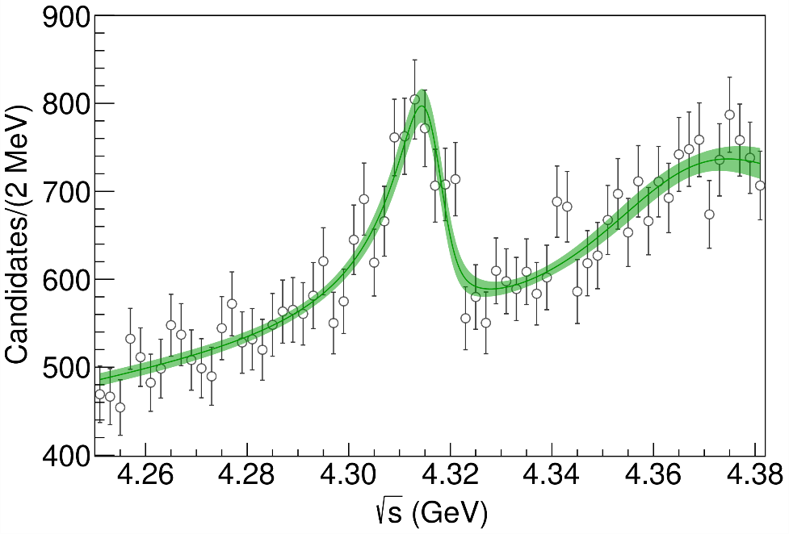
Minimal(istic) model
Fernandez-Ramirez, AP et al. (JPAC), PRL 123, 092001
Model-independent expansion at the $Σ_{c}\overline{D^{0}}$ threshold
$$c_{ii}=0$$
Finite $c_{ii}$
A. Pilloni – Pentaquarks: new state of matter?
Notes:
2 slides su Zc, a Bes e a Belle
2 slide su tetraquark model: dall’hamiltoniana di Jaffe al calcolo delle masse
1 slide su molecular models, dove sono i carichi? (non in Tornqvist, si in Hanhart, vedere Braaten, citare Nefediev)
2 slides su decay channels, dove si dovrebbe vedere, e a seconda del modello, vedere qualche plot
1 slide su Y(4260), tetraquark? C’è lo strano (si vede la f0)
1 slide su Zc a cleo (anche il neutro)

Slide 37
Minimal(istic) model
Model-independent expansion at the $Σ_{c}\overline{D^{0}}$ threshold
$$c_{ii}=0$$
Finite $c_{ii}$
A. Pilloni – Pentaquarks: new state of matter?
Notes:
2 slides su Zc, a Bes e a Belle
2 slide su tetraquark model: dall’hamiltoniana di Jaffe al calcolo delle masse
1 slide su molecular models, dove sono i carichi? (non in Tornqvist, si in Hanhart, vedere Braaten, citare Nefediev)
2 slides su decay channels, dove si dovrebbe vedere, e a seconda del modello, vedere qualche plot
1 slide su Y(4260), tetraquark? C’è lo strano (si vede la f0)
1 slide su Zc a cleo (anche il neutro)

Slide 38
Minimal(istic) model
Model-independent expansion at the $Σ_{c}\overline{D^{0}}$ threshold
Points to a virtual state
$$c_{ii}=0$$
Finite $c_{ii}$
A. Pilloni – Pentaquarks: new state of matter?
Notes:
2 slides su Zc, a Bes e a Belle
2 slide su tetraquark model: dall’hamiltoniana di Jaffe al calcolo delle masse
1 slide su molecular models, dove sono i carichi? (non in Tornqvist, si in Hanhart, vedere Braaten, citare Nefediev)
2 slides su decay channels, dove si dovrebbe vedere, e a seconda del modello, vedere qualche plot
1 slide su Y(4260), tetraquark? C’è lo strano (si vede la f0)
1 slide su Zc a cleo (anche il neutro)

Slide 39
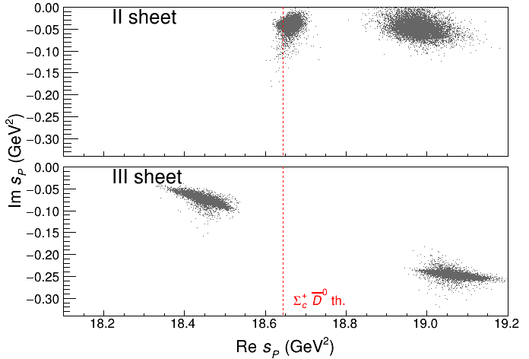
Minimal(istic) model
Model-independent expansion at the $Σ_{c}\overline{D^{0}}$ threshold
Points to a virtual state
Doesn’t point to a resonance
$$c_{ii}=0$$
Finite $c_{ii}$
A. Pilloni – Pentaquarks: new state of matter?
Notes:
2 slides su Zc, a Bes e a Belle
2 slide su tetraquark model: dall’hamiltoniana di Jaffe al calcolo delle masse
1 slide su molecular models, dove sono i carichi? (non in Tornqvist, si in Hanhart, vedere Braaten, citare Nefediev)
2 slides su decay channels, dove si dovrebbe vedere, e a seconda del modello, vedere qualche plot
1 slide su Y(4260), tetraquark? C’è lo strano (si vede la f0)
1 slide su Zc a cleo (anche il neutro)

Slide 40
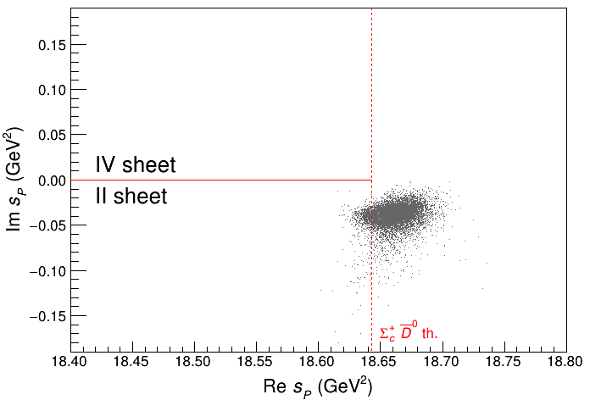
Minimal(istic) model
Model-independent expansion at the $Σ_{c}\overline{D^{0}}$ threshold
Points to a virtual state
Doesn’t point to a resonance
$$c_{ii}=0$$
Finite $c_{ii}$
A. Pilloni – Pentaquarks: new state of matter?
Notes:
2 slides su Zc, a Bes e a Belle
2 slide su tetraquark model: dall’hamiltoniana di Jaffe al calcolo delle masse
1 slide su molecular models, dove sono i carichi? (non in Tornqvist, si in Hanhart, vedere Braaten, citare Nefediev)
2 slides su decay channels, dove si dovrebbe vedere, e a seconda del modello, vedere qualche plot
1 slide su Y(4260), tetraquark? C’è lo strano (si vede la f0)
1 slide su Zc a cleo (anche il neutro)

Slide 41
Epilogue
Why pentaquarks and other exotics are important?
To infer the dynamics of QCD building blocks
Their observation or nonobservation in various reactions teaches us something about their internal structure
To answer fundamental questions about confinement in strongly coupled theories
Thank you!
A. Pilloni – Pentaquarks: new state of matter?
Notes:
2 slides su Zc, a Bes e a Belle
2 slide su tetraquark model: dall’hamiltoniana di Jaffe al calcolo delle masse
1 slide su molecular models, dove sono i carichi? (non in Tornqvist, si in Hanhart, vedere Braaten, citare Nefediev)
2 slides su decay channels, dove si dovrebbe vedere, e a seconda del modello, vedere qualche plot
1 slide su Y(4260), tetraquark? C’è lo strano (si vede la f0)
1 slide su Zc a cleo (anche il neutro)

Slide 42
Backup

Slide 43
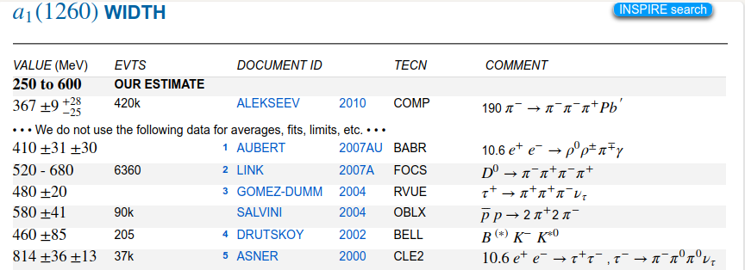
Life is not easy...
A. Pilloni – Pentaquarks: new state of matter?
Notes:
2 slides su Zc, a Bes e a Belle
2 slide su tetraquark model: dall’hamiltoniana di Jaffe al calcolo delle masse
1 slide su molecular models, dove sono i carichi? (non in Tornqvist, si in Hanhart, vedere Braaten, citare Nefediev)
2 slides su decay channels, dove si dovrebbe vedere, e a seconda del modello, vedere qualche plot
1 slide su Y(4260), tetraquark? C’è lo strano (si vede la f0)
1 slide su Zc a cleo (anche il neutro)

Slide 44
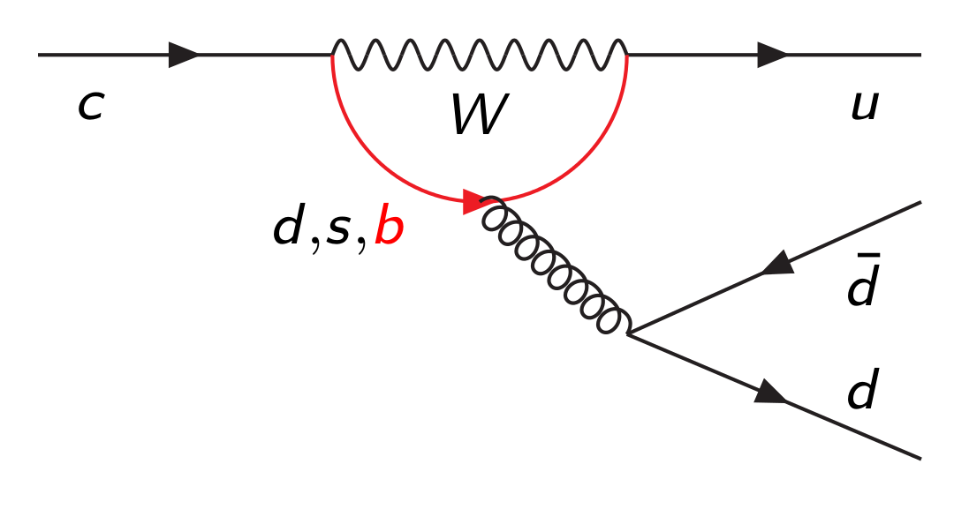
Hadrons are everywhere
$$D^{0}$$
$$\overline{u}$$
$$π^{+}$$
$$π^{+}$$
$$c$$
$$u$$
$$π^{−}$$
$$\overline{d}$$
$$π^{−}$$
$$π^{0}$$
$$d$$
$$π^{0}$$
A. Pilloni – Pentaquarks: new state of matter?
Notes:
2 slides su Zc, a Bes e a Belle
2 slide su tetraquark model: dall’hamiltoniana di Jaffe al calcolo delle masse
1 slide su molecular models, dove sono i carichi? (non in Tornqvist, si in Hanhart, vedere Braaten, citare Nefediev)
2 slides su decay channels, dove si dovrebbe vedere, e a seconda del modello, vedere qualche plot
1 slide su Y(4260), tetraquark? C’è lo strano (si vede la f0)
1 slide su Zc a cleo (anche il neutro)

Slide 45
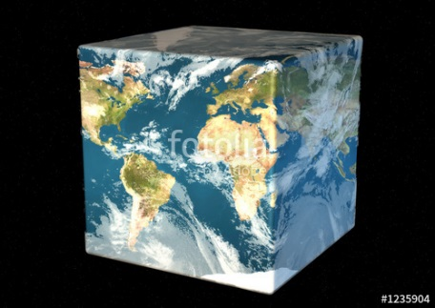
The Richness of the Spectrum
Meson
Baryon
Glueball
Hybrids
Tetraquark
Molecule
Experiment
Data
Amplitude analysis
QCD
Lattice QCD
With great statistics comes great responsibility!
Peter Parker, PhD
A. Pilloni – Pentaquarks: new state of matter?

Slide 46
QCD has no solution. Don’t panic /2
When you are desperate, look for symmetries:
Symmetries are beautiful (and group theory is fun!)
Symmetries constrain your results no matter how complicated your theory is
Look for general properties of interactions
Luckily, strong interactions are the ones with most symmetries
A. Pilloni – Pentaquarks: new state of matter?

Slide 47
Hybrid mesons
Can gluons be constituent of mesons?
Can gluons be constituent of mesons?
$$g$$
$$b$$
$$r$$
$$\overline{b}$$
$$r$$
$$\overline{g}$$
$$\overline{g}$$
$$b$$
$$\overline{r}$$
$$b$$
$$\overline{g}$$
More quantum numbers allowed wrt $q\overline{q}$ states: smoking gun of exotics
A. Pilloni – Pentaquarks: new state of matter?
Notes:
2 slides su Zc, a Bes e a Belle
2 slide su tetraquark model: dall’hamiltoniana di Jaffe al calcolo delle masse
1 slide su molecular models, dove sono i carichi? (non in Tornqvist, si in Hanhart, vedere Braaten, citare Nefediev)
2 slides su decay channels, dove si dovrebbe vedere, e a seconda del modello, vedere qualche plot
1 slide su Y(4260), tetraquark? C’è lo strano (si vede la f0)
1 slide su Zc a cleo (anche il neutro)

Slide 48
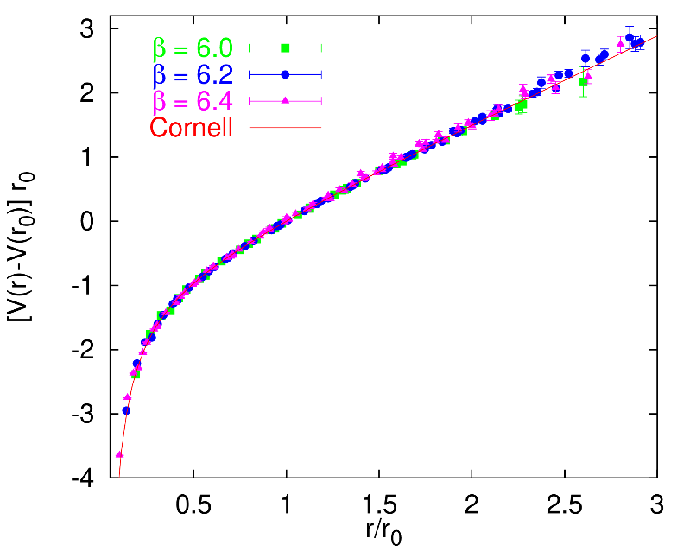
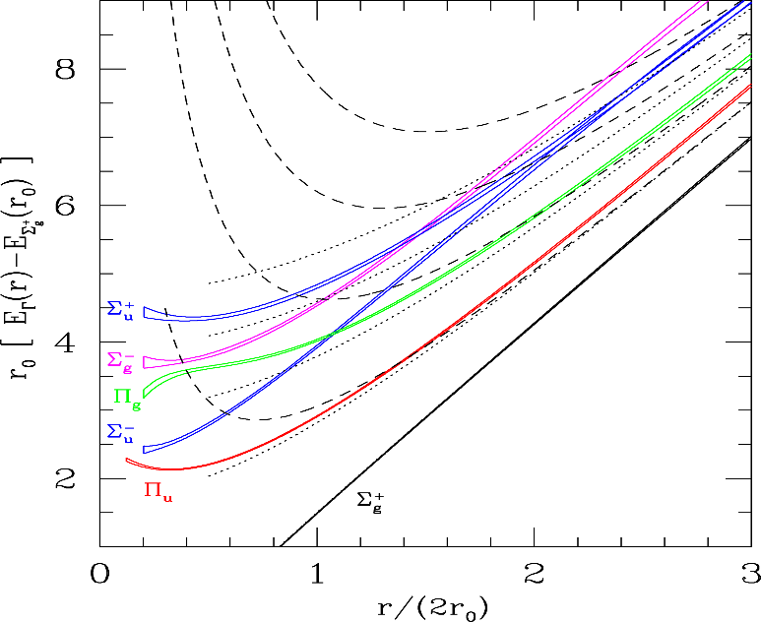
Learning about confinement
If quarks were infinitely heavy, gluonic field is confined in a string
Linear rising potential
What is a constituent gluon?
vibration of the string? → degenerate $J^{PC}={\left(0,1,2\right)}^{−+},{\left(0,1,2\right)}^{+−}$
excitation of a quasiparticle? → degenerate $J^{PC}={\left(0,1,2\right)}^{−+},1^{−−}$
G. Bali
C. Morningstar
J. Dudek
excitation of a quasiparticle! → degenerate $J^{PC}={\left(0,1,2\right)}^{−+},1^{−−}$ says Lattice QCD...
What about real data?
D. Leinweber
A. Pilloni – Pentaquarks: new state of matter?
Notes:
Controlla la parte su Regge

Slide 49
Hybrid hunting
Excited gluon, $$J^{PC}=1^{+−}$$ mass $∼1.0\text{−}1.5 \text{GeV}$
$$\overline{r}$$
$$\overline{g}$$
$$r$$
$$g$$
Look for a $π_{1}$ state with $J^{PC}=1^{−+}$
decaying into $\left\{\begin{matrix}η π \text{and} η^{′}π \\ ρ π→3π \\ b_{1}π→5π\end{matrix}\right.$
Small signal in data
A. Pilloni – Pentaquarks: new state of matter?
Notes:
2 slides su Zc, a Bes e a Belle
2 slide su tetraquark model: dall’hamiltoniana di Jaffe al calcolo delle masse
1 slide su molecular models, dove sono i carichi? (non in Tornqvist, si in Hanhart, vedere Braaten, citare Nefediev)
2 slides su decay channels, dove si dovrebbe vedere, e a seconda del modello, vedere qualche plot
1 slide su Y(4260), tetraquark? C’è lo strano (si vede la f0)
1 slide su Zc a cleo (anche il neutro)

Slide 50
Two hybrid states???
Neither lattice nor models predict two $1^{−+}$ states in this region!
A. Pilloni – Pentaquarks: new state of matter?
Notes:
2 slides su Zc, a Bes e a Belle
2 slide su tetraquark model: dall’hamiltoniana di Jaffe al calcolo delle masse
1 slide su molecular models, dove sono i carichi? (non in Tornqvist, si in Hanhart, vedere Braaten, citare Nefediev)
2 slides su decay channels, dove si dovrebbe vedere, e a seconda del modello, vedere qualche plot
1 slide su Y(4260), tetraquark? C’è lo strano (si vede la f0)
1 slide su Zc a cleo (anche il neutro)

Slide 51
Data in $η^{(′)}π$
$$π_{1}\left(1400\right)?$$
$$a_{2}\left(1320\right)$$
$$a_{2}^{′}\left(1700\right)$$
$$π_{1}\left(1600\right)?$$
$$a_{2}\left(1320\right)$$
$$a_{2}^{′}\left(1700\right)$$
$$J^{PC}=1^{−+}$$
$$J^{PC}=2^{++}$$
A. Pilloni – Pentaquarks: new state of matter?
Notes:
Controlla la parte su Regge

Slide 52
Amplitudes for $η^{(′)}π$
We build the partial wave amplitudes according to the $N/D$ method
Jackura, Mikhasenko, AP et al. (JPAC & COMPASS), PLB
Rodas, AP et al. (JPAC), PRL
$$a\left(s\right)=\frac{n\left(s\right)}{D\left(s\right)}$$
$$D(s)$$
$$n(s)$$
The $n\left(s\right)$ → background physics, process-dependent, smooth
The $D(s)$ contains all the Final State Interactions constrained by unitarity → universal
A. Pilloni – Prospects for Hadron Spectroscopy at JLab
Notes:
Controlla la parte su Regge

Slide 53
Fit to $η^{(′)}π$
$$π_{1}\left(1400\right)?$$
$$a_{2}\left(1320\right)$$
$$a_{2}^{′}\left(1700\right)$$
$$π_{1}\left(1600\right)?$$
$$a_{2}\left(1320\right)$$
$$a_{2}^{′}\left(1700\right)$$
$$J^{PC}=1^{−+}$$
$$J^{PC}=2^{++}$$
A. Pilloni – Pentaquarks: new state of matter?
Notes:
Controlla la parte su Regge

Slide 54
Pole hunting
$$a_{2}^{′}\left(1700\right)$$
$$a_{2}^{′}\left(1700\right)$$
$$a_{2}\left(1320\right)$$
$$a_{2}\left(1320\right)$$
A. Pilloni – Pentaquarks: new state of matter?
Notes:
Controlla la parte su Regge

Slide 55
Pole hunting
$$π_{1}$$
$$π_{1}$$
A. Pilloni – Pentaquarks: new state of matter?
Notes:
Controlla la parte su Regge

Slide 56
Statistical Bootstrap
A. Pilloni – Pentaquarks: new state of matter?
Notes:
Controlla la parte su Regge

Slide 57
Statistical Bootstrap
For each fit, we search poles: two clusters in D-wave: $a_{2}\left(1320\right)$ and $a_{2}^{′}\left(1700\right)$
A. Pilloni – Pentaquarks: new state of matter?
Notes:
Controlla la parte su Regge

Slide 58
Statistical Bootstrap
Only one stable cluster in $P$-wave: a single $π_{1}$
A. Pilloni – Pentaquarks: new state of matter?
Notes:
Controlla la parte su Regge

Slide 59
Final results
Agreement with Lattice is restored
That’s the most rigorous extraction of an exotic meson available so far!
A. Pilloni – Pentaquarks: new state of matter?
Notes:
Controlla la parte su Regge

Slide 60
Open challenges: the $XYZ$ states
AP et al., PLB
Pole
Triangle
Esposito, AP, Polosa, Phys.Rept.
A. Pilloni – Pentaquarks: new state of matter?
Notes:
2 slides su Zc, a Bes e a Belle
2 slide su tetraquark model: dall’hamiltoniana di Jaffe al calcolo delle masse
1 slide su molecular models, dove sono i carichi? (non in Tornqvist, si in Hanhart, vedere Braaten, citare Nefediev)
2 slides su decay channels, dove si dovrebbe vedere, e a seconda del modello, vedere qualche plot
1 slide su Y(4260), tetraquark? C’è lo strano (si vede la f0)
1 slide su Zc a cleo (anche il neutro)

Slide 61
Accessing the spectrum is key to understand the theories
The Hydrogen spectrum helped us discover Quantum Mechanics
We know the levels with remarkable precision
Solve the Hydrogen spectrum, pass Quantum Mechanics 101
Solve the strong interaction spectrum, win a Prize, etc. etc. etc...
A. Pilloni – Pentaquarks: new state of matter?

Slide 62
The four forces
Standard model Works from ${10}^{3}$ to ${10}^{−18} \text{m}$
$$U∼\frac{m_{1}m_{2}}{r}$$
$$U∼\frac{q_{1}q_{2}}{r}$$
$$U∼\frac{g_{s1}g_{s2}}{r}e^{−r/λ_{s}}$$
$$λ_{s}∼1.4×{10}^{−15} \text{m}$$
$$U∼\frac{g_{w1}g_{w2}}{r}e^{−r/λ_{w}}$$
$$λ_{w}∼2.5×{10}^{−18} \text{m}$$
A. Pilloni – Pentaquarks: new state of matter?
Notes:
2 slides su Zc, a Bes e a Belle
2 slide su tetraquark model: dall’hamiltoniana di Jaffe al calcolo delle masse
1 slide su molecular models, dove sono i carichi? (non in Tornqvist, si in Hanhart, vedere Braaten, citare Nefediev)
2 slides su decay channels, dove si dovrebbe vedere, e a seconda del modello, vedere qualche plot
1 slide su Y(4260), tetraquark? C’è lo strano (si vede la f0)
1 slide su Zc a cleo (anche il neutro)

Slide 63
Three quarks for Muster Mark
Gluons appear in 8 color-anticolor combinations
$$\overline{r}$$
$$\overline{b}$$
$$g$$
$$\overline{g}$$
$$r$$
$$b$$
$$b$$
$$\overline{g}$$
$$r$$
$$\overline{b}$$
They mediate the interaction between quarks
A. Pilloni – Pentaquarks: new state of matter?
Notes:
2 slides su Zc, a Bes e a Belle
2 slide su tetraquark model: dall’hamiltoniana di Jaffe al calcolo delle masse
1 slide su molecular models, dove sono i carichi? (non in Tornqvist, si in Hanhart, vedere Braaten, citare Nefediev)
2 slides su decay channels, dove si dovrebbe vedere, e a seconda del modello, vedere qualche plot
1 slide su Y(4260), tetraquark? C’è lo strano (si vede la f0)
1 slide su Zc a cleo (anche il neutro)

Slide 64
Joint Physics Analysis Center
A. Pilloni – The pole hunter

Slide 65
How we probe the forces
We smash particles against each other, the best way of creating new particles
It’s like if in a car accident, the pieces of the collision would create new fancy, expensive cars
(Do not try with your car. Believe me, it’s a bad idea)
A. Pilloni – Pentaquarks: new state of matter?

Slide 66
How we probe the forces at CERN
LHC collides protons at $13 \text{TeV}$ (kinetic energy of a mosquito)
A. Pilloni – Pentaquarks: new state of matter?

Slide 67
Standard Model Constituents
Standard model is a remarkable simple theory
The particle in the spectrum can easily fit in a table
Lightest massive particle $<3 μ\text{eV}$
Heaviest particle $∼175 \text{GeV}$ (gold atom)
Masses span 17 orders of magnitude
H
Higgs
"Higgs interaction"
125,000
A. Pilloni – Pentaquarks: new state of matter?

Slide 68
Standard Model Constituents
According to relativity, the interaction cannot be instantaneous, but is mediated by fields that propagate with finite speed
In relativistic quantum mechanichs, these fields are quantized in particles
The range of the interaction depend on the mass of the mediator,
$λ∼\frac{ℏc}{m}$ (Compton wavelength)
H
Higgs
"Higgs interaction"
125,000
A. Pilloni – Pentaquarks: new state of matter?

Slide 69
Quantum ChromoDynamics (QCD)
Quarks appear in 6 flavors, with (very) different masses
Each quark can be in 3 identical colors
$$r,g,b$$
Each gluon can be in 8 colors
$r\overline{g},r\overline{b},b\overline{g}$, $b\overline{r}$,$g\overline{b}$, $g\overline{r}$, $$r\overline{r}−b\overline{b},r\overline{r}+b\overline{b}−2g\overline{g}$$
H
Higgs
"Higgs interaction"
125,000
Gluon is massless. Long range?
Have you ever observed a quark?
A. Pilloni – Pentaquarks: new state of matter?

Slide 70
Welcome to Hell
Review of Particle Physics
Only white particles have been observed so far, forming an extremly rich zoo of hadrons
A. Pilloni – Pentaquarks: new state of matter?

Slide 71
Flavor symmetry
Hadron appear in approximate degenerate multiplets (group theory needed)
This observation led to the discovery of quark constituents without observing a single quark!
Amplitudes of particles in the same multiplet are related (Wigner-Eckart theorem)
A. Pilloni – Pentaquarks: new state of matter?

Slide 72
Pole hunting
I sheet
Bound states on the real axis 1st sheet
Not-so-bound (virtual) states on the real axis 2nd sheet
II sheet
A. Pilloni – Pentaquarks: new state of matter?
Notes:
Controlla la parte su Regge

Slide 73
Unitarity
Probability conservation implies ${\left|S\left(E\right)\right|}^{2}=1$
For the amplitude, this turns into
$$f\left(E+iε\right)−f\left(E−iε\right)≠0$$
Branch cut!
Example: $i\sqrt{E}$...
$$i\sqrt{e^{iπ}}=−1$$
$$i\sqrt{1}=i$$
$$i\sqrt{e^{2iπ}}=−i$$
A. Pilloni – Pentaquarks: new state of matter?
Notes:
Controlla la parte su Regge

Slide 74
Unitarity
Probability conservation implies ${\left|S\left(E\right)\right|}^{2}=1$
For the amplitude, this turns into
$$f\left(E+iε\right)−f\left(E−iε\right)≠0$$
Branch cut!
Example: $i\sqrt{E}$...
$$i\sqrt{e^{iπ}}=1$$
...but I can decide to get the negative solution
$$i\sqrt{e^{2iπ}}=i$$
$$i\sqrt{1}=−i$$
A. Pilloni – Pentaquarks: new state of matter?
Notes:
Controlla la parte su Regge

Slide 75
Unitarity
Probability conservation a branch cut on the real axis, two sheets continuosly connected
A. Pilloni – Pentaquarks: new state of matter?
Notes:
Controlla la parte su Regge

Slide 76
Crossing symmetry
$$π^{+}$$
$$K^{+}$$
$$π^{+}$$
$$K^{−}$$
$$π^{+}$$
$$K^{+}$$
$$π^{−}$$
$$K^{−}$$
$$π^{+}$$
$$K^{−}$$
$$π^{+}$$
$$K^{+}$$
All these processes are not independent, but are described by the same amplitude!
Simplification – Complication!
A. Pilloni – Pentaquarks: new state of matter?
Notes:
Controlla la parte su Regge

Slide 77
Searching for resonances in $ηπ$
Smooth «background»
Precise determination of pole position
Notes:
Controlla la parte su Regge

Slide 78
Systematic studies
For each class, the maximum deviation of mass and width is taken as a systematic error Deviation smaller than the statistical error are neglected Systematic of different classes are summed in quadrature
A. Pilloni – Determination of the lightest hybrid meson pole
Notes:
Controlla la parte su Regge

Slide 79
Quarkonium orthodoxy
$$Q$$
$$\overline{Q}$$
Potential models
(meaningful when $M_{Q}$ large)
$$α_{s}\left(M_{Q}\right)∼0.3$$
(perturbative regime)
Solve NR Schrödinger eq. → spectrum
A. Pilloni – Pentaquarks: new state of matter?
Notes:
2 slides su Zc, a Bes e a Belle
2 slide su tetraquark model: dall’hamiltoniana di Jaffe al calcolo delle masse
1 slide su molecular models, dove sono i carichi? (non in Tornqvist, si in Hanhart, vedere Braaten, citare Nefediev)
2 slides su decay channels, dove si dovrebbe vedere, e a seconda del modello, vedere qualche plot
1 slide su Y(4260), tetraquark? C’è lo strano (si vede la f0)
1 slide su Zc a cleo (anche il neutro)

Slide 80
Example: The charged $Z_{c}\left(3900\right)$
A charged charmonium-like resonance has been claimed by BESIII in 2013.
$e^{+}e^{−}→Z_{c}{\left(3900\right)}^{+}π^{−}→J/ψ{ π}^{+}π^{−}$ and $→{\left(DD^{∗}\right)}^{+}π^{−}$ $M=3888.7±3.4$MeV, $Γ=35±7$ MeV
Such a state would require a minimal 4q content and would be manifestly exotic
A. Pilloni – Pentaquarks: new state of matter?
Notes:
Y(4260), M=4263 +- 5, Gamma = 95+-14
D_1(2420)^0, M=2421.3 ±0.6, Gamma =27.1 ±2.7
D_1(2420)^+-, M=2423.4 ±3.1, Gamma =25 ±6
I D_1 hanno J^P = 1^+
La molecola D_1 D sta 22 MeV sotto
Se la Y è D_1 D, il pione lega fortemente, come fa la Y a essere così larga?
Come funziona lo scambio del pione???

Slide 81
Amplitude analysis for $Z_{c}(3900)$
One can test different parametrizations of the amplitude, which correspond to different singularities → different natures
AP et al. (JPAC), PLB772, 200
$$Z_{c}\left(3900\right)?$$
$${u: D}_{0}(2400)$$
$${u:Z}_{c}\left(3900\right)?$$
$$"σ, f_{0}(980)"$$
$$D_{1}(2420)$$
Triangle rescattering, logarithmic branching point
(anti)bound state, II/IV sheet pole
(«molecule»)
Resonance, III sheet pole
(«compact state»)
$$π$$
$$D_{1}$$
$$Y$$
$$D^{∗}$$
$$π$$
$$\overline{D}$$
$$J/ψ$$
Tornqvist, Z.Phys. C61, 525
Swanson, Phys.Rept. 429
Hanhart et al. PRL111, 132003
Maiani et al., PRD71, 014028
Faccini et al., PRD87, 111102
Esposito et al., Phys.Rept. 668
Szczepaniak, PLB747, 410
A. Pilloni – Pentaquarks: new state of matter?
Notes:
Controlla la parte su Regge

Slide 82
Fit: III
A. Pilloni – Pentaquarks: new state of matter?
Notes:
Controlla la parte su Regge

Slide 83
Fit: III+tr.
A. Pilloni – Pentaquarks: new state of matter?
Notes:
Controlla la parte su Regge

Slide 84
Fit: IV+tr.
A. Pilloni – Pentaquarks: new state of matter?
Notes:
Controlla la parte su Regge

Slide 85
Fit: tr.
A. Pilloni – Pentaquarks: new state of matter?
Notes:
Controlla la parte su Regge

Slide 86
Pole extraction
III
III+tr.
IV+tr.
A. Pilloni – Pentaquarks: new state of matter?
Not conclusive at this stage
Notes:
Controlla la parte su Regge

Slide 87
Finite energy sum rules
PWA in the low energy region
Resonance extraction
Analytically connected
Regge exchanges at high energy
A. Pilloni – Pentaquarks: new state of matter?
Notes:
Controlla la parte su Regge

Slide 88
Pole hunting
I sheet
Extracting physics information means to hunt for poles in the complex plane
Pole position → Mass and width
Residues → Couplings
Virtual state
II sheet
Bound state
Resonance
A. Pilloni – Pentaquarks: new state of matter?
Notes:
Controlla la parte su Regge

Slide 89
$X(3872)$
Discovered in $B→K X→K J/ψ ππ$
Quantum numbers $1^{++}$
Very close to $DD^{∗}$ threshold
Too narrow for an above-treshold charmonium
Isospin violation too big $\frac{Γ\left(X→J/ψ ω\right)}{Γ\left(X→J/ψ ρ\right)}\sim 0.8±0.3$
Mass prediction not compatible with $χ_{c1}(2P)$
$M=3871.68±0.17$MeV
$$M_{X}−M_{DD^{∗}}=−3±192 \text{keV}$$
$Γ<1.2 \text{MeV}\text{ @90\%}$
A. Pilloni – Pentaquarks: new state of matter?

Slide 90
$X(3872)$
Large prompt production at hadron colliders
$$σ_{B}/σ_{TOT}=\left(26.3±2.3±1.6\right)\%$$
$$σ_{PR}×B(X→J/ψππ)=\left(1.06±0.11±0.15\right) \text{nb}$$
CMS, JHEP 1304, 154
A. Pilloni – Pentaquarks: new state of matter?

Slide 91
Vector $Y$ states
Lots of unexpected ${J^{PC}=1}^{−−}$ states found in ISR/direct production (and nowhere else!)
Seen in few final states, mostly $J/ψ ππ$ and $ψ\left(2S\right) ππ$
Not seen decaying into open charm pairs
Large HQSS violation
Belle $J/ψππ$
BES $h_{c}ππ$
A. Pilloni – Pentaquarks: new state of matter?
Notes:
Y(4260), M=4263 +- 5, Gamma = 95+-14
D_1(2420)^0, M=2421.3 ±0.6, Gamma =27.1 ±2.7
D_1(2420)^+-, M=2423.4 ±3.1, Gamma =25 ±6
I D_1 hanno J^P = 1^+
La molecola D_1 D sta 22 MeV sotto
Se la Y è D_1 D, il pione lega fortemente, come fa la Y a essere così larga?
Come funziona lo scambio del pione???

Slide 92
Vector $Y$ states in BESIII
BESIII, PRL118, 092002 (2017)
BESIII, PRL118, 092001 (2017)
$$e^{+}e^{−}→J/ψ ππ$$
$$e^{+}e^{−}→h_{c} ππ$$
New BESIII data show a peculiar lineshape for the $Y(4260)$
The state appear lighter and narrower, compatible with the ones in $h_{c}ππ$ and $χ_{c0}ω$
A broader old-fashioned $Y(4260)$ is appearing in $\overline{D}D^{∗}π$, maybe indicating a ${\overline{D}D}_{1}$
dominance
$$e^{+}e^{−}→π^{+}D^{0}D^{∗−}$$
A. Pilloni – Pentaquarks: new state of matter?
Notes:
Y(4260), M=4263 +- 5, Gamma = 95+-14
D_1(2420)^0, M=2421.3 ±0.6, Gamma =27.1 ±2.7
D_1(2420)^+-, M=2423.4 ±3.1, Gamma =25 ±6
I D_1 hanno J^P = 1^+
La molecola D_1 D sta 22 MeV sotto
Se la Y è D_1 D, il pione lega fortemente, come fa la Y a essere così larga?
Come funziona lo scambio del pione???
Close propone che la Y è D_1 D^* col pione scambiato in onda S,
La Y però non va in Ds come se fosse tetraquark

Slide 93
Charged $Z$ states: $Z_{c}\left(3900\right), Z_{c}^{′}(4020)$
Charged quarkonium-like resonances have been found, 4q needed
Two states $J^{PC}=1^{+−}$ appear slightly above $D^{(∗)}D^{∗}$ thresholds
$e^{+}e^{−}→Z_{c}{\left(3900\right)}^{+}π^{−}→J/ψ{ π}^{+}π^{−}$ and $→{\left(DD^{∗}\right)}^{+}π^{−}$ $M=3888.7±3.4$MeV, $Γ=35±7$ MeV
$e^{+}e^{−}→Z_{c}^{′}{\left(4020\right)}^{+}π^{−}→h_{c}{ π}^{+}π^{−}$ and $→{\overline{D}}^{∗0}D^{∗+}π^{−}$
$M=4023.9±2.4$MeV, $Γ=10±6$ MeV
A. Pilloni – Pentaquarks: new state of matter?
Notes:
Y(4260), M=4263 +- 5, Gamma = 95+-14
D_1(2420)^0, M=2421.3 ±0.6, Gamma =27.1 ±2.7
D_1(2420)^+-, M=2423.4 ±3.1, Gamma =25 ±6
I D_1 hanno J^P = 1^+
La molecola D_1 D sta 22 MeV sotto
Se la Y è D_1 D, il pione lega fortemente, come fa la Y a essere così larga?
Come funziona lo scambio del pione???

Slide 94
Charged $Z$ states: $Z_{b}\left(10610\right), Z_{b}^{′}(10650)$
Anomalous dipion width in $Υ\left(5S\right)$,
2 orders of magnitude larger than $Υ\left(nS\right)$
Moreover, observed $Υ\left(5S\right)→h_{b}\left(nP\right)ππ$ which violates HQSS
$Υ\left(5S\right)→Z_{b}{\left(10610\right)}^{+}π^{−}→Υ\left(nS\right){ π}^{+}π^{−},h_{b}\left(nP\right){ π}^{+}π^{−}$ and $→{\left(BB^{∗}\right)}^{+}π^{−}$ $M=10607.2±2.0$MeV, $Γ=18.4±2.4$ MeV
$Υ\left(5S\right)→Z_{b}^{′}{\left(10650\right)}^{+}π^{−}→Υ\left(nS\right){ π}^{+}π^{−},h_{b}\left(nP\right){ π}^{+}π^{−}$ and $→{\overline{B}}^{∗0}B^{∗+}π^{−}$
$M=10652.2±1.5$MeV, $Γ=11.5±2.2$ MeV
2 twin resonances!
A. Pilloni – Pentaquarks: new state of matter?
Notes:
Y(4260), M=4263 +- 5, Gamma = 95+-14
D_1(2420)^0, M=2421.3 ±0.6, Gamma =27.1 ±2.7
D_1(2420)^+-, M=2423.4 ±3.1, Gamma =25 ±6
I D_1 hanno J^P = 1^+
La molecola D_1 D sta 22 MeV sotto
Se la Y è D_1 D, il pione lega fortemente, come fa la Y a essere così larga?
Come funziona lo scambio del pione???

Slide 95
Pentaquarks!
LHCb, PRL 115, 072001
LHCb, PRL 117, 082003
Two states seen in $Λ_{b}→\left(J/ψ p\right) K^{−}$,
evidence in $Λ_{b}→\left(J/ψ p\right) π^{−}$
$$M_{1}=4380±8±29 \text{MeV} \\ Γ_{1}=205±18±86 \text{MeV}$$
$$M_{2}=4449.8±1.7±2.5 \text{MeV} \\ Γ_{2}=39±5±19 \text{MeV}$$
Quantum numbers $$J^{P}=\left({\frac{3}{2}}^{−},{\frac{5}{2}}^{+}\right) \text{or}\left({\frac{3}{2}}^{+},{\frac{5}{2}}^{−}\right)\text{or}\left({\frac{5}{2}}^{+},{\frac{3}{2}}^{−}\right)$$
Opposite parities needed for the interference to correctly describe angular distributions, low mass region contaminated by $Λ^{∗}$ (model dependence?)
No obvious threshold nearby
A. Pilloni – Pentaquarks: new state of matter?
Notes:
Y(4260), M=4263 +- 5, Gamma = 95+-14
D_1(2420)^0, M=2421.3 ±0.6, Gamma =27.1 ±2.7
D_1(2420)^+-, M=2423.4 ±3.1, Gamma =25 ±6
I D_1 hanno J^P = 1^+
La molecola D_1 D sta 22 MeV sotto
Se la Y è D_1 D, il pione lega fortemente, come fa la Y a essere così larga?
Come funziona lo scambio del pione???

Slide 96
Pentaquarks!
LHCb, PRL 115, 072001
LHCb, PRL 117, 082003
Two states seen in $Λ_{b}→\left(J/ψ p\right) K^{−}$,
evidence in $Λ_{b}→\left(J/ψ p\right) π^{−}$
$$M_{1}=4380±8±29 \text{MeV} \\ Γ_{1}=205±18±86 \text{MeV}$$
$$M_{2}=4449.8±1.7±2.5 \text{MeV} \\ Γ_{2}=39±5±19 \text{MeV}$$
Quantum numbers $$J^{P}=\left({\frac{3}{2}}^{−},{\frac{5}{2}}^{+}\right) \text{or}\left({\frac{3}{2}}^{+},{\frac{5}{2}}^{−}\right)\text{or}\left({\frac{5}{2}}^{+},{\frac{3}{2}}^{−}\right)$$
Opposite parities needed for the interference to correctly describe angular distributions, low mass region contaminated by $Λ^{∗}$ (model dependence?)
No obvious threshold nearby
MC simul.
A. Pilloni – Pentaquarks: new state of matter?
Notes:
Y(4260), M=4263 +- 5, Gamma = 95+-14
D_1(2420)^0, M=2421.3 ±0.6, Gamma =27.1 ±2.7
D_1(2420)^+-, M=2423.4 ±3.1, Gamma =25 ±6
I D_1 hanno J^P = 1^+
La molecola D_1 D sta 22 MeV sotto
Se la Y è D_1 D, il pione lega fortemente, come fa la Y a essere così larga?
Come funziona lo scambio del pione???

