Slide 1
Search for Neutron Flux Generation in a Plasma Discharge Electrolytic Cell
Alessandro Pilloni
“Sapienza” Università di Roma – INFN sez. Roma 1
Workshop on LENR
Ettore Majorana Foundation and Centre for Scientific Culture
Erice – October 11th, 2014

Slide 2
Preamble
Cirillo, Widom, Srivastava et al. experiment
Neutron emission from plasma discharge electrolytic cell
Widom-Larsen(-Srivastava) theory
LENR (neutron emission) due to strong electromagnetic fields
The experiment proofs the theory
The theory provides reliability to the experiment
We aim to reproduce this experiment and to study the consistence of the theory
A. Pilloni – $Search for Neutron Flux Generation in a Plasma Discharge Electrolytic Cell$
Notes:
Spiegare perché esperimento è connesso alla teoria

Slide 3
Outline
1) Repetition of the Plasma Discharge experiment
ENEA: E. Castagna, S. Lecci, M. Sansovini, F. Sarto, V. Violante (electrochemical experts); M. Angelone, A. Pietropaolo, M. Pillon (fusion neutronics experts)
INFN-Frascati: R. Bedogni, A. Esposito (CR-39 and neutron experts)
Sapienza: R. Faccini, AP, A.D. Polosa (theory and data analysis)
EPJC 74 (2014) 2894
arXiv:1401.8218 (w/ S. Loreti – ENEA)
2) Comments on WLS theory
S. Ciuchi, L. Maiani, A.D. Polosa, V. Riquer, G. Ruocco, M. Vignati, EPJC 72 (2012) 2193
L. Maiani, A.D. Polosa, V. Riquer, EPJC 74 (2014) 2843
some personal additions...
A. Pilloni – $Search for Neutron Flux Generation in a Plasma Discharge Electrolytic Cell$
Notes:
Spiegare perché esperimento è connesso alla teoria

Slide 4
Experimental background

Slide 5
Experimental background
Claims
In a plasma ignited by high voltage in an electrolytic cell with appropriate cathode and solution:
thermal power generated exceeds input electric power
transmutation of elements in cathode occurs
neutrons are produced
Sample References
T. Mizuno, et al., “Isotopic changes of the reaction products induced by cathodic electrolysis in Pd”, J. New Energy 1 (1996) 31
T. Mizuno et al., “Production of Heat during Plasma Electrolysis in Liquid", Jpn J. Appl. Phys. 3 (2000) 6055
D. Cirillo et al., “Experimental evidence of a neutron flux generation in a plasma discharge electrolytic cell”, Key Engineering Materials 495 (2012) 104
Patent US 8419919 B1, “System and methods for generating particles”
Patent WO 1999049471 A1, “Reactor for producing energy and neutrons by electrolytic reaction in light- or heavy- water solution”
A. Pilloni – $Search for Neutron Flux Generation in a Plasma Discharge Electrolytic Cell$

Slide 6
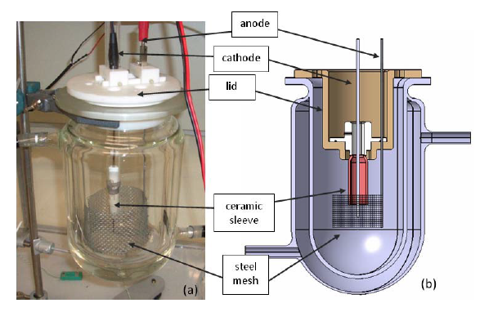
The «Cirillo et al.» experiment /1
D. Cirillo, R. Germano, V. Tontodonato, A. Widom, Y.N. Srivastava, E. Del Giudice, G. Vitiello, “Experimental evidence of a neutron flux generation in a plasma discharge electrolytic cell”
Key Engineering Materials 495 (2012) 104
Further details by A. Widom, J. Swain, Y.N. Srivastava, “Analysis of an attempt at detection of neutrons produced in a plasma discharge electrolytic cell” arXiv:1311.2447
The electrolytic cell
Cathode: tungsten rod in alumina,
Anode: steel mesh, Solution: K₂CO₃
$V=290 \text{V}$, $I=2.5 \text{A}$ , $t=500 \text{s}$
A. Pilloni – $Search for Neutron Flux Generation in a Plasma Discharge Electrolytic Cell$

Slide 7
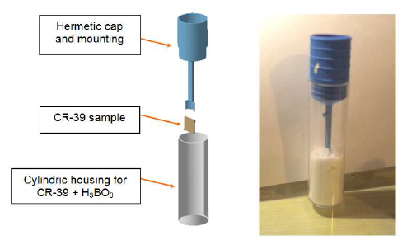
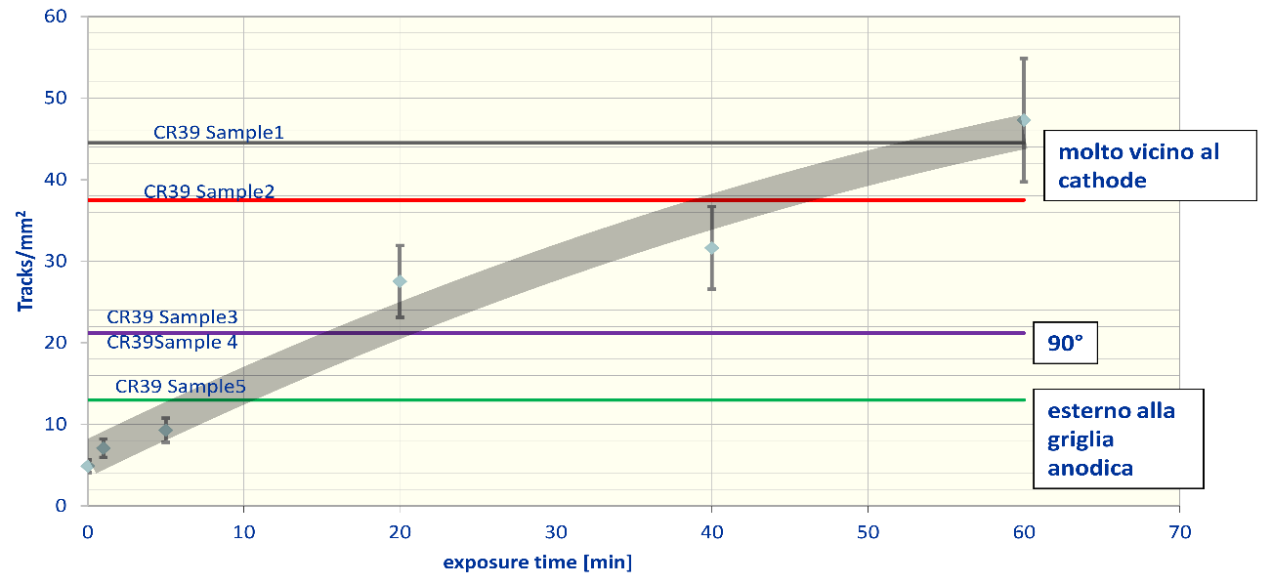
The «Cirillo et al.» experiment /2
Detectors
Neutrons measured with CR-39 detectors in copious H₂BO₃
Observed flux $∼7.2×{10}^{4} \text{n} {\text{s}}^{−1}{\text{c}\text{m}}^{−2}$ “in proximity of the plasma”
No discussion about the neutron spectrum: thermal? fast?
A. Pilloni – $Search for Neutron Flux Generation in a Plasma Discharge Electrolytic Cell$
Notes:
Controlla flux

Slide 8
Our experiment

Slide 9
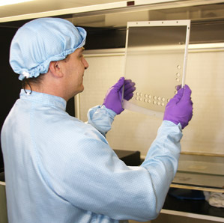
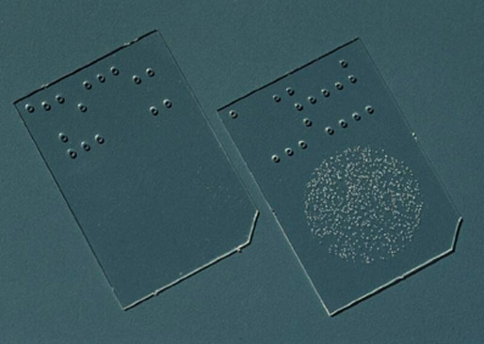
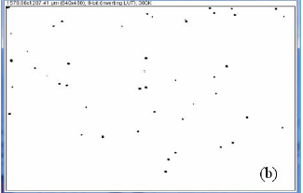
CR-39 Detectors
R. Bedogni et al., Radiat. Meas. 43, S491 (2008)
Slabs of poly-allyl-diglicol-carbonate (PADC) produced by intercast
Cut in pieces (2.224cm²)
Sensitive to fast neutrons:
After n,p scattering protons leave a track
Etching with potassium hydroxide at 70ºC
Read with a custom reader
Number of tracks proportional to integrated impinging neutrons
A. Pilloni – $Search for Neutron Flux Generation in a Plasma Discharge Electrolytic Cell$

Slide 10
CR-39 Detectors for thermal neutrons
Bare CR-39 is not sensitive to thermal neutrons
50μm B film
support
CR-39
Wrap detectors in Boron films $<1.8 \text{MeV}$α particles produced via
B(n,α)Li
The α release tracks in CR-39 detectors
We used CR-39 detectors in several configurations for systematic studies:
Bare
with a 50μm ¹⁰B film
with a large amount of boric acid grains
with ¹⁰B film but shielded with Cadmium (against thermal neutrons)
with ¹⁰B film but shielded with Aluminum (against electromagnetic noise)
A. Pilloni – $Search for Neutron Flux Generation in a Plasma Discharge Electrolytic Cell$

Slide 11
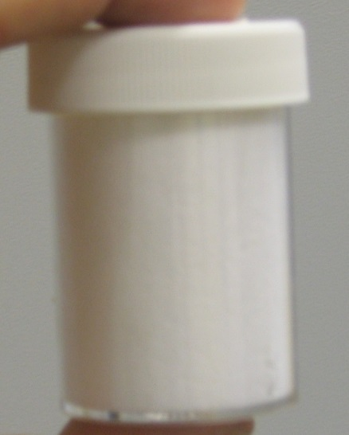
CR-39 Detectors with copious Boron
Boron stops thermal neutrons, but also the emitted α particles
TEST: no signal observed at ENEA-IMRI thermal neutron source
Large amounts of boric acid make the detectors insensitive to thermal neutrons
CONCLUSION: The detector used by Cirillo et al. are not very sensitive to slow neutrons
Sensitivity to faster neutron is discussed assuming a partially moderated spectrum
Response to a known source of AmB has been studied
A. Pilloni – $Search for Neutron Flux Generation in a Plasma Discharge Electrolytic Cell$

Slide 12
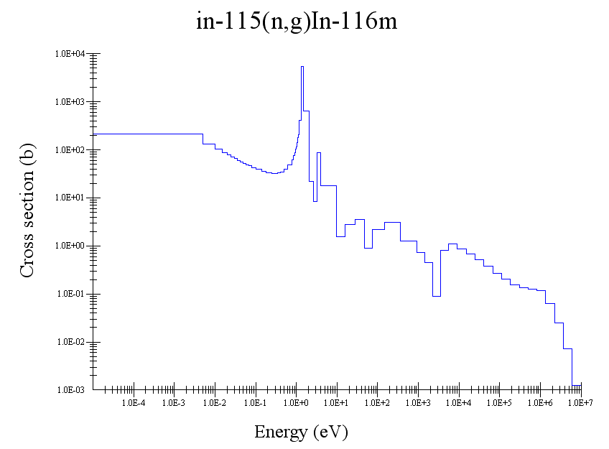
Indium Disks Detectors
5cm Indium disks (30g total)
Do not suffer from electromagnetic/thermal/acoustic noise
Long enough half-life to have time to integrate signal
Independent of the signal time structure if smaller than $∼$minutes
Routinely used with pulsed sources Antonini et al., NIMA, 51 (1978) 567
Two steps:
Neutrons activate Indium (more sensitive to thermal neutrons) ¹¹⁵In(n,γ)¹¹⁶In
Gamma lines @1293, 1047 and 416 keV with $T_{1/2}=\log{2}/λ=54 \text{min}$
The activity ($α$) from an irradiation lasted $t_{r}$ is measured with a HPGe detector (after a time $t_{a}$)
We can obtain the flux
$$φ=\frac{α}{Nσ\left(1−e^{−λt_{r}}\right)e^{−λt_{a}}}$$
Used also in Cirllo et al exp, but no signal was seen (arXiv:1311.2447)
A. Pilloni – $Search for Neutron Flux Generation in a Plasma Discharge Electrolytic Cell$

Slide 13
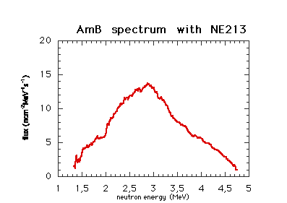
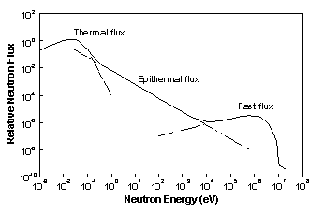
Neutron Spectrum
The AmB spectrum after traversing water gets moderated to epithermal + thermal
➔ Partially moderated (PM) spectrum
Neutron detection depends on the energy spectrum
A. Pilloni – $Search for Neutron Flux Generation in a Plasma Discharge Electrolytic Cell$

Slide 14
Cross check with a neutron source
A run was taken putting inside the electrolytic cell (switched off) a $5.5×10^{4} \text{n} {\text{s}}^{−1}$ AmB neutron source.
Measurements by the detectors on the exterior of the cell ($\sim 5 \text{cm}$ from source) We have a partially moderated (PM spectrum):
CR-39 with ¹⁰B $185±12 \text{n} {\text{cm}}^{−2}{\text{s}}^{−1}$
Indium disk $375±125 \text{n} {\text{cm}}^{−2}{\text{s}}^{−1}$
Conclusion from the test: both detectors are sensitive to a source 1-2 order of magnitudes smaller than Cirillo et al.
Note: CR-39 calibration constants, obtained with a thermal neutron spectrum, was used, there might be corrections to apply
A. Pilloni – $Search for Neutron Flux Generation in a Plasma Discharge Electrolytic Cell$

Slide 15
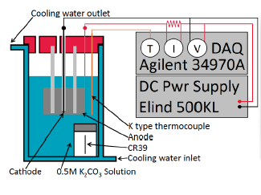
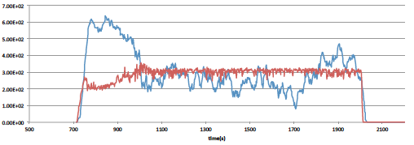
The electrolytic cell
Tungsten cathode
Quartz sheath around it, with only tip out (increases impedance and strengthens plasma)
Anode: grid of titanium plated with platinum
Anodic and cathodic region separated by quartz (as in Mizuno cells)
$V=150−300 \text{V}$, $I∼1−2 \text{A}$
Stable current after transient
I
V
A. Pilloni – $Search for Neutron Flux Generation in a Plasma Discharge Electrolytic Cell$
Notes:
Aggiungere foto catodo

Slide 16
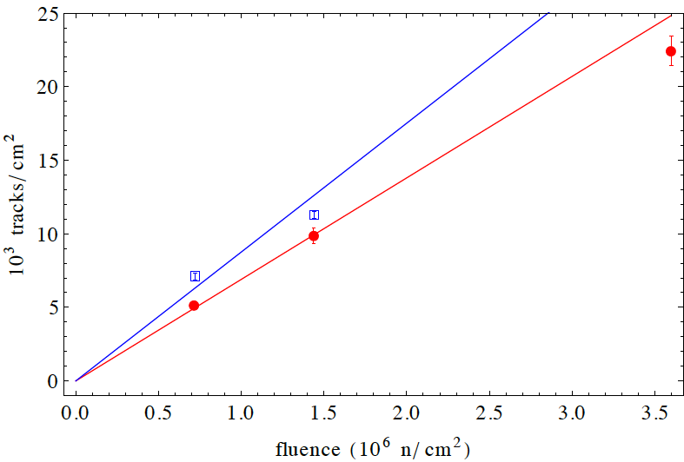
Data taking Campaigns and calibration
 | WHEN | CR-39
Run1 | March 2013 | Stock A
Run2 | June 2013 | Stock B
Run 3 | September 2013 | Stock B
Conversion between the observed track density ($D$) to number of neutrons that impacted the detector (integrated)
Calibrated using the thermal neutron fluence produced at ENEA-IMRI thermal facility ($F=1.2 {10}^{4} {\text{c}\text{m}}^{−2} {\text{s}}^{−1}$)
$$F=\frac{D−D_{bkg}}{c T }$$
Run2/3 $c=\left(8.3±0.8\right){10}^{−3} \text{trks}/\text{n}$
Run1 $c=\left(6.9±0.3\right){10}^{−3} \text{trks}/\text{n}$
Time of exposure
A. Pilloni – $Search for Neutron Flux Generation in a Plasma Discharge Electrolytic Cell$

Slide 17
Comparison with Cirillo et al.
The difference in sensitivity between our measurement and the Cirillo et al. can be seen from the calibration constants:
Us: $70−80 {10}^{−4} \text{trks}/\text{n}$
Cirillo et al.: $∼{10}^{−4} \text{trks}/\text{n}$
CR-39 Samples exposed to cell flux for $500 \text{s}$
very close to cathode
ENEA-IMRI thermal facility equivalent fluence is here!
outside anodic grid
D. Cirillo, http://www.22passi.it/pirelli/D_Cirillo_ISPRA_12_2012_ufficiale.pdf
A. Pilloni – $Search for Neutron Flux Generation in a Plasma Discharge Electrolytic Cell$
Notes:
Metti un segno sul valore corrispondente della sorgente enea

Slide 18
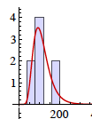
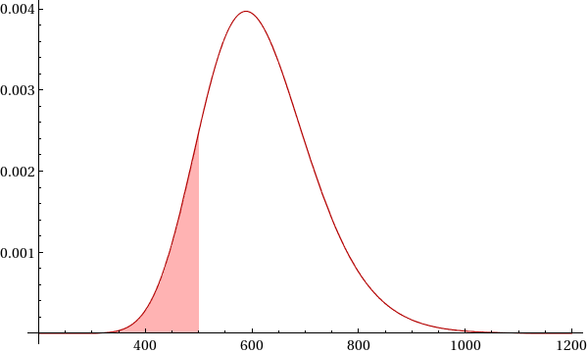
Background
Estimated with non-irradiated detectors
Fits with a log-normal function
R. Bedogni et al., Radiat. Meas. 43, 1108 (2008)
$$L\left(D|μ,σ\right)=\frac{\exp\left[−\frac{{\left(\log{D}−μ\right)}^{2}}{2σ^{2}}\right]}{\sqrt{2π}Dσ}$$
Estimate $P(D)$ probability of “being signal” if a track density $D$ is measured
Declare a signal significant if $P(D)>99\%$
If no significant signal, compute upper limit $D_{max}$ @95%C.L. with a bayesian approach
Run 1
$$P\left(D\right)=\int_{0}^{D}{L(x|μ,σ)dx}$$
$$P\left(x<D_{max} | D\right)=\frac{\int_{0}^{D_{max}}{L\left(D | μ+ξ,σ\right)dξ}}{\int_{0}^{∞}{L\left(D | μ+ξ,σ\right)dξ}}=95\%$$
A. Pilloni – $Search for Neutron Flux Generation in a Plasma Discharge Electrolytic Cell$

Slide 19
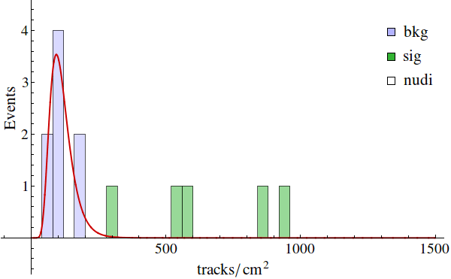
Results: Run 1
CR-39 detectors with thin Boron showed a small but significant excess !!
Indium disks and CR-39 with thick boron showed no signal
➔ upper limit ${10}^{4}$ times smaller than Cirillo et al. ($72000 \text{n} {\text{cm}}^{−2}{\text{s}}^{−1}$)
If CR-39 signal is due to a neutron flux, it is $\sim 300$ times smaller than in Cirillo et al.
A. Pilloni – $Search for Neutron Flux Generation in a Plasma Discharge Electrolytic Cell$

Slide 20
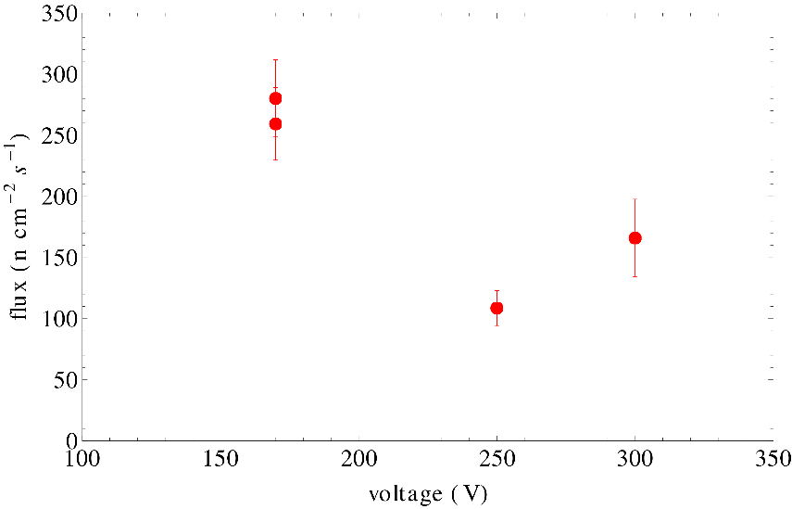
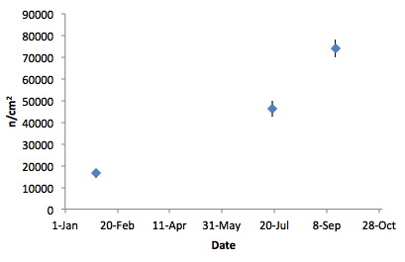
Analysis of the excess
Does not depend on position (inside/outside cell)
The only configuration that does not show it is the closest to Cirillo et al.: inside and with thick boron
Does not depend on Voltage
We realized background CR-39 had an inconsistent treatment:
they were not wrapped with Boron
they were analyzed when calibration took place: 40 days before the run with the cell
Assuming thermal neutron calibration
Run 3
Slope between Run2/3 $∼460 \text{n} {\text{cm}}^{−2}{\text{day}}^{−1}$
Naked CR-39 detectors show same behavior
Run 1
Run 2
Cosmic rays $∼850 \text{part} {\text{cm}}^{−2}{\text{day}}^{−1}$
Radon @Naples would fake $1900 \text{part} {\text{cm}}^{−2}{\text{day}}^{−1}$
Matiulla, J. Rad. Nucl. Chem. 298 (2013) 369
A. Pilloni – $Search for Neutron Flux Generation in a Plasma Discharge Electrolytic Cell$

Slide 21
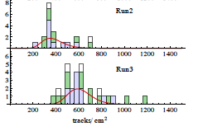
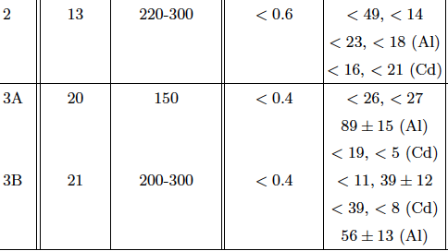
Results: Run2-3
Repeat experiment with uniform background treatment
All detectors where outside the cell ($5 \text{cm}$ from cathode)
Wrap some detectors in Al (screen e.m. bkg) or Cd (screen neutrons)
No significant signal observed neither in In disks nor CR-39 detectors
Only outliers CR-39 detectors with Al (photo-electrons?!?)
Limits set at less than 1 (In disks) and tens (CR-39) $\text{n} {\text{cm}}^{−2}{\text{s}}^{−1}$ (cfr. $7.2×{10}^{4} \text{n} {\text{cm}}^{−2}{\text{s}}^{−1}$ in Cirillo et al.)
Wrapped in Al
A. Pilloni – $Search for Neutron Flux Generation in a Plasma Discharge Electrolytic Cell$

Slide 22
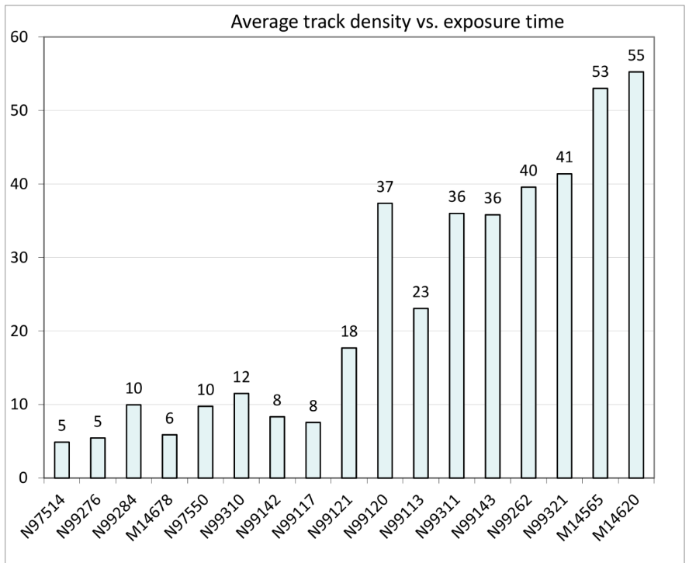
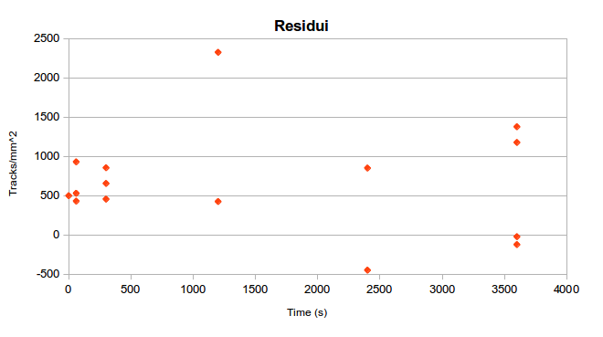
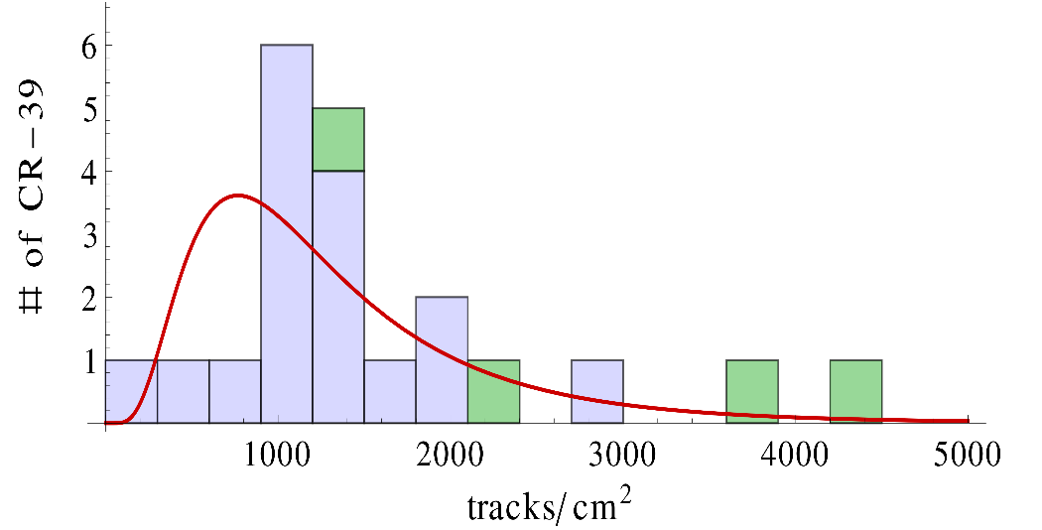
Reverse-engineering of Cirillo et al.
We used Cirillo et al.’s calibration data to extract the residues distribution → background
Name | $$\text{trks} {\text{cm}}^{−2}$$ | $$P(D)$$ | $$\# σ$$
CR39 Sample 1 | 4450 | 98.9% | 2.5
CR-39 Sample 2 | 3750 | 97.7% | 2.3
CR-39 Sample 3-4 | 2113 | 85.4% | 1.5
CR-39 Sample 5 | 1302 | 60.2% | 0.85
A. Pilloni – $Search for Neutron Flux Generation in a Plasma Discharge Electrolytic Cell$

Slide 23
Comments on the experiments
We built a group of experts from ENEA, INFN, and “Sapienza” to verify the evidence of neutron production in electrolytic cells with Tungsten cathode and K₂CO₃ solution
We could not reproduce Cirillo et al. experiment, and put upper limits @95%C.L. :
$Φ<105 \text{n} {\text{cm}}^{−2}{\text{s}}^{−1}$ for CR-39 at $∼5 \text{cm}$ from the cathode
$Φ<1.5 \text{n} {\text{cm}}^{−2}{\text{s}}^{−1}$ for In disks at $∼5 \text{cm}$ from the cathode
$Φ<900 \text{n} {\text{cm}}^{−2}{\text{s}}^{−1}$ for In disks assuming AmB spectrum, at $∼2 \text{cm}$ from the cathode (with MC)
cfr. with $Φ∼7.2×{10}^{4} \text{n} {\text{cm}}^{−2}{\text{s}}^{−1}$ in Cirillo et al.
This discrepancy could be due to the scarce sensitivity of Cirillo et al.’s detectors we tried an a posteriori analysis which infers background distributions and suggest that Cirillo et al.’s claims are not statistically significative
We evidenced limits in the use of CR-39 for measurements of neutron fluxes:
Background from ambient (cosmic/Radon) sources
Instrumental effects from wrapping (B/Al/Cd)
A. Pilloni – $Search for Neutron Flux Generation in a Plasma Discharge Electrolytic Cell$

Slide 24
Comments on WLS theory

Slide 25
WLS theory: the idea /1
WLS theory aims to prove the existence of nuclear reactions induced by collective behavior of electrons in strong electromagnetic fields using standard model physics only
EPJC 46 (2006) 107-111
Step 1: Electrons take an effective mass $m^{∗}=βm_{e}$ due to strong electromagnetic plane waves ($β∼20$)
$$\left(p^{μ}−eA^{μ}\right)\left(p_{μ}−eA_{μ}\right)=m_{e}^{2}$$
$$p^{μ}p_{μ}=m_{e}^{2}−e^{2}\overline{A^{μ}A_{μ}}=m^{∗2}$$
If $A^{μ}$ is a plane wave, $\overline{A^{μ}A_{μ}}$ is gauge-invariant and negative-definite Linear terms in $A^{μ}$ vanish in the time average
(from now on $ℏ=c=1$)
‘the collective motions of the surface (metallic hydride) protons produce the oscillating fields that renormalize the electron mass’ […] ‘highly loaded palladium hydrides present a full proton layer on the hydride surface oscillating with some frequency 𝜴’.
A. Pilloni – $Search for Neutron Flux Generation in a Plasma Discharge Electrolytic Cell$

Slide 26
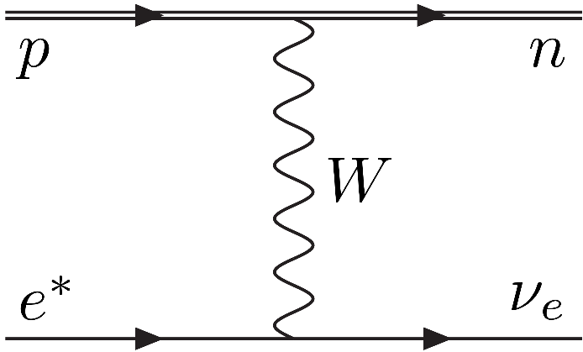
WLS theory: the idea /2
WLS theory aims to prove the existence of nuclear reactions induced by collective behavior of electrons in strong electromagnetic fields using standard model physics only
EPJC 46 (2006) 107-111
Step 2: the reaction $e^{∗}p→n ν_{e}$ is energetically feasible if $m^{∗}>m_{n}−m_{p}$ $(β>β_{0}∼2.5)$
A rate is evaluated using ordinary Fermi 4-fermion theory
$$Γ_{WLS}={\left(G_{F}m_{e}^{2}\right)}^{2}\frac{m_{e}}{2π^{2}}{\left(β−β_{0}\right)}^{2}∼0.56 \text{Hz}$$
arXiv:nucl-th/0608059
A. Pilloni – $Search for Neutron Flux Generation in a Plasma Discharge Electrolytic Cell$

Slide 27
WLS vs. Rome group
Some discussions have occurred during last two years
Original WL papers
$$Γ∼0.56 \text{Hz}$$
Wave function is missing, $$Γ∼1.8×{10}^{−3} \text{Hz}$$
Widom and Larsen, nucl-th/0608059
Continuous spectrum has to be considered
$$Γ∼0.7 \text{Hz}$$
Ciuchi et al. EPJC 72 (2012) 2193
But Debye Screening?
$$Γ∼{10}^{−7} \text{Hz}$$
Widom, Swain, Srivastava 1210.5212, 1305.4899
No Debye Screening, use slow electrons
$$Γ∼{10}^{1,000,000}\text{Hz}$$
Maiani, Polosa, Riquer EPJC 74 (2014) 2843
WSS, arXiv:1409.5344
A. Pilloni – $Search for Neutron Flux Generation in a Plasma Discharge Electrolytic Cell$

Slide 28
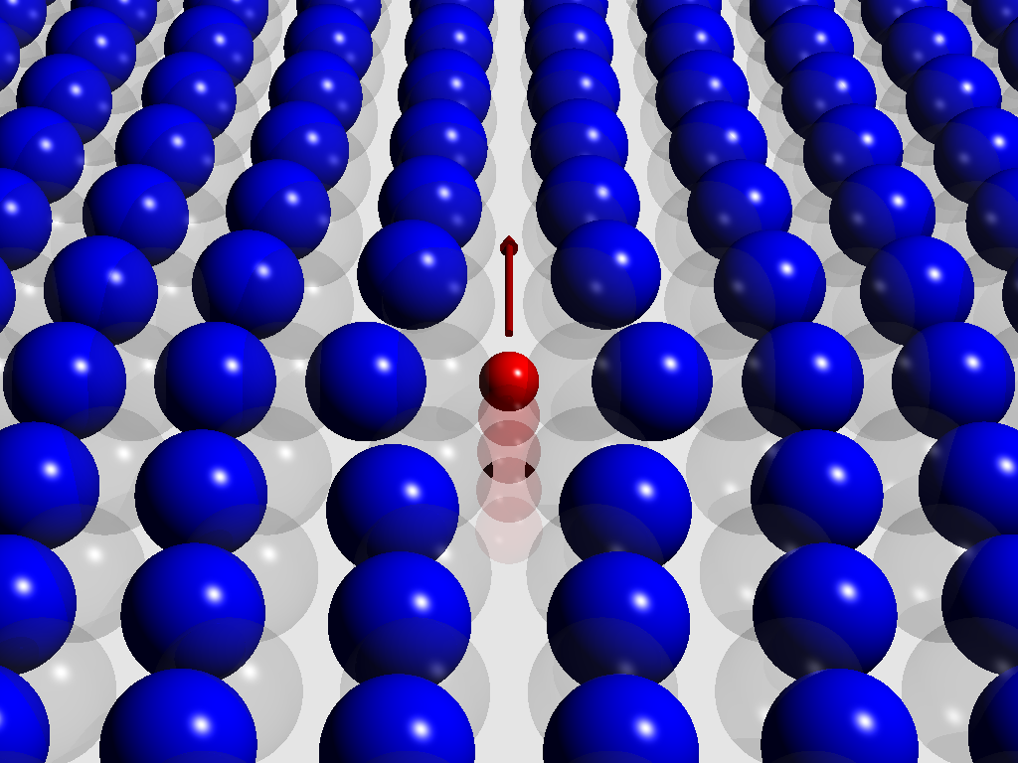
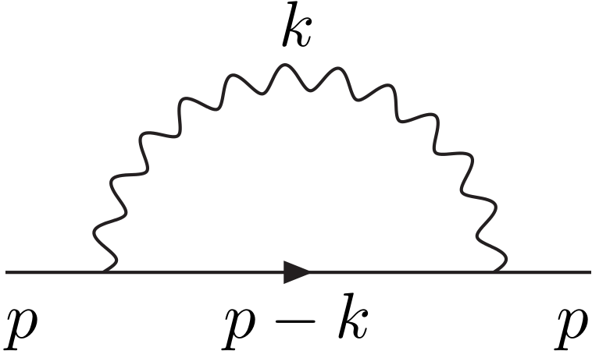
Effective mass /1
The concept of effective mass is common in condensed matter physics
Many properties are expressed in terms of quasi-particles, whose mass is a redefinition of the original mass of the carrier
Example: the polaron (electron-phonon q.p.)
$$E=\frac{p^{2}}{2}+ΔE \\ ∼\frac{p^{2}}{2}−γ−\frac{γ}{12}p^{2}+… \\ ∼\frac{p^{2}}{2\left(1+γ/6\right)}+…$$
Values of $β∼2−3$ are much more common
However, effective mass is not a real mass!
In fact you can have also $β<1$, which is hard to understand in terms of a bare electron plus the interactions with force mediators
A. F. Santander-Syro et al., Nature 469, 189-193 (2011)
A. Pilloni – $Search for Neutron Flux Generation in a Plasma Discharge Electrolytic Cell$
Notes:
Polarone, massa di banda, ponderomotore

Slide 29
Effective mass /2
The concept of effective mass is common in condensed matter physics
Many properties are expressed in terms of quasi-particles, whose mass is a redefinition of the original mass of the carrier
Anyway, the exchange of a $W$ boson happens on
a time scale $τ_{W}∼1/M_{W}∼{10}^{−21} \text{s}$
For the effective mass term to arise, you have to average over EM period
Weak interactions have not to resolve EM oscillation
$τ_{EM}≪τ_{W}$ → $E_{EM}≫100 \text{GeV}$
No hope to produce such EM waves with electrolytic cells!
A. Pilloni – $Search for Neutron Flux Generation in a Plasma Discharge Electrolytic Cell$
Notes:
Polarone, massa di banda, ponderomotore

Slide 30
Local interactions
However, let us assume such a mechanism to make sense, and let us allow for $β∼20$, in the WLS rate a crucial ingredient is missing
$Γ=ρv σ={\left|ψ\left(0\right)\right|}^{2}v σ$
We can assume
$${\left|ψ\left(0\right)\right|}^{2}=\frac{1}{{π\left(a^{∗}\right)}^{3} }=\frac{β^{3}}{π a^{3} }=\frac{m_{e}^{3}α^{3}β^{3}}{π }$$
$$σ=\frac{{\left(G_{F}m_{e}\right)}^{2}}{2π}\left(1+3λ^{2}\right)\frac{{\left(β−β_{0}\right)}^{2}}{v}$$
To get
$$Γ_{bound}=\frac{{\left(G_{F}m_{e}^{2}\right)}^{2}}{2π^{2}}m_{e}α^{3}β^{3}\left(1+3λ^{2}\right){\left(β−β_{0}\right)}^{2}$$
$$=α^{3}β^{3}Γ_{WLS}∼Γ_{WLS}/300∼1.8×{10}^{−3} \text{Hz}$$
e
p
The cross section is evaluated in the hypothesis of free asymptotic states
This term takes into account the locality and is proportional to the probability density for the two particles to be in the same point
Ciuchi et al. EPJC 72 (2012) 2193
A. Pilloni – $Search for Neutron Flux Generation in a Plasma Discharge Electrolytic Cell$

Slide 31
Coulombian scattering
However, WSS replied that in plasma regime, electrons are not bound
Wave functions of continuous spectrum have to be used
Sommerfeld enhancement
$${\left|ψ\left(0\right)\right|}^{2}=\frac{\frac{2π}{ka}}{1−\exp\left(−\frac{2π}{ka}\right)}∼\frac{2πα}{v}$$
$$ψ=e^{−\frac{π}{ka}} Γ\left(1+\frac{i}{ka}\right)e^{ikz}F\left(−\frac{i}{ka},1,k(r−z)\right)$$
$$\frac{Γ_{plasma}}{Γ_{bound}}=\frac{{n\left|ψ_{plasma}\left(0\right)\right|}^{2} vσ}{{\left|ψ_{bound}\left(0\right)\right|}^{2} vσ}∼\frac{2π^{2}nα}{β^{3}a^{3}}\left\langle \frac{1}{v}\right\rangle ∼\frac{2π^{2}nα}{β^{3}a^{3}}\sqrt{\frac{2{βm}_{e}}{πk_{B}T}}$$
A factor $β^{−5/2}$ is missing, this reduce the result of a factor $6×{10}^{−4}$
Kummer function
$$\frac{Γ_{plasma}}{Γ_{bound}}=\frac{{n\left|ψ_{plasma}\left(0\right)\right|}^{2} vσ}{{\left|ψ_{bound}\left(0\right)\right|}^{2} vσ}∼\frac{2π^{2}nα}{a^{3}}\left\langle \frac{1}{v}\right\rangle ∼\frac{2π^{2}nα}{a^{3}}\sqrt{\frac{2m_{e}}{πk_{B}T}}$$
According to WSS, this term should provide a factor $>300$ which regains the gap
Widom, Swain, Srivastava 1305.4899
A. Pilloni – $Search for Neutron Flux Generation in a Plasma Discharge Electrolytic Cell$

Slide 32
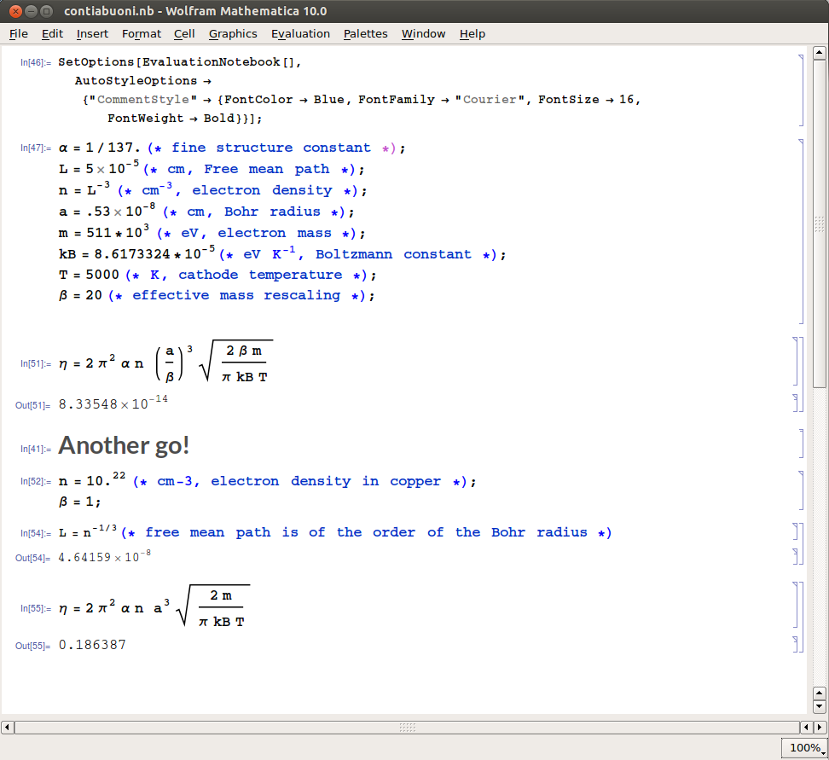
Coulombian scattering?
Where is the factor 300???
???
Gerard Butler, «300»
A. Pilloni – $Search for Neutron Flux Generation in a Plasma Discharge Electrolytic Cell$

Slide 33
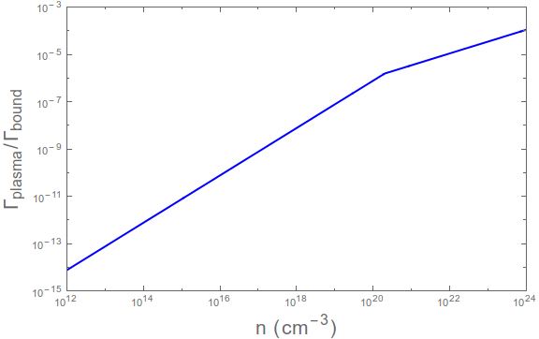
Debye screening
In a plasma the long-range Coulomb interaction is screened
$$V\left(r\right)=−\frac{α}{r}\exp\left(−\frac{r}{Λ_{D}}\right)$$
$$Λ_{D}=\sqrt{\frac{k_{B}T}{4π n α }}$$
WKB approximation
Screened region
WSS objected that Debye description holds only if
$$4πn^{2/3}Λ_{D}^{2}≪1$$
$$n≪4×{10}^{21} {\text{cm}}^{−3}$$
This does not modify the argument in the realistic plasma region
(note that WKB breaks up at $n∼8×{10}^{21}{\text{cm}}^{−3}$)
This provides a cut-off for Sommerfeld enhancement if $λ>Λ_{D}$
Unscreened region
$${\left|ψ\left(0\right)\right|}^{2}∼\frac{{βΛ}_{D}}{a}$$
Realistic plasma
Maiani, Polosa, Riquer EPJC 74 (2014) 2843
A. Pilloni – $Search for Neutron Flux Generation in a Plasma Discharge Electrolytic Cell$

Slide 34
Debye vs. Thomas-Fermi screening
Recently, WSS criticized the recourse to Debye screening description, arguing that in a cold plasma environment the Thomas-Fermi screening is more accurate
Thomas-Fermi screening is due to quantum corrections to Coulomb potential
$$Λ_{TF}=\sqrt{\frac{1}{4π α }\frac{∂μ}{∂n}}$$
$$Λ_{D}=\sqrt{\frac{k_{B}T}{4π n α}}$$
Lindhard function
$$V\left(k\right)=\frac{1}{k^{2}}→\frac{1}{k^{2}+4π e^{2}N(μ)}$$
Too bad that in a cold plasma electrons are expected to fit Maxwell-Boltzmann distribution
$$n∝\exp{βμ→Λ_{TF}≡Λ_{D}}$$
WSS, arXiv:1409.5344
A. Pilloni – $Search for Neutron Flux Generation in a Plasma Discharge Electrolytic Cell$

Slide 35
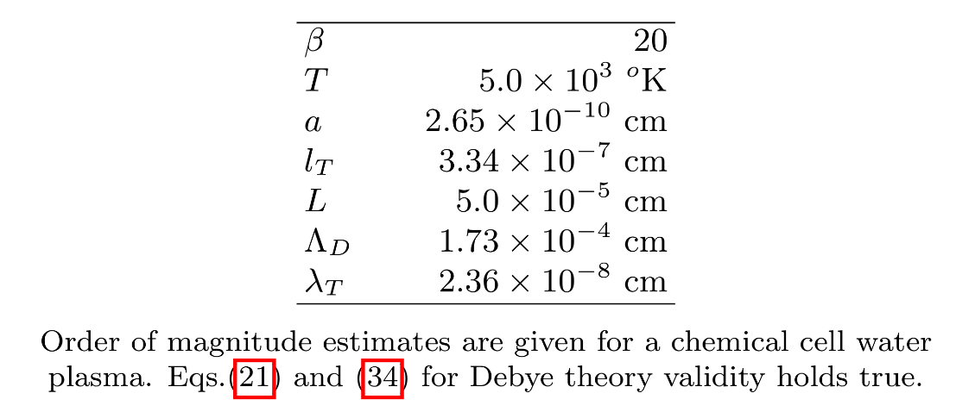
Low energy regime /1
Another point raised by WSS is that WKB approximation is not reliable in $k→0$ regime
A limit on variable scattering amplitude can be given by means of Calogero equation
$$χ^{′′}+\left(k^{2}−2m^{∗} V(r)\right)χ=0$$
Radial Schrödinger equation for $l=0$
$χ=w\left(r,k\right)\sin\left(kr+η(k,r)\right)$; $χ′=kw\left(r,k\right)\cos\left(kr+η(k,r)\right)$
$$w\left(k,r\right)=w\left(k,0\right)\exp\left[\int_{0}^{r}{\frac{2m^{∗}V\left(r′\right)}{2k}\sin\left(2kr′+2η(k,r′)\right)dr′}\right]$$
By normalizing $w\left(k,∞\right)=1, \lim_{k→0}{{\left|w(0,k)\right|}^{2}≥\exp\left[\int_{0}^{∞}{2r^{2}m^{∗}V\left(r^{′}\right)}\right]=\exp\left(\frac{4Λ_{TF}}{a^{∗}}\right)}$
With the numbers proposed by WSS,
$$\exp\left(\frac{4Λ_{D}}{a^{∗}}\right)∼{10}^{1,131,741}$$
WSS does not provide any estimate for $Λ_{TF}$, but we expect $Λ_{TF}=Λ_{D}$
to compare with $∼{10}^{84}$ proton in universe
WSS, arXiv:1409.5344
A. Pilloni – $Search for Neutron Flux Generation in a Plasma Discharge Electrolytic Cell$

Slide 36
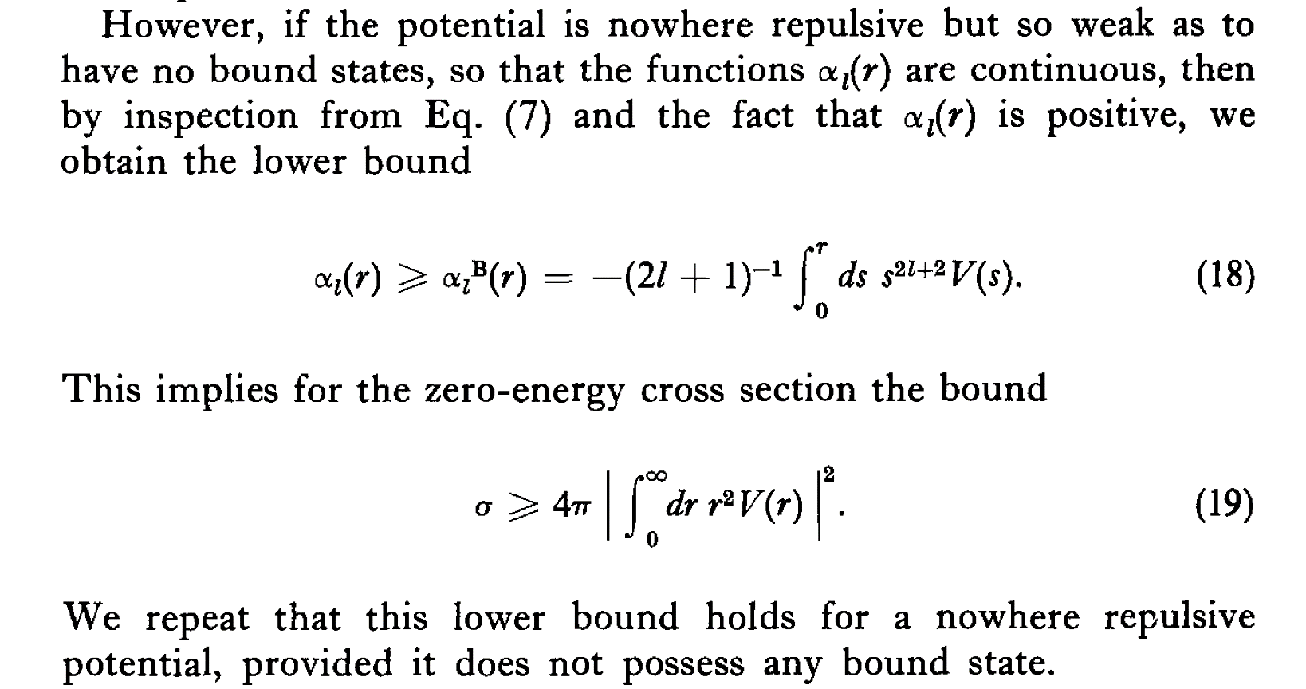
Low energy regime /2
Clearly this is a joke, WSS consider that $Λ_{TF}$ may be significantly different from $Λ_{D}$
However, the lower bound does not hold:
Calogero, Variable Phase Method Approach to Potential Scattering
This is not the case for a Yukawa-like potential with $Λ_{D}≫a$
A. Pilloni – $Search for Neutron Flux Generation in a Plasma Discharge Electrolytic Cell$

Slide 37
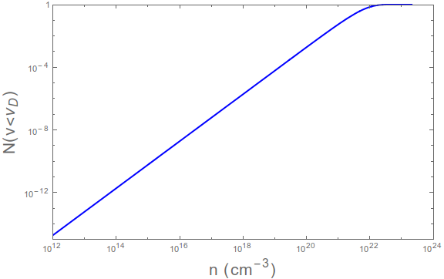
Low energy regime /3
Moreover, WSS changed mind with respect to the other papers, where $v∼v_{T}∼\sqrt{\frac{πk_{B}T}{2m^{∗}}}≫v_{D}=\frac{1}{m^{∗}Λ_{D}}$
The limit $k→0$ means that we are looking for $λ≫$ other length scales, i.e. $Λ_{D}$
According to Maxwell-Boltzann distribution, how many electrons are slower than $1/m^{∗}Λ_{D}$?
$$N=\int_{0}^{\frac{1}{m^{∗}Λ_{D}}}{\frac{4πv^{2}\exp\left(−\frac{m^{∗}v^{2}}{k_{B}T}\right)}{{\left(\frac{2πk_{B}T}{m^{∗}}\right)}^{\frac{3}{2}}}}dv$$
A suppression of at least ${10}^{−8}$ expected for realistic plasma regimes
Realistic plasma
A. Pilloni – $Search for Neutron Flux Generation in a Plasma Discharge Electrolytic Cell$

Slide 38
Conclusions
Cirillo, Widom, Srivastava et al. experiment
Neutron emission from plasma discharge electrolytic cell
Widom-Larsen(-Srivastava) theory
LENR (neutron emission) due to strong electromagnetic fields
Our group did not see any statistically significant neutron flux in plasma discharge electrolytic cells
This is crucial to probe the nature of physics in LENR experiment
WLS theory reveals many weaknesses and is not able to predict the existence of LENR phenomena
LENR is still not explainable by means of SM physics
Thank you!
A. Pilloni – $Search for Neutron Flux Generation in a Plasma Discharge Electrolytic Cell$

Slide 39
Backup

Slide 40
Comparison of the experiments
Differences between the experiments
Quartz shield around cathode (as in Mizuno exp.) vs ceramic casing
Quartz separator between anode and cathode vs. nothing
Neutron detectors and their location
The comparison between the experiments depends on the hypothesis on the production energy spectrum
Since the detectors used by Cirillo et al. are shielded from thermal neutrons, the spectrum of the allegedly produced neutrons would be faster ➔ will assume AmB
Detectors placed inside the cell: during Run1, with incorrect background suppression, some CR-39 detectors were placed inside the cell
Those with thick Boron (same as CE) showed no signal
Those with thin Boron showed an excess 100 times smaller than the CE
Detectors placed outside the cell: for an AmB like spectrum we set a limit (with In ) $Φ<64 \text{n} {\text{cm}}^{−2}{\text{s}}^{−1}$ @95%C.L. @5cm from cathode.
Correcting for geometry and spectrum (with MC) we estimate $Φ<900 \text{n} {\text{cm}}^{−2}{\text{s}}^{−1}$ @95%C.L. @2cm from cathode (cfr $7.2×{10}^{3} \text{n} {\text{cm}}^{−2}{\text{s}}^{−1}$ measured in CE)
A. Pilloni – $Search for Neutron Flux Generation in a Plasma Discharge Electrolytic Cell$

Slide 41
Cathode
Cirillo et al. claim that no LENR take place unless the “cathode surface has cracks, with a sharp point but certainly not regular surfaces”.
The required amount of roughness to have the alleged processes occur needs to be quantified in order to be reproducible
Anyway, our cathode was not polished at all…
A. Pilloni – $Search for Neutron Flux Generation in a Plasma Discharge Electrolytic Cell$

Slide 42
WKB approximation
In a plasma the long-range Coulomb interaction is screened
$$χ^{′′}+\left(k^{2}−2m V(r)\right)χ=0$$
Radial Schrödinger equation for $l=0$
$$χ∼\frac{A}{\sqrt{2m\left(E−V(x^{′})\right)}}\exp\left(±i \int_{x_{0}}^{x}{\sqrt{2m\left(E−V(x^{′})\right)}}dx′\right)$$
The approximation is good as long as $\left|\frac{k^{′}\left(x\right)}{k^{2}(x)}\right|≪1→v≫\frac{αa}{βΛ_{D}}$
If we use thermal velocity, we get a bound on density $n≪8×{10}^{21} {\text{cm}}^{3}$
Maiani, Polosa, Riquer EPJC 74 (2014) 2843
A. Pilloni – $Search for Neutron Flux Generation in a Plasma Discharge Electrolytic Cell$

Slide 43
Motion in an EM plane wave
$$\vec{p}=m\vec{v}=\vec{P}+e\vec{A}$$
Kinetic momentum
Canonical momentum
Let us start from Hamilton-Jacobi equation: $\left(\frac{∂S}{∂x_{μ}}+e A^{μ}\right)\left(\frac{∂S}{∂x^{μ}}+e A_{μ}\right)=m^{2}$ where $A^{μ}=A^{μ}\left(ξ\right)≡A^{μ}(kx)$ and $k^{2}=Ak=0$
We seek for a solution $S=−fx+F(ξ)$ with $f^{2}=m^{2}$, plugging in HJ equation we get
$S=−fx+\frac{e}{γ}∫fA dξ+\frac{e^{2}}{2γ}∫A^{2} dξ$, with $γ=kf$
If the plane wave is propagating along the x axis, and choose a gauge with $A^{0}=A^{x}=0$ and choose a reference frame at rest with the center of the oscillation, we have
$$p^{x}=\frac{e^{2}}{2γ}\left(A^{2}−\overline{A^{2}}\right)$$
$$p^{y,z}=−\frac{e}{γ}A^{y,z}$$
$$E=γ+\frac{e^{2}}{2γ}\left(A^{2}−\overline{A^{2}}\right)$$
We still have
$$E^{2}−{\vec{p}}^{2}=m^{2}$$
Landau-Lifshitz, vol. 2, §47
A. Pilloni – $Search for Neutron Flux Generation in a Plasma Discharge Electrolytic Cell$

Slide 44
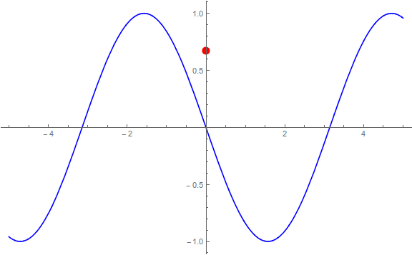
Motion in an EM plane wave
We still have
$$E^{2}−{\vec{p}}^{2}=m^{2}$$
Landau-Lifshitz, vol. 2, §47
A. Pilloni – $Search for Neutron Flux Generation in a Plasma Discharge Electrolytic Cell$

Slide 45
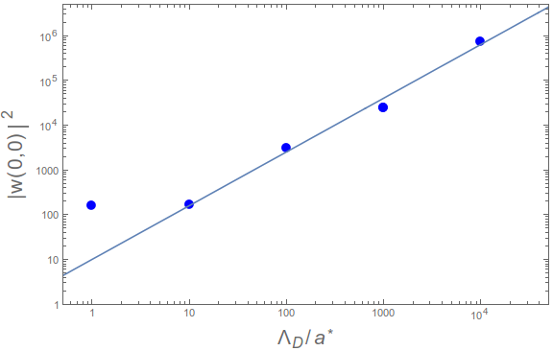
Lower limit
Numerically, the lower bound proposed by WSS is not exponential, but
$$∼10{\left(\frac{Λ_{D}}{a^{∗}}\right)}^{1.2}$$
It is killed by the Maxwell-Boltzmann factor
A. Pilloni – $Search for Neutron Flux Generation in a Plasma Discharge Electrolytic Cell$

Slide 46
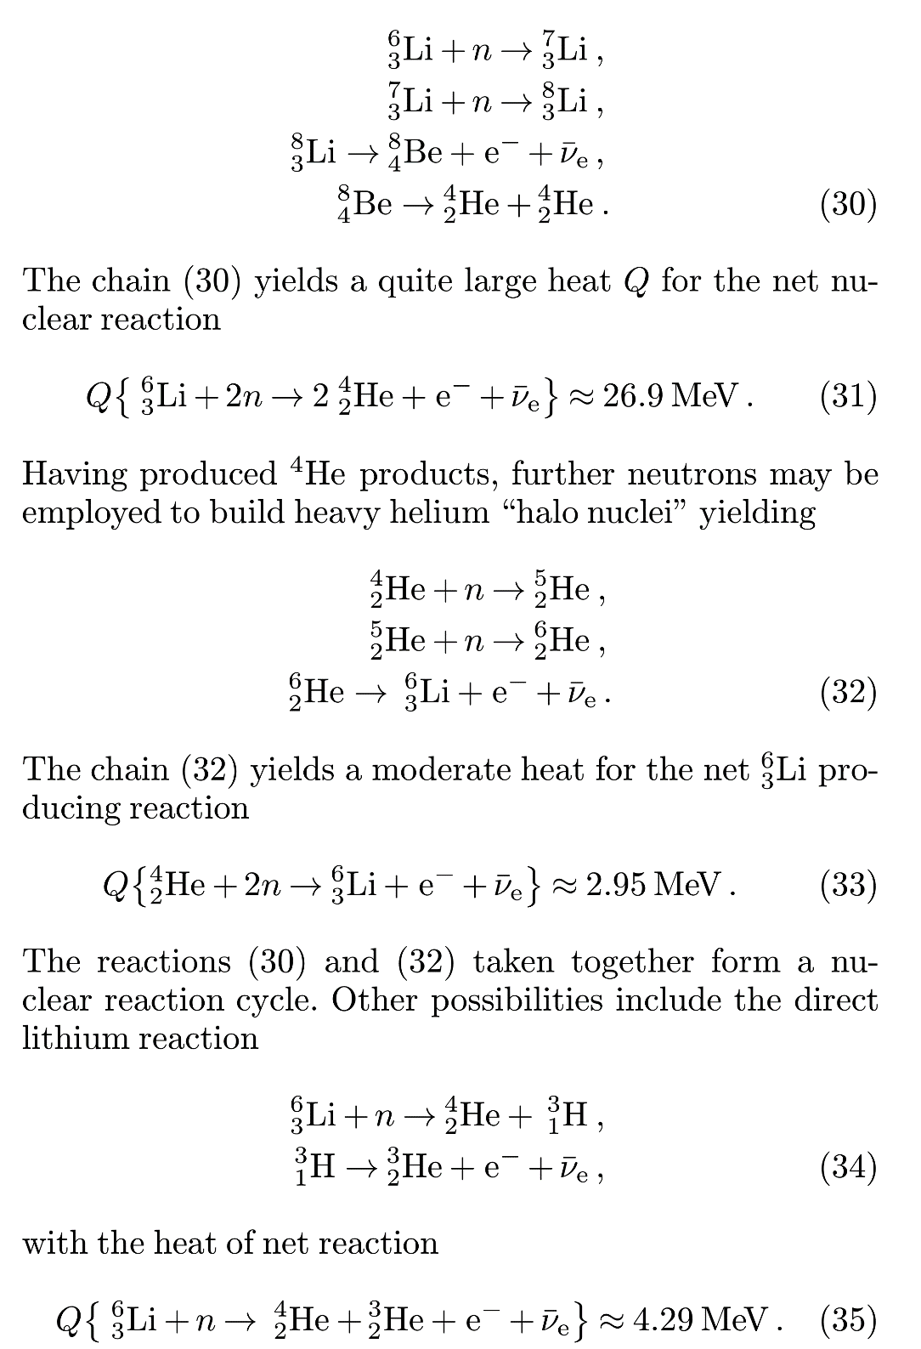
WL nuclear chains
Widom and Larsen, EPJC 46 (2006) 107-111
A. Pilloni – $Search for Neutron Flux Generation in a Plasma Discharge Electrolytic Cell$

Slide 47
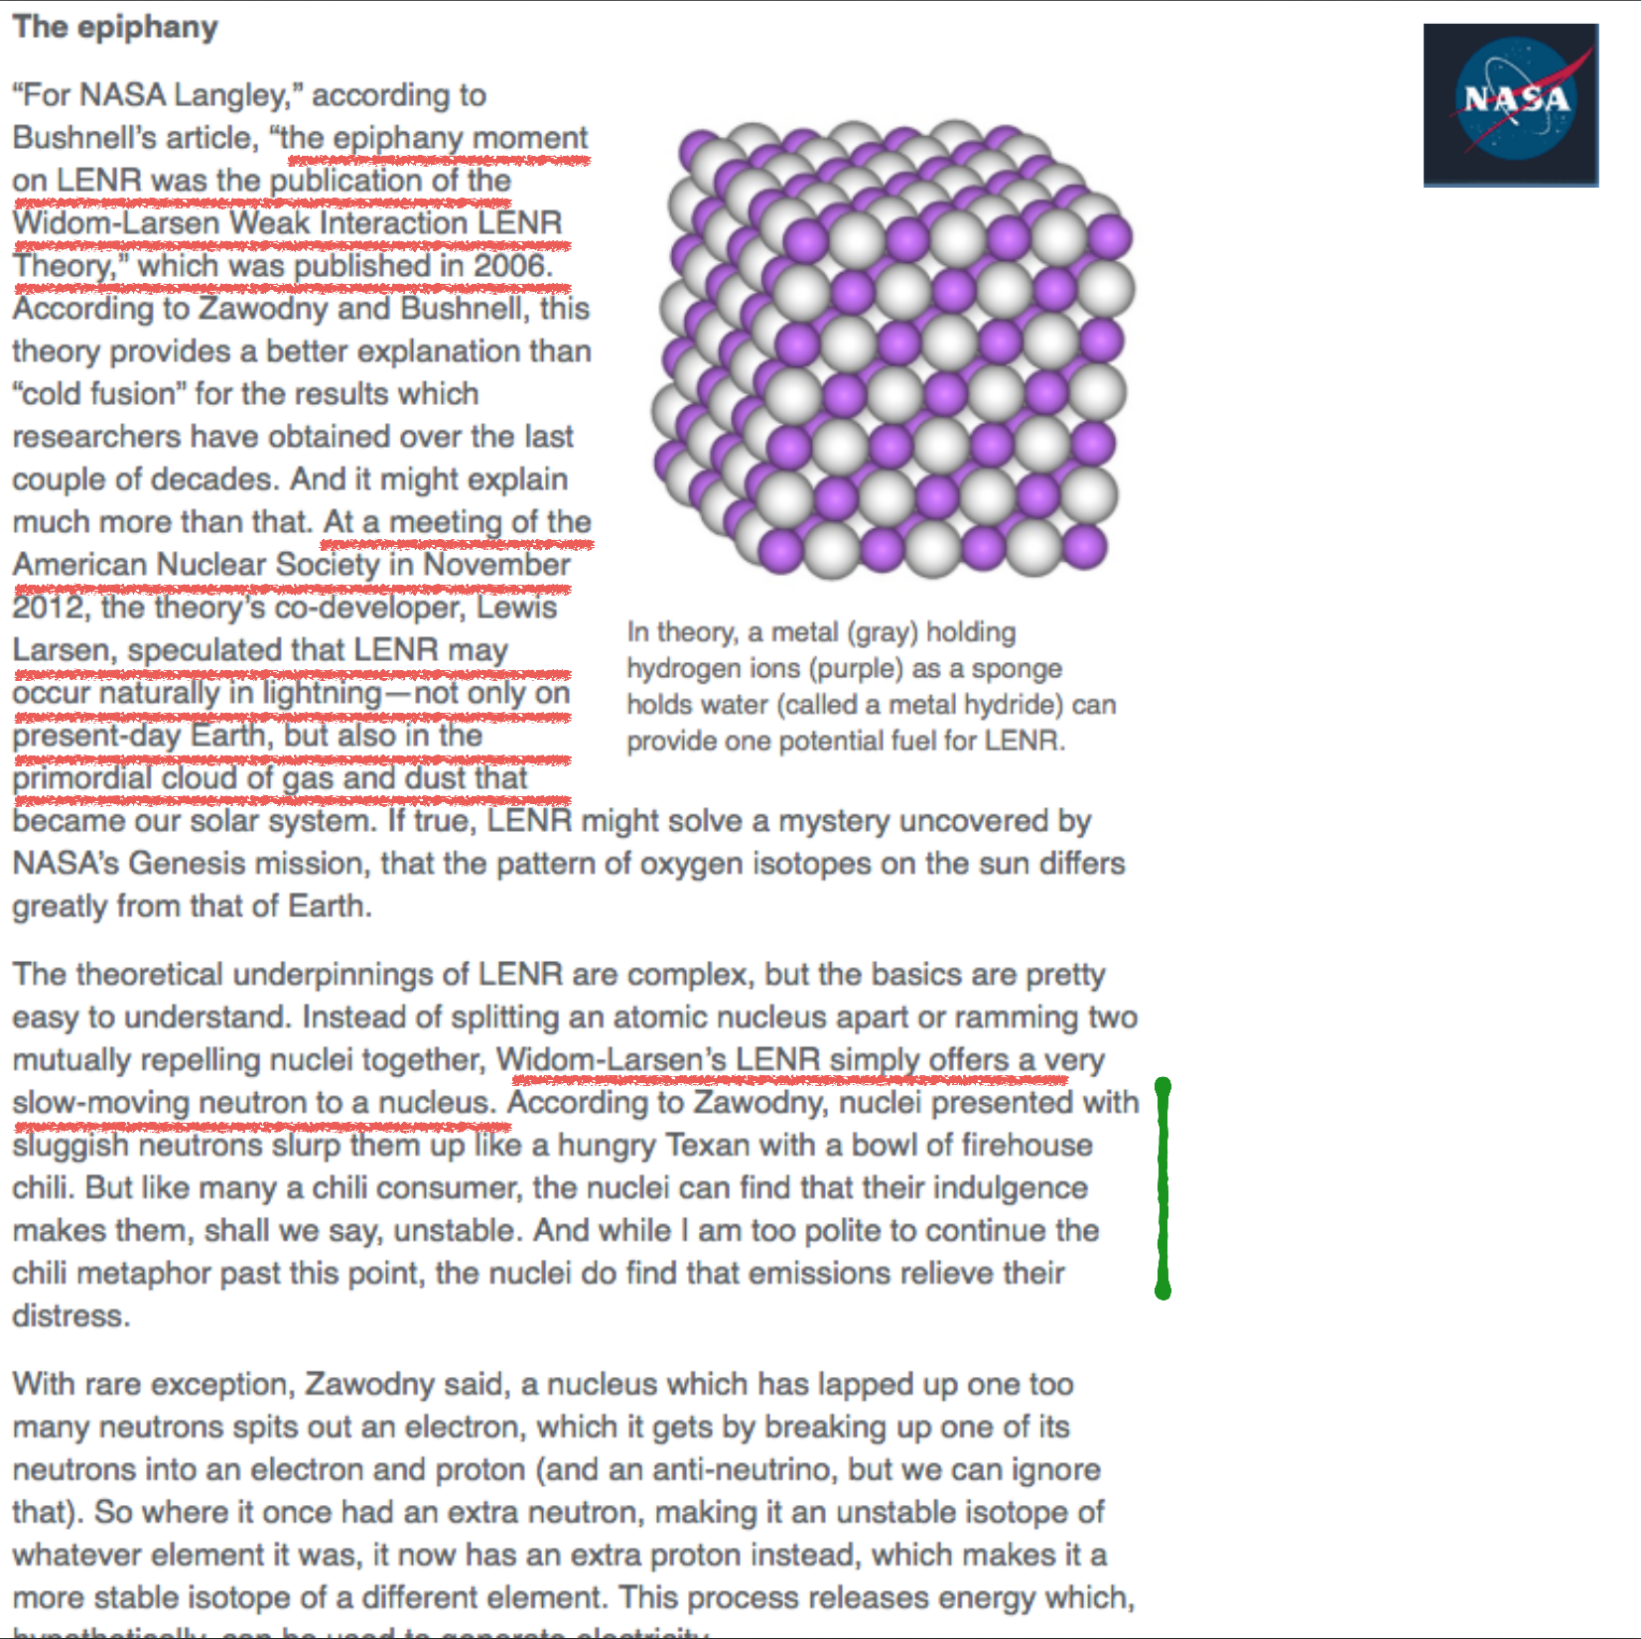
WL theory at NASA
Bob Silger, http://climate.nasa.gov/news/864/
A. Pilloni – $Search for Neutron Flux Generation in a Plasma Discharge Electrolytic Cell$

Slide 48
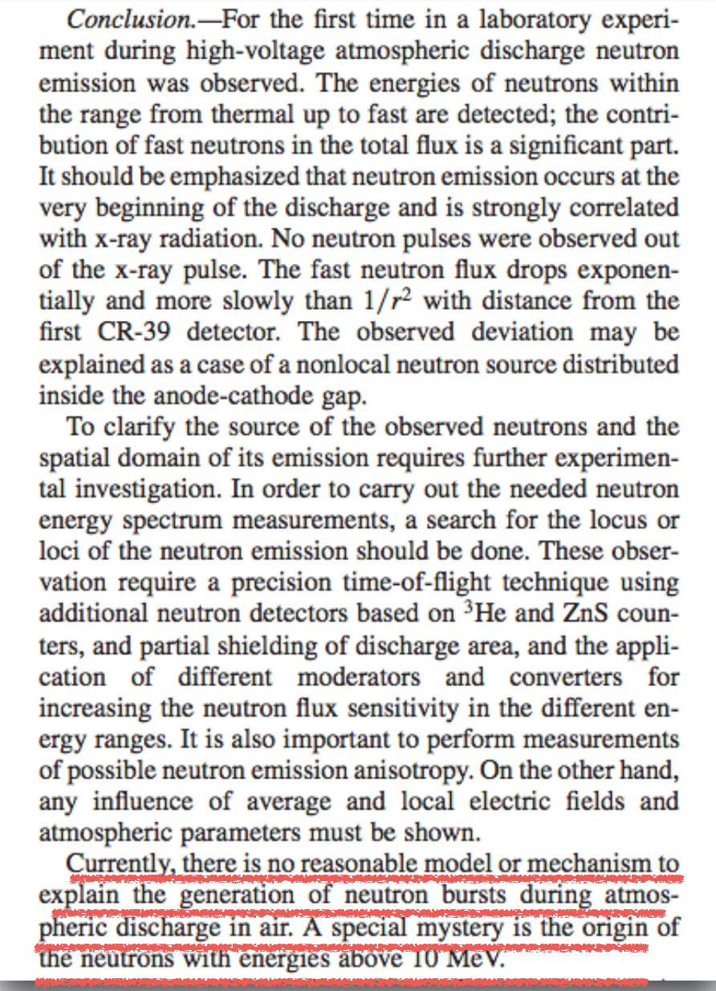
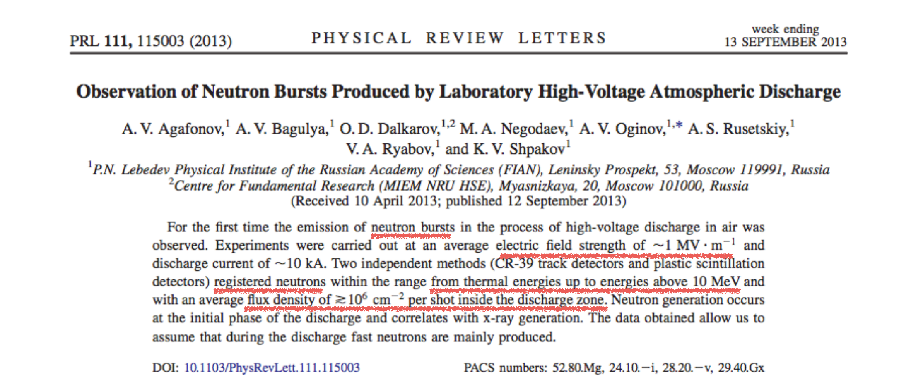
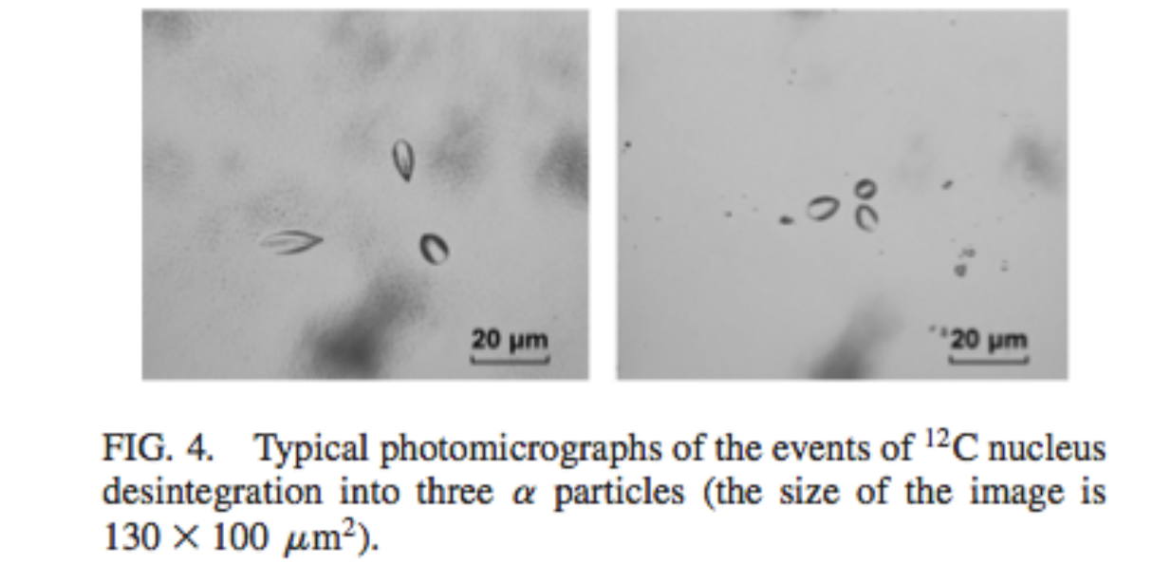
Neutrons in lightnings
Agafonov et al., PRL 111, 115003 (2013)
A. Pilloni – $Search for Neutron Flux Generation in a Plasma Discharge Electrolytic Cell$

