Slide 1
Predictive power of different theory approaches to heavy-heavy states
Alessandro Pilloni
Deciphering Strong-interaction phenomenology through precision Hadron Spectroscopy, MIAPP, October 25th, 2019

Slide 2
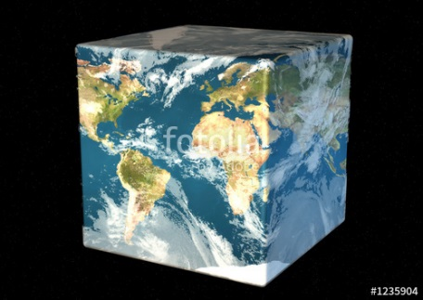
Hadron Spectroscopy
Hybrids
Tetraquark
Meson
Baryon
Glueball
$$π$$
$$π$$
$$J/ψ$$
$$π$$
Hadroquarkonium
Molecule
Experiment
Data
Amplitude analysis
Properties,
Model building
Lattice QCD
Interpretations on the spectrum leads to understanding fundamental laws of nature

Slide 3
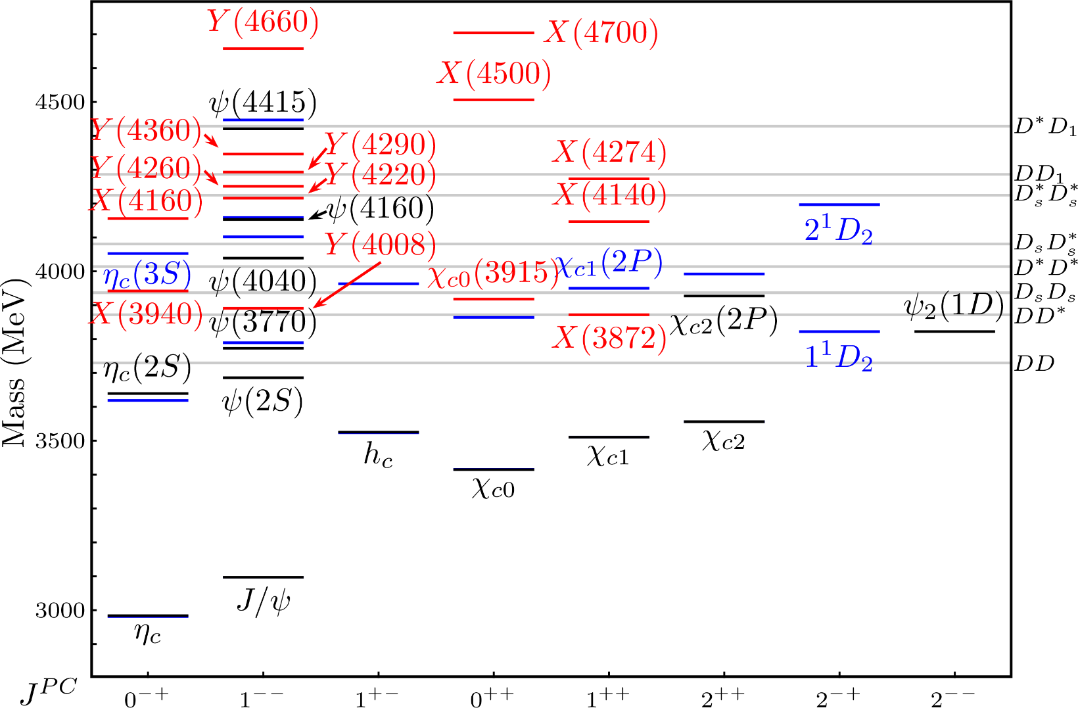
Exotic landscape
Esposito, AP, Polosa, Phys.Rept. 668
A host of unexpected resonances have appeared
decaying mostly into charmonium + light
Hardly reconciled with usual charmonium interpretation
A. Pilloni – Predictive power of different theory approaches
Notes:
2 slides su Zc, a Bes e a Belle
2 slide su tetraquark model: dall’hamiltoniana di Jaffe al calcolo delle masse
1 slide su molecular models, dove sono i carichi? (non in Tornqvist, si in Hanhart, vedere Braaten, citare Nefediev)
2 slides su decay channels, dove si dovrebbe vedere, e a seconda del modello, vedere qualche plot
1 slide su Y(4260), tetraquark? C’è lo strano (si vede la f0)
1 slide su Zc a cleo (anche il neutro)

Slide 4
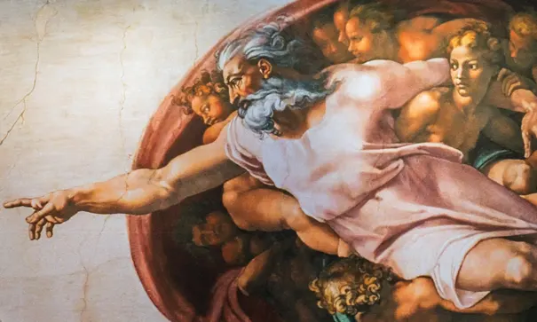
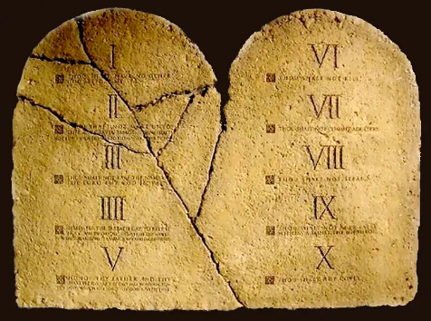
Top-down approach
You are given a model/theory
$$f(s)$$
You calculate the amplitude
You compare with data. Or you don’t.
Predictive power ✓
Physical interpretation ✓ (within the model! ✗) Biased by the input ✗
A. Pilloni – Predictive power of different theory approaches

Slide 5
Options on the market
«Quark model»-like:
QM 4q, Born-Oppenheimer 4q, Hybrids, Molecules in potential models...
Spectrum calculated as bound states of some potential
Decay rates as «overlap integrals» between two static configurations
Comprehensive picture ✓ No scattering dynamics ✗
«Scattering»-like:
(dynamical-generated) molecules, triangles...
States as poles of scattering amplitudes
Couplings as residues at the poles
Scattering dynamics ✓ More case-by-case ✓✗
A. Pilloni – Predictive power of different theory approaches

Slide 6
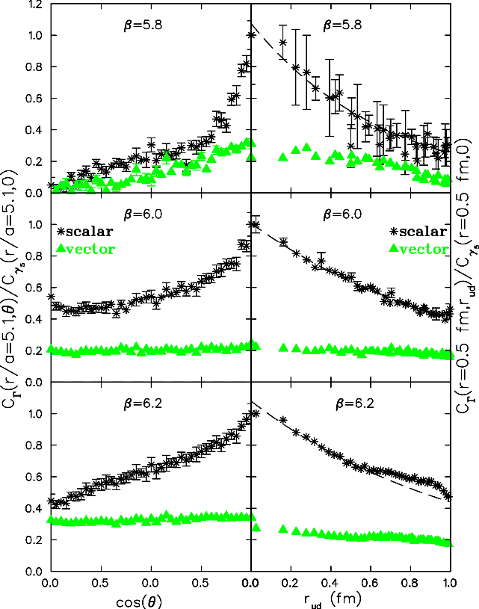
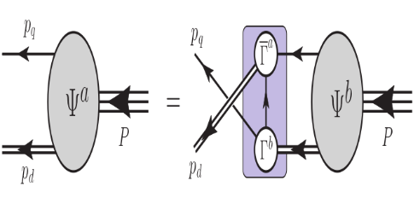
Diquarks: pros and cons
Evidence (?) of diquarks in LQCD ✓
Alexandrou, de Forcrand, Lucini, PRL 97, 222002
Diquark correlations appear in DS calculations for baryons ✓ Segovia et al. Phys.Lett. B750 (2015) 100-10
Solution: Shut up and let’s see where it goes
Diquarks do not necessarily survive in multiquark states ✗
Pointlike approximation looks crude ✗ What’s the scale of diquarks inside hadrons? ✗
A. Pilloni – Predictive power of different theory approaches

Slide 7
Constituent quark model
Godfrey and Isgur, PRD 32, 189 Capstick and Isgur, PRD 33, 2809
A. Pilloni – Predictive power of different theory approaches

Slide 8
Constituent quark model
Godfrey and Isgur, PRD 32, 189 Capstick and Isgur, PRD 33, 2809
All spatial dependence absorbed into an effective «diquark mass»
A. Pilloni – Predictive power of different theory approaches

Slide 9
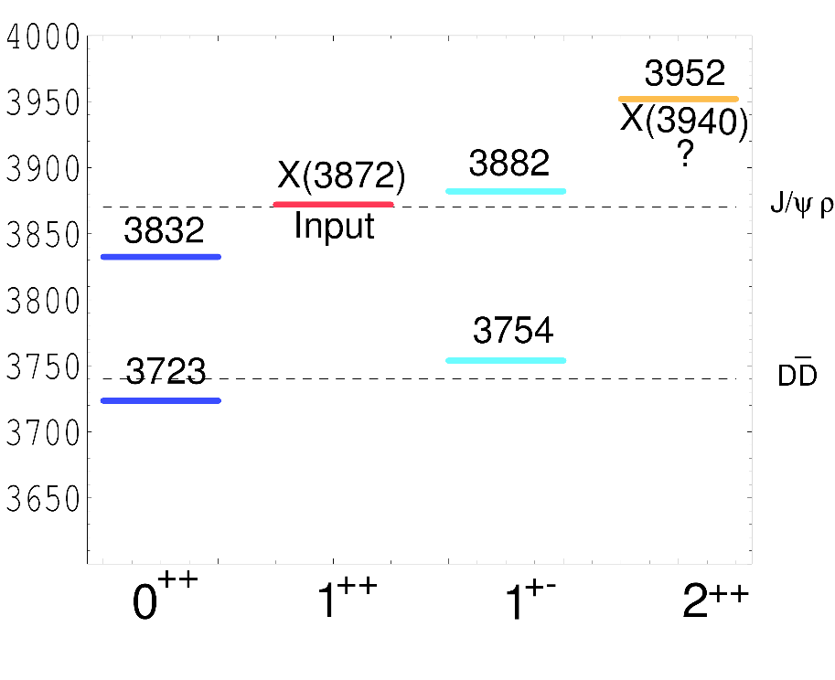
Tetraquark (2005)
$${\overline{3}}_{c}$$
$$\overline{c}$$
$$c$$
In a constituent quark model, we can think of a
diquark-antidiquark compact state
$$3_{c}$$
$$q$$
$${\left[cq\right]}_{S=0,1}{\left[\overline{c}\overline{q}′\right]}_{S=0,1}$$
$$\overline{q}$$
Maiani, Piccinini, Polosa, Riquer PRD71 014028
same + Faccini, AP, PRD87 111102
Spectrum according to color-spin hamiltonian:
$$H=\sum_{dq}{m_{dq}}+2\sum_{i<j}{κ_{ij} \vec{S_{i}}∙\vec{S_{j}} \frac{λ_{i}^{a}}{2}\frac{λ_{j}^{a}}{2}}$$
Decay pattern mostly driven by HQSS ✓
Fair understanding of existing spectrum ✓
A full nonet for each level is expected ✗
$$κ_{q\overline{q}}=315 \text{MeV}\text{,} κ_{c\overline{c}}=59 \text{MeV}\text{,}$$
$$κ_{cq}=22 \text{MeV}\text{,} κ_{c\overline{q}}=72 \text{MeV}$$
A. Pilloni – Predictive power of different theory approaches
Notes:
Y(4260), M=4263 +- 5, Gamma = 95+-14
D_1(2420)^0, M=2421.3 ±0.6, Gamma =27.1 ±2.7
D_1(2420)^+-, M=2423.4 ±3.1, Gamma =25 ±6
I D_1 hanno J^P = 1^+
La molecola D_1 D sta 22 MeV sotto
Se la Y è D_1 D, il pione lega fortemente, come fa la Y a essere così larga?
Come funziona lo scambio del pione???
Close propone che la Y è D_1 D^* col pione scambiato in onda S,
La Y però non va in Ds come se fosse tetraquark

Slide 10
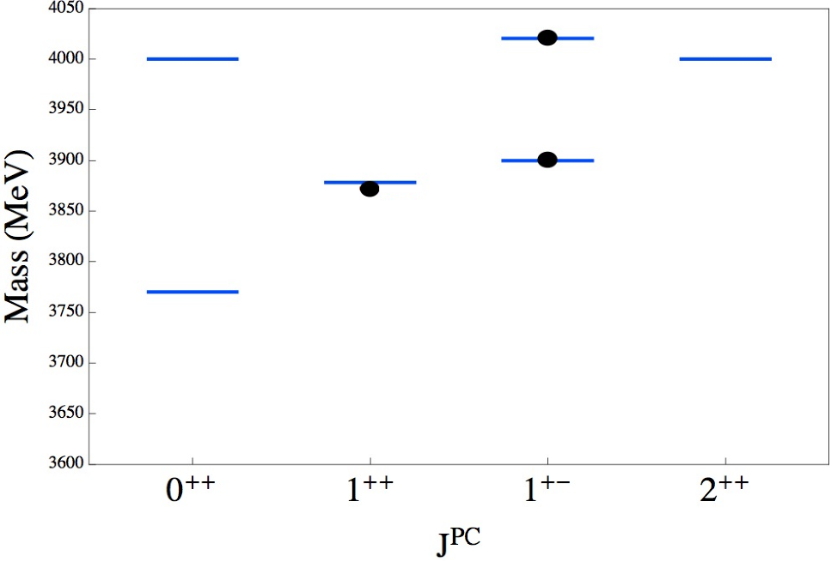
Tetraquark: new ansatz (2014)
$${\overline{3}}_{c}$$
$$\overline{c}$$
$$c$$
Type I-model predicts no $Z_{c}^{′}(4020)$, and disfavors $Z_{c}\left(3900\right)→J/ψπ$
$$3_{c}$$
$$q$$
$$\overline{q}$$
Maiani, Piccinini, Polosa, Riquer PRD89 114010
New ansatz: the diquarks are compact objects spacially separated from each other,
The spin-spin interaction is local, only $κ_{cq}≠0$
Existing spectrum is fitted if $κ_{cq}=67 \text{MeV}$
A. Pilloni – Predictive power of different theory approaches
Notes:
Y(4260), M=4263 +- 5, Gamma = 95+-14
D_1(2420)^0, M=2421.3 ±0.6, Gamma =27.1 ±2.7
D_1(2420)^+-, M=2423.4 ±3.1, Gamma =25 ±6
I D_1 hanno J^P = 1^+
La molecola D_1 D sta 22 MeV sotto
Se la Y è D_1 D, il pione lega fortemente, come fa la Y a essere così larga?
Come funziona lo scambio del pione???
Close propone che la Y è D_1 D^* col pione scambiato in onda S,
La Y però non va in Ds come se fosse tetraquark

Slide 11
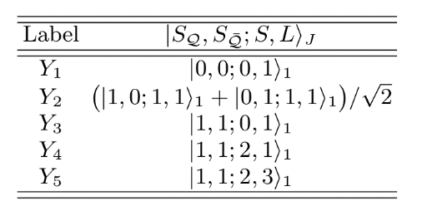
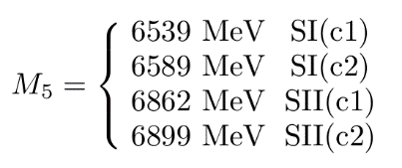
Tetraquark: new ansatz (2014)
Maiani, Piccinini, Polosa, Riquer PRD89 114010
Ali, et al. EPJC78, 1, 29 Maiani, Polosa, Riquer, PLB778, 247-251
Two different mass scenarios
Prediction for a high $Y_{5}$
A. Pilloni – Predictive power of different theory approaches
Notes:
Y(4260), M=4263 +- 5, Gamma = 95+-14
D_1(2420)^0, M=2421.3 ±0.6, Gamma =27.1 ±2.7
D_1(2420)^+-, M=2423.4 ±3.1, Gamma =25 ±6
I D_1 hanno J^P = 1^+
La molecola D_1 D sta 22 MeV sotto
Se la Y è D_1 D, il pione lega fortemente, come fa la Y a essere così larga?
Come funziona lo scambio del pione???
Close propone che la Y è D_1 D^* col pione scambiato in onda S,
La Y però non va in Ds come se fosse tetraquark

Slide 12
Dynamical movie
Z⁺(4430)
c̄ d̄
Ψ(2S)
c u
π⁺
Brodsky, Hwang, Lebed PRL 113 112001
Since this is still a $3⟷\overline{3}$ color interaction, just use the Cornell potential: $V\left(r\right)=−\frac{4}{3}\frac{α_{s}}{r}+br+\frac{32πα_{s}}{9m_{cq}^{2} }{\left(\frac{σ}{\sqrt{π}}\right)}^{3}e^{−σ^{2}r^{2}}S_{cq}∙S_{\overline{cq}},$
e.g. Barnes et al., PRD 72, 054026
Use that the kinetic energy released in ${\overline{B}}^{0}⟶K^{−}Z^{+}(4430)$ converts into potential energy until the diquarks come to rest
Hadronization most effective at this point (WKB turning point)
$$\frac{B\left(Z^{+}(4430)→ψ(2S)π^{+}\right)}{B\left(Z^{+}\left(4430\right)→J/ψ π^{+}\right)}∼72$$
$$(>10 \text{exp}\text{.)}$$
$$r_{Z}=1.16 fm,\left\langle r_{ψ(2S)}\right\rangle =0.80 fm,\left\langle r_{J/ψ}\right\rangle =0.39 fm$$
A. Pilloni – Predictive power of different theory approaches
$$\left\langle r_{J/ψ}\right\rangle =0.39 fm$$

Slide 13
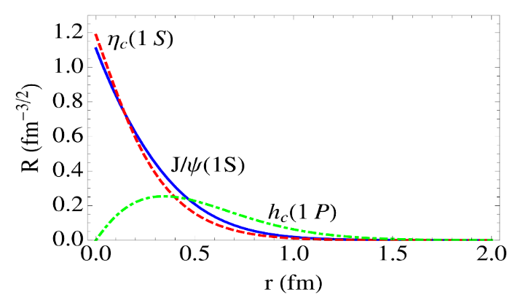
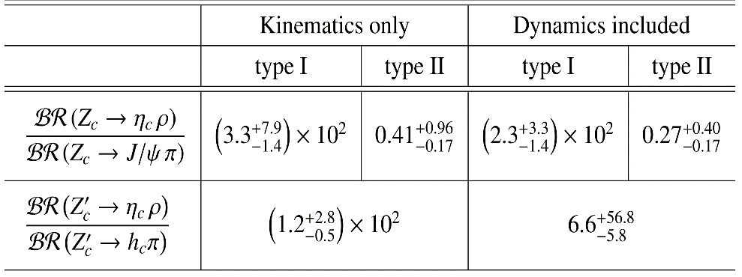
$Z_{c}\left(3900\right)→η_{c}ρ$
Esposito, Guerrieri, AP, PLB 746, 194-201
If tetraquark
Kinematics with HQSS, dynamics estimated according to Brodsky et al., PRL113, 112001
$$A=\left\langle χ_{c\overline{c}} | χ_{c}⊗χ_{\overline{c}}\right\rangle \left\langle φ_{c\overline{c}} | {\hat{T}}_{⊥HQS} | φ\left[cq\right][\overline{c}\overline{q}]\right\rangle +O\left(\frac{Λ_{QCD}}{m_{c}}\right)$$
Uncertainty
$$∼25\%$$
Clebsch-Gordan
Reduced matrix element
approximated as a constant
or $∝ψ_{c\overline{c}}(r_{Z})$
A. Pilloni – Predictive power of different theory approaches
Notes:
Y(4260), M=4263 +- 5, Gamma = 95+-14
D_1(2420)^0, M=2421.3 ±0.6, Gamma =27.1 ±2.7
D_1(2420)^+-, M=2423.4 ±3.1, Gamma =25 ±6
I D_1 hanno J^P = 1^+
La molecola D_1 D sta 22 MeV sotto
Se la Y è D_1 D, il pione lega fortemente, come fa la Y a essere così larga?
Come funziona lo scambio del pione???
Close propone che la Y è D_1 D^* col pione scambiato in onda S,
La Y però non va in Ds come se fosse tetraquark

Slide 14
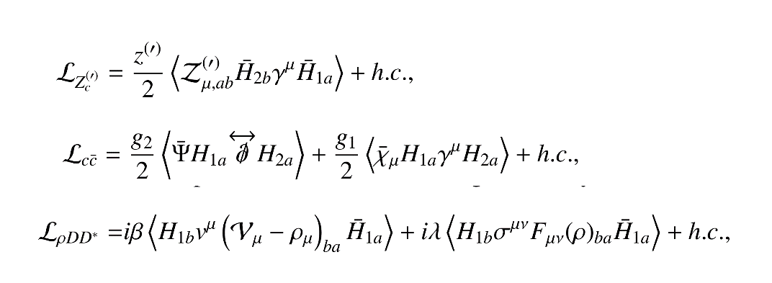
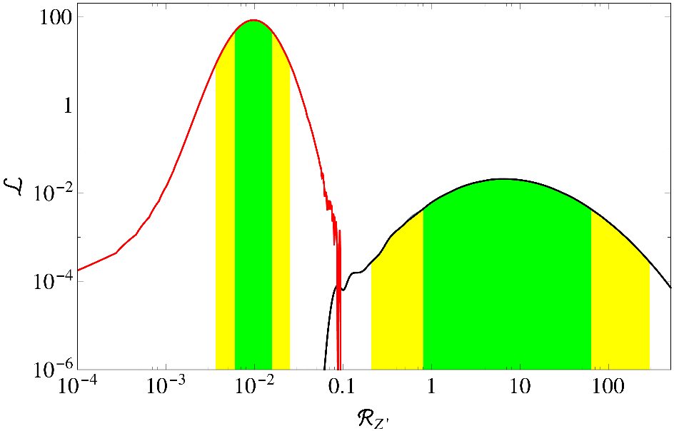
$Z_{c}\left(3900\right)→η_{c}ρ$
Esposito, Guerrieri, AP, PLB 746, 194-201
If molecule
Non-Relativistic Effective Theory, HQET+NRQCD and Hidden gauge Lagrangian
Uncertainty estimated with power counting at NLO
Molecule
Tetraquark
A. Pilloni – Predictive power of different theory approaches
Notes:
Y(4260), M=4263 +- 5, Gamma = 95+-14
D_1(2420)^0, M=2421.3 ±0.6, Gamma =27.1 ±2.7
D_1(2420)^+-, M=2423.4 ±3.1, Gamma =25 ±6
I D_1 hanno J^P = 1^+
La molecola D_1 D sta 22 MeV sotto
Se la Y è D_1 D, il pione lega fortemente, come fa la Y a essere così larga?
Come funziona lo scambio del pione???
Close propone che la Y è D_1 D^* col pione scambiato in onda S,
La Y però non va in Ds come se fosse tetraquark

Slide 15
$Z_{c}\left(3900\right)→η_{c}ρ$
1906.00831
(Slide by P. Ronggang)
A. Pilloni – Predictive power of different theory approaches
Notes:
Y(4260), M=4263 +- 5, Gamma = 95+-14
D_1(2420)^0, M=2421.3 ±0.6, Gamma =27.1 ±2.7
D_1(2420)^+-, M=2423.4 ±3.1, Gamma =25 ±6
I D_1 hanno J^P = 1^+
La molecola D_1 D sta 22 MeV sotto
Se la Y è D_1 D, il pione lega fortemente, come fa la Y a essere così larga?
Come funziona lo scambio del pione???
Close propone che la Y è D_1 D^* col pione scambiato in onda S,
La Y però non va in Ds come se fosse tetraquark

Slide 16
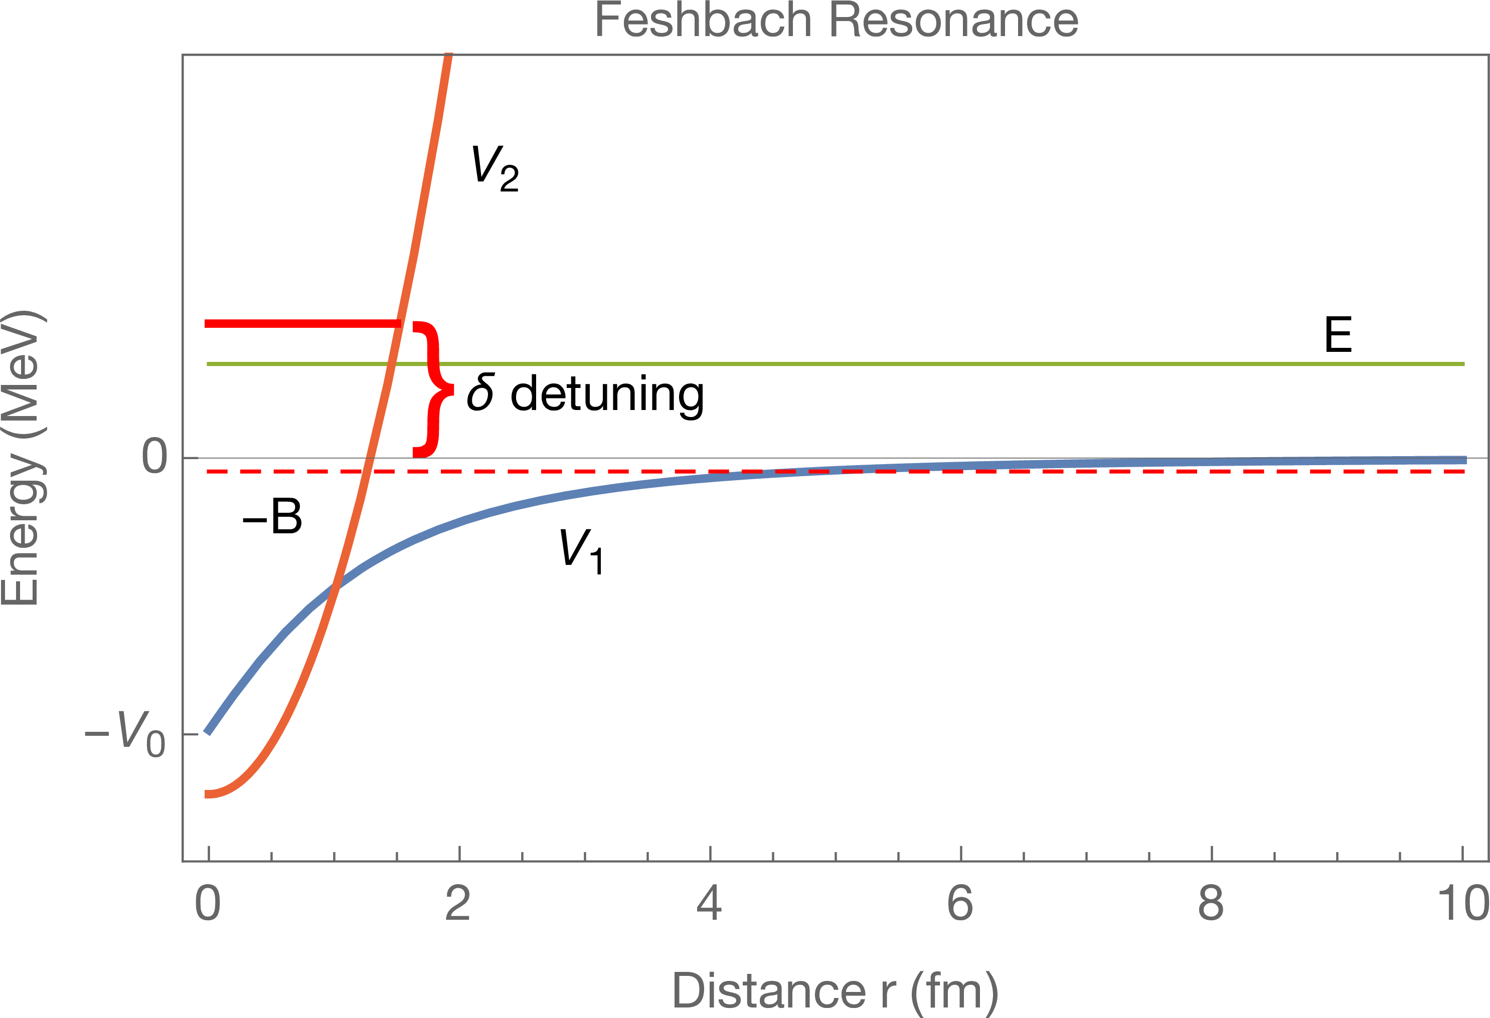
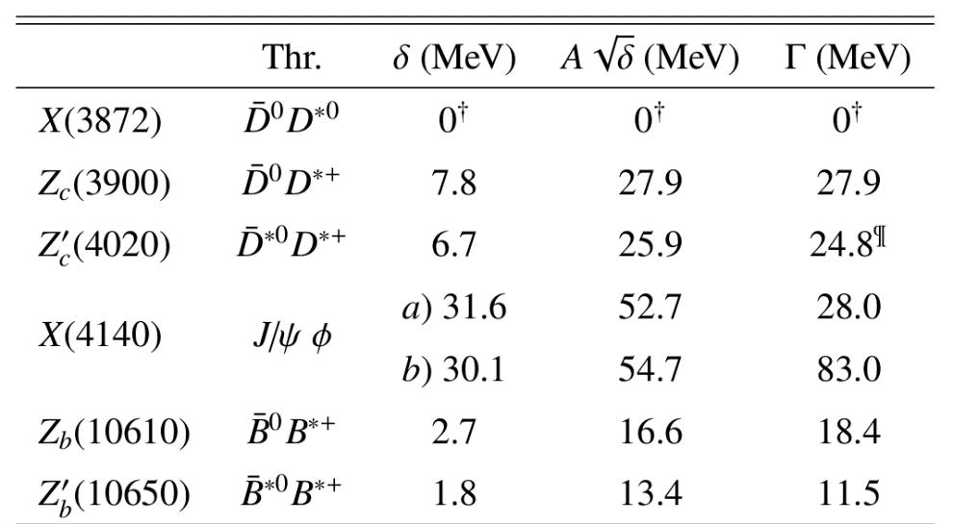
Taking thresholds into account
Esposito, AP, Polosa, PLB758, 292
$V_{Q}$ (tetraquark)
Let $P$ and $Q$ be orthogonal subspaces of the Hilbert space
$H=H_{PP}+H_{QQ}$
We have the (weak) scattering length $a_{P}$ in the open channel.
We add an off-diagonal $H_{QP}$ which connects the two subspaces
$V_{P}$ (meson-meson)
(Breit-Wigner masses and widths are used)
A. Pilloni – Predictive power of different theory approaches
Notes:
2 slides su Zc, a Bes e a Belle
2 slide su tetraquark model: dall’hamiltoniana di Jaffe al calcolo delle masse
1 slide su molecular models, dove sono i carichi? (non in Tornqvist, si in Hanhart, vedere Braaten, citare Nefediev)
2 slides su decay channels, dove si dovrebbe vedere, e a seconda del modello, vedere qualche plot
1 slide su Y(4260), tetraquark? C’è lo strano (si vede la f0)
1 slide su Zc a cleo (anche il neutro)

Slide 17
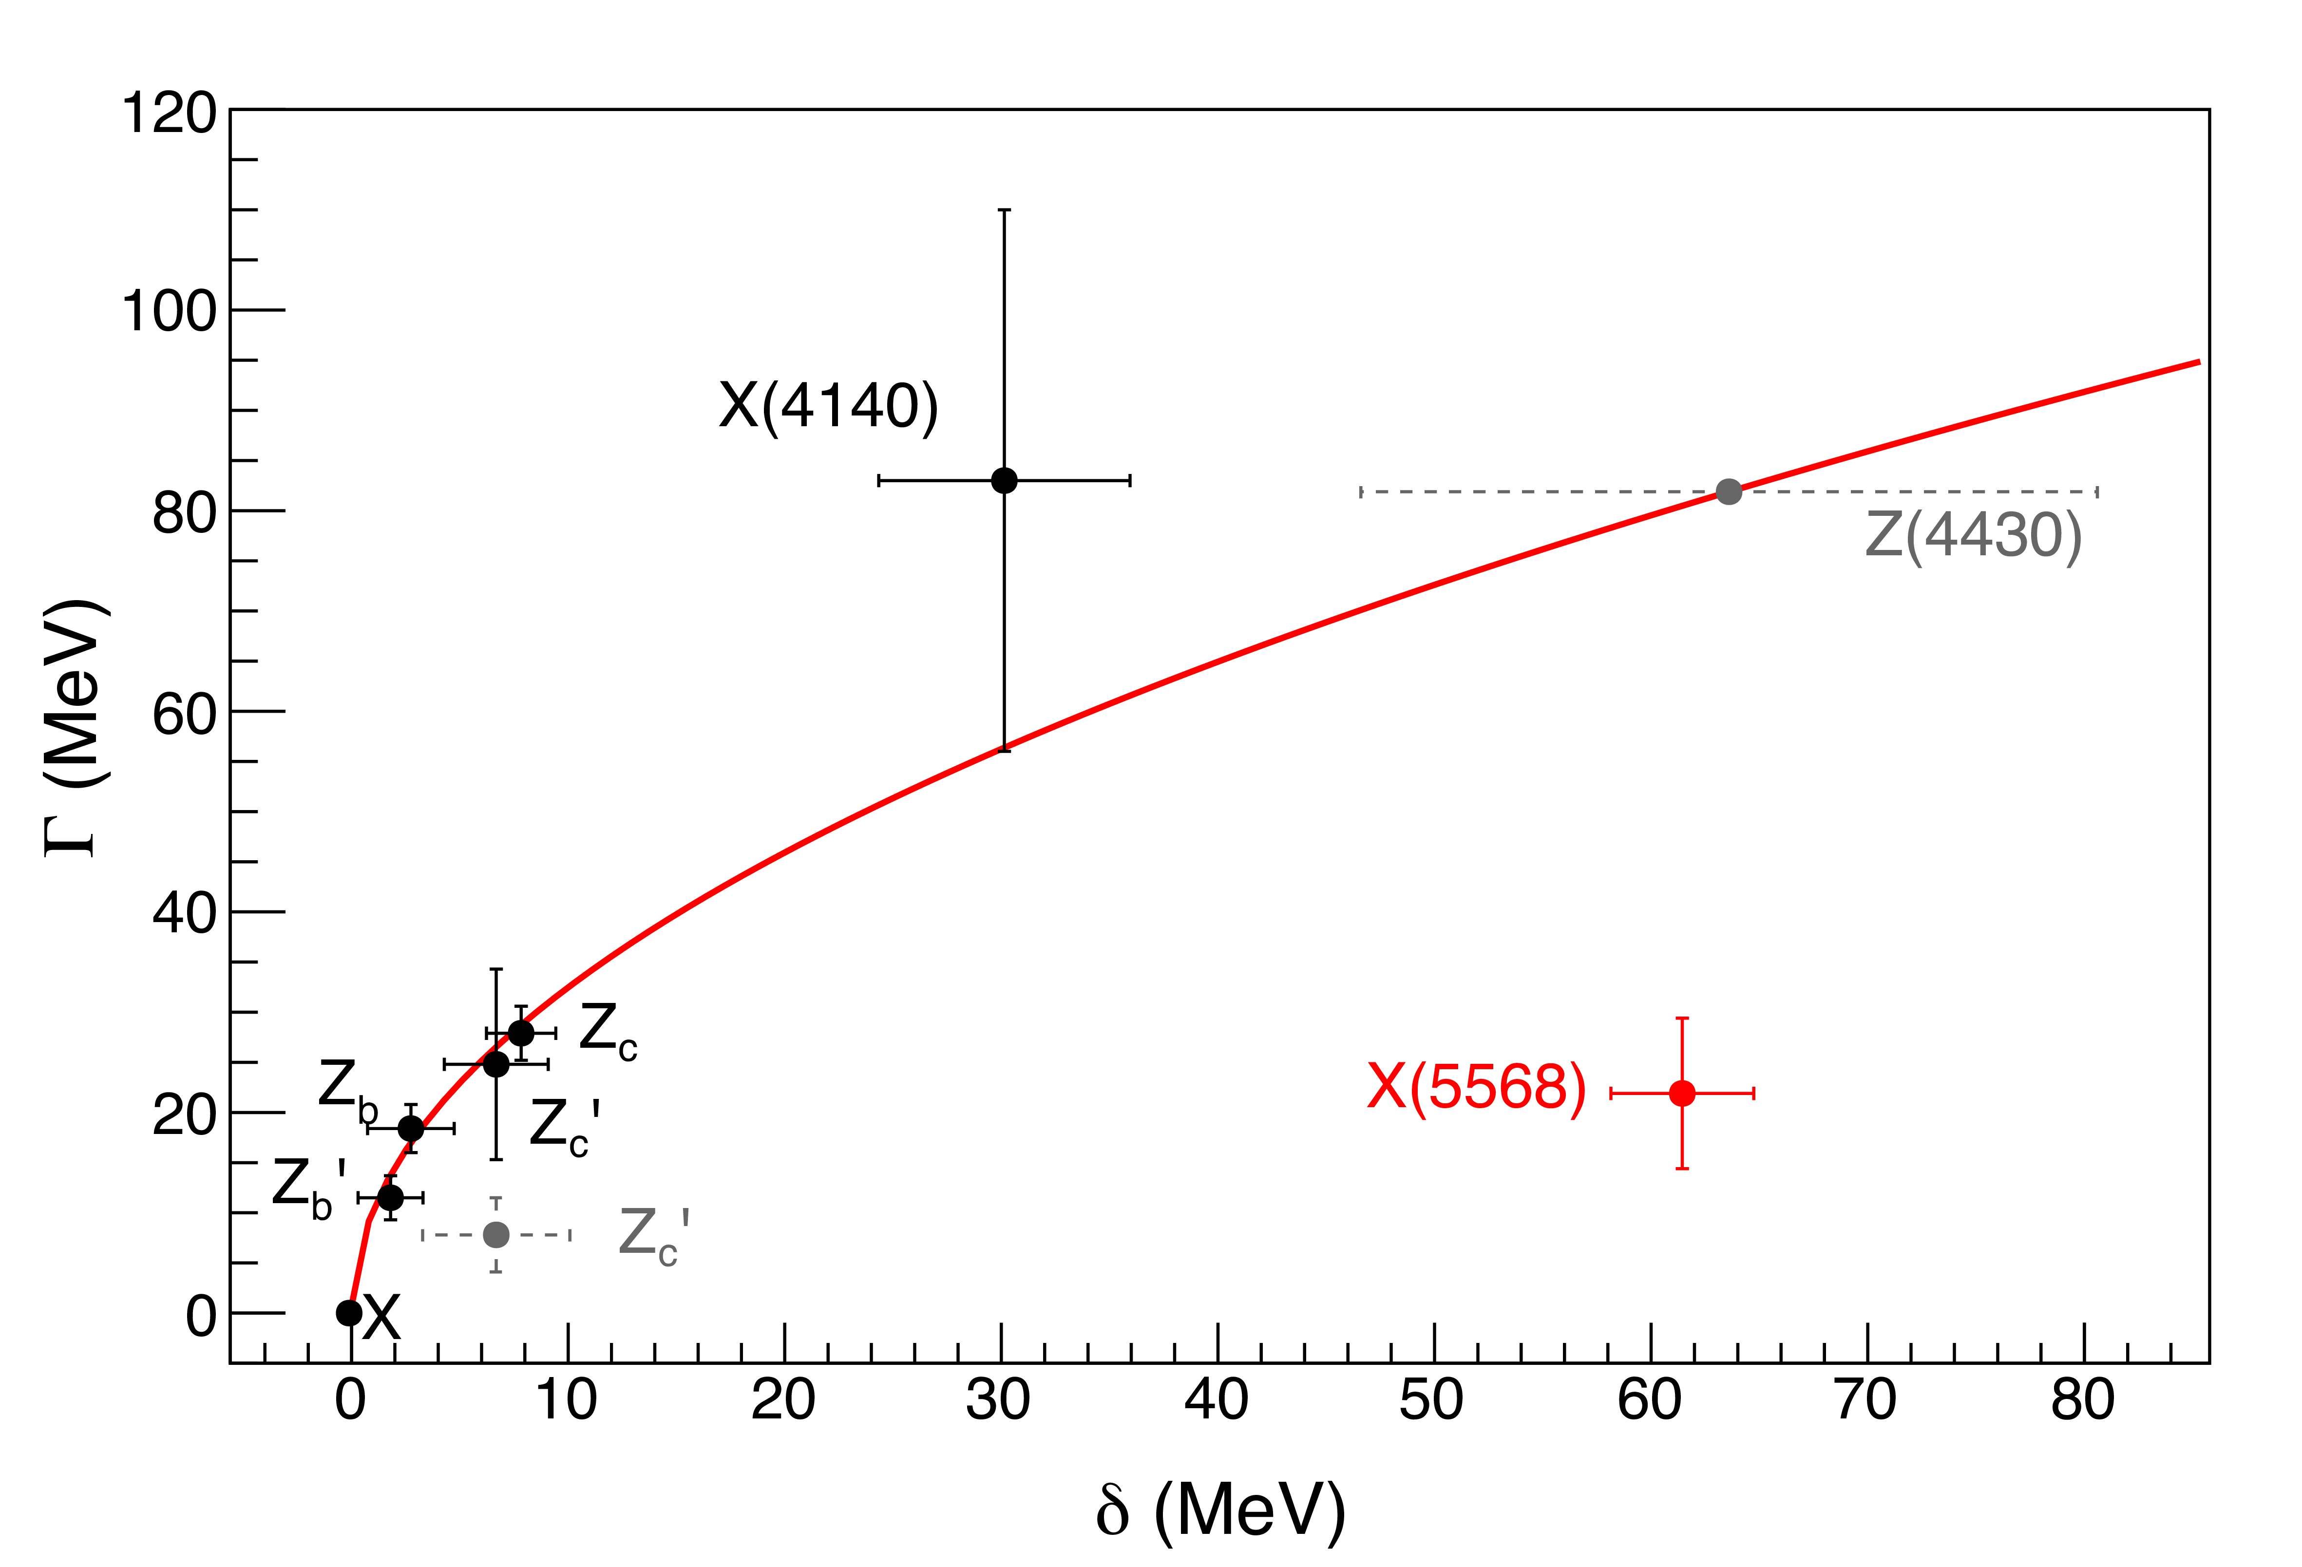
Taking thresholds into account
Esposito, AP, Polosa, PLB758, 292
$$Γ=−16π^{3} ρ ℑ\left(T\right)∼16π^{4} ρ {\left|H_{PQ}\right|}^{2}δ\left(\frac{p_{1}^{2}}{2M}+\frac{p_{2}^{2}}{2M}−δ\right)$$
$$Γ∼A\sqrt{δ}$$
We therefore expect to see a level if:
$δ>0$ the state lies above threshold
$δ<\frac{{\overline{p}}^{2}}{2M}$, only the closest threshold contributes
The states $ψ_{Q}$ and $ψ_{P}$ are orthogonal
Very good agreement
Not included in the model
Unconfirmed
All the resonances can be fitted with
$$A=\left(10.3±1.3\right) {\text{MeV}}^{1/2}$$
$$χ^{2}/\text{DOF}=1.2/5$$
A. Pilloni – Predictive power of different theory approaches
Notes:
2 slides su Zc, a Bes e a Belle
2 slide su tetraquark model: dall’hamiltoniana di Jaffe al calcolo delle masse
1 slide su molecular models, dove sono i carichi? (non in Tornqvist, si in Hanhart, vedere Braaten, citare Nefediev)
2 slides su decay channels, dove si dovrebbe vedere, e a seconda del modello, vedere qualche plot
1 slide su Y(4260), tetraquark? C’è lo strano (si vede la f0)
1 slide su Zc a cleo (anche il neutro)

Slide 18
Repulsion between diquarks
Solution: at small separations the inter-diquark potential is repulsive
Selem, Wilczek, hep-ph/0602128 Esposito, Polosa, EPJC 78, 9, 782 Maiani, Polosa, Riquer PLB 778, 247
In absence of a repulsive barrier, the tetraquark would just decay in a pair of mesons, the barrier making it metastable
Diquarks are separated → spin-spin interactions outside the diquarks are suppressed
At short distances the barrier is dominant → the Coulomb part plays little role
Harder to tunnel a heavy quark → decay into open flavor more likely than into quarkonia
$$[Qq]$$
$$[\overline{Q}\overline{q}]$$
1 fm
Origin of the barrier from the repulsion of ${\left(Q\overline{Q}\right)}_{8}$, discussed in Maiani, Polosa, Riquer, PRD 100, 014002
A. Pilloni – Predictive power of different theory approaches
Notes:
2 slides su Zc, a Bes e a Belle
2 slide su tetraquark model: dall’hamiltoniana di Jaffe al calcolo delle masse
1 slide su molecular models, dove sono i carichi? (non in Tornqvist, si in Hanhart, vedere Braaten, citare Nefediev)
2 slides su decay channels, dove si dovrebbe vedere, e a seconda del modello, vedere qualche plot
1 slide su Y(4260), tetraquark? C’è lo strano (si vede la f0)
1 slide su Zc a cleo (anche il neutro)

Slide 19
Repulsion between diquarks
(Slide by A. Esposito)
A. Pilloni – Predictive power of different theory approaches
Notes:
2 slides su Zc, a Bes e a Belle
2 slide su tetraquark model: dall’hamiltoniana di Jaffe al calcolo delle masse
1 slide su molecular models, dove sono i carichi? (non in Tornqvist, si in Hanhart, vedere Braaten, citare Nefediev)
2 slides su decay channels, dove si dovrebbe vedere, e a seconda del modello, vedere qualche plot
1 slide su Y(4260), tetraquark? C’è lo strano (si vede la f0)
1 slide su Zc a cleo (anche il neutro)

Slide 20
Tetraquark decay
(Slide by A. Esposito)
A. Pilloni – Predictive power of different theory approaches
Notes:
2 slides su Zc, a Bes e a Belle
2 slide su tetraquark model: dall’hamiltoniana di Jaffe al calcolo delle masse
1 slide su molecular models, dove sono i carichi? (non in Tornqvist, si in Hanhart, vedere Braaten, citare Nefediev)
2 slides su decay channels, dove si dovrebbe vedere, e a seconda del modello, vedere qualche plot
1 slide su Y(4260), tetraquark? C’è lo strano (si vede la f0)
1 slide su Zc a cleo (anche il neutro)

Slide 21
Tetraquark decay
If $δ≪m_{1},m_{2}$, the decay rate is given by
With a dynamical model one provides an expression for $A$ All parameters in A are already, the only new one being $R$
One can get the same value $A≃10 {\text{MeV}}^{1/2}$ for both charm and bottom, by choosing
$R_{c}≃1.3 \text{fm}$, $R_{b}≃1 \text{fm}$,
The repulsive barrier makes the tetraquark slightly larger than a standard hadron, with the bottom tetraquarks more compact than the charm ones
A. Pilloni – Predictive power of different theory approaches
Notes:
2 slides su Zc, a Bes e a Belle
2 slide su tetraquark model: dall’hamiltoniana di Jaffe al calcolo delle masse
1 slide su molecular models, dove sono i carichi? (non in Tornqvist, si in Hanhart, vedere Braaten, citare Nefediev)
2 slides su decay channels, dove si dovrebbe vedere, e a seconda del modello, vedere qualche plot
1 slide su Y(4260), tetraquark? C’è lo strano (si vede la f0)
1 slide su Zc a cleo (anche il neutro)

Slide 22
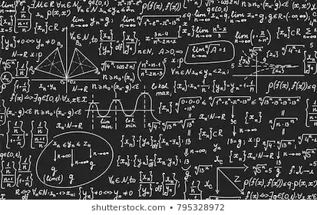
Bottom-up approach
Less predictive power ✗
Some physical interpretation ✗ Minimally biased ✓
You extract physics
You choose a set of generic amplitudes
You start with data
A. Pilloni – Predictive power of different theory approaches

Slide 23
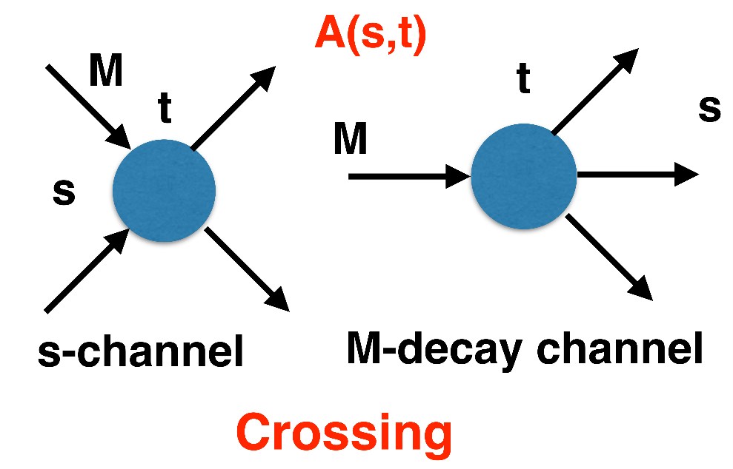
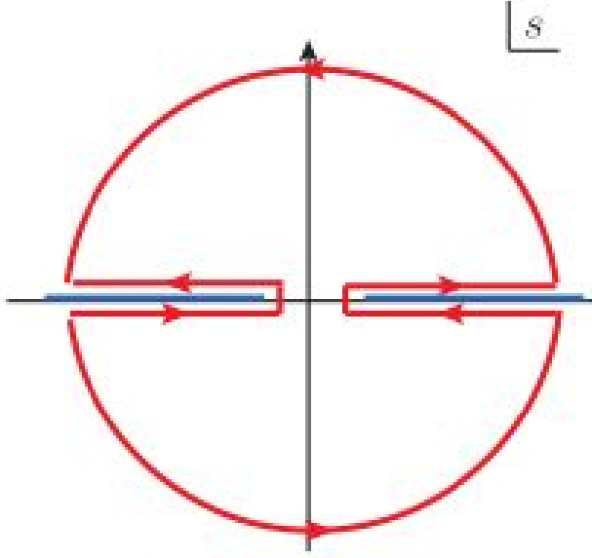
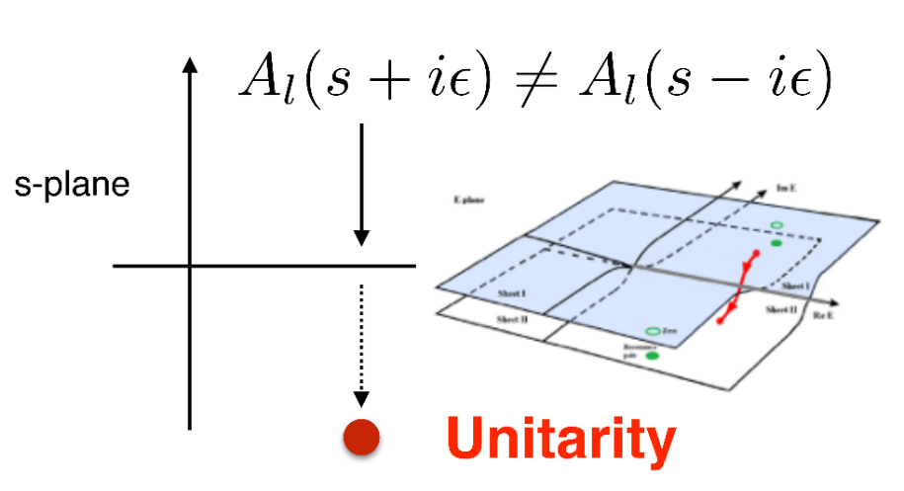
$S$-Matrix principles
$$t_{l}\left(s\right)=\lim_{ε→0}t_{l}(s+iε)⁡$$
Analyticity
$$\text{Im} t_{l}=ρ_{l}{\left|t_{l}\right|}^{2} ⁡$$
These are constraints the amplitudes have to satisfy, but do not fix the dynamics
They can be imposed with an increasing amount of rigor, to extract robust physics information
The «background» phenomena can be effectively parameterized in a controlled way
+ Lorentz, discrete & global symmetries
A. Pilloni – Predictive power of different theory approaches
Notes:
Controlla la parte su Regge

Slide 24
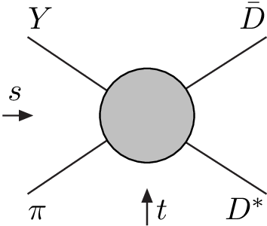
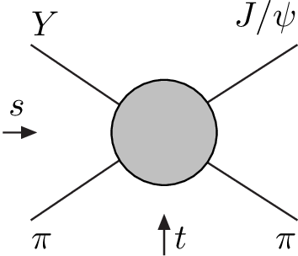
Amplitude analysis for $Z_{c}(3900)$
One can test different parametrizations of the amplitude, which correspond to different singularities → different natures
AP et al. (JPAC), PLB772, 200
Triangle rescattering, logarithmic branching point
(anti)bound state, II/IV sheet pole
(«molecule»)
Resonance, III sheet pole
(«compact state»)
$$π$$
$$D_{1}$$
$$Y$$
$$D^{∗}$$
$$π$$
$$\overline{D}$$
$$J/ψ$$
Szczepaniak, PLB747, 410-416
Szczepaniak, PLB757, 61-64
Guo et al. PRD92, 071502
Tornqvist, Z.Phys. C61, 525
Swanson, Phys.Rept. 429
Hanhart et al. PRL111, 132003
Maiani et al., PRD71, 014028
Faccini et al., PRD87, 111102
Esposito et al., Phys.Rept. 668
A. Pilloni – Predictive power of different theory approaches
Notes:
Controlla la parte su Regge

Slide 25
Amplitude model
$$Z_{c}\left(3900\right)?$$
$${u: D}_{0}(2400)$$
$${u:Z}_{c}\left(3900\right)?$$
$$"σ, f_{0}(980)"$$
$$D_{1}(2420)$$
Khuri-Treiman
A. Pilloni – Predictive power of different theory approaches

Slide 26
Triangle singularity
$$π$$
$$D_{1}$$
$$Y(4260)$$
$$D^{∗}$$
$$π$$
$$\overline{D}$$
$$J/ψ$$
Logarithmic branch points due to exchanges in the cross channels can simulate a resonant behavior, only in very special kinematical conditions (Coleman and Norton, Nuovo Cim. 38, 438),
However, this effects cancels in Dalitz projections, no peaks (Schmid, Phys.Rev. 154, 1363)
Szczepaniak, PLB747, 410-416
Szczepaniak, PLB757, 61-64
Guo, Meissner, Wang, Yang PRD92, 071502
...but the cancellation can be spread in different channels, you might still see peaks in other channels only!
A. Pilloni – Predictive power of different theory approaches

Slide 27
Testing scenarios
We approximate all the particles to be scalar – this affects the value of couplings, which are not normalized anyway – but not the position of singularities. This also limits the number of free parameters
The scattering matrix is parametrized as ${\left(t^{−1}\right)}_{ij}=K_{ij}−i ρ_{i} δ_{ij}$
Four different scenarios considered:
«III»: the K matrix is $\frac{g_{i} g_{j}}{M^{2}−s}$, this generates a pole in the closest unphysical sheet the rescattering integral is set to zero
«III+tr.»: same, but with the correct value of the rescattering integral
«IV+tr.»: the K matrix is constant, this generates a pole in the IV sheet
«tr.»: same, but the pole is pushed far away by adding a penalty in the $χ^{2}$
A. Pilloni – Predictive power of different theory approaches

Slide 28
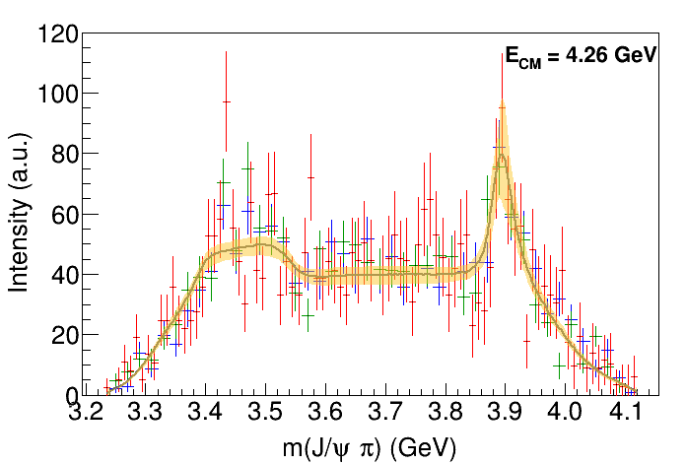
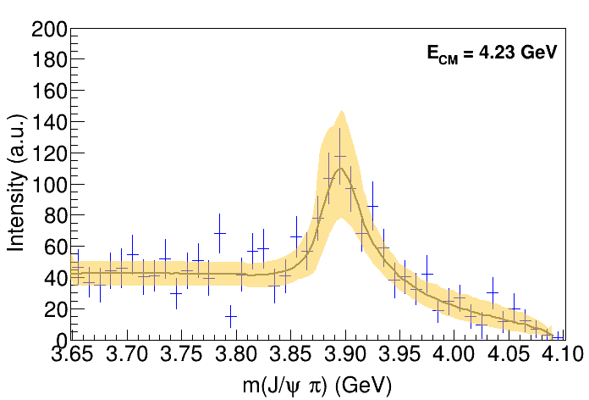
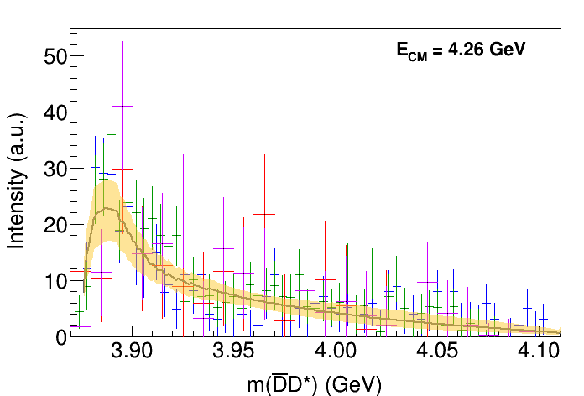
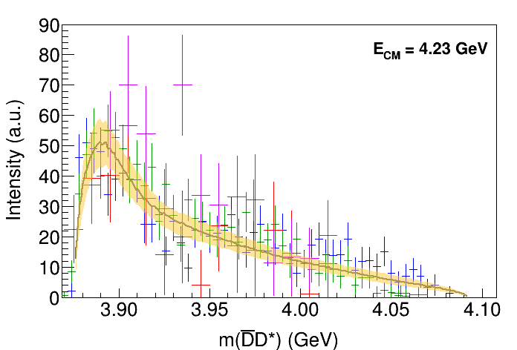
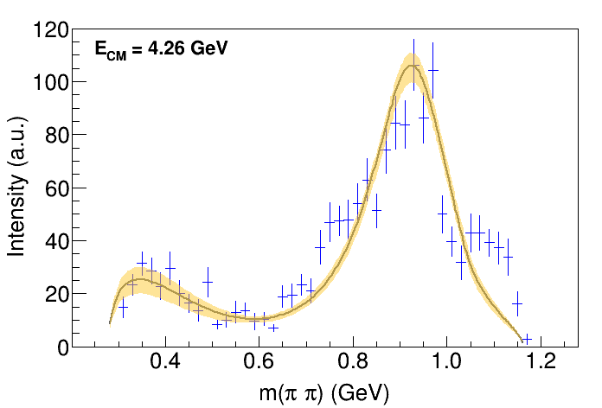
Fit: III
A. Pilloni – Predictive power of different theory approaches
Notes:
Controlla la parte su Regge

Slide 29
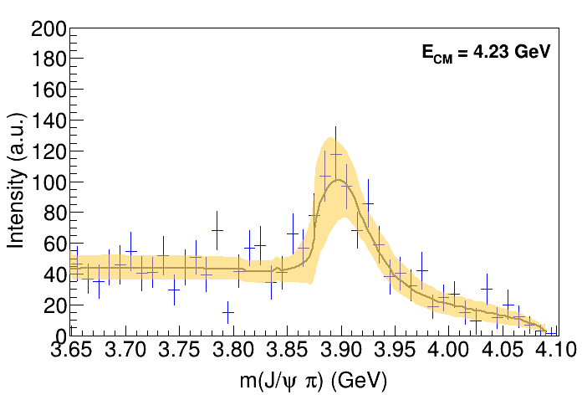
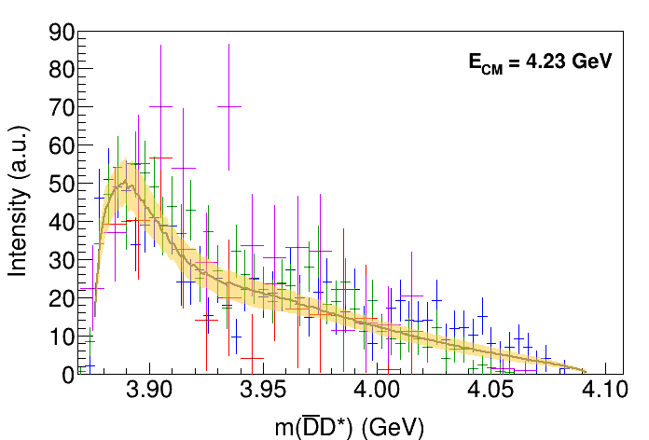
Fit: III+tr.
A. Pilloni – Predictive power of different theory approaches
Notes:
Controlla la parte su Regge

Slide 30
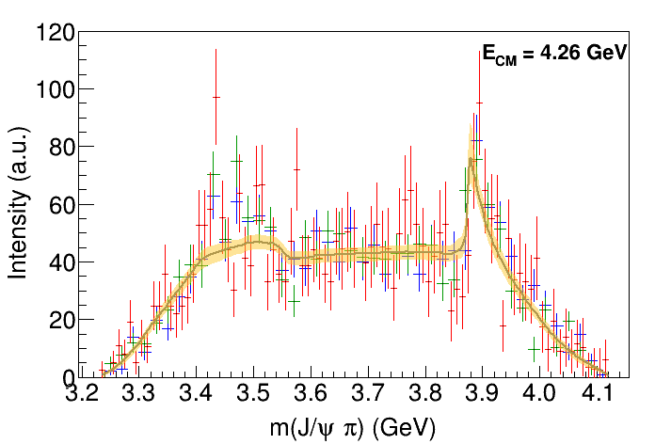
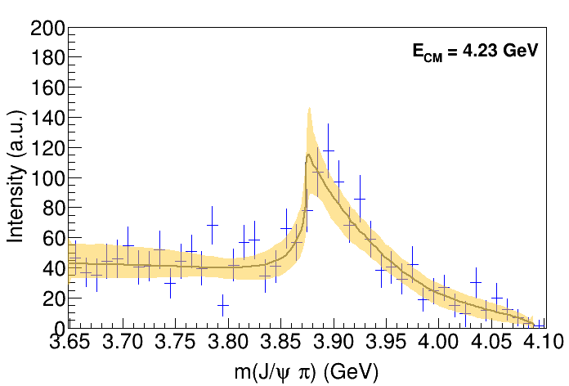
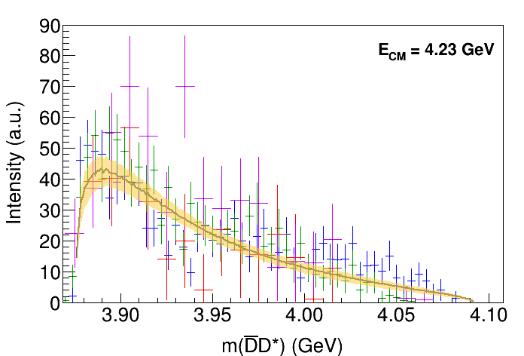
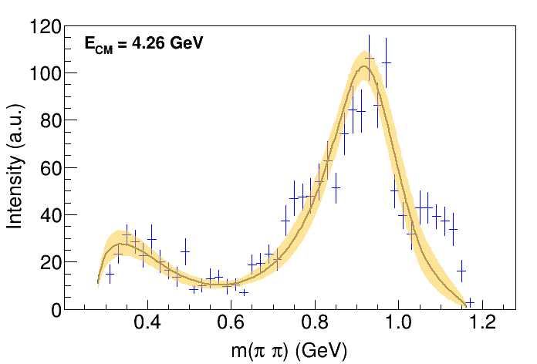
Fit: IV+tr.
A. Pilloni – Predictive power of different theory approaches
Notes:
Controlla la parte su Regge

Slide 31
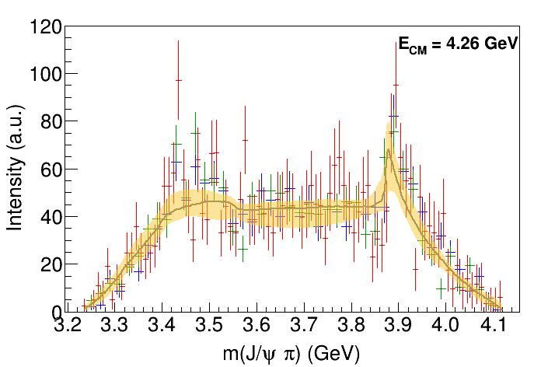
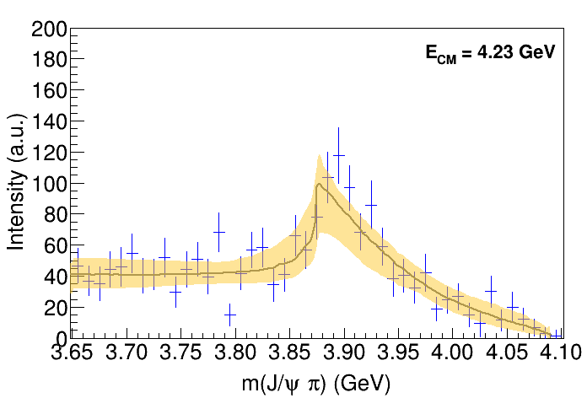
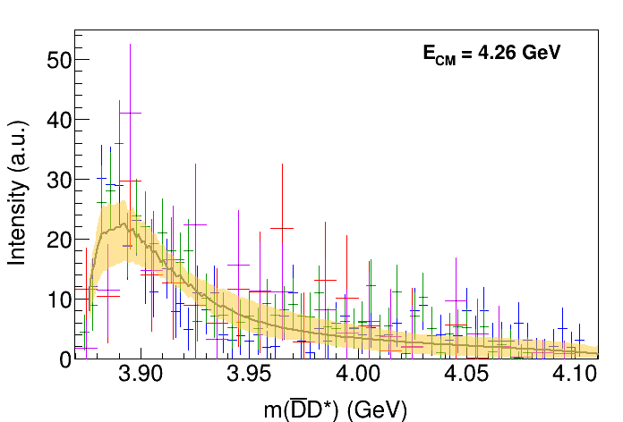
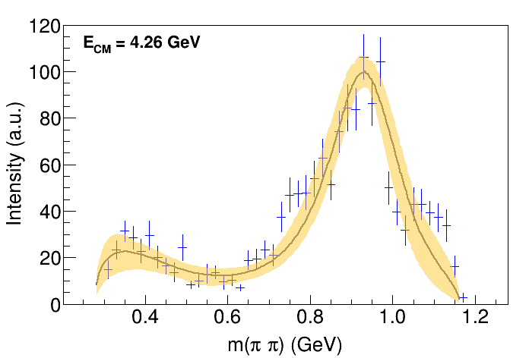
Fit: tr.
A. Pilloni – Predictive power of different theory approaches
Notes:
Controlla la parte su Regge

Slide 32
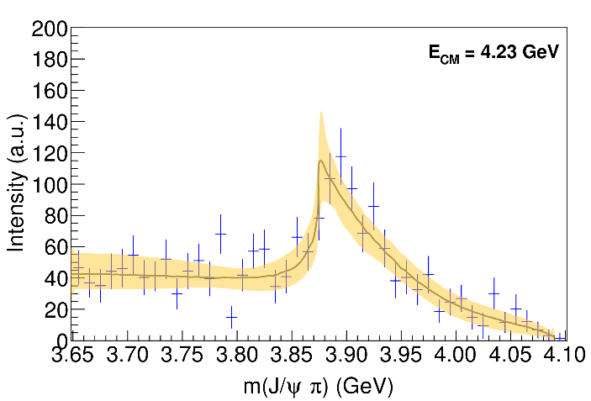
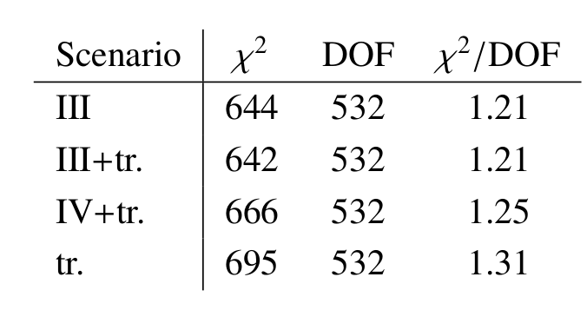
Fit summary
III
IV+tr.
III+tr.
tr.
Naive loglikelihood ratio test give a $∼4σ$ significance of the scenario III+tr. over IV+tr., looking at plots it looks too much – better using some more solid test
A. Pilloni – Predictive power of different theory approaches
Notes:
Controlla la parte su Regge

Slide 33
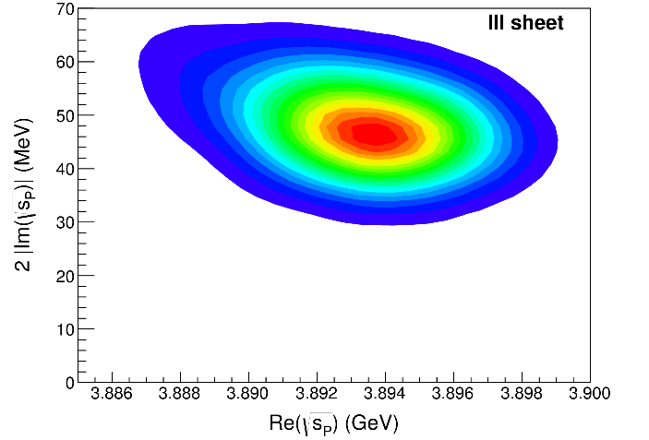
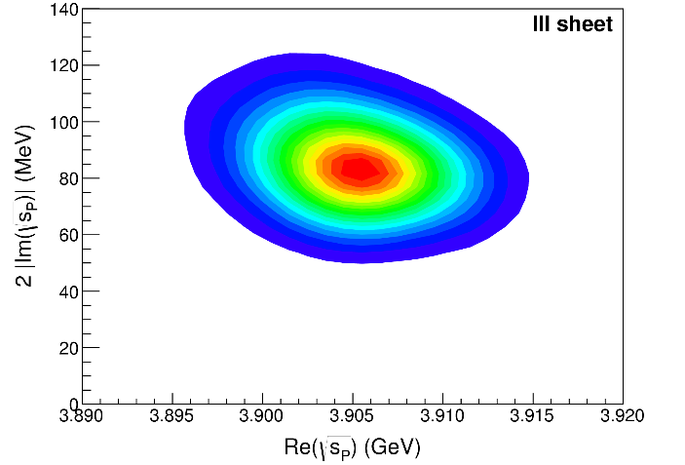
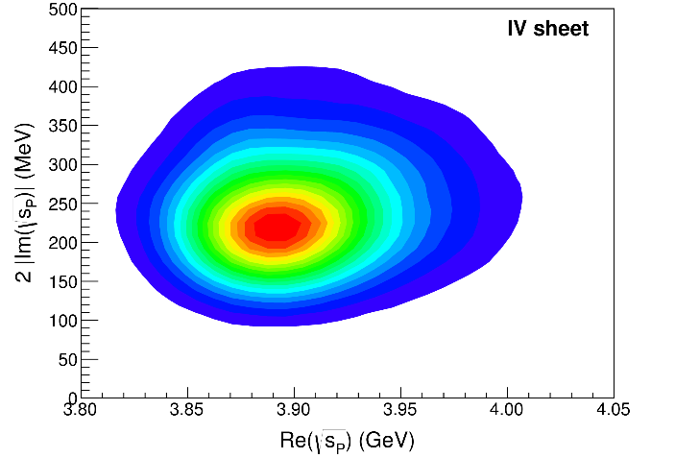
Pole extraction
III
III+tr.
IV+tr.
A. Pilloni – Predictive power of different theory approaches
Not conclusive at this stage
Notes:
Controlla la parte su Regge

Slide 34
New pentaquarks discovered
LHCb, PRL 122, 222001
A higher statistics 1D analysis is able to resolve the fine structure of the $P_{c}(4450)$ peak.
Moreover, a new isolated $P_{c}(4312)$ at the $Σ_{c}^{+}{\overline{D}}^{0}$ threshold appears
The old assignment of quantum numbers might be jeopardized by this new finding
A. Pilloni – Predictive power of different theory approaches
Notes:
Controlla la parte su Regge

Slide 35
Bound and virtual states
Decreasing the potential strength, the pole reaches threshold
The pole jumps on the 2nd sheet (dineutron), it becomes a virtual state
Example from $pn$ scattering Bound state on the real axis 1st sheet (deuteron)
$$V(r)$$
$$\text{Im} E$$
$$r$$
$$V$$
Deuteron
$$\text{Re} E$$
$${}_{}^{1}S$$
Deuteron pole
Dineutron pole
$${}_{}^{3}S$$
A. Pilloni – Predictive power of different theory approaches
Notes:
Controlla la parte su Regge

Slide 36
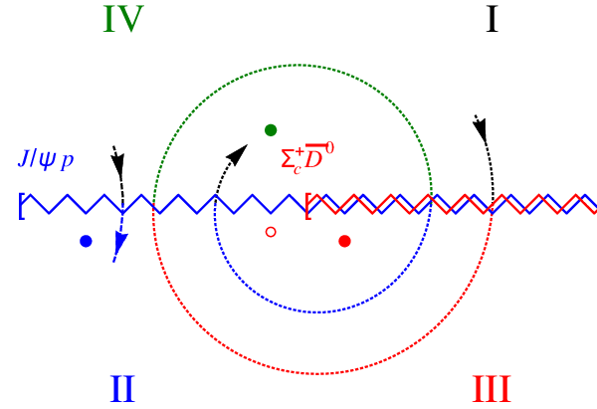
Bound and virtual states
The situation is more complicated when more channels are open
Virtual state
Bound state
Resonance
A. Pilloni – Predictive power of different theory approaches
Notes:
Controlla la parte su Regge

Slide 37
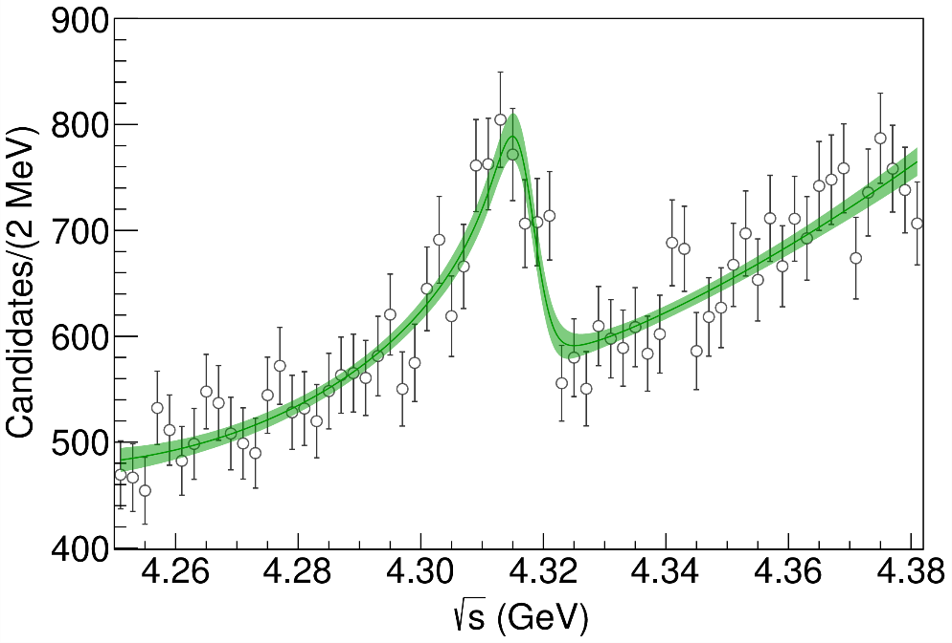
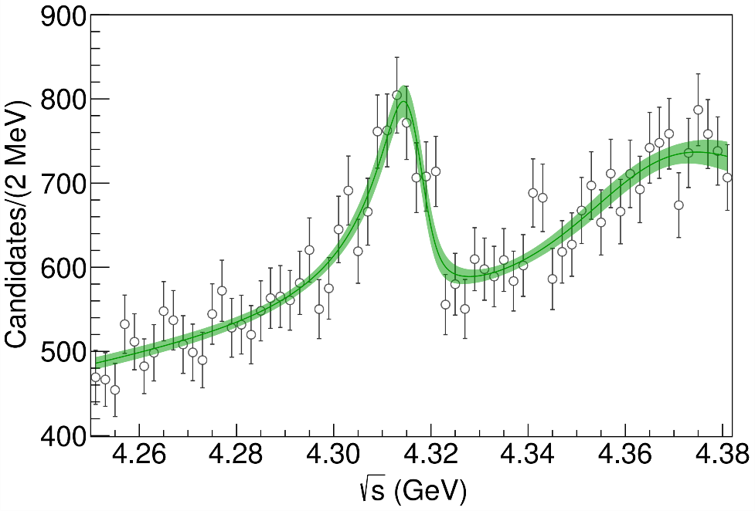
Minimal(istic) model
( data)
Fernandez-Ramirez, AP et al. (JPAC), PRL 123, 092001
Effective range expansion We can set $c_{ii}=0$ to reduce to the scattering length approximation
$$c_{ii}=0$$
Finite $c_{ii}$
A. Pilloni – Predictive power of different theory approaches
Notes:
2 slides su Zc, a Bes e a Belle
2 slide su tetraquark model: dall’hamiltoniana di Jaffe al calcolo delle masse
1 slide su molecular models, dove sono i carichi? (non in Tornqvist, si in Hanhart, vedere Braaten, citare Nefediev)
2 slides su decay channels, dove si dovrebbe vedere, e a seconda del modello, vedere qualche plot
1 slide su Y(4260), tetraquark? C’è lo strano (si vede la f0)
1 slide su Zc a cleo (anche il neutro)

Slide 38
Minimal(istic) model
Effective range expansion We can set $c_{ii}=0$ to reduce to the scattering length approximation
$$c_{ii}=0$$
Finite $c_{ii}$
A. Pilloni – Predictive power of different theory approaches
Notes:
2 slides su Zc, a Bes e a Belle
2 slide su tetraquark model: dall’hamiltoniana di Jaffe al calcolo delle masse
1 slide su molecular models, dove sono i carichi? (non in Tornqvist, si in Hanhart, vedere Braaten, citare Nefediev)
2 slides su decay channels, dove si dovrebbe vedere, e a seconda del modello, vedere qualche plot
1 slide su Y(4260), tetraquark? C’è lo strano (si vede la f0)
1 slide su Zc a cleo (anche il neutro)

Slide 39
Minimal(istic) model
Effective range expansion We can set $c_{ii}=0$ to reduce to the scattering length approximation
Points to a virtual state
$$c_{ii}=0$$
Finite $c_{ii}$
A. Pilloni – Predictive power of different theory approaches
Notes:
2 slides su Zc, a Bes e a Belle
2 slide su tetraquark model: dall’hamiltoniana di Jaffe al calcolo delle masse
1 slide su molecular models, dove sono i carichi? (non in Tornqvist, si in Hanhart, vedere Braaten, citare Nefediev)
2 slides su decay channels, dove si dovrebbe vedere, e a seconda del modello, vedere qualche plot
1 slide su Y(4260), tetraquark? C’è lo strano (si vede la f0)
1 slide su Zc a cleo (anche il neutro)

Slide 40
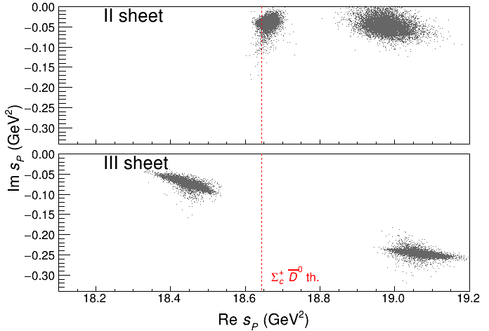
Minimal(istic) model
Effective range expansion We can set $c_{ii}=0$ to reduce to the scattering length approximation
Points to a virtual state
Doesn’t point to a resonance
$$c_{ii}=0$$
Finite $c_{ii}$
A. Pilloni – Predictive power of different theory approaches
Notes:
2 slides su Zc, a Bes e a Belle
2 slide su tetraquark model: dall’hamiltoniana di Jaffe al calcolo delle masse
1 slide su molecular models, dove sono i carichi? (non in Tornqvist, si in Hanhart, vedere Braaten, citare Nefediev)
2 slides su decay channels, dove si dovrebbe vedere, e a seconda del modello, vedere qualche plot
1 slide su Y(4260), tetraquark? C’è lo strano (si vede la f0)
1 slide su Zc a cleo (anche il neutro)

Slide 41
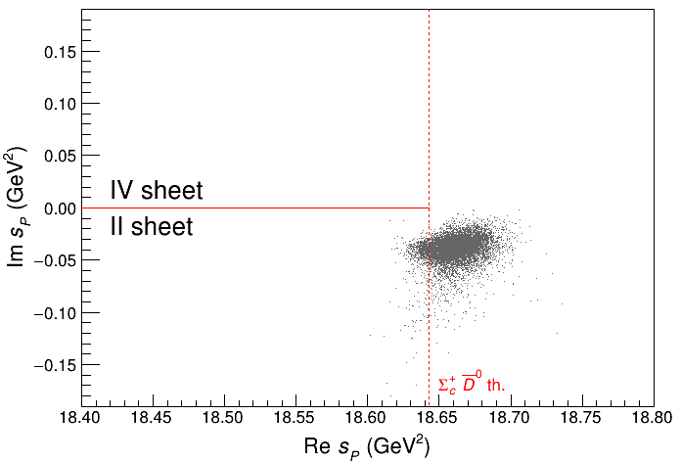
Minimal(istic) model
Effective range expansion We can set $c_{ii}=0$ to reduce to the scattering length approximation
Points to a virtual state
Doesn’t point to a resonance
$$c_{ii}=0$$
Finite $c_{ii}$
A. Pilloni – Predictive power of different theory approaches
Notes:
2 slides su Zc, a Bes e a Belle
2 slide su tetraquark model: dall’hamiltoniana di Jaffe al calcolo delle masse
1 slide su molecular models, dove sono i carichi? (non in Tornqvist, si in Hanhart, vedere Braaten, citare Nefediev)
2 slides su decay channels, dove si dovrebbe vedere, e a seconda del modello, vedere qualche plot
1 slide su Y(4260), tetraquark? C’è lo strano (si vede la f0)
1 slide su Zc a cleo (anche il neutro)

Slide 42
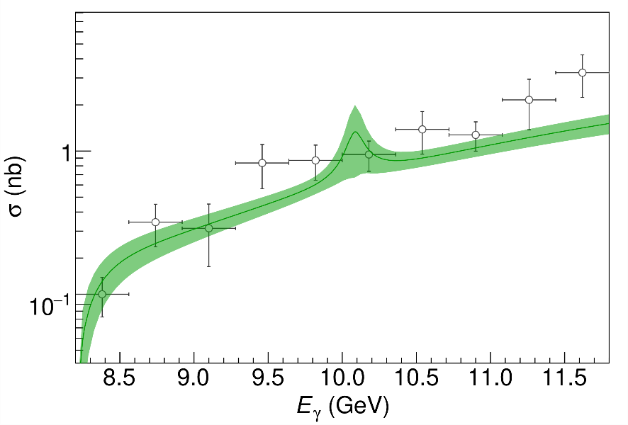
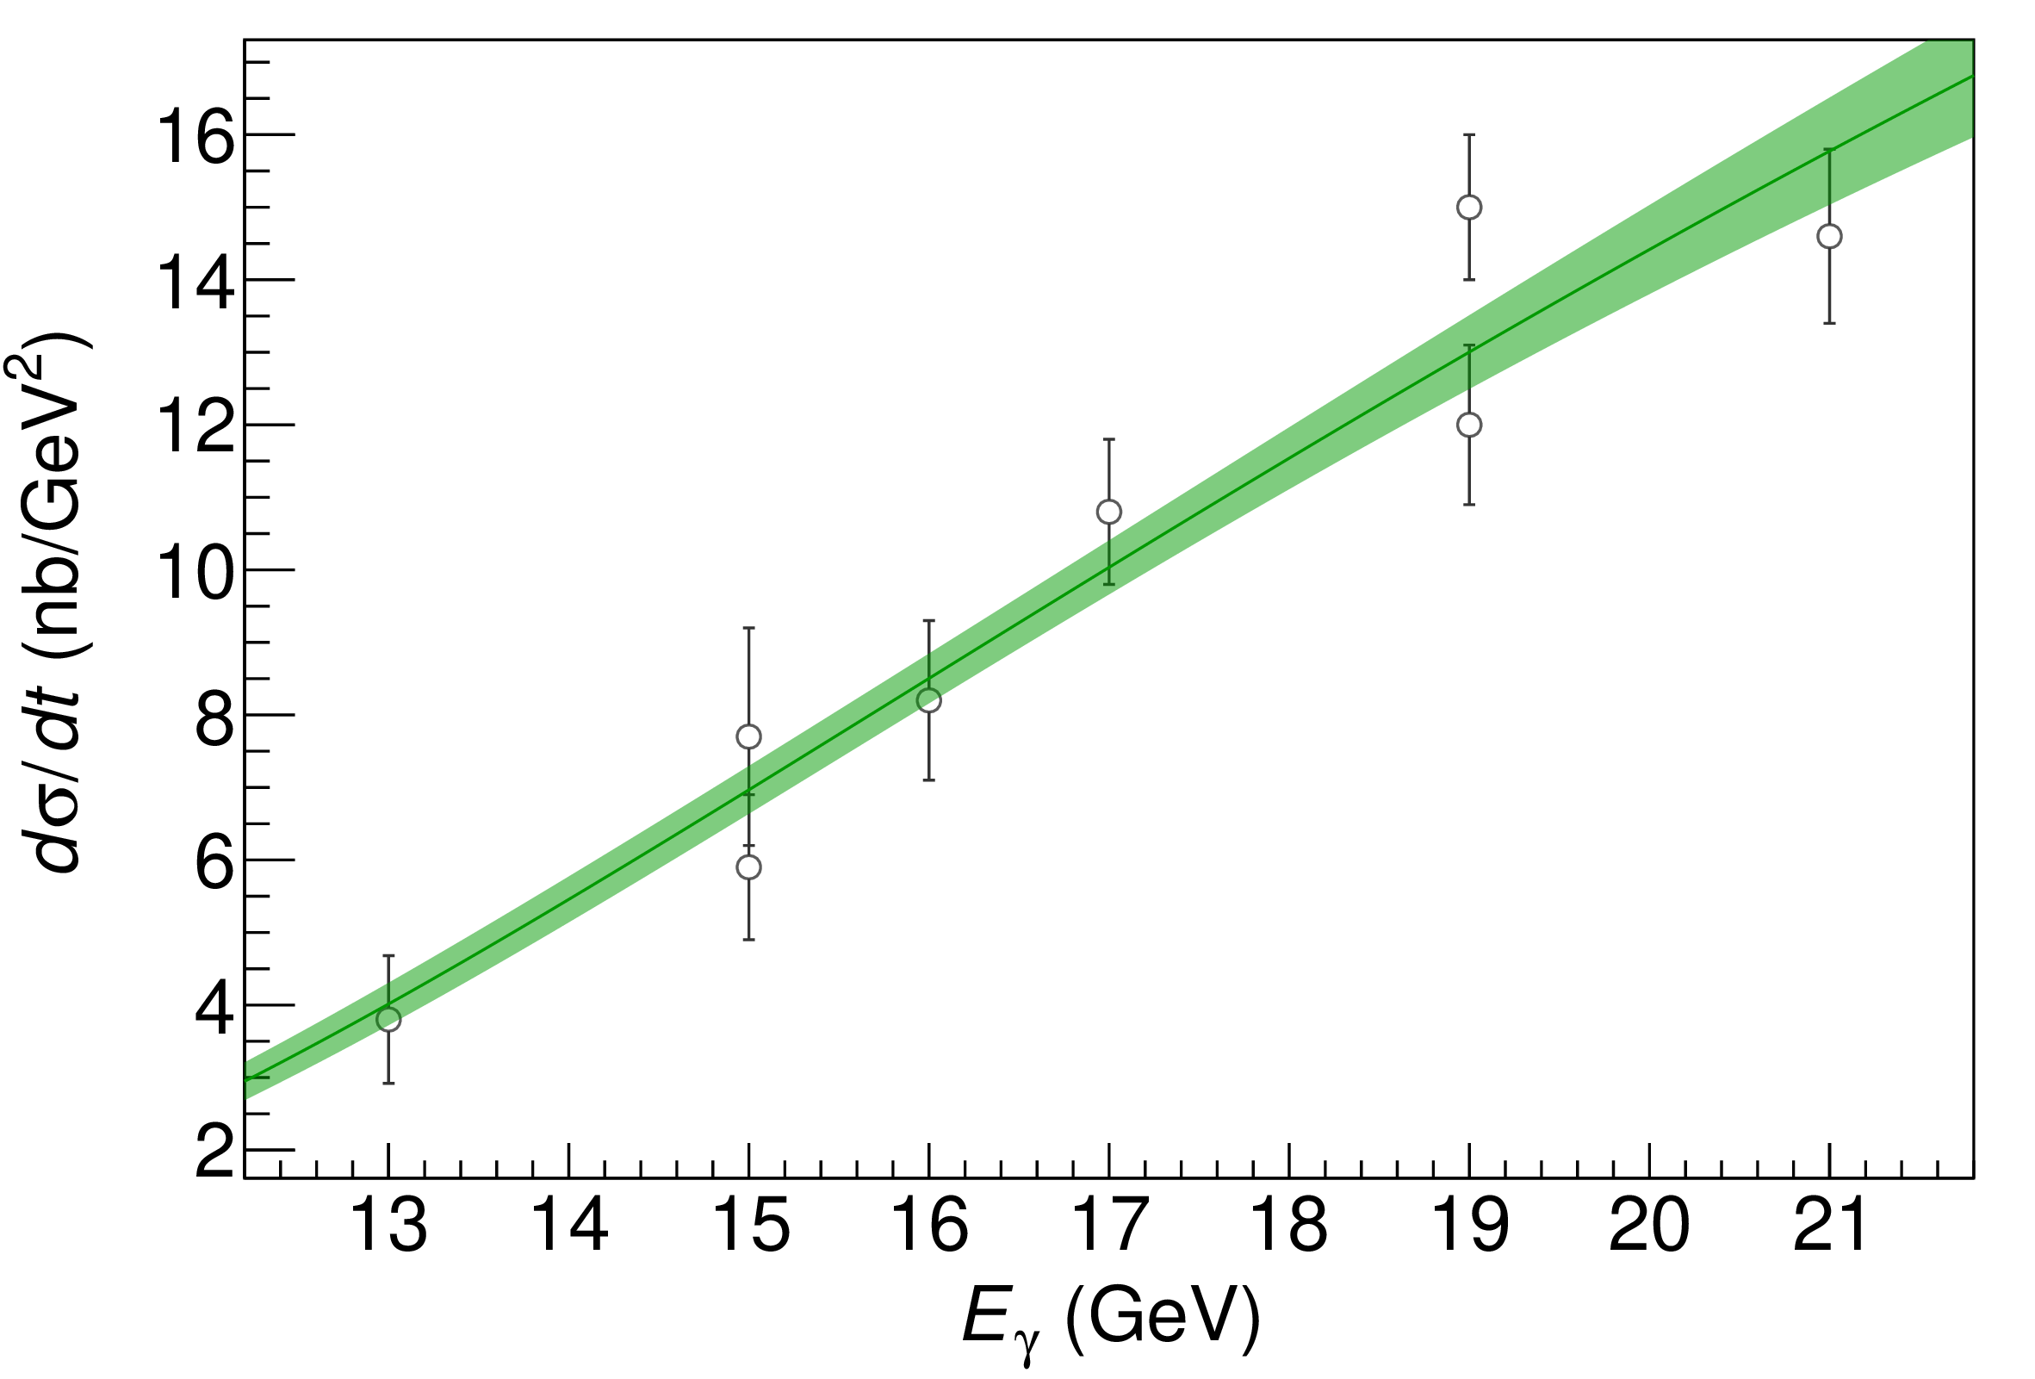
$P_{c}$ photoproduction
Karliner & Rosner, PLB752, 329
Hiller Blin, AP et al. (JPAC), PRD94, 034002
D. Winney, C. Fanelli, AP et al. (JPAC) PRD100, 034019
The background is described via an Effective Vector Pomeron
Vector meson dominance relates radiative width to hadronic one
Fit the model to GlueX and SLAC data, upper limit $BR_{J/ψp}<4.3\%$ for $J^{P}={\frac{3}{2}}^{−}$
A. Pilloni – Predictive power of different theory approaches
Notes:
Controlla la parte su Regge

Slide 43
Polarization observables
One can take advantage of the polarized beam at Jlab Need polarized target ($A_{LL}$) or polarization of recoiling proton ($K_{LL}$)
$$K_{LL}$$
(in SBS acceptance)
A. Pilloni – Heavy quark Spectroscopy
Notes:
Controlla la parte su Regge

Slide 44
Conclusions & prospects
The study of heavy-heavy quark sector is a challenging task
Experiments are very prolific! Constant feedback on predictions
Study of spectra and decay patterns will improve our understanding, new data expected by, BESIII, LHCb, Belle II
Complementary models are useful to describe the XYZ sector
A more refined study of amplitudes provides a complimentary tool to give insights on the nature of some of the states
Thank you
A. Pilloni – Predictive power of different theory approaches
Notes:
2 slides su Zc, a Bes e a Belle
2 slide su tetraquark model: dall’hamiltoniana di Jaffe al calcolo delle masse
1 slide su molecular models, dove sono i carichi? (non in Tornqvist, si in Hanhart, vedere Braaten, citare Nefediev)
2 slides su decay channels, dove si dovrebbe vedere, e a seconda del modello, vedere qualche plot
1 slide su Y(4260), tetraquark? C’è lo strano (si vede la f0)
1 slide su Zc a cleo (anche il neutro)

Slide 45
INT Program : «Accessing and Understanding the QCD spectrum» August 17-September 18, 2020
Briceno [ODU]
Notes:
2 slides su Zc, a Bes e a Belle
2 slide su tetraquark model: dall’hamiltoniana di Jaffe al calcolo delle masse
1 slide su molecular models, dove sono i carichi? (non in Tornqvist, si in Hanhart, vedere Braaten, citare Nefediev)
2 slides su decay channels, dove si dovrebbe vedere, e a seconda del modello, vedere qualche plot
1 slide su Y(4260), tetraquark? C’è lo strano (si vede la f0)
1 slide su Zc a cleo (anche il neutro)

Slide 46
Backup

Slide 47
Diquarks
Attraction and repulsion in 1-gluon exchange approximation is given by
$$R=\frac{1}{2}\left(C_{2}\left(R_{12}\right)−C_{2}\left(R_{1}\right)−C_{2}\left(R_{2}\right)\right)$$
$$R_{1}=−\frac{4}{3}, R_{8}=+\frac{1}{6}$$
$$R_{3}=−\frac{2}{3}, R_{6}=+\frac{1}{3}$$
$$j$$
$$l$$
$$3_{c}×3_{c}∈{\overline{3}}_{c}$$
$$T_{ij}^{a}$$
$$T_{kl}^{a}$$
$$i$$
$$k$$
The singlet $1_{c}$ is attractive
H-shape with a 4 quark system
Cardoso, Cardoso, Bicudo, PRD84, 054508
A. Pilloni – Predictive power of different theory approaches

Slide 48
A new look to $X(3872)$
Maiani, Polosa, Riquer PLB 778, 247
Size of the diquark-antidiquark bound state: $R$
Size of the diquark: $r$
There are two possible descriptions of the $X(3872)$
$$X_{u}=\left[cu\right][\overline{c}\overline{u}]$$
$$X_{d}=\left[cd\right][\overline{c}\overline{d}]$$
We introduce the ratio $λ=R/r≥1$
For appropriate values of $λ$, these two states can be quasi-degenerate in mass!
$$M(X_{u})−M(X_{d}) =f(λ)$$
degeneracy occurs for $λ∼3$
A. Pilloni – Predictive power of different theory approaches
Notes:
2 slides su Zc, a Bes e a Belle
2 slide su tetraquark model: dall’hamiltoniana di Jaffe al calcolo delle masse
1 slide su molecular models, dove sono i carichi? (non in Tornqvist, si in Hanhart, vedere Braaten, citare Nefediev)
2 slides su decay channels, dove si dovrebbe vedere, e a seconda del modello, vedere qualche plot
1 slide su Y(4260), tetraquark? C’è lo strano (si vede la f0)
1 slide su Zc a cleo (anche il neutro)

Slide 49
$B→X K$
Maiani, Polosa, Riquer PLB 778, 247
$$B^{0}\left(\overline{b}d\right)→\overline{s}\overline{c}c+\left(u\overline{u} \text{or} d\overline{d}\right)+d$$
The final state kaon can be formed with a $d$ from the sea ($K^{0}$), with a $u$ from the sea ($K^{+}$), or with the spectator $d$ ($K^{0}$). Let’s name the sea amplitude $A_{2}$ and the other $A_{1}$
$$A\left(B^{0}→X_{d}K^{0}\right)∼A_{1}+A_{2}$$
$$A\left(B^{0}→X_{u}K^{0}\right)∼A_{1}$$
$$A\left(B^{0}→X^{−}K^{+}\right)∼A_{2}$$
$$A\left(B^{+}→X_{u}K^{+}\right)∼A_{1}+A_{2}$$
$$A\left(B^{+}→X_{d}K^{+}\right)∼A_{1}$$
$$A\left(B^{+}→X^{+}K^{0}\right)∼A_{2}$$
$2A_{1}+A_{2}=2α$ has $I=0$
$A_{2}=2β$ has $I=1$
$$X_{1}^{0}=X_{u}\cos{φ}+X_{d}\sin{φ}$$
$$X_{2}^{0}={−X}_{u}\sin{φ}+X_{d}\cos{φ}$$
A. Pilloni – Predictive power of different theory approaches
Notes:
2 slides su Zc, a Bes e a Belle
2 slide su tetraquark model: dall’hamiltoniana di Jaffe al calcolo delle masse
1 slide su molecular models, dove sono i carichi? (non in Tornqvist, si in Hanhart, vedere Braaten, citare Nefediev)
2 slides su decay channels, dove si dovrebbe vedere, e a seconda del modello, vedere qualche plot
1 slide su Y(4260), tetraquark? C’è lo strano (si vede la f0)
1 slide su Zc a cleo (anche il neutro)

Slide 50
$B→X K$
Maiani, Polosa, Riquer PLB 778, 247
(Slide by A. Polosa)
It is still possible to find room in the parameter space to comply with the experimental upper limits on $B→X^{−}K^{+}$
A. Pilloni – Predictive power of different theory approaches
Notes:
2 slides su Zc, a Bes e a Belle
2 slide su tetraquark model: dall’hamiltoniana di Jaffe al calcolo delle masse
1 slide su molecular models, dove sono i carichi? (non in Tornqvist, si in Hanhart, vedere Braaten, citare Nefediev)
2 slides su decay channels, dove si dovrebbe vedere, e a seconda del modello, vedere qualche plot
1 slide su Y(4260), tetraquark? C’è lo strano (si vede la f0)
1 slide su Zc a cleo (anche il neutro)

Slide 51
Quarkonium orthodoxy
$$Q$$
$$\overline{Q}$$
Potential models
(meaningful when $M_{Q}→∞$)
$$V\left(r\right)=−\frac{C_{F}α_{s}}{r}+σr$$
(Cornell potential)
$$α_{s}\left(M_{Q}\right)∼0.3$$
(perturbative regime)
OZI-rule, QCD multipole
Solve NR Schrödinger eq. → spectrum
Effective theories
(HQET, NRQCD, pNRQCD...)
Heavy quark spin flip suppressed by quark mass, approximate heavy quark spin symmetry (HQSS)
Integrate out heavy DOF
↓
(spectrum), decay & production rates
A. Pilloni – Predictive power of different theory approaches
Notes:
2 slides su Zc, a Bes e a Belle
2 slide su tetraquark model: dall’hamiltoniana di Jaffe al calcolo delle masse
1 slide su molecular models, dove sono i carichi? (non in Tornqvist, si in Hanhart, vedere Braaten, citare Nefediev)
2 slides su decay channels, dove si dovrebbe vedere, e a seconda del modello, vedere qualche plot
1 slide su Y(4260), tetraquark? C’è lo strano (si vede la f0)
1 slide su Zc a cleo (anche il neutro)

Slide 52
Multiscale system
Systematically integrate out the heavy scale,
$$m_{Q}≫Λ_{QCD}$$
$$m_{Q}≫m_{Q}v≫m_{Q}v^{2}$$
$$m_{b}∼5 \text{GeV}, m_{c}∼1.5 \text{GeV}$$
$$v_{b}^{2}∼0.1, v_{c}^{2}∼0.3$$
Full QCD
NRQCD
pNRQCD
Factorization (to be proved) of universal LDMEs
Good description of many production channels, some known puzzles (polarizations)
A. Pilloni – Predictive power of different theory approaches
Notes:
2 slides su Zc, a Bes e a Belle
2 slide su tetraquark model: dall’hamiltoniana di Jaffe al calcolo delle masse
1 slide su molecular models, dove sono i carichi? (non in Tornqvist, si in Hanhart, vedere Braaten, citare Nefediev)
2 slides su decay channels, dove si dovrebbe vedere, e a seconda del modello, vedere qualche plot
1 slide su Y(4260), tetraquark? C’è lo strano (si vede la f0)
1 slide su Zc a cleo (anche il neutro)

Slide 53
$X(3872)$
Discovered in $B→K X→K J/ψ ππ$
Quantum numbers $1^{++}$
Very close to $DD^{∗}$ threshold
Too narrow for an above-treshold charmonium
Isospin violation too big $\frac{Γ\left(X→J/ψ ω\right)}{Γ\left(X→J/ψ ρ\right)}\sim 0.8±0.3$
Mass prediction not compatible with $χ_{c1}(2P)$
$M=3871.68±0.17$MeV
$$M_{X}−M_{DD^{∗}}=−3±192 \text{keV}$$
$Γ<1.2 \text{MeV}\text{ @90\%}$
A. Pilloni – Predictive power of different theory approaches

Slide 54
$X(3872)$
Large prompt production at hadron colliders
$$σ_{B}/σ_{TOT}=\left(26.3±2.3±1.6\right)\%$$
$$σ_{PR}×B(X→J/ψππ)=\left(1.06±0.11±0.15\right) \text{nb}$$
CMS, JHEP 1304, 154
A. Pilloni – Predictive power of different theory approaches

Slide 55
Vector $Y$ states
Lots of unexpected ${J^{PC}=1}^{−−}$ states found in ISR/direct production (and nowhere else!)
Seen in few final states, mostly $J/ψ ππ$ and $ψ\left(2S\right) ππ$
Not seen decaying into open charm pairs
Large HQSS violation
Belle $J/ψππ$
BES $h_{c}ππ$
A. Pilloni – Predictive power of different theory approaches
Notes:
Y(4260), M=4263 +- 5, Gamma = 95+-14
D_1(2420)^0, M=2421.3 ±0.6, Gamma =27.1 ±2.7
D_1(2420)^+-, M=2423.4 ±3.1, Gamma =25 ±6
I D_1 hanno J^P = 1^+
La molecola D_1 D sta 22 MeV sotto
Se la Y è D_1 D, il pione lega fortemente, come fa la Y a essere così larga?
Come funziona lo scambio del pione???

Slide 56
Vector $Y$ states in BESIII
BESIII, PRL118, 092002 (2017)
BESIII, PRL118, 092001 (2017)
$$e^{+}e^{−}→J/ψ ππ$$
New BESIII data show a peculiar lineshape for the $Y(4260)$
The state appear lighter and narrower, compatible with the ones in $h_{c}ππ$ and $χ_{c0}ω$
A broader old-fashioned $Y(4260)$ is appearing in $\overline{D}D^{∗}π$, maybe indicating a ${\overline{D}D}_{1}$
dominance
$$e^{+}e^{−}→π^{+}D^{0}D^{∗−}$$
A. Pilloni – Predictive power of different theory approaches
Notes:
Y(4260), M=4263 +- 5, Gamma = 95+-14
D_1(2420)^0, M=2421.3 ±0.6, Gamma =27.1 ±2.7
D_1(2420)^+-, M=2423.4 ±3.1, Gamma =25 ±6
I D_1 hanno J^P = 1^+
La molecola D_1 D sta 22 MeV sotto
Se la Y è D_1 D, il pione lega fortemente, come fa la Y a essere così larga?
Come funziona lo scambio del pione???
Close propone che la Y è D_1 D^* col pione scambiato in onda S,
La Y però non va in Ds come se fosse tetraquark

Slide 57
Charged $Z$ states: $Z_{c}\left(3900\right), Z_{c}^{′}(4020)$
Charged quarkonium-like resonances have been found, 4q needed
Two states $J^{PC}=1^{+−}$ appear slightly above $D^{(∗)}D^{∗}$ thresholds
$e^{+}e^{−}→Z_{c}{\left(3900\right)}^{+}π^{−}→J/ψ{ π}^{+}π^{−}$ and $→{\left(DD^{∗}\right)}^{+}π^{−}$ $M=3888.7±3.4$MeV, $Γ=35±7$ MeV
$e^{+}e^{−}→Z_{c}^{′}{\left(4020\right)}^{+}π^{−}→h_{c}{ π}^{+}π^{−}$ and $→{\overline{D}}^{∗0}D^{∗+}π^{−}$
$M=4023.9±2.4$MeV, $Γ=10±6$ MeV
A. Pilloni – Predictive power of different theory approaches
Notes:
Y(4260), M=4263 +- 5, Gamma = 95+-14
D_1(2420)^0, M=2421.3 ±0.6, Gamma =27.1 ±2.7
D_1(2420)^+-, M=2423.4 ±3.1, Gamma =25 ±6
I D_1 hanno J^P = 1^+
La molecola D_1 D sta 22 MeV sotto
Se la Y è D_1 D, il pione lega fortemente, come fa la Y a essere così larga?
Come funziona lo scambio del pione???

Slide 58
Charged $Z$ states: $Z_{b}\left(10610\right), Z_{b}^{′}(10650)$
Anomalous dipion width in $Υ\left(5S\right)$,
2 orders of magnitude larger than $Υ\left(nS\right)$
Moreover, observed $Υ\left(5S\right)→h_{b}\left(nP\right)ππ$ which violates HQSS
$Υ\left(5S\right)→Z_{b}{\left(10610\right)}^{+}π^{−}→Υ\left(nS\right){ π}^{+}π^{−},h_{b}\left(nP\right){ π}^{+}π^{−}$ and $→{\left(BB^{∗}\right)}^{+}π^{−}$ $M=10607.2±2.0$MeV, $Γ=18.4±2.4$ MeV
$Υ\left(5S\right)→Z_{b}^{′}{\left(10650\right)}^{+}π^{−}→Υ\left(nS\right){ π}^{+}π^{−},h_{b}\left(nP\right){ π}^{+}π^{−}$ and $→{\overline{B}}^{∗0}B^{∗+}π^{−}$
$M=10652.2±1.5$MeV, $Γ=11.5±2.2$ MeV
2 twin resonances!
A. Pilloni – Predictive power of different theory approaches
Notes:
Y(4260), M=4263 +- 5, Gamma = 95+-14
D_1(2420)^0, M=2421.3 ±0.6, Gamma =27.1 ±2.7
D_1(2420)^+-, M=2423.4 ±3.1, Gamma =25 ±6
I D_1 hanno J^P = 1^+
La molecola D_1 D sta 22 MeV sotto
Se la Y è D_1 D, il pione lega fortemente, come fa la Y a essere così larga?
Come funziona lo scambio del pione???

Slide 59
Tetraquark: the $c\overline{c}s\overline{s}$ states
Good description of the spectrum but one has to assume the axial assignment for the $X\left(4274\right)$ to be incorrect (two unresolved states with $0^{++}$ and $2^{++}$)
Maiani, Polosa and Riquer, arXiv:1607.02405
Esposito, AP, Polosa, to appear
A. Pilloni Predictive power of different theory approaches
Notes:
Y(4260), M=4263 +- 5, Gamma = 95+-14
D_1(2420)^0, M=2421.3 ±0.6, Gamma =27.1 ±2.7
D_1(2420)^+-, M=2423.4 ±3.1, Gamma =25 ±6
I D_1 hanno J^P = 1^+
La molecola D_1 D sta 22 MeV sotto
Se la Y è D_1 D, il pione lega fortemente, come fa la Y a essere così larga?
Come funziona lo scambio del pione???
Close propone che la Y è D_1 D^* col pione scambiato in onda S,
La Y però non va in Ds come se fosse tetraquark

Slide 60
Pentaquarks!
LHCb, PRL 115, 072001
LHCb, PRL 117, 082003
Two states seen in $Λ_{b}→\left(J/ψ p\right) K^{−}$,
evidence in $Λ_{b}→\left(J/ψ p\right) π^{−}$
$$M_{1}=4380±8±29 \text{MeV} \\ Γ_{1}=205±18±86 \text{MeV}$$
$$M_{2}=4449.8±1.7±2.5 \text{MeV} \\ Γ_{2}=39±5±19 \text{MeV}$$
Quantum numbers $$J^{P}=\left({\frac{3}{2}}^{−},{\frac{5}{2}}^{+}\right) \text{or}\left({\frac{3}{2}}^{+},{\frac{5}{2}}^{−}\right)\text{or}\left({\frac{5}{2}}^{+},{\frac{3}{2}}^{−}\right)$$
Opposite parities needed for the interference to correctly describe angular distributions, low mass region contaminated by $Λ^{∗}$ (model dependence?)
No obvious threshold nearby
A. Pilloni – Predictive power of different theory approaches
Notes:
Y(4260), M=4263 +- 5, Gamma = 95+-14
D_1(2420)^0, M=2421.3 ±0.6, Gamma =27.1 ±2.7
D_1(2420)^+-, M=2423.4 ±3.1, Gamma =25 ±6
I D_1 hanno J^P = 1^+
La molecola D_1 D sta 22 MeV sotto
Se la Y è D_1 D, il pione lega fortemente, come fa la Y a essere così larga?
Come funziona lo scambio del pione???

Slide 61
Pentaquarks!
LHCb, PRL 115, 072001
LHCb, PRL 117, 082003
Two states seen in $Λ_{b}→\left(J/ψ p\right) K^{−}$,
evidence in $Λ_{b}→\left(J/ψ p\right) π^{−}$
$$M_{1}=4380±8±29 \text{MeV} \\ Γ_{1}=205±18±86 \text{MeV}$$
$$M_{2}=4449.8±1.7±2.5 \text{MeV} \\ Γ_{2}=39±5±19 \text{MeV}$$
Quantum numbers $$J^{P}=\left({\frac{3}{2}}^{−},{\frac{5}{2}}^{+}\right) \text{or}\left({\frac{3}{2}}^{+},{\frac{5}{2}}^{−}\right)\text{or}\left({\frac{5}{2}}^{+},{\frac{3}{2}}^{−}\right)$$
Opposite parities needed for the interference to correctly describe angular distributions, low mass region contaminated by $Λ^{∗}$ (model dependence?)
No obvious threshold nearby
MC simul.
A. Pilloni – Predictive power of different theory approaches
Notes:
Y(4260), M=4263 +- 5, Gamma = 95+-14
D_1(2420)^0, M=2421.3 ±0.6, Gamma =27.1 ±2.7
D_1(2420)^+-, M=2423.4 ±3.1, Gamma =25 ±6
I D_1 hanno J^P = 1^+
La molecola D_1 D sta 22 MeV sotto
Se la Y è D_1 D, il pione lega fortemente, come fa la Y a essere così larga?
Come funziona lo scambio del pione???

Slide 62
New pentaquarks discovered
LHCb, PRL 122, 222001
A higher statistics 1D analysis is able to resolve the fine structure of the $P_{c}(4450)$ peak.
Moreover, a new isolated $P_{c}(4312)$ at the $Σ_{c}^{+}{\overline{D}}^{0}$ threshold appears
The old assignment of quantum numbers might be jeopardized by this new finding
A. Pilloni – Predictive power of different theory approaches
Notes:
Controlla la parte su Regge

Slide 63
Charged $Z$ states: $Z(4430)$
$$Z{\left(4430\right)}^{+}→ψ(2S){ π}^{+} \\ {I^{G}J}^{PC}=1^{+}1^{+−}$$
$M=4475±7_{−25}^{+15}$MeV
$Γ=172±{13}_{−34}^{+37}$MeV
Far from open charm thresholds
If the amplitude is a free complex number, in each bin of $m_{ψ^{′}π^{−}}^{2}$, the resonant behaviour appears as well
A. Pilloni – Predictive power of different theory approaches
Notes:
Y(4260), M=4263 +- 5, Gamma = 95+-14
D_1(2420)^0, M=2421.3 ±0.6, Gamma =27.1 ±2.7
D_1(2420)^+-, M=2423.4 ±3.1, Gamma =25 ±6
I D_1 hanno J^P = 1^+
La molecola D_1 D sta 22 MeV sotto
Se la Y è D_1 D, il pione lega fortemente, come fa la Y a essere così larga?
Come funziona lo scambio del pione???

Slide 64
Barionio
Baryonium
C. Sabelli
a structure $\left[cq\right][\overline{c}\overline{q}]$ can explain the dominance of baryon channel
Isospin violation expected,
$$α_{s}\left(m_{c}\right)≪1$$
Rossi, Veneziano, NPB 123, 507;
Phys.Rept. 63, 149;
PLB70, 255;
JHEP 1606, 041
$$\frac{B\left(Y\left(4660\right)→Λ_{c}^{+}Λ_{c}^{−}\right)}{B\left(Y\left(4660\right)→ψ\left(2S\right)ππ\right)}=25±7$$
Cotugno, Faccini, Polosa, Sabelli,
PRL 104, 132005
A. Pilloni – Predictive power of different theory approaches
Notes:
2 slides su Zc, a Bes e a Belle
2 slide su tetraquark model: dall’hamiltoniana di Jaffe al calcolo delle masse
1 slide su molecular models, dove sono i carichi? (non in Tornqvist, si in Hanhart, vedere Braaten, citare Nefediev)
2 slides su decay channels, dove si dovrebbe vedere, e a seconda del modello, vedere qualche plot
1 slide su Y(4260), tetraquark? C’è lo strano (si vede la f0)
1 slide su Zc a cleo (anche il neutro)

Slide 65
How to improve the model
Molnar, Danilkin, Vanderhaeghen, PLB 797, 134851
Ex. $e^{+}e^{−}→ψ^{′}ππ$
Khuri-Treiman with spin, Omnès function for $ππ$
A. Pilloni – Predictive power of different theory approaches
Notes:
2 slides su Zc, a Bes e a Belle
2 slide su tetraquark model: dall’hamiltoniana di Jaffe al calcolo delle masse
1 slide su molecular models, dove sono i carichi? (non in Tornqvist, si in Hanhart, vedere Braaten, citare Nefediev)
2 slides su decay channels, dove si dovrebbe vedere, e a seconda del modello, vedere qualche plot
1 slide su Y(4260), tetraquark? C’è lo strano (si vede la f0)
1 slide su Zc a cleo (anche il neutro)

Slide 66
How to improve the model
Molnar, Danilkin, Vanderhaeghen, PLB 797, 134851
$$Z_{c}(3900)$$
$$Z_{c}(3900)$$
Notes:
2 slides su Zc, a Bes e a Belle
2 slide su tetraquark model: dall’hamiltoniana di Jaffe al calcolo delle masse
1 slide su molecular models, dove sono i carichi? (non in Tornqvist, si in Hanhart, vedere Braaten, citare Nefediev)
2 slides su decay channels, dove si dovrebbe vedere, e a seconda del modello, vedere qualche plot
1 slide su Y(4260), tetraquark? C’è lo strano (si vede la f0)
1 slide su Zc a cleo (anche il neutro)

Slide 67
How to improve the model
Molnar, Danilkin, Vanderhaeghen, PLB 797, 134851
No $Z_{c}$
B$road Z_{c}′$
Notes:
2 slides su Zc, a Bes e a Belle
2 slide su tetraquark model: dall’hamiltoniana di Jaffe al calcolo delle masse
1 slide su molecular models, dove sono i carichi? (non in Tornqvist, si in Hanhart, vedere Braaten, citare Nefediev)
2 slides su decay channels, dove si dovrebbe vedere, e a seconda del modello, vedere qualche plot
1 slide su Y(4260), tetraquark? C’è lo strano (si vede la f0)
1 slide su Zc a cleo (anche il neutro)

Slide 68
Weinberg theorem
Resonant scattering amplitude
$$f\left(ab→c→ab\right)=−\frac{1}{8π E_{CM}}g^{2}\frac{1}{{\left(p_{a}+p_{b}\right)}^{2}−m_{c}^{2}}$$
with $m_{c}=m_{a}+m_{b}−B$, and $B,T≪m_{a,b}$
$$f\left(ab→c→ab\right)=−\frac{1}{16π{\left(m_{a}+m_{b}\right)}^{2}}g^{2}\frac{1}{B+T}$$
This has to be compared with the potential scattering for slow particles ($kR≪1$, being $R∼1/m_{π}$ the range of interaction) in an attractive potential $U$ with a superficial level at $−B$
$$f\left(ab→ab\right)=−\frac{1}{\sqrt{2μ}}\frac{\sqrt{B}−i\sqrt{T}}{B+T},B=\frac{g^{4}}{512π^{2}}\frac{μ^{5}}{{\left(m_{a}m_{b}\right)}^{2}}$$
This has to be fulfilled by EVERY molecular state, but:
$X(3872)$, $B=0, g≠0$
$Zs$, $B<0$, repulsive interaction!
$Y(4260)$, $kR∼1.4$
Weinberg, PR 130, 776
Weinberg, PR 137, B672
Polosa, PLB 746, 248
A. Pilloni – Predictive power of different theory approaches

Slide 69
Prompt production of $X(3872)$
$X(3872)$ is the Queen of exotic resonances, the most popular interpretation is a $D^{0}{\overline{D}}^{0∗}$ molecule (bound state, pole in the 1st Riemann sheet?) but it is copiously promptly produced at hadron colliders
However, the applicability of Watson theorem is challenged by the presence of pions that interfere with $DD^{∗}$ propagation
$$D^{∗}$$
$$π$$
$$π$$
(CDF acceptance)
$$π$$
$$π$$
$$π$$
$$\overline{D^{0}}$$
A solution can be FSI (rescattering of $DD^{∗}$), which allow $k_{max}$ to be as large as $5m_{π}$, $σ\left(p\overline{p}→DD^{∗}|k<k_{max}\right)≈230 \text{nb}$
Artoisenet and Braaten, PRD81, 114018
However, the rescattering is flawed by the presence of pions that interfere with $DD^{∗}$ propagation. Estimating the effect of these pions increases $σ$, but not enough
Bignamini et al. PLB684, 228-230
Esposito, Piccinini, AP, Polosa, JMP 4, 1569
Guerrieri, Piccinini, AP, Polosa, PRD90, 034003
$$σ_{MC}\left(p\overline{p}→DD^{∗}|k<k_{max}\right)≈0.1 \text{nb}$$
$σ_{exp}\left(p\overline{p}→X(3872)\right)≈30−70 \text{nb}$!!!
Bignamini et al. PRL103 (2009) 162001
Notes:
2 slides su Zc, a Bes e a Belle
2 slide su tetraquark model: dall’hamiltoniana di Jaffe al calcolo delle masse
1 slide su molecular models, dove sono i carichi? (non in Tornqvist, si in Hanhart, vedere Braaten, citare Nefediev)
2 slides su decay channels, dove si dovrebbe vedere, e a seconda del modello, vedere qualche plot
1 slide su Y(4260), tetraquark? C’è lo strano (si vede la f0)
1 slide su Zc a cleo (anche il neutro)

Slide 70
Nuclear modification factors
We can use deuteron data to extract the values of the nuclear modification factors (caveat: for RAA data have different $\sqrt{s}$)
$$R_{CP}=\frac{N_{coll}^{P}{\left(\frac{dN}{dp_{T}}\right)}_{\text{C}}}{N_{coll}^{C}{\left(\frac{dN}{dp_{T}}\right)}_{P}}$$
$$R_{AA}=\frac{{\left(\frac{dN}{dp_{T}}\right)}_{\text{Pb}\text{−}\text{Pb}}}{N_{coll}{\left(\frac{dN}{dp_{T}}\right)}_{pp}}$$
Larger than 1 at $p_{T}>2\text{.5 }\text{GeV}$
A. Pilloni – Predictive power of different theory approaches
Notes:
2 slides su Zc, a Bes e a Belle
2 slide su tetraquark model: dall’hamiltoniana di Jaffe al calcolo delle masse
1 slide su molecular models, dove sono i carichi? (non in Tornqvist, si in Hanhart, vedere Braaten, citare Nefediev)
2 slides su decay channels, dove si dovrebbe vedere, e a seconda del modello, vedere qualche plot
1 slide su Y(4260), tetraquark? C’è lo strano (si vede la f0)
1 slide su Zc a cleo (anche il neutro)

Slide 71
Light nuclei at ALICE vs. $X(3872)$
Esposito, Guerrieri, Maiani, Piccinini, AP, Polosa, Riquer, PRD92, 034028
We assume a pure Glauber model (RAA = 1) and a value RAA = 5 to rescale Pb-Pb data to pp
The $X\left(3872\right)$ is way larger than the extrapolated cross section
Are they similar objects?
Exponential extr.
Blast-wave extr.
A. Pilloni – Predictive power of different theory approaches
Notes:
2 slides su Zc, a Bes e a Belle
2 slide su tetraquark model: dall’hamiltoniana di Jaffe al calcolo delle masse
1 slide su molecular models, dove sono i carichi? (non in Tornqvist, si in Hanhart, vedere Braaten, citare Nefediev)
2 slides su decay channels, dove si dovrebbe vedere, e a seconda del modello, vedere qualche plot
1 slide su Y(4260), tetraquark? C’è lo strano (si vede la f0)
1 slide su Zc a cleo (anche il neutro)

