Slide 1
Prospects for Hadron Spectroscopy
Alessandro Pilloni
Messina University, November 19th, 2019

Slide 2
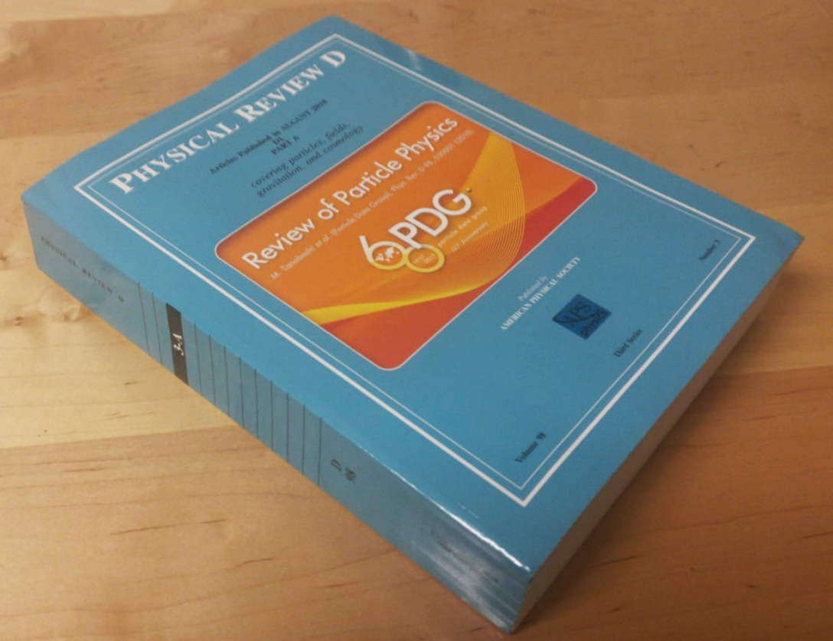
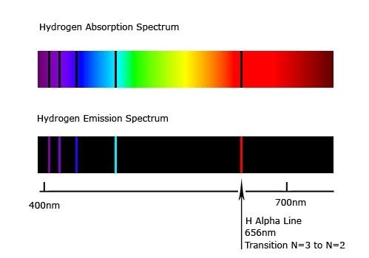
Accessing the spectrum is key to understand the theories
The Hydrogen spectrum helped us discover Quantum Mechanics
We know the levels with remarkable precision
Solve the Hydrogen spectrum, pass Quantum Mechanics 101
Solve the strong interaction spectrum, win a Prize, etc. etc. etc...
A. Pilloni – Prospects for Hadron Spectroscopy

Slide 3
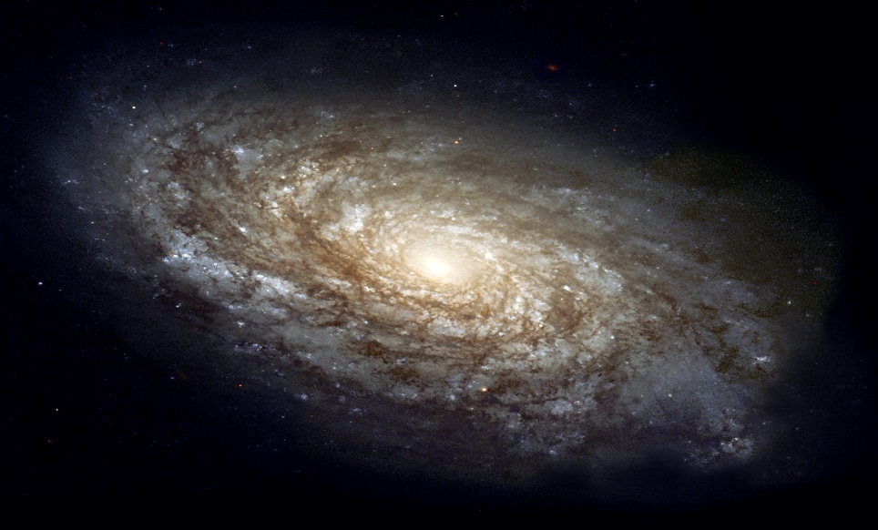
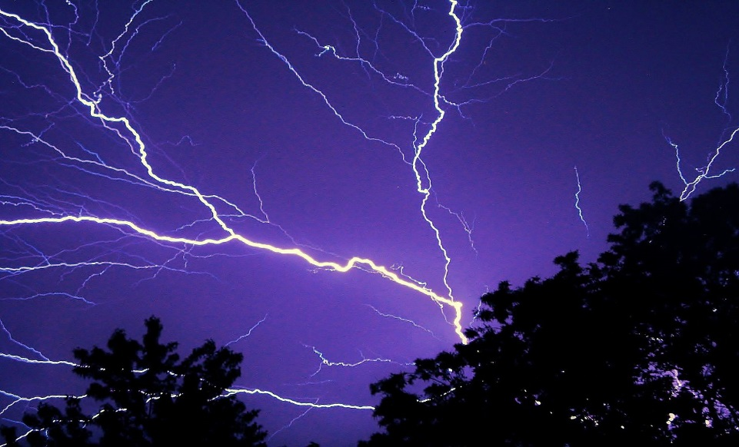
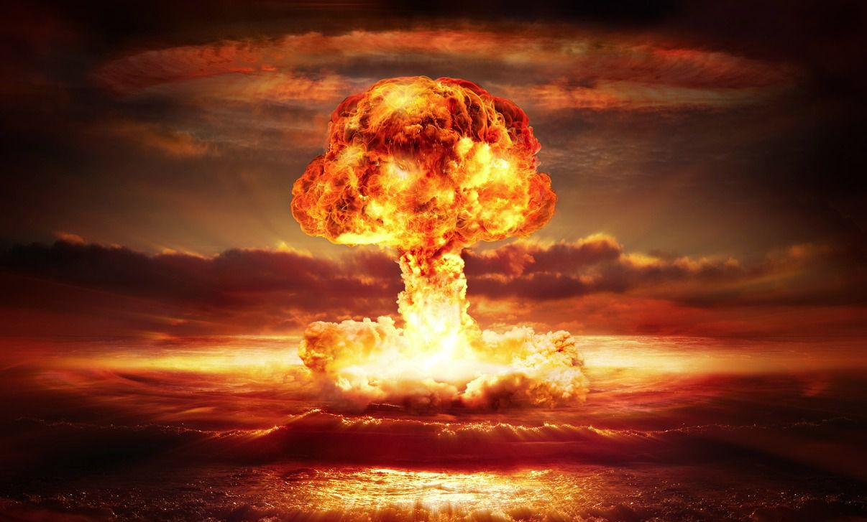
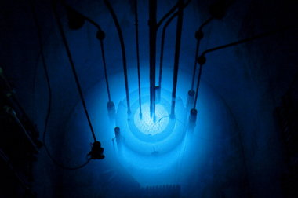
The four forces
Standard model Works from ${10}^{3}$ to ${10}^{−18} \text{m}$
$$U∼\frac{m_{1}m_{2}}{r}$$
$$U∼\frac{q_{1}q_{2}}{r}$$
$$U∼\frac{g_{s1}g_{s2}}{r}e^{−r/λ_{s}}$$
$$λ_{s}∼1.4×{10}^{−15} \text{m}$$
$$U∼\frac{g_{w1}g_{w2}}{r}e^{−r/λ_{w}}$$
$$λ_{w}∼2.5×{10}^{−18} \text{m}$$
A. Pilloni – Prospects for Hadron Spectroscopy
Notes:
2 slides su Zc, a Bes e a Belle
2 slide su tetraquark model: dall’hamiltoniana di Jaffe al calcolo delle masse
1 slide su molecular models, dove sono i carichi? (non in Tornqvist, si in Hanhart, vedere Braaten, citare Nefediev)
2 slides su decay channels, dove si dovrebbe vedere, e a seconda del modello, vedere qualche plot
1 slide su Y(4260), tetraquark? C’è lo strano (si vede la f0)
1 slide su Zc a cleo (anche il neutro)

Slide 4
The strong force
It binds protons and neutrons inside nuclei
It is relevant at short distances only
Particles interacting via the strong force are called hadrons
Hadrons are composite objects, formed by quarks, and bound by gluons (the mediators of the strong force)
Quarks are confined inside hadrons
Strong means strong: the force between two quarks in a hadron is roughly the same as the weight of a truck
A. Pilloni – Prospects for Hadron Spectroscopy
Notes:
2 slides su Zc, a Bes e a Belle
2 slide su tetraquark model: dall’hamiltoniana di Jaffe al calcolo delle masse
1 slide su molecular models, dove sono i carichi? (non in Tornqvist, si in Hanhart, vedere Braaten, citare Nefediev)
2 slides su decay channels, dove si dovrebbe vedere, e a seconda del modello, vedere qualche plot
1 slide su Y(4260), tetraquark? C’è lo strano (si vede la f0)
1 slide su Zc a cleo (anche il neutro)

Slide 5
Three quarks for Muster Mark
Quarks appear in 3 colors
Antiquarks appear in 3 anticolors
$$π^{0}$$
$$\overline{g}$$
$$g$$
$$\overline{r}$$
$$r$$
$$\overline{b}$$
$$b$$
Quarks appear in 6 flavors
$q\overline{q}$ pairs form a meson
Hadrons must be white:
A. Pilloni – Prospects for Hadron Spectroscopy
Notes:
2 slides su Zc, a Bes e a Belle
2 slide su tetraquark model: dall’hamiltoniana di Jaffe al calcolo delle masse
1 slide su molecular models, dove sono i carichi? (non in Tornqvist, si in Hanhart, vedere Braaten, citare Nefediev)
2 slides su decay channels, dove si dovrebbe vedere, e a seconda del modello, vedere qualche plot
1 slide su Y(4260), tetraquark? C’è lo strano (si vede la f0)
1 slide su Zc a cleo (anche il neutro)

Slide 6
Three quarks for Muster Mark
Quarks appear in 3 colors
Antiquarks appear in 3 anticolors
$$\overline{g}$$
$$g$$
$$\overline{Λ}$$
$$\overline{r}$$
$$r$$
$$p$$
$$\overline{b}$$
$$b$$
$qqq$ triplets form a baryon
Hadrons must be white:
$\overline{q}\overline{q}\overline{q}$ triplets form an antibaryon
A. Pilloni – Prospects for Hadron Spectroscopy
Notes:
2 slides su Zc, a Bes e a Belle
2 slide su tetraquark model: dall’hamiltoniana di Jaffe al calcolo delle masse
1 slide su molecular models, dove sono i carichi? (non in Tornqvist, si in Hanhart, vedere Braaten, citare Nefediev)
2 slides su decay channels, dove si dovrebbe vedere, e a seconda del modello, vedere qualche plot
1 slide su Y(4260), tetraquark? C’è lo strano (si vede la f0)
1 slide su Zc a cleo (anche il neutro)

Slide 7
Three quarks for Muster Mark
Gluons appear in 8 color-anticolor combinations
$$\overline{r}$$
$$\overline{b}$$
$$g$$
$$\overline{g}$$
$$r$$
$$b$$
$$b$$
$$\overline{g}$$
$$r$$
$$\overline{b}$$
They mediate the interaction between quarks
A. Pilloni – Prospects for Hadron Spectroscopy
Notes:
2 slides su Zc, a Bes e a Belle
2 slide su tetraquark model: dall’hamiltoniana di Jaffe al calcolo delle masse
1 slide su molecular models, dove sono i carichi? (non in Tornqvist, si in Hanhart, vedere Braaten, citare Nefediev)
2 slides su decay channels, dove si dovrebbe vedere, e a seconda del modello, vedere qualche plot
1 slide su Y(4260), tetraquark? C’è lo strano (si vede la f0)
1 slide su Zc a cleo (anche il neutro)

Slide 8
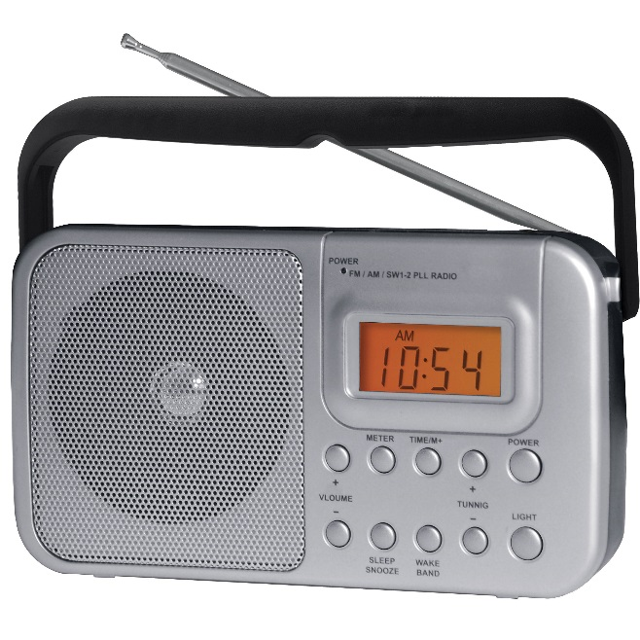
We have E&M theory: QED
Linear at the classical level → Maxwell equations
Any electromagnetic process is described by this equation (in principle)
A. Pilloni – Prospects for Hadron Spectroscopy

Slide 9
We have E&M theory: QED
The electric charge is small, «Taylor» expansion
$$f∼\frac{e^{2}}{4π}f_{0}+{\left(\frac{e^{2}}{4π}\right)}^{2}f_{1}+{\left(\frac{e^{2}}{4π}\right)}^{3}f_{2}+{\left(\frac{e^{2}}{4π}\right)}^{4}f_{3}+…$$
$$\frac{e^{2}}{4π}∼\frac{1}{137}≪1$$
A. Pilloni – Prospects for Hadron Spectroscopy

Slide 10
We have strong theory: QCD
Matrix equation
Gluons self-interact → Nonlinear even at classical level
A. Pilloni – Prospects for Hadron Spectroscopy

Slide 11
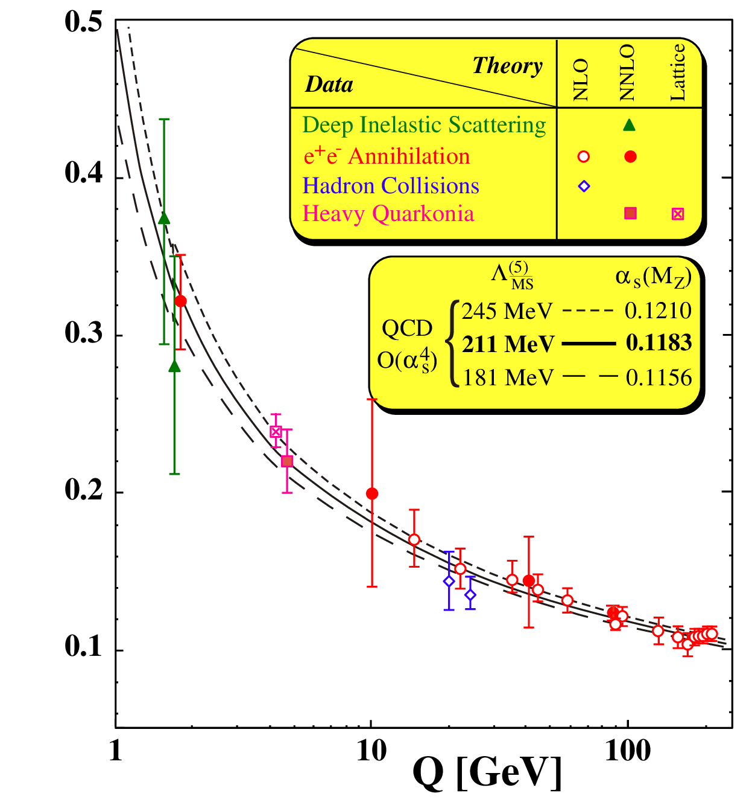
Asymptotic freedom
$\frac{g_{s}^{2}}{4π}(Q)$
At high energies $\frac{g_{s}^{2}}{4π}≪1$
A. Pilloni – Prospects for Hadron Spectroscopy

Slide 12
At low energies?
At low energies $\frac{g_{s}^{2}}{4π}>1$, no hierarchy
Emerging properties: Confinement; Mass generation
No calculable solution yet
$\frac{g_{s}^{2}}{4π}(Q)$
A. Pilloni – Prospects for Hadron Spectroscopy

Slide 13
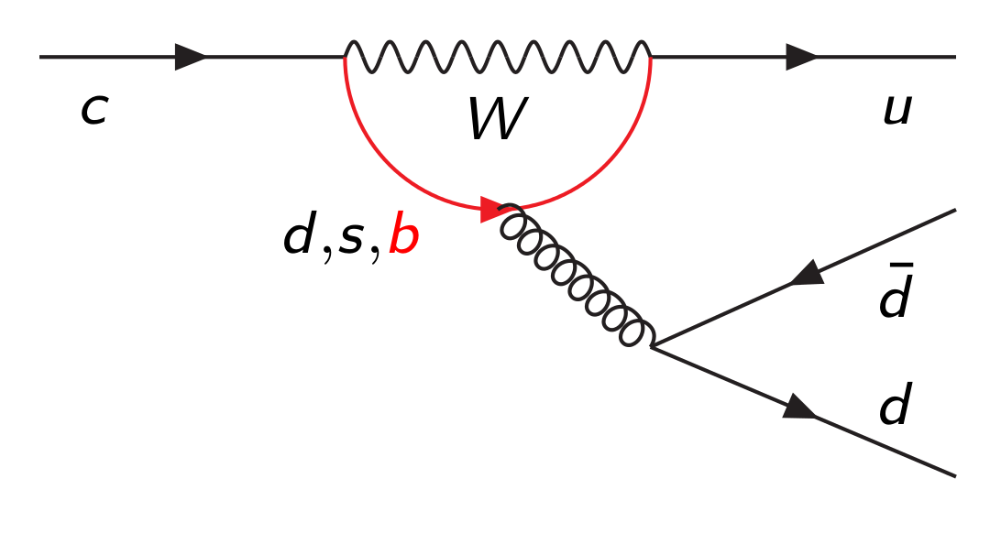
Hadrons are everywhere
$$D^{0}$$
$$\overline{u}$$
$$π^{+}$$
$$π^{+}$$
$$c$$
$$u$$
$$π^{−}$$
$$\overline{d}$$
$$π^{−}$$
$$π^{0}$$
$$d$$
$$π^{0}$$
A. Pilloni – Prospects for Hadron Spectroscopy
Notes:
2 slides su Zc, a Bes e a Belle
2 slide su tetraquark model: dall’hamiltoniana di Jaffe al calcolo delle masse
1 slide su molecular models, dove sono i carichi? (non in Tornqvist, si in Hanhart, vedere Braaten, citare Nefediev)
2 slides su decay channels, dove si dovrebbe vedere, e a seconda del modello, vedere qualche plot
1 slide su Y(4260), tetraquark? C’è lo strano (si vede la f0)
1 slide su Zc a cleo (anche il neutro)

Slide 14
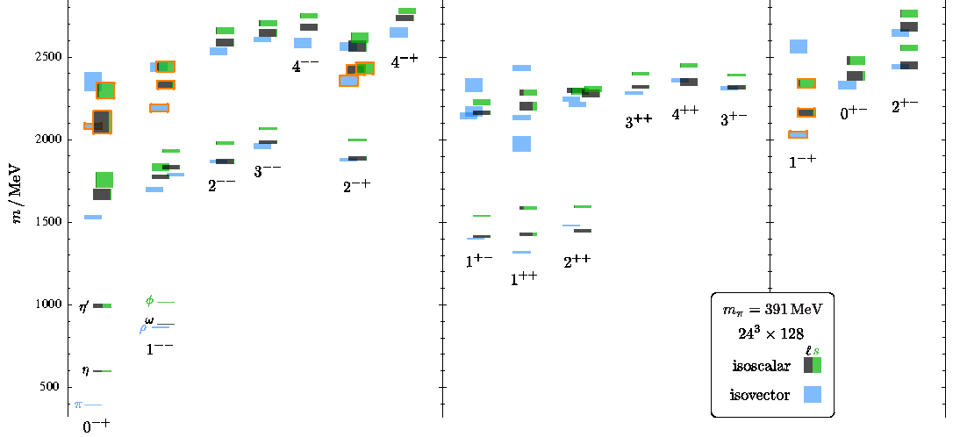
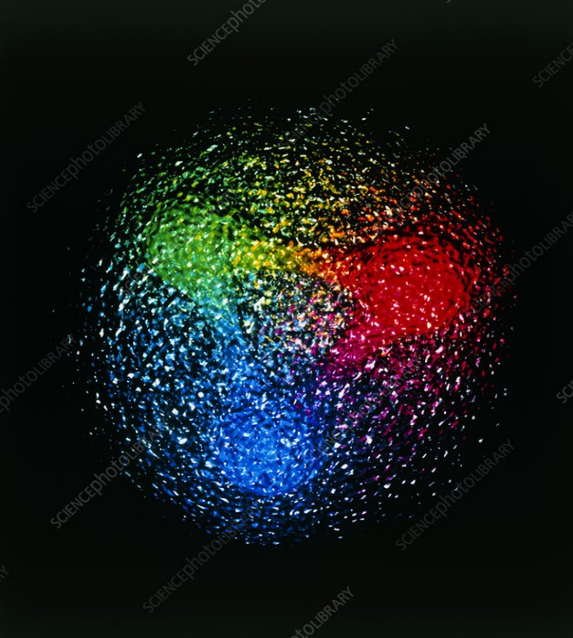
QCD has no solution. Don’t panic /1
Plan of attack
Collect data
Identify states
Compare with expectations
Answer big questions
We can build models to describe the spectrum. Grasp some aspects of QCD, get insights
Analytical methods
Lattice QCD (not a model but...)
The excited spectrum is populated by unstable states, is $∼{10}^{−24} s$
Feedback from experiments
A. Pilloni – Prospects for Hadron Spectroscopy

Slide 15
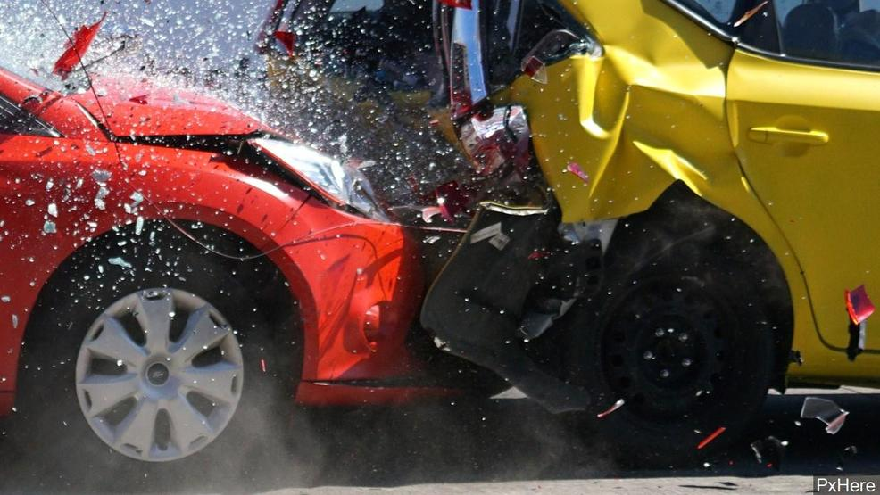
Unraveling QCD
Products
Beam
Target
Beam
Products
A. Pilloni – Prospects for Hadron Spectroscopy

Slide 16
Unraveling QCD
Electromagnetic machines
$$e^{+}e^{−}→γ^{∗}→\text{hadrons}$$
Electrohadron machines
Cross sections
Cleanliness
$$e^{−}→e^{−}γ^{(∗)}$$
$$\text{and} γ^{(∗)}p,γ^{(∗)}A→\text{hadrons}$$
Hadron machines
$$pp,p\overline{p},π^{−}p,pA,AA→ \text{hadrons}$$
A. Pilloni – Prospects for Hadron Spectroscopy

Slide 17
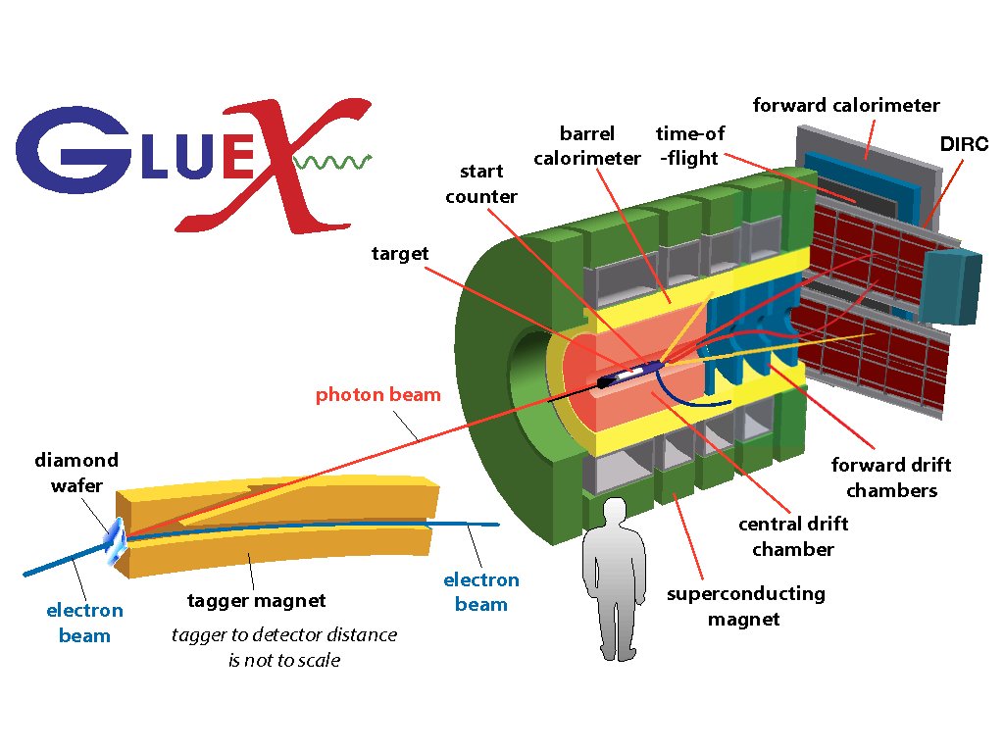
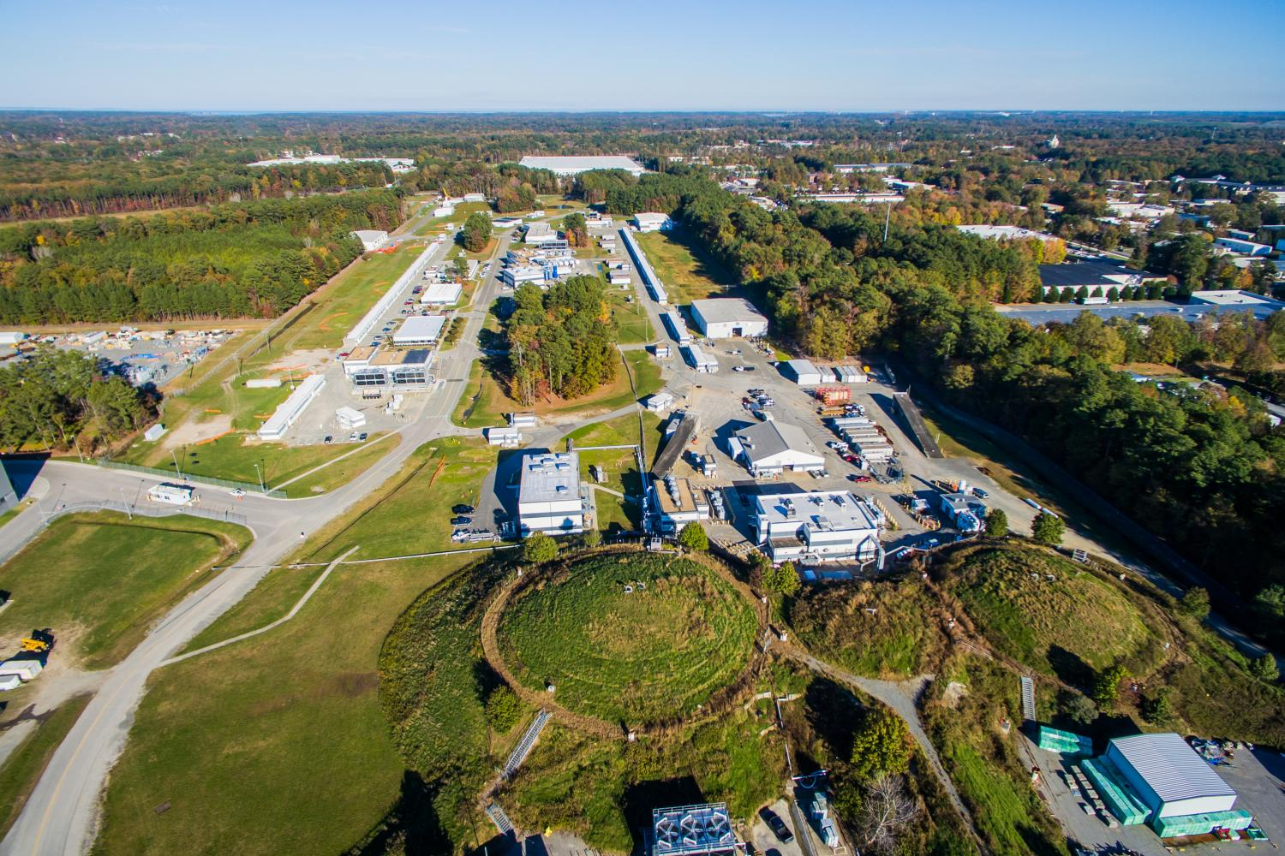
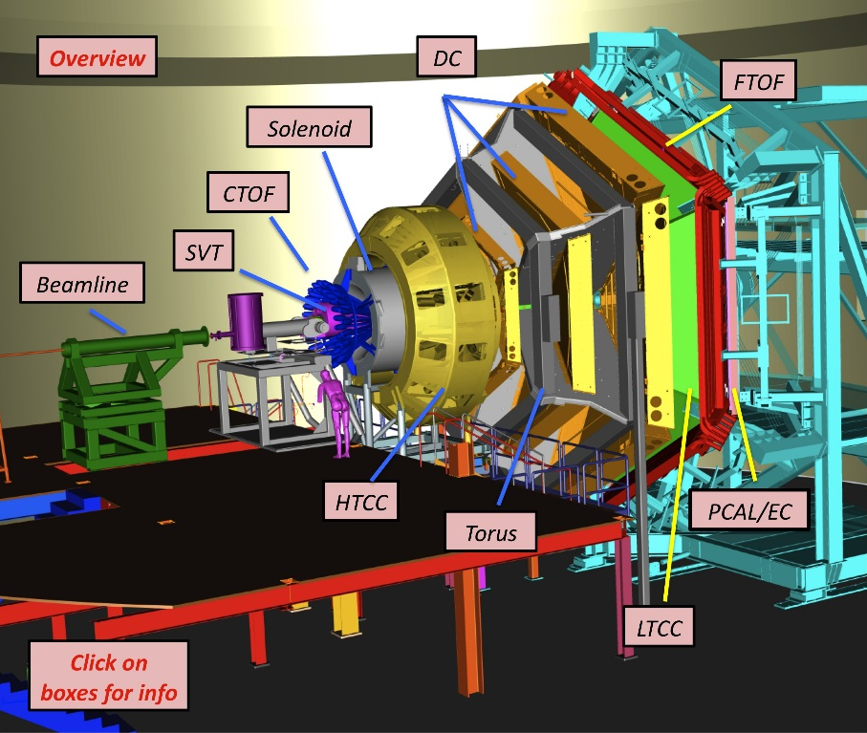
Unraveling QCD at JLab
Electrons at $12 \text{GeV}$
Liquid Hydrogen Target (mostly)
Study hadrons made of light quarks
A. Pilloni – Prospects for Hadron Spectroscopy

Slide 18
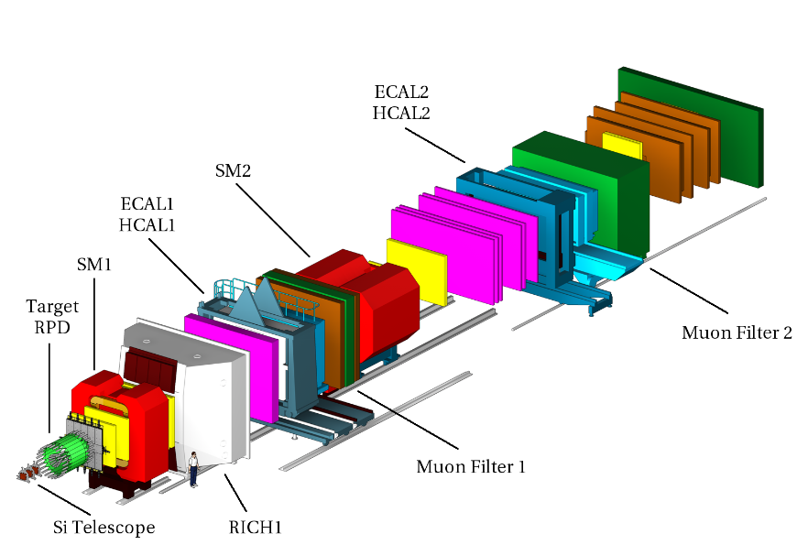
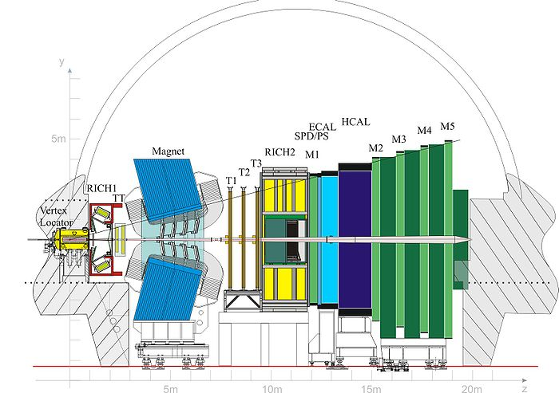
Unraveling QCD at CERN
LHC
Protons at $450 \text{GeV}$
S$p$S
Two proton beams at $7000 \text{GeV}$
secondary pion beam at $190 \text{GeV}$, Liquid Hydrogen target
Study HEP + heavy hadrons
Study hadrons made of light quarks
A. Pilloni – Prospects for Hadron Spectroscopy

Slide 19
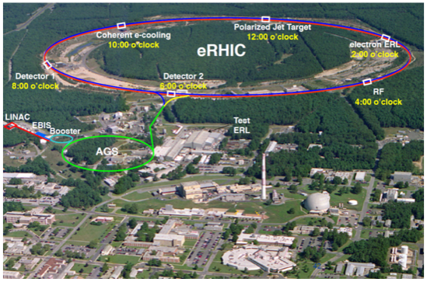
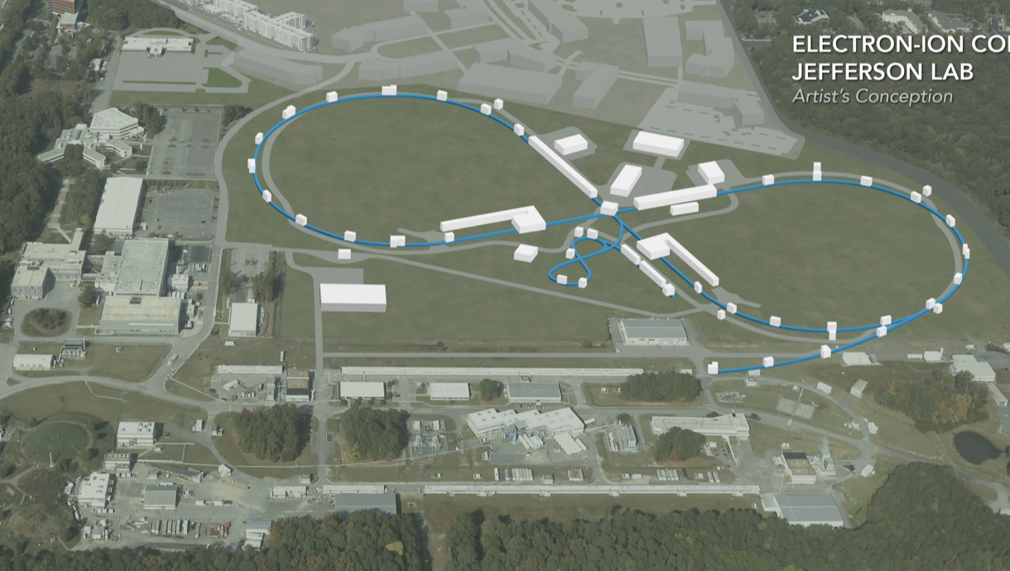
Unraveling QCD at the EIC
Two options discussed
eRHIC
$e^{−}$: 15-20 GeV
$p$: 100-250 GeV
Higher energy
JLEIC
$e^{−}$ 3-10 GeV
$p$ 20-100 GeV
Higher luminosity

Slide 20
EIC physics so far
Spectroscopy
$$X\left(3872\right)?$$
A. Pilloni – Spectroscopy at EIC
Notes:
2 slides su Zc, a Bes e a Belle
2 slide su tetraquark model: dall’hamiltoniana di Jaffe al calcolo delle masse
1 slide su molecular models, dove sono i carichi? (non in Tornqvist, si in Hanhart, vedere Braaten, citare Nefediev)
2 slides su decay channels, dove si dovrebbe vedere, e a seconda del modello, vedere qualche plot
1 slide su Y(4260), tetraquark? C’è lo strano (si vede la f0)
1 slide su Zc a cleo (anche il neutro)

Slide 21
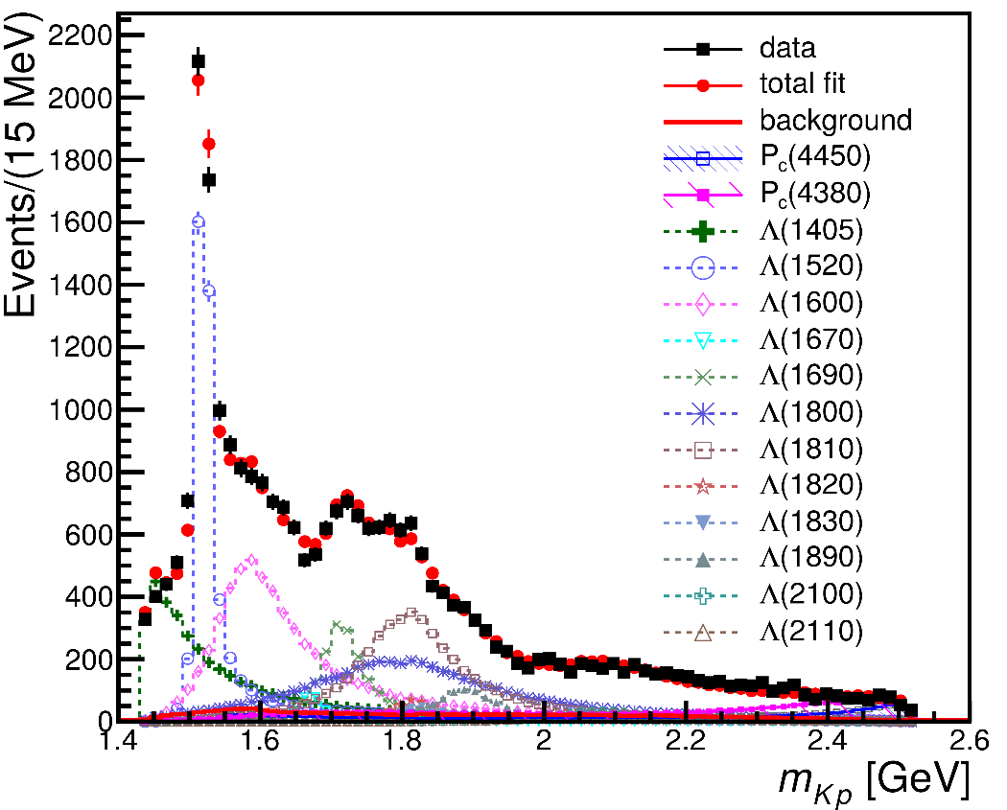
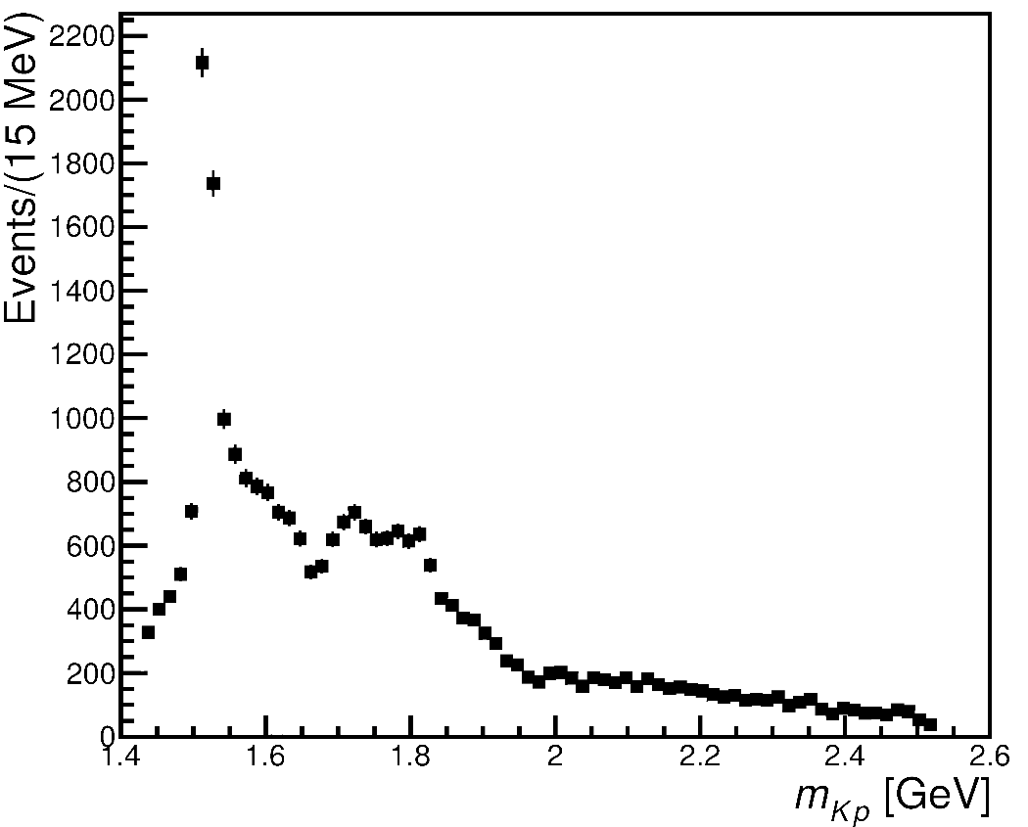
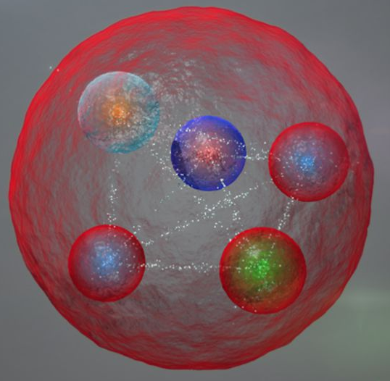
From data to the spectrum
Wow!
Mmh...?
The connection between data and hadrons is not easy!
A. Pilloni – Prospects for Hadron Spectroscopy

Slide 22
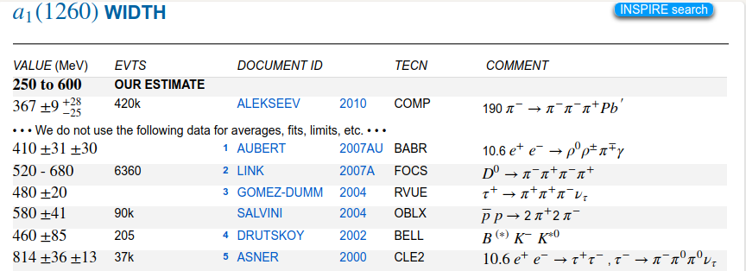
Life is not easy...
A. Pilloni – Prospects for Hadron Spectroscopy
Notes:
2 slides su Zc, a Bes e a Belle
2 slide su tetraquark model: dall’hamiltoniana di Jaffe al calcolo delle masse
1 slide su molecular models, dove sono i carichi? (non in Tornqvist, si in Hanhart, vedere Braaten, citare Nefediev)
2 slides su decay channels, dove si dovrebbe vedere, e a seconda del modello, vedere qualche plot
1 slide su Y(4260), tetraquark? C’è lo strano (si vede la f0)
1 slide su Zc a cleo (anche il neutro)

Slide 23
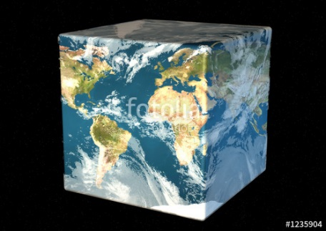
The Richness of the Spectrum
Meson
Baryon
Glueball
Hybrids
Tetraquark
Molecule
Experiment
Data
Amplitude analysis
QCD
Lattice QCD
With great statistics comes great responsibility!
Peter Parker, PhD
A. Pilloni – Prospects for Hadron Spectroscopy

Slide 24
QCD has no solution. Don’t panic /2
When you are desperate, look for symmetries:
Symmetries are beautiful (and group theory is fun!)
Symmetries constrain your results no matter how complicated your theory is
Look for general properties of interactions
Luckily, strong interactions are the ones with most symmetries
A. Pilloni – Prospects for Hadron Spectroscopy

Slide 25
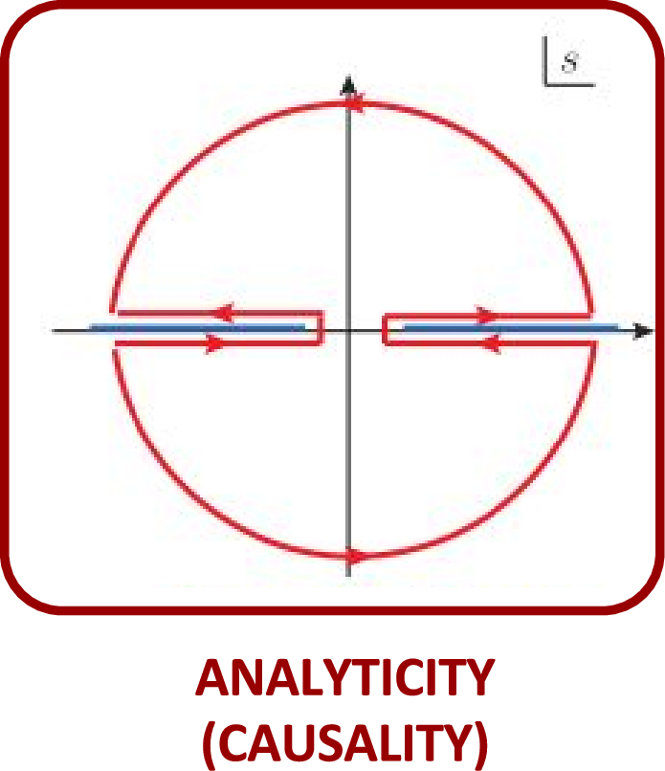
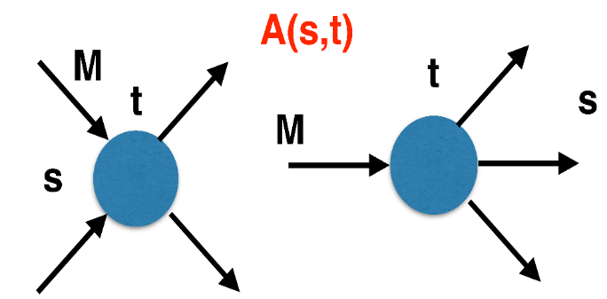
The S-Matrix principles
Future cannot change the past
100%, something will happen
The anti-particle is an anti-particle and not just a different particle
(analyticity)
(unitarity)
(crossing symmetry)
Sherlock Holmes, QFT
Analyticity
Unitarity
Crossing
Parametrize your ignorance.
Build a model.
Fit data.
Have fun.
A. Pilloni – Prospects for Hadron Spectroscopy

Slide 26
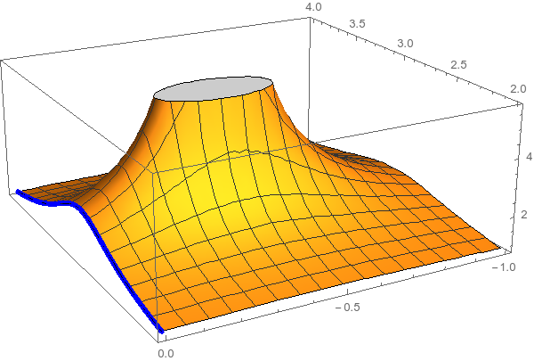
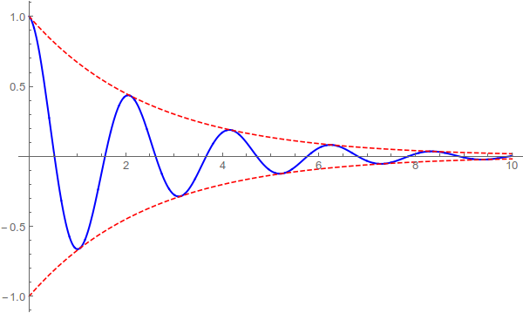
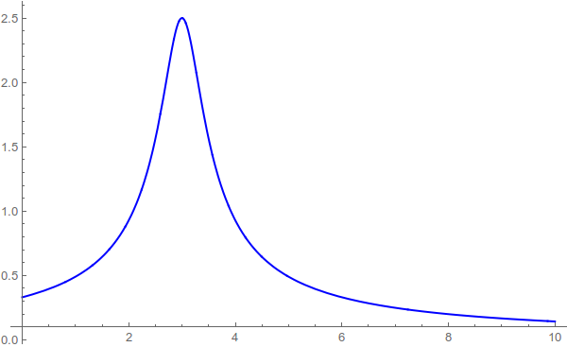
Resonances = Unstable states
$$ψ(t)=e^{−i E_{0} t} e^{− \frac{Γ}{2} t }$$
$$ψ(E)=\frac{1}{E−E_{0}+i\frac{Γ}{2}}$$
The function explodes for value of energy $E=E_{0}−i\frac{Γ}{2}$
Resonances are poles in the complex energy plane
Excited states are unstable
They manifest as resonant peaks
A. Pilloni – Prospects for Hadron Spectroscopy

Slide 27
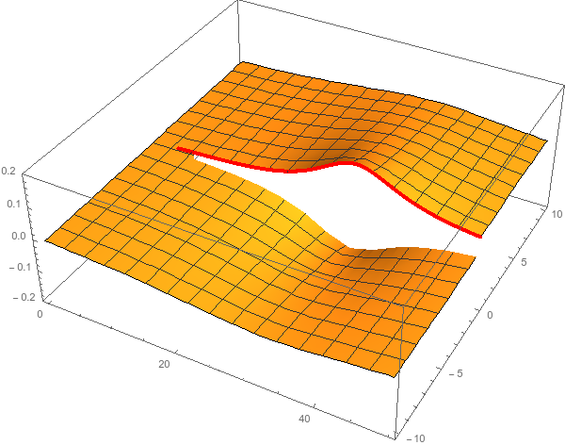
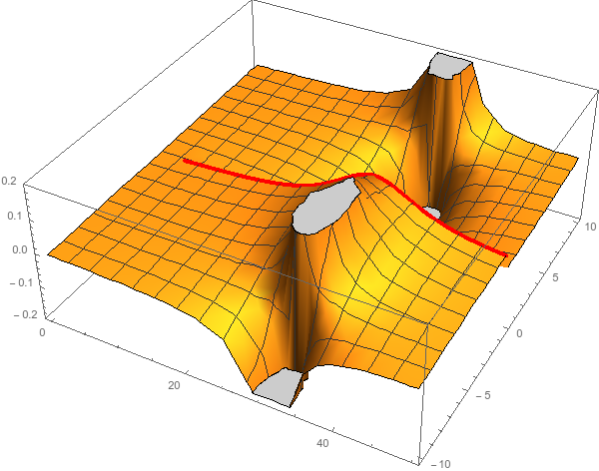
Unitarity & Pole hunting
Unitarity creates a branch cut on the real axis, two sheets continuosly connected
I sheet
II sheet
Finding resonances means writing analytic amplitude, and hunting for poles in the complex plane
A. Pilloni – Prospects for Hadron Spectroscopy
Notes:
Controlla la parte su Regge

Slide 28
Hybrid mesons
Can gluons be constituent of mesons?
Can gluons be constituent of mesons?
$$g$$
$$b$$
$$r$$
$$\overline{b}$$
$$r$$
$$\overline{g}$$
$$\overline{g}$$
$$b$$
$$\overline{r}$$
$$b$$
$$\overline{g}$$
More quantum numbers allowed wrt $q\overline{q}$ states: smoking gun of exotics
A. Pilloni – Prospects for Hadron Spectroscopy
Notes:
2 slides su Zc, a Bes e a Belle
2 slide su tetraquark model: dall’hamiltoniana di Jaffe al calcolo delle masse
1 slide su molecular models, dove sono i carichi? (non in Tornqvist, si in Hanhart, vedere Braaten, citare Nefediev)
2 slides su decay channels, dove si dovrebbe vedere, e a seconda del modello, vedere qualche plot
1 slide su Y(4260), tetraquark? C’è lo strano (si vede la f0)
1 slide su Zc a cleo (anche il neutro)

Slide 29
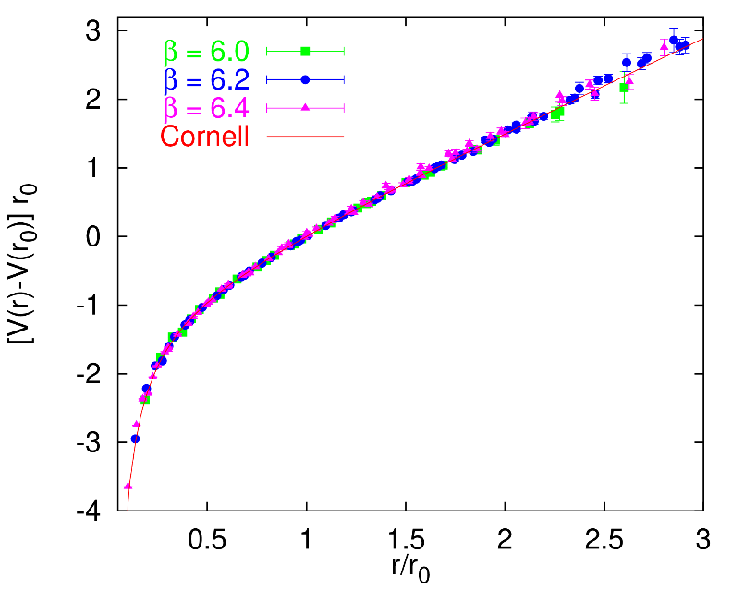
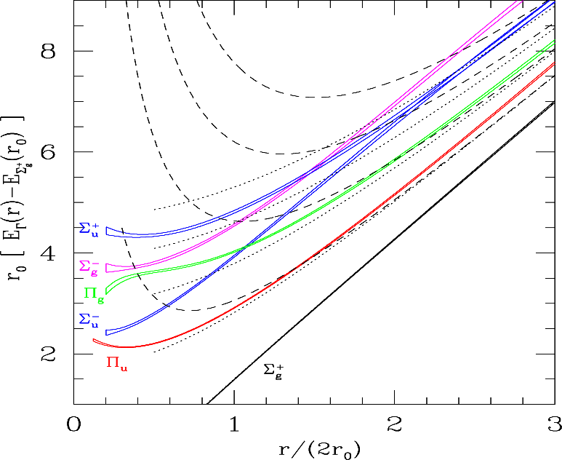
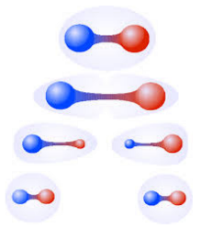
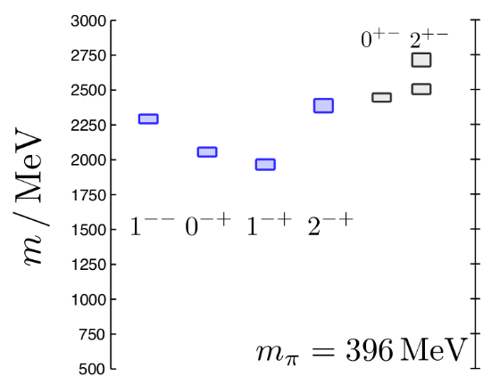
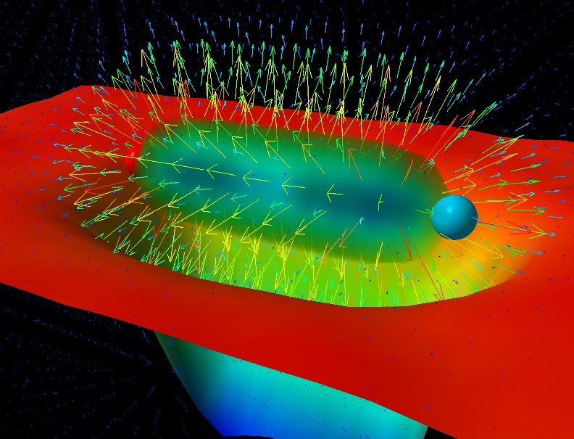
Learning about confinement
If quarks were infinitely heavy, gluonic field is confined in a string
Linear rising potential
What is a constituent gluon?
vibration of the string? → degenerate $J^{PC}={\left(0,1,2\right)}^{−+},{\left(0,1,2\right)}^{+−}$
excitation of a quasiparticle? → degenerate $J^{PC}={\left(0,1,2\right)}^{−+},1^{−−}$
G. Bali
C. Morningstar
J. Dudek
excitation of a quasiparticle! → degenerate $J^{PC}={\left(0,1,2\right)}^{−+},1^{−−}$ says Lattice QCD...
What about real data?
D. Leinweber
A. Pilloni – Prospects for Hadron Spectroscopy
Notes:
Controlla la parte su Regge

Slide 30
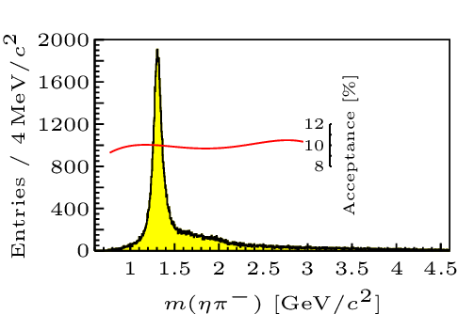
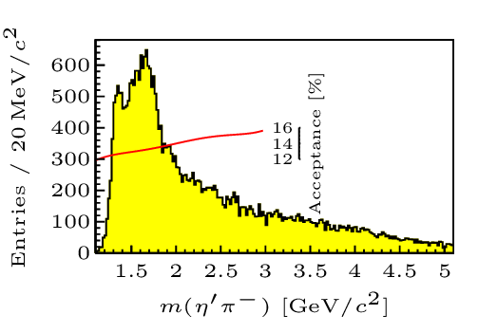
Hybrid hunting
Excited gluon, $$J^{PC}=1^{+−}$$ mass $∼1.0\text{−}1.5 \text{GeV}$
$$\overline{r}$$
$$\overline{g}$$
$$r$$
$$g$$
Look for a $π_{1}$ state with $J^{PC}=1^{−+}$
decaying into $\left\{\begin{matrix}η π \text{and} η^{′}π \\ ρ π→3π \\ b_{1}π→5π\end{matrix}\right.$
Small signal in data
A. Pilloni – Prospects for hadron spectroscopy
Notes:
2 slides su Zc, a Bes e a Belle
2 slide su tetraquark model: dall’hamiltoniana di Jaffe al calcolo delle masse
1 slide su molecular models, dove sono i carichi? (non in Tornqvist, si in Hanhart, vedere Braaten, citare Nefediev)
2 slides su decay channels, dove si dovrebbe vedere, e a seconda del modello, vedere qualche plot
1 slide su Y(4260), tetraquark? C’è lo strano (si vede la f0)
1 slide su Zc a cleo (anche il neutro)

Slide 31
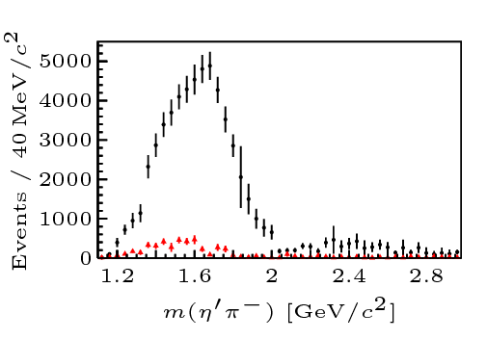
Two hybrid states???
Neither lattice nor models predict two $1^{−+}$ states in this region!
A. Pilloni – Prospects for Hadron Spectroscopy
Notes:
2 slides su Zc, a Bes e a Belle
2 slide su tetraquark model: dall’hamiltoniana di Jaffe al calcolo delle masse
1 slide su molecular models, dove sono i carichi? (non in Tornqvist, si in Hanhart, vedere Braaten, citare Nefediev)
2 slides su decay channels, dove si dovrebbe vedere, e a seconda del modello, vedere qualche plot
1 slide su Y(4260), tetraquark? C’è lo strano (si vede la f0)
1 slide su Zc a cleo (anche il neutro)

Slide 32
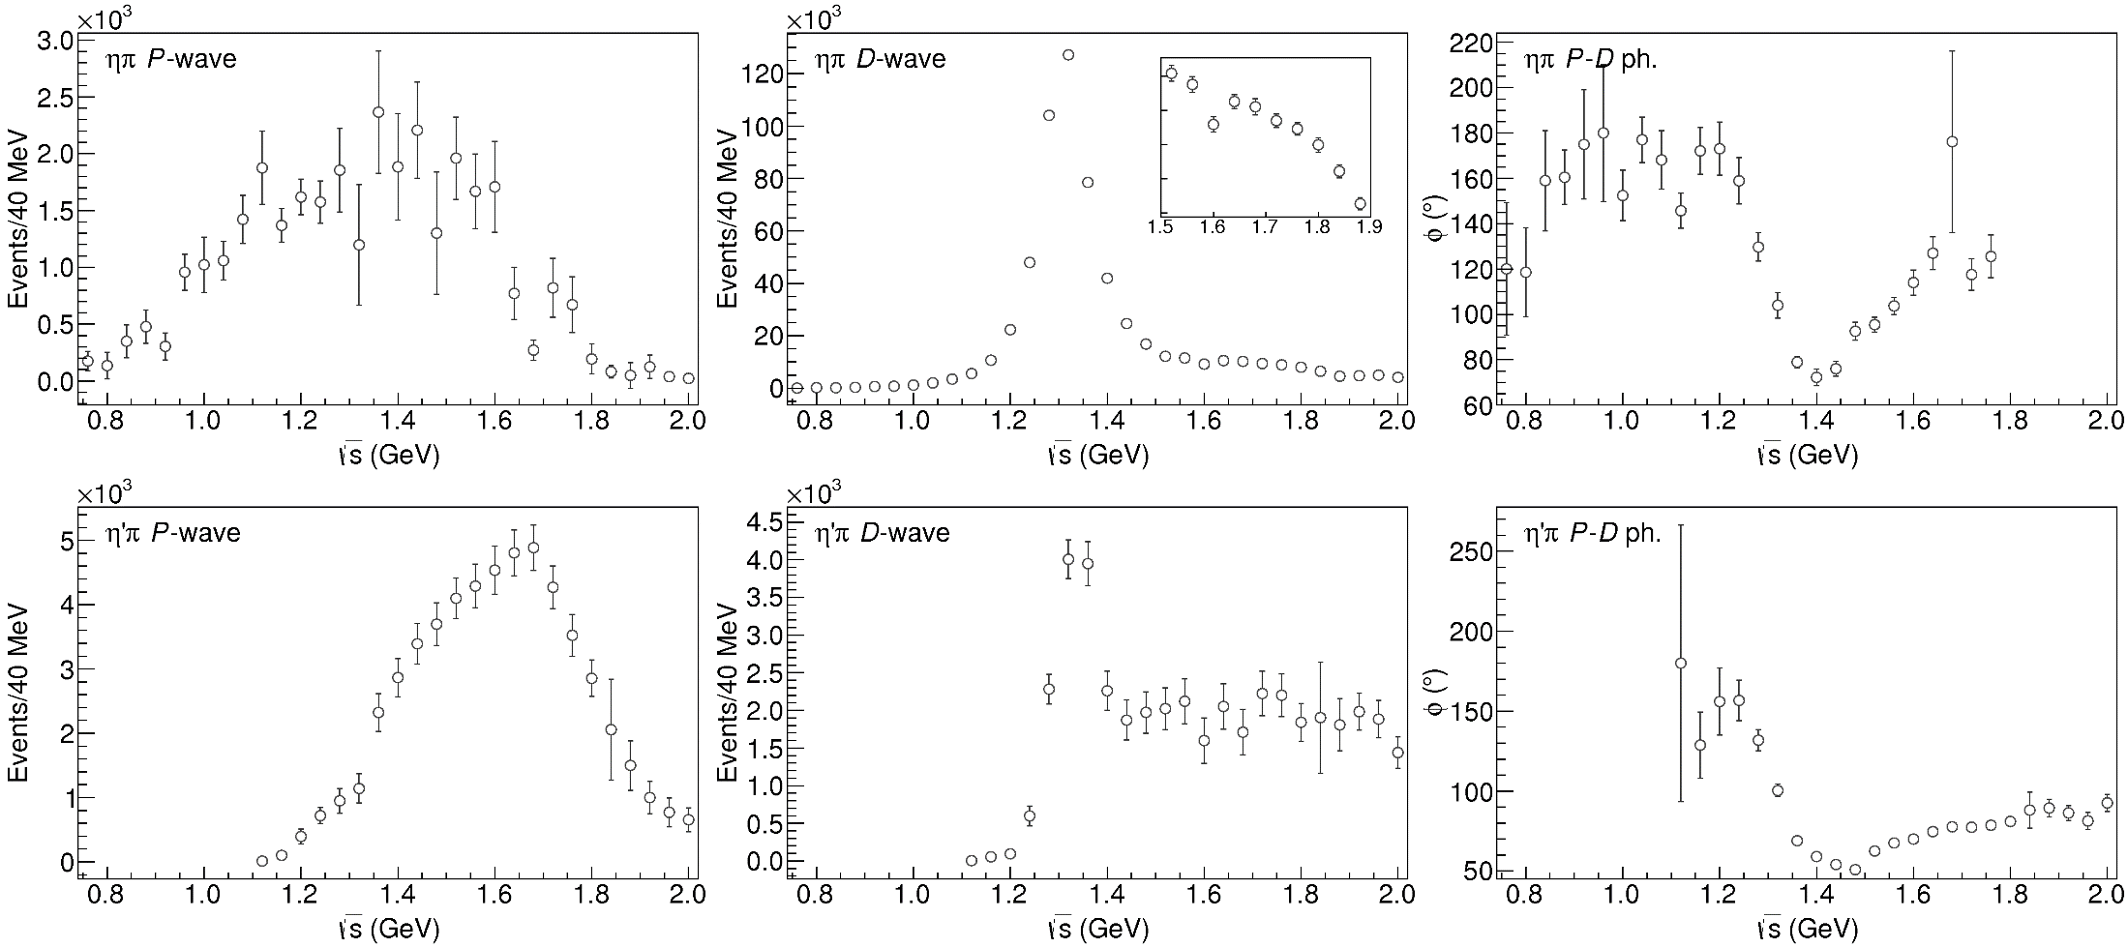
Data in $η^{(′)}π$
( data)
$$π_{1}\left(1400\right)?$$
$$a_{2}\left(1320\right)$$
$$a_{2}^{′}\left(1700\right)$$
$$π_{1}\left(1600\right)?$$
$$a_{2}\left(1320\right)$$
$$a_{2}^{′}\left(1700\right)$$
$$J^{PC}=1^{−+}$$
$$J^{PC}=2^{++}$$
A. Pilloni – Prospects for Hadron Spectroscopy
Notes:
Controlla la parte su Regge

Slide 33
Amplitudes for $η^{(′)}π$
We build the partial wave amplitudes according to the $N/D$ method
Jackura, Mikhasenko, AP et al. (JPAC & COMPASS), PLB
Rodas, AP et al. (JPAC), PRL
$$a\left(s\right)=\frac{n\left(s\right)}{D\left(s\right)}$$
$$D(s)$$
$$n(s)$$
The $n\left(s\right)$ → background physics, process-dependent, smooth
The $D(s)$ contains all the Final State Interactions constrained by unitarity → universal
A. Pilloni – Prospects for Hadron Spectroscopy at JLab
Notes:
Controlla la parte su Regge

Slide 34
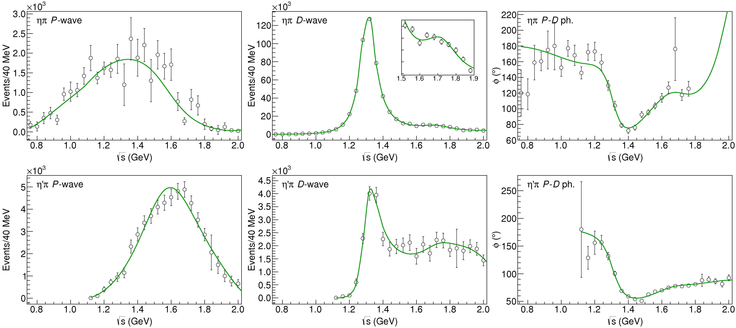
Fit to $η^{(′)}π$
( data)
$$π_{1}\left(1400\right)?$$
$$a_{2}\left(1320\right)$$
$$a_{2}^{′}\left(1700\right)$$
$$π_{1}\left(1600\right)?$$
$$a_{2}\left(1320\right)$$
$$a_{2}^{′}\left(1700\right)$$
$$J^{PC}=1^{−+}$$
$$J^{PC}=2^{++}$$
A. Pilloni – Prospects for Hadron Spectroscopy
Notes:
Controlla la parte su Regge

Slide 35
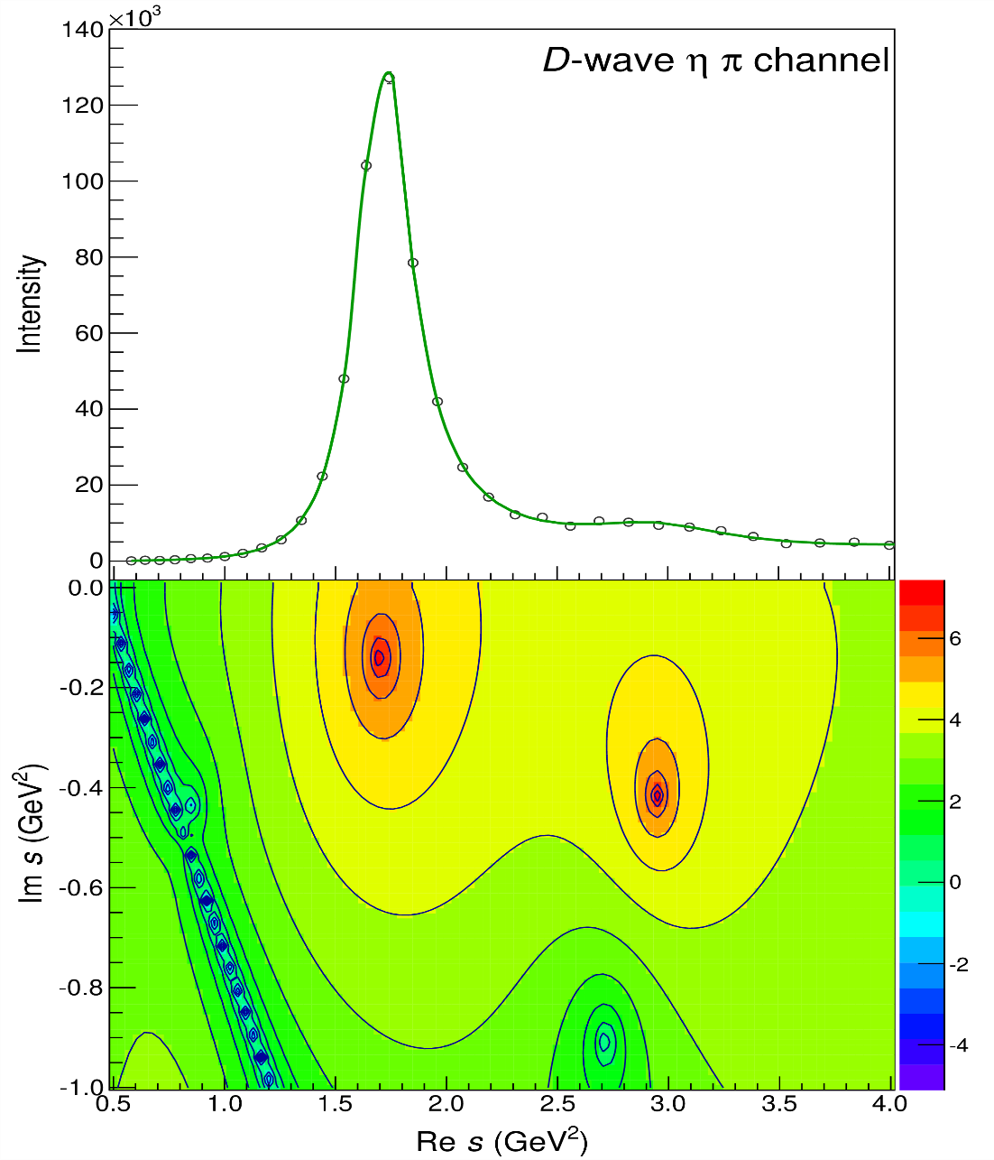
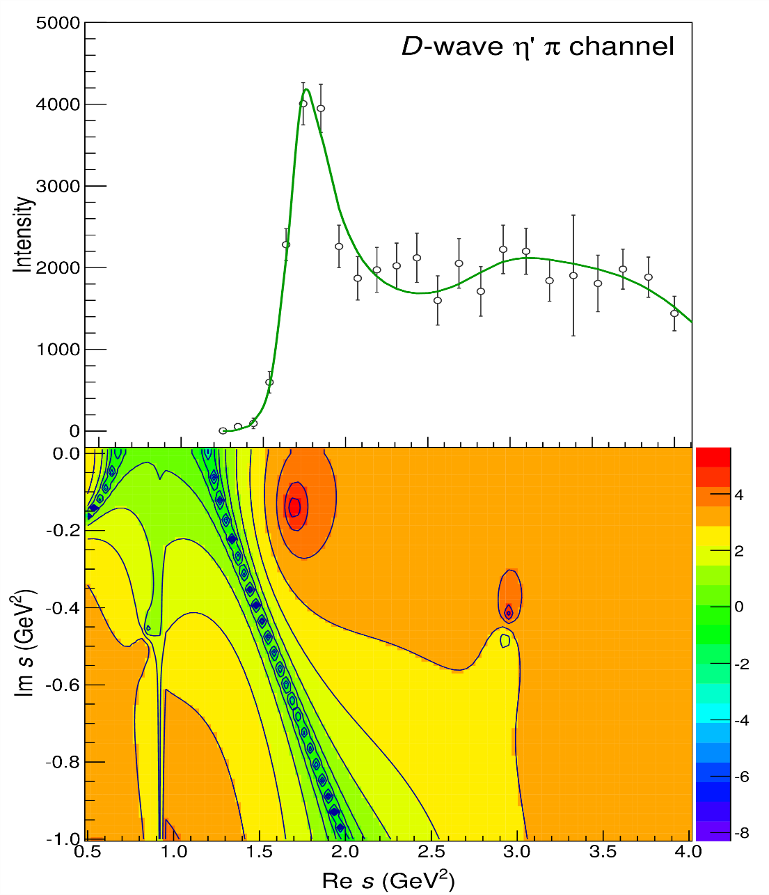
Pole hunting
$$a_{2}^{′}\left(1700\right)$$
$$a_{2}^{′}\left(1700\right)$$
$$a_{2}\left(1320\right)$$
$$a_{2}\left(1320\right)$$
A. Pilloni – Prospects for Hadron Spectroscopy
Notes:
Controlla la parte su Regge

Slide 36
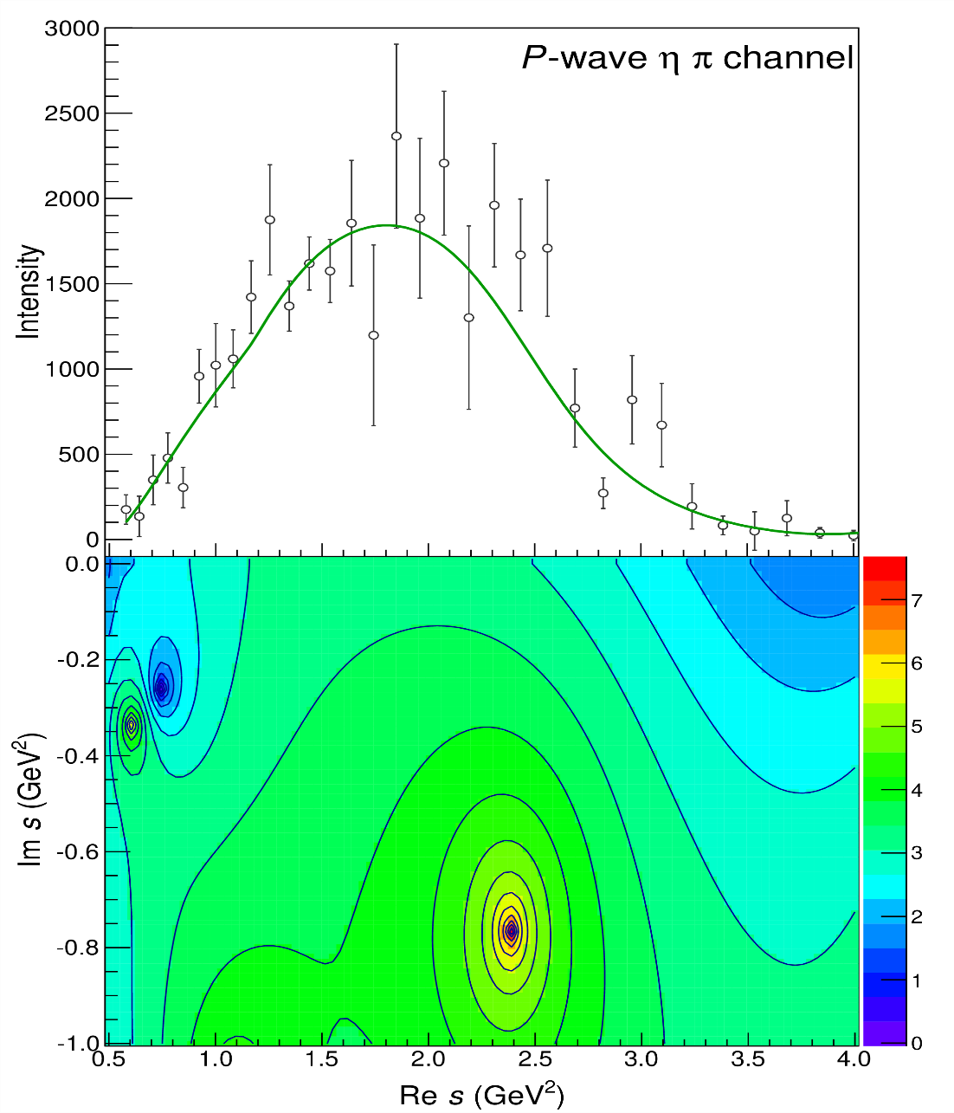
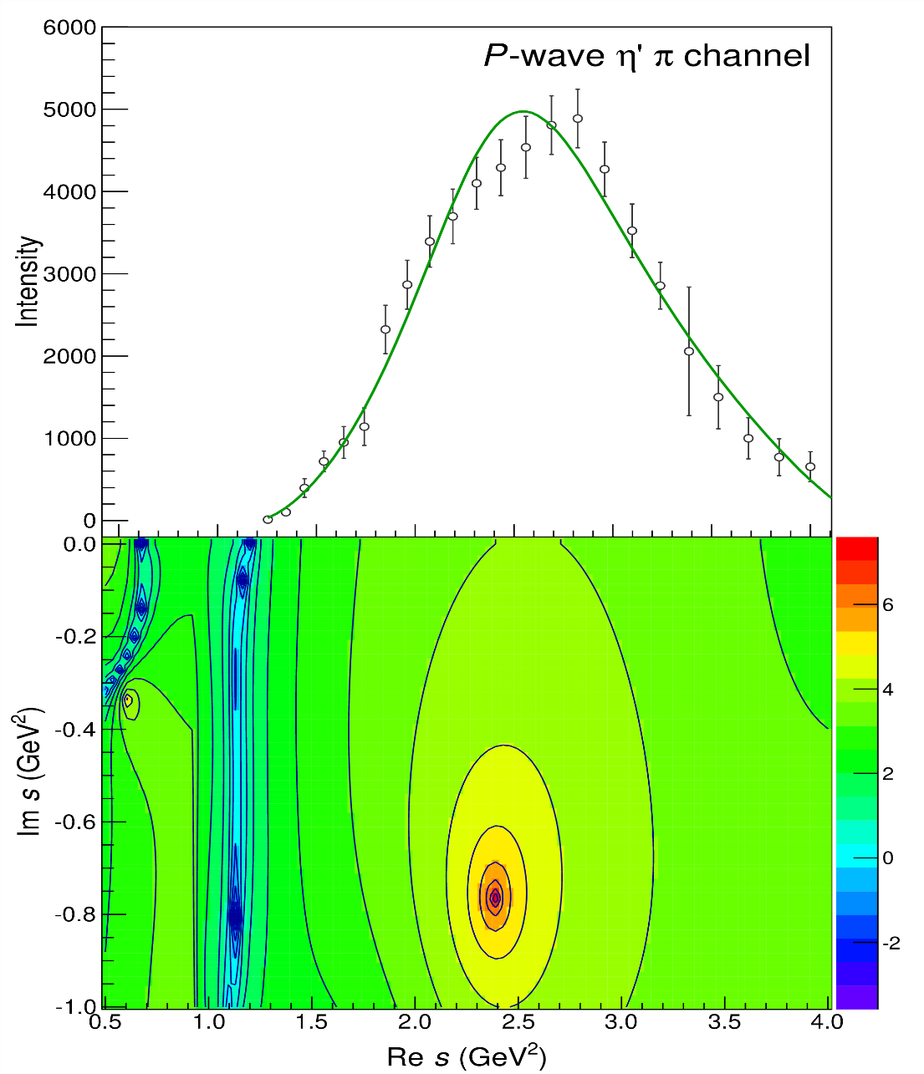
Pole hunting
$$π_{1}$$
$$π_{1}$$
A. Pilloni – Prospects for Hadron Spectroscopy
Notes:
Controlla la parte su Regge

Slide 37
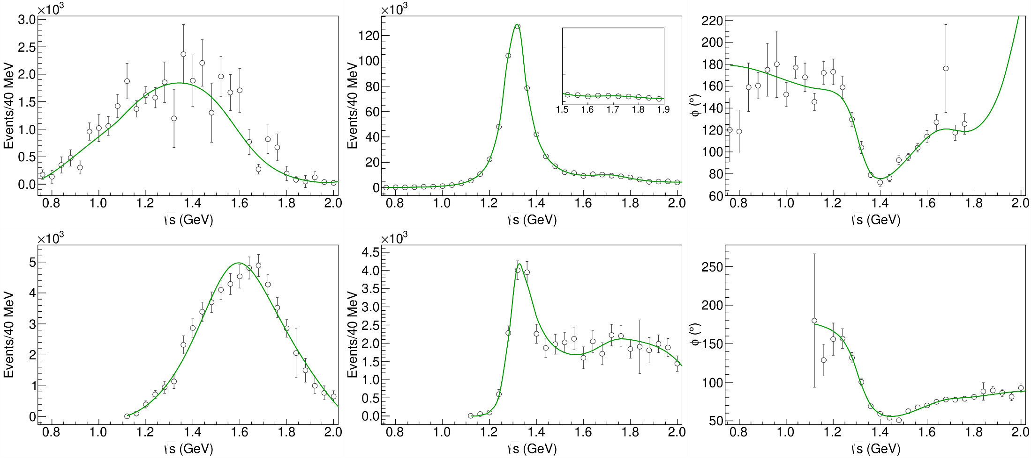
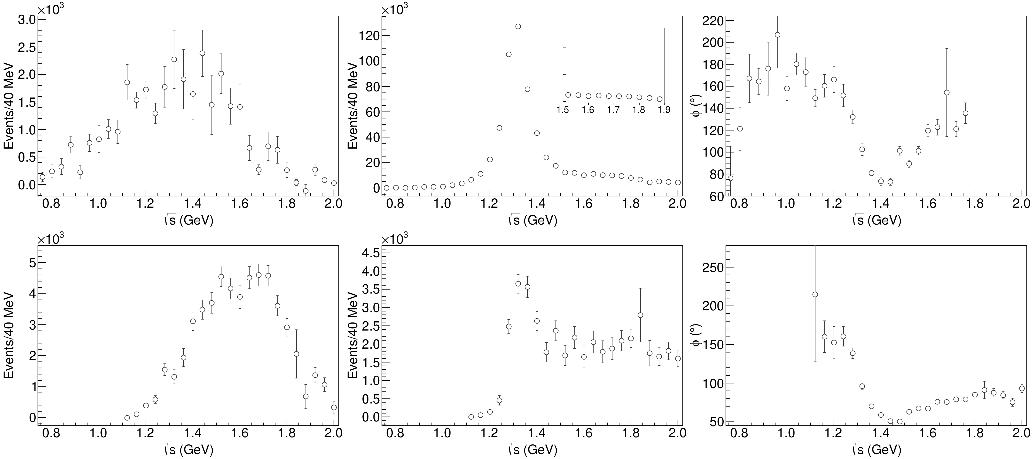
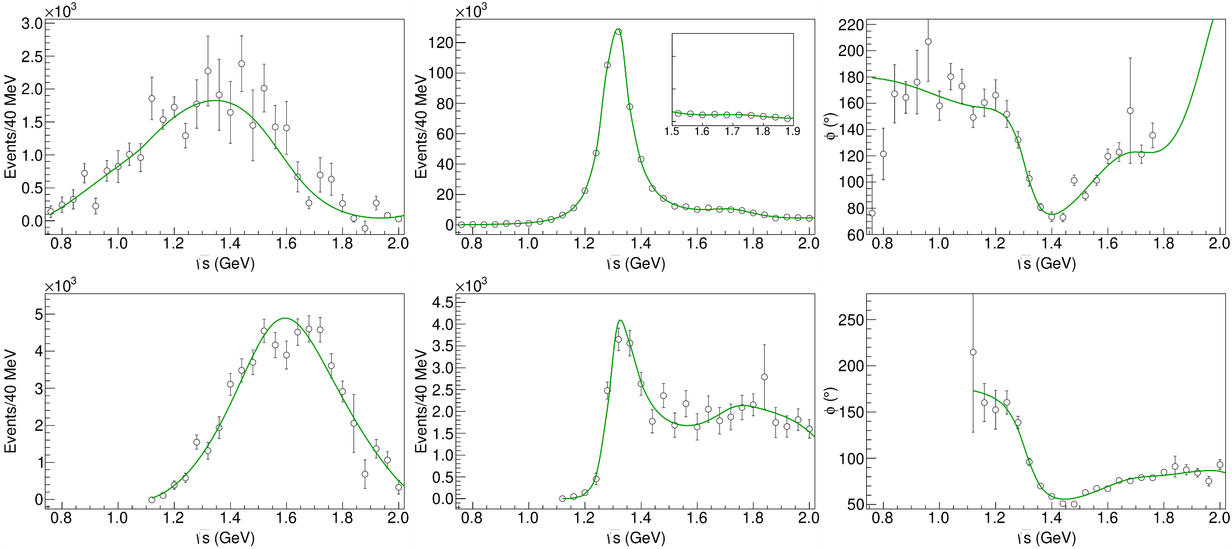
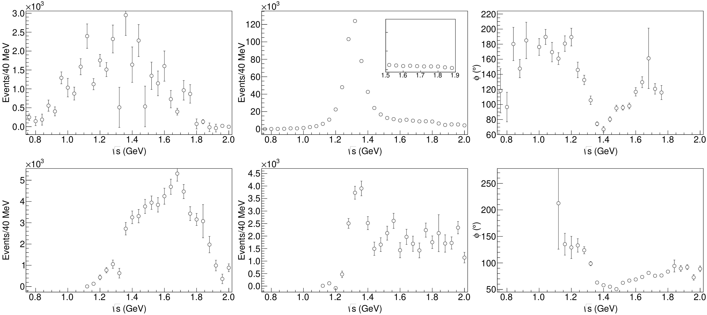
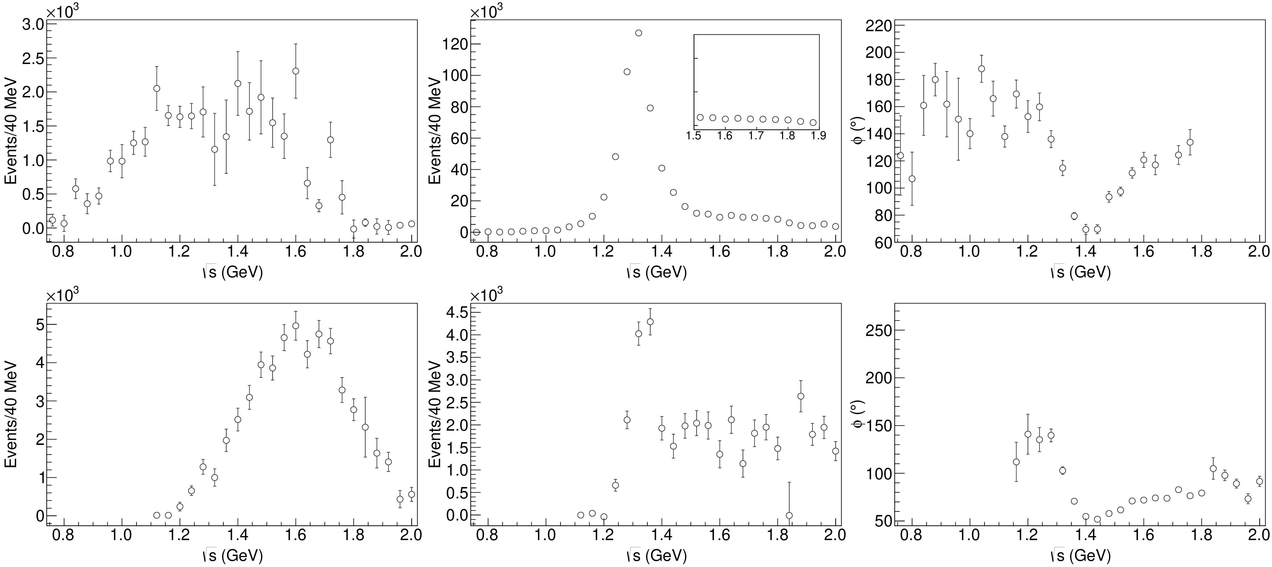
Statistical Bootstrap
A. Pilloni – Prospects for Hadron Spectroscopy
Notes:
Controlla la parte su Regge

Slide 38
Statistical Bootstrap
For each fit, we search poles: two clusters in D-wave: $a_{2}\left(1320\right)$ and $a_{2}^{′}\left(1700\right)$
A. Pilloni – Prospects for Hadron Spectroscopy
Notes:
Controlla la parte su Regge

Slide 39
Statistical Bootstrap
Only one stable cluster in $P$-wave: a single $π_{1}$
A. Pilloni – Prospects for Hadron Spectroscopy
Notes:
Controlla la parte su Regge

Slide 40
Final results
Agreement with Lattice is restored
That’s the most rigorous extraction of an exotic meson available so far!
A. Pilloni – Prospects for Hadron Spectroscopy
Notes:
Controlla la parte su Regge

Slide 41
Open challenges: the $XYZ$ states
Fernandez-R., AP et al., PRL
AP et al., PLB
Pole
Triangle
Esposito, AP, Polosa, Phys.Rept.
A. Pilloni – Prospects for Hadron Spectroscopy
Notes:
2 slides su Zc, a Bes e a Belle
2 slide su tetraquark model: dall’hamiltoniana di Jaffe al calcolo delle masse
1 slide su molecular models, dove sono i carichi? (non in Tornqvist, si in Hanhart, vedere Braaten, citare Nefediev)
2 slides su decay channels, dove si dovrebbe vedere, e a seconda del modello, vedere qualche plot
1 slide su Y(4260), tetraquark? C’è lo strano (si vede la f0)
1 slide su Zc a cleo (anche il neutro)

Slide 42
Joint Physics Analysis Center
A. Pilloni – The pole hunter

Slide 43
Epilogue
Why hadron spectroscopy is important?
To infer the dynamics of QCD building blocks
To reduce the «hadronic uncertainties» in precision physics (e.g. $τ$ EDM, $g_{μ}−2$, CPV in hadronic $B$ decays...)
To answer fundamental questions about confinement and mass generation
(the honest answer would be «because we are nerds and we like it», but we cannot answer like this to funding agencies)
Thank you!
A. Pilloni – Prospects for Hadron Spectroscopy
Notes:
2 slides su Zc, a Bes e a Belle
2 slide su tetraquark model: dall’hamiltoniana di Jaffe al calcolo delle masse
1 slide su molecular models, dove sono i carichi? (non in Tornqvist, si in Hanhart, vedere Braaten, citare Nefediev)
2 slides su decay channels, dove si dovrebbe vedere, e a seconda del modello, vedere qualche plot
1 slide su Y(4260), tetraquark? C’è lo strano (si vede la f0)
1 slide su Zc a cleo (anche il neutro)

Slide 44
Backup

Slide 45
How we probe the forces
We smash particles against each other, the best way of creating new particles
It’s like if in a car accident, the pieces of the collision would create new fancy, expensive cars
(Do not try with your car. Believe me, it’s a bad idea)
A. Pilloni – Prospects for Hadron Spectroscopy

Slide 46
How we probe the forces at CERN
LHC collides protons at $13 \text{TeV}$ (kinetic energy of a mosquito)
A. Pilloni – Prospects for Hadron Spectroscopy

Slide 47
Standard Model Constituents
Standard model is a remarkable simple theory
The particle in the spectrum can easily fit in a table
Lightest massive particle $<3 μ\text{eV}$
Heaviest particle $∼175 \text{GeV}$ (gold atom)
Masses span 17 orders of magnitude
H
Higgs
"Higgs interaction"
125,000
A. Pilloni – Prospects for Hadron Spectroscopy

Slide 48
Standard Model Constituents
According to relativity, the interaction cannot be instantaneous, but is mediated by fields that propagate with finite speed
In relativistic quantum mechanichs, these fields are quantized in particles
The range of the interaction depend on the mass of the mediator,
$λ∼\frac{ℏc}{m}$ (Compton wavelength)
H
Higgs
"Higgs interaction"
125,000
A. Pilloni – Prospects for Hadron Spectroscopy

Slide 49
Quantum ChromoDynamics (QCD)
Quarks appear in 6 flavors, with (very) different masses
Each quark can be in 3 identical colors
$$r,g,b$$
Each gluon can be in 8 colors
$r\overline{g},r\overline{b},b\overline{g}$, $b\overline{r}$,$g\overline{b}$, $g\overline{r}$, $$r\overline{r}−b\overline{b},r\overline{r}+b\overline{b}−2g\overline{g}$$
H
Higgs
"Higgs interaction"
125,000
Gluon is massless. Long range?
Have you ever observed a quark?
A. Pilloni – Prospects for Hadron Spectroscopy

Slide 50
Welcome to Hell
Review of Particle Physics
Only white particles have been observed so far, forming an extremly rich zoo of hadrons
A. Pilloni – Prospects for Hadron Spectroscopy

Slide 51
Flavor symmetry
Hadron appear in approximate degenerate multiplets (group theory needed)
This observation led to the discovery of quark constituents without observing a single quark!
Amplitudes of particles in the same multiplet are related (Wigner-Eckart theorem)
A. Pilloni – Prospects for Hadron Spectroscopy

Slide 52
Pole hunting
I sheet
Bound states on the real axis 1st sheet
Not-so-bound (virtual) states on the real axis 2nd sheet
II sheet
A. Pilloni – Prospects for Hadron Spectroscopy
Notes:
Controlla la parte su Regge

Slide 53
Unitarity
Probability conservation implies ${\left|S\left(E\right)\right|}^{2}=1$
For the amplitude, this turns into
$$f\left(E+iε\right)−f\left(E−iε\right)≠0$$
Branch cut!
Example: $i\sqrt{E}$...
$$i\sqrt{e^{iπ}}=−1$$
$$i\sqrt{1}=i$$
$$i\sqrt{e^{2iπ}}=−i$$
A. Pilloni – Prospects for Hadron Spectroscopy
Notes:
Controlla la parte su Regge

Slide 54
Unitarity
Probability conservation implies ${\left|S\left(E\right)\right|}^{2}=1$
For the amplitude, this turns into
$$f\left(E+iε\right)−f\left(E−iε\right)≠0$$
Branch cut!
Example: $i\sqrt{E}$...
$$i\sqrt{e^{iπ}}=1$$
...but I can decide to get the negative solution
$$i\sqrt{e^{2iπ}}=i$$
$$i\sqrt{1}=−i$$
A. Pilloni – Prospects for Hadron Spectroscopy
Notes:
Controlla la parte su Regge

Slide 55
Unitarity
Probability conservation a branch cut on the real axis, two sheets continuosly connected
A. Pilloni – Prospects for Hadron Spectroscopy
Notes:
Controlla la parte su Regge

Slide 56
Crossing symmetry
$$π^{+}$$
$$K^{+}$$
$$π^{+}$$
$$K^{−}$$
$$π^{+}$$
$$K^{+}$$
$$π^{−}$$
$$K^{−}$$
$$π^{+}$$
$$K^{−}$$
$$π^{+}$$
$$K^{+}$$
All these processes are not independent, but are described by the same amplitude!
Simplification – Complication!
A. Pilloni – Prospects for Hadron Spectroscopy
Notes:
Controlla la parte su Regge

Slide 57
Searching for resonances in $ηπ$
Smooth «background»
Precise determination of pole position
Notes:
Controlla la parte su Regge

Slide 58
Systematic studies
For each class, the maximum deviation of mass and width is taken as a systematic error Deviation smaller than the statistical error are neglected Systematic of different classes are summed in quadrature
A. Pilloni – Determination of the lightest hybrid meson pole
Notes:
Controlla la parte su Regge

Slide 59
Quarkonium orthodoxy
$$Q$$
$$\overline{Q}$$
Potential models
(meaningful when $M_{Q}$ large)
$$α_{s}\left(M_{Q}\right)∼0.3$$
(perturbative regime)
Solve NR Schrödinger eq. → spectrum
A. Pilloni – Prospects for Hadron Spectroscopy
Notes:
2 slides su Zc, a Bes e a Belle
2 slide su tetraquark model: dall’hamiltoniana di Jaffe al calcolo delle masse
1 slide su molecular models, dove sono i carichi? (non in Tornqvist, si in Hanhart, vedere Braaten, citare Nefediev)
2 slides su decay channels, dove si dovrebbe vedere, e a seconda del modello, vedere qualche plot
1 slide su Y(4260), tetraquark? C’è lo strano (si vede la f0)
1 slide su Zc a cleo (anche il neutro)

Slide 60
Example: The charged $Z_{c}\left(3900\right)$
A charged charmonium-like resonance has been claimed by BESIII in 2013.
$e^{+}e^{−}→Z_{c}{\left(3900\right)}^{+}π^{−}→J/ψ{ π}^{+}π^{−}$ and $→{\left(DD^{∗}\right)}^{+}π^{−}$ $M=3888.7±3.4$MeV, $Γ=35±7$ MeV
Such a state would require a minimal 4q content and would be manifestly exotic
A. Pilloni – Prospects for Hadron Spectroscopy
Notes:
Y(4260), M=4263 +- 5, Gamma = 95+-14
D_1(2420)^0, M=2421.3 ±0.6, Gamma =27.1 ±2.7
D_1(2420)^+-, M=2423.4 ±3.1, Gamma =25 ±6
I D_1 hanno J^P = 1^+
La molecola D_1 D sta 22 MeV sotto
Se la Y è D_1 D, il pione lega fortemente, come fa la Y a essere così larga?
Come funziona lo scambio del pione???

Slide 61
Amplitude analysis for $Z_{c}(3900)$
One can test different parametrizations of the amplitude, which correspond to different singularities → different natures
AP et al. (JPAC), PLB772, 200
$$Z_{c}\left(3900\right)?$$
$${u: D}_{0}(2400)$$
$${u:Z}_{c}\left(3900\right)?$$
$$"σ, f_{0}(980)"$$
$$D_{1}(2420)$$
Triangle rescattering, logarithmic branching point
(anti)bound state, II/IV sheet pole
(«molecule»)
Resonance, III sheet pole
(«compact state»)
$$π$$
$$D_{1}$$
$$Y$$
$$D^{∗}$$
$$π$$
$$\overline{D}$$
$$J/ψ$$
Tornqvist, Z.Phys. C61, 525
Swanson, Phys.Rept. 429
Hanhart et al. PRL111, 132003
Maiani et al., PRD71, 014028
Faccini et al., PRD87, 111102
Esposito et al., Phys.Rept. 668
Szczepaniak, PLB747, 410
A. Pilloni – Prospects for Hadron Spectroscopy
Notes:
Controlla la parte su Regge

Slide 62
Fit: III
A. Pilloni – Prospects for Hadron Spectroscopy
Notes:
Controlla la parte su Regge

Slide 63
Fit: III+tr.
A. Pilloni – Prospects for Hadron Spectroscopy
Notes:
Controlla la parte su Regge

Slide 64
Fit: IV+tr.
A. Pilloni – Prospects for Hadron Spectroscopy
Notes:
Controlla la parte su Regge

Slide 65
Fit: tr.
A. Pilloni – Prospects for Hadron Spectroscopy
Notes:
Controlla la parte su Regge

Slide 66
Pole extraction
III
III+tr.
IV+tr.
A. Pilloni – Prospects for Hadron Spectroscopy
Not conclusive at this stage
Notes:
Controlla la parte su Regge

Slide 67
Finite energy sum rules
PWA in the low energy region
Resonance extraction
Analytically connected
Regge exchanges at high energy
A. Pilloni – Prospects for Hadron Spectroscopy
Notes:
Controlla la parte su Regge

Slide 68
Pole hunting
I sheet
Extracting physics information means to hunt for poles in the complex plane
Pole position → Mass and width
Residues → Couplings
Virtual state
II sheet
Bound state
Resonance
A. Pilloni – Prospects for Hadron Spectroscopy
Notes:
Controlla la parte su Regge

Slide 69
$X(3872)$
Discovered in $B→K X→K J/ψ ππ$
Quantum numbers $1^{++}$
Very close to $DD^{∗}$ threshold
Too narrow for an above-treshold charmonium
Isospin violation too big $\frac{Γ\left(X→J/ψ ω\right)}{Γ\left(X→J/ψ ρ\right)}\sim 0.8±0.3$
Mass prediction not compatible with $χ_{c1}(2P)$
$M=3871.68±0.17$MeV
$$M_{X}−M_{DD^{∗}}=−3±192 \text{keV}$$
$Γ<1.2 \text{MeV}\text{ @90\%}$
A. Pilloni – Prospects for Hadron Spectroscopy

Slide 70
$X(3872)$
Large prompt production at hadron colliders
$$σ_{B}/σ_{TOT}=\left(26.3±2.3±1.6\right)\%$$
$$σ_{PR}×B(X→J/ψππ)=\left(1.06±0.11±0.15\right) \text{nb}$$
CMS, JHEP 1304, 154
A. Pilloni – Prospects for Hadron Spectroscopy

Slide 71
Vector $Y$ states
Lots of unexpected ${J^{PC}=1}^{−−}$ states found in ISR/direct production (and nowhere else!)
Seen in few final states, mostly $J/ψ ππ$ and $ψ\left(2S\right) ππ$
Not seen decaying into open charm pairs
Large HQSS violation
Belle $J/ψππ$
BES $h_{c}ππ$
A. Pilloni – Prospects for Hadron Spectroscopy
Notes:
Y(4260), M=4263 +- 5, Gamma = 95+-14
D_1(2420)^0, M=2421.3 ±0.6, Gamma =27.1 ±2.7
D_1(2420)^+-, M=2423.4 ±3.1, Gamma =25 ±6
I D_1 hanno J^P = 1^+
La molecola D_1 D sta 22 MeV sotto
Se la Y è D_1 D, il pione lega fortemente, come fa la Y a essere così larga?
Come funziona lo scambio del pione???

Slide 72
Vector $Y$ states in BESIII
BESIII, PRL118, 092002 (2017)
BESIII, PRL118, 092001 (2017)
$$e^{+}e^{−}→J/ψ ππ$$
$$e^{+}e^{−}→h_{c} ππ$$
New BESIII data show a peculiar lineshape for the $Y(4260)$
The state appear lighter and narrower, compatible with the ones in $h_{c}ππ$ and $χ_{c0}ω$
A broader old-fashioned $Y(4260)$ is appearing in $\overline{D}D^{∗}π$, maybe indicating a ${\overline{D}D}_{1}$
dominance
$$e^{+}e^{−}→π^{+}D^{0}D^{∗−}$$
A. Pilloni – Prospects for Hadron Spectroscopy
Notes:
Y(4260), M=4263 +- 5, Gamma = 95+-14
D_1(2420)^0, M=2421.3 ±0.6, Gamma =27.1 ±2.7
D_1(2420)^+-, M=2423.4 ±3.1, Gamma =25 ±6
I D_1 hanno J^P = 1^+
La molecola D_1 D sta 22 MeV sotto
Se la Y è D_1 D, il pione lega fortemente, come fa la Y a essere così larga?
Come funziona lo scambio del pione???
Close propone che la Y è D_1 D^* col pione scambiato in onda S,
La Y però non va in Ds come se fosse tetraquark

Slide 73
Charged $Z$ states: $Z_{c}\left(3900\right), Z_{c}^{′}(4020)$
Charged quarkonium-like resonances have been found, 4q needed
Two states $J^{PC}=1^{+−}$ appear slightly above $D^{(∗)}D^{∗}$ thresholds
$e^{+}e^{−}→Z_{c}{\left(3900\right)}^{+}π^{−}→J/ψ{ π}^{+}π^{−}$ and $→{\left(DD^{∗}\right)}^{+}π^{−}$ $M=3888.7±3.4$MeV, $Γ=35±7$ MeV
$e^{+}e^{−}→Z_{c}^{′}{\left(4020\right)}^{+}π^{−}→h_{c}{ π}^{+}π^{−}$ and $→{\overline{D}}^{∗0}D^{∗+}π^{−}$
$M=4023.9±2.4$MeV, $Γ=10±6$ MeV
A. Pilloni – Prospects for Hadron Spectroscopy
Notes:
Y(4260), M=4263 +- 5, Gamma = 95+-14
D_1(2420)^0, M=2421.3 ±0.6, Gamma =27.1 ±2.7
D_1(2420)^+-, M=2423.4 ±3.1, Gamma =25 ±6
I D_1 hanno J^P = 1^+
La molecola D_1 D sta 22 MeV sotto
Se la Y è D_1 D, il pione lega fortemente, come fa la Y a essere così larga?
Come funziona lo scambio del pione???

Slide 74
Charged $Z$ states: $Z_{b}\left(10610\right), Z_{b}^{′}(10650)$
Anomalous dipion width in $Υ\left(5S\right)$,
2 orders of magnitude larger than $Υ\left(nS\right)$
Moreover, observed $Υ\left(5S\right)→h_{b}\left(nP\right)ππ$ which violates HQSS
$Υ\left(5S\right)→Z_{b}{\left(10610\right)}^{+}π^{−}→Υ\left(nS\right){ π}^{+}π^{−},h_{b}\left(nP\right){ π}^{+}π^{−}$ and $→{\left(BB^{∗}\right)}^{+}π^{−}$ $M=10607.2±2.0$MeV, $Γ=18.4±2.4$ MeV
$Υ\left(5S\right)→Z_{b}^{′}{\left(10650\right)}^{+}π^{−}→Υ\left(nS\right){ π}^{+}π^{−},h_{b}\left(nP\right){ π}^{+}π^{−}$ and $→{\overline{B}}^{∗0}B^{∗+}π^{−}$
$M=10652.2±1.5$MeV, $Γ=11.5±2.2$ MeV
2 twin resonances!
A. Pilloni – Prospects for Hadron Spectroscopy
Notes:
Y(4260), M=4263 +- 5, Gamma = 95+-14
D_1(2420)^0, M=2421.3 ±0.6, Gamma =27.1 ±2.7
D_1(2420)^+-, M=2423.4 ±3.1, Gamma =25 ±6
I D_1 hanno J^P = 1^+
La molecola D_1 D sta 22 MeV sotto
Se la Y è D_1 D, il pione lega fortemente, come fa la Y a essere così larga?
Come funziona lo scambio del pione???

Slide 75
Pentaquarks!
LHCb, PRL 115, 072001
LHCb, PRL 117, 082003
Two states seen in $Λ_{b}→\left(J/ψ p\right) K^{−}$,
evidence in $Λ_{b}→\left(J/ψ p\right) π^{−}$
$$M_{1}=4380±8±29 \text{MeV} \\ Γ_{1}=205±18±86 \text{MeV}$$
$$M_{2}=4449.8±1.7±2.5 \text{MeV} \\ Γ_{2}=39±5±19 \text{MeV}$$
Quantum numbers $$J^{P}=\left({\frac{3}{2}}^{−},{\frac{5}{2}}^{+}\right) \text{or}\left({\frac{3}{2}}^{+},{\frac{5}{2}}^{−}\right)\text{or}\left({\frac{5}{2}}^{+},{\frac{3}{2}}^{−}\right)$$
Opposite parities needed for the interference to correctly describe angular distributions, low mass region contaminated by $Λ^{∗}$ (model dependence?)
No obvious threshold nearby
A. Pilloni – Prospects for Hadron Spectroscopy
Notes:
Y(4260), M=4263 +- 5, Gamma = 95+-14
D_1(2420)^0, M=2421.3 ±0.6, Gamma =27.1 ±2.7
D_1(2420)^+-, M=2423.4 ±3.1, Gamma =25 ±6
I D_1 hanno J^P = 1^+
La molecola D_1 D sta 22 MeV sotto
Se la Y è D_1 D, il pione lega fortemente, come fa la Y a essere così larga?
Come funziona lo scambio del pione???

Slide 76
Pentaquarks!
LHCb, PRL 115, 072001
LHCb, PRL 117, 082003
Two states seen in $Λ_{b}→\left(J/ψ p\right) K^{−}$,
evidence in $Λ_{b}→\left(J/ψ p\right) π^{−}$
$$M_{1}=4380±8±29 \text{MeV} \\ Γ_{1}=205±18±86 \text{MeV}$$
$$M_{2}=4449.8±1.7±2.5 \text{MeV} \\ Γ_{2}=39±5±19 \text{MeV}$$
Quantum numbers $$J^{P}=\left({\frac{3}{2}}^{−},{\frac{5}{2}}^{+}\right) \text{or}\left({\frac{3}{2}}^{+},{\frac{5}{2}}^{−}\right)\text{or}\left({\frac{5}{2}}^{+},{\frac{3}{2}}^{−}\right)$$
Opposite parities needed for the interference to correctly describe angular distributions, low mass region contaminated by $Λ^{∗}$ (model dependence?)
No obvious threshold nearby
MC simul.
A. Pilloni – Prospects for Hadron Spectroscopy
Notes:
Y(4260), M=4263 +- 5, Gamma = 95+-14
D_1(2420)^0, M=2421.3 ±0.6, Gamma =27.1 ±2.7
D_1(2420)^+-, M=2423.4 ±3.1, Gamma =25 ±6
I D_1 hanno J^P = 1^+
La molecola D_1 D sta 22 MeV sotto
Se la Y è D_1 D, il pione lega fortemente, come fa la Y a essere così larga?
Come funziona lo scambio del pione???

Slide 77
New pentaquarks discovered
LHCb, PRL 122, 222001
A higher statistics 1D analysis is able to resolve the fine structure of the $P_{c}(4450)$ peak.
Moreover, a new isolated $P_{c}(4312)$ at the $Σ_{c}^{+}{\overline{D}}^{0}$ threshold appears
The old assignment of quantum numbers might be jeopardized by this new finding
A. Pilloni – Predictive power of different theory approaches
Notes:
Controlla la parte su Regge

Slide 78
Bound and virtual states
Decreasing the potential strength, the pole reaches threshold
The pole jumps on the 2nd sheet (dineutron), it becomes a virtual state
Example from $pn$ scattering Bound state on the real axis 1st sheet (deuteron)
$$V(r)$$
$$\text{Im} E$$
$$r$$
$$V$$
Deuteron
$$\text{Re} E$$
$${}_{}^{1}S$$
Deuteron pole
Dineutron pole
$${}_{}^{3}S$$
A. Pilloni – Predictive power of different theory approaches
Notes:
Controlla la parte su Regge

Slide 79
Bound and virtual states
The situation is more complicated when more channels are open
Virtual state
Bound state
Resonance
A. Pilloni – Predictive power of different theory approaches
Notes:
Controlla la parte su Regge

Slide 80
Minimal(istic) model
( data)
Fernandez-Ramirez, AP et al. (JPAC), PRL 123, 092001
Effective range expansion We can set $c_{ii}=0$ to reduce to the scattering length approximation
$$c_{ii}=0$$
Finite $c_{ii}$
A. Pilloni – Predictive power of different theory approaches
Notes:
2 slides su Zc, a Bes e a Belle
2 slide su tetraquark model: dall’hamiltoniana di Jaffe al calcolo delle masse
1 slide su molecular models, dove sono i carichi? (non in Tornqvist, si in Hanhart, vedere Braaten, citare Nefediev)
2 slides su decay channels, dove si dovrebbe vedere, e a seconda del modello, vedere qualche plot
1 slide su Y(4260), tetraquark? C’è lo strano (si vede la f0)
1 slide su Zc a cleo (anche il neutro)

Slide 81
Minimal(istic) model
Effective range expansion We can set $c_{ii}=0$ to reduce to the scattering length approximation
$$c_{ii}=0$$
Finite $c_{ii}$
A. Pilloni – Predictive power of different theory approaches
Notes:
2 slides su Zc, a Bes e a Belle
2 slide su tetraquark model: dall’hamiltoniana di Jaffe al calcolo delle masse
1 slide su molecular models, dove sono i carichi? (non in Tornqvist, si in Hanhart, vedere Braaten, citare Nefediev)
2 slides su decay channels, dove si dovrebbe vedere, e a seconda del modello, vedere qualche plot
1 slide su Y(4260), tetraquark? C’è lo strano (si vede la f0)
1 slide su Zc a cleo (anche il neutro)

Slide 82
Minimal(istic) model
Effective range expansion We can set $c_{ii}=0$ to reduce to the scattering length approximation
Points to a virtual state
$$c_{ii}=0$$
Finite $c_{ii}$
A. Pilloni – Predictive power of different theory approaches
Notes:
2 slides su Zc, a Bes e a Belle
2 slide su tetraquark model: dall’hamiltoniana di Jaffe al calcolo delle masse
1 slide su molecular models, dove sono i carichi? (non in Tornqvist, si in Hanhart, vedere Braaten, citare Nefediev)
2 slides su decay channels, dove si dovrebbe vedere, e a seconda del modello, vedere qualche plot
1 slide su Y(4260), tetraquark? C’è lo strano (si vede la f0)
1 slide su Zc a cleo (anche il neutro)

Slide 83
Minimal(istic) model
Effective range expansion We can set $c_{ii}=0$ to reduce to the scattering length approximation
Points to a virtual state
Doesn’t point to a resonance
$$c_{ii}=0$$
Finite $c_{ii}$
A. Pilloni – Predictive power of different theory approaches
Notes:
2 slides su Zc, a Bes e a Belle
2 slide su tetraquark model: dall’hamiltoniana di Jaffe al calcolo delle masse
1 slide su molecular models, dove sono i carichi? (non in Tornqvist, si in Hanhart, vedere Braaten, citare Nefediev)
2 slides su decay channels, dove si dovrebbe vedere, e a seconda del modello, vedere qualche plot
1 slide su Y(4260), tetraquark? C’è lo strano (si vede la f0)
1 slide su Zc a cleo (anche il neutro)

Slide 84
Minimal(istic) model
Effective range expansion We can set $c_{ii}=0$ to reduce to the scattering length approximation
Points to a virtual state
Doesn’t point to a resonance
$$c_{ii}=0$$
Finite $c_{ii}$
A. Pilloni – Predictive power of different theory approaches
Notes:
2 slides su Zc, a Bes e a Belle
2 slide su tetraquark model: dall’hamiltoniana di Jaffe al calcolo delle masse
1 slide su molecular models, dove sono i carichi? (non in Tornqvist, si in Hanhart, vedere Braaten, citare Nefediev)
2 slides su decay channels, dove si dovrebbe vedere, e a seconda del modello, vedere qualche plot
1 slide su Y(4260), tetraquark? C’è lo strano (si vede la f0)
1 slide su Zc a cleo (anche il neutro)

Slide 85
$P_{c}$ photoproduction
Karliner & Rosner, PLB752, 329
Hiller Blin, AP et al. (JPAC), PRD94, 034002
D. Winney, C. Fanelli, AP et al. (JPAC) PRD100, 034019
The background is described via an Effective Vector Pomeron
Vector meson dominance relates radiative width to hadronic one
Fit the model to GlueX and SLAC data, upper limit $BR_{J/ψp}<4.3\%$ for $J^{P}={\frac{3}{2}}^{−}$
A. Pilloni – Predictive power of different theory approaches
Notes:
Controlla la parte su Regge

Slide 86
Polarization observables
One can take advantage of the polarized beam at Jlab Need polarized target ($A_{LL}$) or polarization of recoiling proton ($K_{LL}$)
$$K_{LL}$$
(in SBS acceptance)
A. Pilloni – Heavy quark Spectroscopy
Notes:
Controlla la parte su Regge

Slide 87
Two options for the EIC
eRHIC
arXiv:1409.1633
Energy range:
e-: 15-20 GeV
p: 100-250 GeV
W: 40-120 GeV
JLEIC
arXiv:1504.07961
Energy range:
e-: 3-10 GeV
p : 20-100 GeV
W: 20-100 GeV

Slide 88
Two options for the EIC
eRHIC
arXiv:1409.1633
Energy range:
e-: 15-20 GeV
p: 100-250 GeV
W: 40-120 GeV
Luminosity vs. COM energy
JLEIC
arXiv:1504.07961
Energy range:
e-: 3-10 GeV
p : 20-100 GeV
W: 20-100 GeV

Slide 89
EIC vs. rest of the world
Luminosity 100-1000 times that of HERA Enable 3D tomography of gluons and sea quarks in protons
Polarized protons and light nuclear beams Critical to all spin physics related studies, including precise knowledge of gluon’s spin & angular momentum contributions from partons to the nucleon’s spin
Nuclear beams of all A (p→U) to study gluon density at saturation scale and to search for coherent effects like the color glass condensate and test universality
Centre of mass variability with minimal loss of luminosity Critical to study onset of interesting QCD phenomena
Detector & IR designs mindful of “Lessons learned from HERA” No bends in e-beam, maximal forward acceptance….

Slide 90
EIC detector challenges
Resolve partons in nucleons
high beam energies and luminosities
$Q^{2}$ up to $∼1000 {\text{GeV}}^{2}$
Need to resolve quantities ($k_{T}$, $b_{T}$) of the order a few hundred MeV in the proton
Correlated quantities, multi-dim analyses
High Granularity, wide dynamic range
Need to detect all types of remnants to seek for correlations:
scattered electron
particles associated with initial ion
particles associated with struck parton
Large acceptance, Forward particle detection, Excellent PID

Slide 91
EIC community worldwide
734 collaborators, 29 countries, 167 institutions... (February 24, 2018)

