Slide 1
Exotic hadron spectroscopy I: From experiment to theory
Alessandro Pilloni
DTP, May 3rd, 2022

Slide 2
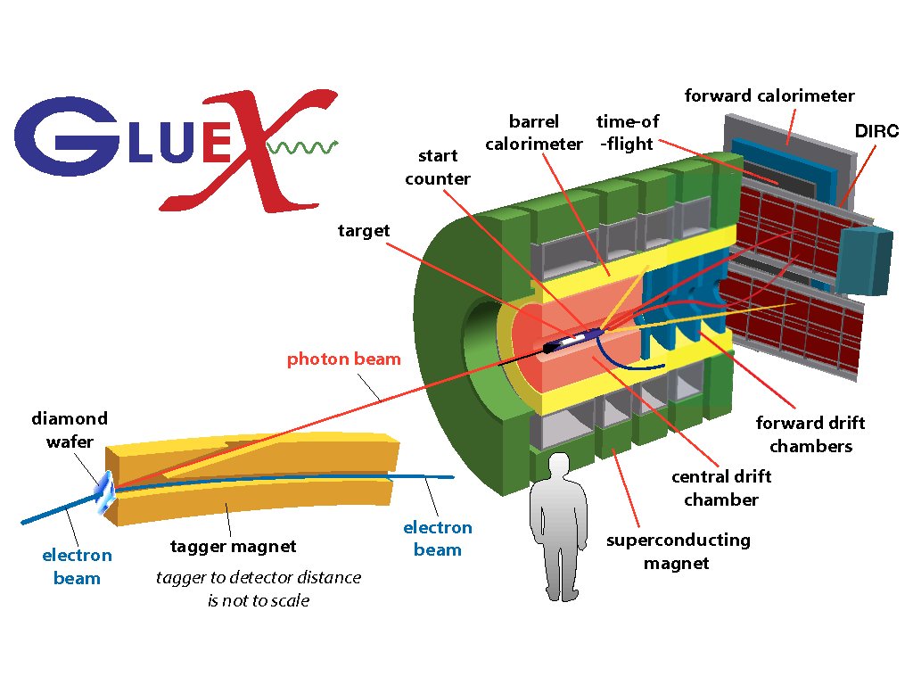
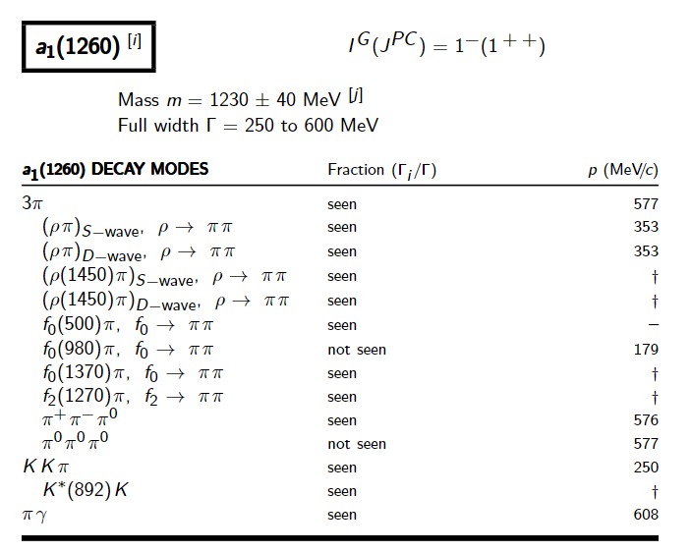
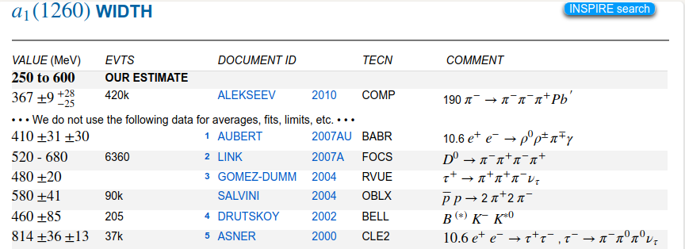
How theorists think of experiments
All the information about hadrons is collected by the Particle Data Group
$$G$$
Changing beam and target, you can change the font
P
D
What theorists see…
What experimentalists present…
A. Pilloni – Exotic hadron spectroscopy

Slide 3
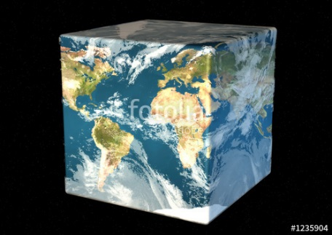
The Richness of the Spectrum
Meson
Baryon
Glueball
Hybrids
Tetraquark
Molecule
Experiment
Data
Amplitude analysis
QCD
Lattice QCD
With great statistics comes great responsibility!
Peter Parker, PhD
For theorists, this is an experimental business
For experimentalists, this is grandma’s recipe
A. Pilloni – Exotic hadron spectroscopy

Slide 4
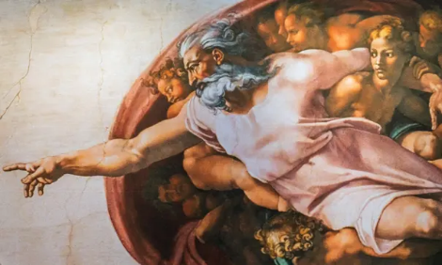
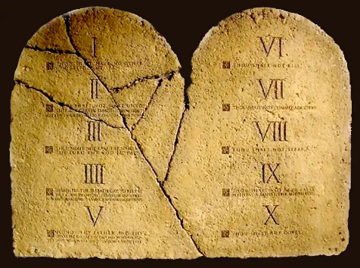
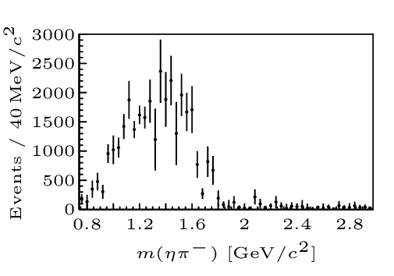
Top-down approach
You are given a model/theory
$$f(s)$$
You calculate the amplitude
You compare with data. Or you don’t.
Predictive power ✓
Physical interpretation ✓ (within the model! ✗) Biased by the input ✗
A. Pilloni – Exotic hadron spectroscopy

Slide 5
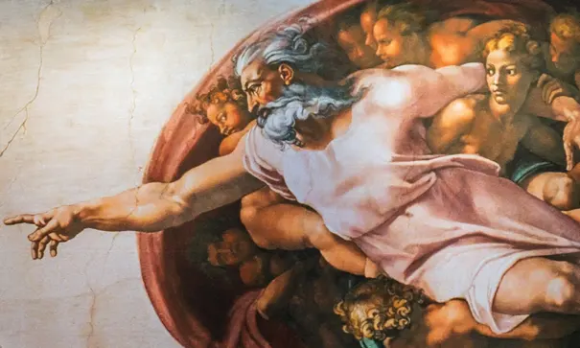
Options on the market
Quark-level calculations:
Quark models, pNRQCD, Hybrids, ...
Spectrum generally calculated as bound states of some potential
Decay rates as «overlap integrals» between two static configurations
Comprehensive picture ✓ Little scattering dynamics ✗
Hadron level calculations:
Compact states vs. molecules, triangles...
States as poles of scattering amplitudes
Couplings as residues at the poles
Scattering dynamics ✓ More case-by-case ✓✗
A. Pilloni – Exotic hadron spectroscopy

Slide 6
Constituent quark model
Godfrey and Isgur, PRD 32, 189 Capstick and Isgur, PRD 33, 2809
A. Pilloni – Exotic hadron spectroscopy

Slide 7
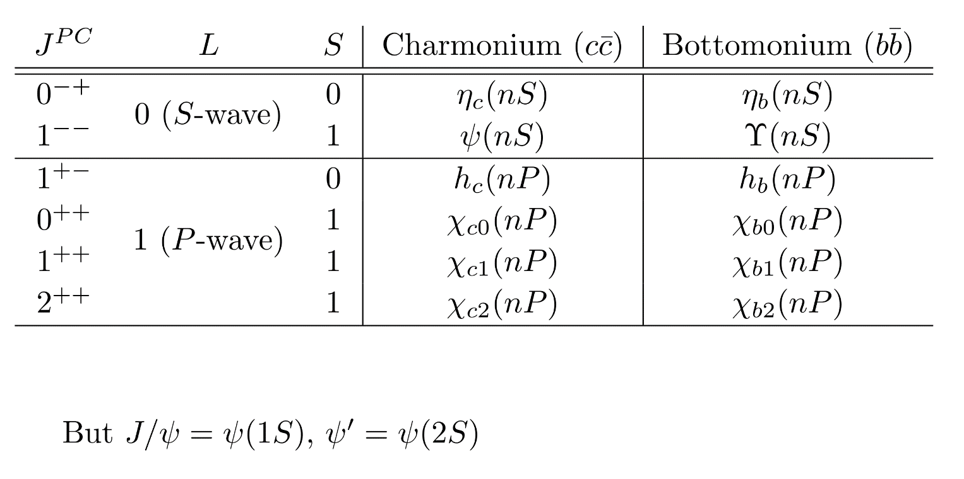
Dictionary – Quark model
$L=$orbital angular momentum
$S=$spin $q+\overline{q}$
$J=$total angular momentum
$=$ exp. measured spin
$I=$isospin $=$ 0 for quarkonia
$$q$$
$$L−S≤J≤L+S$$
$$P={\left(−1\right)}^{L+1}, C={\left(−1\right)}^{L+S}$$
$$G={\left(−1\right)}^{L+S+I}$$
$$\overline{q}$$
QUESTION: Why is the quark model (multiplets of spin and flavor) wrong?
Answer: Coleman-Mandula theorem forbids nontrivial combination of spacetime and internal symmetries
A. Pilloni – Exotic hadron spectroscopy
Notes:
2 slides su Zc, a Bes e a Belle
2 slide su tetraquark model: dall’hamiltoniana di Jaffe al calcolo delle masse
1 slide su molecular models, dove sono i carichi? (non in Tornqvist, si in Hanhart, vedere Braaten, citare Nefediev)
2 slides su decay channels, dove si dovrebbe vedere, e a seconda del modello, vedere qualche plot
1 slide su Y(4260), tetraquark? C’è lo strano (si vede la f0)
1 slide su Zc a cleo (anche il neutro)

Slide 8
Definition of exotics
Despite it’s wrong, the vaste majority of hadrons obeys QM
Whatever is beyond $q\overline{q}$ for mesons and $qqq$ for baryons is exotic
Flavor exotics: e.g. doubly charged meson, baryon with positive strangeness Ex.: $T_{cc}^{+}$ ; if OZI rule enforced, $Z_{c,b}$, $P_{c}$…
Spin exotics: $J^{PC}$ not allowed in QM Ex.: $π_{1}(1600)$
Criptoexotics: $J^{PC}$ allowed, but properties not compatible with QM expectations Ex.: $Y(4260)$, $Λ(1405)$, hybrid baryons, $X(3872)$
Unjustified personal explanation: QM-allowed signatures can be written as leading-twist quark bilinears
Ex.: $\overline{ψ} \left(γ_{μ} \overset{⃡}{D_{ν}}+γ_{ν}\overset{⃡}{D_{μ}}\right)ψ$ is $2^{++}$
Ex.: $\overline{ψ}\left(γ^{μ} D_{μ}D_{ν}−γ^{μ}D_{ν}D_{μ}\right)ψ=i\overline{ψ} γ^{μ} F_{μν}ψ$ is $1^{−+}$
A. Pilloni – Exotic hadron spectroscopy
Notes:
2 slides su Zc, a Bes e a Belle
2 slide su tetraquark model: dall’hamiltoniana di Jaffe al calcolo delle masse
1 slide su molecular models, dove sono i carichi? (non in Tornqvist, si in Hanhart, vedere Braaten, citare Nefediev)
2 slides su decay channels, dove si dovrebbe vedere, e a seconda del modello, vedere qualche plot
1 slide su Y(4260), tetraquark? C’è lo strano (si vede la f0)
1 slide su Zc a cleo (anche il neutro)

Slide 9
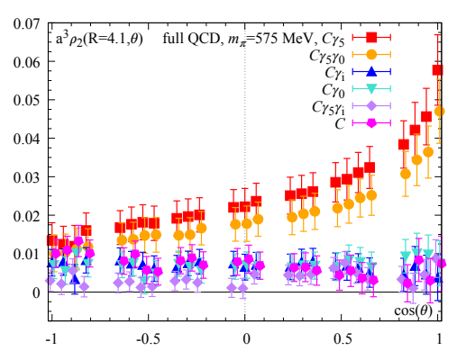
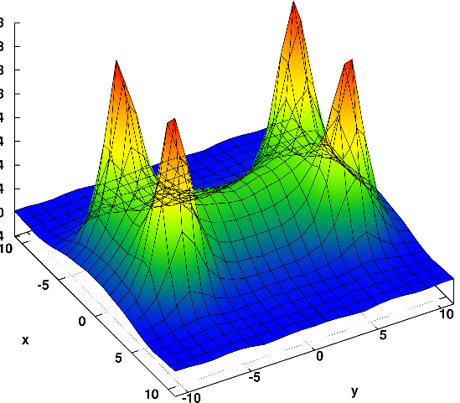
Diquarks
Attraction and repulsion in 1-gluon exchange approximation is given by
$$R=\frac{1}{2}\left(C_{2}\left(R_{12}\right)−C_{2}\left(R_{1}\right)−C_{2}\left(R_{2}\right)\right)$$
$$R_{1}=−\frac{4}{3}, R_{8}=+\frac{1}{6}$$
$$R_{3}=−\frac{2}{3}, R_{6}=+\frac{1}{3}$$
$$j$$
$$l$$
$$3_{c}×3_{c}∈{\overline{3}}_{c}$$
$$T_{ij}^{a}$$
$$T_{kl}^{a}$$
$$i$$
$$k$$
Francis et al. 2106.09080
H-shape with a 4 quark system
Cardoso, Cardoso, Bicudo, PRD84, 054508
A. Pilloni – Exotic hadron spectroscopy

Slide 10
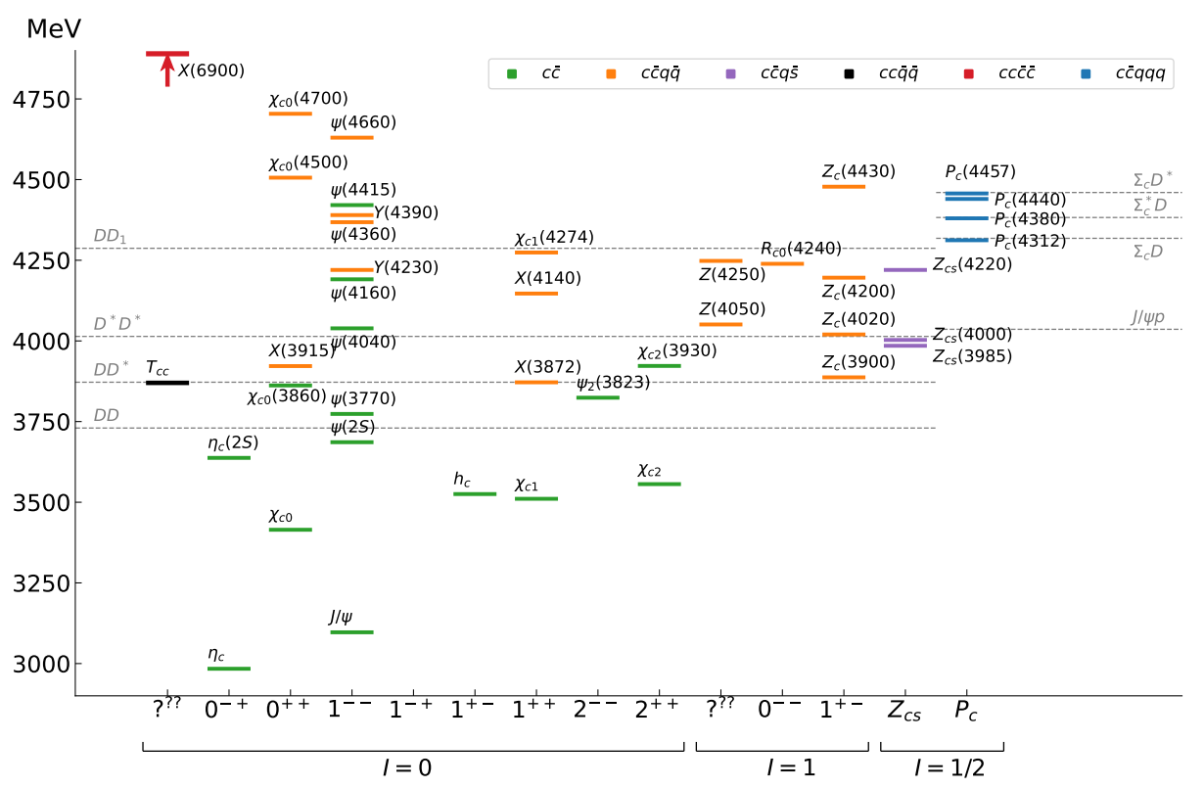
Exotic landscape in $c\overline{c}$
Esposito, AP, Polosa, Phys.Rept. 668
JPAC, arXiv:2112.13436
A host of unexpected resonances have appeared
decaying mostly into charmonium + light Hardly reconciled with usual $q\overline{q}$ pheno
A. Pilloni – Exotic hadron spectroscopy
Notes:
2 slides su Zc, a Bes e a Belle
2 slide su tetraquark model: dall’hamiltoniana di Jaffe al calcolo delle masse
1 slide su molecular models, dove sono i carichi? (non in Tornqvist, si in Hanhart, vedere Braaten, citare Nefediev)
2 slides su decay channels, dove si dovrebbe vedere, e a seconda del modello, vedere qualche plot
1 slide su Y(4260), tetraquark? C’è lo strano (si vede la f0)
1 slide su Zc a cleo (anche il neutro)

Slide 11
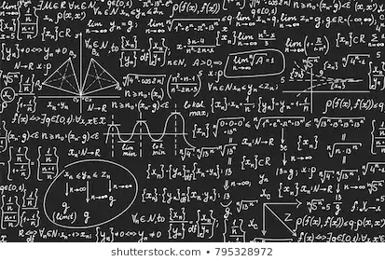
Bottom-up approach
Less predictive power ✗
Some physical interpretation ✗ Minimally biased ✓
You extract physics
You choose a set of generic amplitudes at the hadron level
You start with data
A. Pilloni – Exotic hadron spectroscopy

Slide 12
Life is not easy...
A. Pilloni – Exotic hadron spectroscopy
Notes:
2 slides su Zc, a Bes e a Belle
2 slide su tetraquark model: dall’hamiltoniana di Jaffe al calcolo delle masse
1 slide su molecular models, dove sono i carichi? (non in Tornqvist, si in Hanhart, vedere Braaten, citare Nefediev)
2 slides su decay channels, dove si dovrebbe vedere, e a seconda del modello, vedere qualche plot
1 slide su Y(4260), tetraquark? C’è lo strano (si vede la f0)
1 slide su Zc a cleo (anche il neutro)

Slide 13
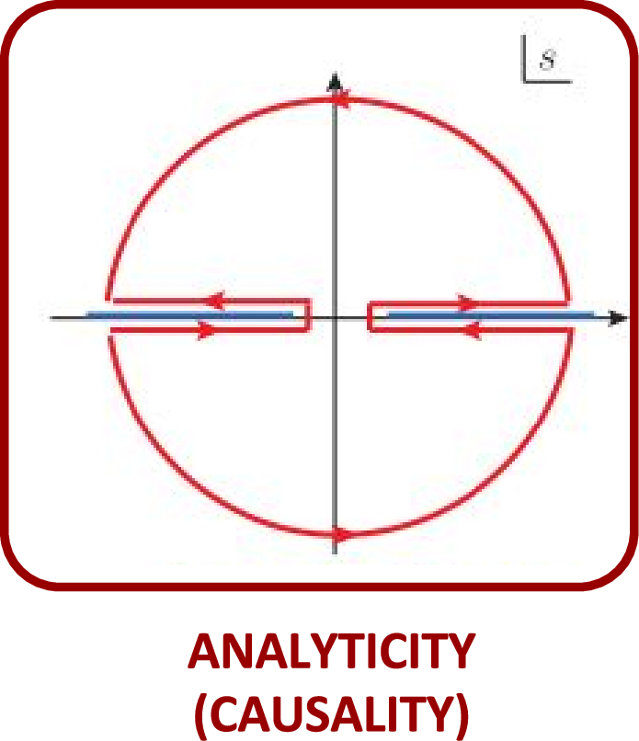
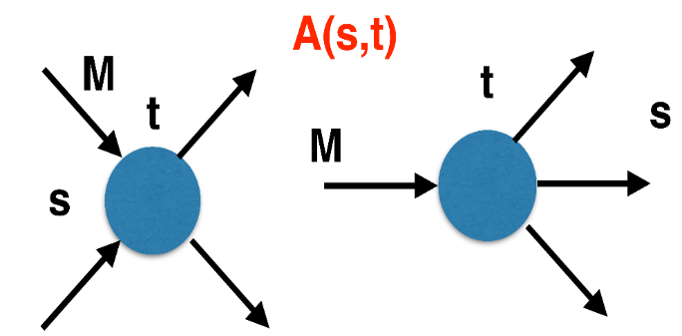
The S-Matrix principles
Future cannot change the past
100%, something will happen
The anti-particle is an anti-particle and not just a different particle
(analyticity)
(unitarity)
(crossing symmetry)
Sherlock Holmes, QFT
Analyticity
Unitarity
Crossing
Parametrize your ignorance.
Build a model.
Fit data.
Have fun.
A. Pilloni – Exotic hadron spectroscopy

Slide 14
$S$-Matrix principles
$$t_{l}\left(s\right)=\lim_{ε→0}t_{l}(s+iε)⁡$$
Analyticity
$$\text{Im} t_{l}=ρ_{l}{\left|t_{l}\right|}^{2} ⁡$$
These are constraints the amplitudes have to satisfy, but do not fix the dynamics
They can be imposed with an increasing amount of rigor, to extract robust physics information
The «background» phenomena can be effectively parameterized in a controlled way
+ Lorentz, discrete & global symmetries
A. Pilloni – Exotic hadron spectroscopy
Notes:
Controlla la parte su Regge

Slide 15
Basics of $2→2$ elastic scattering
Let us consider the elastic scattering of two equal mass spinless particles
$s={\left(p_{1}+p_{2}\right)}^{2}=$ energy squared
$t={\left(p_{1}−p_{3}\right)}^{2}∝\cos{θ}=$ momentum transferred
$$3$$
$$1$$
$$θ$$
$$2$$
$$4$$
Legendre polynomial
$$A\left(s,t\right)=\sum_{l}{A_{l}\left(s\right)P_{l}(\cos{θ})}$$
$$\text{Im} A_{l}\left(s\right)=ρ\left(s\right){\left|A_{l}\left(s\right)\right|}^{2}$$
Phase space (known)
Partial wave
Partial waves diagonalize unitarity: each one statisfy a separate equation Each partial wave has definite orbital angular momentum = spin
Remember: I can only measure cross section (amplitude squared)
A. Pilloni – Exotic hadron spectroscopy

Slide 16
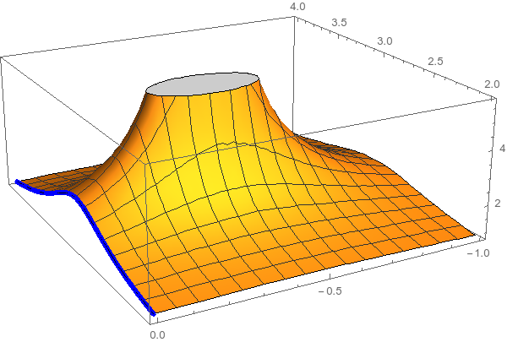
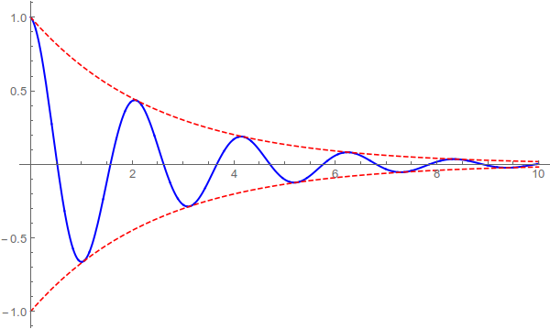
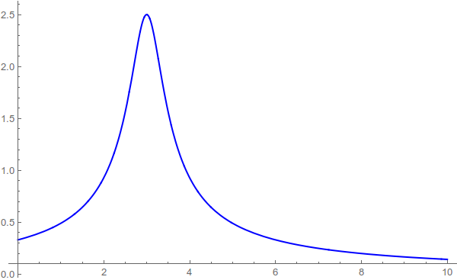
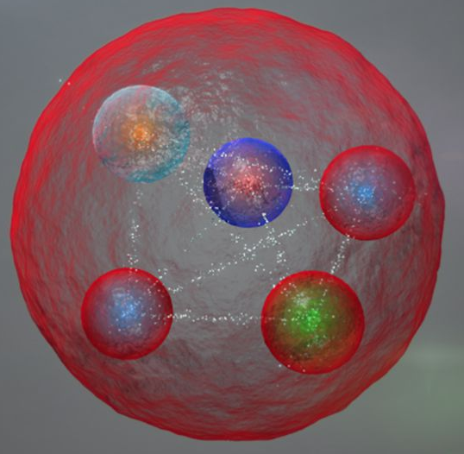
Resonances = Unstable states
$$ψ(t)=e^{−i E_{0} t} e^{− \frac{Γ}{2} t }$$
$$ψ(E)=\frac{1}{E−E_{0}+i\frac{Γ}{2}}$$
The function explodes for value of energy $E=E_{0}−i\frac{Γ}{2}$
Resonances are poles in the complex energy plane
Excited states are unstable
They manifest as resonant peaks
A. Pilloni – Exotic hadron spectroscopy

Slide 17
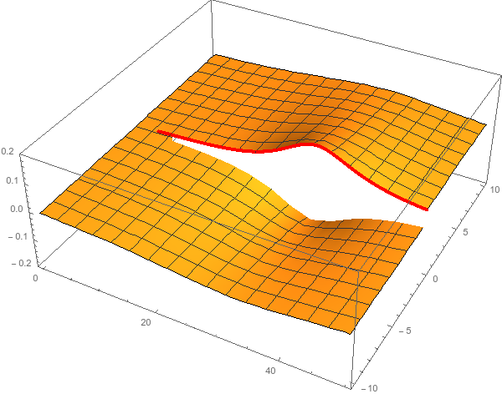
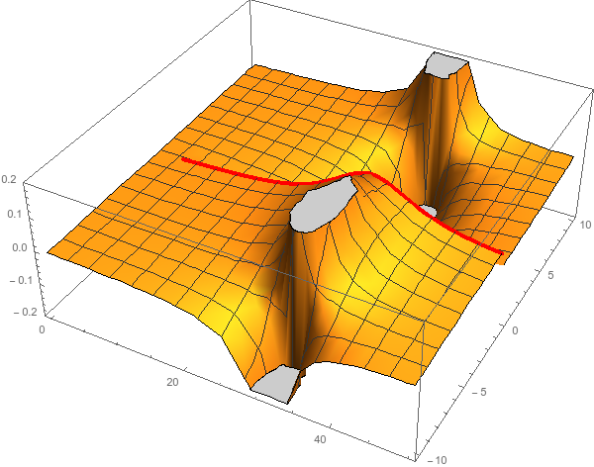
Unitarity & Pole hunting
Unitarity creates a branch cut on the real axis, two sheets continuosly connected
I sheet
II sheet
Finding resonances means writing analytic amplitude, and hunting for poles in the complex plane
A. Pilloni – Exotic hadron spectroscopy
Notes:
Controlla la parte su Regge

Slide 18
You shall not sum!
The simplest ansatz for a PW amplitude is the Breit-Wigner
What if I have two resonances? Can I add two BWs?
$$A_{l}\left(s\right)=\frac{g^{2}}{m^{2}−s−i g^{2}ρ(s)}$$
$$A_{l}\left(s\right)=\frac{g_{1}^{2}}{m_{1}^{2}−s−i g_{1}^{2}ρ(s)}+\frac{g_{2}^{2} e^{iα}}{m_{2}^{2}−s−i g_{2}^{2}ρ(s)}$$
Unitarity is broken, $\text{Im} A_{l}\left(s\right)≠ρ\left(s\right){\left|A_{l}\left(s\right)\right|}^{2}$
Unitarity is saturated, $\text{Im} A_{l}\left(s\right)=\text{Im}\frac{m^{2}−s+i g^{2}ρ(s)}{{\left|m^{2}−s−i g^{2}ρ\left(s\right)\right|}^{2}}=ρ\left(s\right){\left|A_{l}\left(s\right)\right|}^{2}$
But that’s precisely what experimentalists do!
Phases take partially into account the modifications of unitarity due to inelastic channels. However, when we shoot for precision, we need better ansätze (will show examples in the next lectures)
Of course they are not stupid, this works if the two resonances are well isolated. Unfortunately we have no simple alternative solution that can work in all situation, we have to proceed case by case and we live on different timescales
A. Pilloni – Exotic hadron spectroscopy
Notes:
Controlla la parte su Regge

Slide 19
Bound and virtual states
Decreasing the potential strength, the pole reaches threshold
The pole jumps on the 2nd sheet (dineutron), it becomes a virtual state
Example from $pn$ scattering Bound state on the real axis 1st sheet (deuteron)
$$V(r)$$
$$\text{Im} E$$
$$r$$
$$V$$
Deuteron
$$\text{Re} E$$
$${}_{}^{1}S$$
Deuteron pole
Dineutron pole
$${}_{}^{3}S$$
A. Pilloni – Exotic hadron spectroscopy
Notes:
Controlla la parte su Regge

Slide 20
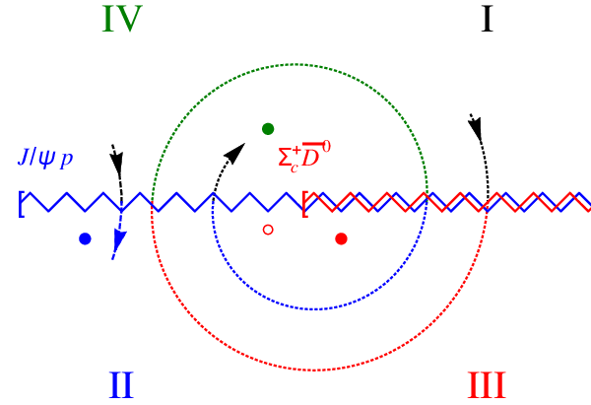
Bound and virtual states
The situation is more complicated when more channels are open
Virtual state
Bound state
Resonance
A. Pilloni – Exotic hadron spectroscopy
Notes:
Controlla la parte su Regge

Slide 21
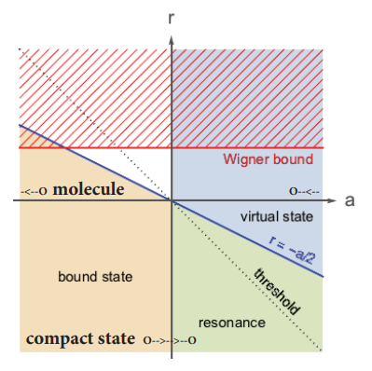
Bound and virtual states
The amplitude close to threshold can be expanded as
$$A\left(E\right)=\frac{1}{\frac{1}{a}+\frac{1}{2}r_{0}k^{2}−ik+O\left(k^{4}\right)}$$
$a$ is the scattering length
$r_{0}$is the effective range
The sign of $a$ controls whether we have a bound or virtual state
A. Pilloni – Exotic hadron spectroscopy
Notes:
Controlla la parte su Regge

Slide 22
Weinberg’s criterion and lineshapes
Let us imagine to have a theory with a bound state with a binding momentum much smaller than the inverse of the range of the potential
The potential is just a delta function, we calculate the $2→2$ scattering amplitude
+
+
+ …
$$A(E)=\frac{1}{1/a−i\sqrt{2μE}}$$
This has a pole at $E_{B}=−\frac{1}{2μa^{2}}$ and residue $g^{2}=\sqrt{\frac{2B}{μ}}$
A. Pilloni – Exotic hadron spectroscopy
Notes:
Controlla la parte su Regge

Slide 23
Weinberg’s criterion and lineshapes
Now let us consider the propagation of a bare intermediate state
+
+
+ …
$$A\left(E\right)=\frac{g_{0}^{2}}{E_{0}−E−ig_{0}^{2}\sqrt{2μE}}=\frac{g_{0}^{2}}{{−E}_{B}−E−ig_{0}^{2}\sqrt{2μE}−g_{0}^{2}\sqrt{2μE_{B}}}$$
This has a pole at $E_{B}$ and residue $g^{2}=\sqrt{\frac{2B}{μ}}\left(1−Z\right)$ where $Z$ is the w.f. renormalization, $Z={\left(1+g_{0}^{2}\sqrt{\frac{μ}{2B}}\right)}^{−1}$= overlap between the bare state and the continuum
A. Pilloni – Exotic hadron spectroscopy
Notes:
Controlla la parte su Regge

Slide 24
Weinberg’s criterion and lineshapes
The amplitude can be rewritten as
$$A\left(E\right)=\frac{1}{\frac{1}{a}+\frac{1}{2}r_{0}k^{2}−ik}$$
Thus identifying $a=−2 \frac{1−Z}{2−Z}\frac{1}{\sqrt{2μE_{B}}}$, $r_{0}=−\frac{Z}{1−Z}\frac{1}{\sqrt{2μE_{B}}}$
So a negative $r_{0}$ points to a short range component in the wave function
This is true up to corrections of the order of the range of the potential, which btw are positive under general assumptions
Esposito, Maiani, Pilloni, Polosa, Riquer, 105 (2022) 3, L031503
A. Pilloni – Exotic hadron spectroscopy
Notes:
Controlla la parte su Regge

Slide 25
L. Maiani
A. Pilloni – Exotic hadron spectroscopy
Notes:
Controlla la parte su Regge

Slide 26
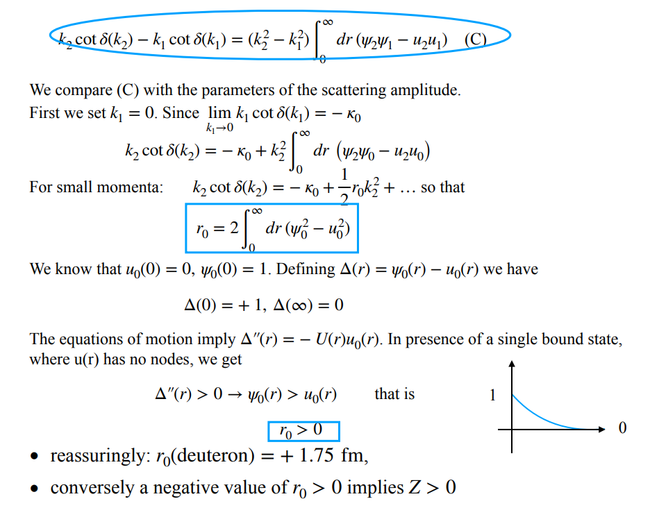
L. Maiani
A. Pilloni – Exotic hadron spectroscopy
Notes:
Controlla la parte su Regge

Slide 27
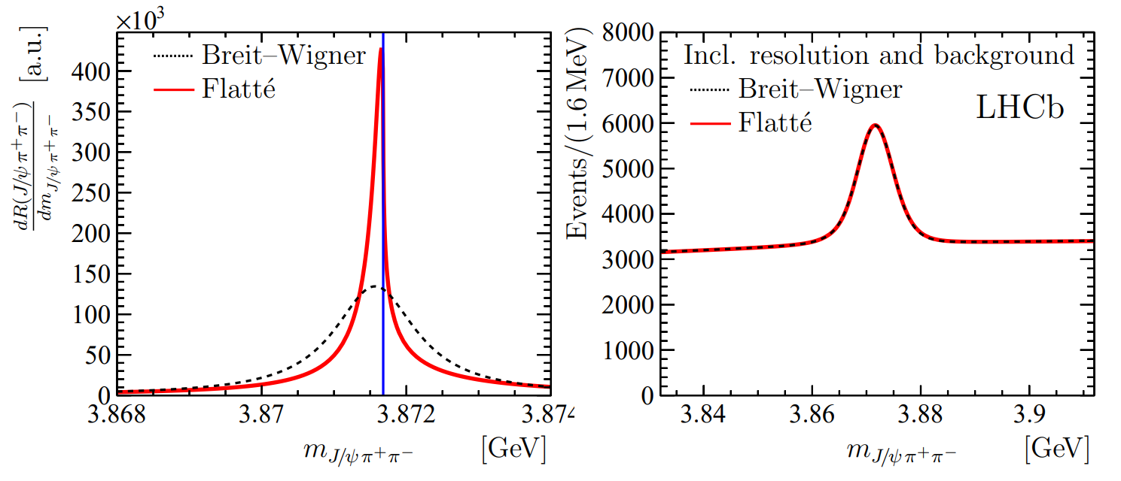
Weinberg’s criterion and lineshapes
Thus a precise measurement of the amplitude at threshold determines the nature of a state
Experimental resolution can hinder this; different lineshapes are indistinguishable
A. Pilloni – Exotic hadron spectroscopy
Notes:
Controlla la parte su Regge

Slide 28
Unraveling QCD
Electromagnetic machines
$$e^{+}e^{−}→γ^{∗}→\text{hadrons}$$
Electrohadron machines
Cross sections
Cleanliness
$$e^{−}→e^{−}γ^{(∗)}$$
$$\text{and} γ^{(∗)}p,γ^{(∗)}A→\text{hadrons}$$
Hadron machines
$$pp,p\overline{p},π^{−}p,pA,AA→ \text{hadrons}$$
A. Pilloni – Exotic hadron spectroscopy

Slide 29
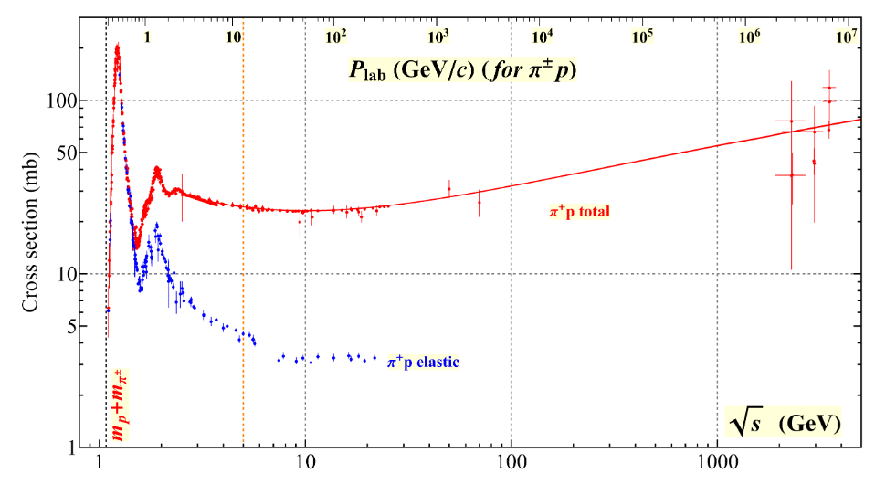
How to produce resonances: scattering
$$π^{±}$$
$$3$$
$$1$$
$$N$$
$$2$$
$$4$$
The cleanest way to access resonance properties is to study (elastic) hadron scattering Initial state is restricted to (quasi-)stable particles: $p, \overline{p}, A; π^{±}, K^{±}, K_{L}^{0}$
For $πN$ all data have been collected and PW-analyzed in several databases: SAID, MAID, Bonn-Gatchina, Bonn-Jülich, ANL-Osaka…
A. Pilloni – Exotic hadron spectroscopy
Notes:
Controlla la parte su Regge

Slide 30
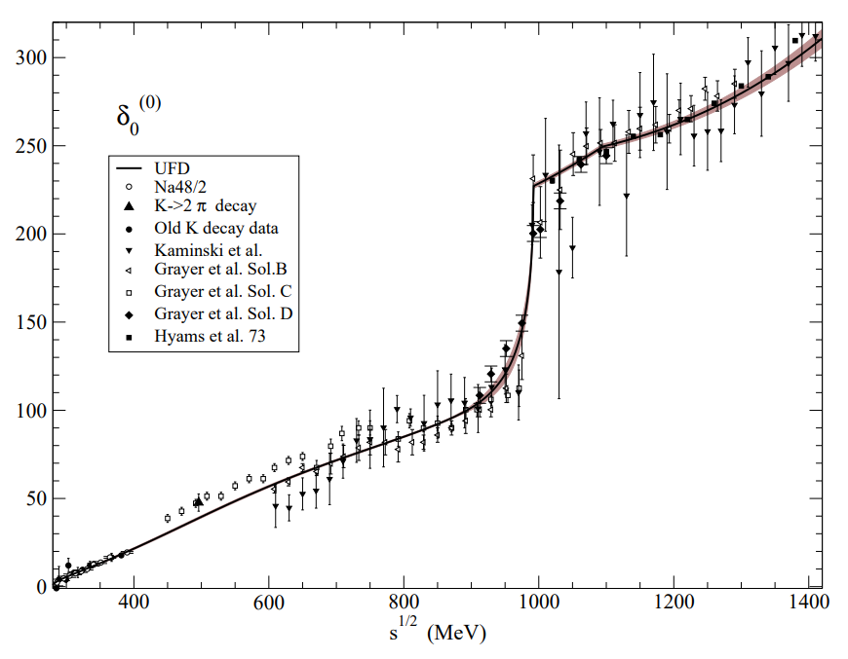
How to produce resonances: scattering
$$π^{±},K^{±}$$
$$π,K$$
$$π$$
$$π$$
$$p$$
$$p,n,Δ^{++}$$
In practice one cannot collide two pion beams, so extrapolations from proton targets are needed
Most refined analyses apply to meson scattering: $ππ$ and $πK$ This + S-matrix input allow us to obtain the most precise extraction of the lightest scalars, $σ$ and $κ$
Pelaez, Phys.Rept. 658 (2016) 1
Pelaez, arXiv:2010.11222
A. Pilloni – Exotic hadron spectroscopy
Notes:
Controlla la parte su Regge

Slide 31
How to produce resonances: $e^{+}e^{−}$ and $γγ$
$$Z$$
$$e^{+}$$
$$q$$
$$γ^{(∗)}$$
$$q$$
$$1^{−−}$$
$$0^{±+}$$
$$γ^{(∗)}$$
$$2^{±+}$$
$$\overline{q}$$
$$\overline{q}$$
$$Z$$
$$3^{++}$$
$$e^{−}$$
Extra ISR can lower the energy
Central exclusive production (CEP)
Electromagnetic probes are the cleanest Form factors give information about the meson wave function
also
A. Pilloni – Exotic hadron spectroscopy
Notes:
Controlla la parte su Regge

Slide 32
How to produce resonances: photo- and electroproduction
$$e^{−}$$
$$γ^{(∗)}$$
$$Q^{2}=4E_{e}E_{e′}\sin^{2}{\frac{θ_{e}}{2}}$$
$$N$$
Photo- and electroproduction allows us to get information about the structure of nucleon excitations
The $Q^{2}$ dependence at the resonance pole can be compared with (quark model, DSE) calculations
If $Q^{2}$ is large, one enters the realm of pQCD and can put constraints to PDF behavior at large x (ask Astrid)
A. Pilloni – Exotic hadron spectroscopy
Notes:
Controlla la parte su Regge

Slide 33
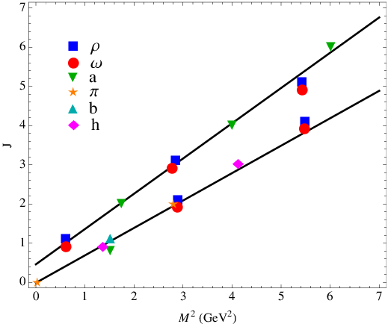
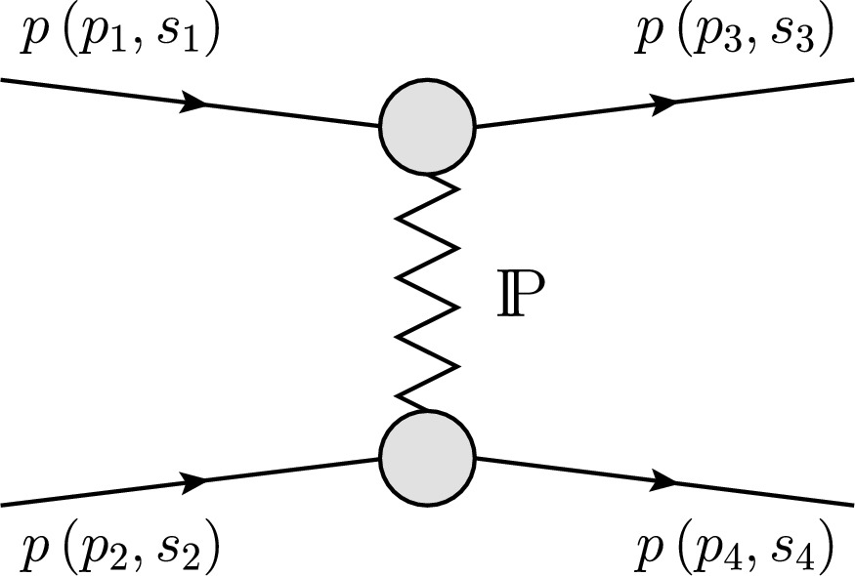
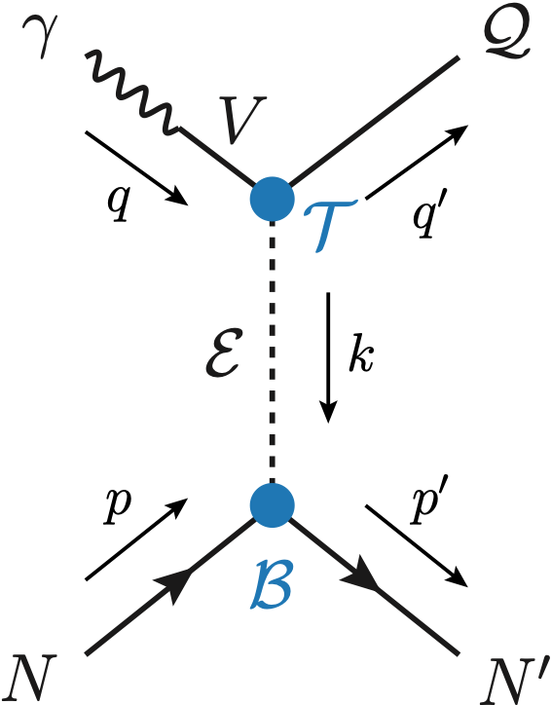
Peripheral production
Above the resonance region, I can consider the tails of $t$ channel exchanges
Crossing symmetry tells me the amplitude is $A\left(s,t\right)=A_{j}\left(t\right)P_{j}(\cos{θ_{t})}$
$P_{j}(\cos{θ_{t})}∝s j$, exceeding unitarity bound Regge physics kicks in: tower of particles with arbitrary spin
Explains why diffractive peaks appear: amplitudes fall off exponentially with $t$
To explain why $pp$ cross section grows logarithmically, we introduce an ad-hoc trajectory, with no known mesons lying on it
Since $pp$ and $p\overline{p}$ asymptotically approach, this trajectory has vacuum quantum numbers
This is named Pomeron (IP ) after Pomeranchuk
Mesons in the angular momentum-mass squared plane appear on approximate linear Regge trajectories
This is a manifestation of confinement
$$s^{j}⟶s^{α_{0}+α^{′}t }$$
Holds at low energy, fixed spin
Holds at high energy, resummation of leading $s$ power
$α_{0}≃1+ε$, $dσ/dt∝\log{s}$
If$α_{0}<1$, $dσ/dt$ decreases with energy
A. Pilloni – Exotic hadron spectroscopy

Slide 34
Hadron decays
Huge datasets come from the decay of narrow states The narrower the state, the more its production is independent of the decay dynamics
The best tool is the isobar model, i.e. writing the amplitude as a truncated sum of PW-like pieces
$$D^{0}→3π$$
Unitarity can be imposed to this expression with Khuri-Treiman equations
A. Pilloni – Exotic hadron spectroscopy
Notes:
Controlla la parte su Regge

Slide 35
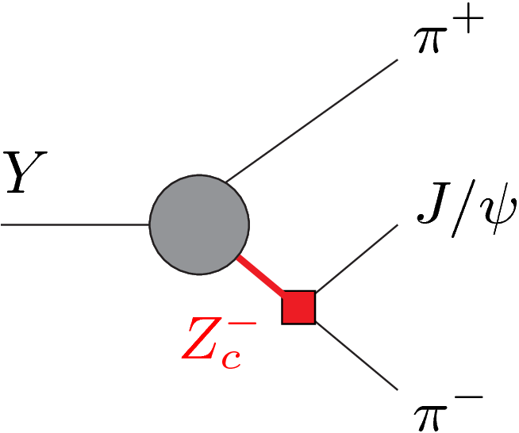
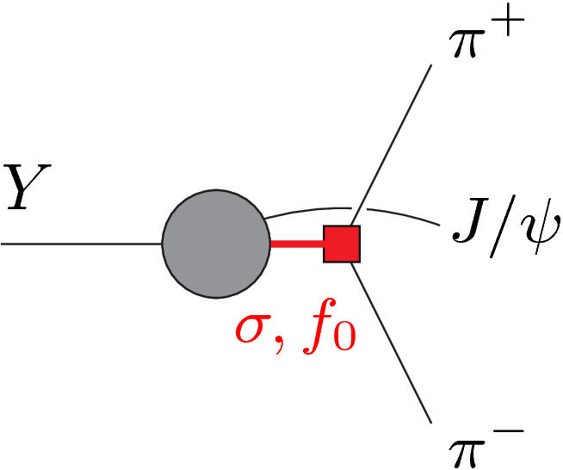
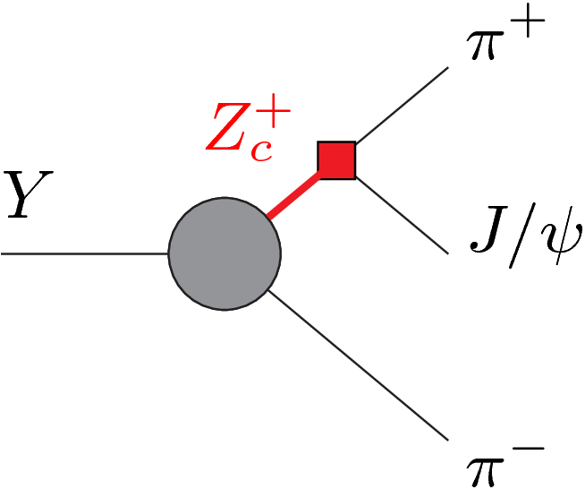
KT equations
+
+
KT formalism was introduced to describe $K→3π$ Khuri and Treiman, PR119, 1115
Used recently for several reactions, Niecknig and Kubis, JHEP 10, 142
Colangelo, et al., PRL118, 022001
AP et al. [JPAC], PLB772, 200
Albaladejo, AP et al. [JPAC], 1803.06027
The formalism implements the all-order rescattering in all the 3 channels at once
A. Pilloni – Exotic hadron spectroscopy
Notes:
2 slides su Zc, a Bes e a Belle
2 slide su tetraquark model: dall’hamiltoniana di Jaffe al calcolo delle masse
1 slide su molecular models, dove sono i carichi? (non in Tornqvist, si in Hanhart, vedere Braaten, citare Nefediev)
2 slides su decay channels, dove si dovrebbe vedere, e a seconda del modello, vedere qualche plot
1 slide su Y(4260), tetraquark? C’è lo strano (si vede la f0)
1 slide su Zc a cleo (anche il neutro)

Slide 36
Triangle singularity
Unitarized isobar models contain rescattering diagrams as this
In special kinematical conditions,
the amplitude develops a logarithmic branch point in the physical region, that can simulate a resonant behavior
Coleman and Norton, Nuovo Cim. 38, 438
$$π$$
$$D_{1}$$
$$Y(4260)$$
$$D^{∗}$$
$$π$$
$$\overline{D}$$
$$J/ψ$$
However, this effects cancels in Dalitz projections, no peaks Schmid, Phys.Rev. 154, 1363
...but the cancellation can be spread in different channels, you might still see peaks in other channels only!
A. Pilloni – Amplitude analysis and exotic states

Slide 37
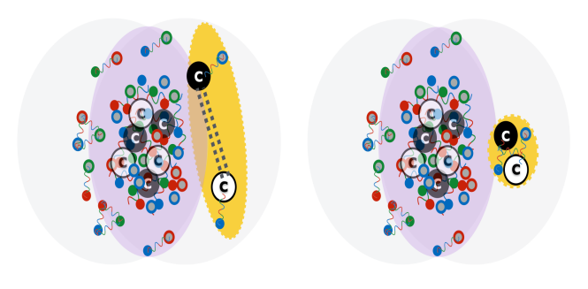
Inclusive production
Cross sections can be calculated with pQCD in presence of a hard scale
Another valuable piece of information is the production of resonances in high multiplicity collisions
The study of the yields as a function of the activity in the event tells us about the propagation in (hot/cold) media
This can add other pieces to the puzzle about the nature of a given resonance
$$D^{∗}$$
$$π$$
$$π$$
$$π$$
$$π$$
$$π$$
$$\overline{D^{0}}$$
A. Pilloni – Exotic hadron spectroscopy
Notes:
Controlla la parte su Regge

Slide 38
Next lectures
The light exotics: the scalar nonet, hybrids and glueballs
The XYZ crowd: classification, lineshape studies, propagation of X(3872) in high multiplicity environments
Thank you
A. Pilloni – Exotic hadron spectroscopy
Notes:
2 slides su Zc, a Bes e a Belle
2 slide su tetraquark model: dall’hamiltoniana di Jaffe al calcolo delle masse
1 slide su molecular models, dove sono i carichi? (non in Tornqvist, si in Hanhart, vedere Braaten, citare Nefediev)
2 slides su decay channels, dove si dovrebbe vedere, e a seconda del modello, vedere qualche plot
1 slide su Y(4260), tetraquark? C’è lo strano (si vede la f0)
1 slide su Zc a cleo (anche il neutro)

Slide 39
Backup

Slide 40
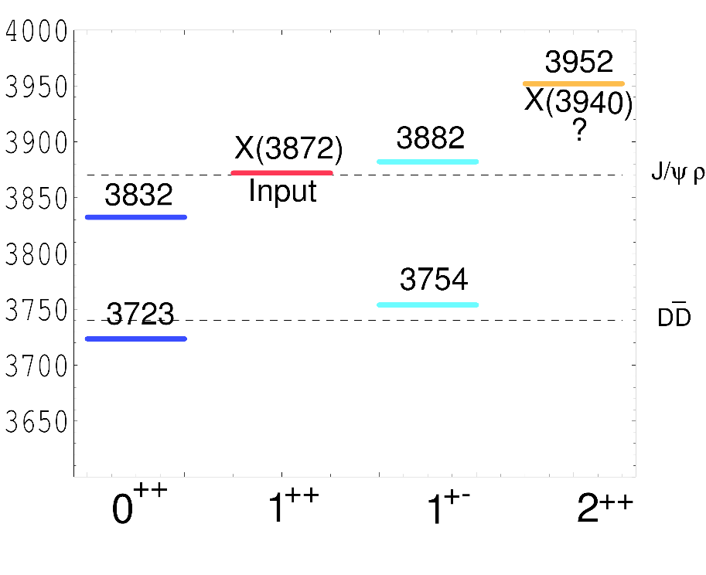
Tetraquark (2005)
$${\overline{3}}_{c}$$
$$\overline{c}$$
$$c$$
In a constituent quark model, we can think of a
diquark-antidiquark compact state
$$3_{c}$$
$$q$$
$${\left[cq\right]}_{S=0,1}{\left[\overline{c}\overline{q}′\right]}_{S=0,1}$$
$$\overline{q}$$
Maiani, Piccinini, Polosa, Riquer PRD71 014028
same + Faccini, AP, PRD87 111102
Spectrum according to color-spin hamiltonian:
$$H=\sum_{dq}{m_{dq}}+2\sum_{i<j}{κ_{ij} \vec{S_{i}}∙\vec{S_{j}} \frac{λ_{i}^{a}}{2}\frac{λ_{j}^{a}}{2}}$$
Decay pattern mostly driven by HQSS ✓
Fair understanding of existing spectrum ✓
A full nonet for each level is expected ✗
$$κ_{q\overline{q}}=315 \text{MeV}\text{,} κ_{c\overline{c}}=59 \text{MeV}\text{,}$$
$$κ_{cq}=22 \text{MeV}\text{,} κ_{c\overline{q}}=72 \text{MeV}$$
A. Pilloni – Exotic hadron spectroscopy
Notes:
Y(4260), M=4263 +- 5, Gamma = 95+-14
D_1(2420)^0, M=2421.3 ±0.6, Gamma =27.1 ±2.7
D_1(2420)^+-, M=2423.4 ±3.1, Gamma =25 ±6
I D_1 hanno J^P = 1^+
La molecola D_1 D sta 22 MeV sotto
Se la Y è D_1 D, il pione lega fortemente, come fa la Y a essere così larga?
Come funziona lo scambio del pione???
Close propone che la Y è D_1 D^* col pione scambiato in onda S,
La Y però non va in Ds come se fosse tetraquark

Slide 41
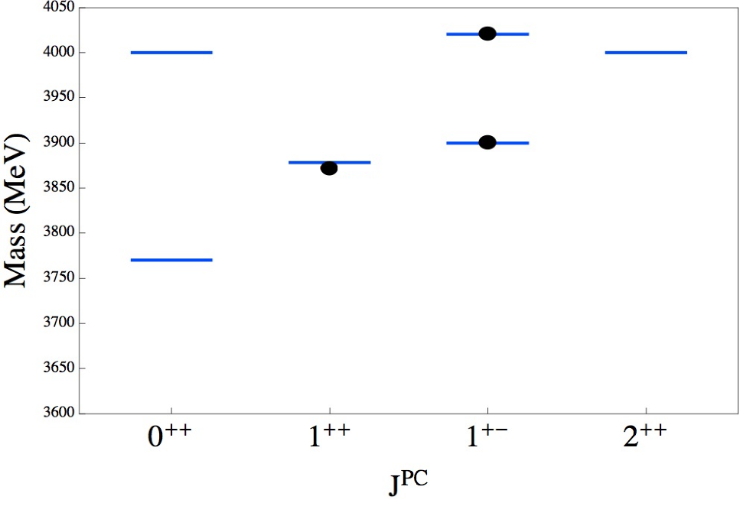
Tetraquark: new ansatz (2014)
$${\overline{3}}_{c}$$
$$\overline{c}$$
$$c$$
Type I-model predicts no $Z_{c}^{′}(4020)$, and disfavors $Z_{c}\left(3900\right)→J/ψπ$
$$3_{c}$$
$$q$$
$$\overline{q}$$
Maiani, Piccinini, Polosa, Riquer PRD89 114010
New ansatz: the diquarks are compact objects spacially separated from each other,
The spin-spin interaction is local, only $κ_{cq}≠0$
Existing spectrum is fitted if $κ_{cq}=67 \text{MeV}$
A. Pilloni – Exotic hadron spectroscopy
Notes:
Y(4260), M=4263 +- 5, Gamma = 95+-14
D_1(2420)^0, M=2421.3 ±0.6, Gamma =27.1 ±2.7
D_1(2420)^+-, M=2423.4 ±3.1, Gamma =25 ±6
I D_1 hanno J^P = 1^+
La molecola D_1 D sta 22 MeV sotto
Se la Y è D_1 D, il pione lega fortemente, come fa la Y a essere così larga?
Come funziona lo scambio del pione???
Close propone che la Y è D_1 D^* col pione scambiato in onda S,
La Y però non va in Ds come se fosse tetraquark

Slide 42
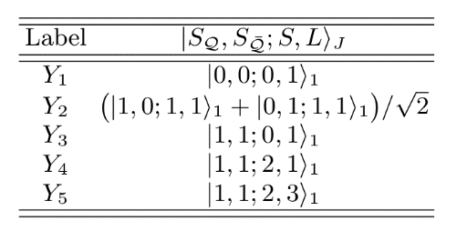
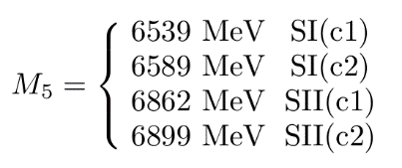
Tetraquark: new ansatz (2014)
Maiani, Piccinini, Polosa, Riquer PRD89 114010
Ali, et al. EPJC78, 1, 29 Maiani, Polosa, Riquer, PLB778, 247-251
Two different mass scenarios
Prediction for a high $Y_{5}$
A. Pilloni – Exotic hadron spectroscopy
Notes:
Y(4260), M=4263 +- 5, Gamma = 95+-14
D_1(2420)^0, M=2421.3 ±0.6, Gamma =27.1 ±2.7
D_1(2420)^+-, M=2423.4 ±3.1, Gamma =25 ±6
I D_1 hanno J^P = 1^+
La molecola D_1 D sta 22 MeV sotto
Se la Y è D_1 D, il pione lega fortemente, come fa la Y a essere così larga?
Come funziona lo scambio del pione???
Close propone che la Y è D_1 D^* col pione scambiato in onda S,
La Y però non va in Ds come se fosse tetraquark

Slide 43
Dynamical movie
Z⁺(4430)
c̄ d̄
Ψ(2S)
c u
π⁺
Brodsky, Hwang, Lebed PRL 113 112001
Since this is still a $3⟷\overline{3}$ color interaction, just use the Cornell potential: $V\left(r\right)=−\frac{4}{3}\frac{α_{s}}{r}+br+\frac{32πα_{s}}{9m_{cq}^{2} }{\left(\frac{σ}{\sqrt{π}}\right)}^{3}e^{−σ^{2}r^{2}}S_{cq}∙S_{\overline{cq}},$
e.g. Barnes et al., PRD 72, 054026
Use that the kinetic energy released in ${\overline{B}}^{0}⟶K^{−}Z^{+}(4430)$ converts into potential energy until the diquarks come to rest
Hadronization most effective at this point (WKB turning point)
$$\frac{B\left(Z^{+}(4430)→ψ(2S)π^{+}\right)}{B\left(Z^{+}\left(4430\right)→J/ψ π^{+}\right)}∼72$$
$$(>10 \text{exp}\text{.)}$$
$$r_{Z}=1.16 fm,\left\langle r_{ψ(2S)}\right\rangle =0.80 fm,\left\langle r_{J/ψ}\right\rangle =0.39 fm$$
A. Pilloni – Exotic hadron spectroscopy
$$\left\langle r_{J/ψ}\right\rangle =0.39 fm$$

Slide 44
Barionio
Baryonium
C. Sabelli
a structure $\left[cq\right][\overline{c}\overline{q}]$ can explain the dominance of baryon channel
Isospin violation expected,
$$α_{s}\left(m_{c}\right)≪1$$
Rossi, Veneziano, NPB 123, 507;
Phys.Rept. 63, 149;
PLB70, 255;
JHEP 1606, 041
$$\frac{B\left(Y\left(4660\right)→Λ_{c}^{+}Λ_{c}^{−}\right)}{B\left(Y\left(4660\right)→ψ\left(2S\right)ππ\right)}=25±7$$
Cotugno, Faccini, Polosa, Sabelli,
PRL 104, 132005
A. Pilloni – Exotic hadron spectroscopy
Notes:
2 slides su Zc, a Bes e a Belle
2 slide su tetraquark model: dall’hamiltoniana di Jaffe al calcolo delle masse
1 slide su molecular models, dove sono i carichi? (non in Tornqvist, si in Hanhart, vedere Braaten, citare Nefediev)
2 slides su decay channels, dove si dovrebbe vedere, e a seconda del modello, vedere qualche plot
1 slide su Y(4260), tetraquark? C’è lo strano (si vede la f0)
1 slide su Zc a cleo (anche il neutro)

