Slide 1
Exotic hadron spectroscopy II: Light exotics
Alessandro Pilloni
DTP, May 5th, 2022

Slide 2
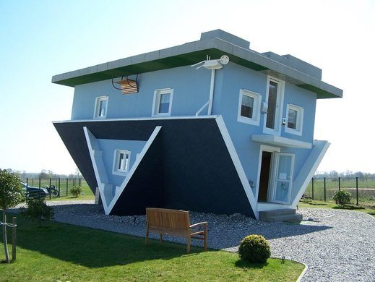
The lightest scalars
$$0^{++}$$
A. Pilloni – Exotic hadron spectroscopy
Notes:
2 slides su Zc, a Bes e a Belle
2 slide su tetraquark model: dall’hamiltoniana di Jaffe al calcolo delle masse
1 slide su molecular models, dove sono i carichi? (non in Tornqvist, si in Hanhart, vedere Braaten, citare Nefediev)
2 slides su decay channels, dove si dovrebbe vedere, e a seconda del modello, vedere qualche plot
1 slide su Y(4260), tetraquark? C’è lo strano (si vede la f0)
1 slide su Zc a cleo (anche il neutro)

Slide 3
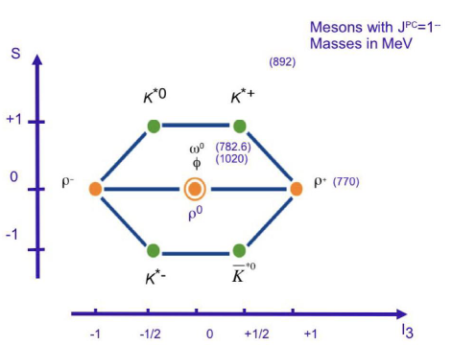
The light vector nonet
$$L=0, S=1$$
$$d\overline{s}$$
$$u\overline{s}$$
$$φ$$
$$2m_{s}$$
$$u\overline{u}+d\overline{d}$$
$$s\overline{s}$$
$$K^{∗}$$
$$m_{s}+m_{q}$$
$$d\overline{u}$$
$$u\overline{d}$$
$$u\overline{u}−d\overline{d}$$
$$ρ,ω$$
$$2m_{q}$$
$$s\overline{u}$$
$$s\overline{d}$$
A. Pilloni – Exotic hadron spectroscopy

Slide 4
The light scalar nonet/1
$$L=1, S=1$$
$$0^{++}$$
$$κ^{0}$$
$$κ^{+}(700)$$
$$a_{0},f_{0}$$
$$??$$
$$f_{0}(980)$$
$$σ(500)$$
$$a_{0}^{−}$$
$$a_{0}^{+}(980)$$
$$κ$$
$$??$$
$$a_{0}^{0}$$
$$σ$$
$$??$$
$$κ^{−}$$
$$\overline{κ^{0}}$$
A. Pilloni – Exotic hadron spectroscopy

Slide 5
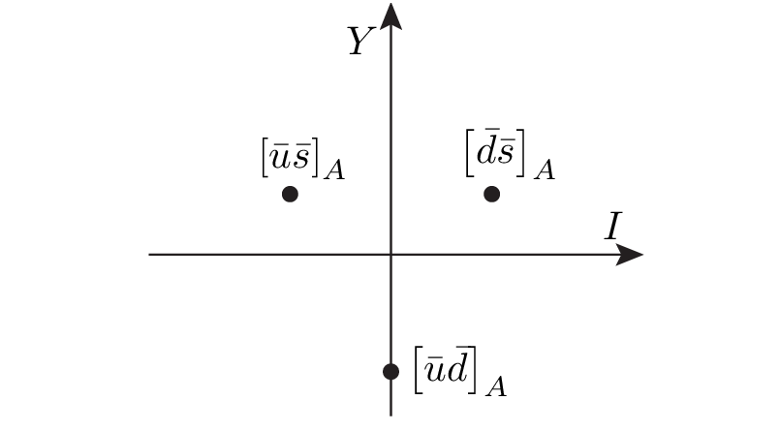
Diquarks
Attraction and repulsion in 1-gluon exchange approximation is given by
$$3_{c}×3_{c}∈{\overline{3}}_{c}$$
Now the two quarks are identical particles, they obey Fermi statistics
If we restrict to the ground state in S-wave, we have two options
$${\overline{3}}_{color}\left(A\right)×{\overline{3}}_{flavor}\left(A\right)×1_{spin}\left(A\right)$$
«Good» diquark
$${\overline{3}}_{color}\left(A\right)×6_{flavor}\left(S\right)×3_{spin}\left(S\right)$$
«Bad» diquark
Because of spin-spin interaction, good diquark are lighter, and easier to produce From the flavor point of view, it behaves like an antiquark
A. Pilloni – Exotic hadron spectroscopy

Slide 6
The light scalar nonet/2
$$L=1, S=1$$
$$0^{++}$$
This also explain the affinity of the $f_{0}(980)$ to kaons
$$κ^{0}$$
$$κ^{+}(700)$$
$$[qs][\overline{q}\overline{s}]$$
$$a_{0},f_{0}$$
$$??$$
$$f_{0}(980)$$
$$σ(500)$$
$$a_{0}^{−}$$
$$a_{0}^{+}(980)$$
$$κ$$
$$[qs][\overline{u}\overline{d}]$$
$$??$$
$$a_{0}^{0}$$
$$σ$$
$$[ud][\overline{u}\overline{d}]$$
$$??$$
$$κ^{−}$$
$$\overline{κ^{0}}$$
A. Pilloni – Exotic hadron spectroscopy

Slide 7
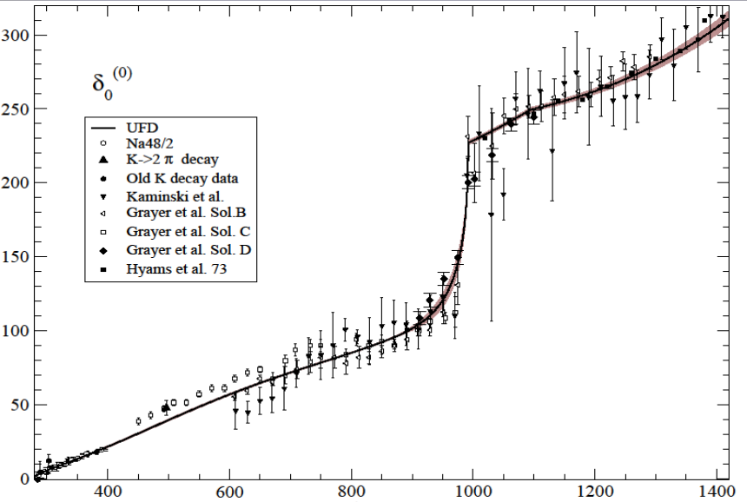
But where is the $σ$?
$$f_{0}(980)$$
The Adler zero is a zero of the $S$-wave amplitude due to chiral symmetry In UχPT it most often generate a pole identified as the $σ$
$$σ???$$
$ππ$ scattering shift for $L=0,I=0$
Really, really need amplitude analysis to get something meaningful about the $σ$
A. Pilloni – Exotic hadron spectroscopy

Slide 8
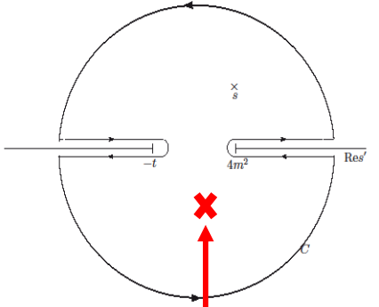
Roy equations (sketched)
1) You use the analytic properties of the amplitude and write Cauchy theorem
2) You use crossing symmetry to rewrite the integral of the left-hand cut as an integral of the right-hand cut
3) You expand the amplitude in partial waves
$$T\left(s,t\right)=\sum_{l}{t_{l}\left(s\right)P_{l}(\cos{θ})}$$
The dispersive integral helps the analytic continuation
Don’t be scared, you’ll have Astrid’s lectures…
A. Pilloni – Exotic hadron spectroscopy

Slide 9
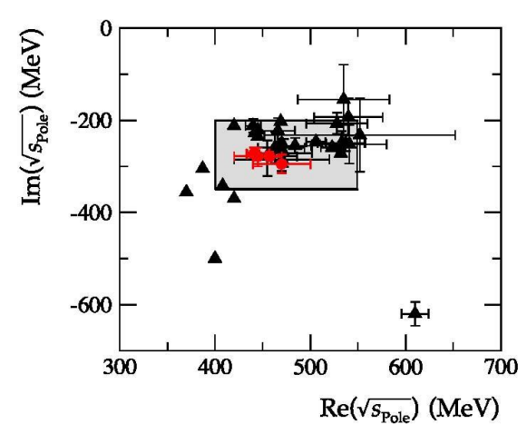
Results
Colangelo, Gasser, Leutwyler, NPB603, 125 (2001)
Caprini, Colangelo, Leutwyler, PRL 96, 132001 (2006)
Garcia-Martin, Kaminski, Peláez, Ruiz de Elvira, PRL107, 072001(2011)
Moussallam, EPJC71, 1814 (2011)
Masjuan, Ruiz de Elvira, Sanz-Cillero, PRD90, 097901 (2014)
Peláez, Phys.Rept. 658 (2016)
Descotes-Genon, Moussallam, EPJC48, 553 (2006)
Peláez, Rodas, arXiv:2010.11222
A. Pilloni – Exotic hadron spectroscopy

Slide 10
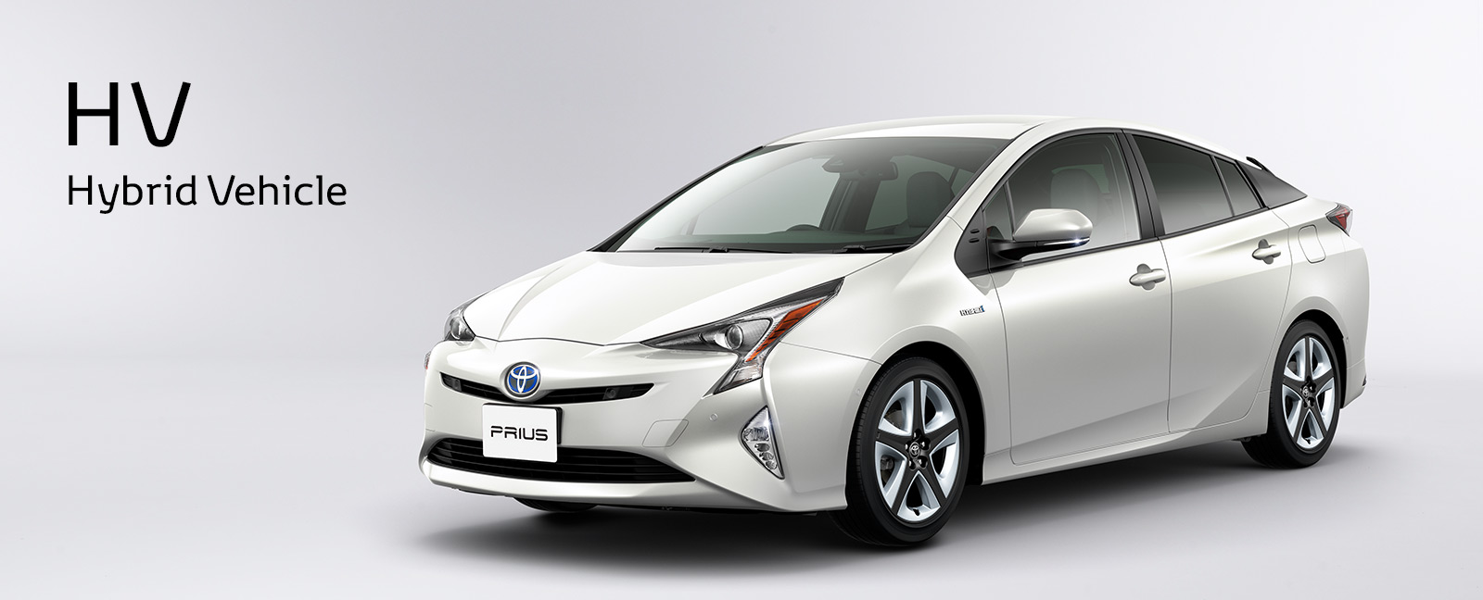
The hybrid $π_{1}$
A. Pilloni – The pole hunter
Notes:
2 slides su Zc, a Bes e a Belle
2 slide su tetraquark model: dall’hamiltoniana di Jaffe al calcolo delle masse
1 slide su molecular models, dove sono i carichi? (non in Tornqvist, si in Hanhart, vedere Braaten, citare Nefediev)
2 slides su decay channels, dove si dovrebbe vedere, e a seconda del modello, vedere qualche plot
1 slide su Y(4260), tetraquark? C’è lo strano (si vede la f0)
1 slide su Zc a cleo (anche il neutro)

Slide 11
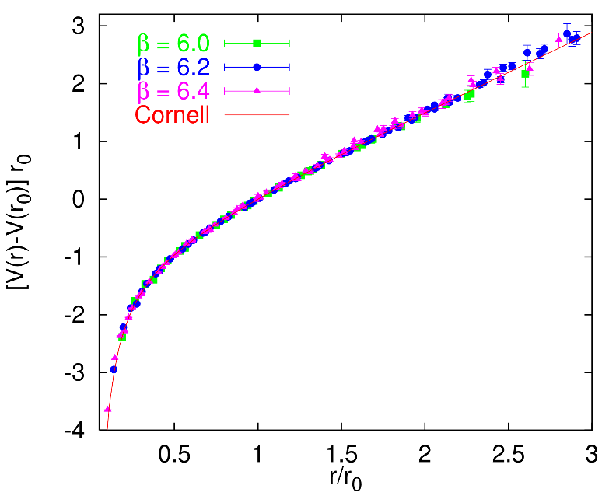
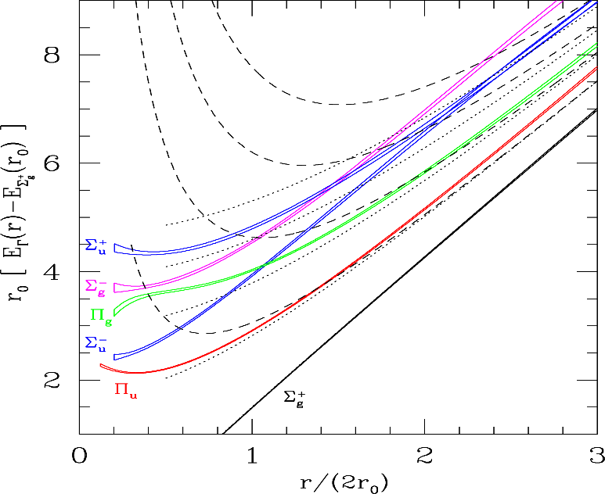
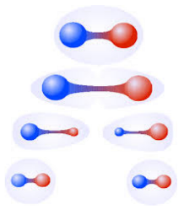
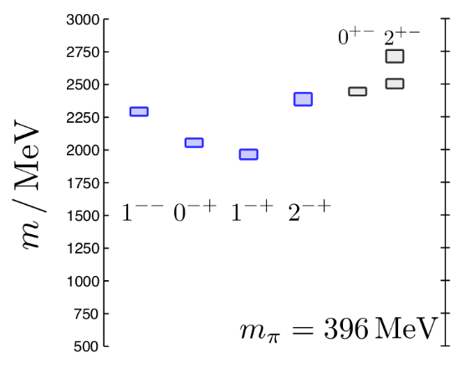
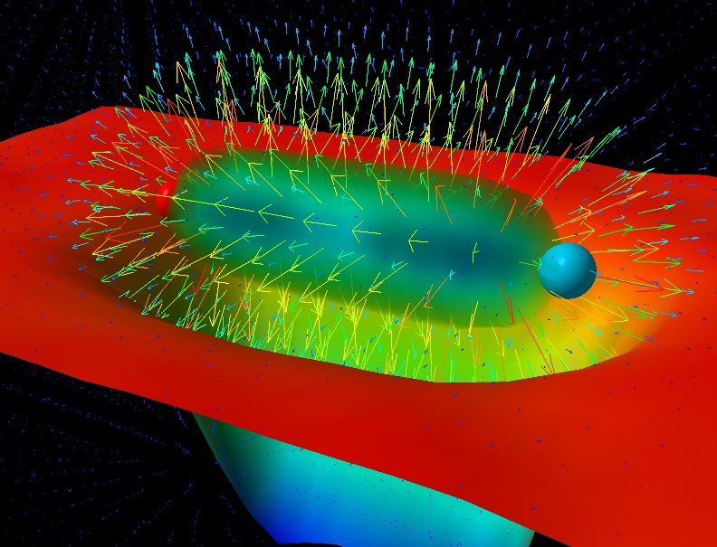
Learning about confinement
If quarks were infinitely heavy, gluonic field is confined in a string
Linear rising potential
What is a constituent gluon?
vibration of the string? → degenerate $J^{PC}={\left(0,1,2\right)}^{−+},{\left(0,1,2\right)}^{+−}$
excitation of a quasiparticle? → degenerate $J^{PC}={\left(0,1,2\right)}^{−+},1^{−−}$
G. Bali
C. Morningstar
J. Dudek
excitation of a quasiparticle! → degenerate $J^{PC}={\left(0,1,2\right)}^{−+},1^{−−}$ says Lattice QCD...
What about real data?
D. Leinweber
A. Pilloni – Exotic hadron spectroscopy
Notes:
Controlla la parte su Regge

Slide 12
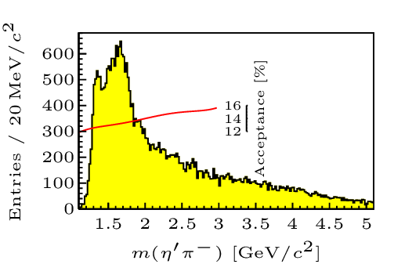
Hybrid hunting
J. Dudek
Excited gluon, $$J^{PC}=1^{+−}$$ mass $∼1.0\text{−}1.5 \text{GeV}$
$$\overline{r}$$
$$\overline{g}$$
$$r$$
excitation of a quasiparticle? → degenerate $J^{PC}={\left(0,1,2\right)}^{−+},1^{−−}$
$$g$$
Look for a $π_{1}$ state with $J^{PC}=1^{−+}$
decaying into $\left\{\begin{matrix}η π \text{and} η^{′}π \\ ρ π→3π \\ b_{1}π→5π\end{matrix}\right.$
Small signal in data
A. Pilloni – Exotic hadron spectroscopy
Notes:
2 slides su Zc, a Bes e a Belle
2 slide su tetraquark model: dall’hamiltoniana di Jaffe al calcolo delle masse
1 slide su molecular models, dove sono i carichi? (non in Tornqvist, si in Hanhart, vedere Braaten, citare Nefediev)
2 slides su decay channels, dove si dovrebbe vedere, e a seconda del modello, vedere qualche plot
1 slide su Y(4260), tetraquark? C’è lo strano (si vede la f0)
1 slide su Zc a cleo (anche il neutro)

Slide 13
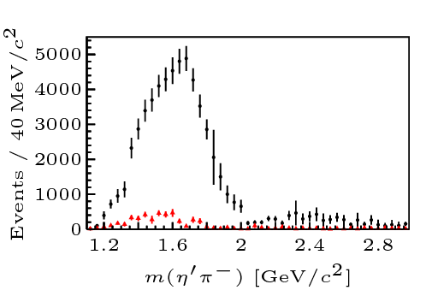
Two hybrid states???
Neither lattice nor models predict two $1^{−+}$ states in this region!
A hybrid meson ($8$) cannot decay into $ηπ$ in the SU(3) limit
Tetraquark ($10⊕\overline{10}$)? Requires doubly charged
A. Pilloni – Exotic hadron spectroscopy
Notes:
2 slides su Zc, a Bes e a Belle
2 slide su tetraquark model: dall’hamiltoniana di Jaffe al calcolo delle masse
1 slide su molecular models, dove sono i carichi? (non in Tornqvist, si in Hanhart, vedere Braaten, citare Nefediev)
2 slides su decay channels, dove si dovrebbe vedere, e a seconda del modello, vedere qualche plot
1 slide su Y(4260), tetraquark? C’è lo strano (si vede la f0)
1 slide su Zc a cleo (anche il neutro)

Slide 14
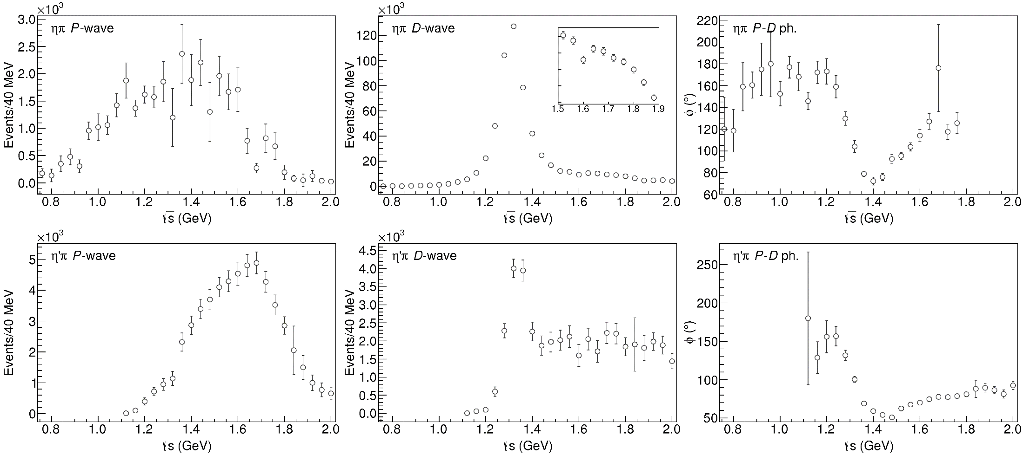
Data in $η^{(′)}π$
( data)
$$π_{1}\left(1400\right)?$$
$$a_{2}\left(1320\right)$$
$$a_{2}^{′}\left(1700\right)$$
$$π_{1}\left(1600\right)?$$
$$a_{2}\left(1320\right)$$
$$a_{2}^{′}\left(1700\right)$$
$$J^{PC}=1^{−+}$$
$$J^{PC}=2^{++}$$
A. Pilloni – Exotic hadron spectroscopy
Notes:
Controlla la parte su Regge

Slide 15
Amplitudes for $η^{(′)}π$
We build the partial wave amplitudes according to the $N/D$ method
Jackura, Mikhasenko, AP et al. (JPAC & COMPASS), PLB
Rodas, AP et al. (JPAC), PRL
$$a\left(s\right)=\frac{n\left(s\right)}{D\left(s\right)}$$
$$D(s)$$
$$n(s)$$
The $n\left(s\right)$ → background physics, process-dependent, smooth
The $D(s)$ contains all the Final State Interactions constrained by unitarity → universal
A. Pilloni – Exotic hadron spectroscopy
Notes:
Controlla la parte su Regge

Slide 16
Coupled channel: the model
A. Rodas, AP et al. (JPAC) PRL122, 042002
Two channels, $i,k=ηπ, η^{′}π$ Two waves, $J=P,D$ 37 fit parameters
1 K-matrix pole for the P-wave
2 K-matrix poles for the D-wave
Left-hand scale (Blatt-Weisskopf radius) $s_{R}=s_{0}=1 {\text{GeV}}^{2}$
$α=2$, 3rd order polynomial for $n_{k}^{J}(s)$
A. Pilloni – Exotic hadron spectroscopy
Notes:
Controlla la parte su Regge

Slide 17
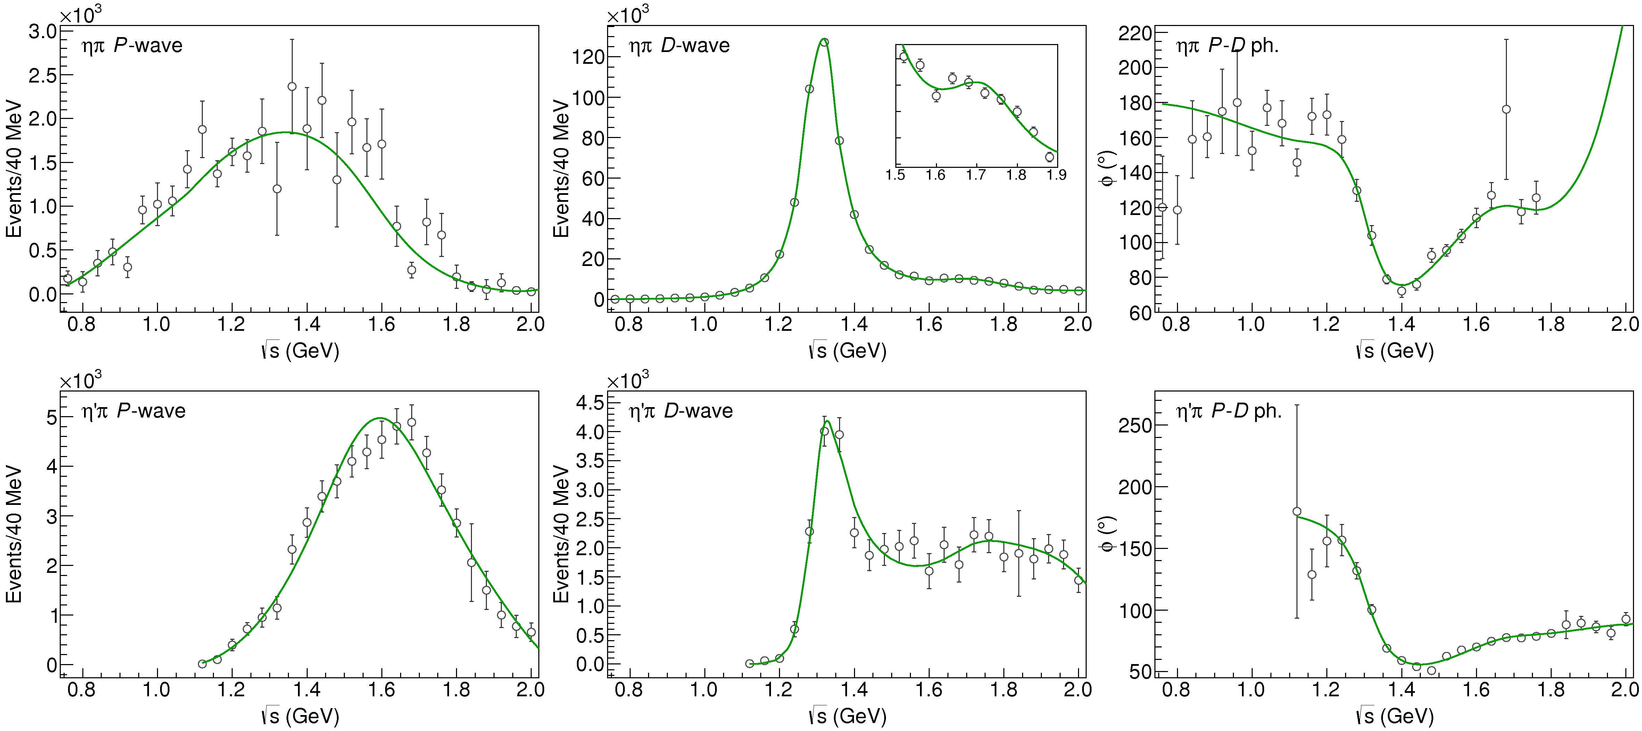
Fit to $η^{(′)}π$
( data)
$$π_{1}\left(1400\right)?$$
$$a_{2}\left(1320\right)$$
$$a_{2}^{′}\left(1700\right)$$
$$π_{1}\left(1600\right)?$$
$$a_{2}\left(1320\right)$$
$$a_{2}^{′}\left(1700\right)$$
$$J^{PC}=1^{−+}$$
$$J^{PC}=2^{++}$$
A. Pilloni – Exotic hadron spectroscopy
Notes:
Controlla la parte su Regge

Slide 18
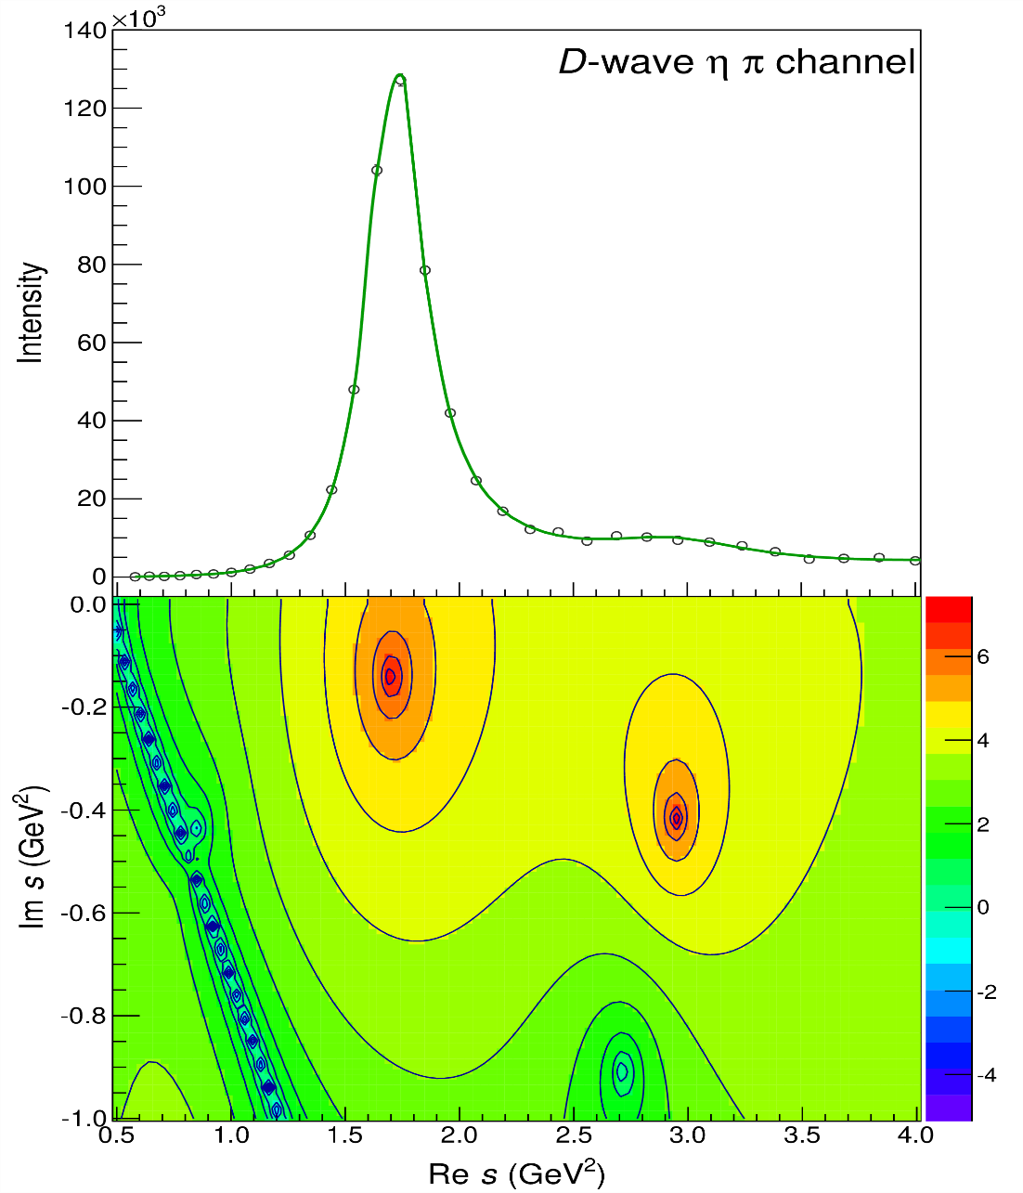
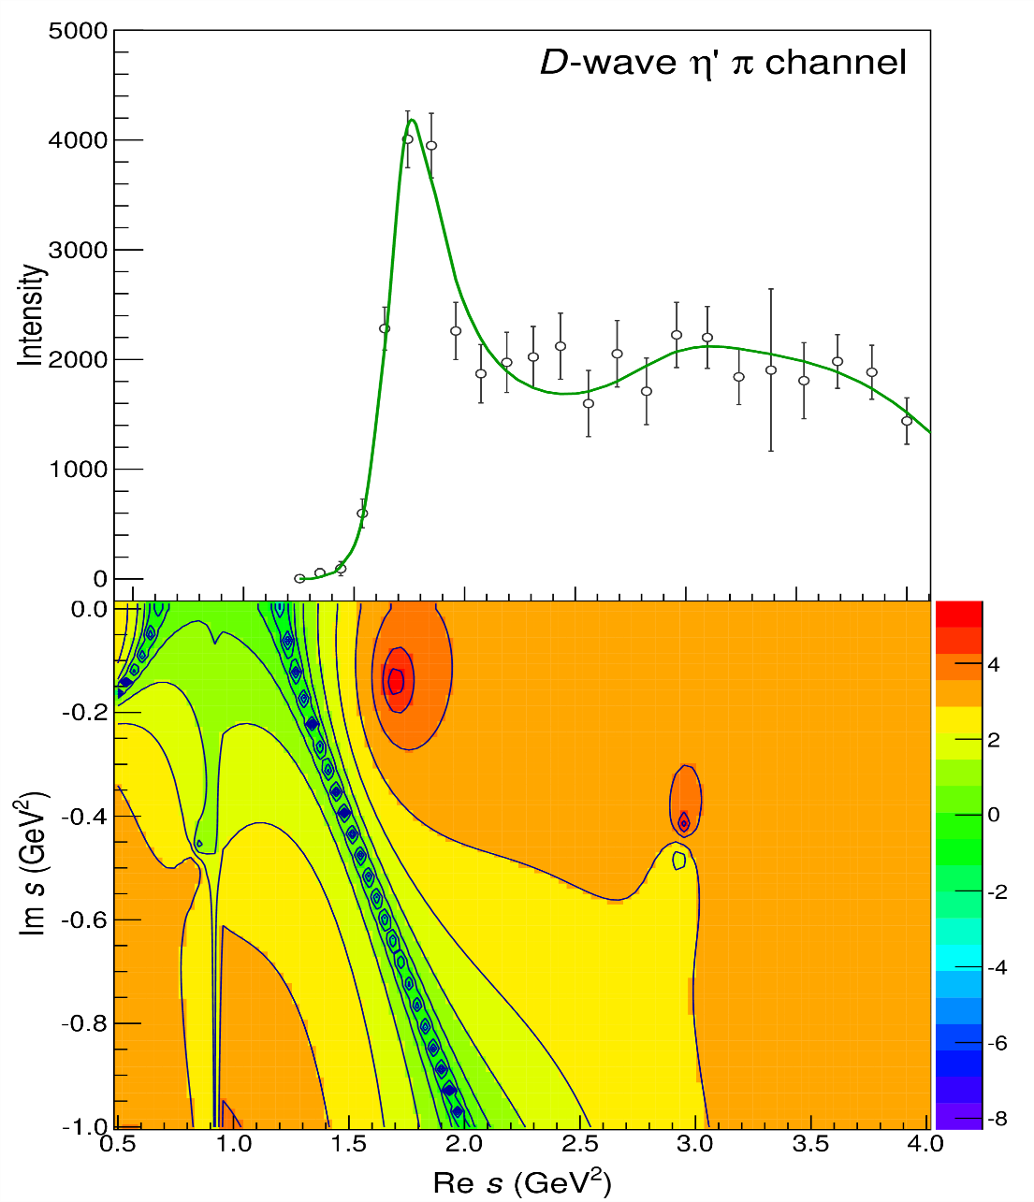
Pole hunting
$$a_{2}^{′}\left(1700\right)$$
$$a_{2}^{′}\left(1700\right)$$
$$a_{2}\left(1320\right)$$
$$a_{2}\left(1320\right)$$
A. Pilloni – Exotic hadron spectroscopy
Notes:
Controlla la parte su Regge

Slide 19
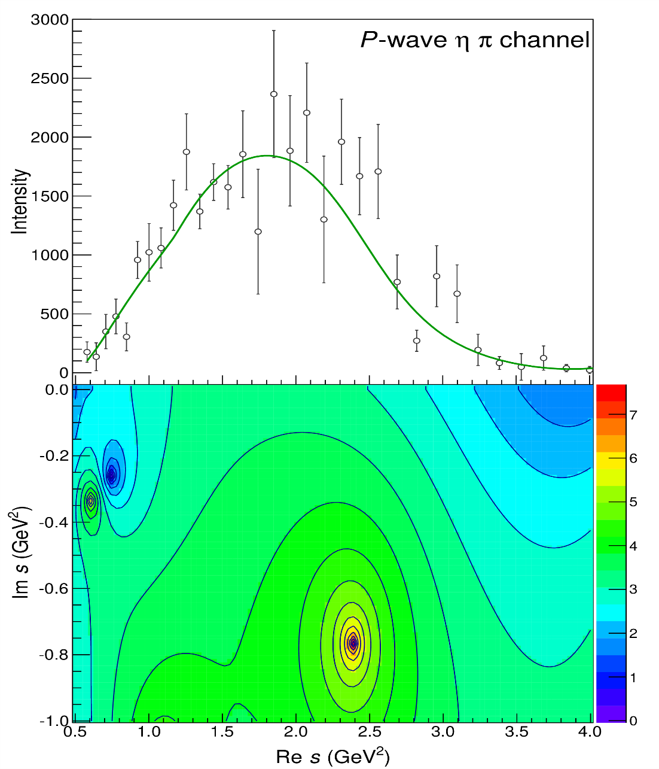
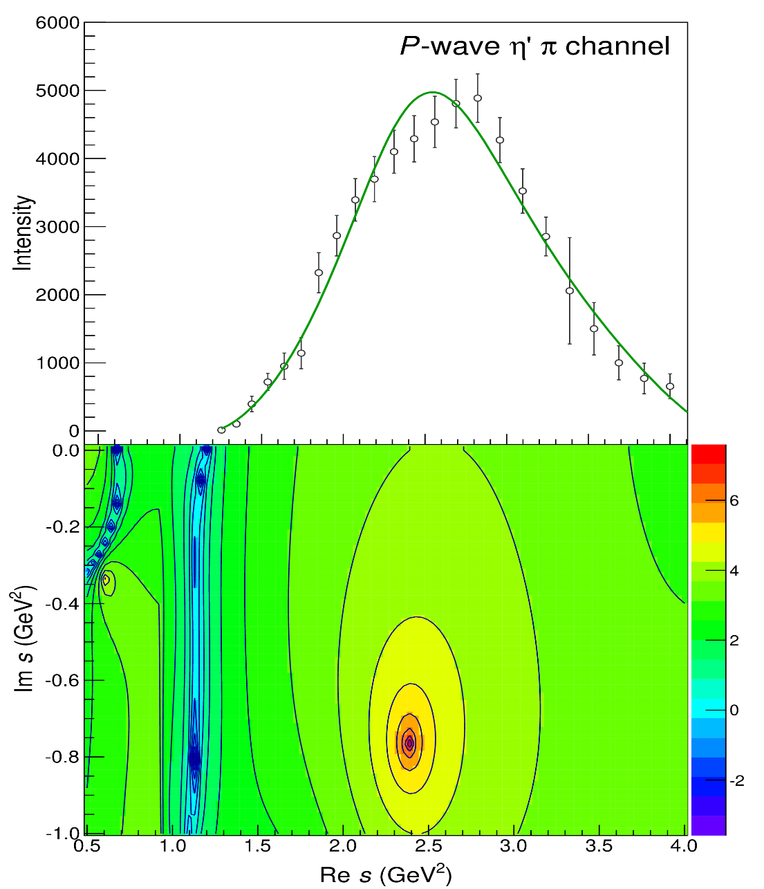
Pole hunting
$$π_{1}$$
$$π_{1}$$
A. Pilloni – Exotic hadron spectroscopy
Notes:
Controlla la parte su Regge

Slide 20
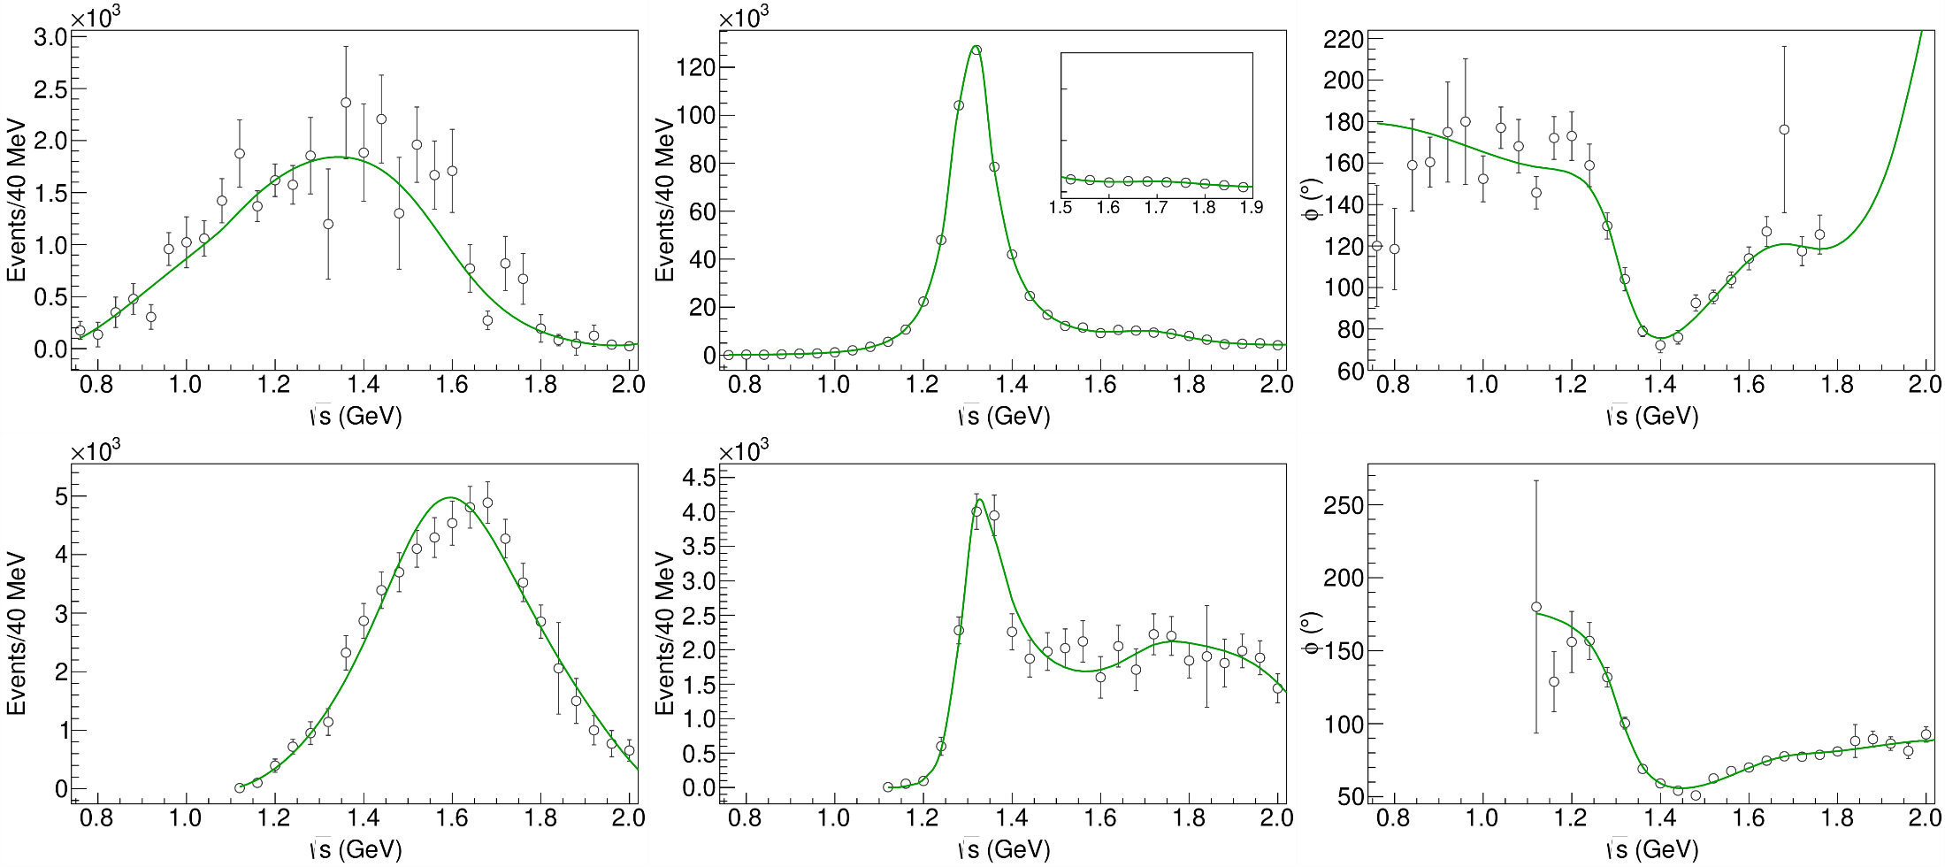
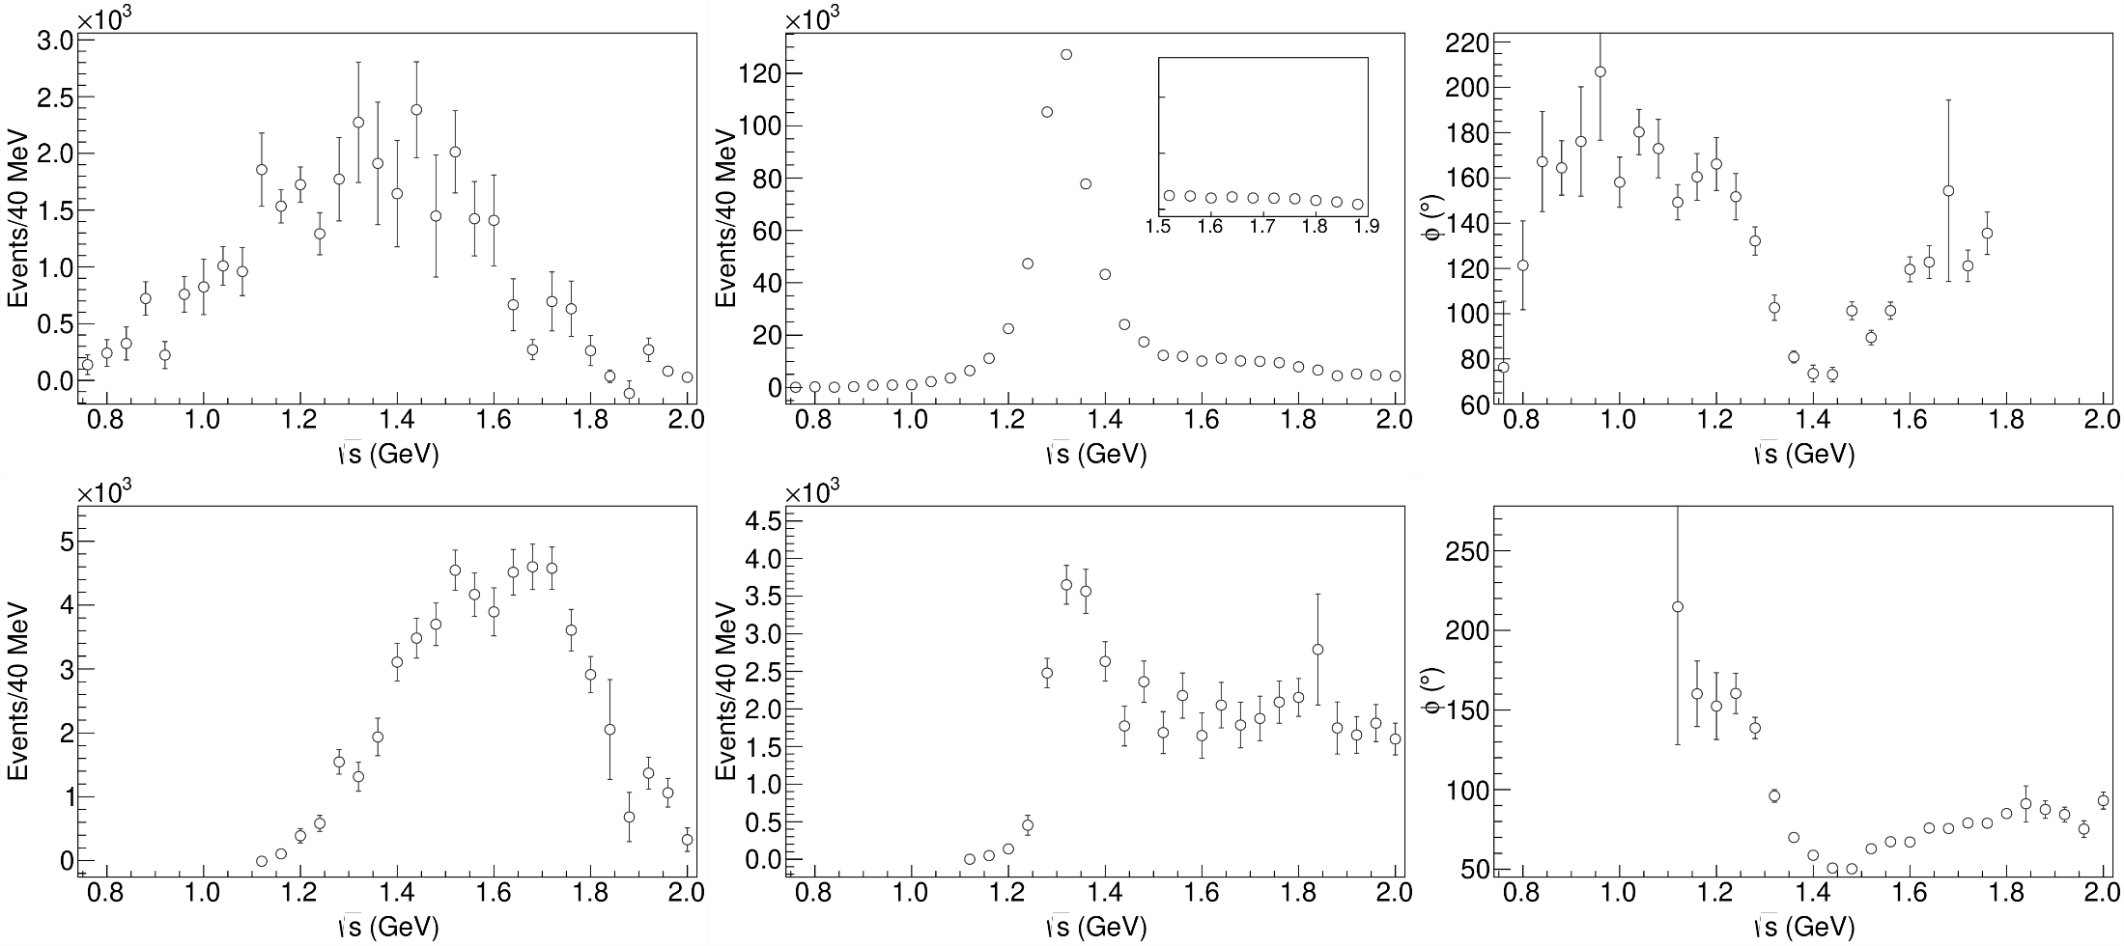
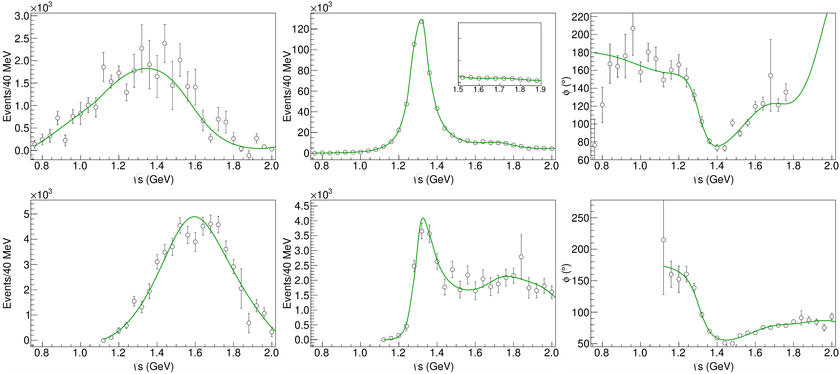
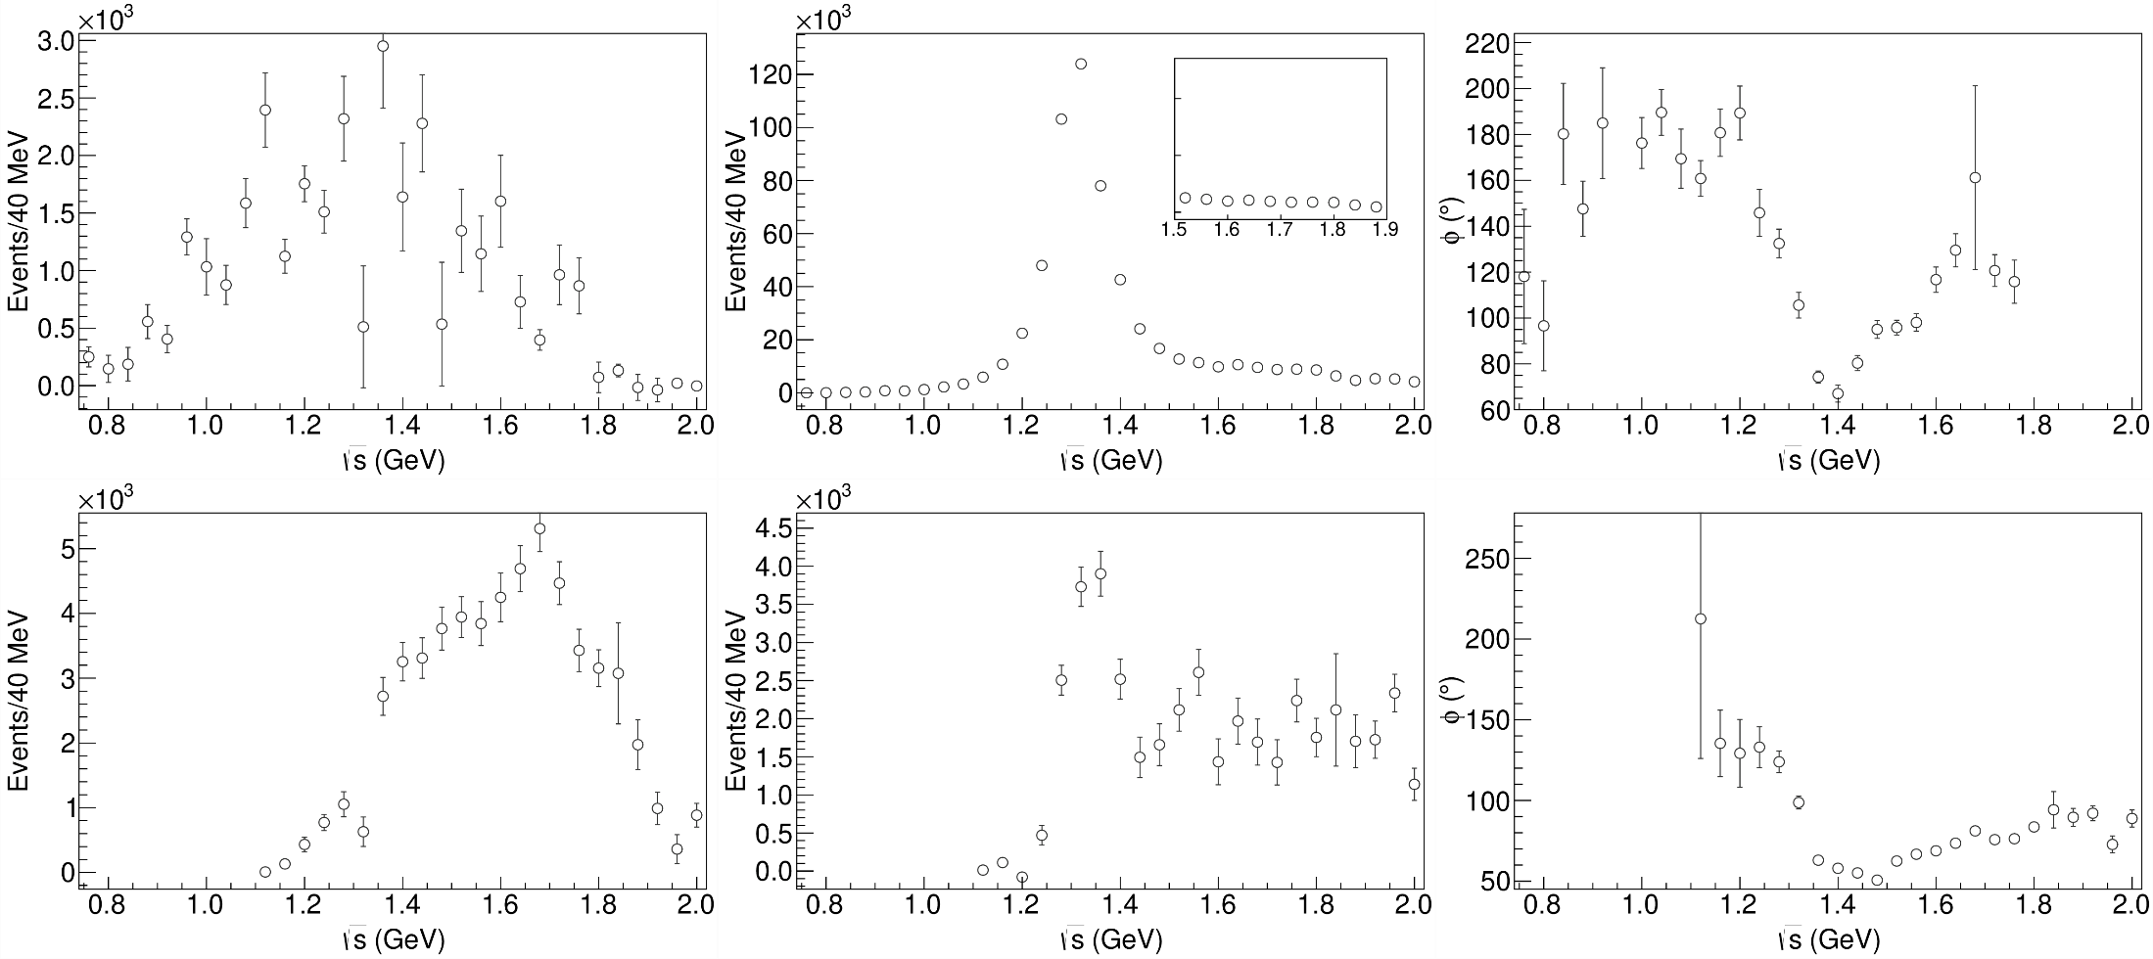
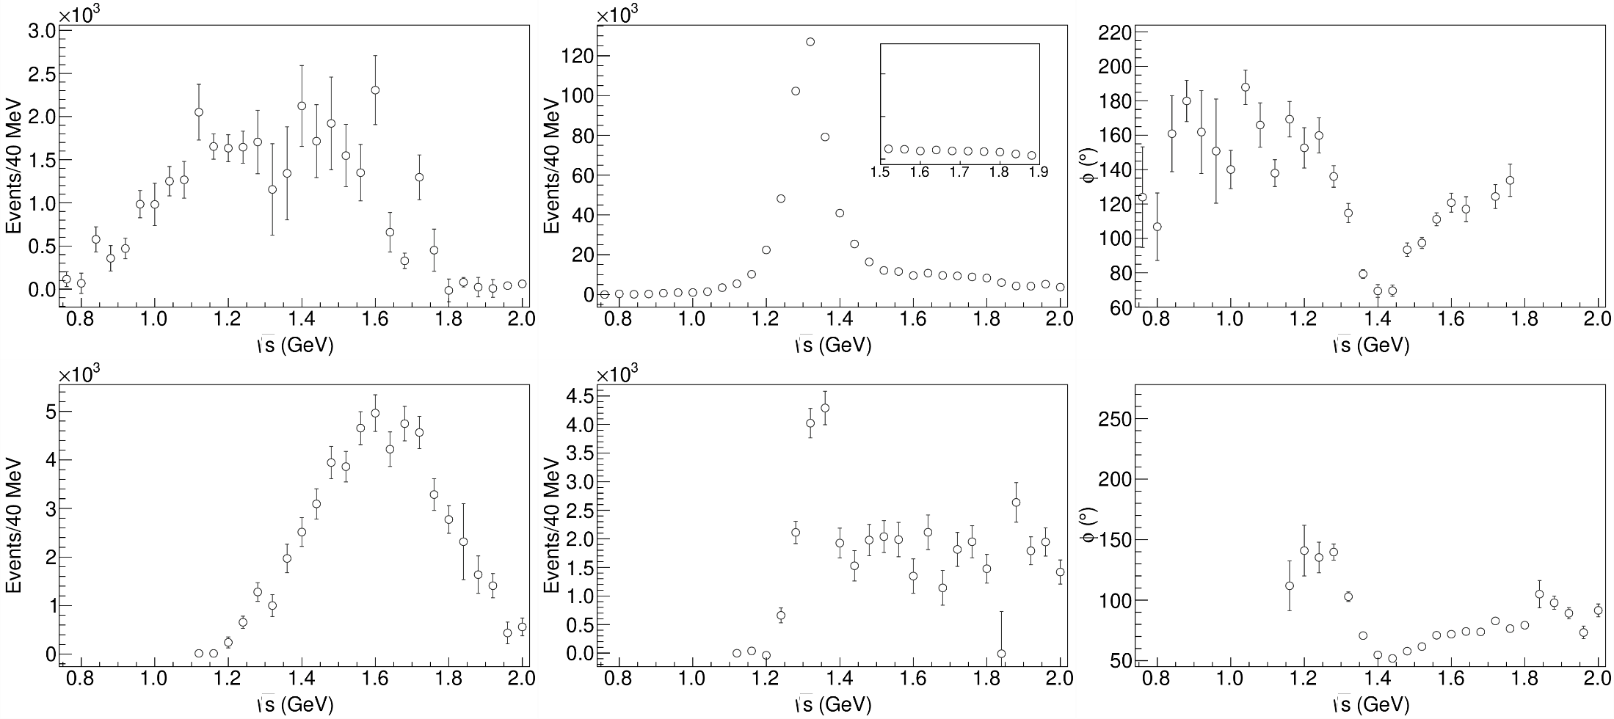
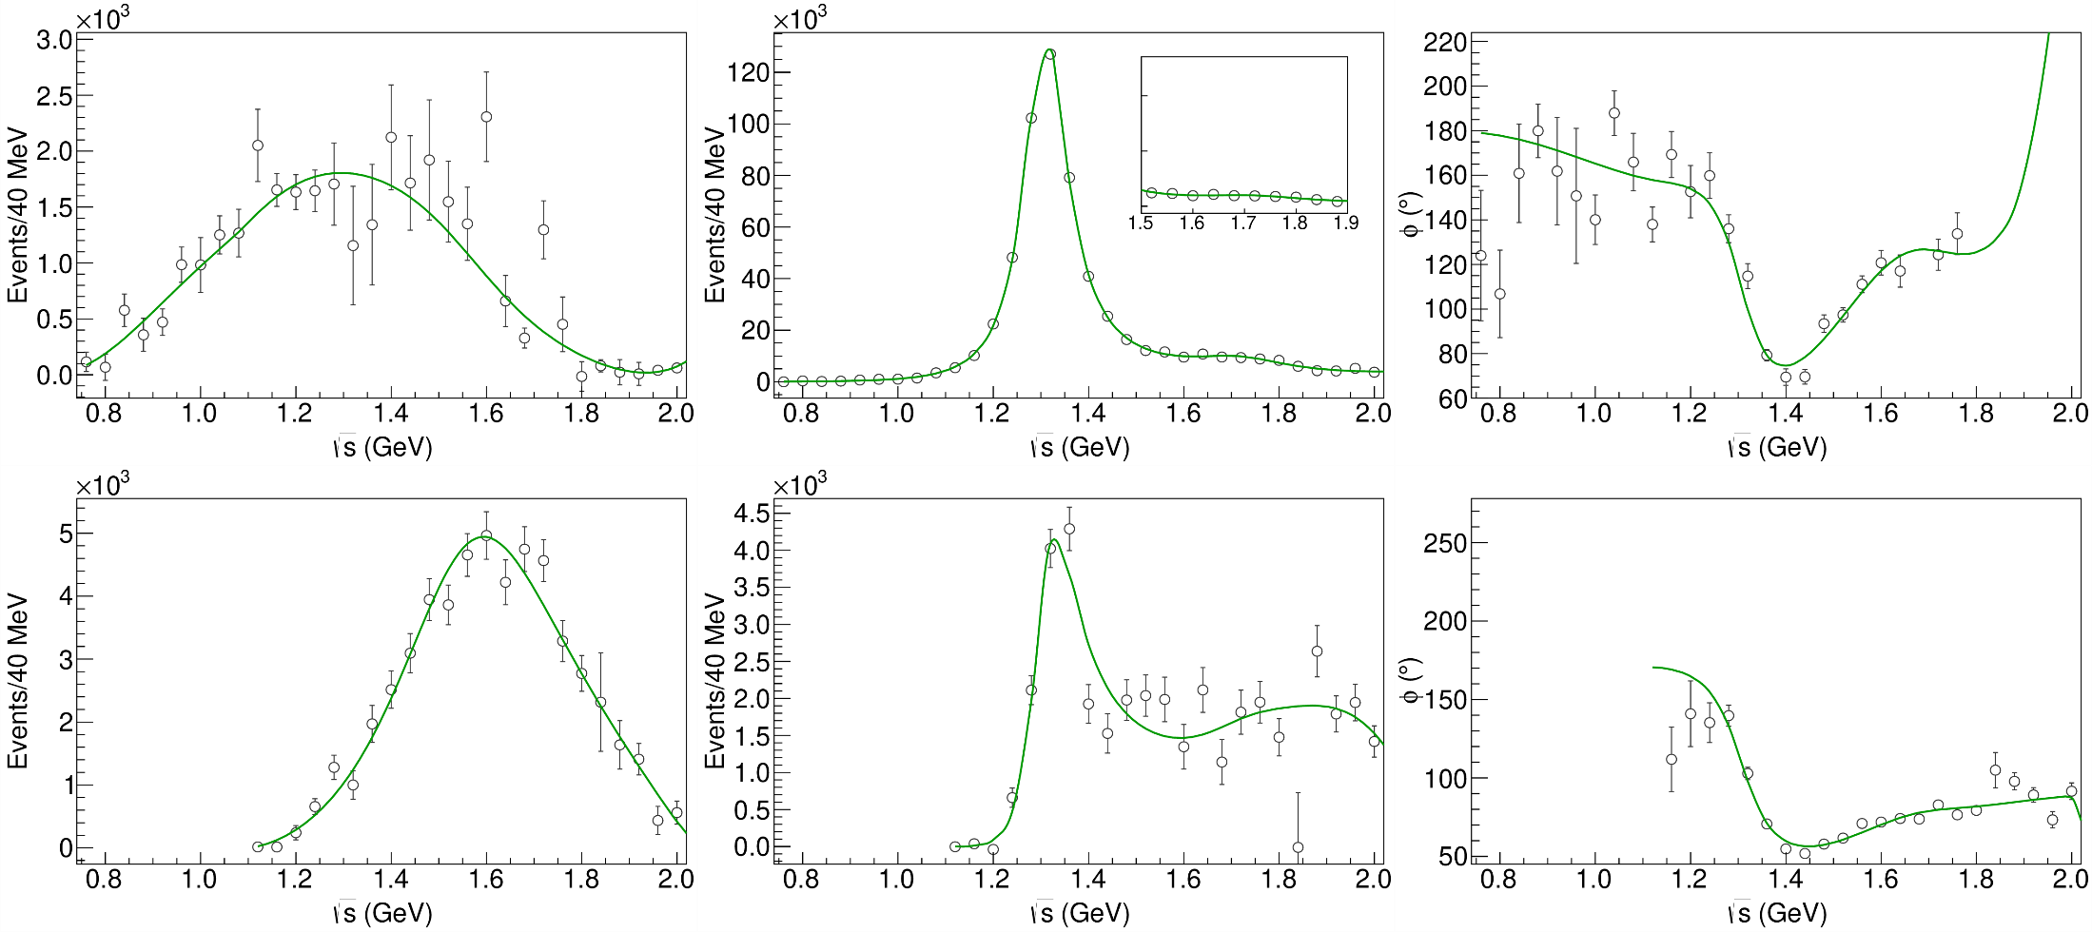
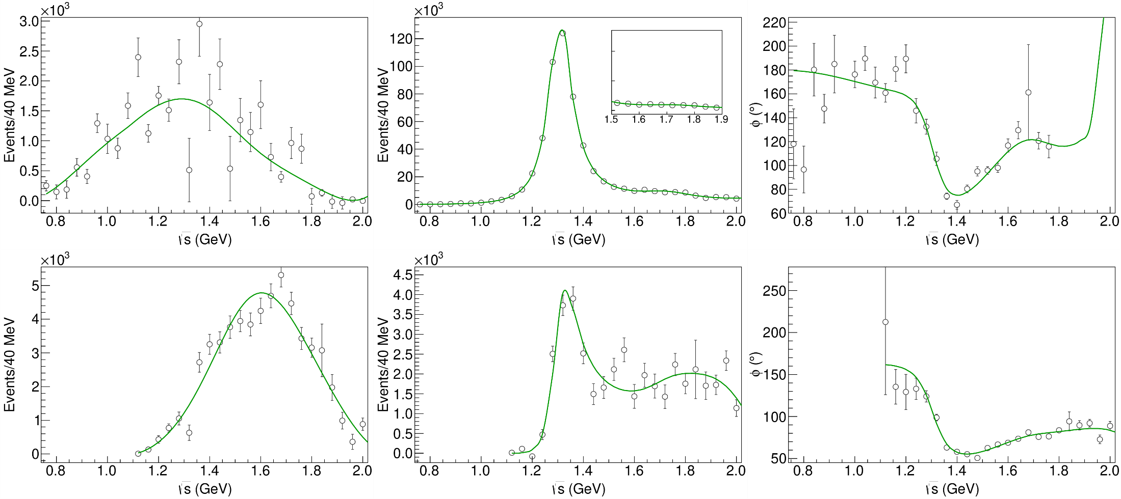
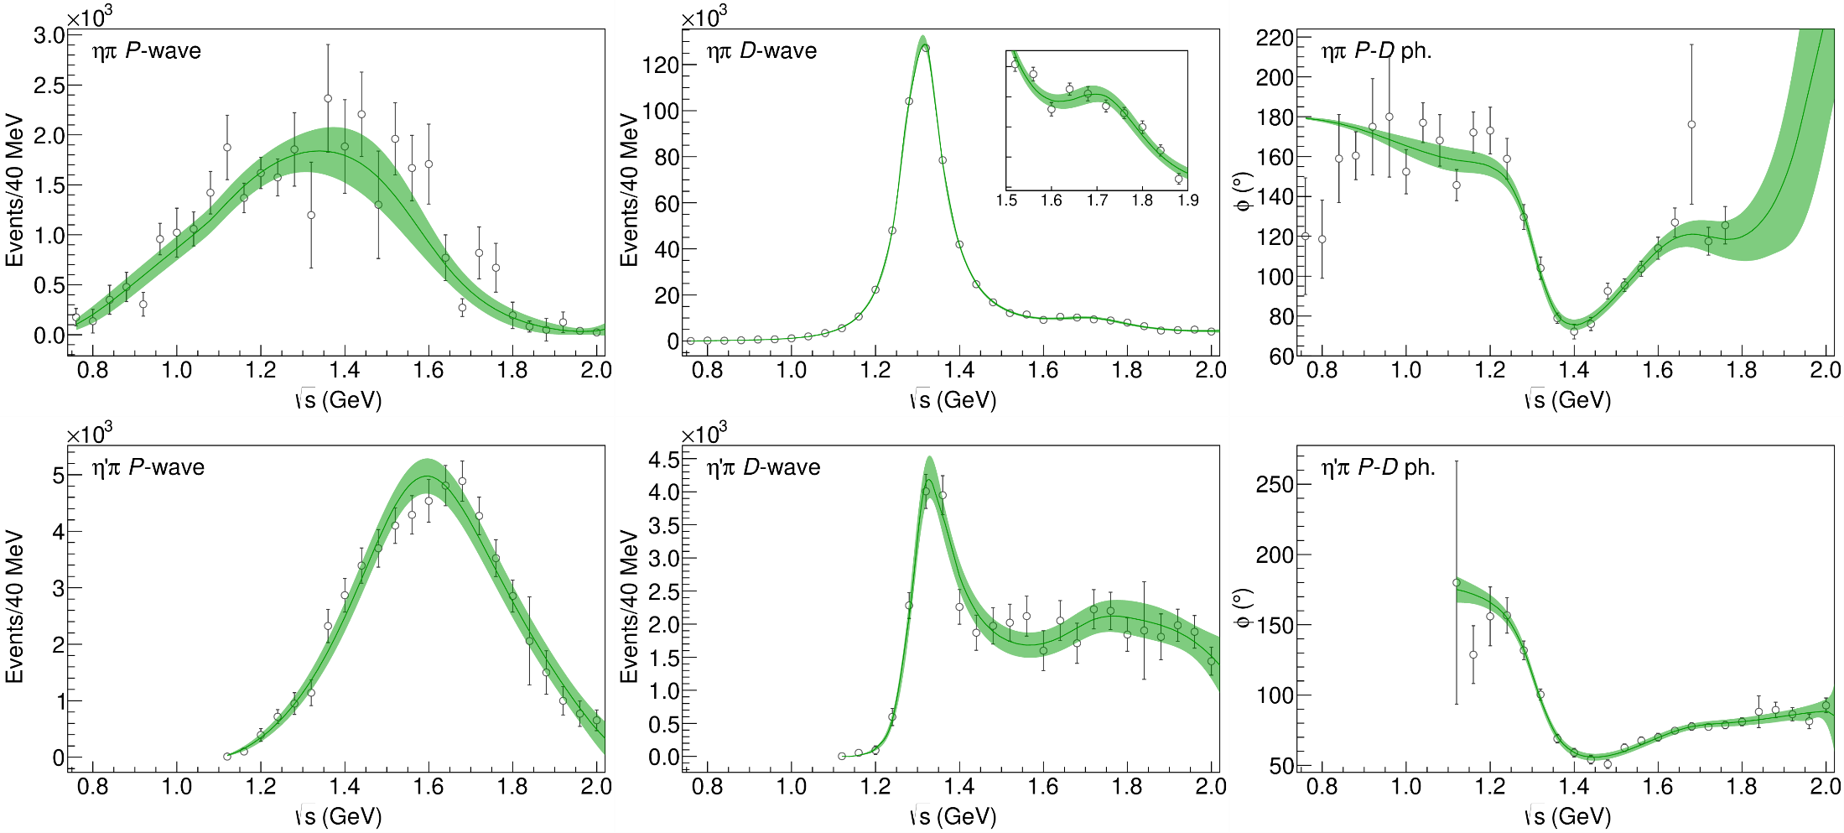
Statistical Bootstrap
A. Pilloni – Exotic hadron spectroscopy
Notes:
Controlla la parte su Regge

Slide 21
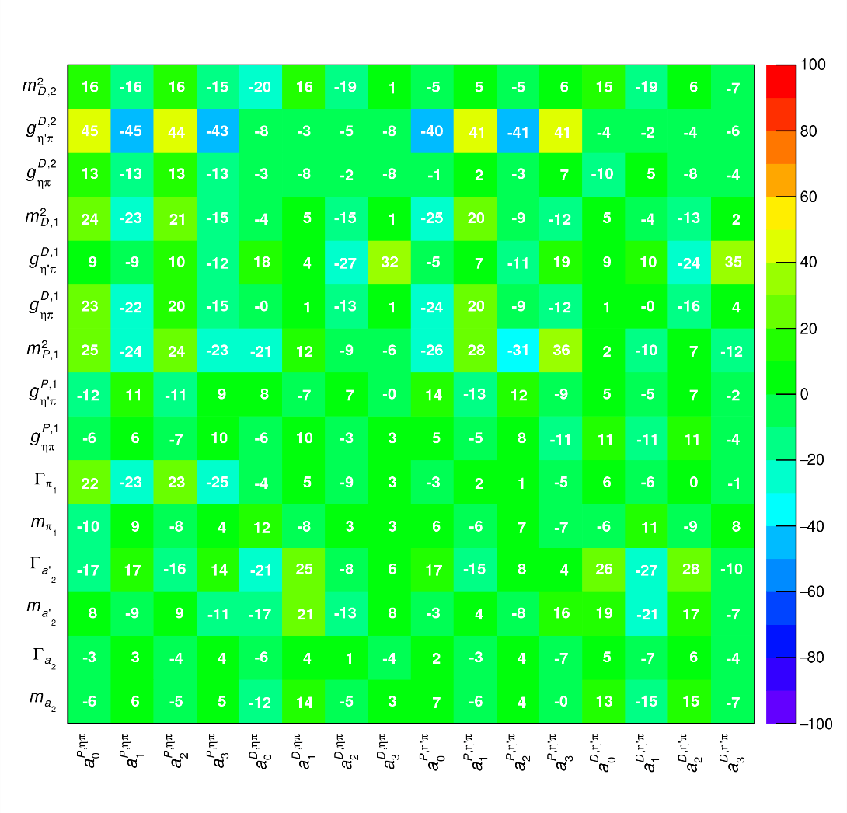
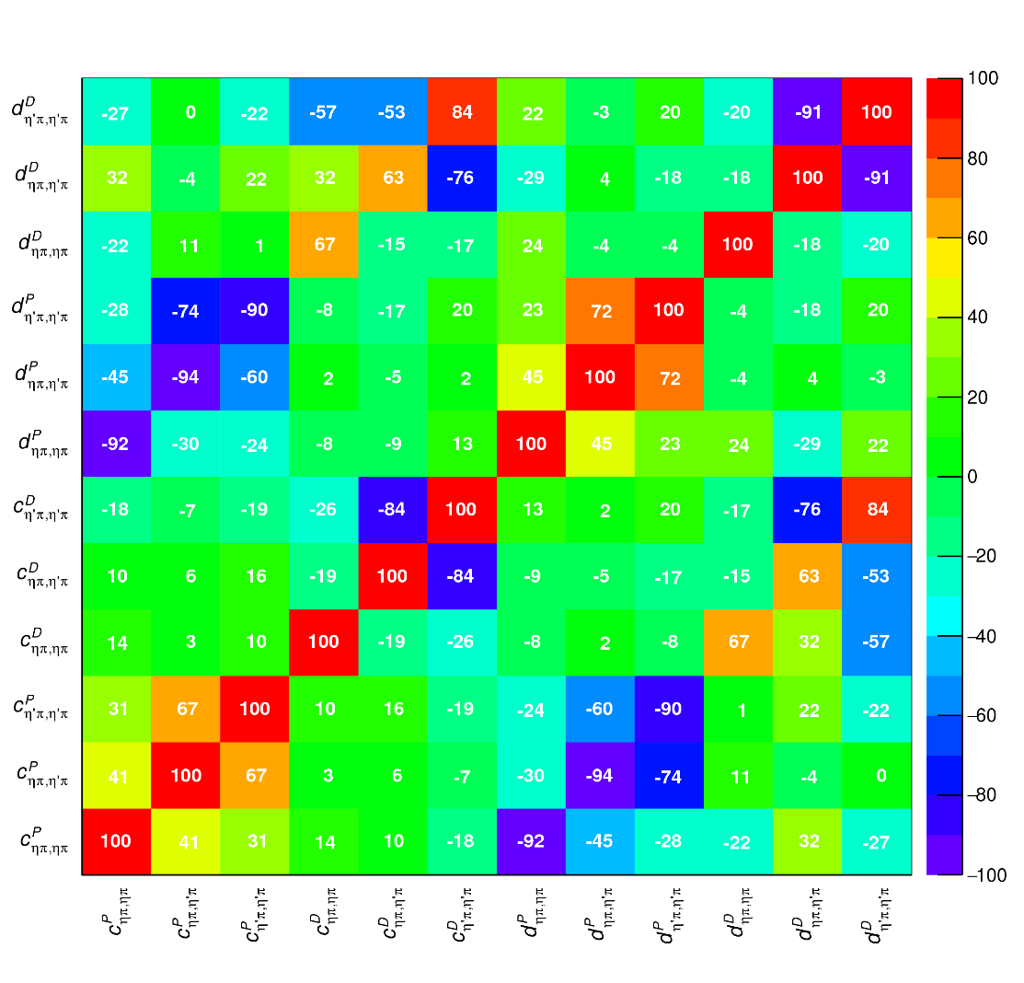
Correlations
Denominator parameters uncorrelated with the numerator ones ✓
Denominator parameters uncorrelated between P- and D-wave ✓
Production (numerator) parameters
K-matrix «bkg» parameters
K-matrix «pole» parameters
K-matrix «bkg» parameters
A. Pilloni – Exotic hadron spectroscopy
Notes:
Controlla la parte su Regge

Slide 22
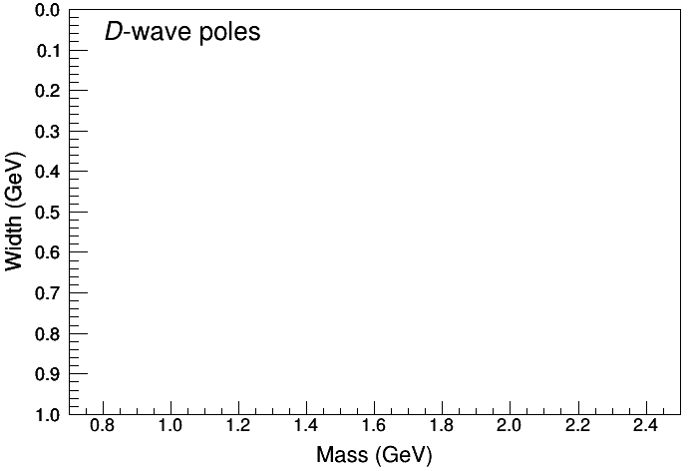
Statistical Bootstrap
For each fit, we search poles: two clusters in D-wave: $a_{2}\left(1320\right)$ and $a_{2}^{′}\left(1700\right)$
A. Pilloni – Challenges in Hadron Spectroscopy
Notes:
Controlla la parte su Regge

Slide 23
Statistical Bootstrap
Only one stable cluster in $P$-wave: a single $π_{1}$
A. Pilloni – Challenges in Hadron Spectroscopy
Notes:
Controlla la parte su Regge

Slide 24
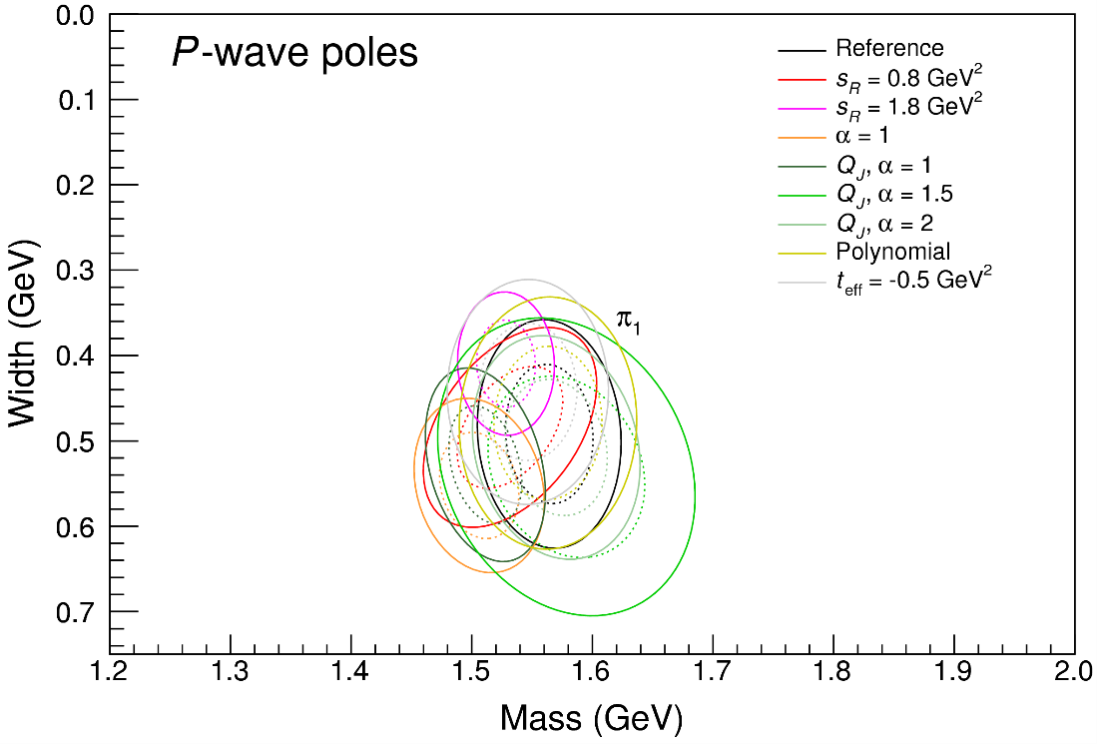
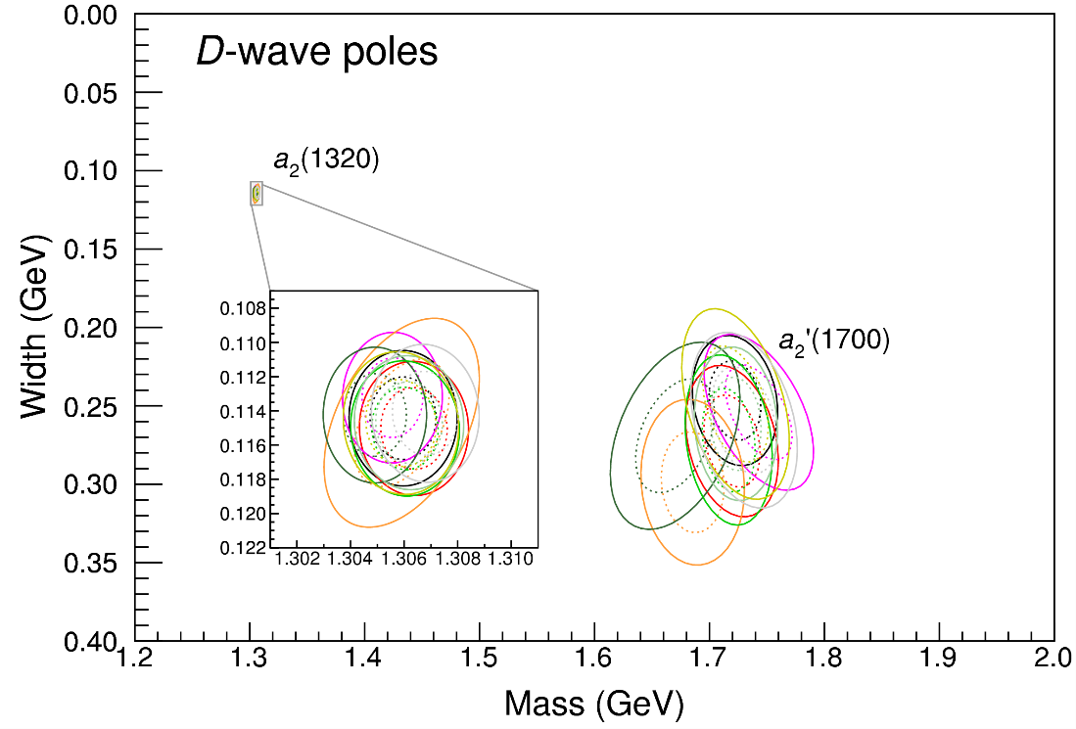
Systematic studies
For each class, the maximum deviation of mass and width is taken as a systematic error Deviation smaller than the statistical error are neglected Systematic of different classes are summed in quadrature
A. Pilloni – Exotic hadron spectroscopy
Notes:
Controlla la parte su Regge

Slide 25
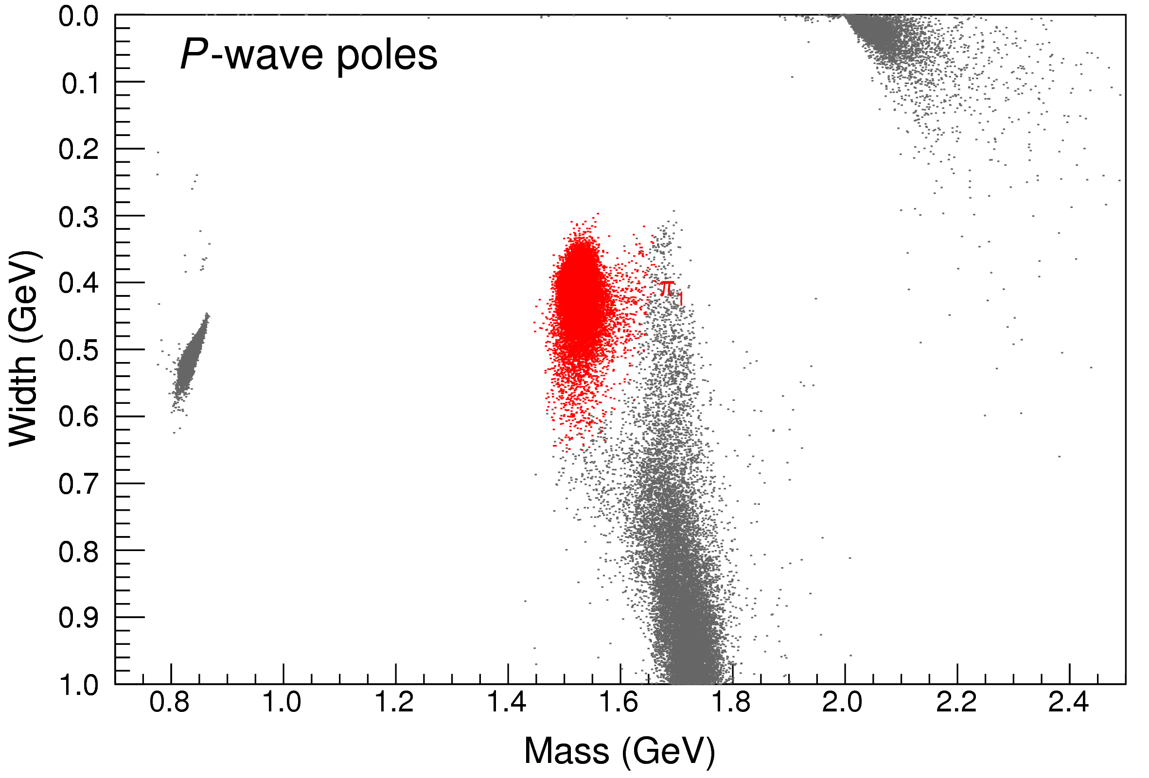
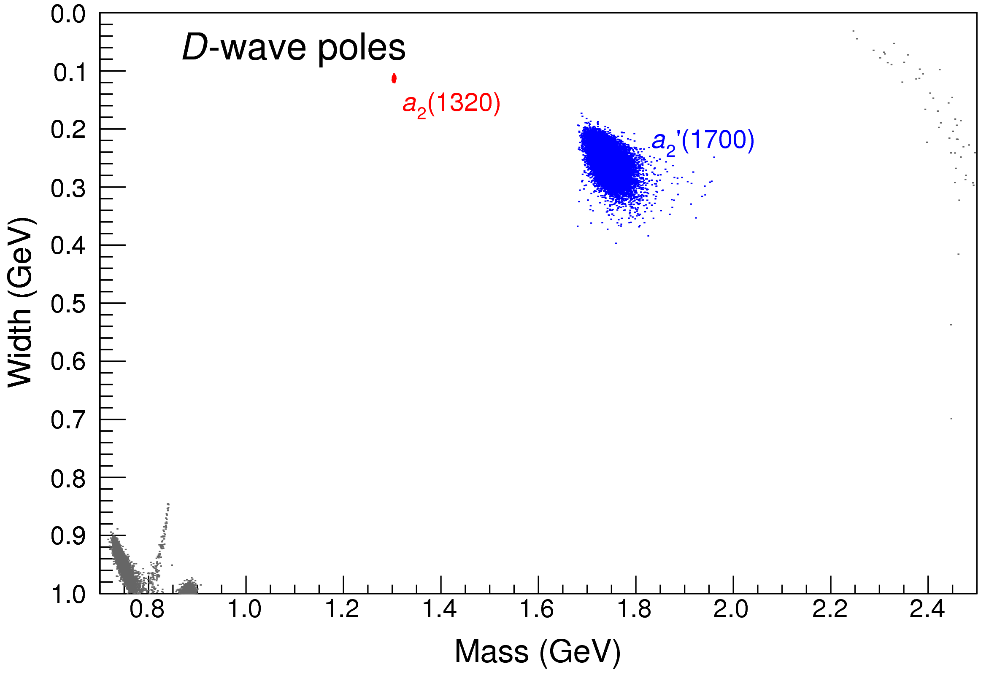
Bootstrap for $s_{R}=1.8 {\text{GeV}}^{2}$
Our skepticism about a second pole in the relevant region is confirmed:
It is unstable and not trustable
A. Pilloni – Exotic hadron spectroscopy
Notes:
Controlla la parte su Regge

Slide 26
Final results
Agreement with Lattice is restored
That’s the most rigorous extraction of an exotic meson available so far!
A. Pilloni – Exotic hadron spectroscopy
Notes:
Controlla la parte su Regge

Slide 27
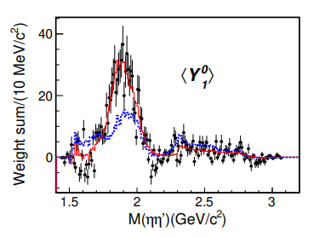
An isoscalar $η_{1}$?
There is a recent claim by BESIII in $J/ψ→γ η η′$ of resonant activity in P-wave
Not enough information to perform a similar analysis but… stay tuned!
BW parameters:
$$M=1855±9_{−1}^{+6} \text{MeV}, \\ Γ=188±{18}_{−8}^{+3} \text{MeV}$$
A. Pilloni – Exotic hadron spectroscopy
Notes:
2 slides su Zc, a Bes e a Belle
2 slide su tetraquark model: dall’hamiltoniana di Jaffe al calcolo delle masse
1 slide su molecular models, dove sono i carichi? (non in Tornqvist, si in Hanhart, vedere Braaten, citare Nefediev)
2 slides su decay channels, dove si dovrebbe vedere, e a seconda del modello, vedere qualche plot
1 slide su Y(4260), tetraquark? C’è lo strano (si vede la f0)
1 slide su Zc a cleo (anche il neutro)

Slide 28
The scalar glueball
$$0^{++}$$
A. Pilloni – Exotic hadron spectroscopy
Notes:
2 slides su Zc, a Bes e a Belle
2 slide su tetraquark model: dall’hamiltoniana di Jaffe al calcolo delle masse
1 slide su molecular models, dove sono i carichi? (non in Tornqvist, si in Hanhart, vedere Braaten, citare Nefediev)
2 slides su decay channels, dove si dovrebbe vedere, e a seconda del modello, vedere qualche plot
1 slide su Y(4260), tetraquark? C’è lo strano (si vede la f0)
1 slide su Zc a cleo (anche il neutro)

Slide 29
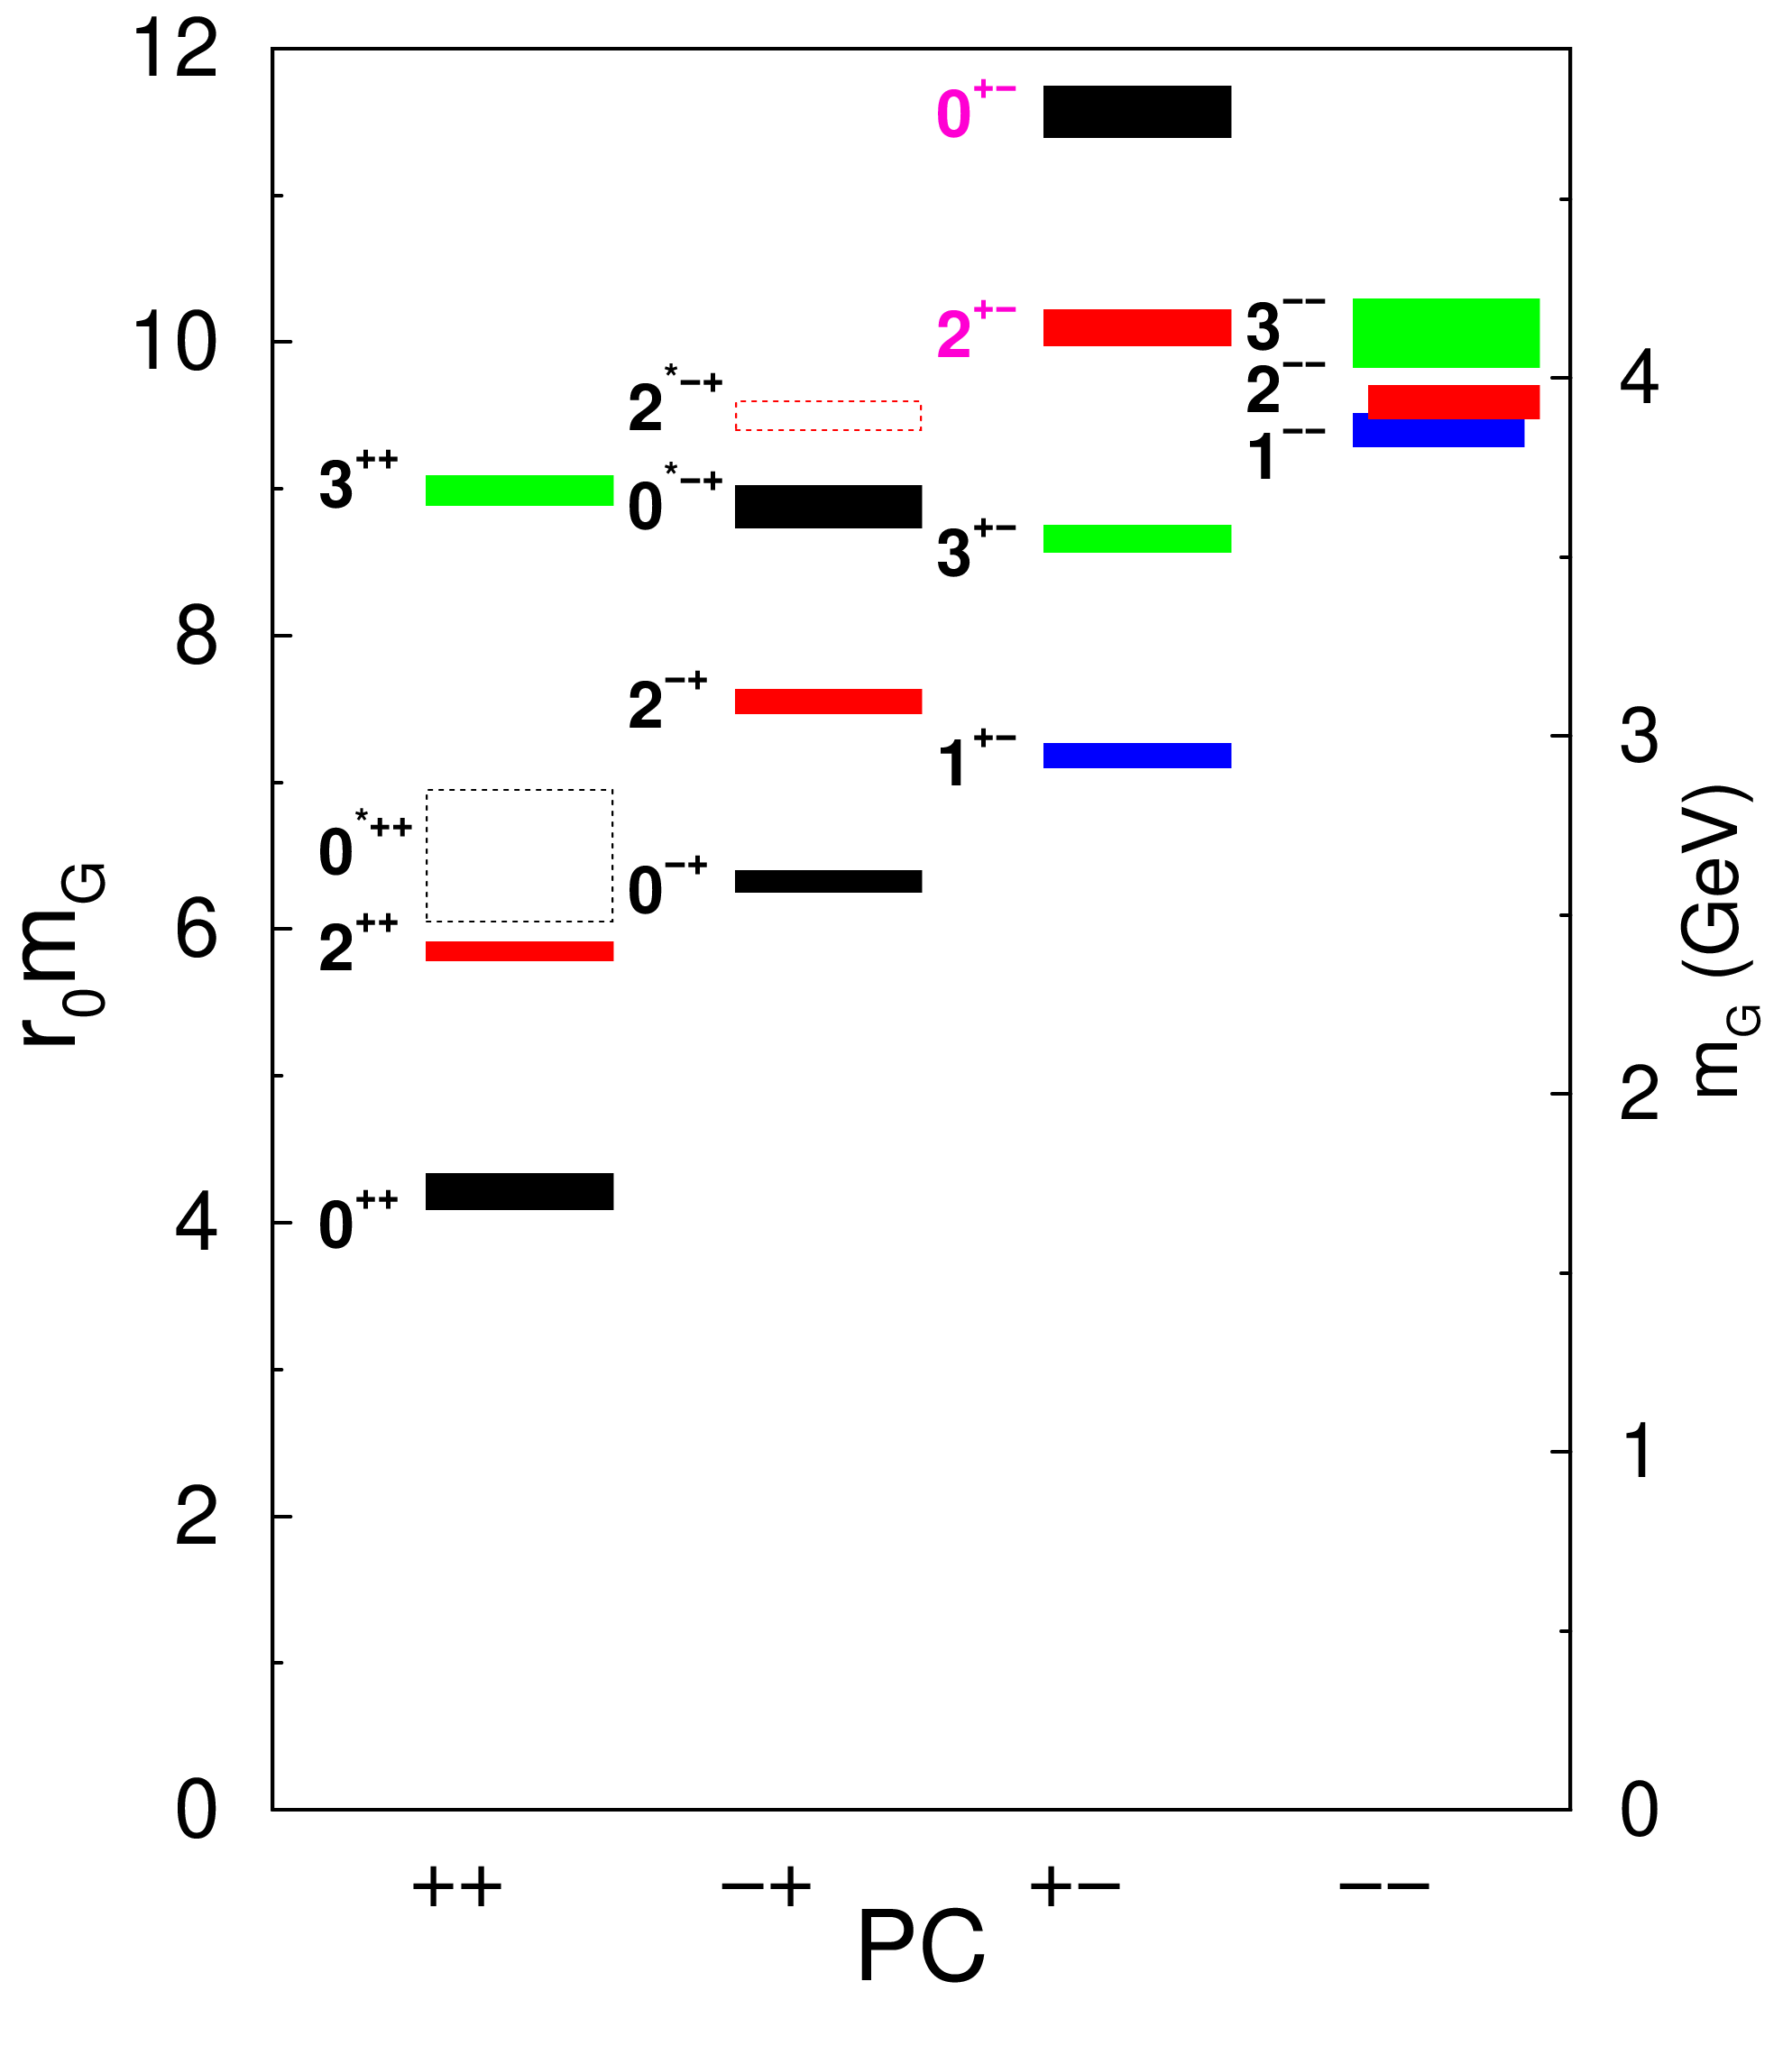
Glueballs
The clearest sign of confinement in pure Yang-Mills The worst state to search in real life
Morningstar and Peardon PRD60, 034509
Gregory et al. JHEP1210, 170
A. Pilloni – Exotic hadron spectroscopy

Slide 30
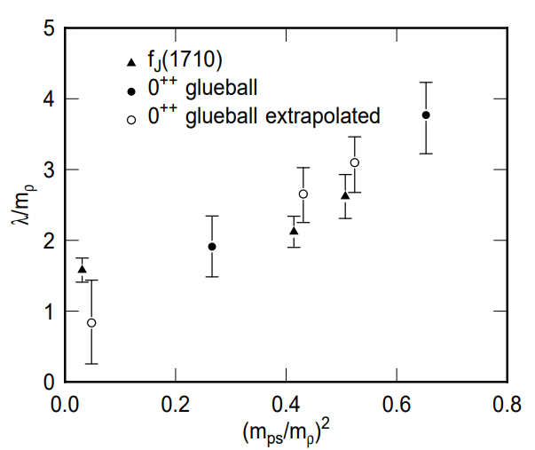
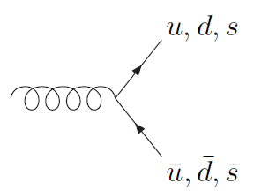
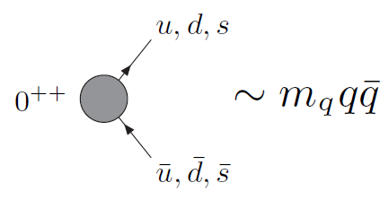
How to identify a glueball
You don’t. Since it mixes with light isoscalars, there is no model-independent way of saying which state is (mostly) the glueball. Only suggestions:
There is one too many wrt QM. Indeed, $f_{0}\left(1370\right),f_{0}\left(1500\right),$ $f_{0}\left(1710\right)$
A glueball couples to photons only throughout mixing, so radiative widths should be small
Their production is enhanced in gluon-rich processes, as $J/ψ$ radiative decays
It couples equally to mesons of all flavors (?)
$$c$$
However, an argument based on chiral symmetry claims the coupling proportional to quark mass
$$J/ψ$$
$$\overline{c}$$
G
A. Pilloni – Exotic hadron spectroscopy

Slide 31
$J/ψ→γ π^{0}π^{0} and→γ K_{S}^{0}K_{S}^{0}$
We consider the $S$ and $D$ wave by BESIII to use the information about their relative phase.
The D-wave is populated by two almost elastic resonances: the $f_{2}(1270)$ and $f_{2}′(1525)$
$f_{2}(1270)$
$f_{2}′(1525)$
A. Pilloni – Amplitude analysis of $J/ψ→γ π^{0}π^{0}$

Slide 32
Same model as before
A. Rodas, AP et al. (JPAC) EPJC82, 1, 80 (2022)
Two/three channels, $i,k=ππ, KK$, $ρρ$ Two waves, $J=S,D$ 40-56 parameters
3 K-matrix pole for the S-wave
3 K-matrix poles for the D-wave
A. Pilloni – Exotic hadron spectroscopy
Notes:
Controlla la parte su Regge

Slide 33
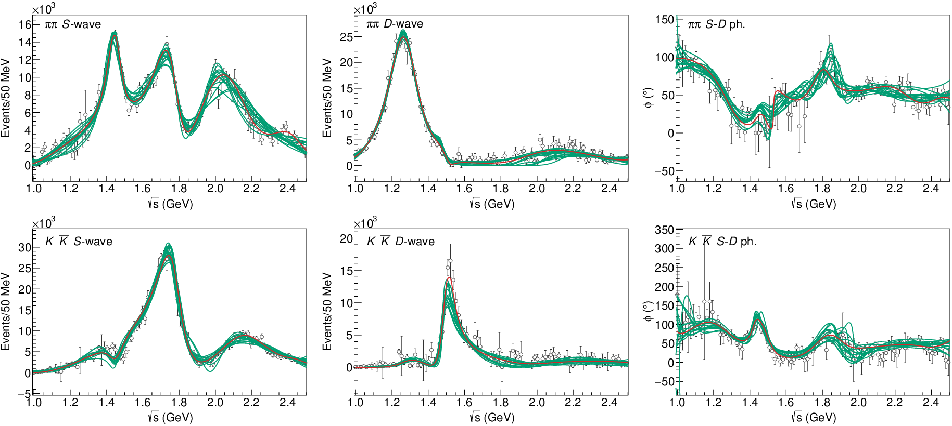
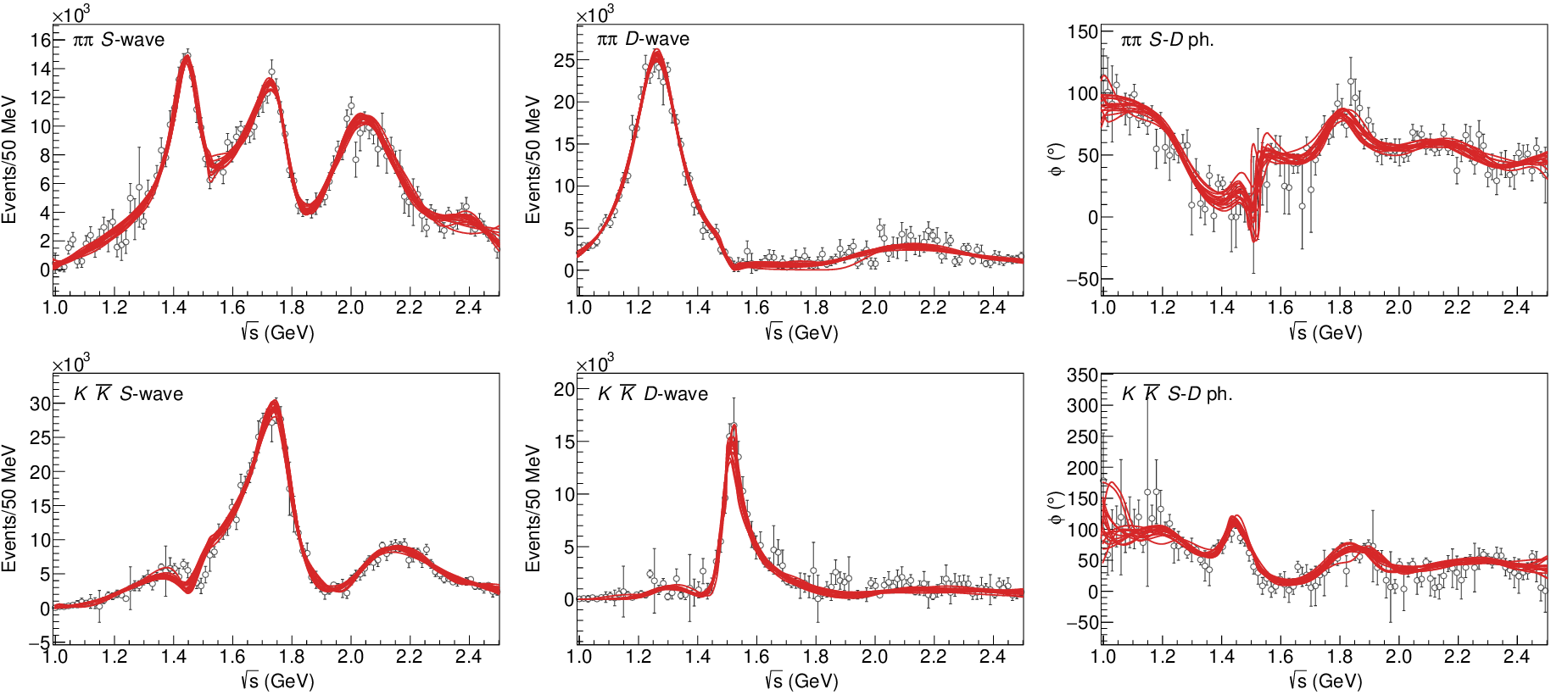
$J/ψ→γ π^{0}π^{0} and→γ K_{S}^{0}K_{S}^{0}$
The fit is decent, but it’s struggling in getting the $f_{2}′$ right Being quasi-elastic, it’s too constrained
Fit quality and local description improve when a third $ρρ$ channel is added
( data)
A. Pilloni – Exotic hadron spectroscopy

Slide 34
Pole extraction
A. Pilloni – Exotic hadron spectroscopy

Slide 35
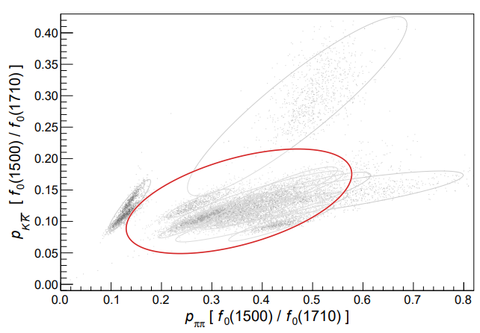
Looking at the residues
Despite the large systematics, the $f_{0}\left(1710\right)$ couples to kaons more than the $f_{0}\left(1500\right)$
Also, the $f_{0}\left(1710\right)$ couples to the initial gluon-rich state more than the $f_{0}\left(1500\right)$
Both these fact suggest a sizeable glueball component for the $f_{0}\left(1710\right)$
A. Pilloni – Exotic hadron spectroscopy

Slide 36
Next lecture
The XYZ crowd: classification, lineshape studies, propagation of X(3872) in high multiplicity environments
Thank you
A. Pilloni – Exotic hadron spectroscopy
Notes:
2 slides su Zc, a Bes e a Belle
2 slide su tetraquark model: dall’hamiltoniana di Jaffe al calcolo delle masse
1 slide su molecular models, dove sono i carichi? (non in Tornqvist, si in Hanhart, vedere Braaten, citare Nefediev)
2 slides su decay channels, dove si dovrebbe vedere, e a seconda del modello, vedere qualche plot
1 slide su Y(4260), tetraquark? C’è lo strano (si vede la f0)
1 slide su Zc a cleo (anche il neutro)

