Slide 1
Status of Spectroscopy of Exotic Hadrons
Alessandro Pilloni
107th SIF Congresso, September 15th, 2021

Slide 2
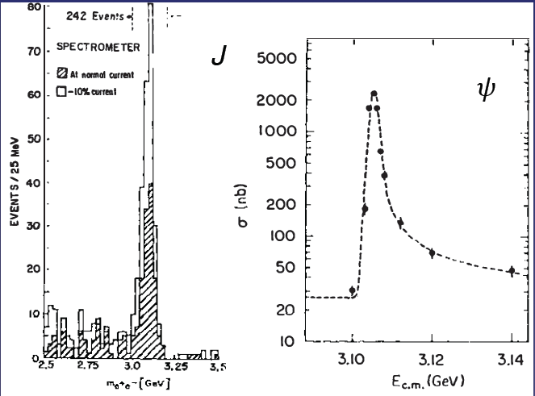
Prologue: Quarkonium
$$Q$$
$$\overline{Q}$$
Potential models
(meaningful when $M_{Q}→∞$)
$$V\left(r\right)=−\frac{C_{F}α_{s}}{r}+σr$$
(Cornell potential)
$$α_{s}\left(M_{Q}\right)∼0.3$$
(perturbative regime)
OZI-rule, QCD multipole
Solve NR Schrödinger eq. → spectrum
Effective theories
(HQET, NRQCD, pNRQCD...)
Heavy quark spin flip suppressed by quark mass, approximate heavy quark spin symmetry (HQSS)
Integrate out heavy DOF
↓
(spectrum), decay & production rates
A. Pilloni – Status of Spectroscopy of Exotic Hadrons
Notes:
2 slides su Zc, a Bes e a Belle
2 slide su tetraquark model: dall’hamiltoniana di Jaffe al calcolo delle masse
1 slide su molecular models, dove sono i carichi? (non in Tornqvist, si in Hanhart, vedere Braaten, citare Nefediev)
2 slides su decay channels, dove si dovrebbe vedere, e a seconda del modello, vedere qualche plot
1 slide su Y(4260), tetraquark? C’è lo strano (si vede la f0)
1 slide su Zc a cleo (anche il neutro)

Slide 3
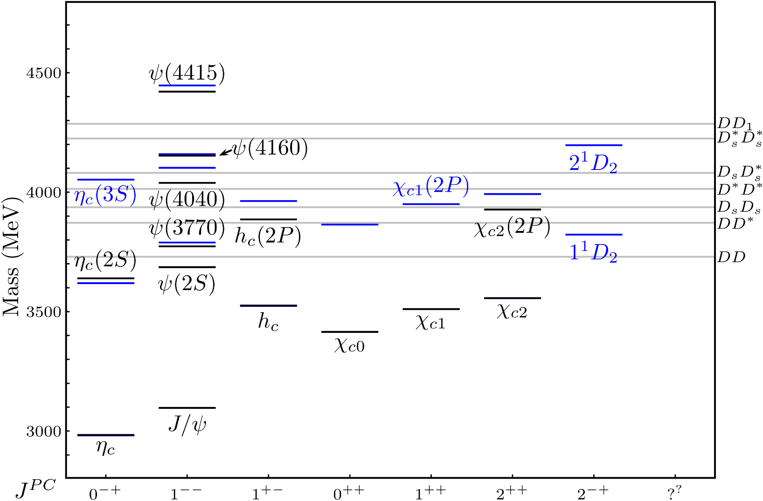
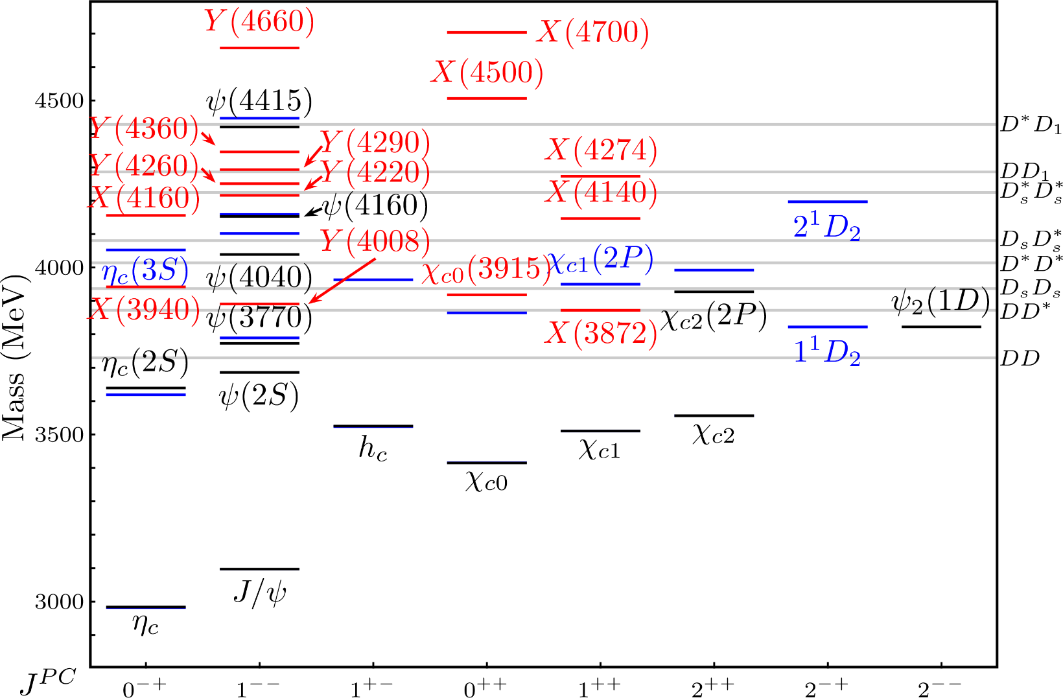
Exotic landscape
Esposito, AP, Polosa, Phys.Rept. 668
A host of unexpected resonances have appeared
decaying mostly into charmonium + light
Hardly reconciled with usual charmonium interpretation
A. Pilloni – Status of Spectroscopy of Exotic Hadrons
Notes:
2 slides su Zc, a Bes e a Belle
2 slide su tetraquark model: dall’hamiltoniana di Jaffe al calcolo delle masse
1 slide su molecular models, dove sono i carichi? (non in Tornqvist, si in Hanhart, vedere Braaten, citare Nefediev)
2 slides su decay channels, dove si dovrebbe vedere, e a seconda del modello, vedere qualche plot
1 slide su Y(4260), tetraquark? C’è lo strano (si vede la f0)
1 slide su Zc a cleo (anche il neutro)

Slide 4
Exotic landscape
Broad mesons seen in $b$ decay:
$X(4140)$, $Z(4430)$, $Z_{cs}(4000)$...
Narrow structures seen in $b$ decay:
$X\left(3872\right), P_{c}$, $P_{cs}$
Scarce consistency between various production mechanisms
Narrow structures seen in $e^{+}e^{−}$:
$X(3872)$, $Y(4260)$, $Z_{c,b}^{(′)}$
A. Pilloni – Status of Spectroscopy of Exotic Hadrons

Slide 5
Models
Compact
Hybrids
Containing gluonic degrees of freedom
Multiquark
Several (cluster) of valence quarks
Hadroquarkonium
Heavy core interacting with a light cloud via Van der Waals forces
$$π$$
$$π$$
$$J/ψ$$
$$π$$
Rescattering effects
Structures generated by cross-channel rescattering, very process-dependent
Molecule
Bound or virtual state generated by long-range exchange forces
Extended
A. Pilloni – Status of Spectroscopy of Exotic Hadrons

Slide 6
The two antagonists
Compact Tetraquarks: 4 constituent quarks bound via color forces Fair understanding of existing spectrum ✓
A full nonet for each level is expected ✗
Proximity to threshold accidental ✗
Associated to CDD poles, no (strong) hierarchy of couplings
Typical size of ordinary hadrons $O(1 \text{fm}\text{)}$
$${\overline{3}}_{c}$$
Compact Tetraquarks: 4 constituent quarks bound via color forces Fair understanding of existing spectrum ✓
A full nonet for each level is expected ✗
Proximity to threshold accidental ✗
Associated to CDD poles, no (strong) hierarchy of couplings
Typical size of ordinary hadrons $O(1 \text{fm}\text{)}$
$$c$$
$$\overline{c}$$
$$3_{c}$$
$$q$$
$$\overline{q}$$
Maiani, Piccinini, Polosa, Riquer PRD71 014028
Esposito, Polosa, EPJC 78, 9, 782 Maiani, Polosa, Riquer PLB 778, 247
Tornqvist, Z.Phys. C61, 525
Braaten and Kusunoki, PRD69 074005
Swanson, Phys.Rept. 429 243-305
Each state is mostly unrelated to others ✗
Proximity to threshold natural ✓
Molecules: 2 well separated hadrons bound via inter-hadron potential
Dominance of a single channel Typical size inverse of binding momentum $O(10 \text{fm}\text{)}$
$$D^{0}$$
$$π^{0}$$
$$\overline{D^{0∗}}$$
A. Pilloni – Status of Spectroscopy of Exotic Hadrons
Notes:
Y(4260), M=4263 +- 5, Gamma = 95+-14
D_1(2420)^0, M=2421.3 ±0.6, Gamma =27.1 ±2.7
D_1(2420)^+-, M=2423.4 ±3.1, Gamma =25 ±6
I D_1 hanno J^P = 1^+
La molecola D_1 D sta 22 MeV sotto
Se la Y è D_1 D, il pione lega fortemente, come fa la Y a essere così larga?
Come funziona lo scambio del pione???
Close propone che la Y è D_1 D^* col pione scambiato in onda S,
La Y però non va in Ds come se fosse tetraquark

Slide 7
Bound and virtual states
Decreasing the potential strength, the pole reaches threshold
The pole jumps on the 2nd sheet (dineutron), it becomes a virtual state
Example from $pn$ scattering Bound state on the real axis 1st sheet (deuteron)
$$V(r)$$
$$\text{Im} E$$
$$r$$
$$V$$
Deuteron
$$\text{Re} E$$
$${}_{}^{1}S$$
Deuteron pole
Dineutron pole
$${}_{}^{3}S$$
A. Pilloni – Status of Spectroscopy of Exotic Hadrons
Notes:
Controlla la parte su Regge

Slide 8
Pentaquarks!
The lowest $P_{c}(4312)$ appears as an isolated peak at the $Σ_{c}^{+}{\overline{D}}^{0}$ threshold
A detailed study of the lineshape provides insight on its nature
Bottom-up approach: DON’T YOU DARE describing everything!!! Focus on the peak region
A. Pilloni – Status of Spectroscopy of Exotic Hadrons
Notes:
Controlla la parte su Regge

Slide 9
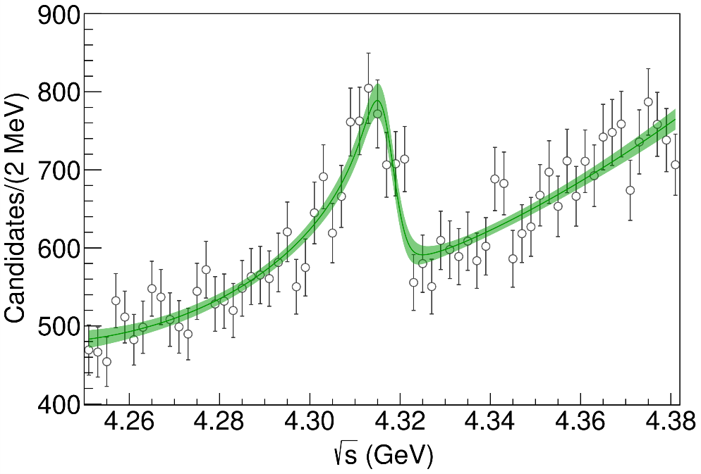
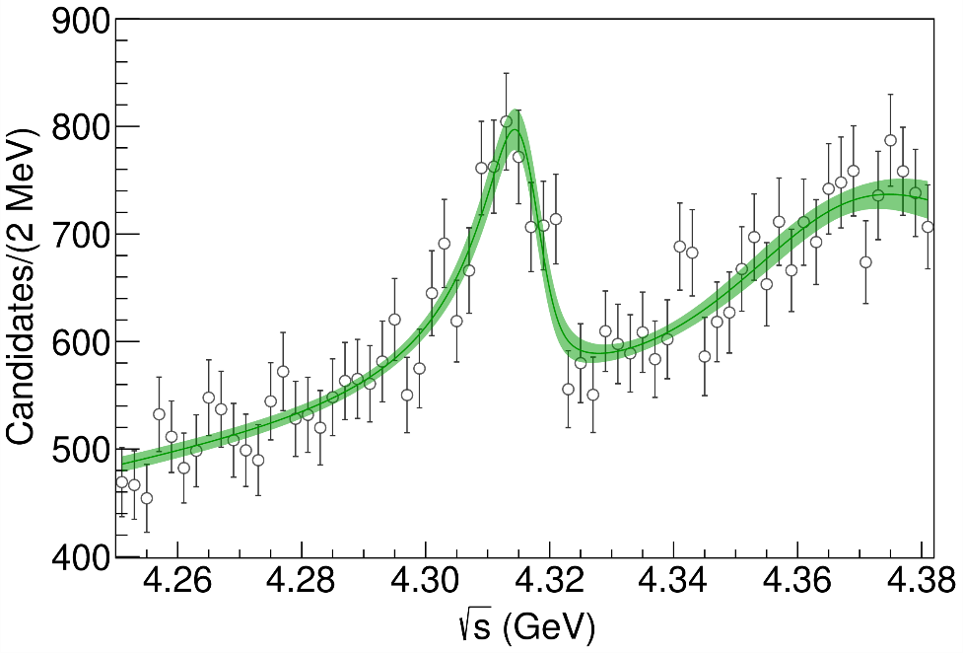
Lineshape of the $P_{c}(4312)$
Fernandez-Ramirez, AP et al. (JPAC), PRL 123, 092001
Effective range expansion We can set $c_{ii}=0$ to reduce to the scattering length approximation
$$c_{ii}=0$$
( data)
Finite $c_{ii}$
A. Pilloni – Status of Spectroscopy of Exotic Hadrons
Notes:
2 slides su Zc, a Bes e a Belle
2 slide su tetraquark model: dall’hamiltoniana di Jaffe al calcolo delle masse
1 slide su molecular models, dove sono i carichi? (non in Tornqvist, si in Hanhart, vedere Braaten, citare Nefediev)
2 slides su decay channels, dove si dovrebbe vedere, e a seconda del modello, vedere qualche plot
1 slide su Y(4260), tetraquark? C’è lo strano (si vede la f0)
1 slide su Zc a cleo (anche il neutro)

Slide 10
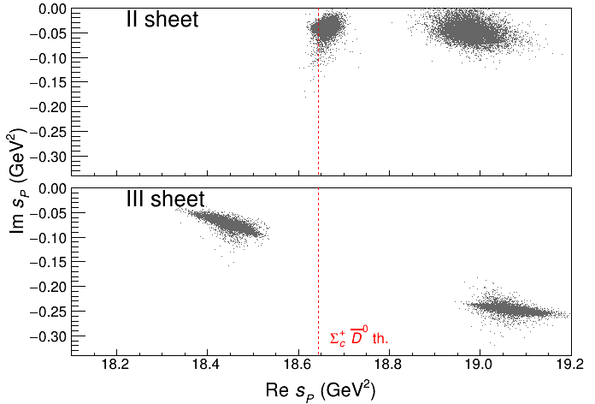
Minimal(istic) model
Effective range expansion We can set $c_{ii}=0$ to reduce to the scattering length approximation
Points to a virtual state
Points to a virtual state
$$c_{ii}=0$$
Finite $c_{ii}$
A. Pilloni – Status of Spectroscopy of Exotic Hadrons
Notes:
2 slides su Zc, a Bes e a Belle
2 slide su tetraquark model: dall’hamiltoniana di Jaffe al calcolo delle masse
1 slide su molecular models, dove sono i carichi? (non in Tornqvist, si in Hanhart, vedere Braaten, citare Nefediev)
2 slides su decay channels, dove si dovrebbe vedere, e a seconda del modello, vedere qualche plot
1 slide su Y(4260), tetraquark? C’è lo strano (si vede la f0)
1 slide su Zc a cleo (anche il neutro)

Slide 11
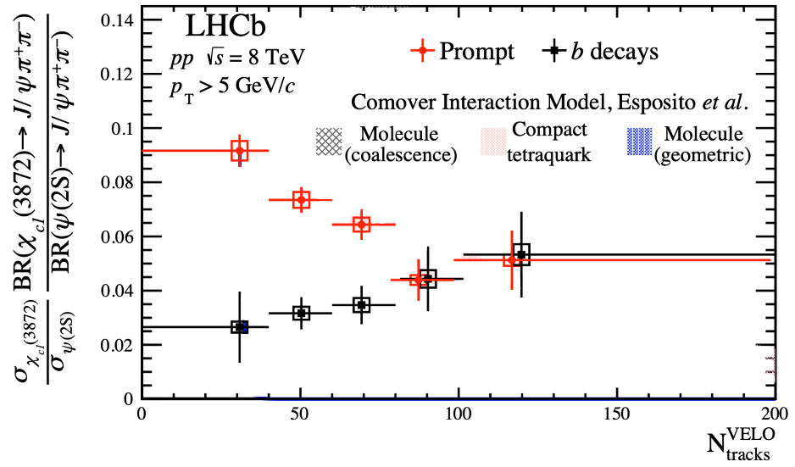
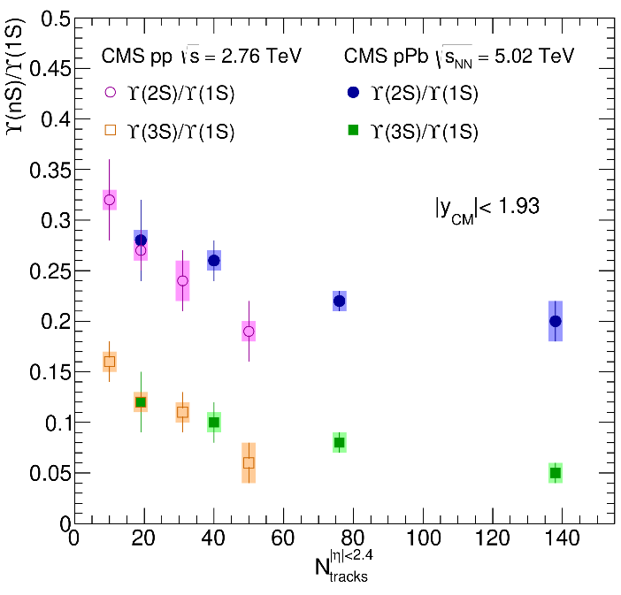
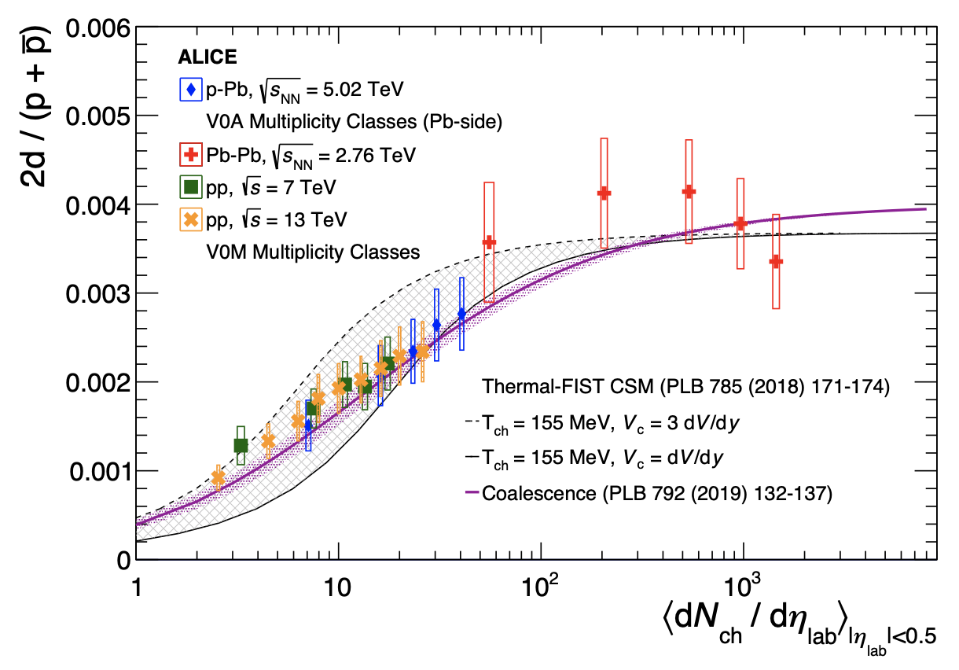
Multiplicity dependence of $X(3872)$
The $X(3872)$is more suppressed wrt $ψ\left(2S\right)$ when more tracks (comovers) are present
Does it make the $X(3872)$a fragile molecule? No.
Does it make the $X(3872)$a fragile molecule?
LHCb PRL126, 092001
Deuteron is a molecule, but it increases
CMS JHEP04(2014), 103
ALICE EPJC80, 9, 889
$Υ(2S)$ and $Υ\left(3S\right)$ are not molecules, but they decrease
$Υ(2S)$ and $Υ\left(3S\right)$ are not molecules, but they decrease
A. Pilloni – Status of Spectroscopy of Exotic Hadrons
Notes:
2 slides su Zc, a Bes e a Belle
2 slide su tetraquark model: dall’hamiltoniana di Jaffe al calcolo delle masse
1 slide su molecular models, dove sono i carichi? (non in Tornqvist, si in Hanhart, vedere Braaten, citare Nefediev)
2 slides su decay channels, dove si dovrebbe vedere, e a seconda del modello, vedere qualche plot
1 slide su Y(4260), tetraquark? C’è lo strano (si vede la f0)
1 slide su Zc a cleo (anche il neutro)

Slide 12
The comover model
The interaction with final state comoving particles can help create/destroy a hadron
Baym PLB138, 18
For a compact state in 𝑝𝑝 collisions the number evolves following
hadron yield
destruction cross section
$$τ\frac{dN_{𝒬}}{dτ}=−⟨vσ⟩_{𝒬}ρ_{c}N_{𝒬}$$
comover density at initial time (Glauber model) $∝N_{ch}$
In the Comover Interaction Model one takes $⟨vσ⟩_{𝒬}∼πr_{𝒬}^{2}$
This has proved to be successful at describing 𝑝Pb and PbPb data
$$⟨vσ⟩_{Υ\left(1S\right)}=0.62 mb,⟨vσ⟩_{Υ\left(2S\right)}=2.46 mb,⟨vσ⟩_{Υ\left(3S\right)}=5.03 mb$$
Ferreiro PLB749, 98
Ferreiro, Lansberg JHEP10(2018), 94
A. Pilloni – Status of Spectroscopy of Exotic Hadrons
Notes:
2 slides su Zc, a Bes e a Belle
2 slide su tetraquark model: dall’hamiltoniana di Jaffe al calcolo delle masse
1 slide su molecular models, dove sono i carichi? (non in Tornqvist, si in Hanhart, vedere Braaten, citare Nefediev)
2 slides su decay channels, dove si dovrebbe vedere, e a seconda del modello, vedere qualche plot
1 slide su Y(4260), tetraquark? C’è lo strano (si vede la f0)
1 slide su Zc a cleo (anche il neutro)

Slide 13
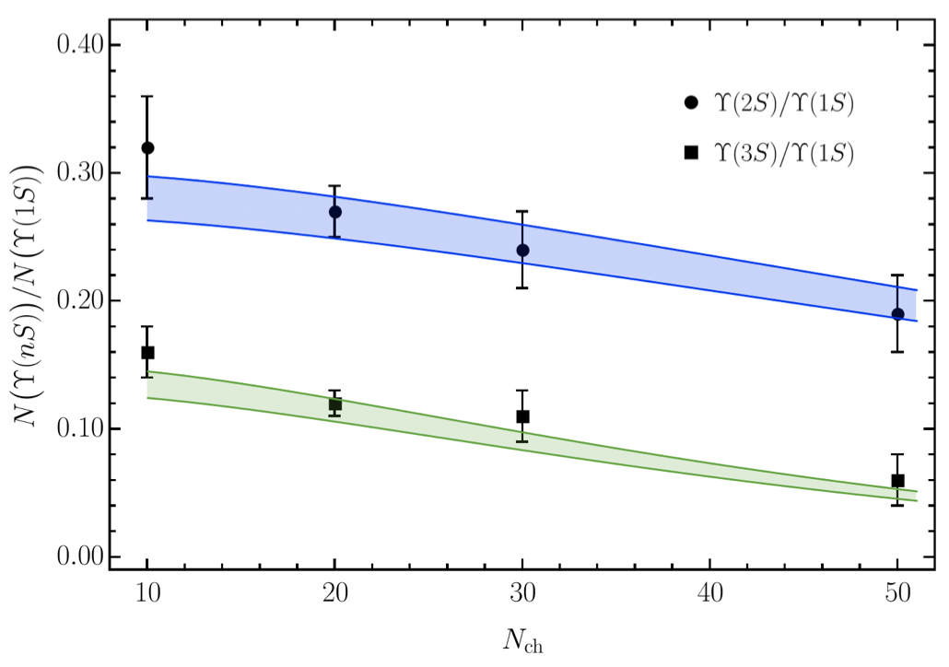
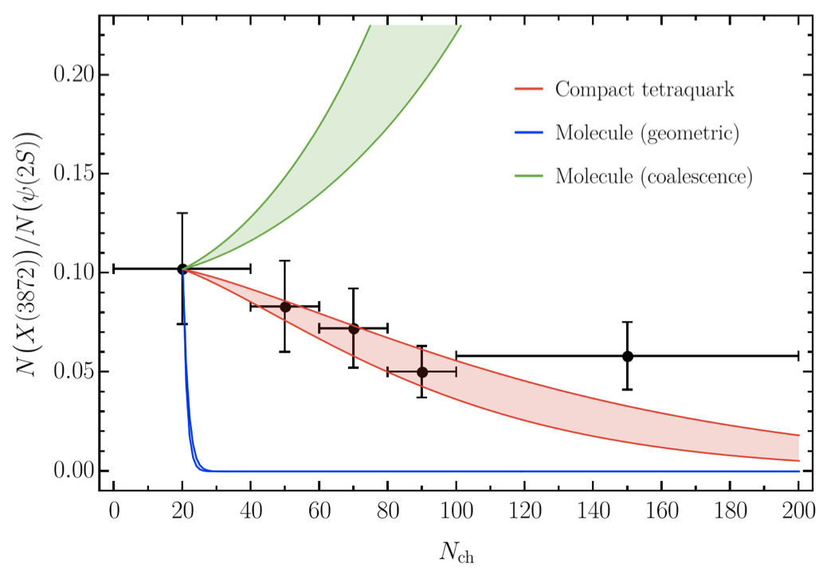
Bottomonia & $X(3872)$
Naive molecule model badly fails
$r_{mol}=6.6 \text{fm}$, ${\left\langle vσ\right\rangle }_{mol}=1197 \text{mb}$
$r_{ψ(2S)}=0.45 \text{fm}$, ${\left\langle vσ\right\rangle }_{ψ(2S)}=5.15 \text{mb}$
Further validate the model using CMS $pp$ data Using same cross sections as in 𝑝Pb and PbPb
Same model for a compact $X(3872)$
$r_{4q}=0.66 \text{fm}$, ${\left\langle vσ\right\rangle }_{4q}=11.61 \text{mb}$
$r_{ψ(2S)}=0.45 \text{fm}$, ${\left\langle vσ\right\rangle }_{ψ(2S)}=5.15 \text{mb}$
However, this is not appropriate as shown by deuteron data
Esposito, Ferreiro, AP, Polosa, Salgado EPJC81, 669
A. Pilloni – Status of Spectroscopy of Exotic Hadrons
Notes:
2 slides su Zc, a Bes e a Belle
2 slide su tetraquark model: dall’hamiltoniana di Jaffe al calcolo delle masse
1 slide su molecular models, dove sono i carichi? (non in Tornqvist, si in Hanhart, vedere Braaten, citare Nefediev)
2 slides su decay channels, dove si dovrebbe vedere, e a seconda del modello, vedere qualche plot
1 slide su Y(4260), tetraquark? C’è lo strano (si vede la f0)
1 slide su Zc a cleo (anche il neutro)

Slide 14
Recombination
The interaction with comovers can either destroy or create a hadronic molecule
Esposito, Piccinini, AP, Polosa, JMP 4, 1569
Guerrieri, Piccinini, AP, Polosa, PRD90, 034003 Esposito, Ferreiro, AP, Polosa, Salgado EPJC81, 669
The number of molecules evolves according to
# of free constituents
# of molecules
$$τ\frac{dN_{m}}{dτ}=ρ_{c}N_{hh}⟨vσ⟩_{m}−ρ_{c}N_{m}⟨vσ⟩_{hh}$$
creation of a molecule
destruction of a molecule
A. Pilloni – Status of Spectroscopy of Exotic Hadrons
Notes:
2 slides su Zc, a Bes e a Belle
2 slide su tetraquark model: dall’hamiltoniana di Jaffe al calcolo delle masse
1 slide su molecular models, dove sono i carichi? (non in Tornqvist, si in Hanhart, vedere Braaten, citare Nefediev)
2 slides su decay channels, dove si dovrebbe vedere, e a seconda del modello, vedere qualche plot
1 slide su Y(4260), tetraquark? C’è lo strano (si vede la f0)
1 slide su Zc a cleo (anche il neutro)

Slide 15
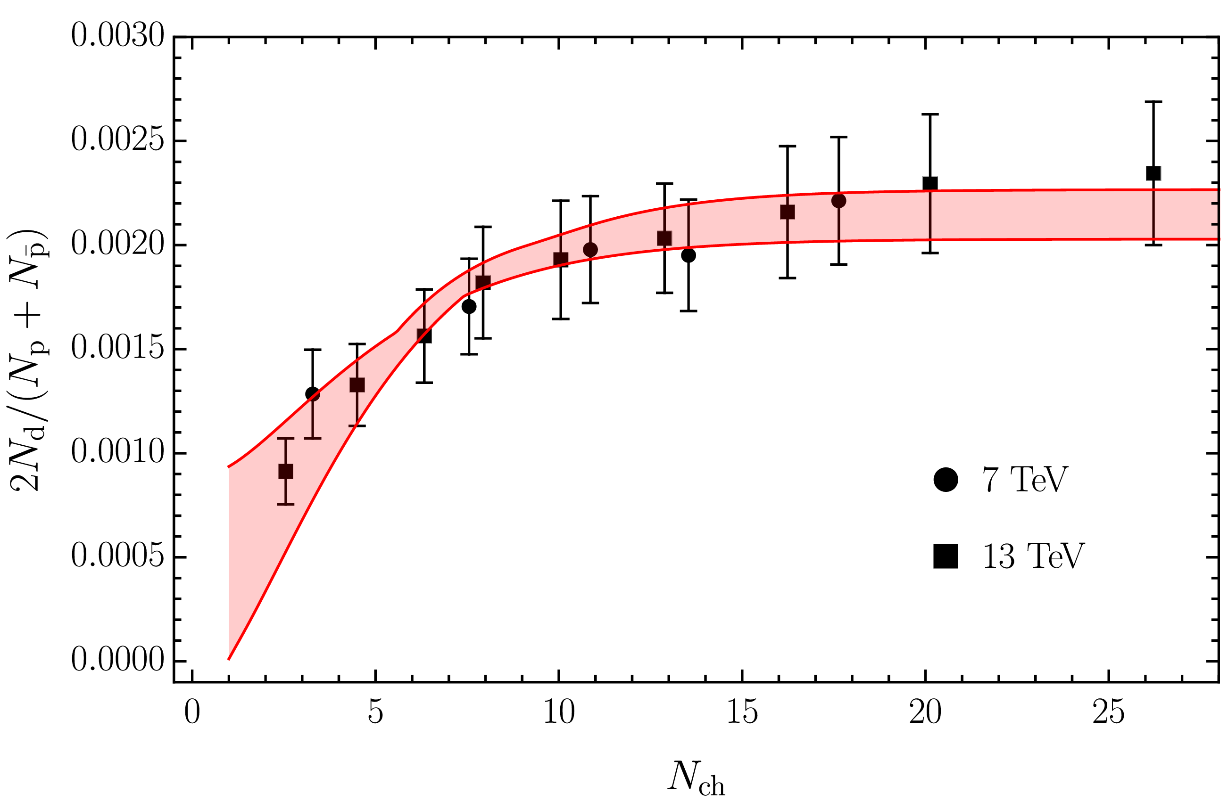
Deuteron
Solution of the evolution equation
$$\frac{N_{m}}{N_{h}}=\frac{{\left\langle vσ\right\rangle }_{m}}{{\left\langle vσ\right\rangle }_{m}+{\left\langle vσ\right\rangle }_{hh}}+\left(\frac{N_{m}^{0}}{N_{h}^{0}}−\frac{{\left\langle vσ\right\rangle }_{m}}{{\left\langle vσ\right\rangle }_{m}+{\left\langle vσ\right\rangle }_{hh}}\right)e^{−\left({\left\langle vσ\right\rangle }_{m}+{\left\langle vσ\right\rangle }_{hh}\right)ρ_{c}\ln\left(ρ_{c}/ρ_{c}^{pp}\right)}$$
Numbers of molecule at $t=0$,
$≈0$ in Pythia
The coalescence momentum for deuteron is known to be $Λ=50 ÷200 \text{MeV}$
${{\left\langle vσ\right\rangle }_{m}=\left(Λ/150 \text{MeV}\right)}^{3}×0.51 \text{mb}$
${\left\langle vσ\right\rangle }_{hh}=4.34 \text{mb}$
A. Pilloni – Status of Spectroscopy of Exotic Hadrons
Notes:
2 slides su Zc, a Bes e a Belle
2 slide su tetraquark model: dall’hamiltoniana di Jaffe al calcolo delle masse
1 slide su molecular models, dove sono i carichi? (non in Tornqvist, si in Hanhart, vedere Braaten, citare Nefediev)
2 slides su decay channels, dove si dovrebbe vedere, e a seconda del modello, vedere qualche plot
1 slide su Y(4260), tetraquark? C’è lo strano (si vede la f0)
1 slide su Zc a cleo (anche il neutro)

Slide 16
$X(3872)$ again
The coalescence momentum for the $X(3872)$ is $Λ=30 ÷300 \text{MeV}$
${{\left\langle vσ\right\rangle }_{m}=\left(Λ/50 \text{MeV}\right)}^{3}×3.1×{10}^{−5} \text{mb}$
${\left\langle vσ\right\rangle }_{hh}=0.50 \text{mb}$
Controversies for $N_{m}/N_{h}$: How is the 𝑋 produced?
Through ${\overline{D}}^{0}D^{∗0}$: $N_{m}/N_{h}≈0$
Through $χ_{c1}(2P)$: $N_{m}/N_{h}≈1$
The difference shown with a green band
A. Pilloni – Status of Spectroscopy of Exotic Hadrons
Notes:
2 slides su Zc, a Bes e a Belle
2 slide su tetraquark model: dall’hamiltoniana di Jaffe al calcolo delle masse
1 slide su molecular models, dove sono i carichi? (non in Tornqvist, si in Hanhart, vedere Braaten, citare Nefediev)
2 slides su decay channels, dove si dovrebbe vedere, e a seconda del modello, vedere qualche plot
1 slide su Y(4260), tetraquark? C’è lo strano (si vede la f0)
1 slide su Zc a cleo (anche il neutro)

Slide 17
Epilogue
Unexpected exotics challenge our understanding of QCD since 2003!
The full picture lacks of consistency, still some indications come the from best known states
Detailed studies of lineshapes offer insight into their nature
Production and propagation in high multiplicity collisions gives a complementary point of view into their structure
Thank you!
A. Pilloni – Status of Spectroscopy of Exotic Hadrons
Notes:
2 slides su Zc, a Bes e a Belle
2 slide su tetraquark model: dall’hamiltoniana di Jaffe al calcolo delle masse
1 slide su molecular models, dove sono i carichi? (non in Tornqvist, si in Hanhart, vedere Braaten, citare Nefediev)
2 slides su decay channels, dove si dovrebbe vedere, e a seconda del modello, vedere qualche plot
1 slide su Y(4260), tetraquark? C’è lo strano (si vede la f0)
1 slide su Zc a cleo (anche il neutro)

Slide 18
Backup

Slide 19
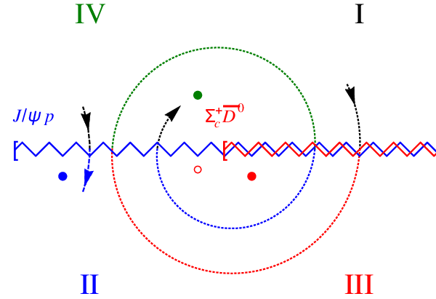
Bound and virtual states
The situation is more complicated when more channels are open
Virtual state
Bound state
Resonance
A. Pilloni – Status of Spectroscopy of Exotic Hadrons
Notes:
Controlla la parte su Regge

Slide 20
Multiscale system
Systematically integrate out the heavy scale,
$$m_{Q}≫Λ_{QCD}$$
$$m_{Q}≫m_{Q}v≫m_{Q}v^{2}$$
$$m_{b}∼5 \text{GeV}, m_{c}∼1.5 \text{GeV}$$
$$v_{b}^{2}∼0.1, v_{c}^{2}∼0.3$$
Full QCD
NRQCD
pNRQCD
Factorization (to be proved) of universal LDMEs
Good description of many production channels, some known puzzles (polarizations)
A. Pilloni – Status of Spectroscopy of Exotic Hadrons
Notes:
2 slides su Zc, a Bes e a Belle
2 slide su tetraquark model: dall’hamiltoniana di Jaffe al calcolo delle masse
1 slide su molecular models, dove sono i carichi? (non in Tornqvist, si in Hanhart, vedere Braaten, citare Nefediev)
2 slides su decay channels, dove si dovrebbe vedere, e a seconda del modello, vedere qualche plot
1 slide su Y(4260), tetraquark? C’è lo strano (si vede la f0)
1 slide su Zc a cleo (anche il neutro)

Slide 21
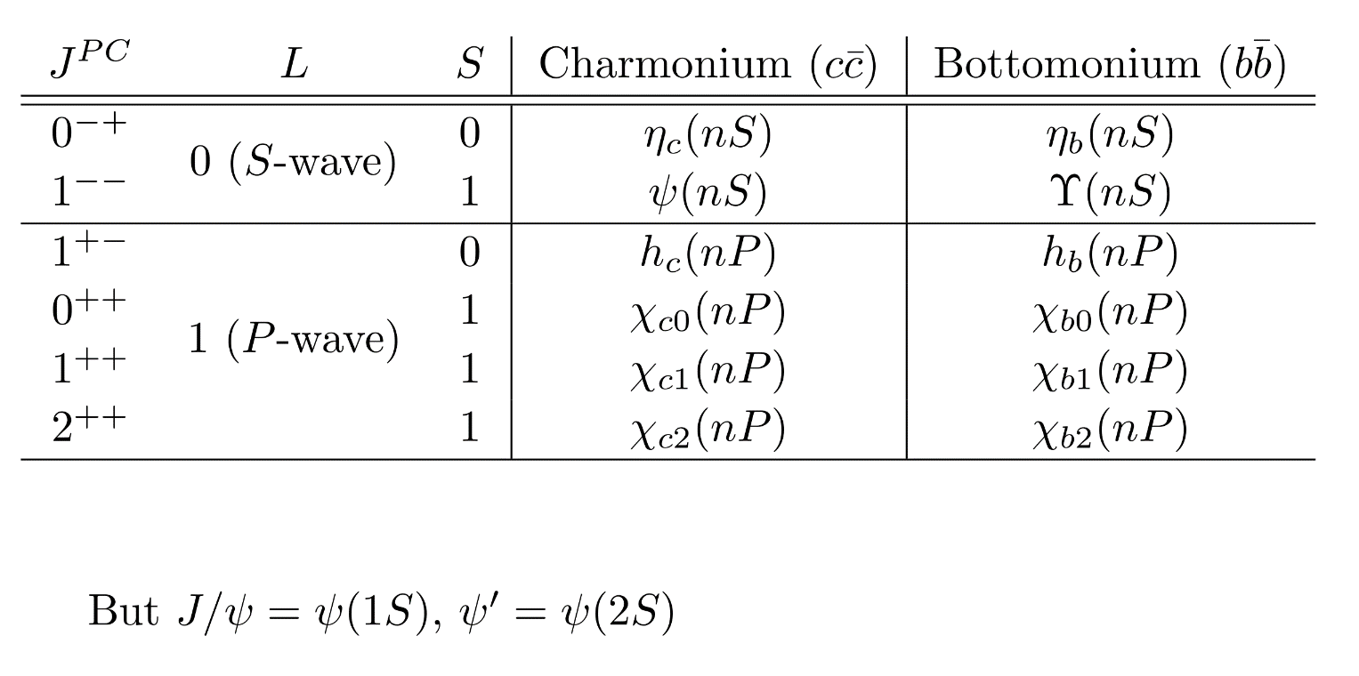
Dictionary – Quark model
$L=$orbital angular momentum
$S=$spin $q+\overline{q}$
$J=$total angular momentum
= exp. measured spin
$I=$isospin = 0 for quarkonia
$$q$$
$$L−S≤J≤L+S$$
$$P={\left(−1\right)}^{L+1}, C={\left(−1\right)}^{L+S}$$
$$G={\left(−1\right)}^{L+S+I}$$
$$\overline{q}$$
A. Pilloni – Status of Spectroscopy of Exotic Hadrons
Notes:
2 slides su Zc, a Bes e a Belle
2 slide su tetraquark model: dall’hamiltoniana di Jaffe al calcolo delle masse
1 slide su molecular models, dove sono i carichi? (non in Tornqvist, si in Hanhart, vedere Braaten, citare Nefediev)
2 slides su decay channels, dove si dovrebbe vedere, e a seconda del modello, vedere qualche plot
1 slide su Y(4260), tetraquark? C’è lo strano (si vede la f0)
1 slide su Zc a cleo (anche il neutro)

Slide 22
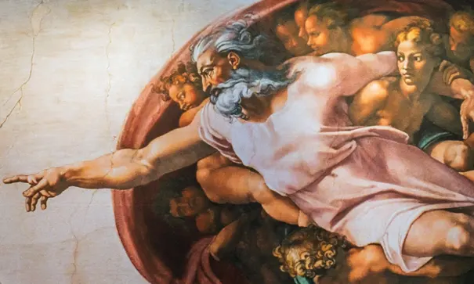
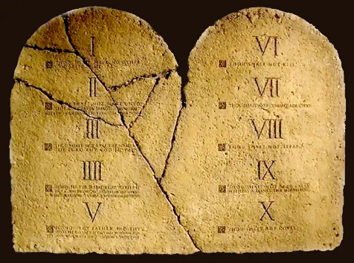
Top-down approach
You are given a model/«theory», not QCD
$$f(s)$$
You calculate the amplitude
You compare with data. Or you don’t.
Predictive power ✓
Physical interpretation ✓ (within the model! ✗) Biased by the input ✗
A. Pilloni – Status of Spectroscopy of Exotic Hadrons

Slide 23
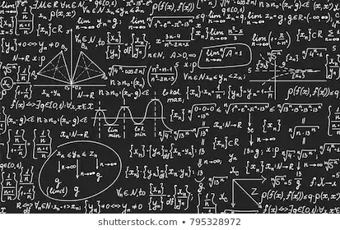
Bottom-up approach
Less predictive power ✗
Some physical interpretation ✗ Minimally biased ✓
You extract physics
You choose a set of generic amplitudes
You start with data
A. Pilloni – Status of Spectroscopy of Exotic Hadrons

Slide 24
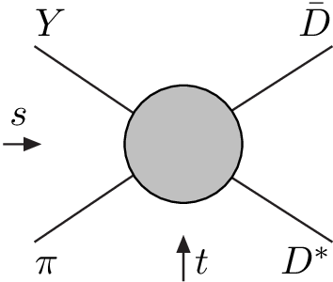
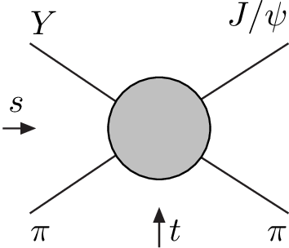
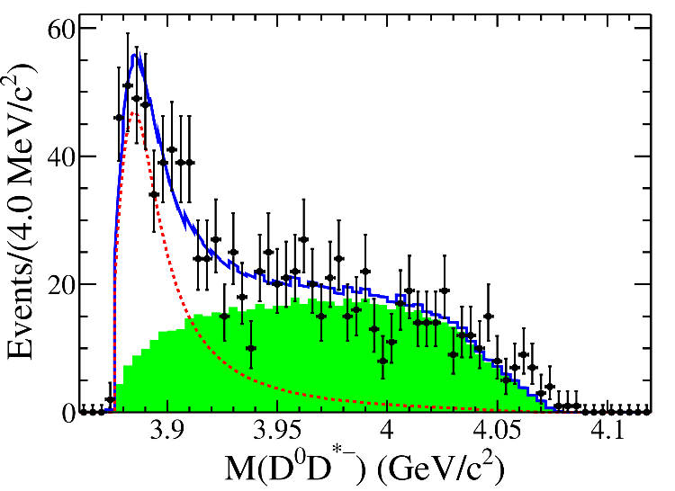
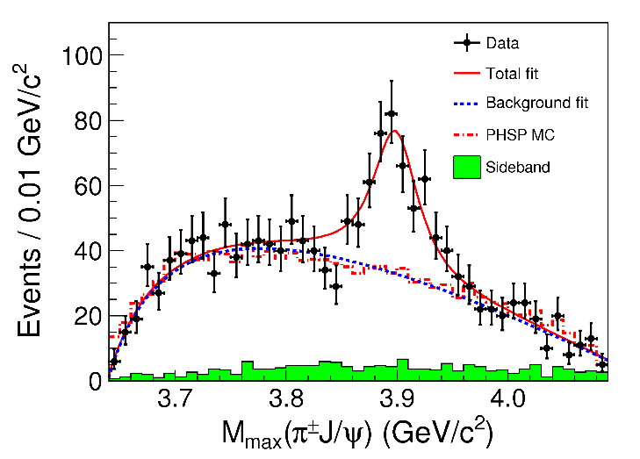
Amplitude analysis for $Z_{c}(3900)$
One can test different parametrizations of the amplitude, different singularities → different natures
AP et al. (JPAC), PLB772, 200
A. Pilloni – Status of Spectroscopy of Exotic Hadrons
Notes:
Controlla la parte su Regge

Slide 25
Amplitude model
$$Z_{c}\left(3900\right)?$$
$${u: D}_{0}(2400)$$
$${u:Z}_{c}\left(3900\right)?$$
$$"σ, f_{0}(980)"$$
$$D_{1}(2420)$$
Logarithmic branch points simulate resonant behavior, only in special kinematics
Coleman and Norton, Nuovo Cim. 38, 438
Schmid, Phys.Rev. 154, 1363
Szczepaniak, PLB747, 410-416
Szczepaniak, PLB757, 61-64
Guo, Nucl.Phys.Rev.37, 406
$$π$$
Isobars
Rescattering
$$D_{1}$$
$$Y(4260)$$
$$D^{∗}$$
$$π$$
$$\overline{D}$$
$$J/ψ$$
Triangle singularity?
A. Pilloni – Status of Spectroscopy of Exotic Hadrons

Slide 26
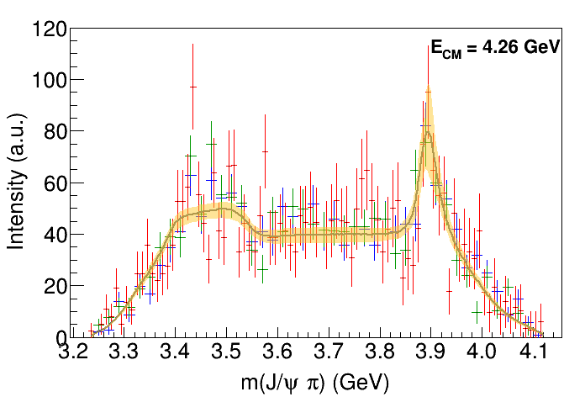
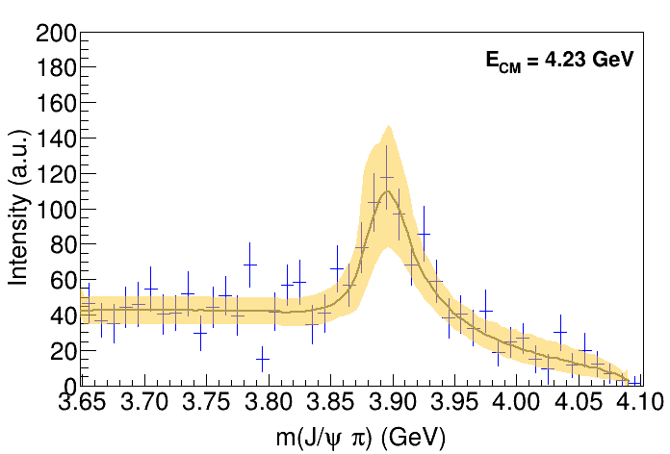
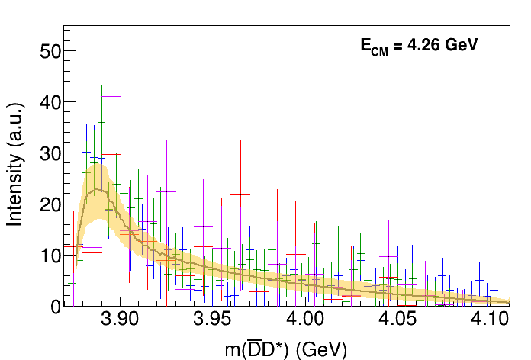
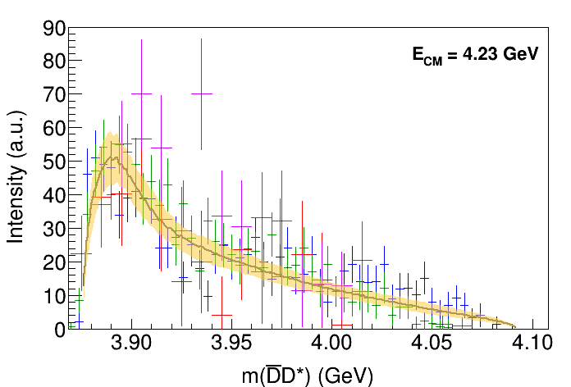
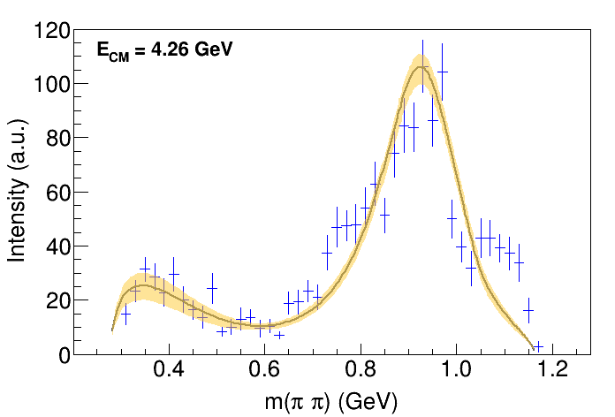
Fit: III
( data)
A. Pilloni – Status of Spectroscopy of Exotic Hadrons
Notes:
Controlla la parte su Regge

Slide 27
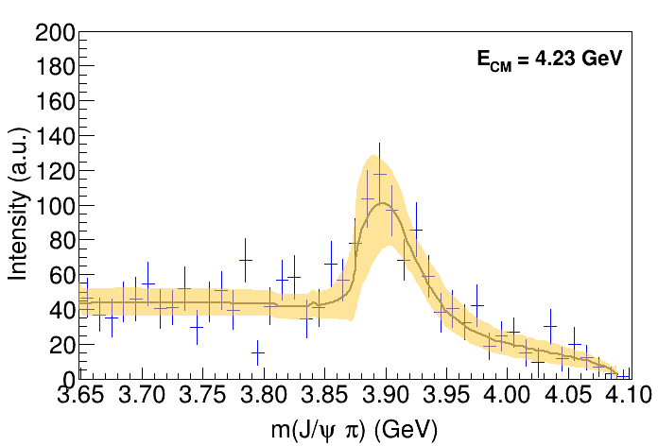
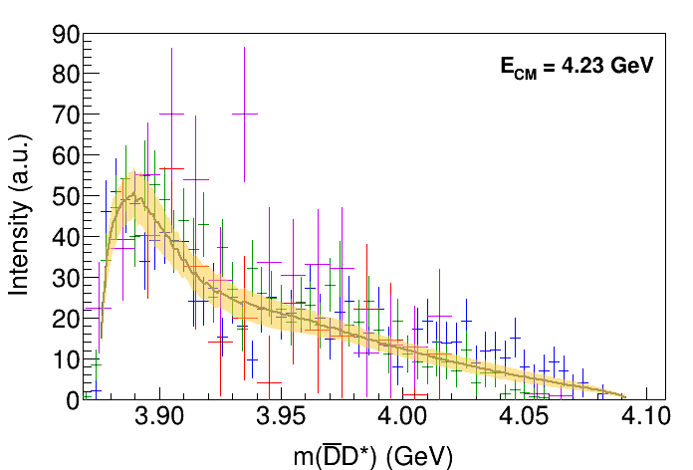
Fit: III+tr.
( data)
A. Pilloni – Status of Spectroscopy of Exotic Hadrons
Notes:
Controlla la parte su Regge

Slide 28
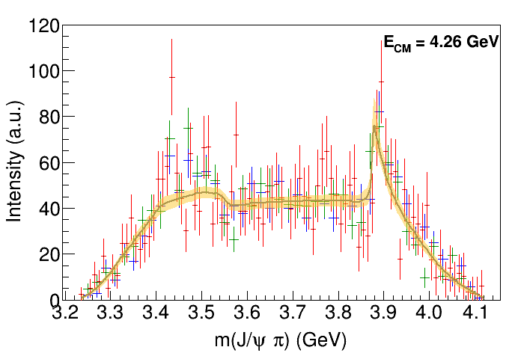
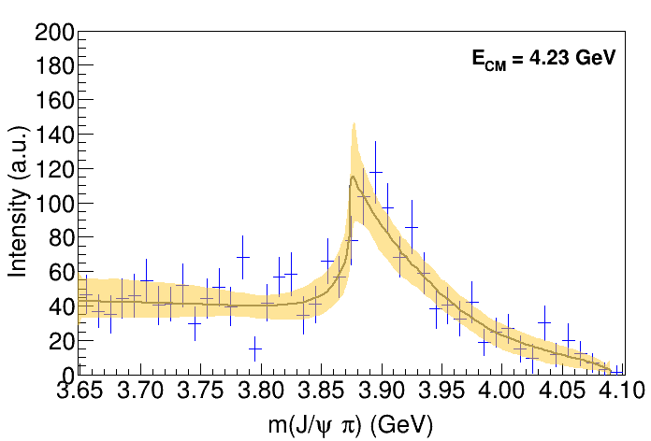
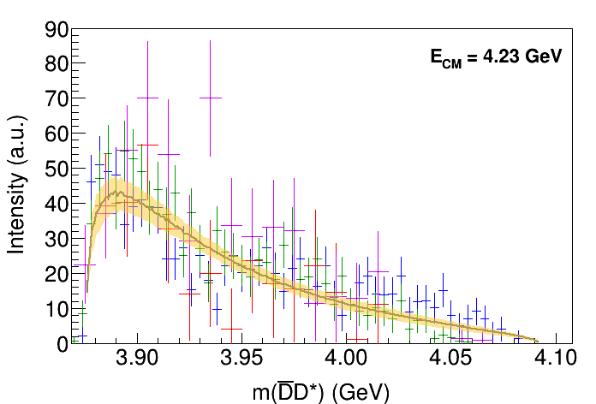
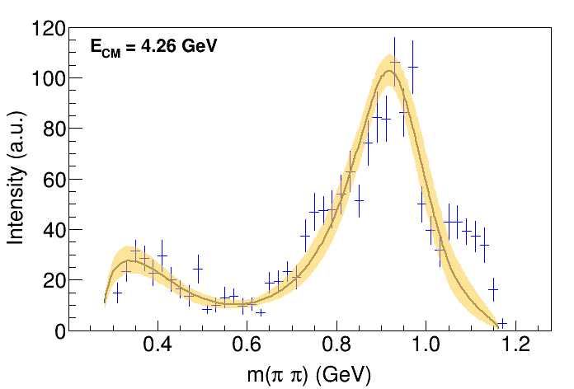
Fit: IV+tr.
( data)
A. Pilloni – Status of Spectroscopy of Exotic Hadrons
Notes:
Controlla la parte su Regge

Slide 29
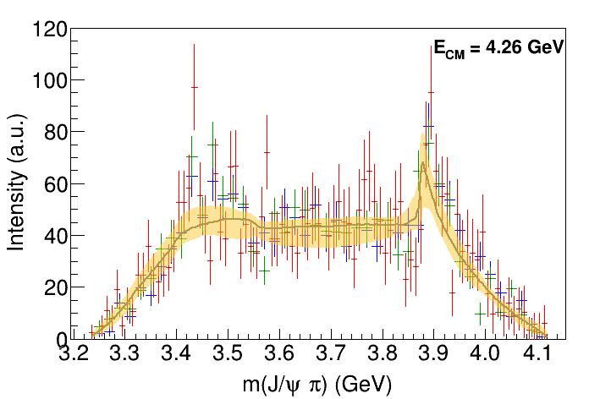
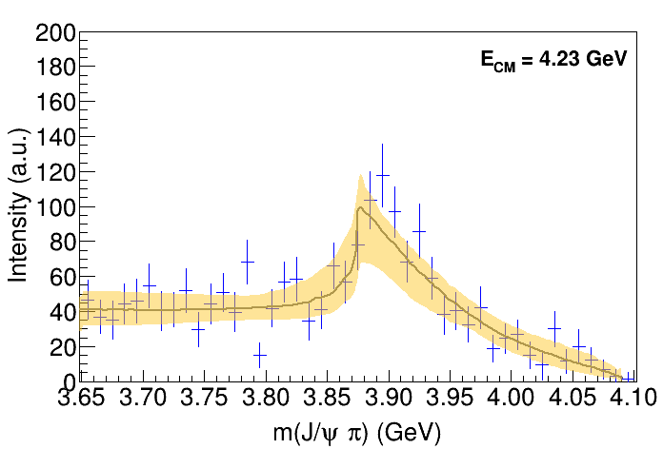
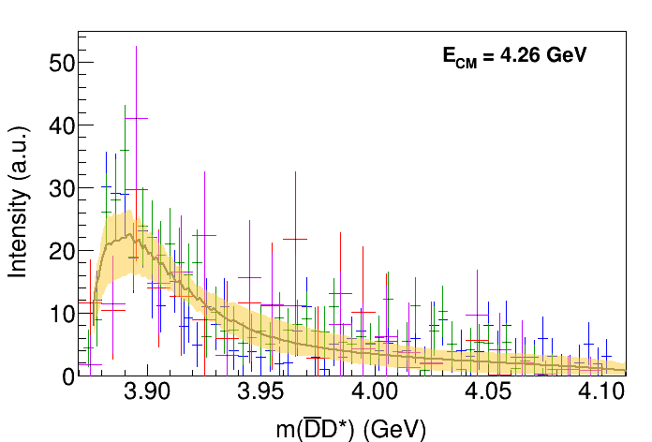
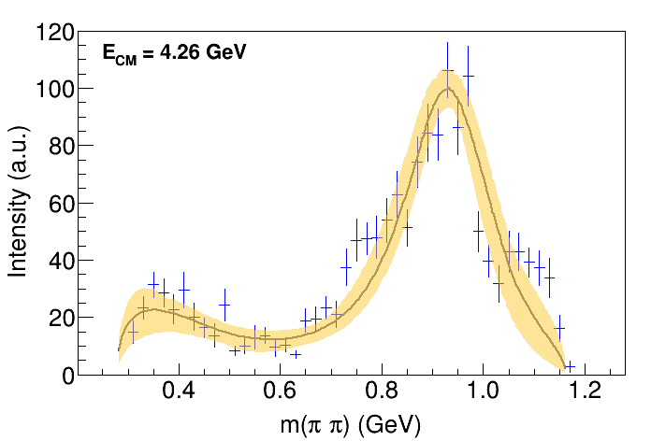
Fit: tr.
( data)
A. Pilloni – Status of Spectroscopy of Exotic Hadrons
Notes:
Controlla la parte su Regge

Slide 30
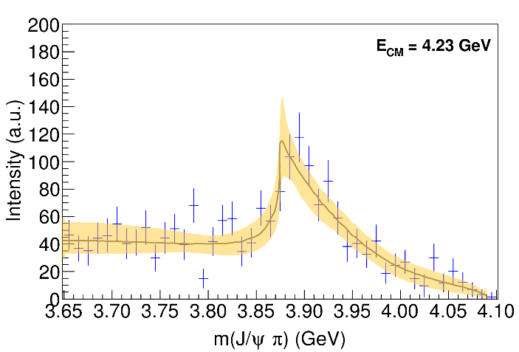
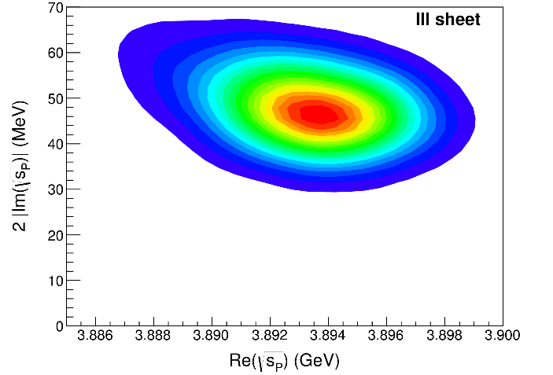
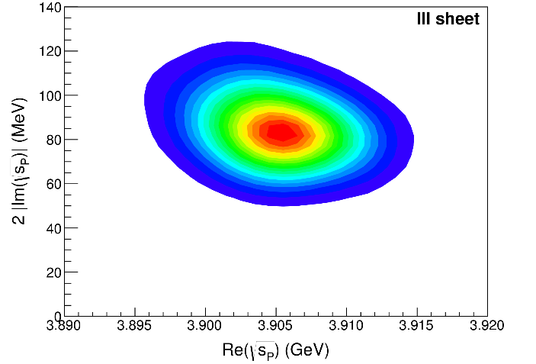
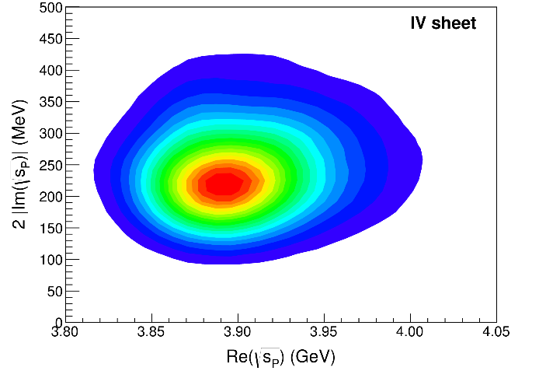
Pole extraction
III
III+tr.
IV+tr.
A. Pilloni – Status of Spectroscopy of Exotic Hadrons
Not conclusive at this stage
Notes:
Controlla la parte su Regge

Slide 31
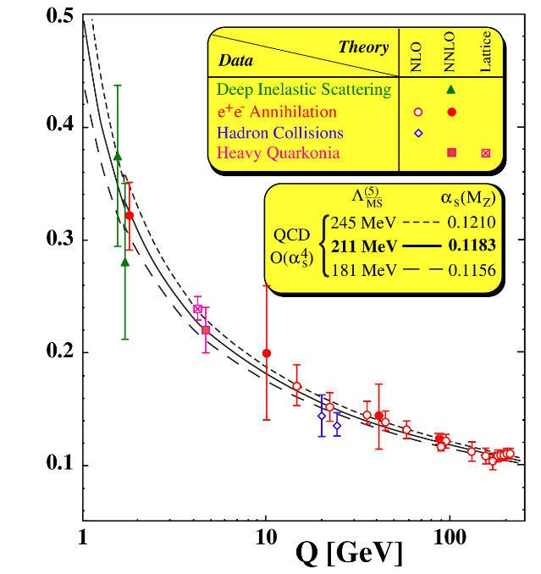
QCD in a nutshell
At low energies the theory is nonperturbative, no analytic solution
Emerging properties: Confinement; Mass generation
Numerical calculations (Lattice QCD) suffer from various limitations
$\frac{g_{s}^{2}}{4π}(Q)$
A. Pilloni – Status of Spectroscopy of Exotic Hadrons
Notes:
2 slides su Zc, a Bes e a Belle
2 slide su tetraquark model: dall’hamiltoniana di Jaffe al calcolo delle masse
1 slide su molecular models, dove sono i carichi? (non in Tornqvist, si in Hanhart, vedere Braaten, citare Nefediev)
2 slides su decay channels, dove si dovrebbe vedere, e a seconda del modello, vedere qualche plot
1 slide su Y(4260), tetraquark? C’è lo strano (si vede la f0)
1 slide su Zc a cleo (anche il neutro)

Slide 32
Open questions
Are the various XYZ multiquark states? Do they all really exist? Is there a pattern?
Where are the glueballs? Have them been seen already?
How to complete the hybrid multiplets? Are there heavy hybrids?
What can we get from Lattice QCD? What is the formalism required?
Where can we get other information about resonances?
What do we learn about QCD eventually?
A. Pilloni – Status of Spectroscopy of Exotic Hadrons
Notes:
2 slides su Zc, a Bes e a Belle
2 slide su tetraquark model: dall’hamiltoniana di Jaffe al calcolo delle masse
1 slide su molecular models, dove sono i carichi? (non in Tornqvist, si in Hanhart, vedere Braaten, citare Nefediev)
2 slides su decay channels, dove si dovrebbe vedere, e a seconda del modello, vedere qualche plot
1 slide su Y(4260), tetraquark? C’è lo strano (si vede la f0)
1 slide su Zc a cleo (anche il neutro)

Slide 33
Average cross sections (CIM)
In the comover interaction model the average cross section is given by
index depending on the nature of the comovers
We take $n=1$
$$⟨vσ⟩_{𝒬}=πr_{𝒬}^{2}∫_{E_{𝒬}^{thr}}^{∞}dE_{c}{\left(1−\frac{E_{𝒬}^{thr}}{E_{c}}\right)}^{n}𝒫\left(E_{c}\right)$$
threshold energy computed wrt the closest OZI-favored mode
distribution of comovers’ energy
$$𝒫(E_{c})∝{\left(e^{{E_{c}}/{T_{eff}}}−1\right)}^{−1}$$
with $T_{eff}=200÷300 MeV$
For excited quarkonia $E_{𝒬}^{thr}≪E_{c}$, hence $⟨vσ⟩_{𝒬}≃πr_{𝒬}^{2}$
A. Pilloni – Status of Spectroscopy of Exotic Hadrons
Notes:
2 slides su Zc, a Bes e a Belle
2 slide su tetraquark model: dall’hamiltoniana di Jaffe al calcolo delle masse
1 slide su molecular models, dove sono i carichi? (non in Tornqvist, si in Hanhart, vedere Braaten, citare Nefediev)
2 slides su decay channels, dove si dovrebbe vedere, e a seconda del modello, vedere qualche plot
1 slide su Y(4260), tetraquark? C’è lo strano (si vede la f0)
1 slide su Zc a cleo (anche il neutro)

Slide 34
Spatial dependence
Spatial distributions need to be taken into account as well
Dynamics along the beam axis is trivial (free stream approximation), in the transverse direction the equation is local
$$\vec{b}$$
$$τ\frac{dN_{𝒬}(\vec{b},\vec{s})}{dτ}=−⟨vσ⟩_{𝒬}ρ_{c}(\vec{b},\vec{s})N_{𝒬}(\vec{b},\vec{s})$$
$$\vec{s}$$
The solution must be convoluted with the profile functions of the two nucleons $ρ_{c}(\vec{b},\vec{s})$ normalized to give the minimum bias number of tracks per event, $\left|\vec{b}\right|$ acts as a proxy to the number of charged tracks (à la Glauber)
For a naive estimate one can assume $ρ_{c}∼\frac{3}{2}\frac{N_{ch}}{σ_{pp}}$
Ferreiro PLB749, 98
Ferreiro, Lansberg JHEP10(2018), 94
A. Pilloni – Status of Spectroscopy of Exotic Hadrons
Notes:
2 slides su Zc, a Bes e a Belle
2 slide su tetraquark model: dall’hamiltoniana di Jaffe al calcolo delle masse
1 slide su molecular models, dove sono i carichi? (non in Tornqvist, si in Hanhart, vedere Braaten, citare Nefediev)
2 slides su decay channels, dove si dovrebbe vedere, e a seconda del modello, vedere qualche plot
1 slide su Y(4260), tetraquark? C’è lo strano (si vede la f0)
1 slide su Zc a cleo (anche il neutro)

Slide 35
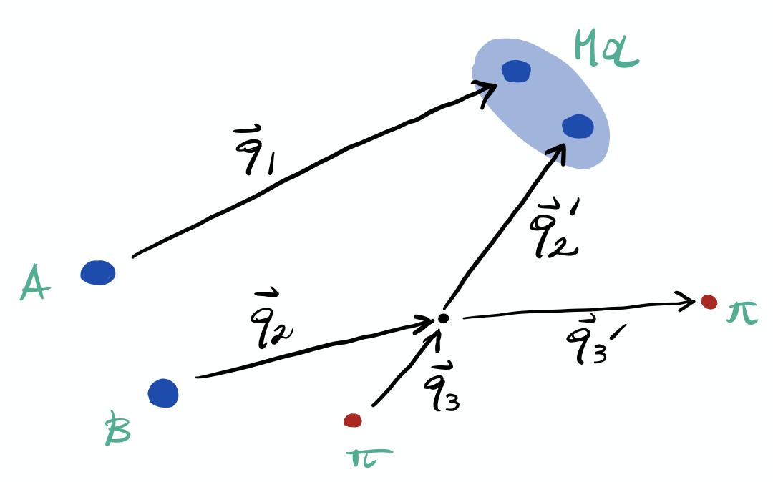
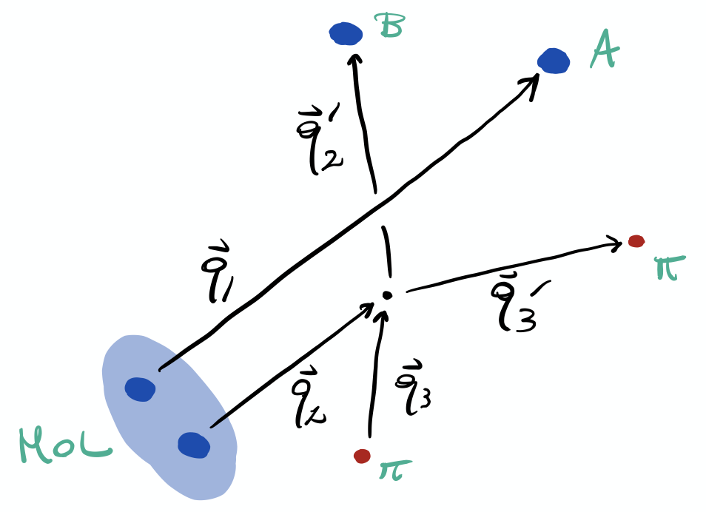
Recombination
The interaction with comovers can either destroy or create a hadronic molecule
$$⟨vσ⟩_{m}=∫_{k<Λ}\frac{d^{3}q_{1}}{(2π)^{3}}\frac{d^{3}q_{2}^{′}}{(2π)^{3}}∫\frac{d^{3}q_{2}}{(2π)^{3}}\frac{d^{3}q_{3}}{(2π)^{3}}\frac{d^{3}q_{3}^{′}}{(2π)^{3}}δ_{P}W(q_{2},q_{3};q_{2}^{′},q_{3}^{′})f_{hh}(q_{1},q_{2})f_{c}(q_{3})$$
Recombination
$$⟨vσ⟩_{hh}=∫_{k<Λ}\frac{d^{3}q_{1}}{(2π)^{3}}\frac{d^{3}q_{2}}{(2π)^{3}}∫\frac{d^{3}q_{2}^{′}}{(2π)^{3}}\frac{d^{3}q_{3}}{(2π)^{3}}\frac{d^{3}q_{3}^{′}}{(2π)^{3}}δ_{P}W(q_{2},q_{3};q_{2}^{′},q_{3}^{′})f_{m}(q_{1},q_{2})f_{c}(q_{3})$$
Dissociation
Matrix element from $πN$ & $πD^{(∗)}$ phenomenology
Free constituents and comovers distributions from Pythia
Molecules distribution from data
A. Pilloni – Status of Spectroscopy of Exotic Hadrons
Notes:
2 slides su Zc, a Bes e a Belle
2 slide su tetraquark model: dall’hamiltoniana di Jaffe al calcolo delle masse
1 slide su molecular models, dove sono i carichi? (non in Tornqvist, si in Hanhart, vedere Braaten, citare Nefediev)
2 slides su decay channels, dove si dovrebbe vedere, e a seconda del modello, vedere qualche plot
1 slide su Y(4260), tetraquark? C’è lo strano (si vede la f0)
1 slide su Zc a cleo (anche il neutro)

Slide 36
Average cross sections (hadron molecule)
The constituent-comover matrix elements is parametrized with an effective coupling $ℳ_{πh→πh}=g^{2}$, with $g_{p}^{2}/(4π)≃10$ and $g_{D}^{2}/(4π)≃5.1$
Built to reproduce the elastic scattering cross section for all comovers energies, $E_{c}∈\left[0,300\right] MeV$
The other ingredients needed to compute the average cross sections are the momentum distributions from Pythia
comovers momentum
ℎℎ relative momentum
ℎℎ total momentum
A. Pilloni – Status of Spectroscopy of Exotic Hadrons
Notes:
2 slides su Zc, a Bes e a Belle
2 slide su tetraquark model: dall’hamiltoniana di Jaffe al calcolo delle masse
1 slide su molecular models, dove sono i carichi? (non in Tornqvist, si in Hanhart, vedere Braaten, citare Nefediev)
2 slides su decay channels, dove si dovrebbe vedere, e a seconda del modello, vedere qualche plot
1 slide su Y(4260), tetraquark? C’è lo strano (si vede la f0)
1 slide su Zc a cleo (anche il neutro)

Slide 37
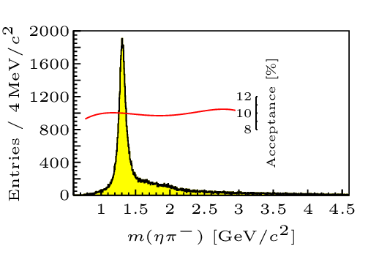
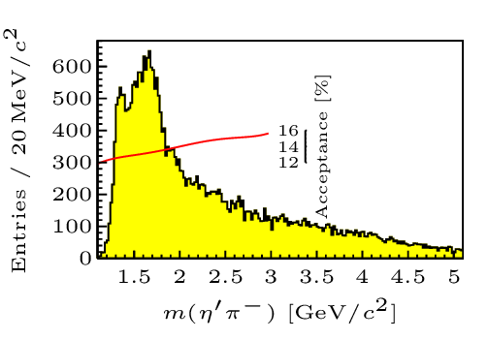
Hybrid hunting
Excited gluon, $$J^{PC}=1^{+−}$$ mass $∼1.0\text{−}1.5 \text{GeV}$
$$\overline{r}$$
$$\overline{g}$$
$$r$$
$$g$$
Look for a $π_{1}$ state with $J^{PC}=1^{−+}$
decaying into $\left\{\begin{matrix}η π \text{and} η^{′}π \\ ρ π→3π \\ b_{1}π→5π\end{matrix}\right.$
Small signal in data
A. Pilloni – Status of Spectroscopy of Exotic Hadrons
Notes:
2 slides su Zc, a Bes e a Belle
2 slide su tetraquark model: dall’hamiltoniana di Jaffe al calcolo delle masse
1 slide su molecular models, dove sono i carichi? (non in Tornqvist, si in Hanhart, vedere Braaten, citare Nefediev)
2 slides su decay channels, dove si dovrebbe vedere, e a seconda del modello, vedere qualche plot
1 slide su Y(4260), tetraquark? C’è lo strano (si vede la f0)
1 slide su Zc a cleo (anche il neutro)

Slide 38
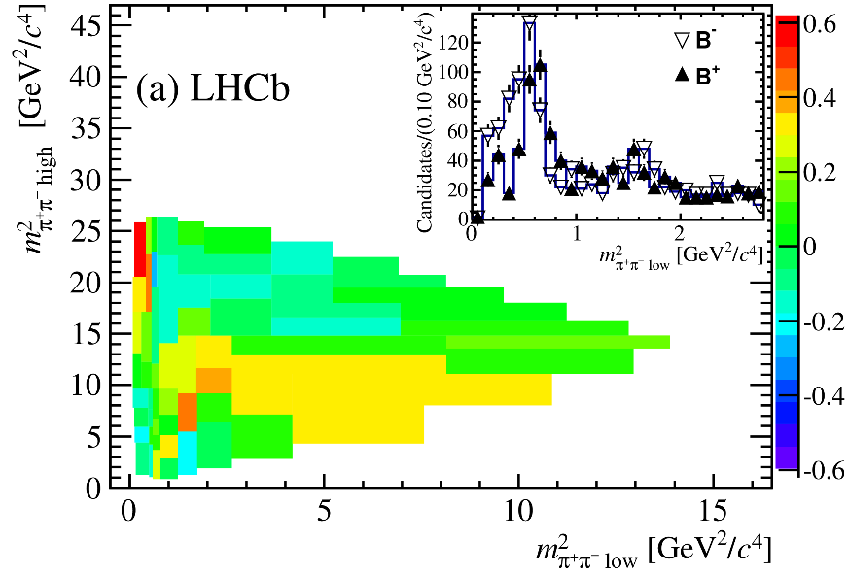
Heavy meson decays
CPV in $B^{+}→3π$
CP-violating phases are extracted from amplitude analyses of 3+ body decays
These provide more contraints to the CKM matrix elements and probe New Physics
The interference between different resonances makes these phases measurable
$$D^{0}→3π$$
Precision hindered by hadron dynamics
Notes:
2 slides su Zc, a Bes e a Belle
2 slide su tetraquark model: dall’hamiltoniana di Jaffe al calcolo delle masse
1 slide su molecular models, dove sono i carichi? (non in Tornqvist, si in Hanhart, vedere Braaten, citare Nefediev)
2 slides su decay channels, dove si dovrebbe vedere, e a seconda del modello, vedere qualche plot
1 slide su Y(4260), tetraquark? C’è lo strano (si vede la f0)
1 slide su Zc a cleo (anche il neutro)

Slide 39
3-body interactions
M. Mai, B. Hu, M. Doring, AP, A. Szczepaniak EPJA53, 9, 177
A. Jackura, ..., AP, et al. (JPAC), EPJC79, 1, 56
M. Mikhasenko, ..., AP, et al. (JPAC), JHEP8 (2019), 080
3-body problem is ubiquitous in hadron physics Formalism for Lattice QCD ready to be applied
A. Pilloni – Status of Spectroscopy of Exotic Hadrons

Slide 40
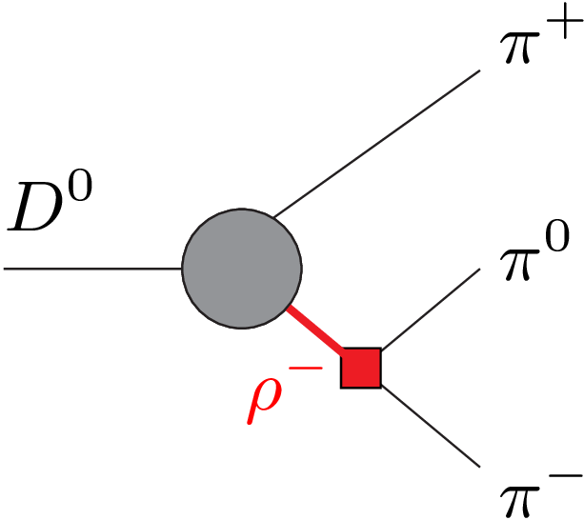
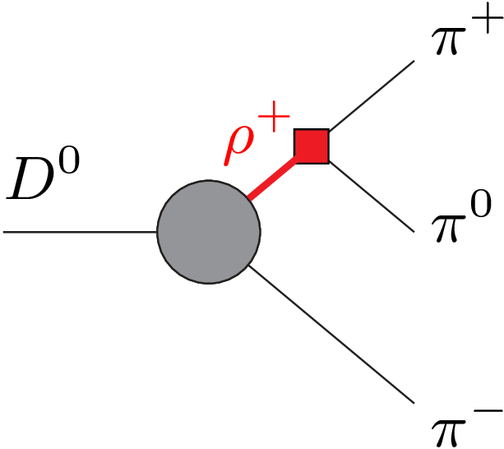
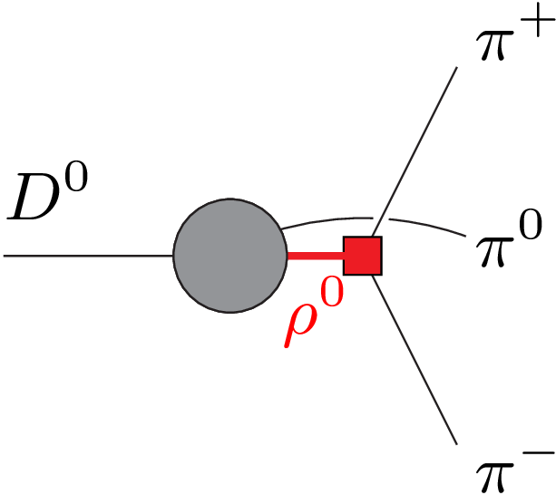
The isobar model
+
+
Product of subsequent quasi-2 body decays
The sum over the three channels breaks unitarity This affects interference pattern between resonances, and so the extraction of CPV phases
A. Pilloni – Status of Spectroscopy of Exotic Hadrons
Notes:
2 slides su Zc, a Bes e a Belle
2 slide su tetraquark model: dall’hamiltoniana di Jaffe al calcolo delle masse
1 slide su molecular models, dove sono i carichi? (non in Tornqvist, si in Hanhart, vedere Braaten, citare Nefediev)
2 slides su decay channels, dove si dovrebbe vedere, e a seconda del modello, vedere qualche plot
1 slide su Y(4260), tetraquark? C’è lo strano (si vede la f0)
1 slide su Zc a cleo (anche il neutro)

Slide 41
Khuri-Treiman equations
Solution : assume the same decomposition, but imposing unitarity to it
Im
Input: $ππ$ phase shift directly from data
KT used recently for several reactions,
Albaladejo, ... AP et al., EPJC80, 12, 1107
but never for CPV ones
Work for the future!
Equivalent to implementing the all-order rescattering in all the 3 channels at once
A. Pilloni – Status of Spectroscopy of Exotic Hadrons
Notes:
Controlla la parte su Regge

Slide 42
Future directions
Systematize the spectrum: towards more global analyses
Hadron interaction in flavor physics
Production of resonances:
Prediction of cross sections for future experiments
Behavior of resonances in media
Reducing the model dependence: exploring ML tools
A. Pilloni – Status of Spectroscopy of Exotic Hadrons
Notes:
2 slides su Zc, a Bes e a Belle
2 slide su tetraquark model: dall’hamiltoniana di Jaffe al calcolo delle masse
1 slide su molecular models, dove sono i carichi? (non in Tornqvist, si in Hanhart, vedere Braaten, citare Nefediev)
2 slides su decay channels, dove si dovrebbe vedere, e a seconda del modello, vedere qualche plot
1 slide su Y(4260), tetraquark? C’è lo strano (si vede la f0)
1 slide su Zc a cleo (anche il neutro)

Slide 43
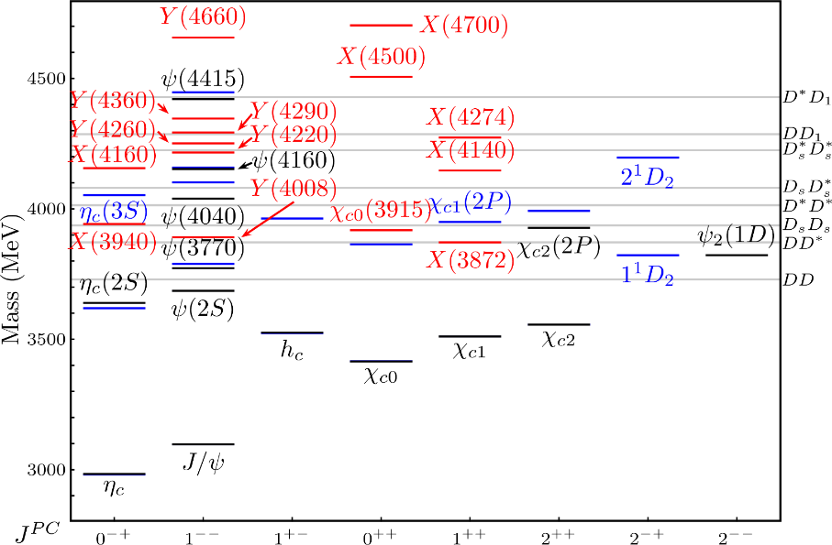
Quark models
Approximate methods (not systematically improvable) picture how quarks bind into hadrons
Meson
Baryon
Richer structures are not excluded, they teach us more about QCD
Model predictions must be benchmarked against data
XYZ states
Glueball
Hybrids
Tetra- and Pentaquark
Esposito, AP, Polosa, Phys.Rept. 668
A. Pilloni – Status of Spectroscopy of Exotic Hadrons
Notes:
2 slides su Zc, a Bes e a Belle
2 slide su tetraquark model: dall’hamiltoniana di Jaffe al calcolo delle masse
1 slide su molecular models, dove sono i carichi? (non in Tornqvist, si in Hanhart, vedere Braaten, citare Nefediev)
2 slides su decay channels, dove si dovrebbe vedere, e a seconda del modello, vedere qualche plot
1 slide su Y(4260), tetraquark? C’è lo strano (si vede la f0)
1 slide su Zc a cleo (anche il neutro)

Slide 44
Unraveling QCD
Products
Beam
Target
Beam
Products
A. Pilloni – Status of Spectroscopy of Exotic Hadrons

Slide 45
Unraveling QCD
Electromagnetic machines
$$e^{+}e^{−}→γ^{∗}→\text{hadrons}$$
Electrohadron machines
Cross sections
Cleanliness
$$e^{−}→e^{−}γ^{(∗)}$$
$$\text{and} γ^{(∗)}p,γ^{(∗)}A→\text{hadrons}$$
Hadron machines
$$pp,p\overline{p},π^{−}p,pA,AA→ \text{hadrons}$$
A. Pilloni – Status of Spectroscopy of Exotic Hadrons

Slide 46
Dictionary – Quark model
$L=$orbital angular momentum
$S=$spin $q+\overline{q}$
$J=$total angular momentum
= exp. measured spin
$I=$isospin = 0 for quarkonia
$$q$$
$$L−S≤J≤L+S$$
$$P={\left(−1\right)}^{L+1}, C={\left(−1\right)}^{L+S}$$
$$G={\left(−1\right)}^{L+S+I}$$
$$\overline{q}$$
A. Pilloni – Status of Spectroscopy of Exotic Hadrons
Notes:
2 slides su Zc, a Bes e a Belle
2 slide su tetraquark model: dall’hamiltoniana di Jaffe al calcolo delle masse
1 slide su molecular models, dove sono i carichi? (non in Tornqvist, si in Hanhart, vedere Braaten, citare Nefediev)
2 slides su decay channels, dove si dovrebbe vedere, e a seconda del modello, vedere qualche plot
1 slide su Y(4260), tetraquark? C’è lo strano (si vede la f0)
1 slide su Zc a cleo (anche il neutro)

Slide 47
$X(3872)$
Discovered in $B→K X→K J/ψ ππ$
Quantum numbers $1^{++}$
Very close to $DD^{∗}$ threshold
Too narrow for an above-treshold charmonium
Isospin violation too big $\frac{Γ\left(X→J/ψ ω\right)}{Γ\left(X→J/ψ ρ\right)}\sim 1.1±0.4$
Mass prediction not compatible with $χ_{c1}(2P)$
$M=3871.69±0.17$MeV
$$M_{X}−M_{DD^{∗}}=−3±192 \text{keV}$$
$Γ=1.19±0.19 \text{MeV}$
A. Pilloni – Status of Spectroscopy of Exotic Hadrons

Slide 48
Prologue: Quarkonium
$$Q$$
$$\overline{Q}$$
Potential models
(meaningful when $M_{Q}→∞$)
$$V\left(r\right)=−\frac{C_{F}α_{s}}{r}+σr$$
(Cornell potential)
$$α_{s}\left(M_{Q}\right)∼0.3$$
(perturbative regime)
OZI-rule, QCD multipole
Solve NR Schrödinger eq. → spectrum
Effective theories
(HQET, NRQCD, pNRQCD...)
Heavy quark spin flip suppressed by quark mass, approximate heavy quark spin symmetry (HQSS)
Integrate out heavy DOF
↓
(spectrum), decay & production rates
A. Pilloni – Status of Spectroscopy of Exotic Hadrons
Notes:
2 slides su Zc, a Bes e a Belle
2 slide su tetraquark model: dall’hamiltoniana di Jaffe al calcolo delle masse
1 slide su molecular models, dove sono i carichi? (non in Tornqvist, si in Hanhart, vedere Braaten, citare Nefediev)
2 slides su decay channels, dove si dovrebbe vedere, e a seconda del modello, vedere qualche plot
1 slide su Y(4260), tetraquark? C’è lo strano (si vede la f0)
1 slide su Zc a cleo (anche il neutro)

Slide 49
The workflow
Meson
Baryon
Glueball
Hybrids
Tetraquark
Molecule
Exotics
Experiment
Amplitude analysis
Data
QCD
Lattice QCD
Interpretation of the spectrum leads to understanding fundamental laws of nature
A. Pilloni – Status of Spectroscopy of Exotic Hadrons

Slide 50
More and more data
!
?
HadSpec, PRD
Unprecedented high statistics from running experiments and Lattice simulations
A. Pilloni – Status of Spectroscopy of Exotic Hadrons
Notes:
2 slides su Zc, a Bes e a Belle
2 slide su tetraquark model: dall’hamiltoniana di Jaffe al calcolo delle masse
1 slide su molecular models, dove sono i carichi? (non in Tornqvist, si in Hanhart, vedere Braaten, citare Nefediev)
2 slides su decay channels, dove si dovrebbe vedere, e a seconda del modello, vedere qualche plot
1 slide su Y(4260), tetraquark? C’è lo strano (si vede la f0)
1 slide su Zc a cleo (anche il neutro)

Slide 51
Prompt production of $X(3872)$
However, the applicability of Watson theorem is challenged by the presence of pions that interfere with $DD^{∗}$ propagation
$$D^{∗}$$
$$π$$
$$π$$
(CDF acceptance)
$$π$$
$$π$$
$$π$$
$$\overline{D^{0}}$$
A solution can be FSI (rescattering of $DD^{∗}$), which allow $k_{max}$ to be as large as $5m_{π}$, $σ\left(p\overline{p}→DD^{∗}|k<k_{max}\right)≈230 \text{nb}$
Artoisenet and Braaten, PRD81, 114018
But comovers interfere w/ $DD^{∗}$ propagation
Bignamini et al. PLB684, 228-230
Esposito, Piccinini, AP, Polosa, JMP 4, 1569
Guerrieri, Piccinini, AP, Polosa, PRD90, 034003
Further in
Albaladejo et al. CPC41, 121001 Esposito et al. CPC42, 114107
$$σ_{MC}\left(p\overline{p}→DD^{∗}|k<k_{max}\right)≈0.1 \text{nb}$$
$σ_{exp}\left(p\overline{p}→X(3872)\right)≈30−70 \text{nb}$!!!
Bignamini et al. PRL103 (2009) 162001
A. Pilloni – Status of Spectroscopy of Exotic Hadrons
Notes:
2 slides su Zc, a Bes e a Belle
2 slide su tetraquark model: dall’hamiltoniana di Jaffe al calcolo delle masse
1 slide su molecular models, dove sono i carichi? (non in Tornqvist, si in Hanhart, vedere Braaten, citare Nefediev)
2 slides su decay channels, dove si dovrebbe vedere, e a seconda del modello, vedere qualche plot
1 slide su Y(4260), tetraquark? C’è lo strano (si vede la f0)
1 slide su Zc a cleo (anche il neutro)

Slide 52
Top-down approach
You are given a model/«theory», not QCD
$$f(s)$$
You calculate the amplitude
You compare with data. Or you don’t.
Predictive power ✓
Physical interpretation ✓ (within the model! ✗) Biased by the input ✗
A. Pilloni – Status of Spectroscopy of Exotic Hadrons

Slide 53
Bottom-up approach
Less predictive power ✗
Some physical interpretation ✗ Minimally biased ✓
You extract physics
You choose a set of generic amplitudes
You start with data
A. Pilloni – Status of Spectroscopy of Exotic Hadrons

Slide 54
Multiscale system
Systematically integrate out the heavy scale,
$$m_{Q}≫Λ_{QCD}$$
$$m_{Q}≫m_{Q}v≫m_{Q}v^{2}$$
$$m_{b}∼5 \text{GeV}, m_{c}∼1.5 \text{GeV}$$
$$v_{b}^{2}∼0.1, v_{c}^{2}∼0.3$$
Full QCD
NRQCD
pNRQCD
Factorization (to be proved) of universal LDMEs
Good description of many production channels, some known puzzles (polarizations)
A. Pilloni – Status of Spectroscopy of Exotic Hadrons
Notes:
2 slides su Zc, a Bes e a Belle
2 slide su tetraquark model: dall’hamiltoniana di Jaffe al calcolo delle masse
1 slide su molecular models, dove sono i carichi? (non in Tornqvist, si in Hanhart, vedere Braaten, citare Nefediev)
2 slides su decay channels, dove si dovrebbe vedere, e a seconda del modello, vedere qualche plot
1 slide su Y(4260), tetraquark? C’è lo strano (si vede la f0)
1 slide su Zc a cleo (anche il neutro)

Slide 55
Unitarity & Pole hunting
Unitarity creates a branch cut on the real axis, two sheets continuosly connected
I sheet
II sheet
Finding resonances means writing analytic amplitude, and hunting for poles in the complex plane
A. Pilloni – Status of Spectroscopy of Exotic Hadrons
Notes:
Controlla la parte su Regge

Slide 56
Bound and virtual states
Decreasing the potential strength, the pole reaches threshold
The pole jumps on the 2nd sheet (dineutron), it becomes a virtual state
Example from $pn$ scattering Bound state on the real axis 1st sheet (deuteron)
$$V(r)$$
$$\text{Im} E$$
$$r$$
$$V$$
Deuteron
$$\text{Re} E$$
$${}_{}^{1}S$$
Deuteron pole
Dineutron pole
$${}_{}^{3}S$$
A. Pilloni – Amplitude analysis and exotic states
Notes:
Controlla la parte su Regge

Slide 57
Bound and virtual states
The situation is more complicated when more channels are open
Virtual state
Bound state
Resonance
A. Pilloni – Amplitude analysis and exotic states
Notes:
Controlla la parte su Regge

Slide 58
Triangle singularity
$$π$$
$$D_{1}$$
Logarithmic branch points can simulate a resonant behavior, only in very special kinematical conditions
Coleman and Norton, Nuovo Cim. 38, 438
$$Y(4260)$$
$$D^{∗}$$
$$π$$
$$\overline{D}$$
$$J/ψ$$
However, this effects cancels in Dalitz projections, no peaks Schmid, Phys.Rev. 154, 1363
Szczepaniak, PLB747, 410-416
Szczepaniak, PLB757, 61-64
Guo, Meissner, Wang, Yang PRD92, 071502
...but the cancellation can be spread in different channels, you might still see peaks in other channels only!
A. Pilloni – Amplitude analysis and exotic states

Slide 59
Amplitude analysis for $Z_{c}(3900)$
One can test different parametrizations of the amplitude, different singularities → different natures
AP et al. (JPAC), PLB772, 200
A. Pilloni – Amplitude analysis and exotic states
Notes:
Controlla la parte su Regge

Slide 60
Amplitude model
$$Z_{c}\left(3900\right)?$$
$${u: D}_{0}(2400)$$
$${u:Z}_{c}\left(3900\right)?$$
$$"σ, f_{0}(980)"$$
$$D_{1}(2420)$$
A. Pilloni – Amplitude analysis and exotic states

Slide 61
Testing scenarios
We approximate all the particles to be scalar – this affects the value of couplings, which are not normalized anyway – but not the position of singularities. This also limits the number of free parameters
The scattering matrix is parametrized as ${\left(t^{−1}\right)}_{ij}=K_{ij}−i ρ_{i} δ_{ij}$
Four different scenarios considered:
«III»: the K matrix is $\frac{g_{i} g_{j}}{M^{2}−s}$, this generates a pole in the closest unphysical sheet the rescattering integral is set to zero
«III+tr.»: same, but with the correct value of the rescattering integral
«IV+tr.»: the K matrix is constant, this generates a virtual state pole in the IV sheet
«tr.»: same, but the pole is pushed far away by adding a penalty in the $χ^{2}$
A. Pilloni – Amplitude analysis and exotic states

Slide 62
Fit: III
( data)
A. Pilloni – Amplitude analysis and exotic states
Notes:
Controlla la parte su Regge

Slide 63
Fit: III+tr.
( data)
A. Pilloni – Amplitude analysis and exotic states
Notes:
Controlla la parte su Regge

Slide 64
Fit: IV+tr.
( data)
A. Pilloni – Amplitude analysis and exotic states
Notes:
Controlla la parte su Regge

Slide 65
Fit: tr.
( data)
A. Pilloni – Amplitude analysis and exotic states
Notes:
Controlla la parte su Regge

Slide 66
Fit summary
III
IV+tr.
III+tr.
tr.
Naive loglikelihood ratio test give a $∼4σ$ significance of the scenario III+tr. over IV+tr., looking at plots it looks too much – better using some more solid test
A. Pilloni – Amplitude analysis and exotic states
Notes:
Controlla la parte su Regge

Slide 67
Pole extraction
III
III+tr.
IV+tr.
A. Pilloni – Amplitude analysis and exotic states
Not conclusive at this stage
Notes:
Controlla la parte su Regge

Slide 68
The $P_{c}(4312)$ pentaquark
$$u$$
Fernandez-Ramirez, AP et al. (JPAC), PRL 123, 092001
$$c$$
$$\overline{c}$$
$$u$$
$$d$$
A. Pilloni – Status of Spectroscopy of Exotic Hadrons
Notes:
2 slides su Zc, a Bes e a Belle
2 slide su tetraquark model: dall’hamiltoniana di Jaffe al calcolo delle masse
1 slide su molecular models, dove sono i carichi? (non in Tornqvist, si in Hanhart, vedere Braaten, citare Nefediev)
2 slides su decay channels, dove si dovrebbe vedere, e a seconda del modello, vedere qualche plot
1 slide su Y(4260), tetraquark? C’è lo strano (si vede la f0)
1 slide su Zc a cleo (anche il neutro)

Slide 69
Minimal(istic) model
Effective range expansion We can set $c_{ii}=0$ to reduce to the scattering length approximation
Points to a virtual state
Doesn’t point to a resonance
$$c_{ii}=0$$
Finite $c_{ii}$
A. Pilloni – Status of Spectroscopy of Exotic Hadrons
Notes:
2 slides su Zc, a Bes e a Belle
2 slide su tetraquark model: dall’hamiltoniana di Jaffe al calcolo delle masse
1 slide su molecular models, dove sono i carichi? (non in Tornqvist, si in Hanhart, vedere Braaten, citare Nefediev)
2 slides su decay channels, dove si dovrebbe vedere, e a seconda del modello, vedere qualche plot
1 slide su Y(4260), tetraquark? C’è lo strano (si vede la f0)
1 slide su Zc a cleo (anche il neutro)

Slide 70
New pentaquarks discovered
LHCb, PRL 122, 222001
A higher statistics 1D analysis is able to resolve the fine structure of the $P_{c}(4450)$ peak.
Moreover, a new isolated $P_{c}(4312)$ at the $Σ_{c}^{+}{\overline{D}}^{0}$ threshold appears
The old assignment of quantum numbers might be jeopardized by this new finding
A. Pilloni – Amplitude analysis and exotic states
Notes:
Controlla la parte su Regge

Slide 71
Minimal(istic) model
Fernandez-Ramirez, AP et al. (JPAC), PRL 123, 092001
Local analysis of the $P_{c}(4312)$ region Three datasets (different cuts) studied
Experimental resolution $σ=2.3 \text{MeV}$ included
Width ${Γ(Σ}_{c}^{+})=1.9 \text{MeV}$ neglected
( data)
A. Pilloni – Amplitude analysis and exotic states
Notes:
2 slides su Zc, a Bes e a Belle
2 slide su tetraquark model: dall’hamiltoniana di Jaffe al calcolo delle masse
1 slide su molecular models, dove sono i carichi? (non in Tornqvist, si in Hanhart, vedere Braaten, citare Nefediev)
2 slides su decay channels, dove si dovrebbe vedere, e a seconda del modello, vedere qualche plot
1 slide su Y(4260), tetraquark? C’è lo strano (si vede la f0)
1 slide su Zc a cleo (anche il neutro)

Slide 72
Minimal(istic) model
( data)
Fernandez-Ramirez, AP et al. (JPAC), PRL 123, 092001
Effective range expansion We can set $c_{ii}=0$ to reduce to the scattering length approximation
$$c_{ii}=0$$
Finite $c_{ii}$
A. Pilloni – Amplitude analysis and exotic states
Notes:
2 slides su Zc, a Bes e a Belle
2 slide su tetraquark model: dall’hamiltoniana di Jaffe al calcolo delle masse
1 slide su molecular models, dove sono i carichi? (non in Tornqvist, si in Hanhart, vedere Braaten, citare Nefediev)
2 slides su decay channels, dove si dovrebbe vedere, e a seconda del modello, vedere qualche plot
1 slide su Y(4260), tetraquark? C’è lo strano (si vede la f0)
1 slide su Zc a cleo (anche il neutro)

Slide 73
Minimal(istic) model
Effective range expansion We can set $c_{ii}=0$ to reduce to the scattering length approximation
$$c_{ii}=0$$
Finite $c_{ii}$
A. Pilloni – Amplitude analysis and exotic states
Notes:
2 slides su Zc, a Bes e a Belle
2 slide su tetraquark model: dall’hamiltoniana di Jaffe al calcolo delle masse
1 slide su molecular models, dove sono i carichi? (non in Tornqvist, si in Hanhart, vedere Braaten, citare Nefediev)
2 slides su decay channels, dove si dovrebbe vedere, e a seconda del modello, vedere qualche plot
1 slide su Y(4260), tetraquark? C’è lo strano (si vede la f0)
1 slide su Zc a cleo (anche il neutro)

Slide 74
Minimal(istic) model
Effective range expansion We can set $c_{ii}=0$ to reduce to the scattering length approximation
Points to a virtual state
$$c_{ii}=0$$
Finite $c_{ii}$
A. Pilloni – Amplitude analysis and exotic states
Notes:
2 slides su Zc, a Bes e a Belle
2 slide su tetraquark model: dall’hamiltoniana di Jaffe al calcolo delle masse
1 slide su molecular models, dove sono i carichi? (non in Tornqvist, si in Hanhart, vedere Braaten, citare Nefediev)
2 slides su decay channels, dove si dovrebbe vedere, e a seconda del modello, vedere qualche plot
1 slide su Y(4260), tetraquark? C’è lo strano (si vede la f0)
1 slide su Zc a cleo (anche il neutro)

Slide 75
Minimal(istic) model
Effective range expansion We can set $c_{ii}=0$ to reduce to the scattering length approximation
Points to a virtual state
Doesn’t point to a resonance
$$c_{ii}=0$$
Finite $c_{ii}$
A. Pilloni – Amplitude analysis and exotic states
Notes:
2 slides su Zc, a Bes e a Belle
2 slide su tetraquark model: dall’hamiltoniana di Jaffe al calcolo delle masse
1 slide su molecular models, dove sono i carichi? (non in Tornqvist, si in Hanhart, vedere Braaten, citare Nefediev)
2 slides su decay channels, dove si dovrebbe vedere, e a seconda del modello, vedere qualche plot
1 slide su Y(4260), tetraquark? C’è lo strano (si vede la f0)
1 slide su Zc a cleo (anche il neutro)

Slide 76
Minimal(istic) model
Effective range expansion We can set $c_{ii}=0$ to reduce to the scattering length approximation
Points to a virtual state
Doesn’t point to a resonance
$$c_{ii}=0$$
Finite $c_{ii}$
A. Pilloni – Amplitude analysis and exotic states
Notes:
2 slides su Zc, a Bes e a Belle
2 slide su tetraquark model: dall’hamiltoniana di Jaffe al calcolo delle masse
1 slide su molecular models, dove sono i carichi? (non in Tornqvist, si in Hanhart, vedere Braaten, citare Nefediev)
2 slides su decay channels, dove si dovrebbe vedere, e a seconda del modello, vedere qualche plot
1 slide su Y(4260), tetraquark? C’è lo strano (si vede la f0)
1 slide su Zc a cleo (anche il neutro)

Slide 77
Statistical Bootstrap
A. Pilloni – Status of Spectroscopy of Exotic Hadrons
Notes:
Controlla la parte su Regge

Slide 78
Statistical Bootstrap
For each fit, we search poles: two clusters in D-wave: $a_{2}\left(1320\right)$ and $a_{2}^{′}\left(1700\right)$
A. Pilloni – Status of Spectroscopy of Exotic Hadrons
Notes:
Controlla la parte su Regge

Slide 79
Statistical Bootstrap
Only one stable cluster in $P$-wave: a single $π_{1}$
A. Pilloni – Status of Spectroscopy of Exotic Hadrons
Notes:
Controlla la parte su Regge

Slide 80
Data in $η^{(′)}π$
( data)
$$π_{1}\left(1400\right)?$$
$$a_{2}\left(1320\right)$$
$$a_{2}^{′}\left(1700\right)$$
$$π_{1}\left(1600\right)?$$
$$a_{2}\left(1320\right)$$
$$a_{2}^{′}\left(1700\right)$$
$$J^{PC}=1^{−+}$$
$$J^{PC}=2^{++}$$
A. Pilloni – Status of Spectroscopy of Exotic Hadrons
Notes:
Controlla la parte su Regge

Slide 81
Exotics at high multiplicity
A. Esposito, E. Ferreiro, AP, A.D. Polosa, C. Salgado arXiv:2006.15044
A. Pilloni – Status of Spectroscopy of Exotic Hadrons
Notes:
2 slides su Zc, a Bes e a Belle
2 slide su tetraquark model: dall’hamiltoniana di Jaffe al calcolo delle masse
1 slide su molecular models, dove sono i carichi? (non in Tornqvist, si in Hanhart, vedere Braaten, citare Nefediev)
2 slides su decay channels, dove si dovrebbe vedere, e a seconda del modello, vedere qualche plot
1 slide su Y(4260), tetraquark? C’è lo strano (si vede la f0)
1 slide su Zc a cleo (anche il neutro)

Slide 82
The two antagonists
Tetraquarks: 4 constituent quarks bound via color forces Typical size of ordinary hadrons $O(1 \text{fm}\text{)}$
$$c$$
$${\overline{3}}_{c}$$
$$\overline{c}$$
Fair understanding of existing spectrum ✓
A full nonet for each level is expected ✗
Proximity to threshold accidental ✗
$$3_{c}$$
$$q$$
$$\overline{q}$$
Maiani, Piccinini, Polosa, Riquer PRD71 014028
Esposito, Polosa, EPJC 78, 9, 782 Maiani, Polosa, Riquer PLB 778, 247
$$[Qq]$$
$$[\overline{Q}\overline{q}]$$
Phenomenology of $X,Z^{(′)}$ states requires a double well potential between diquarks, with a repulsive barrier in between
1.3 fm
A. Pilloni – Status of Spectroscopy of Exotic Hadrons
Notes:
Y(4260), M=4263 +- 5, Gamma = 95+-14
D_1(2420)^0, M=2421.3 ±0.6, Gamma =27.1 ±2.7
D_1(2420)^+-, M=2423.4 ±3.1, Gamma =25 ±6
I D_1 hanno J^P = 1^+
La molecola D_1 D sta 22 MeV sotto
Se la Y è D_1 D, il pione lega fortemente, come fa la Y a essere così larga?
Come funziona lo scambio del pione???
Close propone che la Y è D_1 D^* col pione scambiato in onda S,
La Y però non va in Ds come se fosse tetraquark

Slide 83
The two antagonists
Tetraquarks: 4 constituent quarks bound via color forces Typical size of ordinary hadrons $O(1 \text{fm}\text{)}$
$$c$$
$${\overline{3}}_{c}$$
$$\overline{c}$$
$$3_{c}$$
$$q$$
$$\overline{q}$$
Tornqvist, Z.Phys. C61, 525
Braaten and Kusunoki, PRD69 074005
Swanson, Phys.Rept. 429 243-305
Each state is mostly unrelated to others ✗
Proximity to threshold natural ✓
Molecules: 2 well separated hadrons bound via inter-hadron potential Typical size of nuclei $O(10 \text{fm}\text{)}$
$$D^{0}$$
$$π^{0}$$
$$\overline{D^{0∗}}$$
A. Pilloni – Status of Spectroscopy of Exotic Hadrons
Notes:
Y(4260), M=4263 +- 5, Gamma = 95+-14
D_1(2420)^0, M=2421.3 ±0.6, Gamma =27.1 ±2.7
D_1(2420)^+-, M=2423.4 ±3.1, Gamma =25 ±6
I D_1 hanno J^P = 1^+
La molecola D_1 D sta 22 MeV sotto
Se la Y è D_1 D, il pione lega fortemente, come fa la Y a essere così larga?
Come funziona lo scambio del pione???
Close propone che la Y è D_1 D^* col pione scambiato in onda S,
La Y però non va in Ds come se fosse tetraquark

Slide 84
$X(3872)$
Discovered in $B→K X→K J/ψ ππ$
Quantum numbers $1^{++}$
Very close to $DD^{∗}$ threshold
Too narrow for an above-treshold charmonium
Isospin violation too big $\frac{Γ\left(X→J/ψ ω\right)}{Γ\left(X→J/ψ ρ\right)}\sim 0.8±0.3$
Mass prediction not compatible with $χ_{c1}(2P)$
$M=3871.68±0.17$MeV
$$M_{X}−M_{DD^{∗}}=−3±192 \text{keV}$$
$Γ<1.2 \text{MeV}\text{ @}\text{90}\text{\%}$
A. Pilloni – Status of Spectroscopy of Exotic Hadrons

Slide 85
Prompt production of $X(3872)$
(CDF acceptance)
We expect $k_{max}∼\sqrt{2μ E_{B}}∼50 \text{MeV}$
How likely is it to have a pair so close in phase space starting from collisions at the TeV scale?
$$σ_{MC}\left(p\overline{p}→DD^{∗}|k<k_{max}\right)≈0.1 \text{nb}$$
$σ_{exp}\left(p\overline{p}→X(3872)\right)≈30−70 \text{nb}$!!!
Bignamini et al. PRL103 (2009) 162001
A. Pilloni – Status of Spectroscopy of Exotic Hadrons
Notes:
2 slides su Zc, a Bes e a Belle
2 slide su tetraquark model: dall’hamiltoniana di Jaffe al calcolo delle masse
1 slide su molecular models, dove sono i carichi? (non in Tornqvist, si in Hanhart, vedere Braaten, citare Nefediev)
2 slides su decay channels, dove si dovrebbe vedere, e a seconda del modello, vedere qualche plot
1 slide su Y(4260), tetraquark? C’è lo strano (si vede la f0)
1 slide su Zc a cleo (anche il neutro)

Slide 86
Prompt production of $X(3872)$
However, the applicability of Watson theorem is challenged by the presence of pions that interfere with $DD^{∗}$ propagation
$$D^{∗}$$
(CDF acceptance)
$$\overline{D^{0}}$$
A solution can be FSI (rescattering of $DD^{∗}$), which allow $k_{max}$ to be as large as $5m_{π}$, $σ\left(p\overline{p}→DD^{∗}|k<k_{max}\right)≈230 \text{nb}$
Artoisenet and Braaten, PRD81, 114018
$$σ_{MC}\left(p\overline{p}→DD^{∗}|k<k_{max}\right)≈0.1 \text{nb}$$
$σ_{exp}\left(p\overline{p}→X(3872)\right)≈30−70 \text{nb}$!!!
Bignamini et al. PRL103 (2009) 162001
A. Pilloni – Status of Spectroscopy of Exotic Hadrons
Notes:
2 slides su Zc, a Bes e a Belle
2 slide su tetraquark model: dall’hamiltoniana di Jaffe al calcolo delle masse
1 slide su molecular models, dove sono i carichi? (non in Tornqvist, si in Hanhart, vedere Braaten, citare Nefediev)
2 slides su decay channels, dove si dovrebbe vedere, e a seconda del modello, vedere qualche plot
1 slide su Y(4260), tetraquark? C’è lo strano (si vede la f0)
1 slide su Zc a cleo (anche il neutro)

Slide 87
Prompt production of $X(3872)$
However, the applicability of Watson theorem is challenged by the presence of pions that interfere with $DD^{∗}$ propagation
$$D^{∗}$$
$$π$$
$$π$$
(CDF acceptance)
$$π$$
$$π$$
$$π$$
$$\overline{D^{0}}$$
A solution can be FSI (rescattering of $DD^{∗}$), which allow $k_{max}$ to be as large as $5m_{π}$, $σ\left(p\overline{p}→DD^{∗}|k<k_{max}\right)≈230 \text{nb}$
Artoisenet and Braaten, PRD81, 114018
However, this is controversial because of the presence of comovers that interfere with $DD^{∗}$ propagation
Bignamini et al. PLB684, 228-230
Esposito, Piccinini, AP, Polosa, JMP 4, 1569
Guerrieri, Piccinini, AP, Polosa, PRD90, 034003
$$σ_{MC}\left(p\overline{p}→DD^{∗}|k<k_{max}\right)≈0.1 \text{nb}$$
$σ_{exp}\left(p\overline{p}→X(3872)\right)≈30−70 \text{nb}$!!!
Bignamini et al. PRL103 (2009) 162001
A. Pilloni – Status of Spectroscopy of Exotic Hadrons
Notes:
2 slides su Zc, a Bes e a Belle
2 slide su tetraquark model: dall’hamiltoniana di Jaffe al calcolo delle masse
1 slide su molecular models, dove sono i carichi? (non in Tornqvist, si in Hanhart, vedere Braaten, citare Nefediev)
2 slides su decay channels, dove si dovrebbe vedere, e a seconda del modello, vedere qualche plot
1 slide su Y(4260), tetraquark? C’è lo strano (si vede la f0)
1 slide su Zc a cleo (anche il neutro)

Slide 88
Multiplicity dependence
The $X(3872)$is more and more suppressed wrt $ψ(2S)$when more comovers are present Does it make the $X(3872)$a fragile molecule?
LHCb 2009.06619
A. Pilloni – Status of Spectroscopy of Exotic Hadrons
Notes:
2 slides su Zc, a Bes e a Belle
2 slide su tetraquark model: dall’hamiltoniana di Jaffe al calcolo delle masse
1 slide su molecular models, dove sono i carichi? (non in Tornqvist, si in Hanhart, vedere Braaten, citare Nefediev)
2 slides su decay channels, dove si dovrebbe vedere, e a seconda del modello, vedere qualche plot
1 slide su Y(4260), tetraquark? C’è lo strano (si vede la f0)
1 slide su Zc a cleo (anche il neutro)

Slide 89
Multiplicity dependence
The $X(3872)$is more and more suppressed wrt $ψ(2S)$when more comovers are present Does it make the $X(3872)$a fragile molecule? No.
LHCb 2009.06619
CMS JHEP04(2014), 103
$Υ(2S)$ and $Υ\left(3S\right)$ are not molecules, but they decrease
A. Pilloni – Status of Spectroscopy of Exotic Hadrons
Notes:
2 slides su Zc, a Bes e a Belle
2 slide su tetraquark model: dall’hamiltoniana di Jaffe al calcolo delle masse
1 slide su molecular models, dove sono i carichi? (non in Tornqvist, si in Hanhart, vedere Braaten, citare Nefediev)
2 slides su decay channels, dove si dovrebbe vedere, e a seconda del modello, vedere qualche plot
1 slide su Y(4260), tetraquark? C’è lo strano (si vede la f0)
1 slide su Zc a cleo (anche il neutro)

Slide 90
Multiplicity dependence
The $X(3872)$is more and more suppressed wrt $ψ(2S)$when more comovers are present Does it make the $X(3872)$a fragile molecule? No.
LHCb 2009.06619
Deuteron is a molecule, but it increases
CMS JHEP04(2014), 103
ALICE EPJC80, 9, 889
$Υ(2S)$ and $Υ\left(3S\right)$ are not molecules, but they decrease
A. Pilloni – Status of Spectroscopy of Exotic Hadrons
Notes:
2 slides su Zc, a Bes e a Belle
2 slide su tetraquark model: dall’hamiltoniana di Jaffe al calcolo delle masse
1 slide su molecular models, dove sono i carichi? (non in Tornqvist, si in Hanhart, vedere Braaten, citare Nefediev)
2 slides su decay channels, dove si dovrebbe vedere, e a seconda del modello, vedere qualche plot
1 slide su Y(4260), tetraquark? C’è lo strano (si vede la f0)
1 slide su Zc a cleo (anche il neutro)

Slide 91
The comover model
The interaction with final state comoving particles can help create/destroy a hadron
Baym PLB138, 18
For a compact state in 𝑝𝑝 collisions the number evolves following
hadron yield
destruction cross section
$$τ\frac{dN_{𝒬}}{dτ}=−⟨vσ⟩_{𝒬}ρ_{c}N_{𝒬}$$
comover density at initial time (Glauber model) $∝N_{ch}$
In the Comover Interaction Model one takes $⟨vσ⟩_{𝒬}∼πr_{𝒬}^{2}$
This has proved to be successful at describing 𝑝Pb and PbPb data
Ferreiro PLB749, 98
Ferreiro, Lansberg JHEP10(2018), 94
A. Pilloni – Status of Spectroscopy of Exotic Hadrons
Notes:
2 slides su Zc, a Bes e a Belle
2 slide su tetraquark model: dall’hamiltoniana di Jaffe al calcolo delle masse
1 slide su molecular models, dove sono i carichi? (non in Tornqvist, si in Hanhart, vedere Braaten, citare Nefediev)
2 slides su decay channels, dove si dovrebbe vedere, e a seconda del modello, vedere qualche plot
1 slide su Y(4260), tetraquark? C’è lo strano (si vede la f0)
1 slide su Zc a cleo (anche il neutro)

Slide 92
Average cross sections (CIM)
In the comover interaction model the average cross section is given by
index depending on the nature of the comovers
We take $n=1$
$$⟨vσ⟩_{𝒬}=πr_{𝒬}^{2}∫_{E_{𝒬}^{thr}}^{∞}dE_{c}{\left(1−\frac{E_{𝒬}^{thr}}{E_{c}}\right)}^{n}𝒫\left(E_{c}\right)$$
threshold energy computed wrt the closest OZI-favored mode
distribution of comovers’ energy
$$𝒫(E_{c})∝{\left(e^{{E_{c}}/{T_{eff}}}−1\right)}^{−1}$$
with $T_{eff}=200÷300 MeV$
For excited quarkonia $E_{𝒬}^{thr}≪E_{c}$, hence $⟨vσ⟩_{𝒬}≃πr_{𝒬}^{2}$
A. Pilloni – Status of Spectroscopy of Exotic Hadrons
Notes:
2 slides su Zc, a Bes e a Belle
2 slide su tetraquark model: dall’hamiltoniana di Jaffe al calcolo delle masse
1 slide su molecular models, dove sono i carichi? (non in Tornqvist, si in Hanhart, vedere Braaten, citare Nefediev)
2 slides su decay channels, dove si dovrebbe vedere, e a seconda del modello, vedere qualche plot
1 slide su Y(4260), tetraquark? C’è lo strano (si vede la f0)
1 slide su Zc a cleo (anche il neutro)

Slide 93
Bottomonia & $X(3872)$
Further validate the model using CMS $pp$ data Using same cross sections as in 𝑝Pb and PbPb
Same model for a compact $X(3872)$
$r_{4q}=0.66 \text{fm}$, ${\left\langle vσ\right\rangle }_{4q}=11.61 \text{mb}$
$r_{ψ(2S)}=0.45 \text{fm}$, ${\left\langle vσ\right\rangle }_{ψ(2S)}=5.15 \text{mb}$
Esposito, Ferreiro, AP, Polosa, Salgado 2006.15044
A. Pilloni – Status of Spectroscopy of Exotic Hadrons
Notes:
2 slides su Zc, a Bes e a Belle
2 slide su tetraquark model: dall’hamiltoniana di Jaffe al calcolo delle masse
1 slide su molecular models, dove sono i carichi? (non in Tornqvist, si in Hanhart, vedere Braaten, citare Nefediev)
2 slides su decay channels, dove si dovrebbe vedere, e a seconda del modello, vedere qualche plot
1 slide su Y(4260), tetraquark? C’è lo strano (si vede la f0)
1 slide su Zc a cleo (anche il neutro)

Slide 94
Bottomonia & $X(3872)$
Naive molecule model badly fails
$r_{mol}=6.6 \text{fm}$, ${\left\langle vσ\right\rangle }_{mol}=1197 \text{mb}$
$r_{ψ(2S)}=0.45 \text{fm}$, ${\left\langle vσ\right\rangle }_{ψ(2S)}=5.15 \text{mb}$
Further validate the model using CMS $pp$ data Using same cross sections as in 𝑝Pb and PbPb
However, this is not appropriate as shown by deuteron data
Esposito, Ferreiro, AP, Polosa, Salgado 2006.15044
A. Pilloni – Status of Spectroscopy of Exotic Hadrons
Notes:
2 slides su Zc, a Bes e a Belle
2 slide su tetraquark model: dall’hamiltoniana di Jaffe al calcolo delle masse
1 slide su molecular models, dove sono i carichi? (non in Tornqvist, si in Hanhart, vedere Braaten, citare Nefediev)
2 slides su decay channels, dove si dovrebbe vedere, e a seconda del modello, vedere qualche plot
1 slide su Y(4260), tetraquark? C’è lo strano (si vede la f0)
1 slide su Zc a cleo (anche il neutro)

Slide 95
Recombination
The interaction with comovers can either destroy or create a hadronic molecule
Esposito, Piccinini, AP, Polosa, JMP 4, 1569
Guerrieri, Piccinini, AP, Polosa, PRD90, 034003 Esposito, Ferreiro, AP, Polosa, Salgado 2006.15044
The number of molecules evolves according to
# of free constituents
# of molecules
$$τ\frac{dN_{m}}{dτ}=ρ_{c}N_{hh}⟨vσ⟩_{m}−ρ_{c}N_{m}⟨vσ⟩_{hh}$$
creation of a molecule
destruction of a molecule
A. Pilloni – Status of Spectroscopy of Exotic Hadrons
Notes:
2 slides su Zc, a Bes e a Belle
2 slide su tetraquark model: dall’hamiltoniana di Jaffe al calcolo delle masse
1 slide su molecular models, dove sono i carichi? (non in Tornqvist, si in Hanhart, vedere Braaten, citare Nefediev)
2 slides su decay channels, dove si dovrebbe vedere, e a seconda del modello, vedere qualche plot
1 slide su Y(4260), tetraquark? C’è lo strano (si vede la f0)
1 slide su Zc a cleo (anche il neutro)

Slide 96
Recombination
The interaction with comovers can either destroy or create a hadronic molecule
$$⟨vσ⟩_{m}=∫_{k<Λ}\frac{d^{3}q_{1}}{(2π)^{3}}\frac{d^{3}q_{2}^{′}}{(2π)^{3}}∫\frac{d^{3}q_{2}}{(2π)^{3}}\frac{d^{3}q_{3}}{(2π)^{3}}\frac{d^{3}q_{3}^{′}}{(2π)^{3}}δ_{P}W(q_{2},q_{3};q_{2}^{′},q_{3}^{′})f_{hh}(q_{1},q_{2})f_{c}(q_{3})$$
Recombination
$$⟨vσ⟩_{hh}=∫_{k<Λ}\frac{d^{3}q_{1}}{(2π)^{3}}\frac{d^{3}q_{2}}{(2π)^{3}}∫\frac{d^{3}q_{2}^{′}}{(2π)^{3}}\frac{d^{3}q_{3}}{(2π)^{3}}\frac{d^{3}q_{3}^{′}}{(2π)^{3}}δ_{P}W(q_{2},q_{3};q_{2}^{′},q_{3}^{′})f_{m}(q_{1},q_{2})f_{c}(q_{3})$$
Dissociation
Matrix element from $πN$ & $πD^{(∗)}$ phenomenology
Free constituents and comovers distributions from Pythia
Molecules distribution from data
A. Pilloni – Status of Spectroscopy of Exotic Hadrons
Notes:
2 slides su Zc, a Bes e a Belle
2 slide su tetraquark model: dall’hamiltoniana di Jaffe al calcolo delle masse
1 slide su molecular models, dove sono i carichi? (non in Tornqvist, si in Hanhart, vedere Braaten, citare Nefediev)
2 slides su decay channels, dove si dovrebbe vedere, e a seconda del modello, vedere qualche plot
1 slide su Y(4260), tetraquark? C’è lo strano (si vede la f0)
1 slide su Zc a cleo (anche il neutro)

Slide 97
Average cross sections (hadron molecule)
The constituent-comover matrix elements is parametrized with an effective coupling $ℳ_{πh→πh}=g^{2}$, with $g_{p}^{2}/(4π)≃10$ and $g_{D}^{2}/(4π)≃5.1$
Built to reproduce the elastic scattering cross section for all comovers energies, $E_{c}∈[0,300]\text{MeV}$
The other ingredients needed to compute the average cross sections are the momentum distributions from Pythia
comovers momentum
ℎℎ relative momentum
ℎℎ total momentum
A. Pilloni – Status of Spectroscopy of Exotic Hadrons
Notes:
2 slides su Zc, a Bes e a Belle
2 slide su tetraquark model: dall’hamiltoniana di Jaffe al calcolo delle masse
1 slide su molecular models, dove sono i carichi? (non in Tornqvist, si in Hanhart, vedere Braaten, citare Nefediev)
2 slides su decay channels, dove si dovrebbe vedere, e a seconda del modello, vedere qualche plot
1 slide su Y(4260), tetraquark? C’è lo strano (si vede la f0)
1 slide su Zc a cleo (anche il neutro)

Slide 98
Deuteron
Solution of the evolution equation
$$\frac{N_{m}}{N_{h}}=\frac{{\left\langle vσ\right\rangle }_{m}}{{\left\langle vσ\right\rangle }_{m}+{\left\langle vσ\right\rangle }_{hh}}+\left(\frac{N_{m}^{0}}{N_{h}^{0}}−\frac{{\left\langle vσ\right\rangle }_{m}}{{\left\langle vσ\right\rangle }_{m}+{\left\langle vσ\right\rangle }_{hh}}\right)e^{−\left({\left\langle vσ\right\rangle }_{m}+{\left\langle vσ\right\rangle }_{hh}\right)ρ_{c}\ln\left(ρ_{c}/ρ_{c}^{pp}\right)}$$
Numbers of molecule at $t=0$,
$≈0$ in Pythia
The coalescence momentum for deuteron is known to be $Λ=50 ÷200 \text{MeV}$
${{\left\langle vσ\right\rangle }_{m}=\left(Λ/150 \text{MeV}\right)}^{3}×0.51 \text{mb}$
${\left\langle vσ\right\rangle }_{hh}=4.34 \text{mb}$
A. Pilloni – Status of Spectroscopy of Exotic Hadrons
Notes:
2 slides su Zc, a Bes e a Belle
2 slide su tetraquark model: dall’hamiltoniana di Jaffe al calcolo delle masse
1 slide su molecular models, dove sono i carichi? (non in Tornqvist, si in Hanhart, vedere Braaten, citare Nefediev)
2 slides su decay channels, dove si dovrebbe vedere, e a seconda del modello, vedere qualche plot
1 slide su Y(4260), tetraquark? C’è lo strano (si vede la f0)
1 slide su Zc a cleo (anche il neutro)

Slide 99
$X(3872)$ again
The coalescence momentum for the $X(3872)$ is $Λ=30 ÷300 \text{MeV}$
${{\left\langle vσ\right\rangle }_{m}=\left(Λ/50 \text{MeV}\right)}^{3}×3.1×{10}^{−5} \text{mb}$
${\left\langle vσ\right\rangle }_{hh}=0.50 \text{mb}$
Controversies for $N_{m}/N_{h}$: How is the 𝑋 produced?
Through ${\overline{D}}^{0}D^{∗0}$: $N_{m}/N_{h}≈0$
Through $χ_{c1}(2P)$: $N_{m}/N_{h}≈1$
The difference shown with a green band
A. Pilloni – Status of Spectroscopy of Exotic Hadrons
Notes:
2 slides su Zc, a Bes e a Belle
2 slide su tetraquark model: dall’hamiltoniana di Jaffe al calcolo delle masse
1 slide su molecular models, dove sono i carichi? (non in Tornqvist, si in Hanhart, vedere Braaten, citare Nefediev)
2 slides su decay channels, dove si dovrebbe vedere, e a seconda del modello, vedere qualche plot
1 slide su Y(4260), tetraquark? C’è lo strano (si vede la f0)
1 slide su Zc a cleo (anche il neutro)

Slide 100
The scalar glueball
A. Rodas, AP et al. (JPAC) in progress
$$0^{++}$$
A. Pilloni – Status of Spectroscopy of Exotic Hadrons
Notes:
2 slides su Zc, a Bes e a Belle
2 slide su tetraquark model: dall’hamiltoniana di Jaffe al calcolo delle masse
1 slide su molecular models, dove sono i carichi? (non in Tornqvist, si in Hanhart, vedere Braaten, citare Nefediev)
2 slides su decay channels, dove si dovrebbe vedere, e a seconda del modello, vedere qualche plot
1 slide su Y(4260), tetraquark? C’è lo strano (si vede la f0)
1 slide su Zc a cleo (anche il neutro)

Slide 101
Glueballs
The clearest sign of confinement in pure Yang-Mills The worst state to search in real life
Morningstar and Peardon PRD60, 034509
Gregory et al. JHEP1210, 170
A. Pilloni – Status of Spectroscopy of Exotic Hadrons

Slide 102
$J/ψ→γ π^{0}π^{0} and→γ K_{S}^{0}K_{S}^{0}$
$$c$$
This is a gluon-rich process, expected to be one of the golden channels for the search of the scalar glueball
J/ψ
$$\overline{c}$$
G
A. Pilloni – Amplitude analysis of $J/ψ→γ π^{0}π^{0}$

Slide 103
Same model as before
Two channels, $i,k=ππ, KK$ Two waves, $J=S,D$ 52 parameters
3 K-matrix pole for the S-wave
3 K-matrix poles for the D-wave
A. Pilloni – Status of Spectroscopy of Exotic Hadrons
Notes:
Controlla la parte su Regge

Slide 104
$J/ψ→γ π^{0}π^{0} and→γ K_{S}^{0}K_{S}^{0}$ : in progress
Analysis at advanced stage, draft in preparation, should be submitted in 1 month
Rodas, AP, in preparation

Slide 105
Searching for resonances in $ηπ$
Smooth «background»
Precise determination of pole position
Notes:
Controlla la parte su Regge

Slide 106
Coupled channel: the model
A. Rodas, AP et al. (JPAC) PRL122, 042002
Two channels, $i,k=ηπ, η^{′}π$ Two waves, $J=P,D$ 37 fit parameters
1 K-matrix pole for the P-wave
2 K-matrix poles for the D-wave
Left-hand scale (Blatt-Weisskopf radius) $s_{R}=s_{0}=1 {\text{GeV}}^{2}$
$α=2$, 3rd order polynomial for $n_{k}^{J}(s)$
A. Pilloni – Status of Spectroscopy of Exotic Hadrons
Notes:
Controlla la parte su Regge

Slide 107
Correlations
Denominator parameters uncorrelated with the numerator ones ✓
Denominator parameters uncorrelated between P- and D-wave ✓
Production (numerator) parameters
K-matrix «bkg» parameters
K-matrix «pole» parameters
K-matrix «bkg» parameters
A. Pilloni – Status of Spectroscopy of Exotic Hadrons
Notes:
Controlla la parte su Regge

Slide 108
Systematic studies
For each class, the maximum deviation of mass and width is taken as a systematic error Deviation smaller than the statistical error are neglected Systematic of different classes are summed in quadrature
A. Pilloni – Status of Spectroscopy of Exotic Hadrons
Notes:
Controlla la parte su Regge

Slide 109
Bootstrap for $s_{R}=1.8 {\text{GeV}}^{2}$
Our skepticism about a second pole in the relevant region is confirmed:
It is unstable and not trustable
A. Pilloni – Status of Spectroscopy of Exotic Hadrons
Notes:
Controlla la parte su Regge

Slide 110
Bound and virtual states
Decreasing the potential strength, the pole reaches threshold
The pole jumps on the 2nd sheet (dineutron), it becomes a virtual state
Example from $pn$ scattering Bound state on the real axis 1st sheet (deuteron)
$$V(r)$$
$$\text{Im} E$$
$$r$$
$$V$$
Deuteron
$$\text{Re} E$$
$${}_{}^{1}S$$
Deuteron pole
Dineutron pole
$${}_{}^{3}S$$
A. Pilloni – Status of Spectroscopy of Exotic Hadrons
Notes:
Controlla la parte su Regge

Slide 111
Bound and virtual states
The situation is more complicated when more channels are open
Virtual state
Bound state
Resonance
A. Pilloni – Status of Spectroscopy of Exotic Hadrons
Notes:
Controlla la parte su Regge

Slide 112
Minimal(istic) model
( data)
Fernandez-Ramirez, AP et al. (JPAC), PRL 123, 092001
Effective range expansion We can set $c_{ii}=0$ to reduce to the scattering length approximation
$$c_{ii}=0$$
Finite $c_{ii}$
A. Pilloni – Status of Spectroscopy of Exotic Hadrons
Notes:
2 slides su Zc, a Bes e a Belle
2 slide su tetraquark model: dall’hamiltoniana di Jaffe al calcolo delle masse
1 slide su molecular models, dove sono i carichi? (non in Tornqvist, si in Hanhart, vedere Braaten, citare Nefediev)
2 slides su decay channels, dove si dovrebbe vedere, e a seconda del modello, vedere qualche plot
1 slide su Y(4260), tetraquark? C’è lo strano (si vede la f0)
1 slide su Zc a cleo (anche il neutro)

Slide 113
Minimal(istic) model
Effective range expansion We can set $c_{ii}=0$ to reduce to the scattering length approximation
$$c_{ii}=0$$
Finite $c_{ii}$
A. Pilloni – Status of Spectroscopy of Exotic Hadrons
Notes:
2 slides su Zc, a Bes e a Belle
2 slide su tetraquark model: dall’hamiltoniana di Jaffe al calcolo delle masse
1 slide su molecular models, dove sono i carichi? (non in Tornqvist, si in Hanhart, vedere Braaten, citare Nefediev)
2 slides su decay channels, dove si dovrebbe vedere, e a seconda del modello, vedere qualche plot
1 slide su Y(4260), tetraquark? C’è lo strano (si vede la f0)
1 slide su Zc a cleo (anche il neutro)

Slide 114
Minimal(istic) model
Effective range expansion We can set $c_{ii}=0$ to reduce to the scattering length approximation
Points to a virtual state
$$c_{ii}=0$$
Finite $c_{ii}$
A. Pilloni – Status of Spectroscopy of Exotic Hadrons
Notes:
2 slides su Zc, a Bes e a Belle
2 slide su tetraquark model: dall’hamiltoniana di Jaffe al calcolo delle masse
1 slide su molecular models, dove sono i carichi? (non in Tornqvist, si in Hanhart, vedere Braaten, citare Nefediev)
2 slides su decay channels, dove si dovrebbe vedere, e a seconda del modello, vedere qualche plot
1 slide su Y(4260), tetraquark? C’è lo strano (si vede la f0)
1 slide su Zc a cleo (anche il neutro)

Slide 115
Minimal(istic) model
Effective range expansion We can set $c_{ii}=0$ to reduce to the scattering length approximation
Points to a virtual state
Doesn’t point to a resonance
$$c_{ii}=0$$
Finite $c_{ii}$
A. Pilloni – Status of Spectroscopy of Exotic Hadrons
Notes:
2 slides su Zc, a Bes e a Belle
2 slide su tetraquark model: dall’hamiltoniana di Jaffe al calcolo delle masse
1 slide su molecular models, dove sono i carichi? (non in Tornqvist, si in Hanhart, vedere Braaten, citare Nefediev)
2 slides su decay channels, dove si dovrebbe vedere, e a seconda del modello, vedere qualche plot
1 slide su Y(4260), tetraquark? C’è lo strano (si vede la f0)
1 slide su Zc a cleo (anche il neutro)

Slide 116
Minimal(istic) model
Effective range expansion We can set $c_{ii}=0$ to reduce to the scattering length approximation
Points to a virtual state
Doesn’t point to a resonance
$$c_{ii}=0$$
Finite $c_{ii}$
A. Pilloni – Status of Spectroscopy of Exotic Hadrons
Notes:
2 slides su Zc, a Bes e a Belle
2 slide su tetraquark model: dall’hamiltoniana di Jaffe al calcolo delle masse
1 slide su molecular models, dove sono i carichi? (non in Tornqvist, si in Hanhart, vedere Braaten, citare Nefediev)
2 slides su decay channels, dove si dovrebbe vedere, e a seconda del modello, vedere qualche plot
1 slide su Y(4260), tetraquark? C’è lo strano (si vede la f0)
1 slide su Zc a cleo (anche il neutro)

Slide 117
Nuclear modification factors
We can use deuteron data to extract the values of the nuclear modification factors (caveat: for RAA data have different $\sqrt{s}$)
$$R_{CP}=\frac{N_{coll}^{P}{\left(\frac{dN}{dp_{T}}\right)}_{\text{C}}}{N_{coll}^{C}{\left(\frac{dN}{dp_{T}}\right)}_{P}}$$
$$R_{AA}=\frac{{\left(\frac{dN}{dp_{T}}\right)}_{\text{Pb}\text{−}\text{Pb}}}{N_{coll}{\left(\frac{dN}{dp_{T}}\right)}_{pp}}$$
Larger than 1 at $p_{T}>2\text{.5 }\text{GeV}$
A. Pilloni – Status of Spectroscopy of Exotic Hadrons
Notes:
2 slides su Zc, a Bes e a Belle
2 slide su tetraquark model: dall’hamiltoniana di Jaffe al calcolo delle masse
1 slide su molecular models, dove sono i carichi? (non in Tornqvist, si in Hanhart, vedere Braaten, citare Nefediev)
2 slides su decay channels, dove si dovrebbe vedere, e a seconda del modello, vedere qualche plot
1 slide su Y(4260), tetraquark? C’è lo strano (si vede la f0)
1 slide su Zc a cleo (anche il neutro)

Slide 118
Light nuclei at ALICE vs. $X(3872)$
Esposito, Guerrieri, Maiani, Piccinini, AP, Polosa, Riquer, PRD92, 034028
We assume a pure Glauber model (RAA = 1) and a value RAA = 5 to rescale Pb-Pb data to pp
The $X\left(3872\right)$ is way larger than the extrapolated cross section
Are they similar objects?
Exponential extr.
Blast-wave extr.
A. Pilloni – Status of Spectroscopy of Exotic Hadrons
Notes:
2 slides su Zc, a Bes e a Belle
2 slide su tetraquark model: dall’hamiltoniana di Jaffe al calcolo delle masse
1 slide su molecular models, dove sono i carichi? (non in Tornqvist, si in Hanhart, vedere Braaten, citare Nefediev)
2 slides su decay channels, dove si dovrebbe vedere, e a seconda del modello, vedere qualche plot
1 slide su Y(4260), tetraquark? C’è lo strano (si vede la f0)
1 slide su Zc a cleo (anche il neutro)

Slide 119
$τ→3π ν_{τ}$
The $τ$ sector is ideal for the search of New Physics
The $τ→3π ν_{τ}$ system is particularly interesting:
One can extract the 3-body axial current, and use it to describe the neutrino-nucleon interaction
The decay enters the determination from the spectral function to extract $α_{s}(m_{τ})$
This channel is promising to get a more refined measurement of the $τ$ Electric Dipole Moment
The $3π$data are dominated by the $a_{1}(1260)$ which is still not well established in the PDG
EDM from $τ→πν$
A. Pilloni – Status of Spectroscopy of Exotic Hadrons
Notes:
Controlla la parte su Regge

Slide 120
3-body unitarity
Connections with Lattice QCD
Briceño, Hansen, Sharpe
Mai, Hu, Doring, A. Szczepaniak, EPJA
Jackura, ..., AP, et al. (JPAC), EPJC
A. Pilloni – Status of Spectroscopy of Exotic Hadrons

Slide 121
Factorizable model
Mikhasenko, AP, et al. (JPAC), PRD
Neglecting the disconnected diagrams, one suppresses the dependence on the subchannels
The unitarity equation is now algebraic and easier to handle
Integral over the Dalitz plot (aka quasi 2-body)
A. Pilloni – Status of Spectroscopy of Exotic Hadrons
Notes:
Y(4260), M=4263 +- 5, Gamma = 95+-14
D_1(2420)^0, M=2421.3 ±0.6, Gamma =27.1 ±2.7
D_1(2420)^+-, M=2423.4 ±3.1, Gamma =25 ±6
I D_1 hanno J^P = 1^+
La molecola D_1 D sta 22 MeV sotto
Se la Y è D_1 D, il pione lega fortemente, come fa la Y a essere così larga?
Come funziona lo scambio del pione???
Close propone che la Y è D_1 D^* col pione scambiato in onda S,
La Y però non va in Ds come se fosse tetraquark

Slide 122
Example: $a_{1}\left(1260\right)→3π$
Mikhasenko, AP, et al. (JPAC), PRD
A simple Breit-Wigner form with a quasi 2-body phase space fits well data
A. Pilloni – Status of Spectroscopy of Exotic Hadrons
Notes:
Y(4260), M=4263 +- 5, Gamma = 95+-14
D_1(2420)^0, M=2421.3 ±0.6, Gamma =27.1 ±2.7
D_1(2420)^+-, M=2423.4 ±3.1, Gamma =25 ±6
I D_1 hanno J^P = 1^+
La molecola D_1 D sta 22 MeV sotto
Se la Y è D_1 D, il pione lega fortemente, come fa la Y a essere così larga?
Come funziona lo scambio del pione???
Close propone che la Y è D_1 D^* col pione scambiato in onda S,
La Y però non va in Ds come se fosse tetraquark

Slide 123
3-body unitarity
Mai, AP, et al. EPJA53, 177
Jackura, AP, et al., in progress
Alarcon, Passemar, AP, Weiss, in progress
The KT equations have no control over the total $3π$invariant mass dependence. For heavy mesons, this is a fix number, but for the $τ→3π$ one has to consider the full 3-body scattering
A. Pilloni – Status of Spectroscopy of Exotic Hadrons
Notes:
Controlla la parte su Regge

Slide 124
3-body unitarity
Mai, AP, et al. EPJA53, 177
Jackura, AP, et al., in progress
Alarcon, Passemar, AP, Weiss, in progress
The KT equations have no control over the total $3π$invariant mass dependence. For heavy mesons, this is a fix number, but for the $τ→3π$ one has to consider the full 3-body scattering
The disconnected pieces cancel
A. Pilloni – Status of Spectroscopy of Exotic Hadrons
Notes:
Controlla la parte su Regge

Slide 125
Khuri-Treiman equations
Khuri-Treiman formalism was introduced to describe $K→3π$ Khuri and Treiman, PR119, 1115
Used recently for several reactions, but never for CPV ones
Niecknig and Kubis, JHEP 10, 142
Colangelo, et al., PRL118, 022001
AP et al. [JPAC], PLB772, 200
Albaladejo, AP et al. [JPAC], in progress
The formalism implements the all-order rescattering in all the 3 channels at once
System of coupled integral equations
Input: $ππ$ phase shift
Output: isobars
A. Pilloni – Status of Spectroscopy of Exotic Hadrons
Notes:
Controlla la parte su Regge

Slide 126
Exclusive (quasi-real) photoproduction
XYZ have so far not been seen in photoproduction: independent confirmation
Not affected by 3-body dynamics: determination of resonant nature
Experiments with high luminosity in the appropriate energy range are promising
We study near-threshold (LE) and high energies (HE)
Couplings extracted from data as much as possible, not relying on the nature of XYZ
M. Albaladejo et al. [JPAC], 2008.01001
$$<λ_{𝒬}λ_{N}^{′}|T|λ_{γ}λ_{N}>=\underset{V,ℰ}{∑}\frac{ef_{V}}{m_{V}}𝒯_{λ_{V}=λ_{γ},λ_{𝒬}}^{α_{1}⋯α_{j}}𝒫_{α_{1}⋯α_{j};β_{1}⋯β_{j}}ℬ_{λ_{N}λ_{N}^{′}}^{β_{1}⋯β_{j}}$$
A. Pilloni – Producing Exotic Hadrons at the EIC

Slide 127
Exclusive (quasi-real) photoproduction
XYZ have so far not been seen in photoproduction: independent confirmation
Not affected by 3-body dynamics: determination of resonant nature
Experiments with high luminosity in the appropriate energy range are promising
We study near-threshold (LE) and high energies (HE)
Couplings extracted from data as much as possible, not relying on the nature of XYZ
$$<λ_{𝒬}λ_{N}^{′}|T|λ_{γ}λ_{N}>=\underset{V,ℰ}{∑}\frac{ef_{V}}{m_{V}}𝒯_{λ_{V}=λ_{γ},λ_{𝒬}}^{α_{1}⋯α_{j}}𝒫_{α_{1}⋯α_{j};β_{1}⋯β_{j}}ℬ_{λ_{N}λ_{N}^{′}}^{β_{1}⋯β_{j}}$$
VMD is used to couple the incoming photon to a vector quarkonium V
A. Pilloni – Producing Exotic Hadrons at the EIC

Slide 128
Exclusive (quasi-real) photoproduction
XYZ have so far not been seen in photoproduction: independent confirmation
Not affected by 3-body dynamics: determination of resonant nature
Experiments with high luminosity in the appropriate energy range are promising
We study near-threshold (LE) and high energies (HE)
Couplings extracted from data as much as possible, not relying on the nature of XYZ
$$<λ_{𝒬}λ_{N}^{′}|T|λ_{γ}λ_{N}>=\underset{V,ℰ}{∑}\frac{ef_{V}}{m_{V}}𝒯_{λ_{V}=λ_{γ},λ_{𝒬}}^{α_{1}⋯α_{j}}𝒫_{α_{1}⋯α_{j};β_{1}⋯β_{j}}ℬ_{λ_{N}λ_{N}^{′}}^{β_{1}⋯β_{j}}$$
Top vertex from measured $𝒬→Vℰ$ decay width
A. Pilloni – Producing Exotic Hadrons at the EIC

Slide 129
Exclusive (quasi-real) photoproduction
XYZ have so far not been seen in photoproduction: independent confirmation
Not affected by 3-body dynamics: determination of resonant nature
Experiments with high luminosity in the appropriate energy range are promising
We study near-threshold (LE) and high energies (HE)
Couplings extracted from data as much as possible, not relying on the nature of XYZ
$$<λ_{𝒬}λ_{N}^{′}|T|λ_{γ}λ_{N}>=\underset{V,ℰ}{∑}\frac{ef_{V}}{m_{V}}𝒯_{λ_{V}=λ_{γ},λ_{𝒬}}^{α_{1}⋯α_{j}}𝒫_{α_{1}⋯α_{j};β_{1}⋯β_{j}}ℬ_{λ_{N}λ_{N}^{′}}^{β_{1}⋯β_{j}}$$
Bottom vertex from standard photoproduction pheno, exponential form factors to further suppress large t
A. Pilloni – Producing Exotic Hadrons at the EIC

Slide 130
From threshold to high energy
Fixed-spin exchanges expected to hold from threshold to moderate energies (LE): Contain full $s$ dependence
$t$ channel grows as $s j$, exceeding unitarity bound: Reggeized tower of particles with arbitrary spin at HE
$${\left(\frac{4p(t)q(t)}{s_{0}}\right)}^{j−M}𝒩_{μμ^{′}}^{j}\frac{d_{μμ^{′}}^{j}(θ_{t})}{ξ_{μμ}^{(t)}(s,t)}\frac{1}{t−m_{ℰ}^{2}}⟶−α^{′}Γ(j−α(t))[\frac{1+τe^{−iπα(t)}}{2}]{\left(\frac{s}{s_{0}}\right)}^{α(t)−M}$$
Holds at LE, fixed spin
Holds at HE, resummation of leading $s$ power
A. Pilloni – Producing Exotic Hadrons at the EIC

Slide 131
$Z$ photoproduction
The $Zs$ are charged charmoniumlike $1^{+−}$ states close to open flavor thresholds
Focus on $Z_{c}{\left(3900\right)}^{+}→J/ψ π^{+}$, $Z_{b}{\left(10610\right)}^{+},Z_{b}^{′}{\left(10650\right)}^{+}→Υ(nS) π^{+}$
The pion is exchanged in the $t$-channel
Sizeable cross sections especially at LE
A. Pilloni – Producing Exotic Hadrons at the EIC

Slide 132
$X$ photoproduction
Focus on the famous $1^{++} X\left(3872\right)→J/ψ ρ,ω$
Studying also $X\left(6900\right)→J/ψ J/ψ$ (assumed $0^{++}$)
𝛚 and 𝛒 exchanges give main contributions: need to assume the existence of a OZI-suppressed $X\left(6900\right)→J/ψ ω$
Extremely suppressed cross sections at HE: LE most promising
A. Pilloni – Producing Exotic Hadrons at the EIC

Slide 133
$Y$ (vector) photoproduction
Focus on the $1^{−−} Y\left(4260\right)→J/ψ π^{+}π^{−}$, check with $ψ′→J/ψ π^{+}π^{−}$
Diffractive production, dominated by Pomeron (2-gluon) exchange
Good candidates for EIC: diffractive production increases with energy!
We have $γψ$-pomeron coupling from our analyses 1606.08912, 1907.09393
How to rescale from $J/ψ$ to $ψ′$ ?
$$R_{ψ^{′}}=\sqrt{\frac{g^{2}(ψ^{′}→γgg)}{g^{2}(ψ→γgg)}}∼0.55$$
$$g^{2}(ψ→γgg)=\frac{6m_{ψ}ℬ(ψ→γgg)Γ_{ψ}}{PS(ψ→γgg)}$$
A. Pilloni – Producing Exotic Hadrons at the EIC

Slide 134
$Y$ (vector) photoproduction
Focus on the $1^{−−} Y\left(4260\right)→J/ψ π^{+}π^{−}$, check with $ψ′→J/ψ π^{+}π^{−}$
Diffractive production, dominated by Pomeron (2-gluon) exchange
Good candidates for EIC: diffractive production increases with energy!
We have $γψ$-pomeron coupling from our analyses 1606.08912, 1907.09393
How to rescale from $J/ψ$ to $Y(4260)$ ?
We assume VMD and $g^{2}\left(Y→ψππ\right)=g^{2}\left(Y→ψgg\right)×g^{2}(gg→ππ)$ (Novikov & Shifman)
$$R_{Y}=\frac{ef_{ψ}}{m_{ψ}}\sqrt{\frac{g^{2}(Y→ψππ)}{g^{2}(ψ→γgg)}\frac{g^{2}(ψ^{′}→ψgg)}{g^{2}(ψ^{′}→ψππ)}}$$
Caveat : $BR(Y→ψππ)$ only known times the leptonic width $Γ_{ee}^{Y}$
A. Pilloni – Producing Exotic Hadrons at the EIC

Slide 135
$Y$ (vector) photoproduction
Data from H1 hep-ex/971112
Existing data allow to put a 95% upper limit on the ratio of $ψ′/Y(4260)$ yields
Assuming previous formula, one gets: $Γ_{ee}^{Y}=930 eV$
(cfr. hep-ex/0603024, 2002.05641)
$BR\left(Y→J/ψππ\right)=0.96\%$
$R_{Y}=0.84$
A. Pilloni – Producing Exotic Hadrons at the EIC

Slide 136
Primakoff X photoproduction
Using measurement of $Γ(X→γγ^{∗})$ from Belle, one can get predictions for Primakoff
Makes use of the ion beam, enhancement of cross sections as $Z^{2}$
A. Pilloni – Producing Exotic Hadrons at the EIC

Slide 137
Diffractive semi-inclusive $Z_{c}$ ph.
$$= \text{Im}$$
$$π$$
$$π$$
$$π$$
If the target fragments are separated from the beam ones, one can invoke Regge factorization
Quark-Regge duality allows to replace the intermediate hadrons with Pomeron , prediction reliable for $x_{B}∼1$, $t≪W_{γp}^{2}$
A. Pilloni – Producing Exotic Hadrons at the EIC

Slide 138
Semi-inclusive $X$ production
X. Yao
For large $Q^{2}$ one can invoke NRQCD factorization to describe quarkonium(-like) production
Perturbative partonic matrix element, calculable
Nonperturbative transition matrix element $Q\overline{Q}→H$ fitted from data
A. Pilloni – Producing Exotic Hadrons at the EIC

Slide 139
Semi-inclusive $X$ production
One can assume the same NRQCD factorization for exotics, independent of their internal structure
Artoisenet and Braaten, PRD81, 114018 from Tevatron data
If one consider the first term only, it leads to
X. Yao
A. Pilloni – Producing Exotic Hadrons at the EIC

